Slide 1
PART 1
Explanation / Verification
Of the Model
Looking at
TB Ratio and Prestige Unit Service

Slide 2
RUN 8 - Using
z_prestige_mean
z_cum_tb_rcvd_ratio_snr
z_prestige_tb_interaction
With all Ygs, No SF, No AV

Slide 3
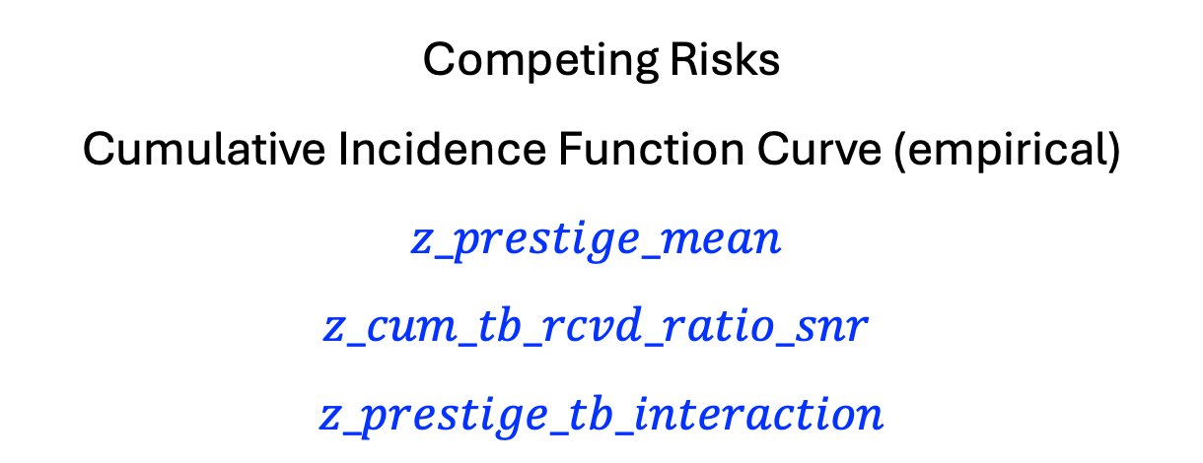
Competing Risks
Cumulative Incidence Function Curve (empirical)
$$z_prestige_mean$$
$$z_cum_tb_rcvd_ratio_snr$$
$$z_prestige_tb_interaction$$

Slide 4
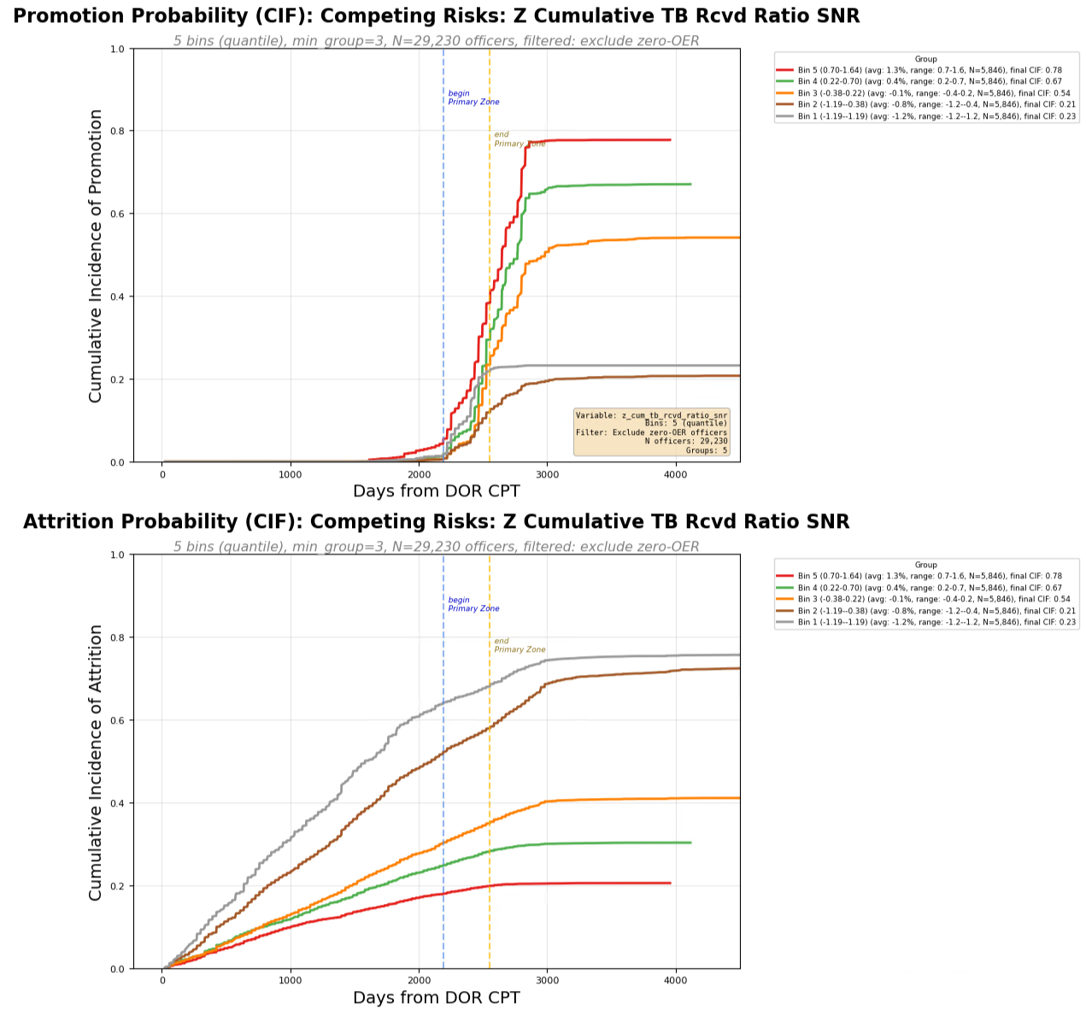
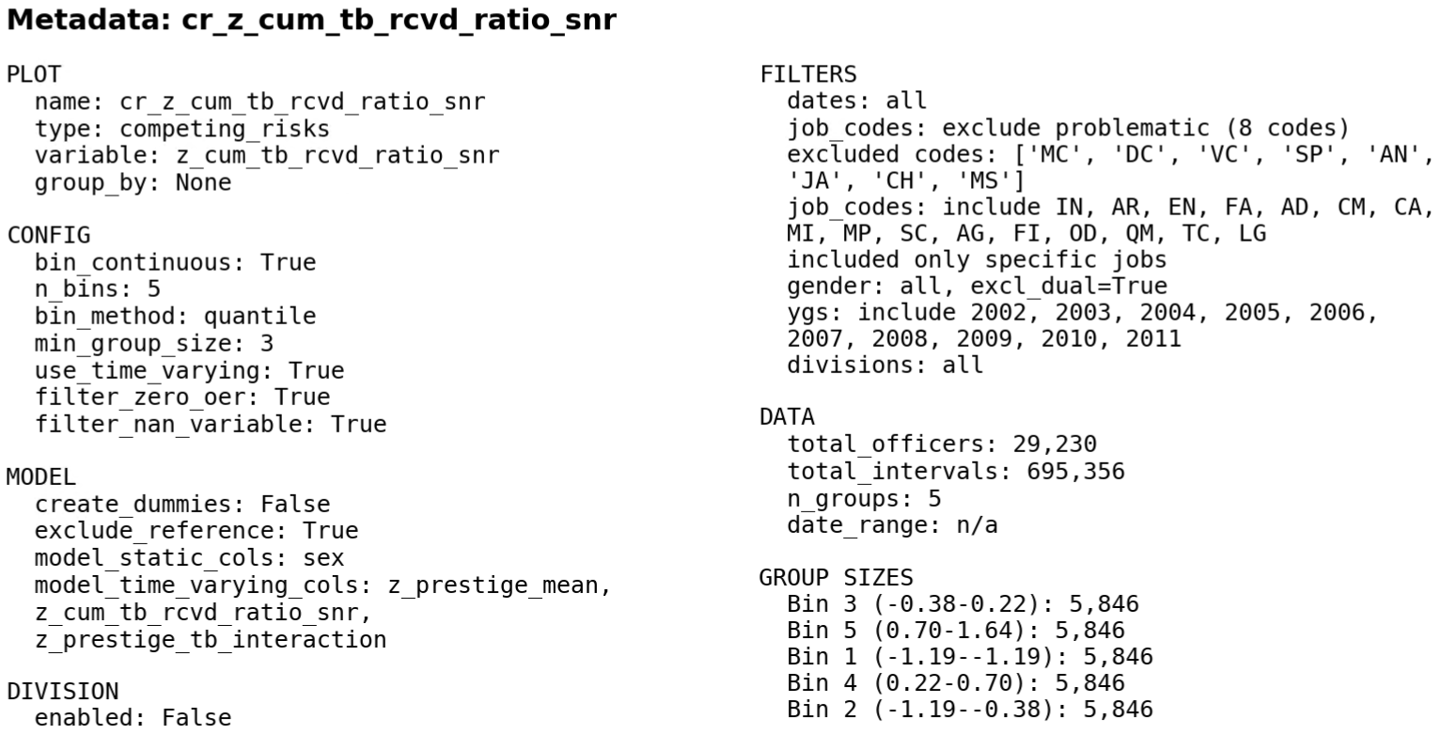
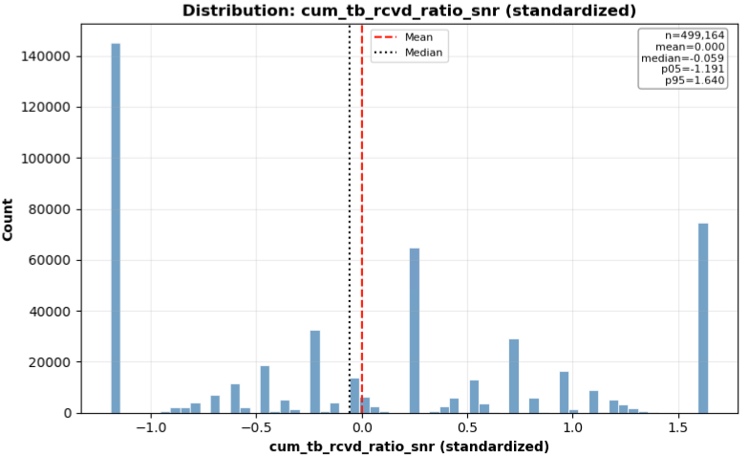

Slide 5
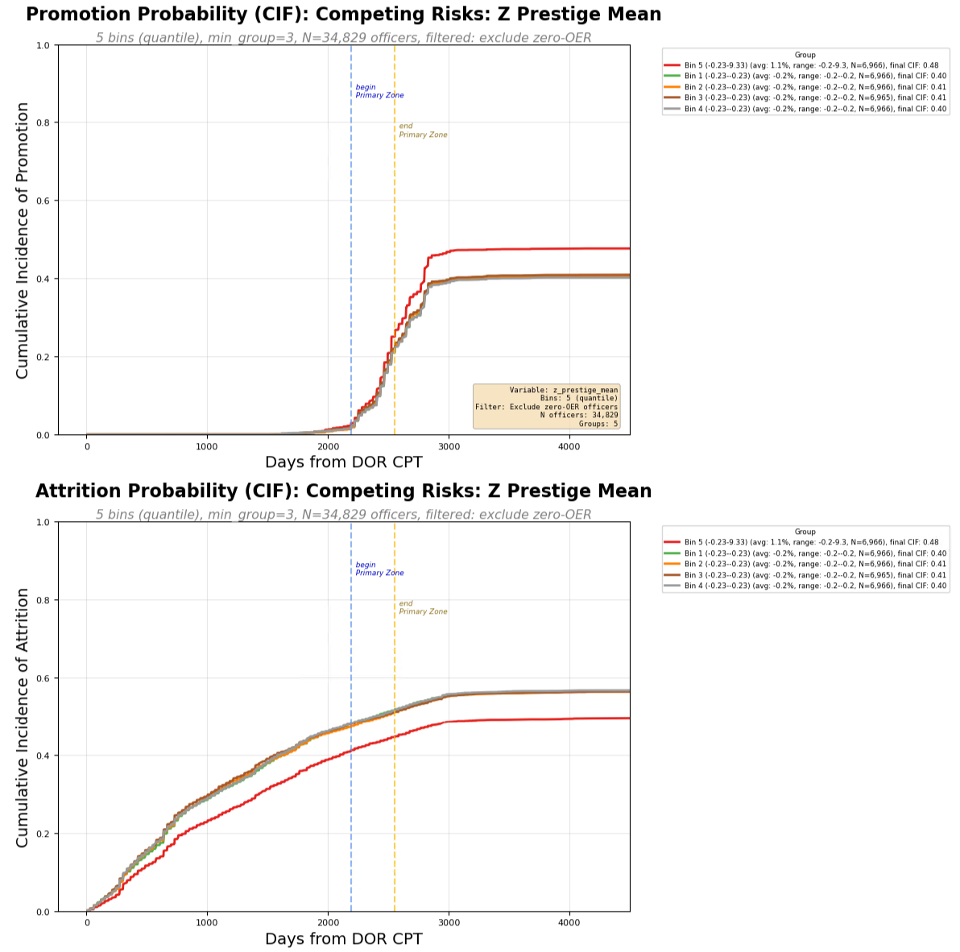
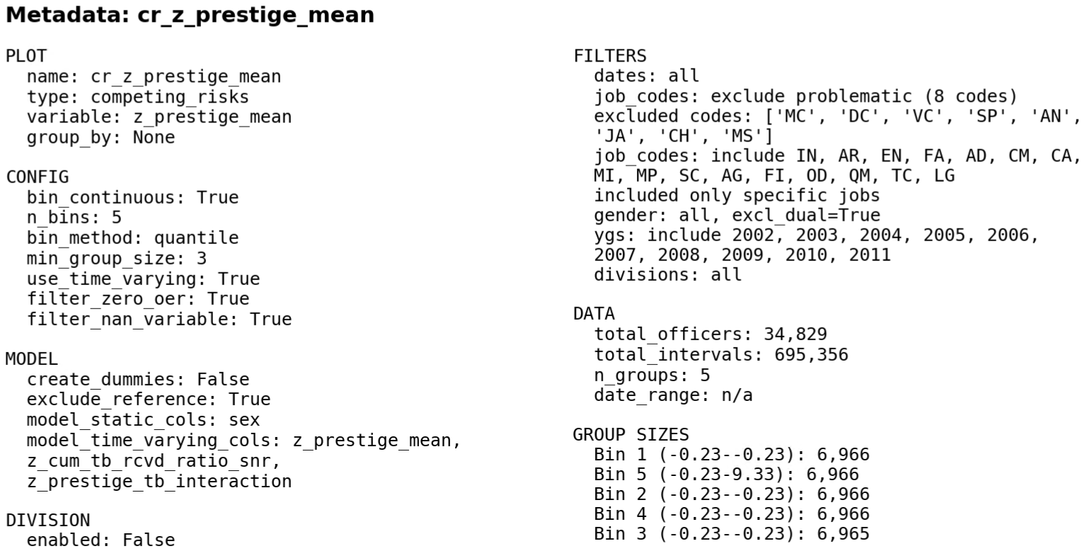
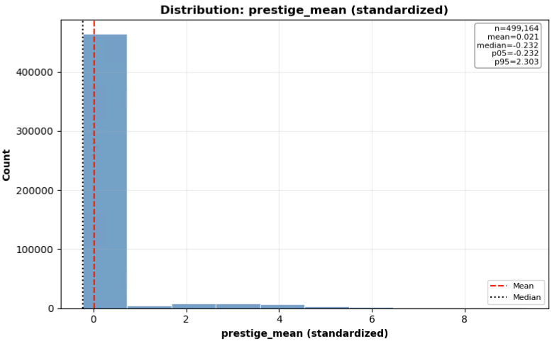

Slide 6
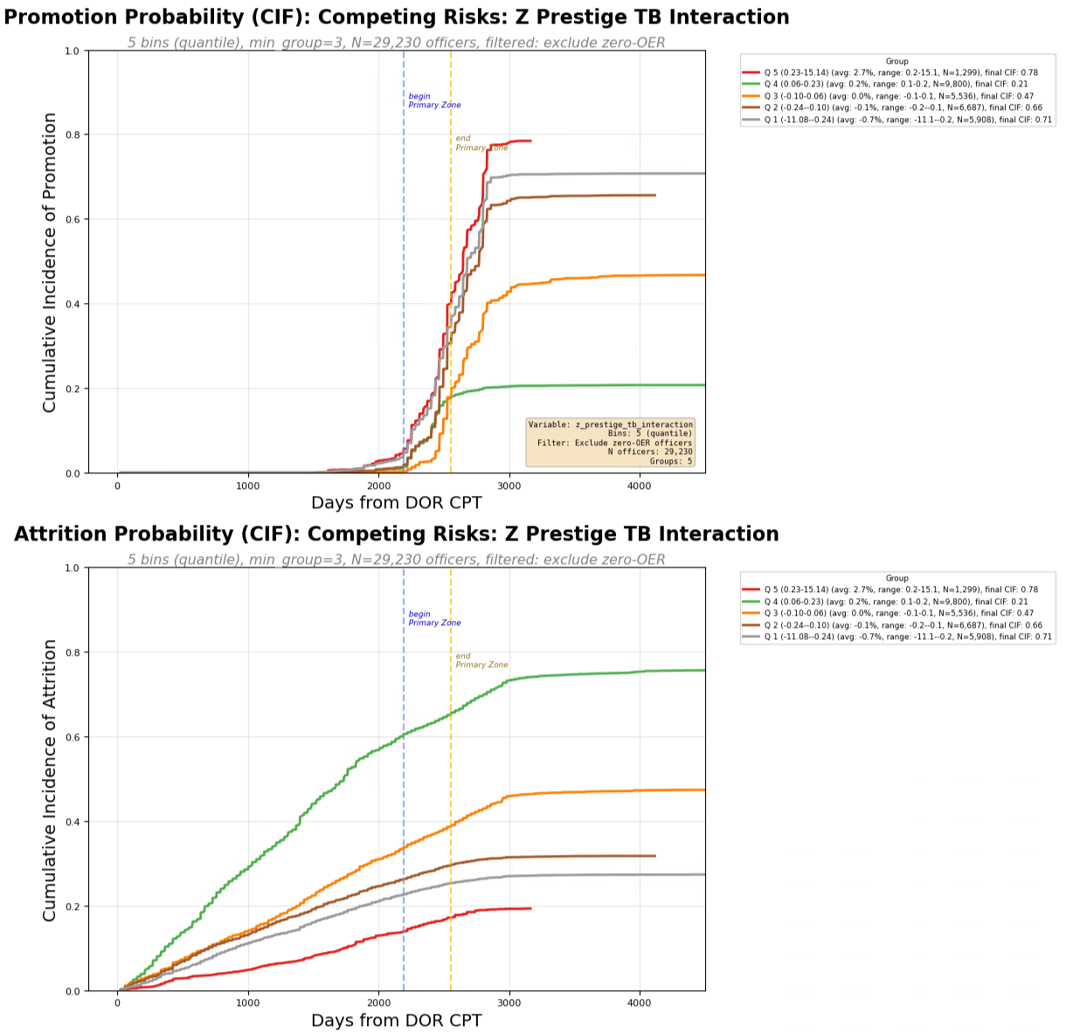
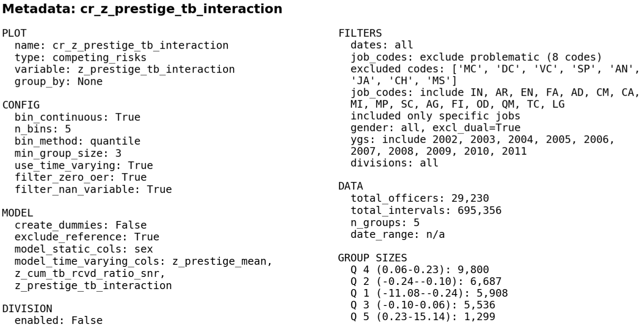

Slide 7
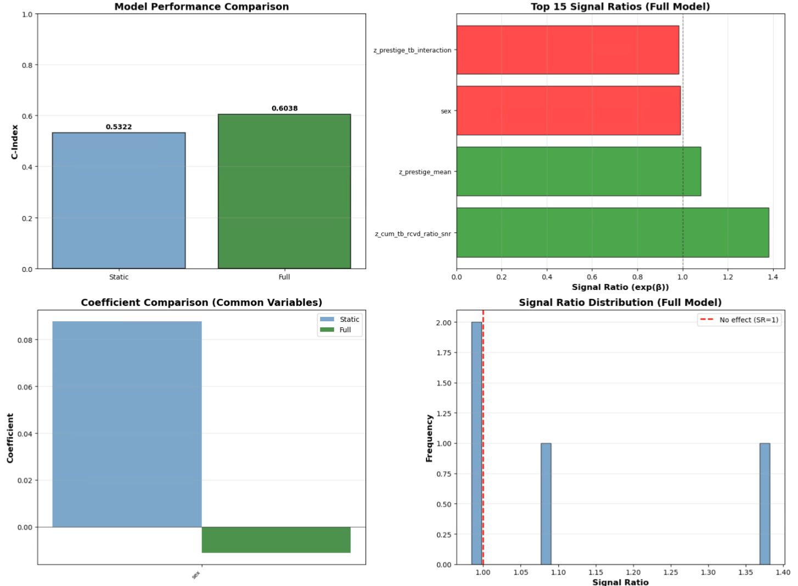

Slide 8
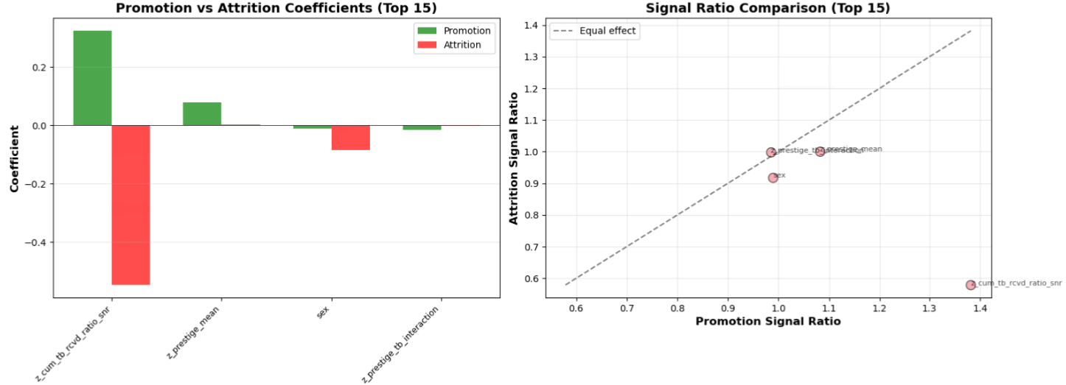

Slide 9
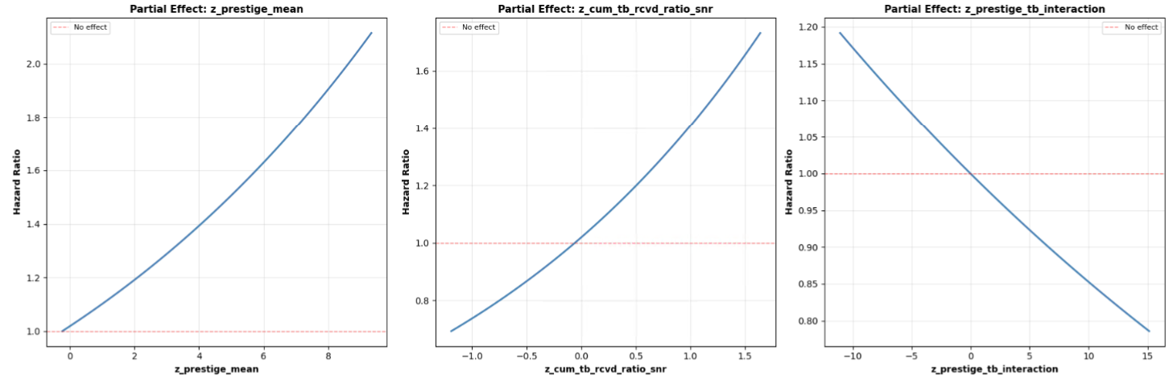

Slide 10
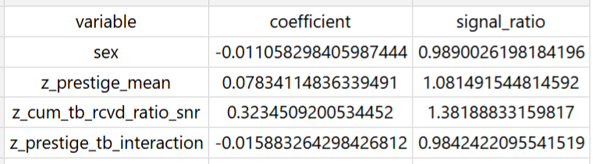


Slide 11
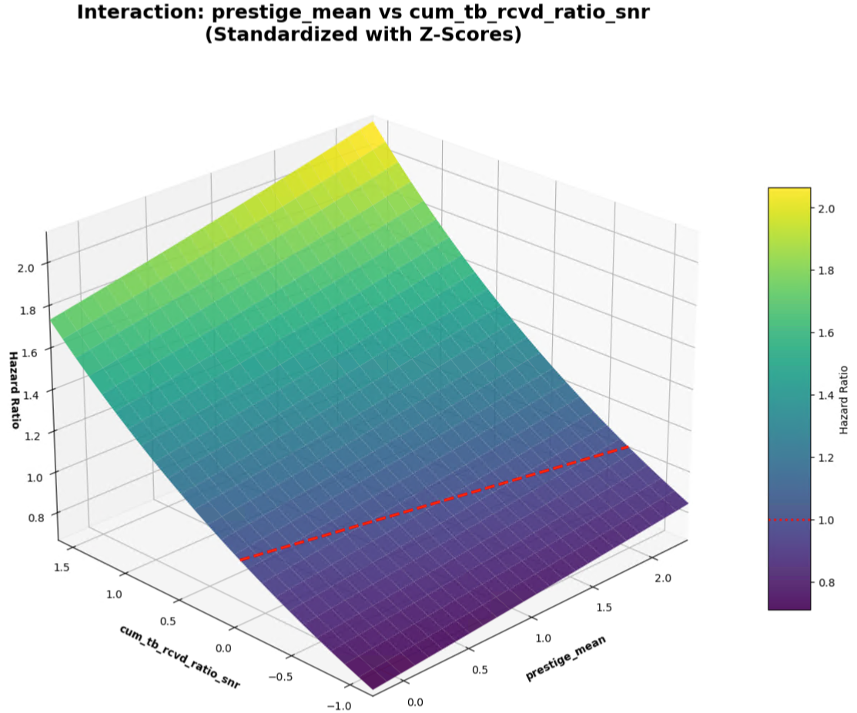

Slide 12
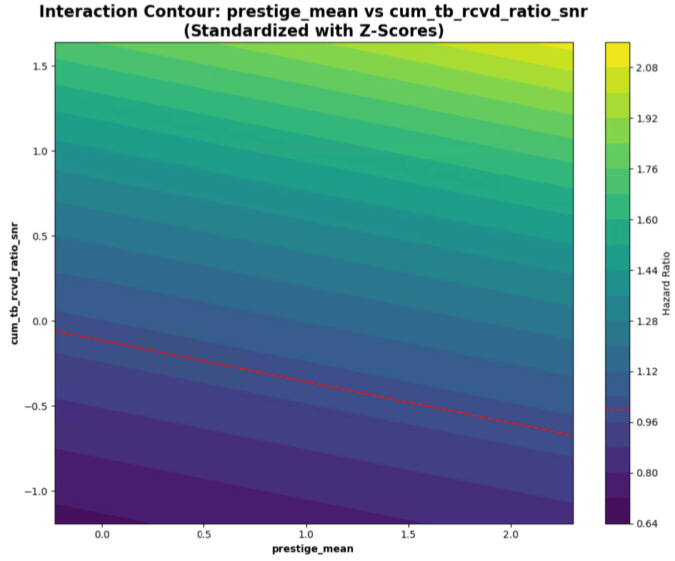
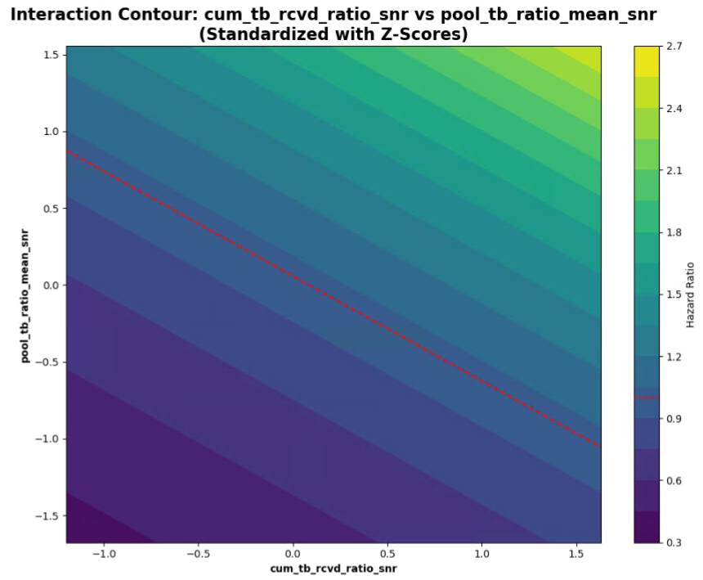

Slide 13
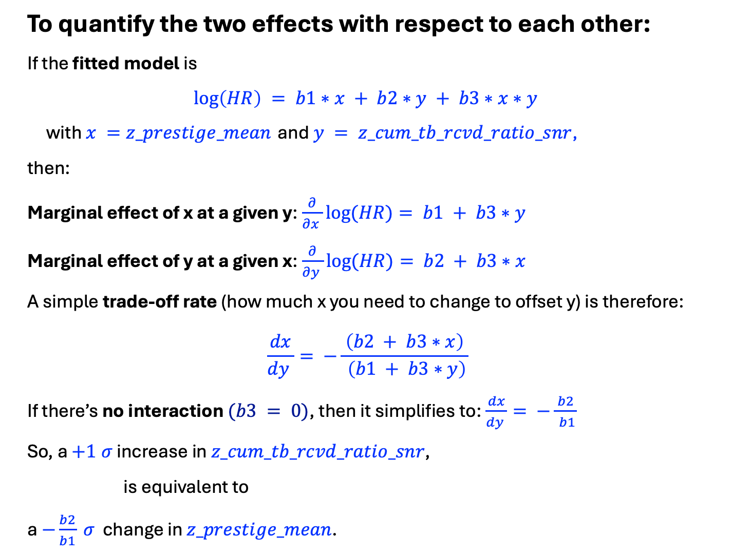
To quantify the two effects with respect to each other:
If the fitted model is
$$\log\left(HR\right) = b1∗x + b2∗y + b3∗x∗y$$
with $x =z_prestige_mean$ and $y = z_cum_tb_rcvd_ratio_snr$,
then:
Marginal effect of x at a given y:$\frac{∂}{∂x }log⁡(HR)= b1 + b3∗y$
Marginal effect of y at a given x:$\frac{∂}{∂y }log⁡(HR)= b2 + b3∗x$
A simple trade‑off rate (how much x you need to change to offset y) is therefore:
$$\frac{dx}{dy }= −\frac{ \left(b2 + b3∗x\right) }{ \left(b1 + b3∗y\right)}$$
If there’s no interaction $(b3 = 0)$, then it simplifies to:$\frac{dx}{dy }= −\frac{ b2 }{ b1}$
So, a $+1 σ$ increase in $z_cum_tb_rcvd_ratio_snr$,
is equivalent to
a $−\frac{b2}{b1} σ$ change in $z_prestige_mean$.

Slide 14
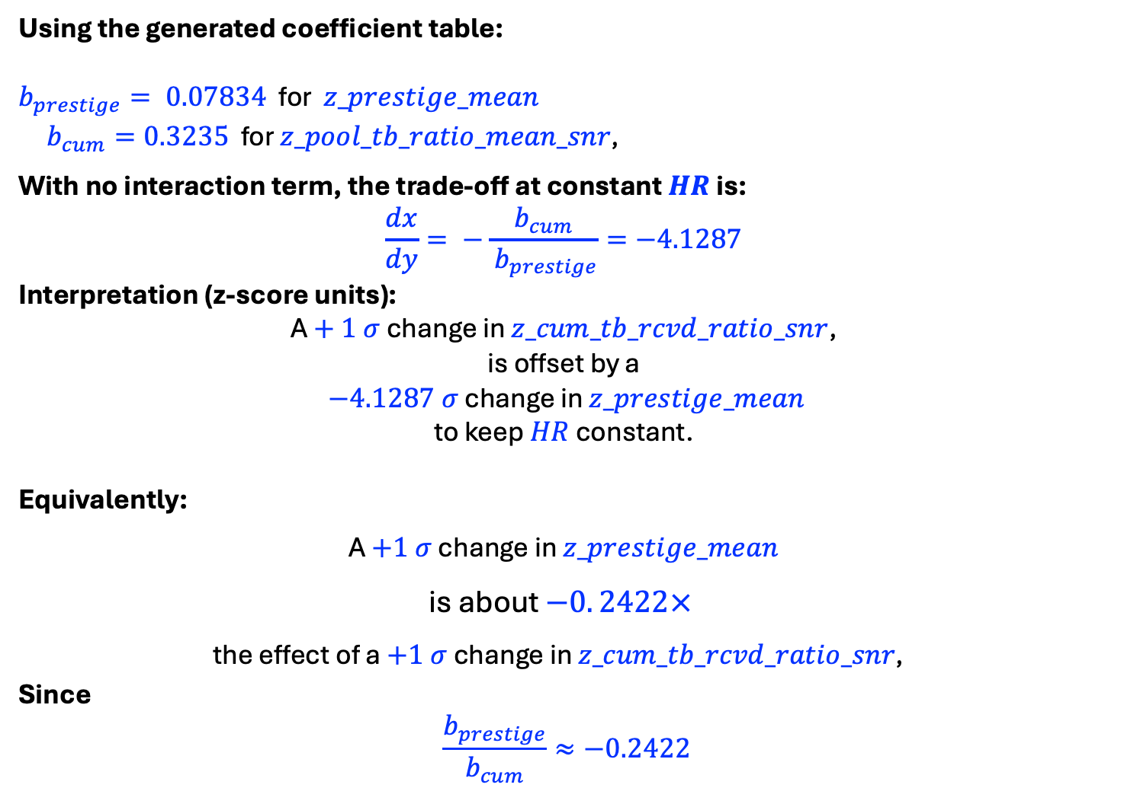
Using the generated coefficient table:
$b_{prestige}= 0.07834$ for $z_prestige_mean$
$b_{cum}=0.3235$ for $z_pool_tb_ratio_mean_snr\text{, }$
With no interaction term, the trade‑off at constant $HR$ is:
$$\frac{dx}{dy}= −\frac{ b_{cum }}{ b_{prestige}}=−4.1287$$
Interpretation (z‑score units):
A $+ 1 σ$ change in $z_cum_tb_rcvd_ratio_snr$,
is offset by a
$−4.1287 σ$ change in $z_prestige_mean$
to keep $HR$ constant.
Equivalently:
A $+1 σ$ change in $z_prestige_mean$
is about $−0. 2422×$
the effect of a $+1 σ$ change in $z_cum_tb_rcvd_ratio_snr\text{, }$
Since
$$\frac{b_{prestige}}{b_{cum}}≈−0.2422$$

Slide 15
PART 2
Looking at TB Ratio and Pool Interactions

Slide 16
RUN 1 - Using
z_cum_tb_rcvd_ratio_snr
z_pool_tb_ratio_mean_snr
z_star_pool_interaction

Slide 17
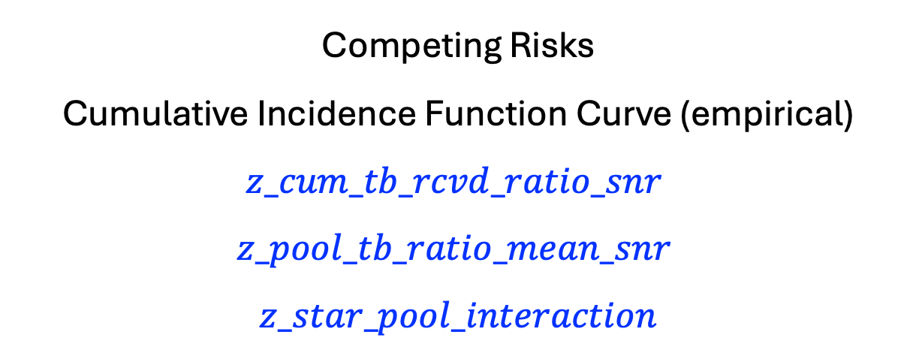
Competing Risks
Cumulative Incidence Function Curve (empirical)
$$z_cum_tb_rcvd_ratio_snr$$
$$z_pool_tb_ratio_mean_snr$$
$$z_star_pool_interaction$$

Slide 18
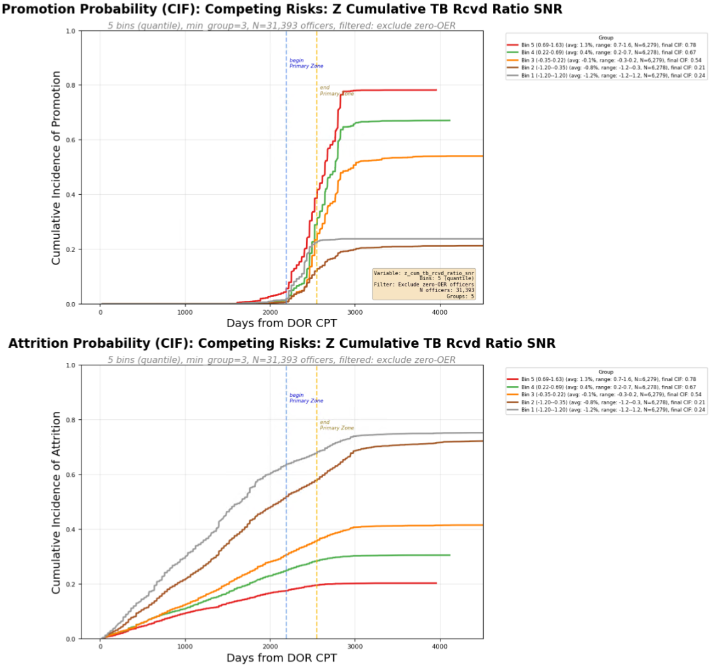
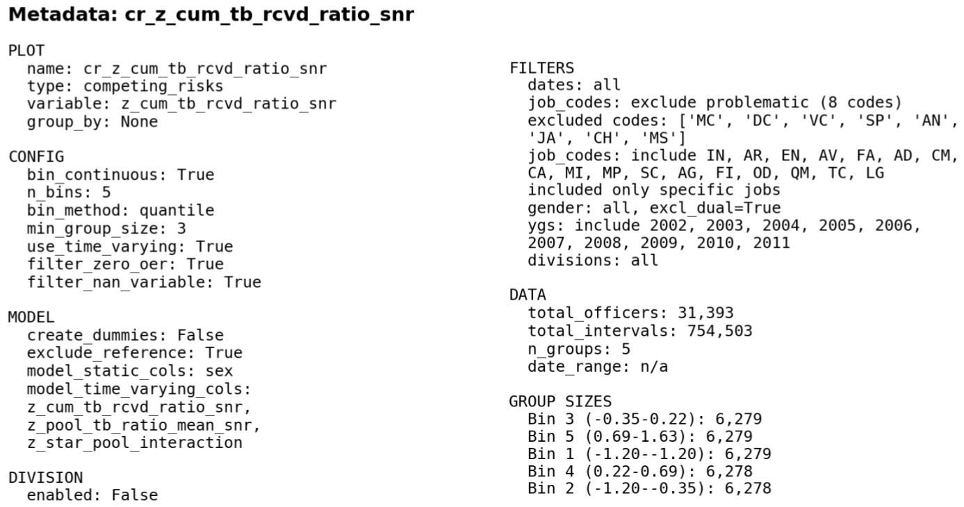
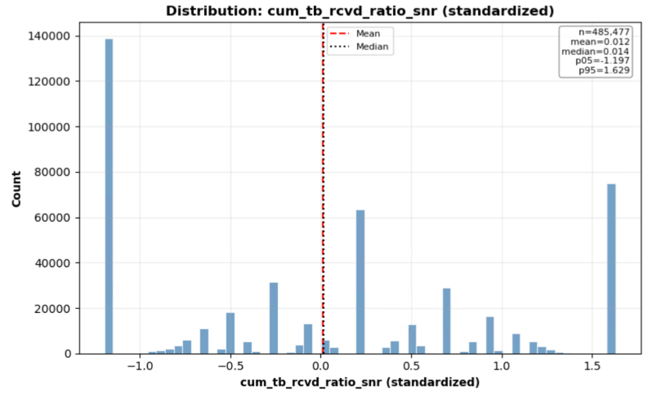

Slide 19
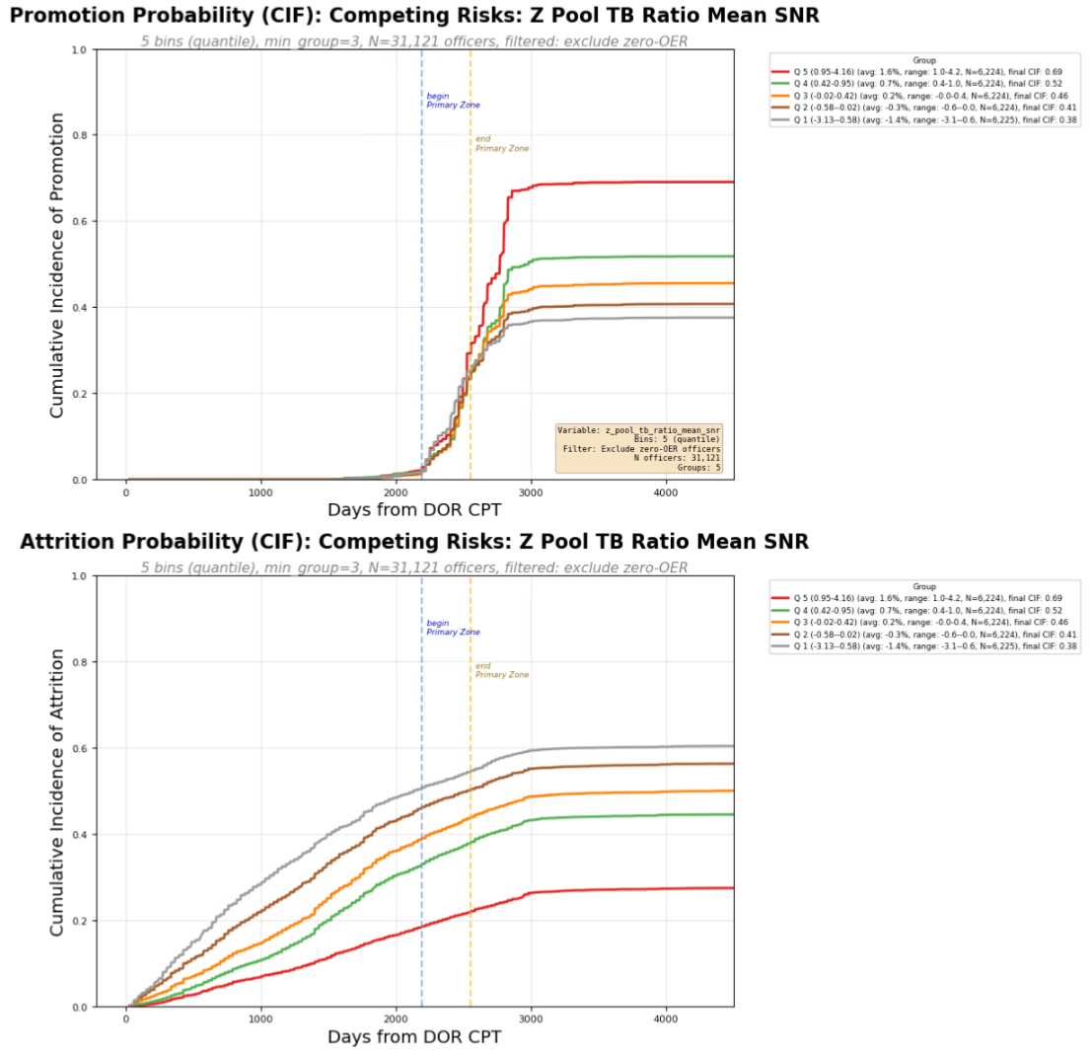
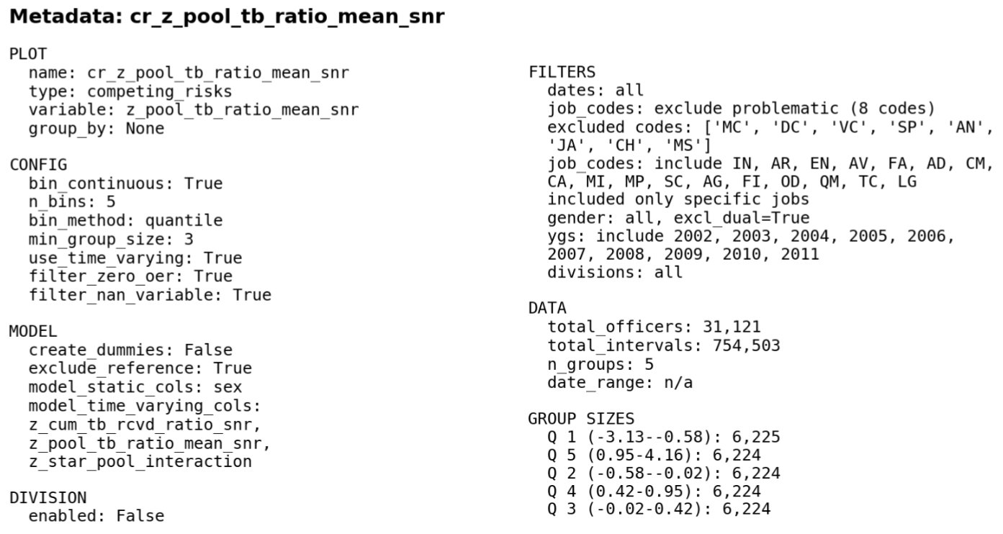
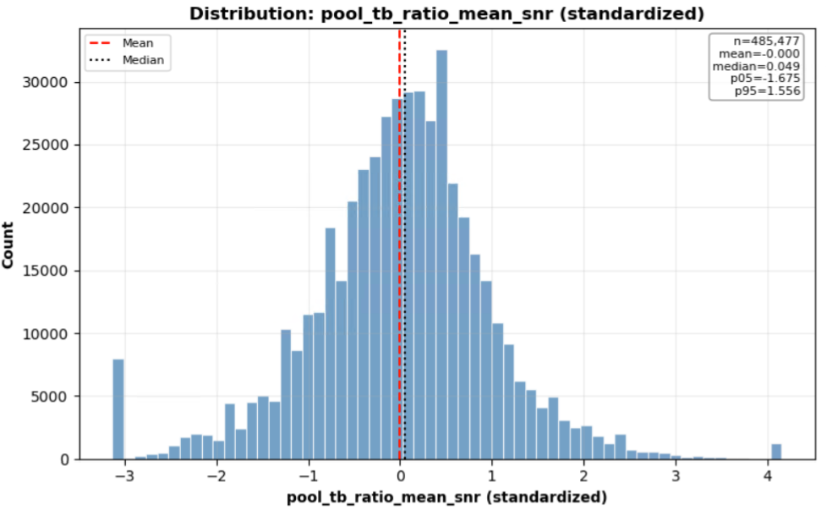

Slide 20
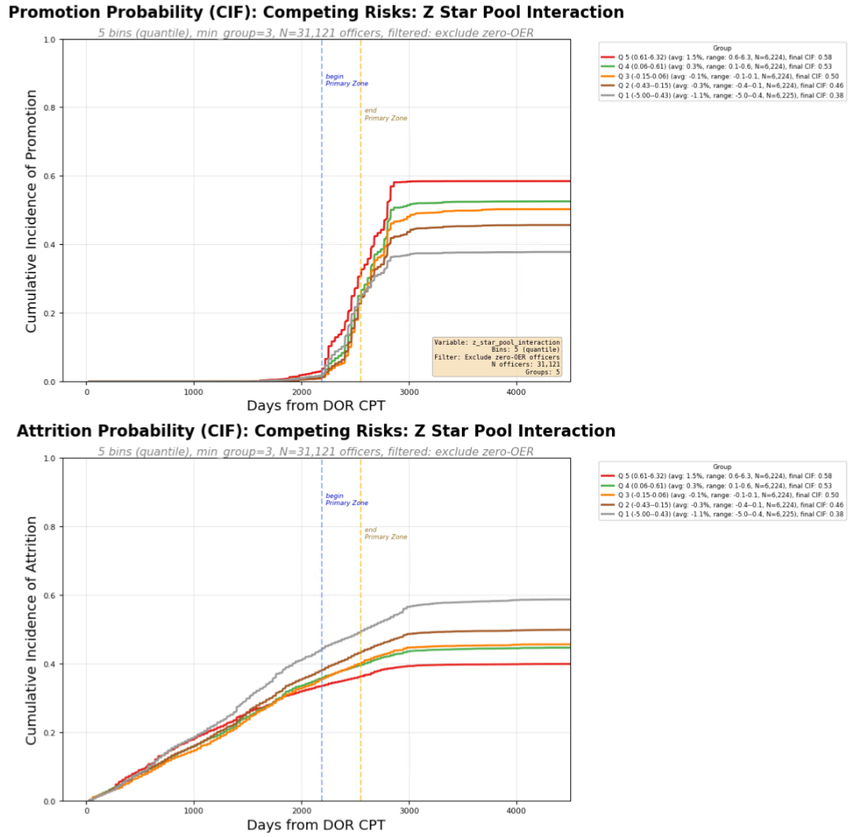
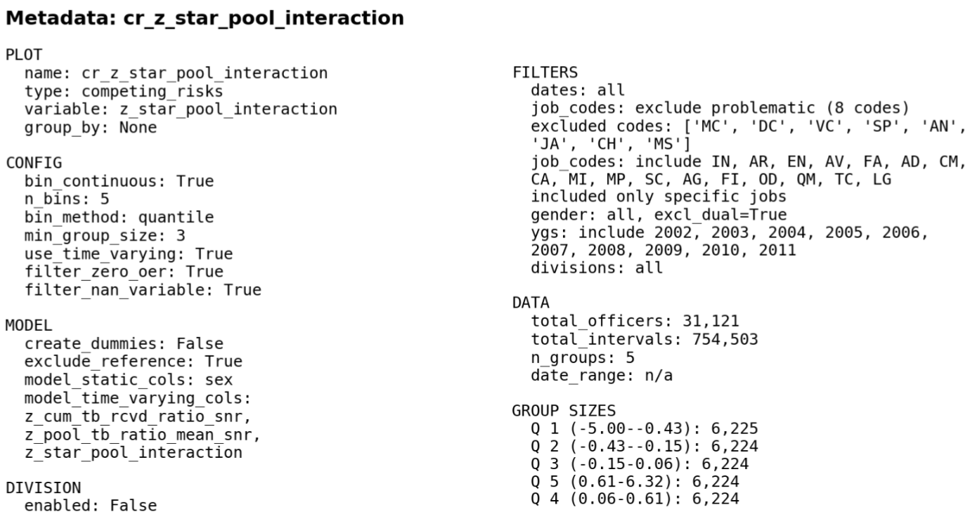

Slide 21
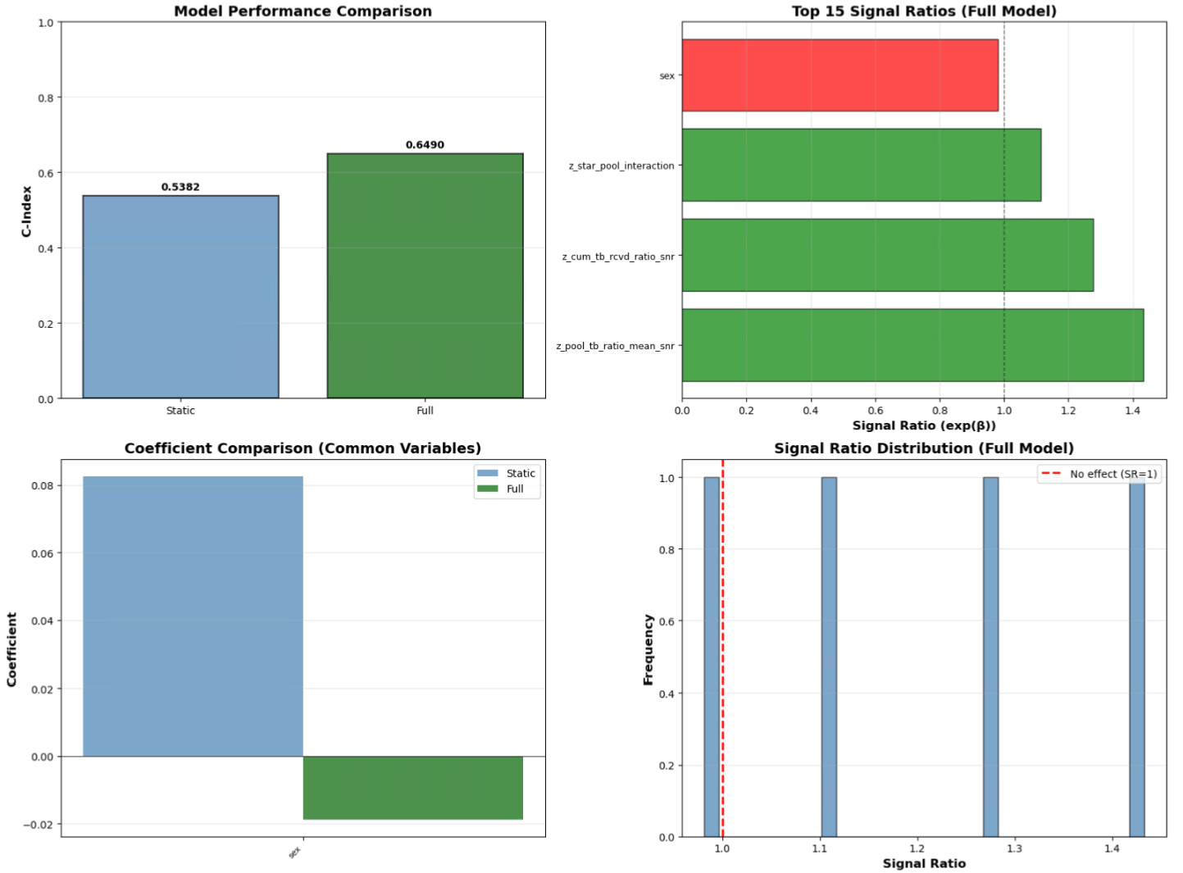

Slide 22
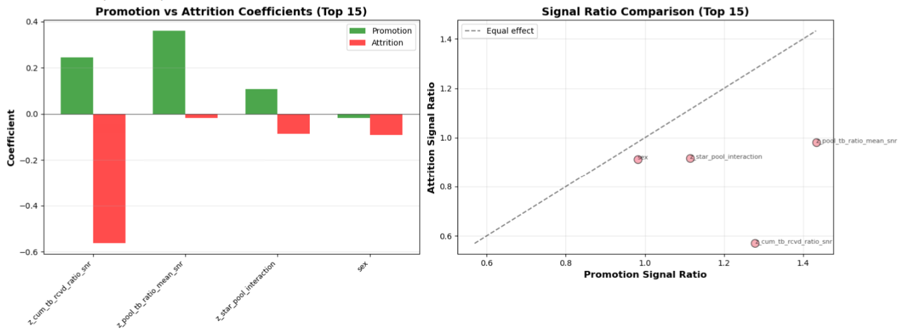

Slide 23
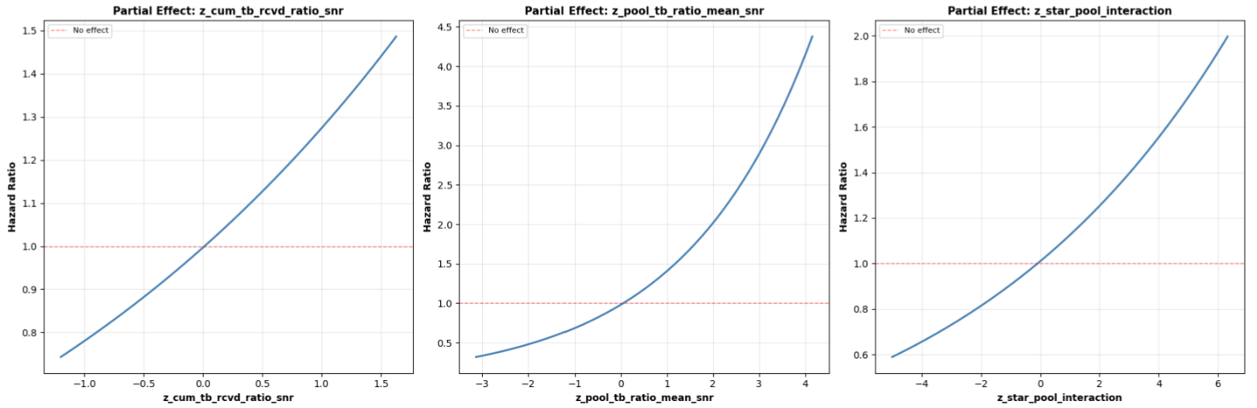

Slide 24
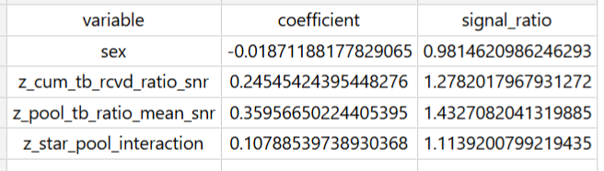
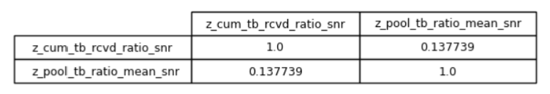

Slide 25
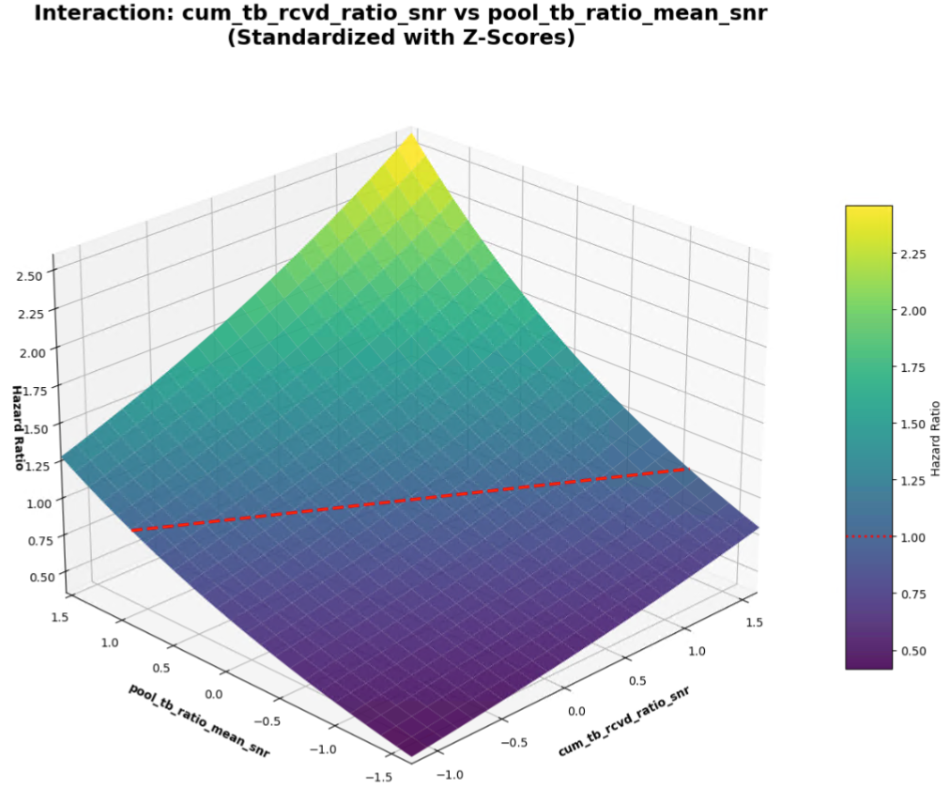

Slide 27
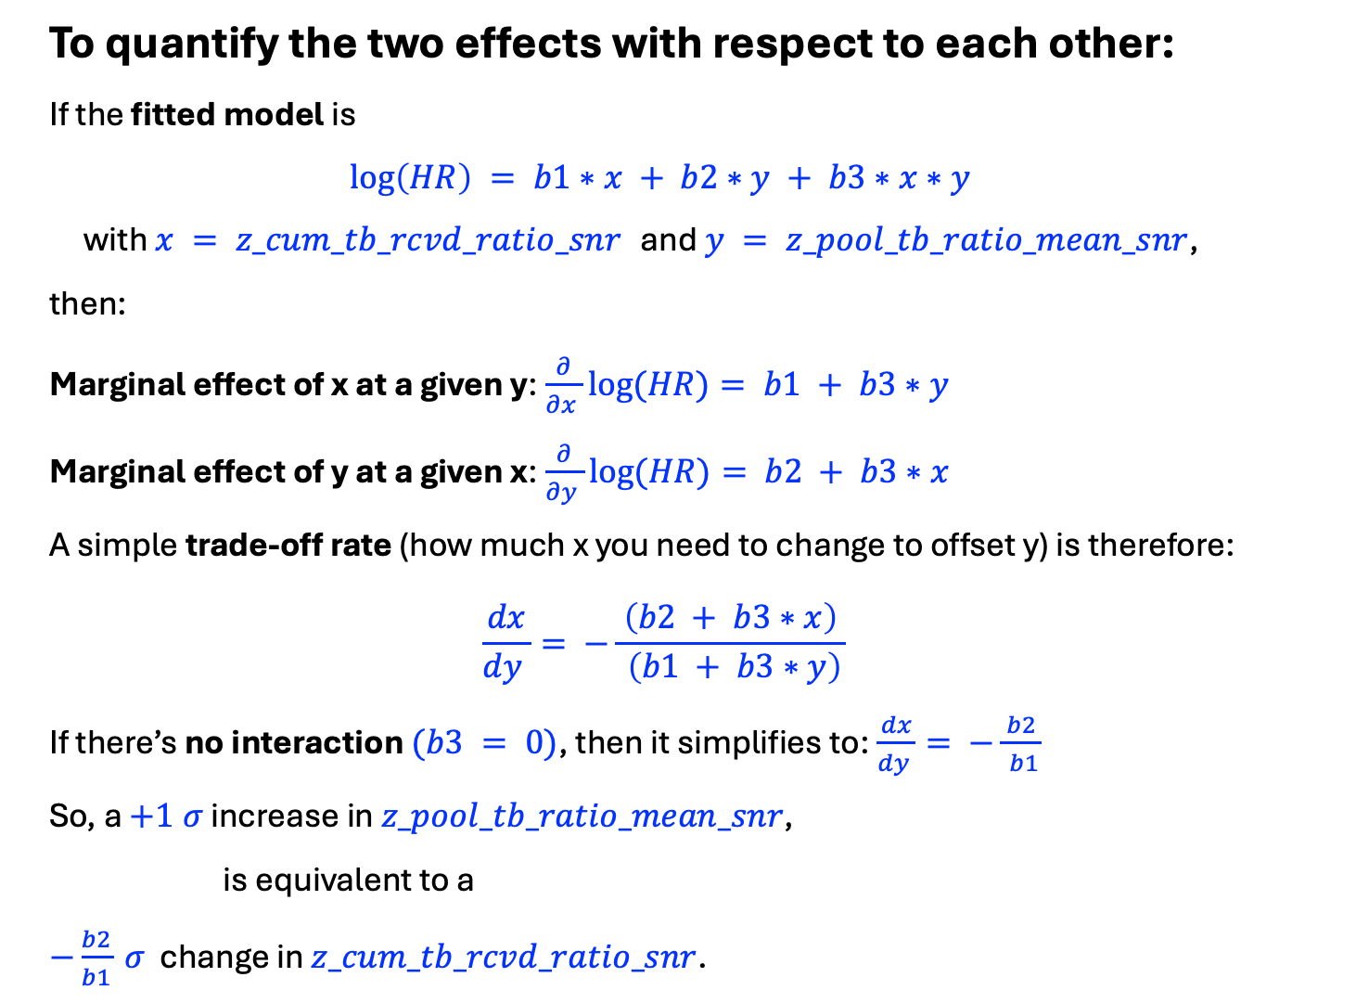
To quantify the two effects with respect to each other:
If the fitted model is
$$\log\left(HR\right) = b1∗x + b2∗y + b3∗x∗y$$
with $x = z_cum_tb_rcvd_ratio_snr$ and $y = z_pool_tb_ratio_mean_snr$,
then:
Marginal effect of x at a given y:$\frac{∂}{∂x }log⁡(HR)= b1 + b3∗y$
Marginal effect of y at a given x:$\frac{∂}{∂y }log⁡(HR)= b2 + b3∗x$
A simple trade‑off rate (how much x you need to change to offset y) is therefore:
$$\frac{dx}{dy }= −\frac{ \left(b2 + b3∗x\right) }{ \left(b1 + b3∗y\right)}$$
If there’s no interaction $(b3 = 0)$, then it simplifies to:$\frac{dx}{dy }= −\frac{ b2 }{ b1}$
So, a $+1 σ$ increase in $z_pool_tb_ratio_mean_snr$,
is equivalent to a
$−\frac{b2}{b1} σ$ change in $z_cum_tb_rcvd_ratio_snr$.

Slide 28
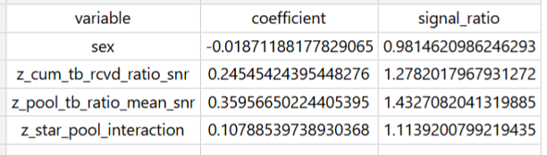
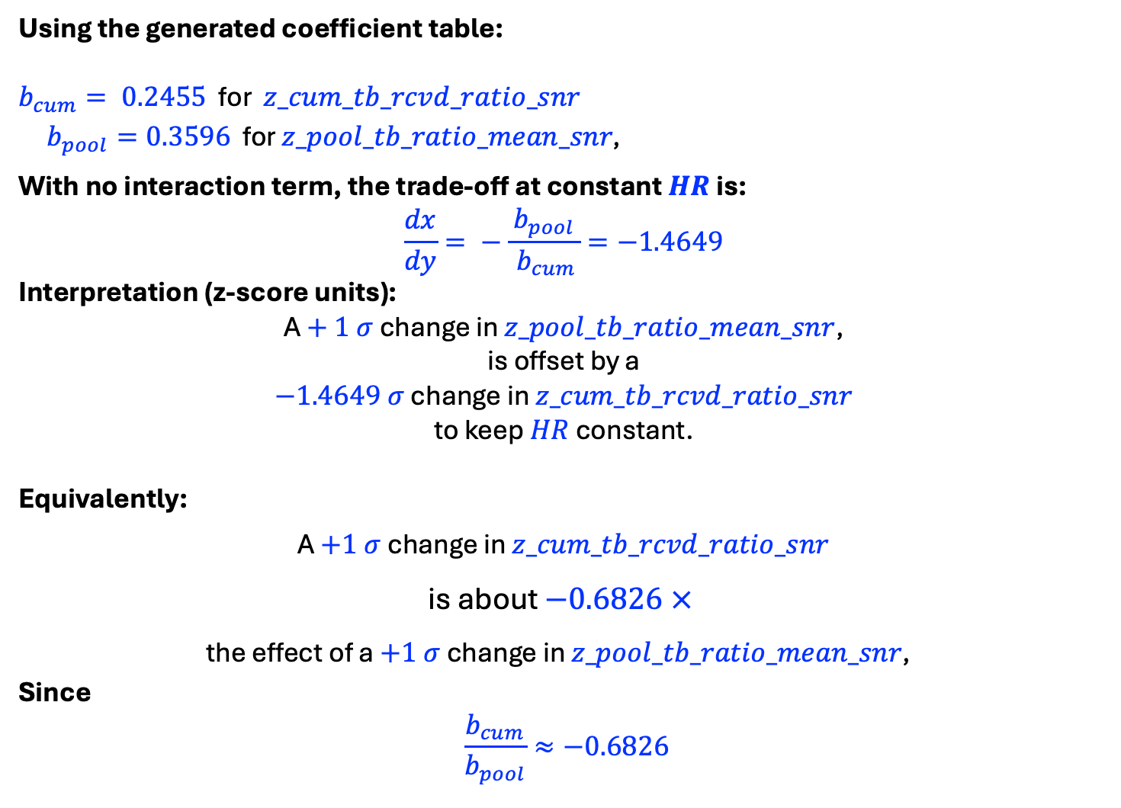
Using the generated coefficient table:
$b_{cum}= 0.2455$ for $z_cum_tb_rcvd_ratio_snr$
$b_{pool}=0.3596$ for $z_pool_tb_ratio_mean_snr\text{, }$
With no interaction term, the trade‑off at constant $HR$ is:
$$\frac{dx}{dy}= −\frac{ b_{pool }}{ b_{cum}}=−1.4649$$
Interpretation (z‑score units):
A $+ 1 σ$ change in $z_pool_tb_ratio_mean_snr$,
is offset by a
$−1.4649 σ$ change in $z_cum_tb_rcvd_ratio_snr$
to keep $HR$ constant.
Equivalently:
A $+1 σ$ change in $z_cum_tb_rcvd_ratio_snr$
is about $−0.6826 ×$
the effect of a $+1 σ$ change in $z_pool_tb_ratio_mean_snr\text{, }$
Since
$$\frac{b_{cum}}{b_{pool}}≈−0.6826$$

Slide 29
RUN 2 - Using
z_tb_ratio_rank_norm_snr
z_pool_tb_ratio_mean_snr
z_rank_pool_interaction

Slide 30
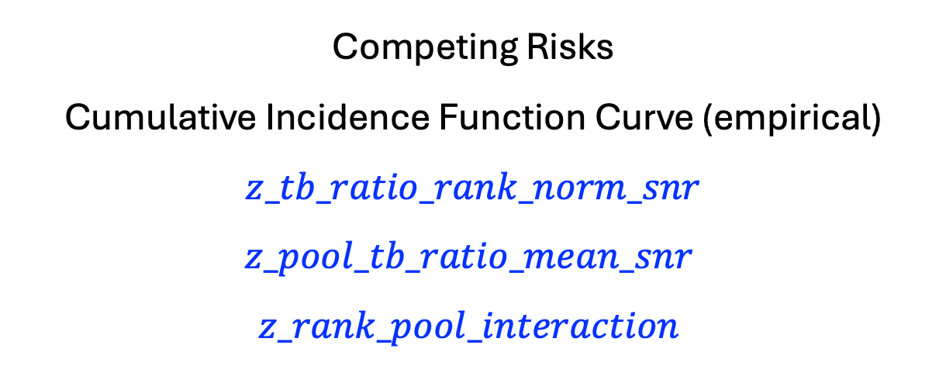
Competing Risks
Cumulative Incidence Function Curve (empirical)
$$z_tb_ratio_rank_norm_snr$$
$$z_pool_tb_ratio_mean_snr$$
$$z_rank_pool_interaction$$

Slide 31
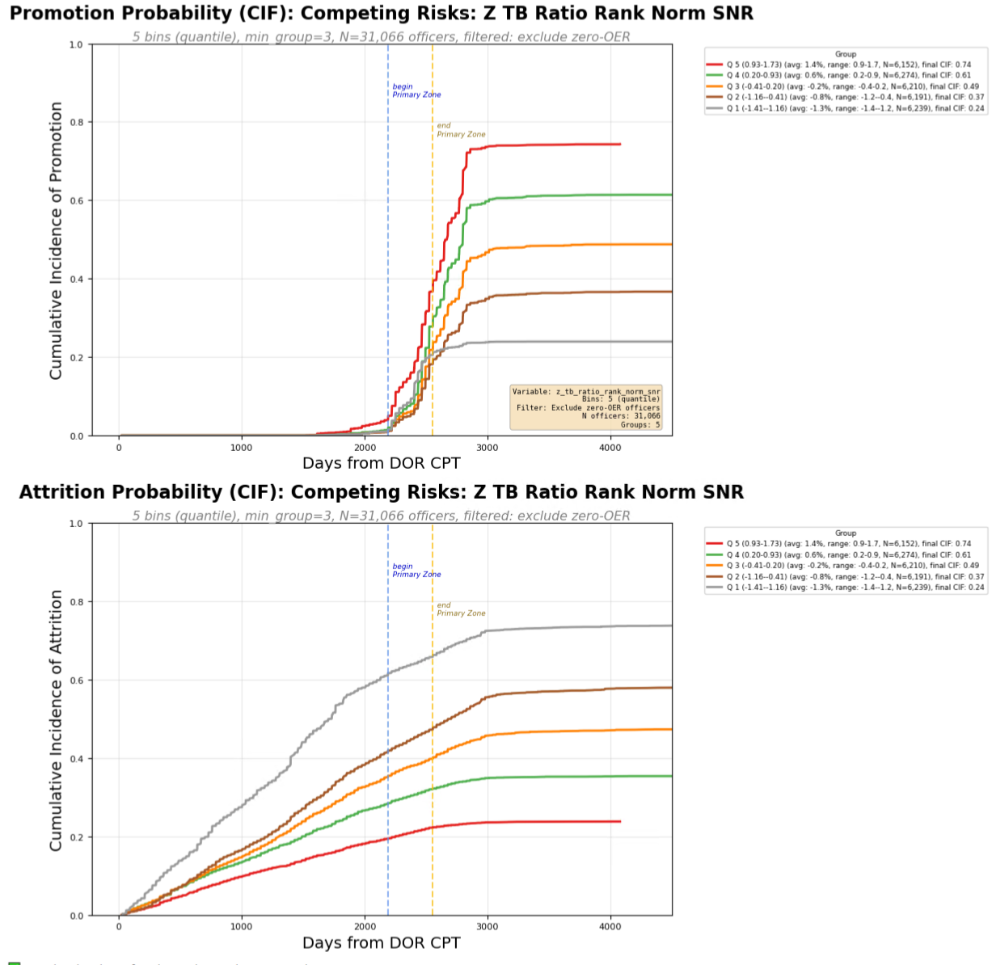
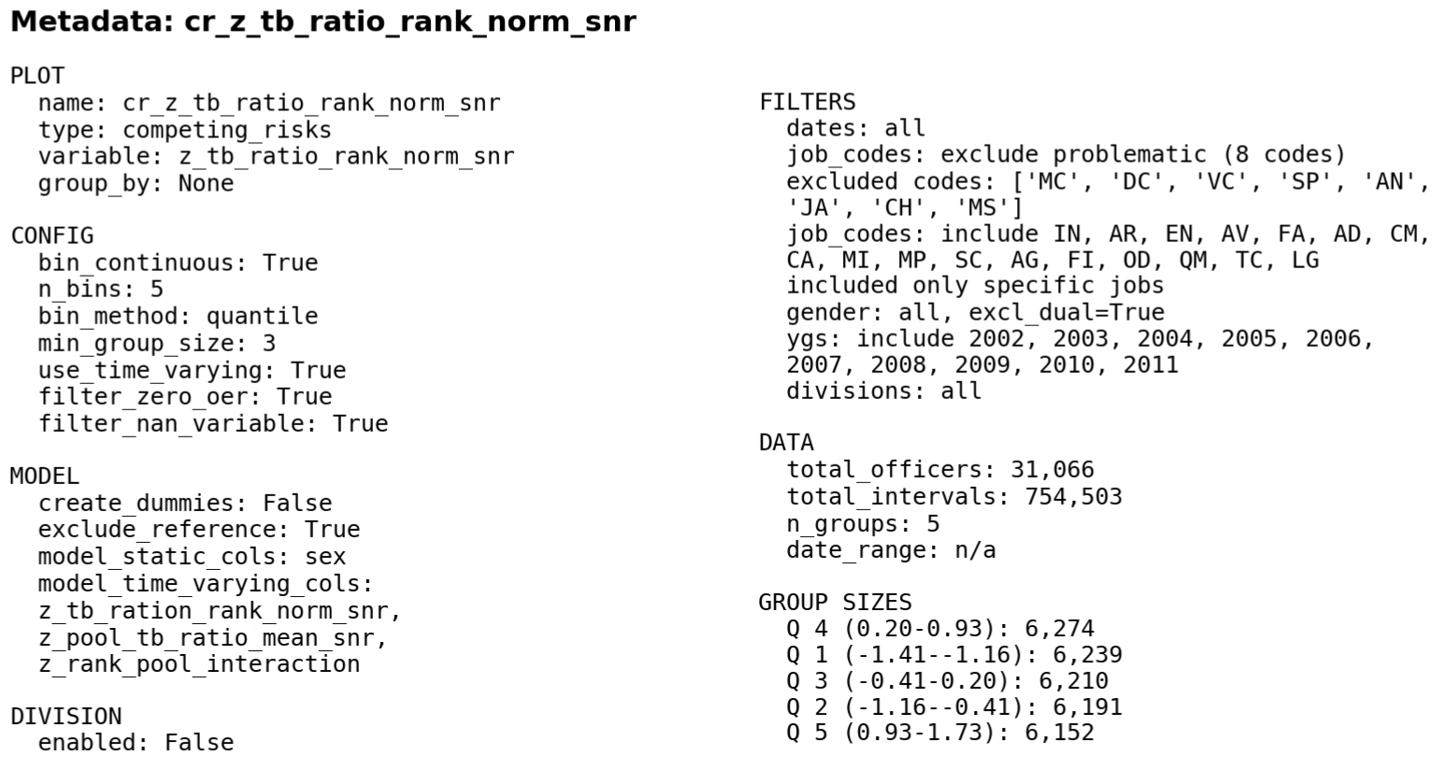
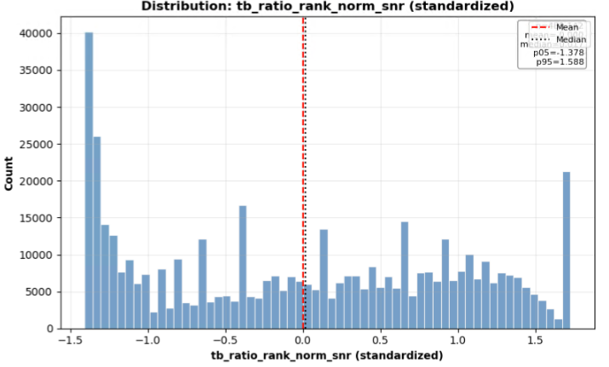

Slide 32
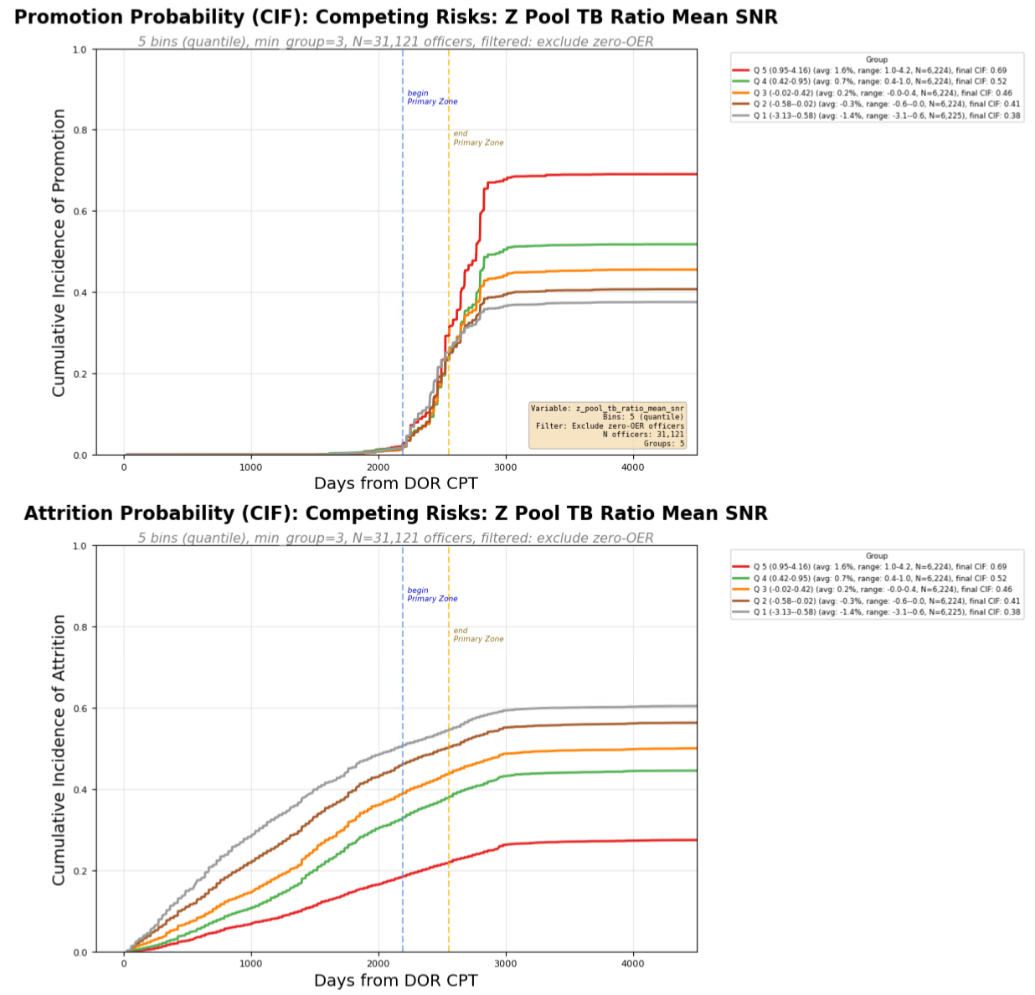
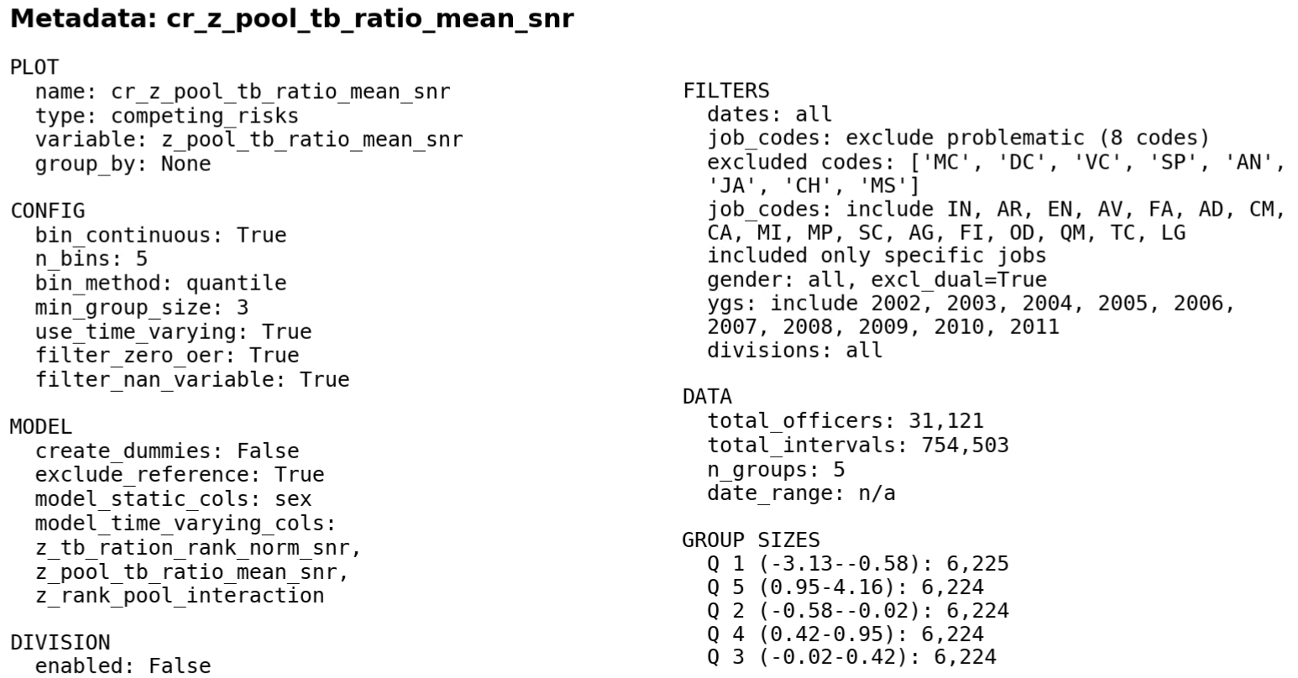
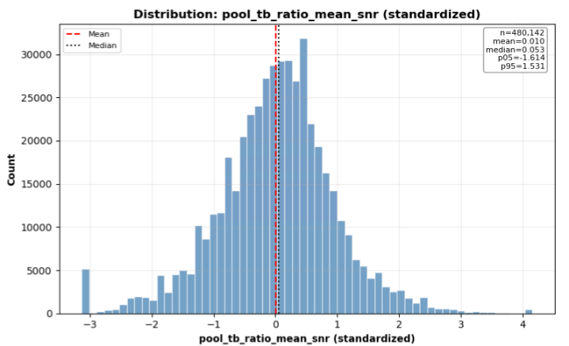

Slide 33
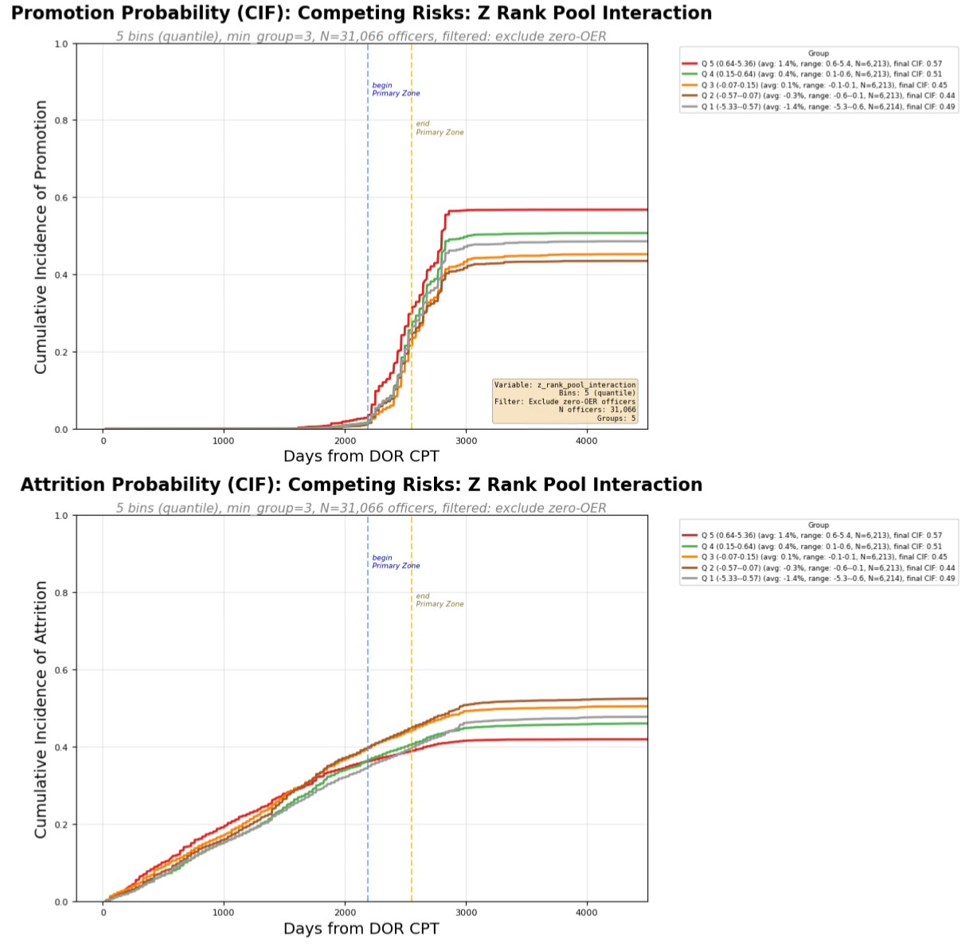
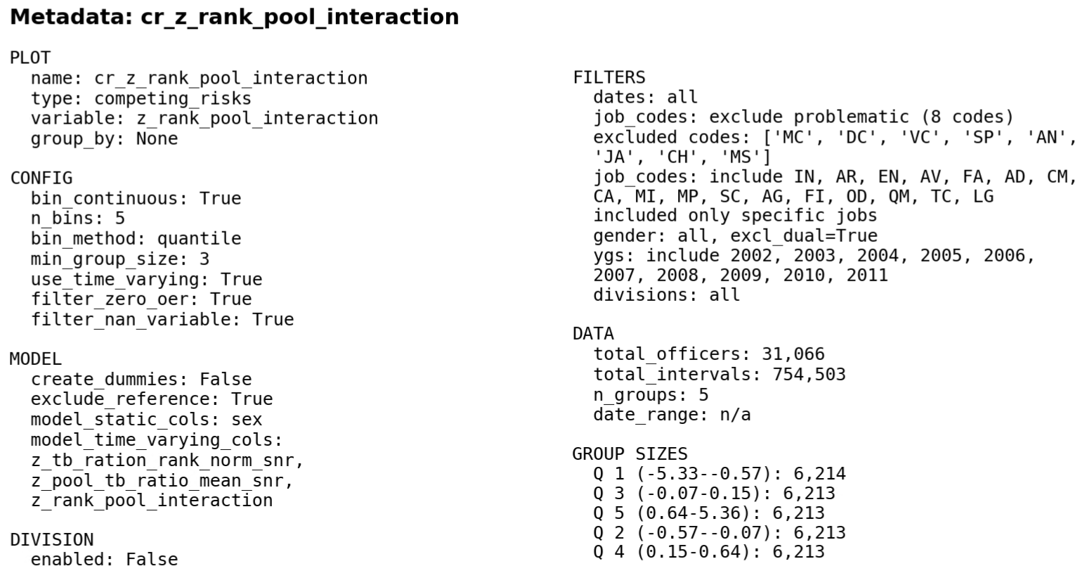

Slide 34
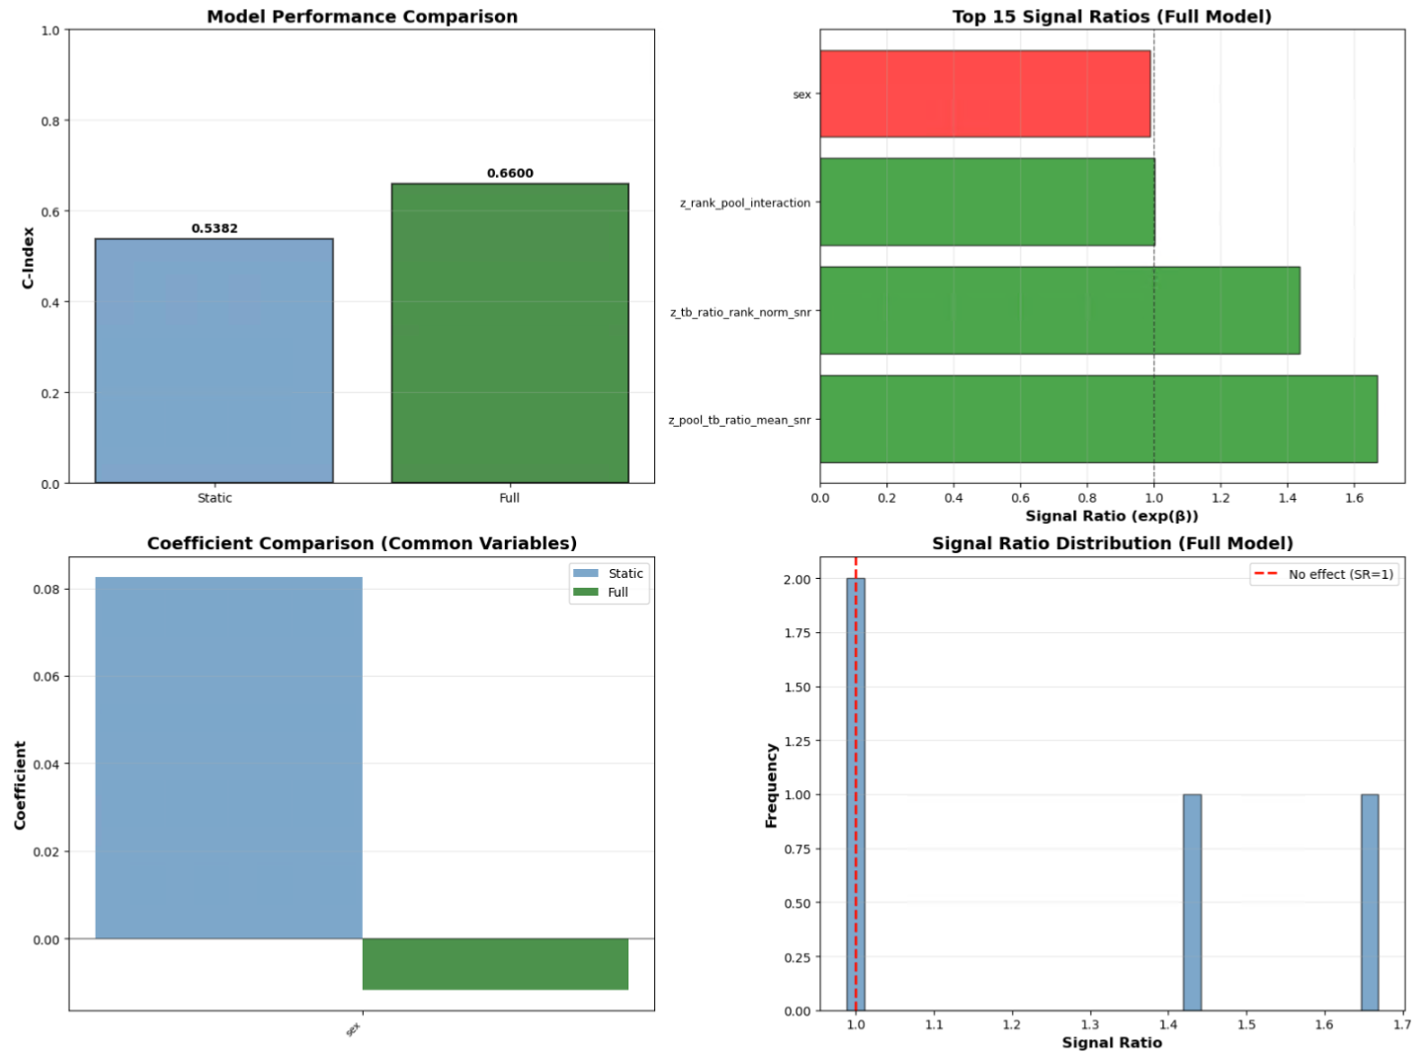

Slide 35
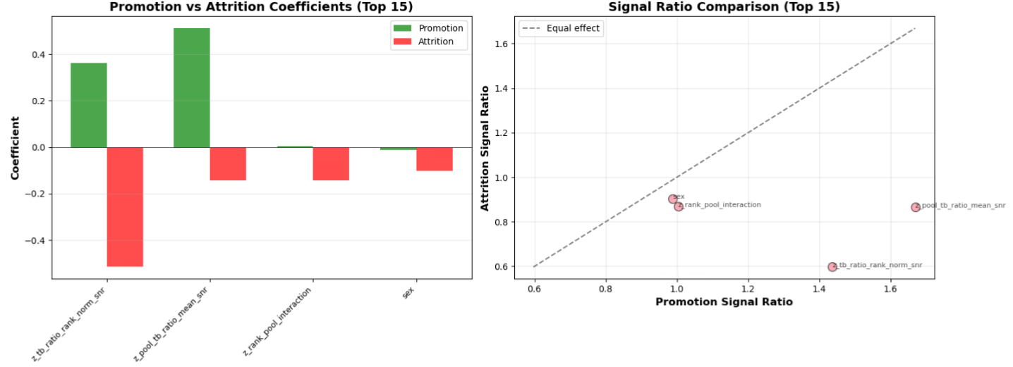

Slide 36
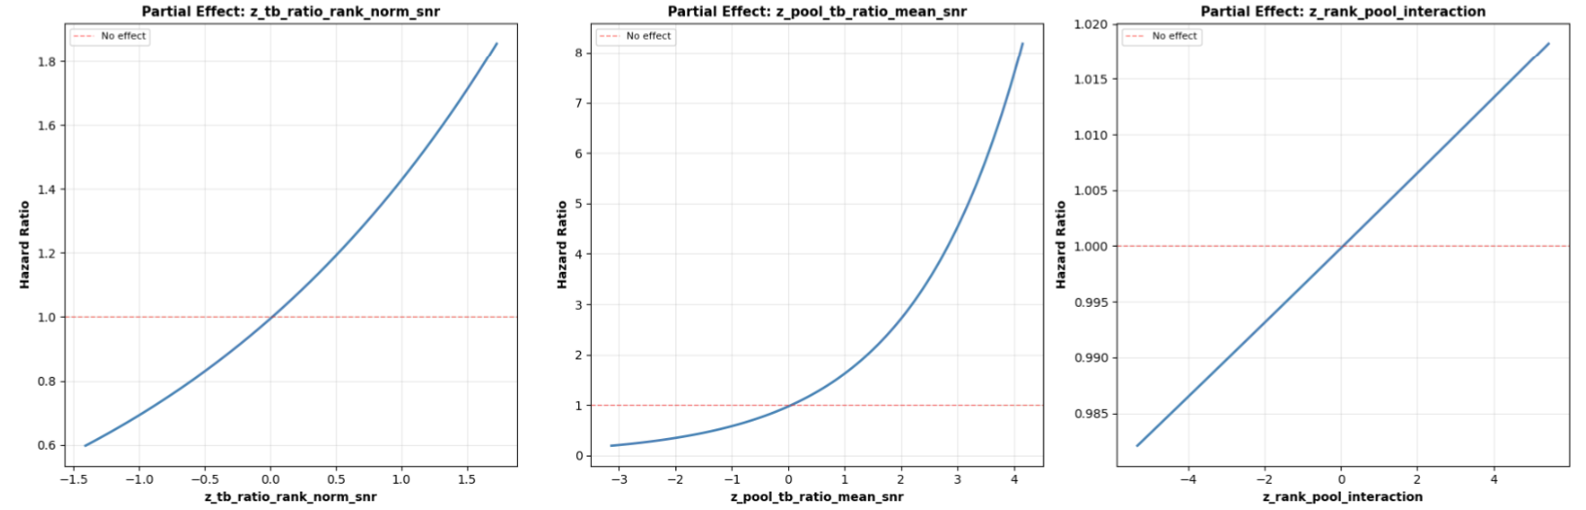

Slide 37
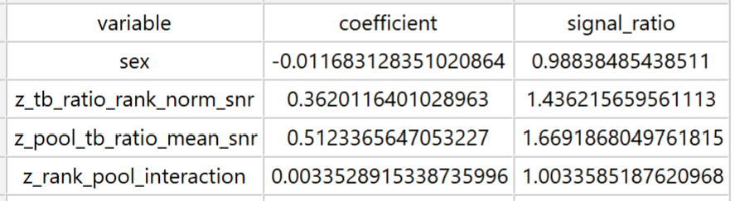
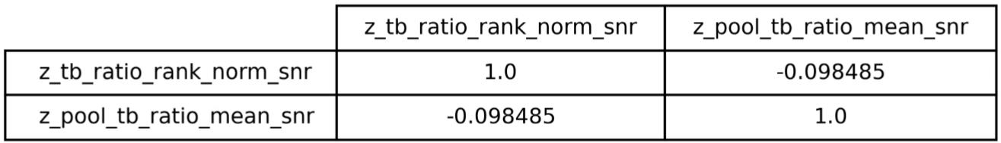

Slide 38


Slide 39


Slide 40

To quantify the two effects with respect to each other:
If the fitted model is
$$\log\left(HR\right) = b1∗x + b2∗y + b3∗x∗y$$
with $x = z_tb_ratio_rank_norm_snr$ and $y = z_pool_tb_ratio_mean_snr$,
then:
Marginal effect of x at a given y:$\frac{∂}{∂x }log⁡(HR)= b1 + b3∗y$
Marginal effect of y at a given x:$\frac{∂}{∂y }log⁡(HR)= b2 + b3∗x$
A simple trade‑off rate (how much x you need to change to offset y) is therefore:
$$\frac{dx}{dy }= −\frac{ \left(b2 + b3∗x\right) }{ \left(b1 + b3∗y\right)}$$
If there’s no interaction $(b3 = 0)$, then it simplifies to:$\frac{dx}{dy }= −\frac{ b2 }{ b1}$
So, a $+1 σ$ increase in $z_pool_tb_ratio_mean_snr$,
is equivalent to a
$−\frac{b2}{b1} σ$ change in $z_tb_ratio_rank_norm_snr$.

Slide 41


Using the generated coefficient table:
$b_{rank}= 0.3620$ for $z_tb_ratio_rank_norm_snr$
$b_{pool}=0.5123$ for $z_pool_tb_ratio_mean_snr\text{, }$
With no interaction term, the trade‑off at constant $HR$ is:
$$\frac{dx}{dy}= −\frac{ b_{pool }}{ b_{rank}}=−1.4152$$
Interpretation (z‑score units):
A $+ 1 σ$ change in $z_pool_tb_ratio_mean_snr$,
is offset by a
$−1.4152 σ$ change in $z_tb_ratio_rank_norm_snr$
to keep $HR$ constant.
Equivalently:
A $+1 σ$ change in $z_tb_ratio_rank_norm_snr$
is about $−0.7066×$
the effect of a $+1 σ$ change in $z_pool_tb_ratio_mean_snr\text{, }$
Since
$$\frac{b_{rank}}{b_{pool}}≈−0.7066$$

Slide 42
RUN 9 - Using
z_prestige_mean
z_cum_tb_rcvd_ratio_snr
z_prestige_tb_interaction
With Ygs 2002-2011, IN, AR, FA Only

Slide 43

Competing Risks
Cumulative Incidence Function Curve (empirical)
$$z_prestige_mean$$
$$z_cum_tb_rcvd_ratio_snr$$
$$z_prestige_tb_interaction$$

Slide 44




Slide 45




Slide 46



Slide 47


Slide 48


Slide 49


Slide 50



Slide 51


Slide 52


Slide 53
To quantify the two effects with respect to each other:
If the fitted model is
$$\log\left(HR\right) = b1∗x + b2∗y + b3∗x∗y$$
with $x =z_prestige_mean$ and $y = z_cum_tb_rcvd_ratio_snr$,
then:
Marginal effect of x at a given y:$\frac{∂}{∂x }log⁡(HR)= b1 + b3∗y$
Marginal effect of y at a given x:$\frac{∂}{∂y }log⁡(HR)= b2 + b3∗x$
A simple trade‑off rate (how much x you need to change to offset y) is therefore:
$$\frac{dx}{dy }= −\frac{ \left(b2 + b3∗x\right) }{ \left(b1 + b3∗y\right)}$$
If there’s no interaction $(b3 = 0)$, then it simplifies to:$\frac{dx}{dy }= −\frac{ b2 }{ b1}$
So, a $+1 σ$ increase in $z_cum_tb_rcvd_ratio_snr$,
is equivalent to
a $−\frac{b2}{b1} σ$ change in $z_prestige_mean$.

Slide 54

Using the generated coefficient table:
$b_{prestige}= 0.05883$ for $z_prestige_mean$
$b_{cum}=0.3437$ for $z_pool_tb_ratio_mean_snr\text{, }$
With no interaction term, the trade‑off at constant $HR$ is:
$$\frac{dx}{dy}= −\frac{ b_{cum }}{ b_{prestige}}=−5.8430$$
Interpretation (z‑score units):
A $+ 1 σ$ change in $z_cum_tb_rcvd_ratio_snr$,
is offset by a
$−5.8430 σ$ change in $z_prestige_mean$
to keep $HR$ constant.
Equivalently:
A $+1 σ$ change in $z_prestige_mean$
is about $−0. 1711 ×$
the effect of a $+1 σ$ change in $z_cum_tb_rcvd_ratio_snr\text{, }$
Since
$$\frac{b_{prestige}}{b_{cum}}≈−0.1711$$

Slide 55
RUN 3 - Using
z_prestige_mean
z_cum_tb_rcvd_ratio_snr
z_prestige_tb_interaction

Slide 56

Competing Risks
Cumulative Incidence Function Curve (empirical)
$$z_prestige_mean$$
$$z_cum_tb_rcvd_ratio_snr$$
$$z_prestige_tb_interaction$$

Slide 57




Slide 58




Slide 59



Slide 60


Slide 61


Slide 62


Slide 63



Slide 64


Slide 65


Slide 66
To quantify the two effects with respect to each other:
If the fitted model is
$$\log\left(HR\right) = b1∗x + b2∗y + b3∗x∗y$$
with $x =z_prestige_mean$ and $y = z_cum_tb_rcvd_ratio_snr$,
then:
Marginal effect of x at a given y:$\frac{∂}{∂x }log⁡(HR)= b1 + b3∗y$
Marginal effect of y at a given x:$\frac{∂}{∂y }log⁡(HR)= b2 + b3∗x$
A simple trade‑off rate (how much x you need to change to offset y) is therefore:
$$\frac{dx}{dy }= −\frac{ \left(b2 + b3∗x\right) }{ \left(b1 + b3∗y\right)}$$
If there’s no interaction $(b3 = 0)$, then it simplifies to:$\frac{dx}{dy }= −\frac{ b2 }{ b1}$
So, a $+1 σ$ increase in $z_cum_tb_rcvd_ratio_snr$,
is equivalent to
a $−\frac{b2}{b1} σ$ change in $z_prestige_mean$.

Slide 67


Using the generated coefficient table:
$b_{prestige}= 0.08717$ for $z_prestige_mean$
$b_{cum}=0.3186$ for $z_pool_tb_ratio_mean_snr\text{, }$
With no interaction term, the trade‑off at constant $HR$ is:
$$\frac{dx}{dy}= −\frac{ b_{cum }}{ b_{prestige}}=−3.6548$$
Interpretation (z‑score units):
A $+ 1 σ$ change in $z_cum_tb_rcvd_ratio_snr$,
is offset by a
$−3.6548 σ$ change in $z_prestige_mean$
to keep $HR$ constant.
Equivalently:
A $+1 σ$ change in $z_prestige_mean$
is about $−0. 2736×$
the effect of a $+1 σ$ change in $z_cum_tb_rcvd_ratio_snr\text{, }$
Since
$$\frac{b_{prestige}}{b_{cum}}≈−0.2736$$

Slide 68
RUN 4 - Using
z_prestige_mean
z_cum_tb_rcvd_ratio_snr
z_prestige_tb_interaction
With just YGs 2002-2006

Slide 69
Competing Risks
Cumulative Incidence Function Curve (empirical)
$$z_prestige_mean$$
$$z_cum_tb_rcvd_ratio_snr$$
$$z_prestige_tb_interaction$$

Slide 76


Slide 79
To quantify the two effects with respect to each other:
If the fitted model is
$$\log\left(HR\right) = b1∗x + b2∗y + b3∗x∗y$$
with $x =z_prestige_mean$ and $y = z_cum_tb_rcvd_ratio_snr$,
then:
Marginal effect of x at a given y:$\frac{∂}{∂x }log⁡(HR)= b1 + b3∗y$
Marginal effect of y at a given x:$\frac{∂}{∂y }log⁡(HR)= b2 + b3∗x$
A simple trade‑off rate (how much x you need to change to offset y) is therefore:
$$\frac{dx}{dy }= −\frac{ \left(b2 + b3∗x\right) }{ \left(b1 + b3∗y\right)}$$
If there’s no interaction $(b3 = 0)$, then it simplifies to:$\frac{dx}{dy }= −\frac{ b2 }{ b1}$
So, a $+1 σ$ increase in $z_cum_tb_rcvd_ratio_snr$,
is equivalent to
a $−\frac{b2}{b1} σ$ change in $z_prestige_mean$.

Slide 80
Using the generated coefficient table:
$b_{prestige}= 0.08717$ for $z_prestige_mean$
$b_{cum}=0.3186$ for $z_pool_tb_ratio_mean_snr\text{, }$
With no interaction term, the trade‑off at constant $HR$ is:
$$\frac{dx}{dy}= −\frac{ b_{cum }}{ b_{prestige}}=−3.6548$$
Interpretation (z‑score units):
A $+ 1 σ$ change in $z_cum_tb_rcvd_ratio_snr$,
is offset by a
$−3.6548 σ$ change in $z_prestige_mean$
to keep $HR$ constant.
Equivalently:
A $+1 σ$ change in $z_prestige_mean$
is about $−0. 2736×$
the effect of a $+1 σ$ change in $z_cum_tb_rcvd_ratio_snr\text{, }$
Since
$$\frac{b_{prestige}}{b_{cum}}≈−0.2736$$

Slide 81



2002-2011 IN only
2002-2011 CS + CSS only
2002-2011 IN only
2002-2011 IN only

