Slide 1
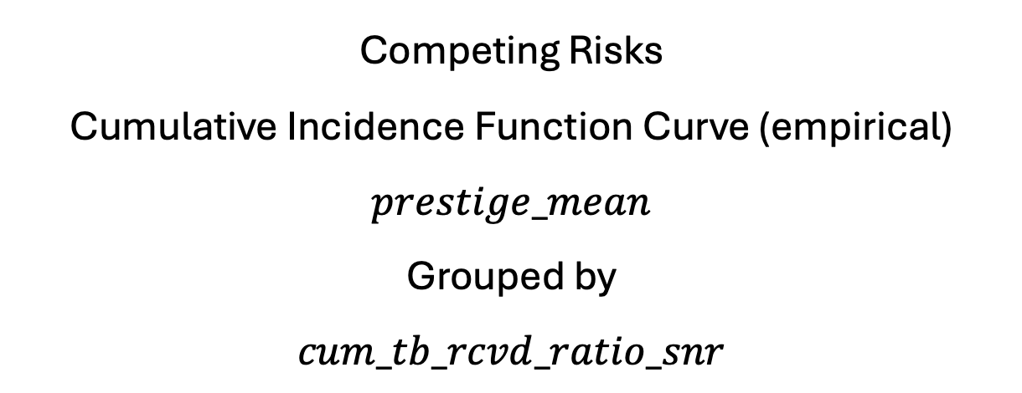
Competing Risks
Cumulative Incidence Function Curve (empirical)
$$prestige_mean$$
Grouped by
$$cum_tb_rcvd_ratio_snr$$

Slide 2
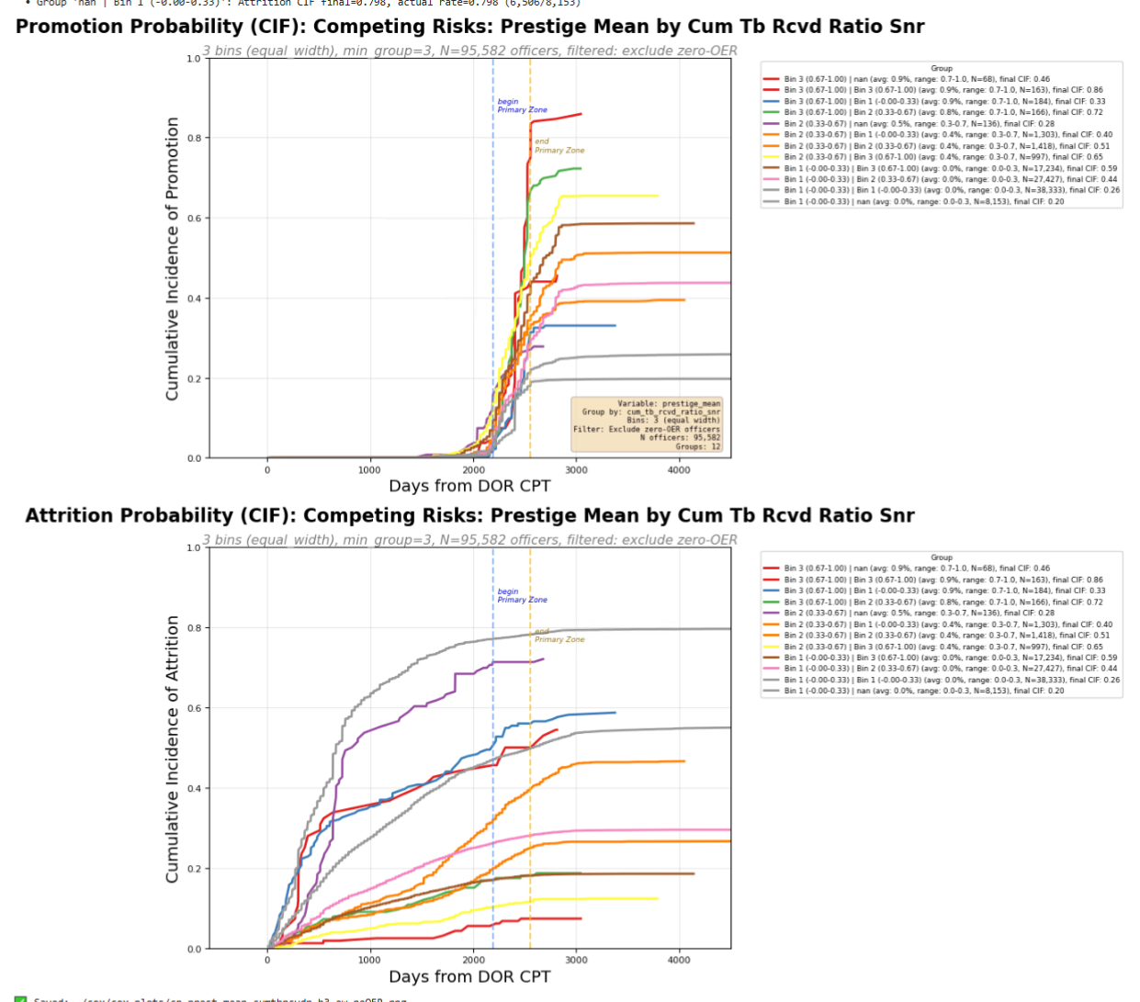

Slide 3
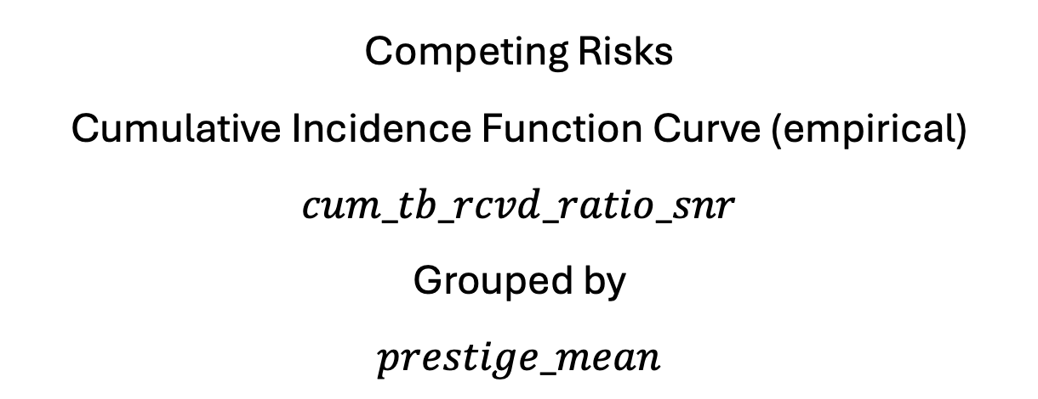
Competing Risks
Cumulative Incidence Function Curve (empirical)
$$cum_tb_rcvd_ratio_snr$$
Grouped by
$$prestige_mean$$

Slide 4
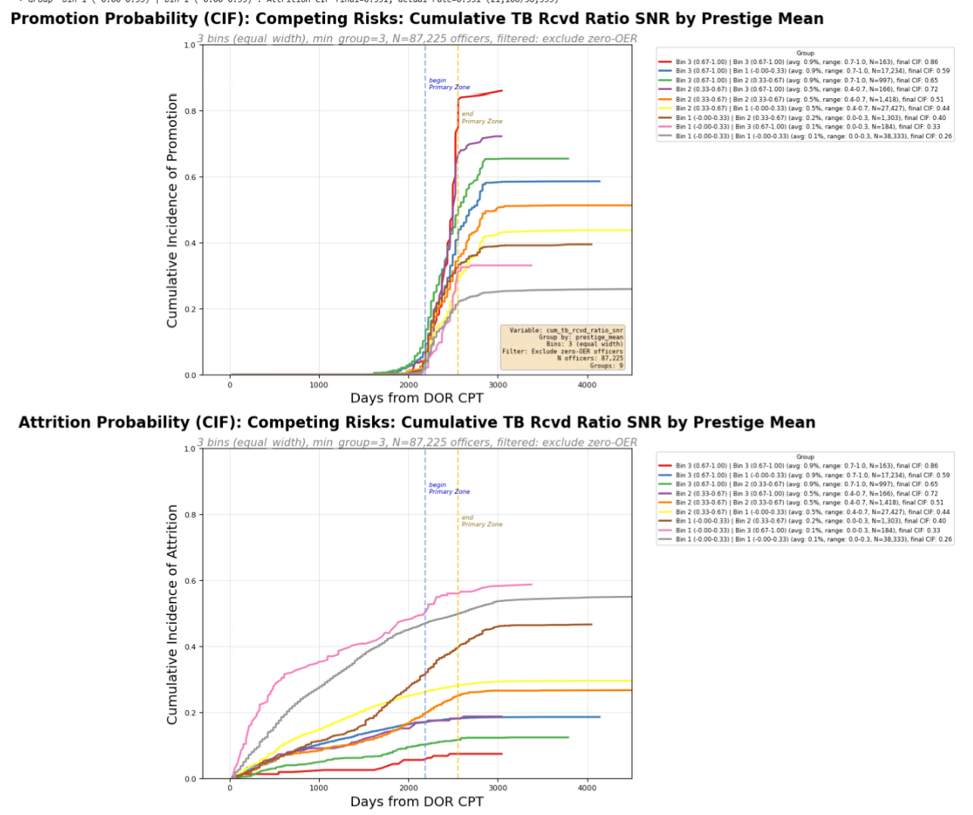

Slide 5
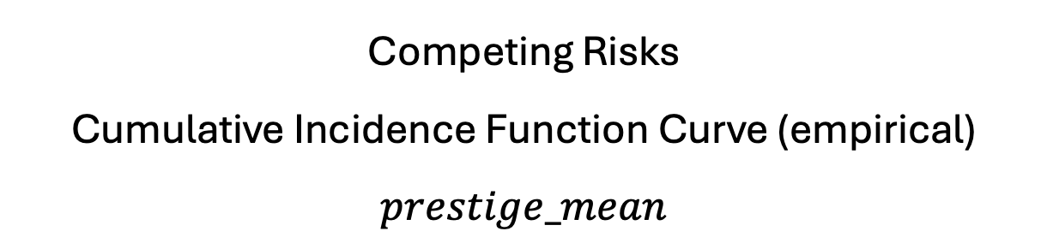
Competing Risks
Cumulative Incidence Function Curve (empirical)
$$prestige_mean$$

Slide 6
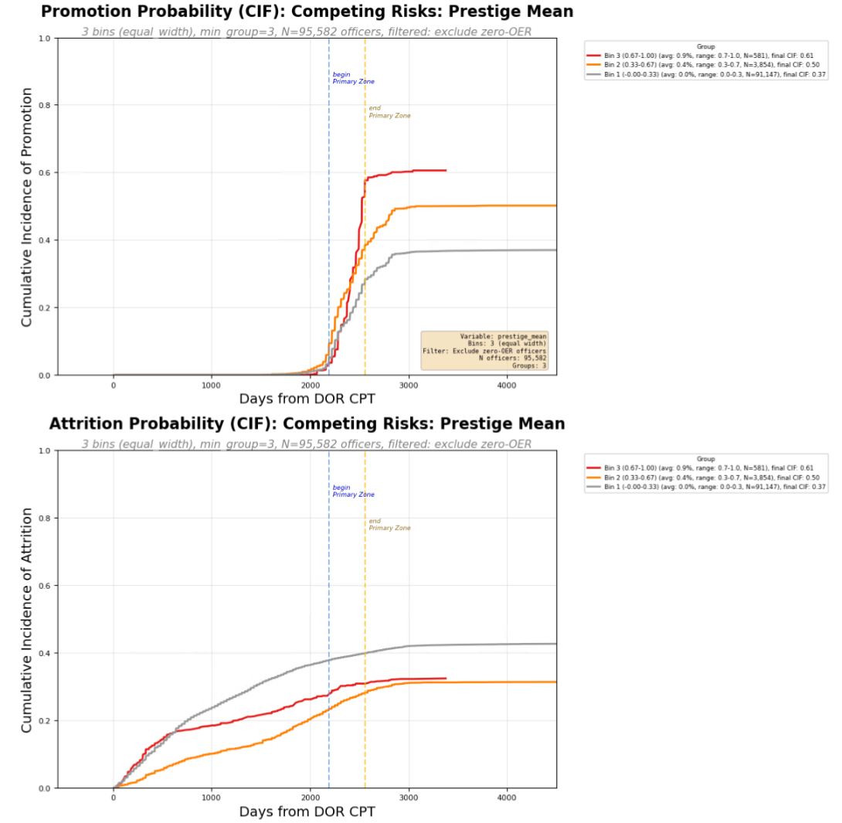

Slide 7
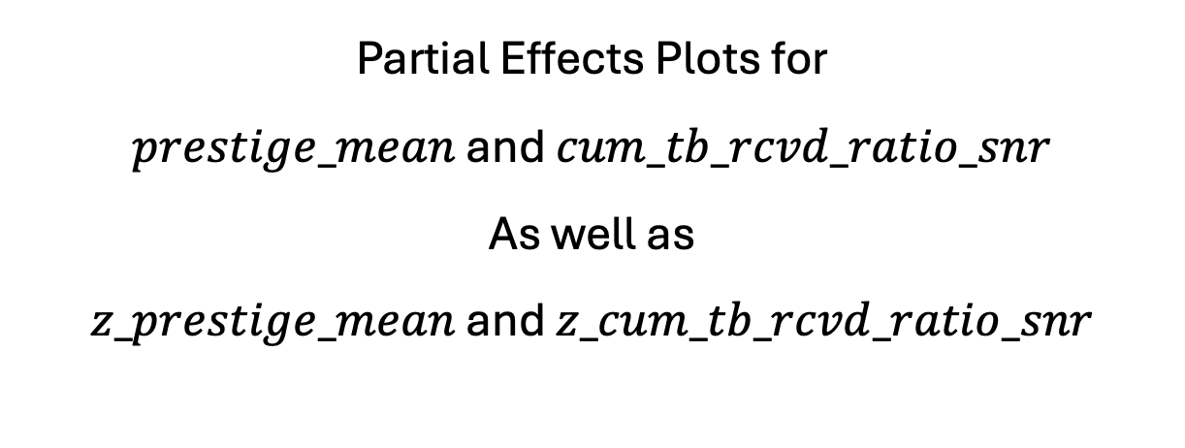
Partial Effects Plots for
$prestige_mean$ and $cum_tb_rcvd_ratio_snr$
As well as
$z_prestige_mean$ and $z_cum_tb_rcvd_ratio_snr$

Slide 8
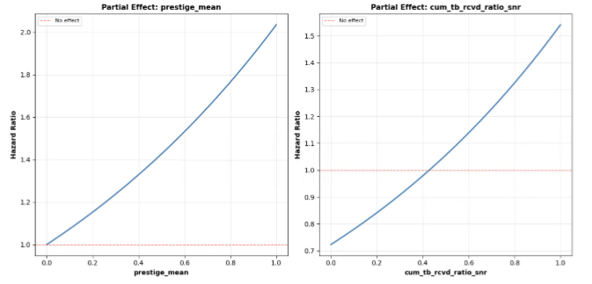
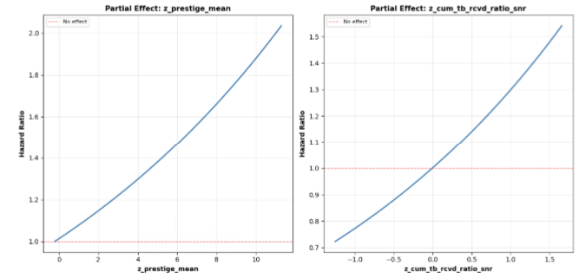

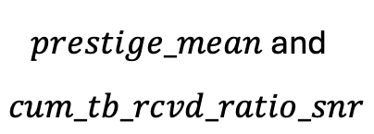
$prestige_mean$ and $cum_tb_rcvd_ratio_snr$
$z_prestige_mean$ and $z_cum_tb_rcvd_ratio_snr$

Slide 9
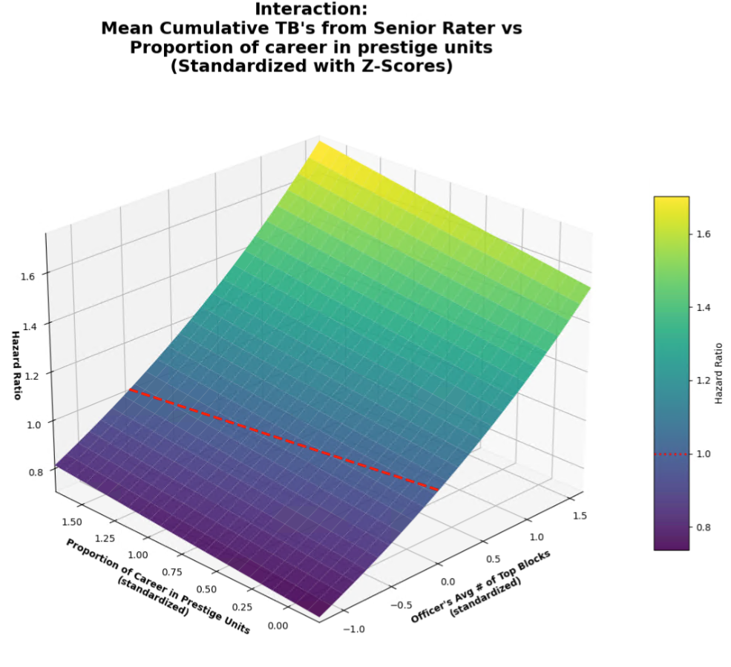

Slide 10
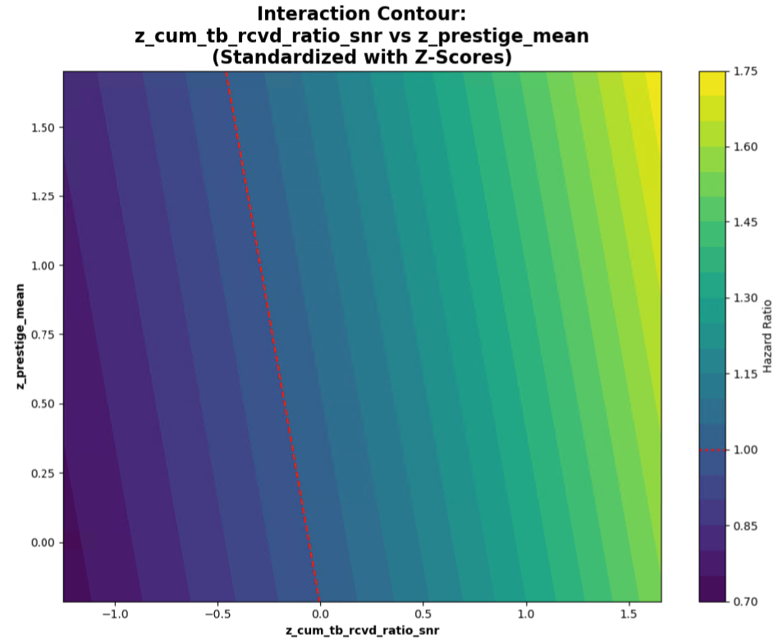

Slide 11


Slide 12
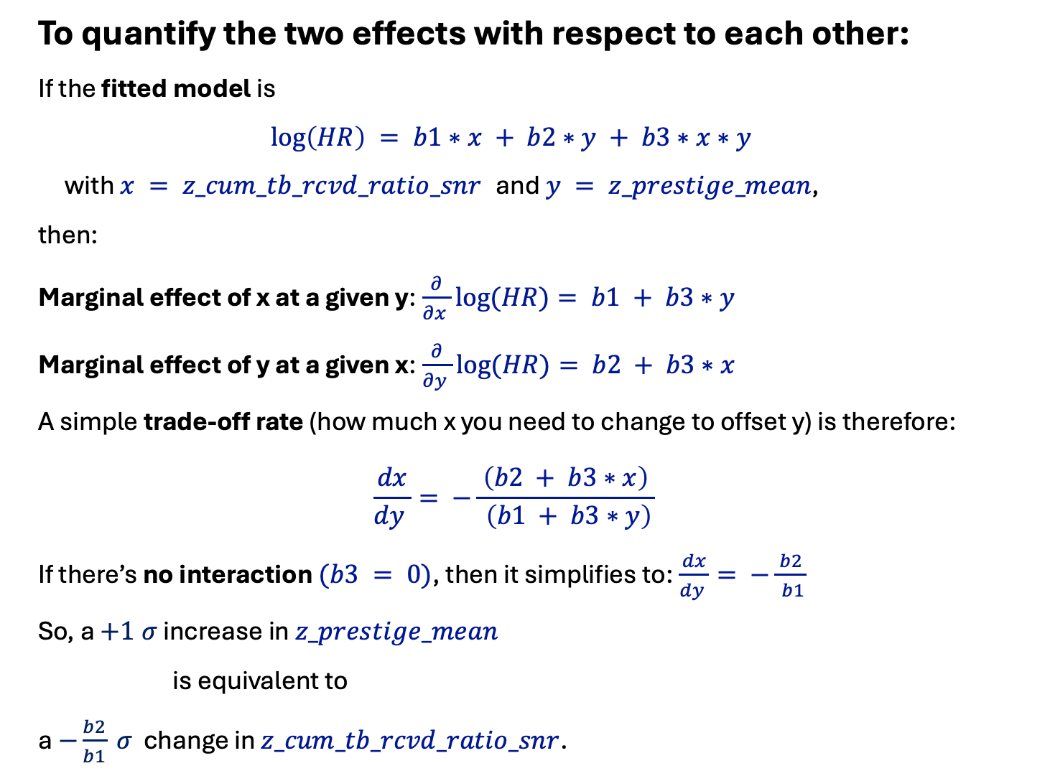
To quantify the two effects with respect to each other:
If the fitted model is
$$\log\left(HR\right) = b1∗x + b2∗y + b3∗x∗y$$
with $x = z_cum_tb_rcvd_ratio_snr$ and $y = z_prestige_mean$,
then:
Marginal effect of x at a given y:$\frac{∂}{∂x }log⁡(HR)= b1 + b3∗y$
Marginal effect of y at a given x:$\frac{∂}{∂y }log⁡(HR)= b2 + b3∗x$
A simple trade‑off rate (how much x you need to change to offset y) is therefore:
$$\frac{dx}{dy }= −\frac{ \left(b2 + b3∗x\right) }{ \left(b1 + b3∗y\right)}$$
If there’s no interaction $(b3 = 0)$, then it simplifies to:$\frac{dx}{dy }= −\frac{ b2 }{ b1}$
So, a $+1 σ$ increase in $z_prestige_mean$
is equivalent to
a $−\frac{b2}{b1} σ$ change in $z_cum_tb_rcvd_ratio_snr$.

Slide 13
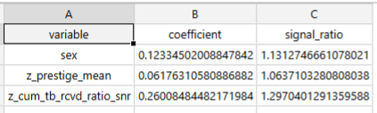
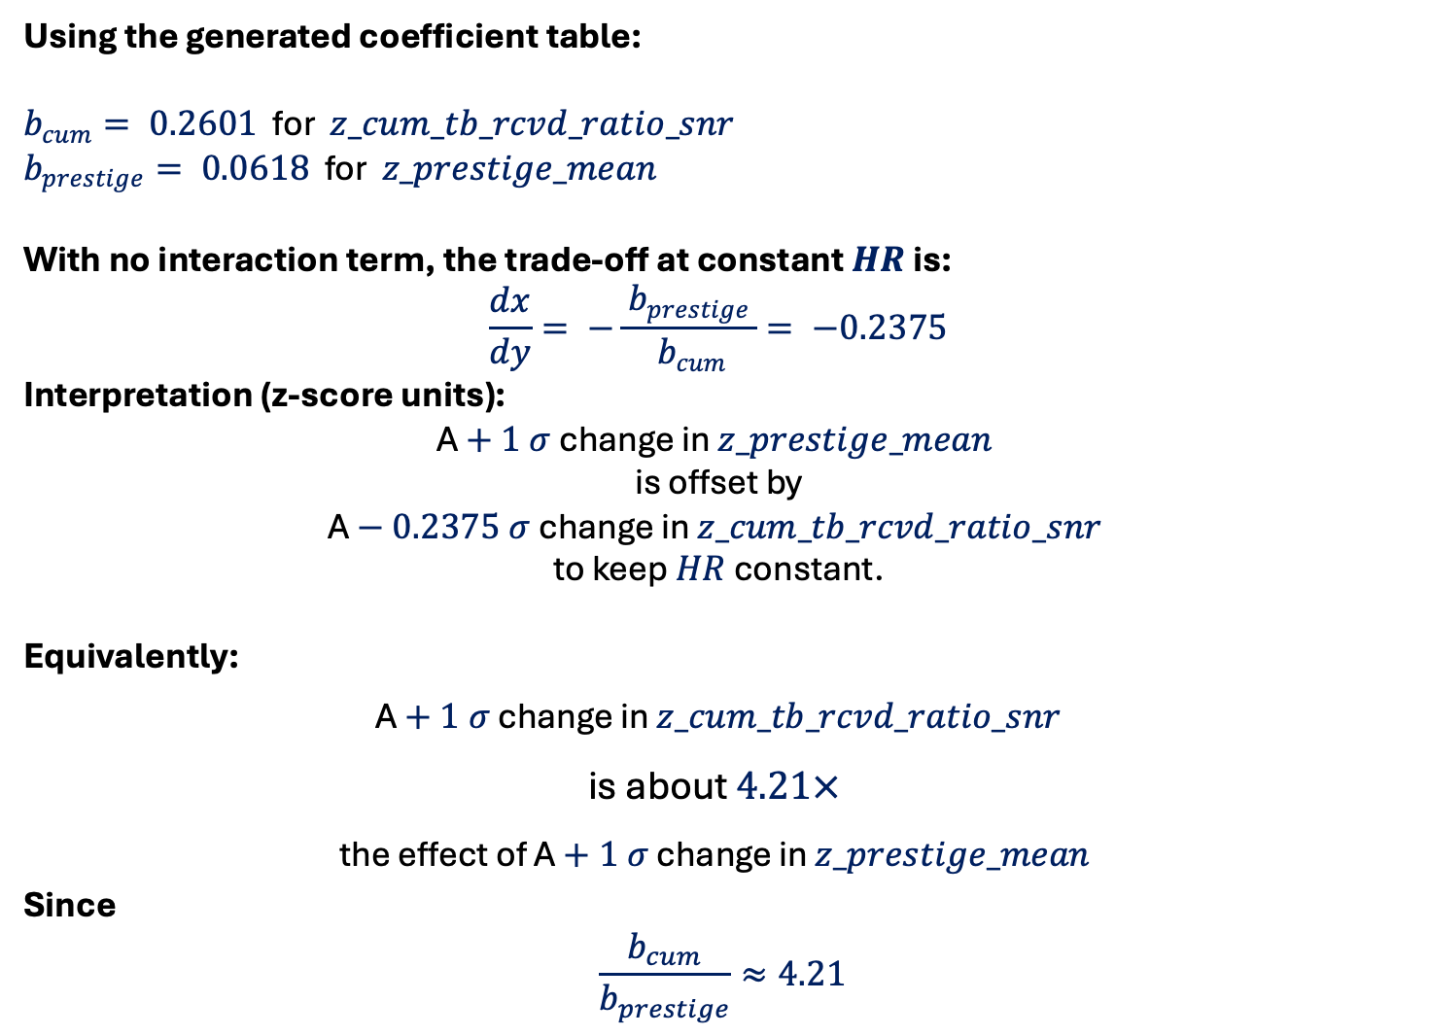
Using the generated coefficient table:
$b_{cum}= 0.2601$ for $z_cum_tb_rcvd_ratio_snr$
$b_{prestige}= 0.0618$ for $z_prestige_mean$
With no interaction term, the trade‑off at constant $HR$ is:
$$\frac{dx}{dy}= −\frac{ b_{prestige }}{ b_{cum}}= −0.2375$$
Interpretation (z‑score units):
A $+ 1 σ$ change in $z_prestige_mean$
is offset by
A $− 0.2375 σ$ change in $z_cum_tb_rcvd_ratio_snr$
to keep $HR$ constant.
Equivalently:
A $+ 1 σ$ change in $z_cum_tb_rcvd_ratio_snr$
is about $4.21×$
the effect of A $+ 1 σ$ change in $z_prestige_mean$
Since
$$\frac{b_{cum}}{b_{prestige}}≈4.21$$

Slide 14
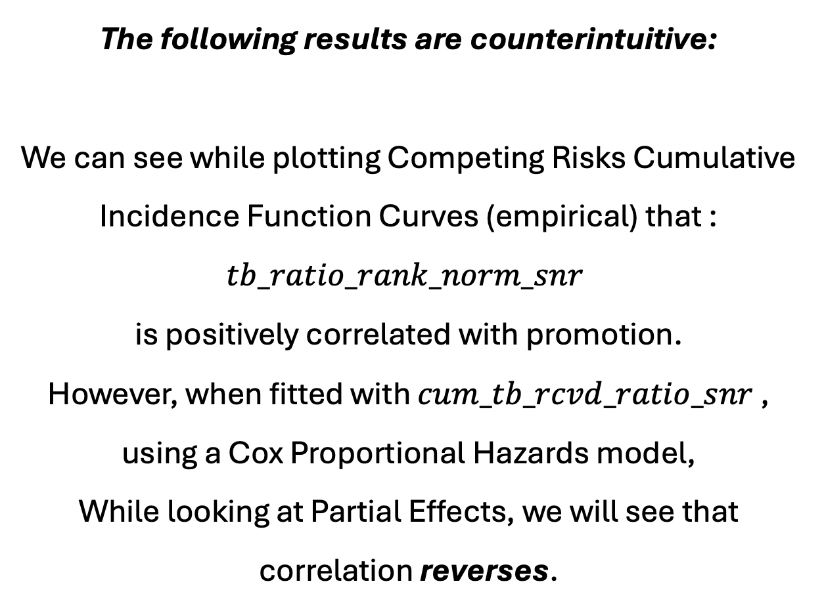
The following results are counterintuitive:
We can see while plotting Competing Risks Cumulative Incidence Function Curves (empirical) that :
$$tb_ratio_rank_norm_snr$$
is positively correlated with promotion.
However, when fitted with $cum_tb_rcvd_ratio_snr$ ,
using a Cox Proportional Hazards model,
While looking at Partial Effects, we will see that correlation reverses.

Slide 15
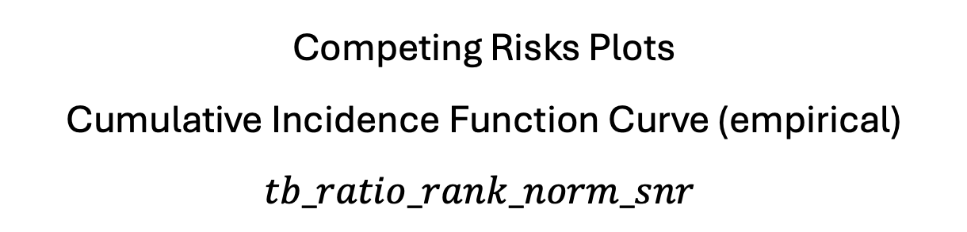
Competing Risks Plots
Cumulative Incidence Function Curve (empirical)
$$tb_ratio_rank_norm_snr$$

Slide 16
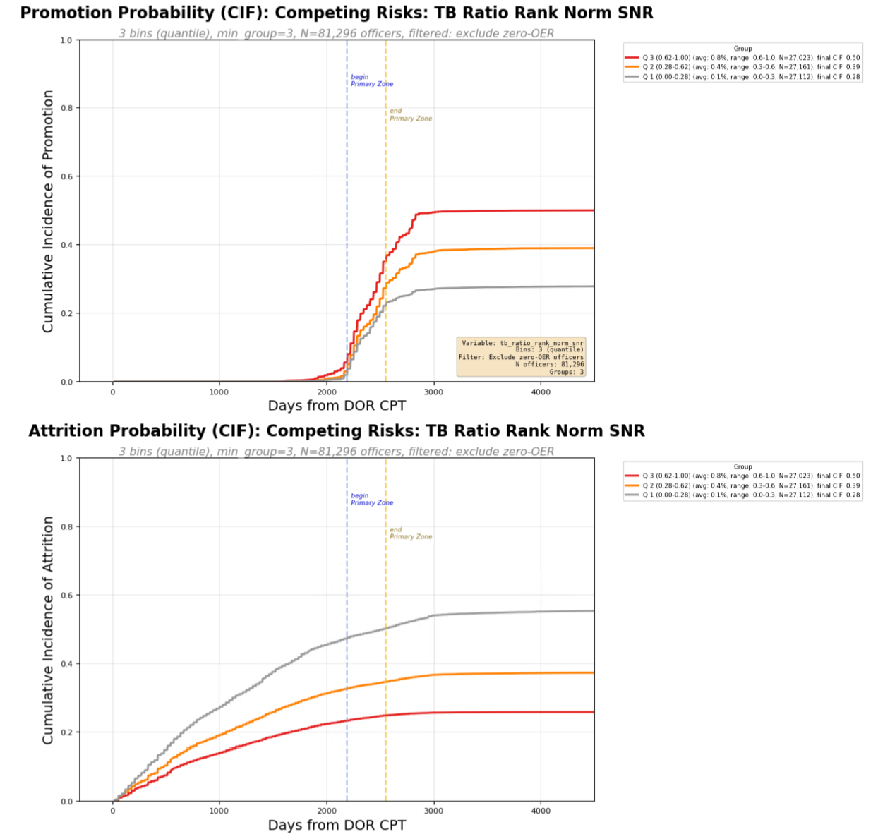

Slide 17
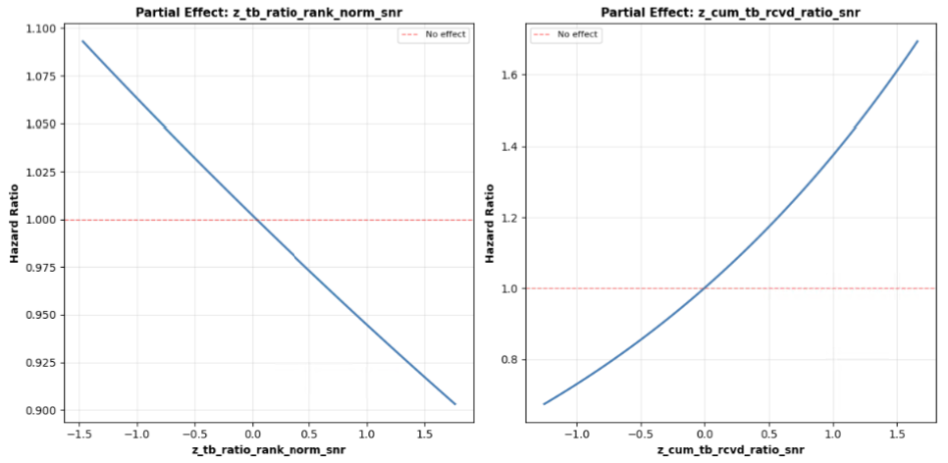

Slide 18
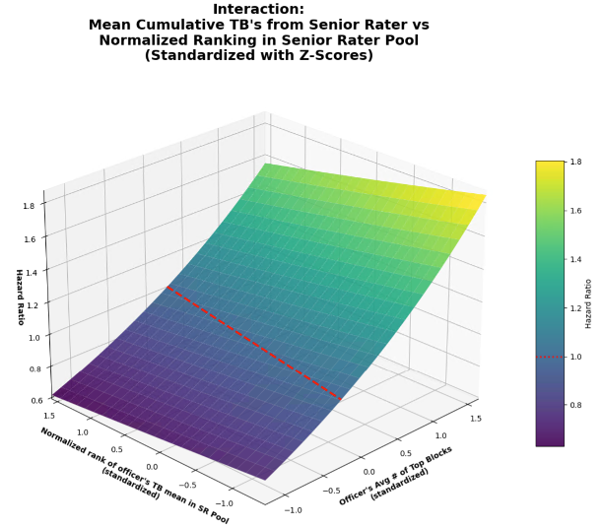

Slide 19
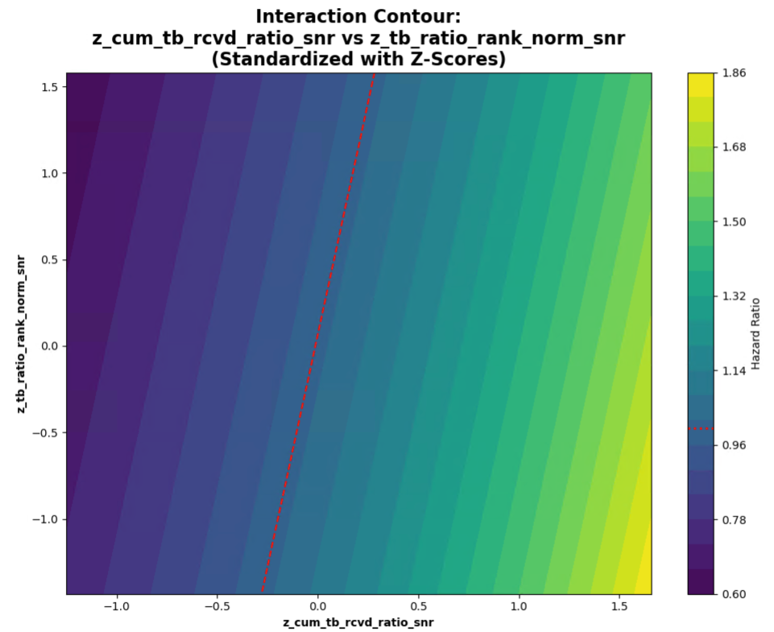

Slide 20
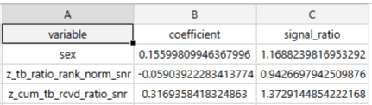

Slide 21
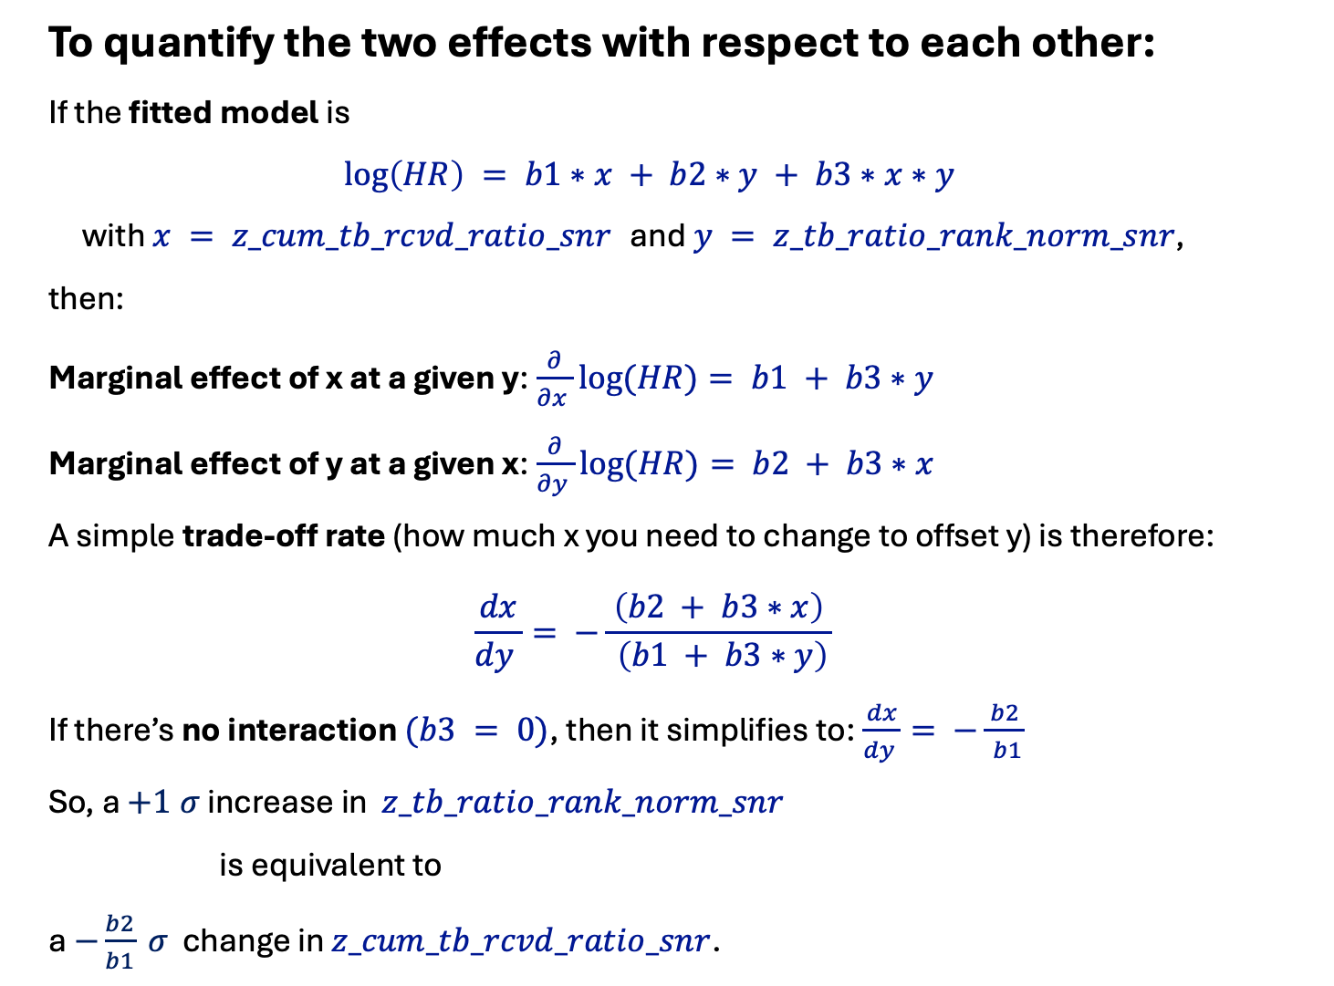
To quantify the two effects with respect to each other:
If the fitted model is
$$\log\left(HR\right) = b1∗x + b2∗y + b3∗x∗y$$
with $x = z_cum_tb_rcvd_ratio_snr$ and $y = z_tb_ratio_rank_norm_snr$,
then:
Marginal effect of x at a given y:$\frac{∂}{∂x }log⁡(HR)= b1 + b3∗y$
Marginal effect of y at a given x:$\frac{∂}{∂y }log⁡(HR)= b2 + b3∗x$
A simple trade‑off rate (how much x you need to change to offset y) is therefore:
$$\frac{dx}{dy }= −\frac{ \left(b2 + b3∗x\right) }{ \left(b1 + b3∗y\right)}$$
If there’s no interaction $(b3 = 0)$, then it simplifies to:$\frac{dx}{dy }= −\frac{ b2 }{ b1}$
So, a $+1 σ$ increase in $z_tb_ratio_rank_norm_snr$
is equivalent to
a $−\frac{b2}{b1} σ$ change in $z_cum_tb_rcvd_ratio_snr$.

Slide 22
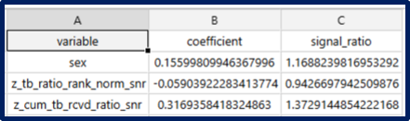
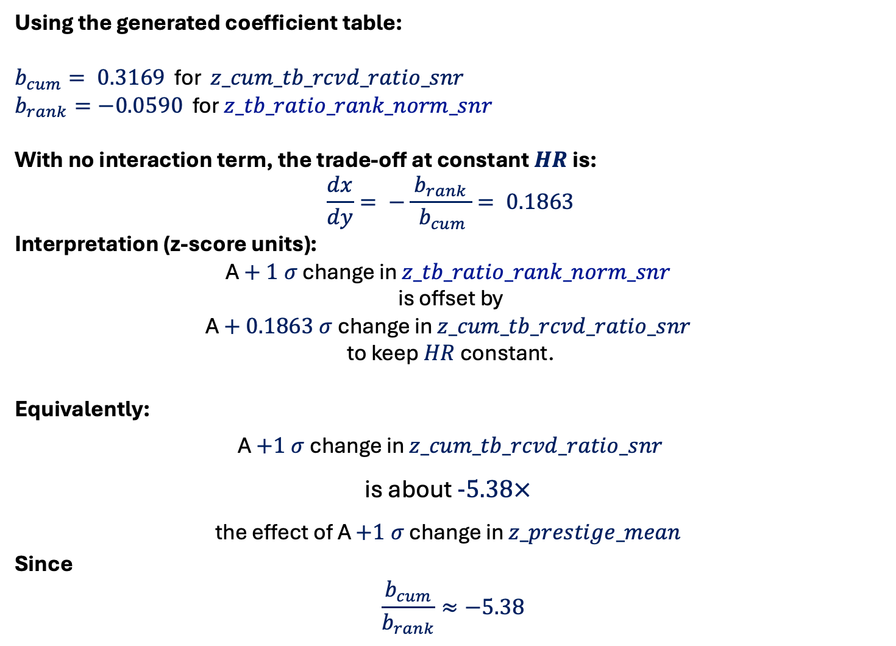
Using the generated coefficient table:
$b_{cum}= 0.3169$ for $z_cum_tb_rcvd_ratio_snr$
$b_{rank}=−0.0590$ for $z_tb_ratio_rank_norm_snr$
With no interaction term, the trade‑off at constant $HR$ is:
$$\frac{dx}{dy}= −\frac{ b_{rank }}{ b_{cum}}= 0.1863$$
Interpretation (z‑score units):
A $+ 1 σ$ change in $z_tb_ratio_rank_norm_snr$
is offset by
A $+ 0.1863 σ$ change in $z_cum_tb_rcvd_ratio_snr$
to keep $HR$ constant.
Equivalently:
A $+1 σ$ change in $z_cum_tb_rcvd_ratio_snr$
is about $−5.38×$
the effect of A $+1 σ$ change in $z_prestige_mean$
Since
$$\frac{b_{cum}}{b_{rank}}≈−5.38$$

Slide 23
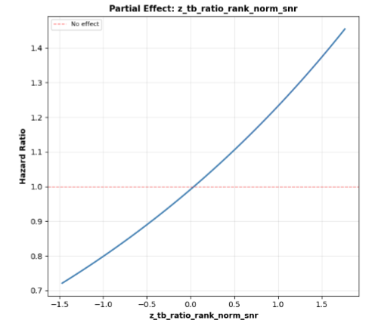

Slide 24
RUN 1 - Using
z_cum_tb_rcvd_ratio_snr
z_pool_tb_ratio_mean_snr
z_star_pool_interaction

Slide 25
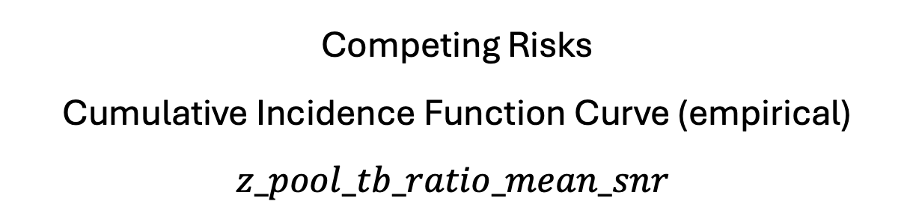
Competing Risks
Cumulative Incidence Function Curve (empirical)
$$z_pool_tb_ratio_mean_snr$$

Slide 26
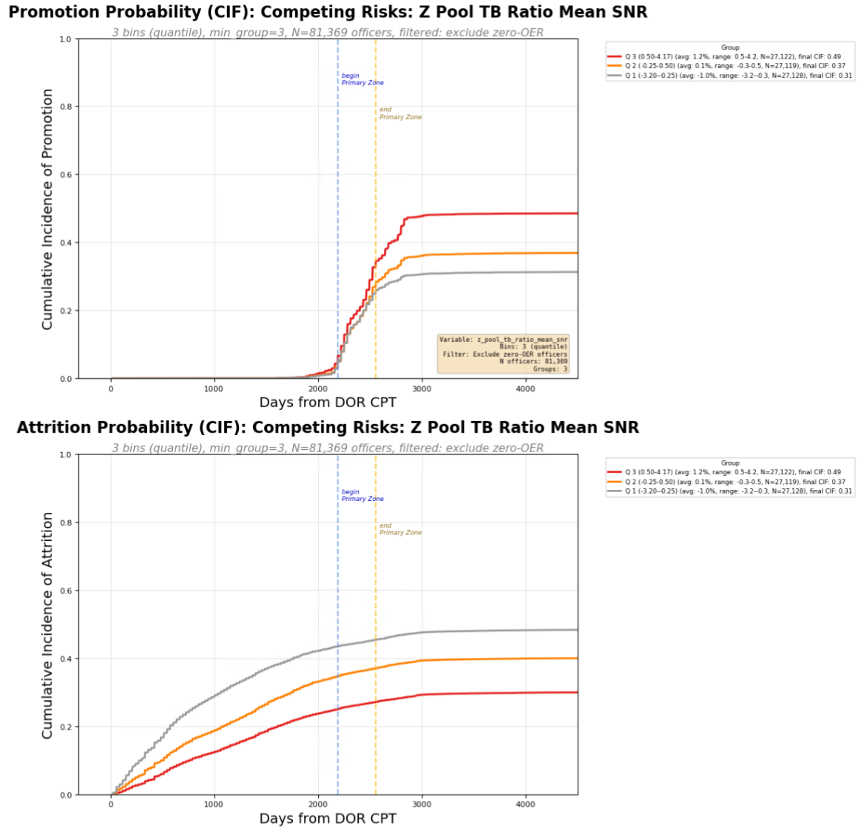

Slide 27
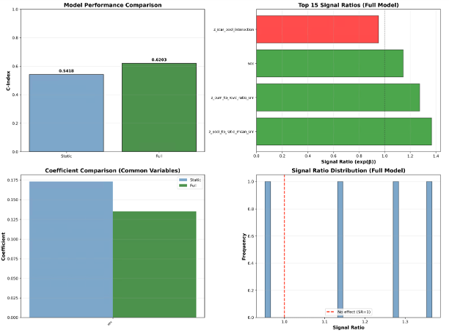

Slide 28
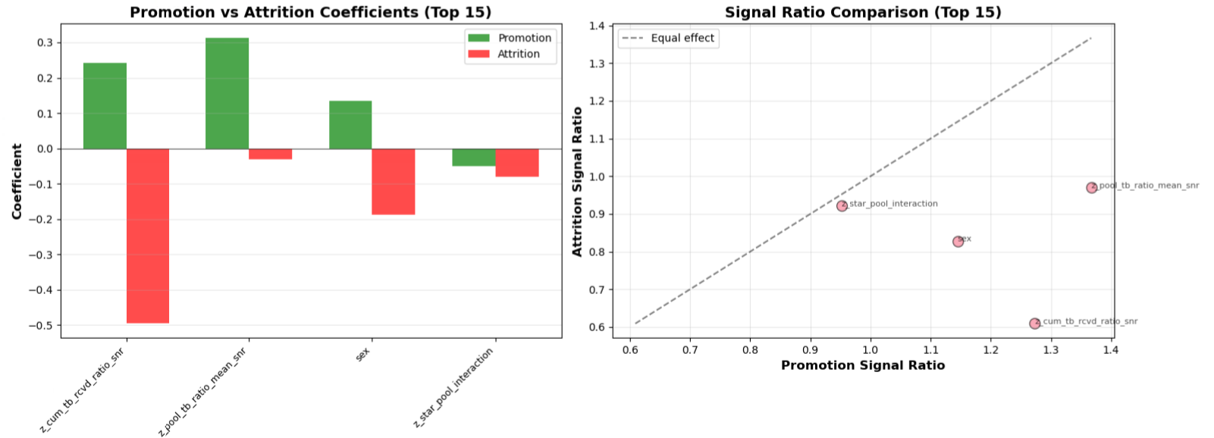

Slide 29
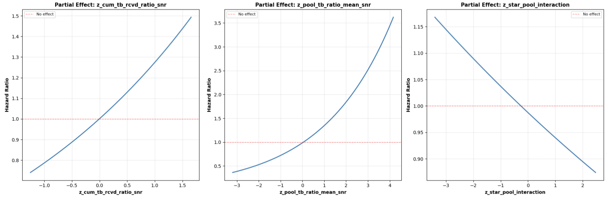

Slide 30
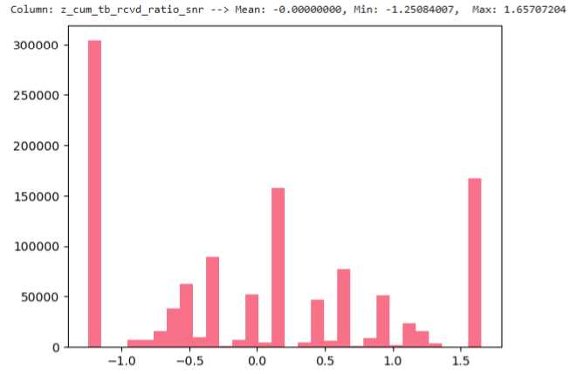
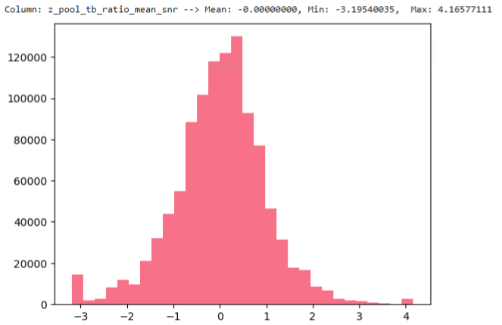
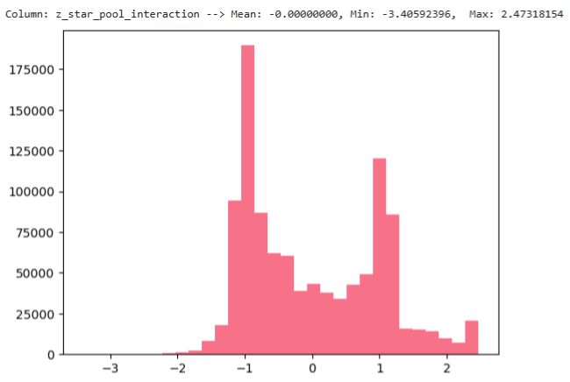

Slide 31
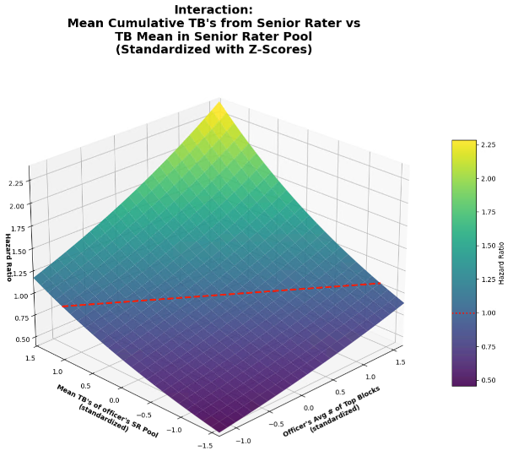

Slide 32
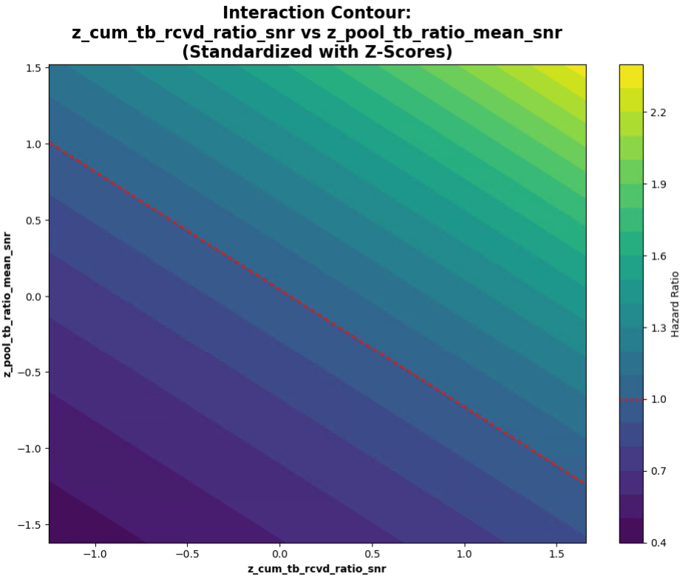

Slide 33
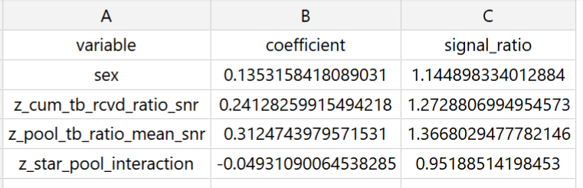

Slide 34

To quantify the two effects with respect to each other:
If the fitted model is
$$\log\left(HR\right) = b1∗x + b2∗y + b3∗x∗y$$
with $x = z_cum_tb_rcvd_ratio_snr$ and $y = z_pool_tb_ratio_mean_snr$,
then:
Marginal effect of x at a given y:$\frac{∂}{∂x }log⁡(HR)= b1 + b3∗y$
Marginal effect of y at a given x:$\frac{∂}{∂y }log⁡(HR)= b2 + b3∗x$
A simple trade‑off rate (how much x you need to change to offset y) is therefore:
$$\frac{dx}{dy }= −\frac{ \left(b2 + b3∗x\right) }{ \left(b1 + b3∗y\right)}$$
If there’s no interaction $(b3 = 0)$, then it simplifies to:$\frac{dx}{dy }= −\frac{ b2 }{ b1}$
So, a $+1 σ$ increase in $z_pool_tb_ratio_mean_snr$,
is equivalent to
a $−\frac{b2}{b1} σ$ change in $z_cum_tb_rcvd_ratio_snr$.

Slide 35
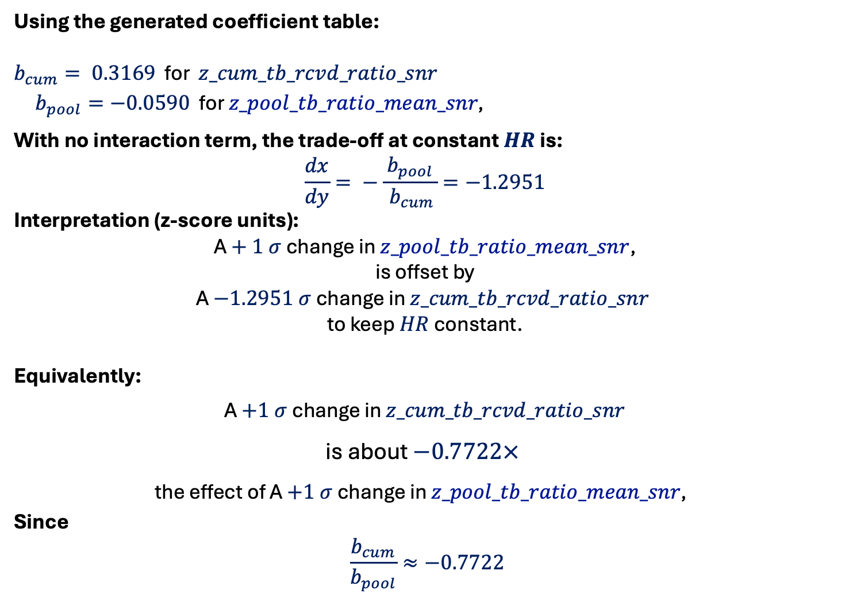
Using the generated coefficient table:
$b_{cum}= 0.3169$ for $z_cum_tb_rcvd_ratio_snr$
$b_{pool}=−0.0590$ for $z_pool_tb_ratio_mean_snr\text{, }$
With no interaction term, the trade‑off at constant $HR$ is:
$$\frac{dx}{dy}= −\frac{ b_{pool }}{ b_{cum}}=−1.2951$$
Interpretation (z‑score units):
A $+ 1 σ$ change in $z_pool_tb_ratio_mean_snr$,
is offset by
A $−1.2951 σ$ change in $z_cum_tb_rcvd_ratio_snr$
to keep $HR$ constant.
Equivalently:
A $+1 σ$ change in $z_cum_tb_rcvd_ratio_snr$
is about $−0.7722×$
the effect of A $+1 σ$ change in $z_pool_tb_ratio_mean_snr\text{, }$
Since
$$\frac{b_{cum}}{b_{pool}}≈−0.7722$$

Slide 36
RUN 2 - Using
z_tb_ratio_rank_norm_snr
z_pool_tb_ratio_mean_snr
z_rank_pool_interaction

Slide 37
Competing Risks
Cumulative Incidence Function Curve (empirical)
$$z_pool_tb_ratio_mean_snr$$

Slide 38
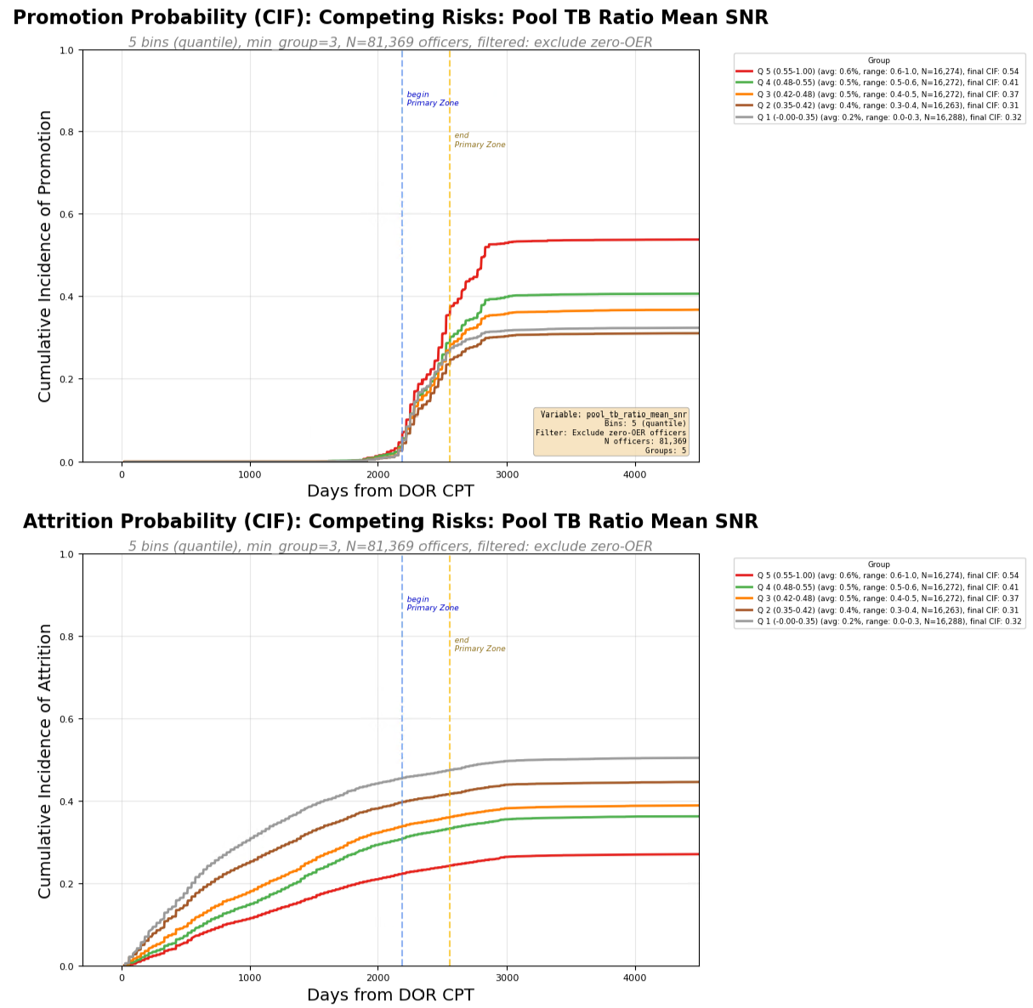

Slide 39
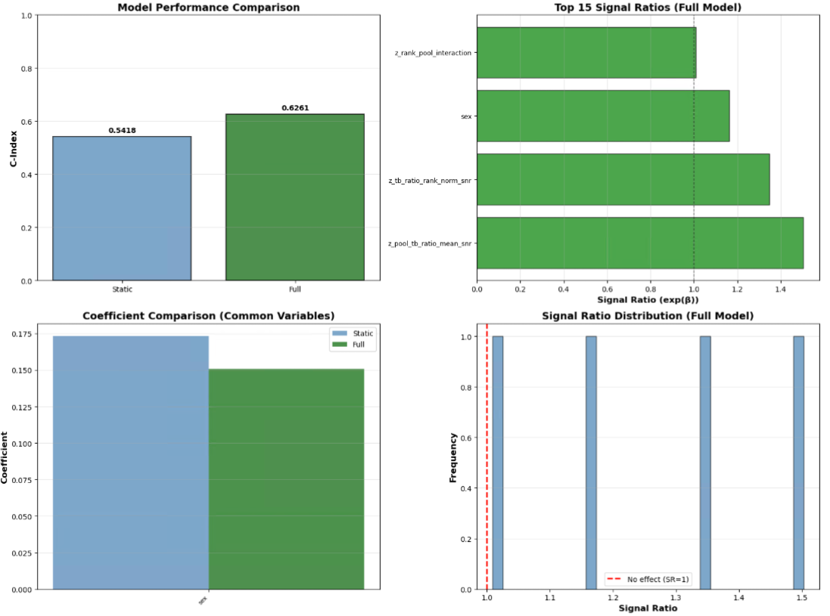

Slide 40
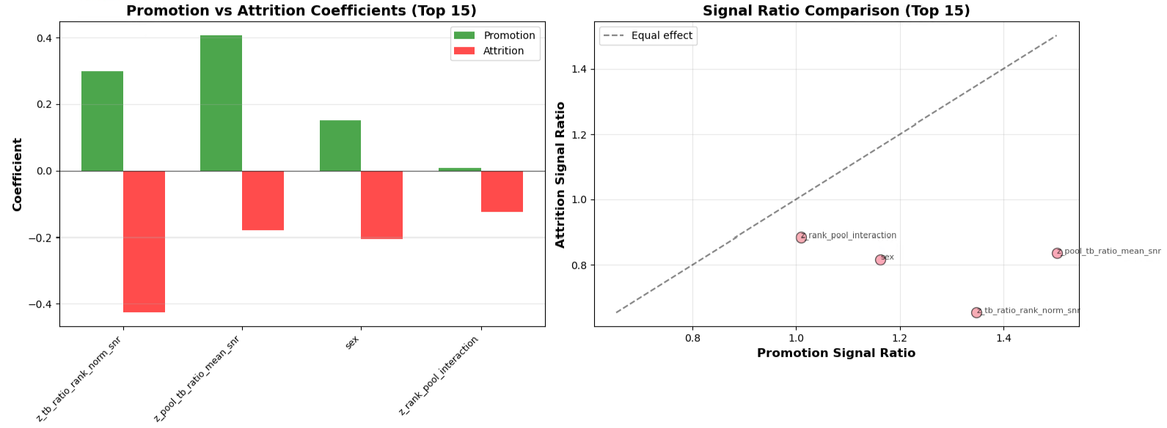

Slide 41
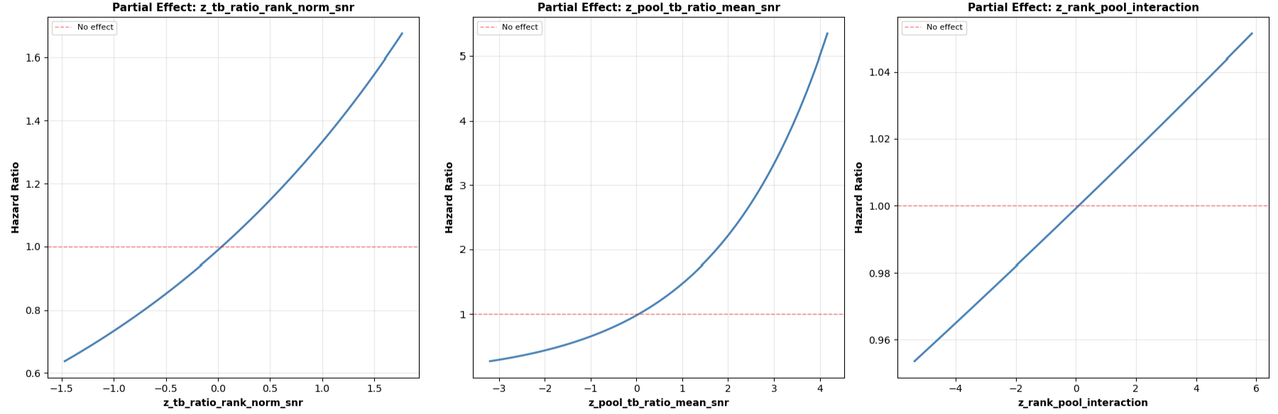

Slide 42
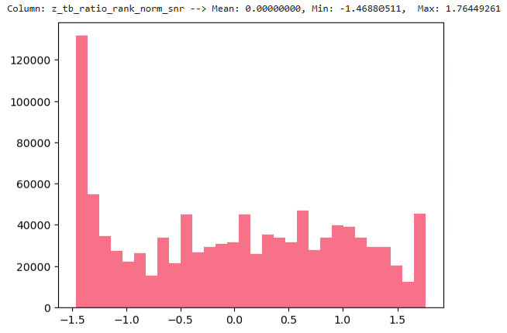
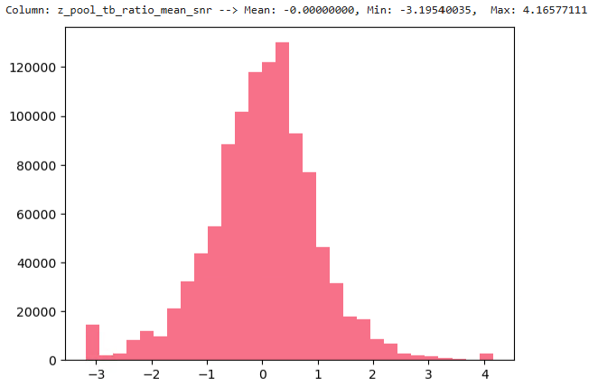
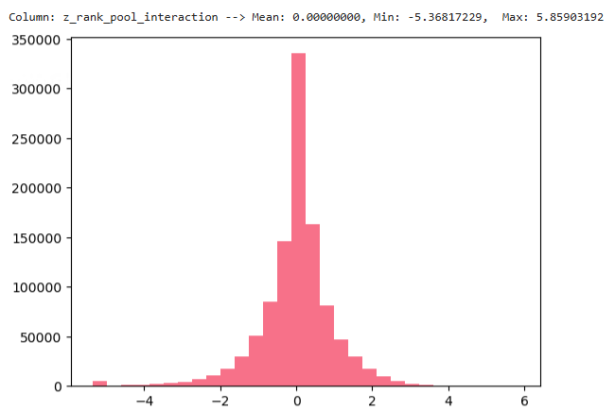

Slide 43
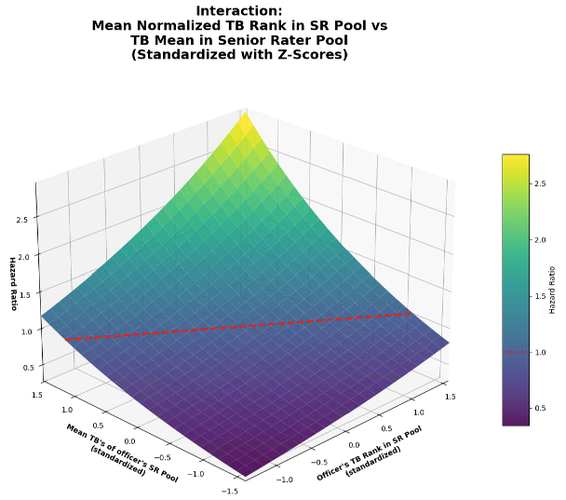

Slide 44
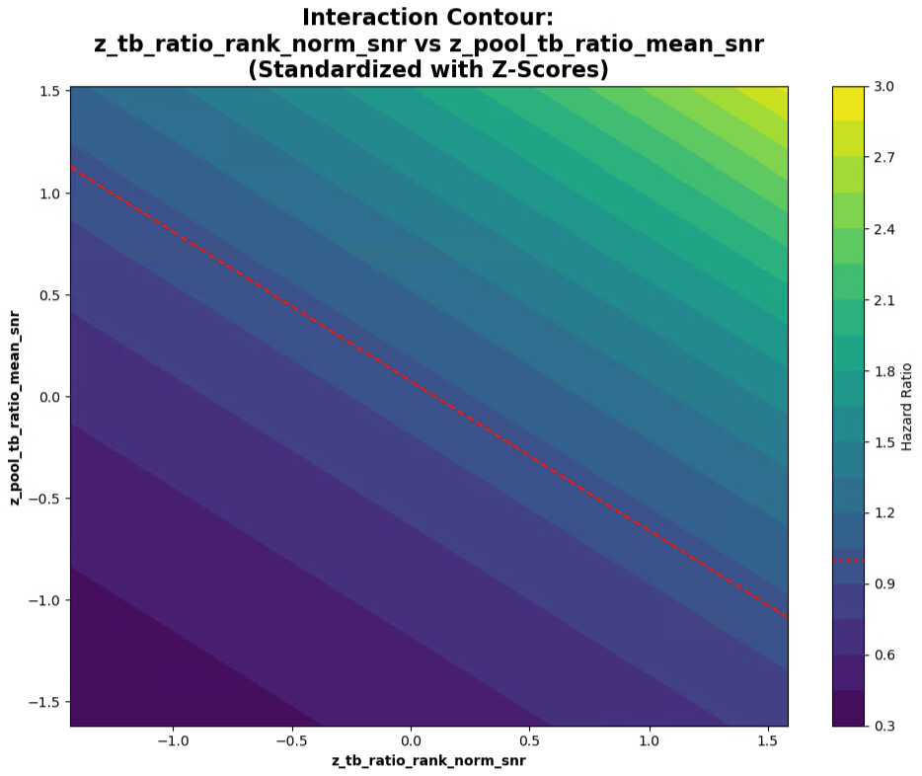

Slide 45
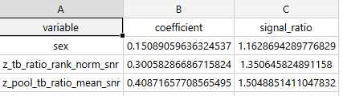
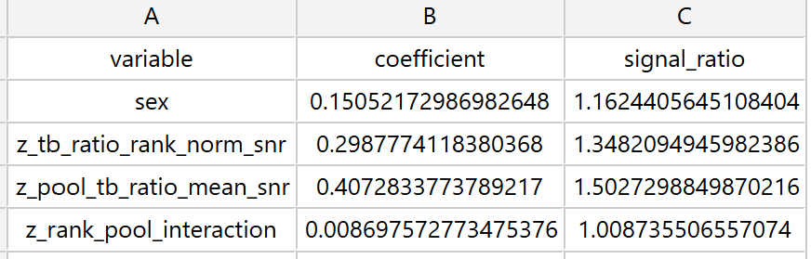

Slide 46
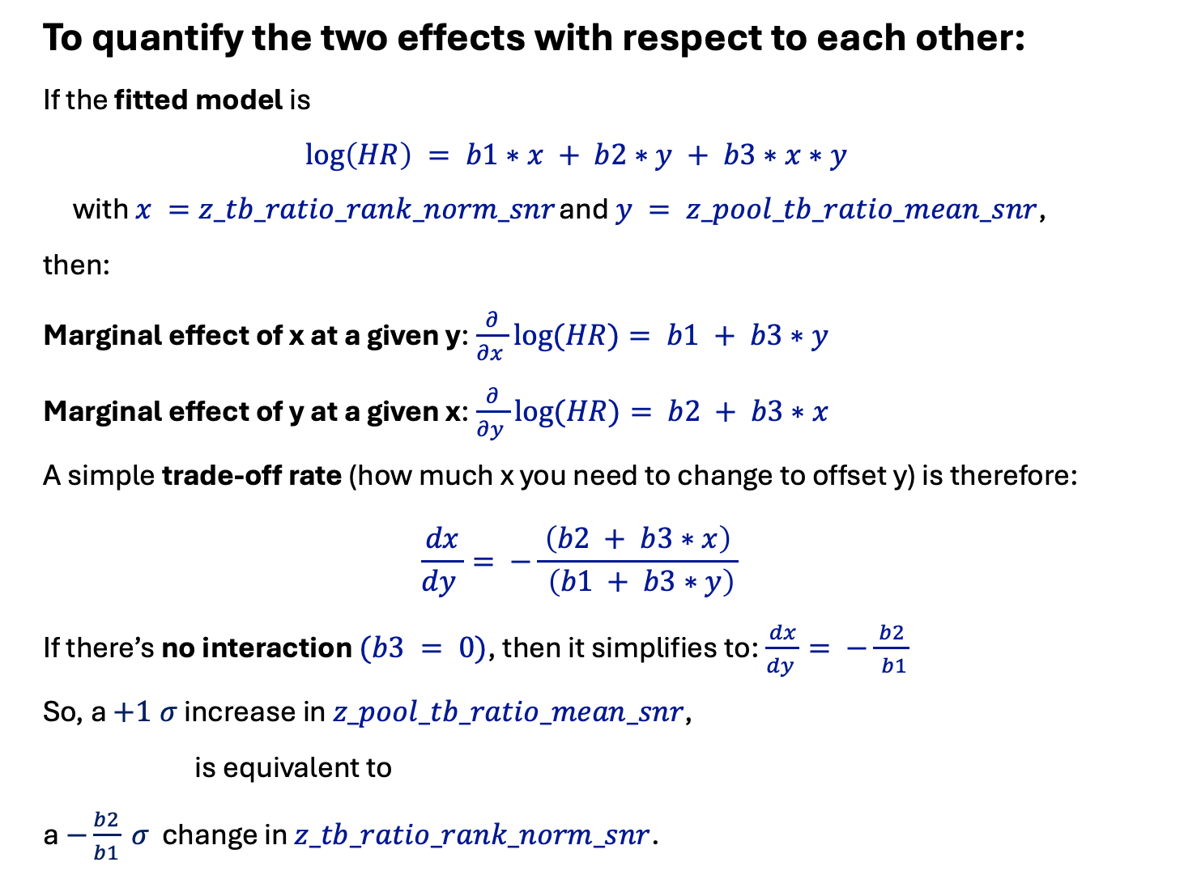
To quantify the two effects with respect to each other:
If the fitted model is
$$\log\left(HR\right) = b1∗x + b2∗y + b3∗x∗y$$
with $x =z_tb_ratio_rank_norm_snr$ and $y = z_pool_tb_ratio_mean_snr$,
then:
Marginal effect of x at a given y:$\frac{∂}{∂x }log⁡(HR)= b1 + b3∗y$
Marginal effect of y at a given x:$\frac{∂}{∂y }log⁡(HR)= b2 + b3∗x$
A simple trade‑off rate (how much x you need to change to offset y) is therefore:
$$\frac{dx}{dy }= −\frac{ \left(b2 + b3∗x\right) }{ \left(b1 + b3∗y\right)}$$
If there’s no interaction $(b3 = 0)$, then it simplifies to:$\frac{dx}{dy }= −\frac{ b2 }{ b1}$
So, a $+1 σ$ increase in $z_pool_tb_ratio_mean_snr$,
is equivalent to
a $−\frac{b2}{b1} σ$ change in $z_tb_ratio_rank_norm_snr$.

Slide 47

Using the generated coefficient table:
$b_{rank}= 0.3169$ for $z_tb_ratio_rank_norm_snr$.
$b_{pool}=−0.0590$ for $z_pool_tb_ratio_mean_snr$
With no interaction term, the trade‑off at constant $HR$ is:
$$\frac{dx}{dy}= −\frac{ b_{pool }}{ b_{rank}}=−1.3632$$
Interpretation (z‑score units):
A $+ 1 σ$ change in $z_pool_tb_ratio_mean_snr$
is offset by
A $+ 0.1863 σ$ change in $z_tb_ratio_rank_norm_snr$
to keep $HR$ constant.
Equivalently:
A $+1 σ$ change in $z_tb_ratio_rank_norm_snr$
is about $−0.7336×$
the effect of A $+1 σ$ change in $z_pool_tb_ratio_mean_snr$
Since
$$\frac{b_{rank}}{b_{pool}}≈−0.7336$$

