Slide 1
RUN 8 - Using
z_prestige_mean
z_cum_tb_rcvd_ratio_snr
z_prestige_tb_interaction
With all Ygs, No SF, No AV

Slide 2
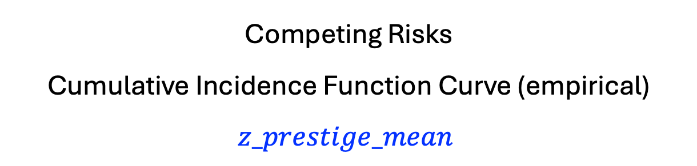
Competing Risks
Cumulative Incidence Function Curve (empirical)
$$z_prestige_mean$$

Slide 3
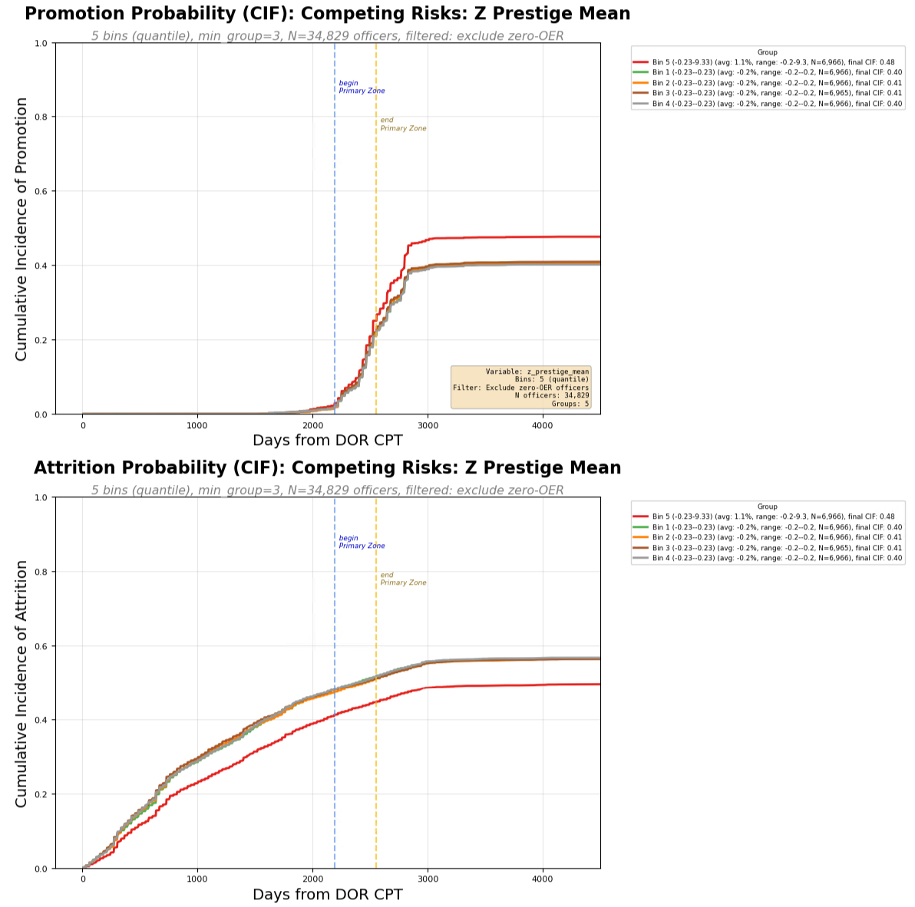
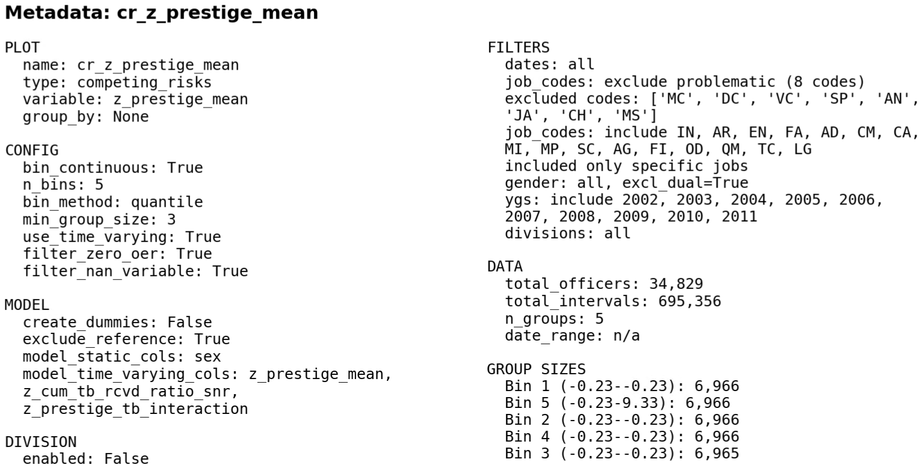

Slide 4
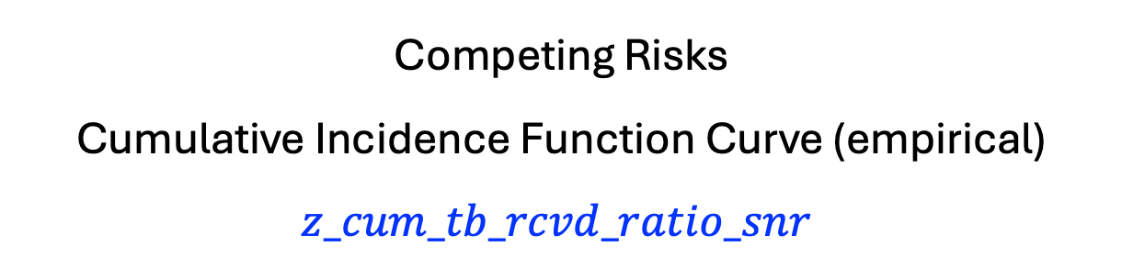
Competing Risks
Cumulative Incidence Function Curve (empirical)
$$z_cum_tb_rcvd_ratio_snr$$

Slide 5
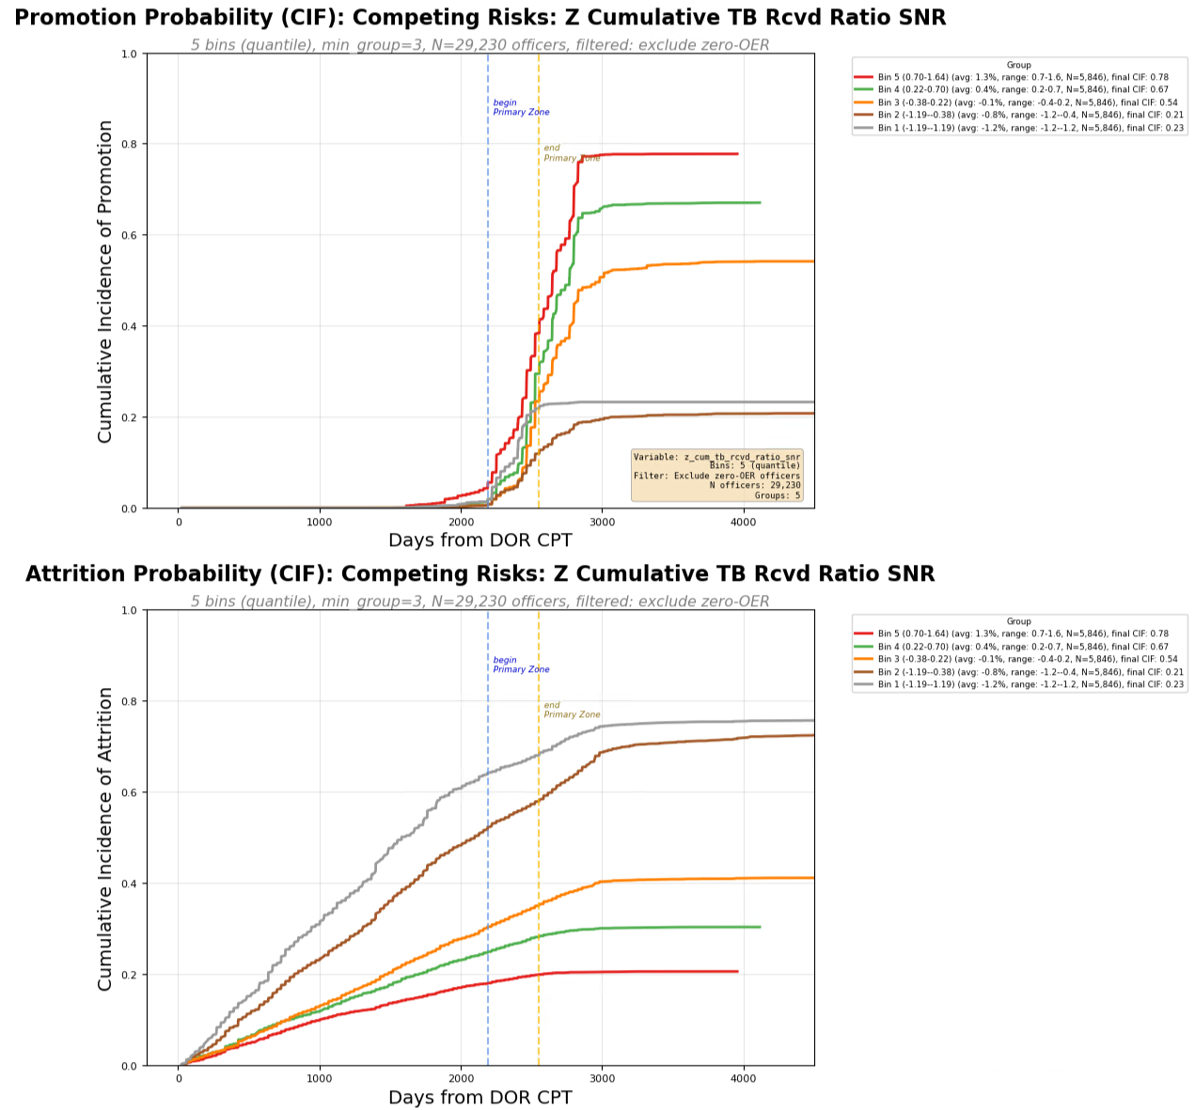
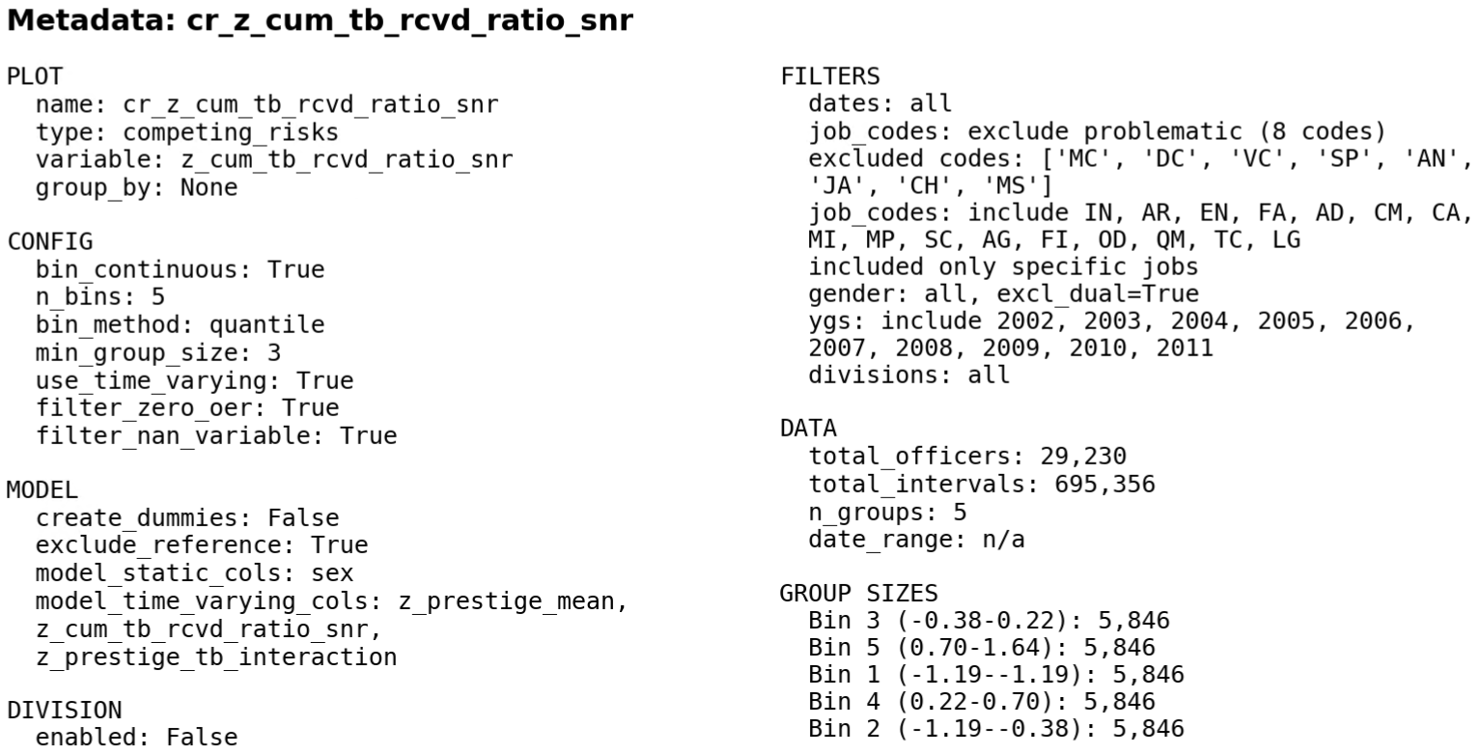

Slide 6
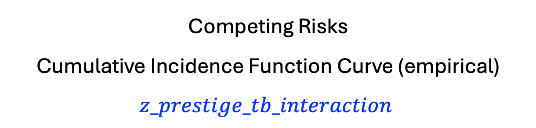
Competing Risks
Cumulative Incidence Function Curve (empirical)
$$z_prestige_tb_interaction$$

Slide 7
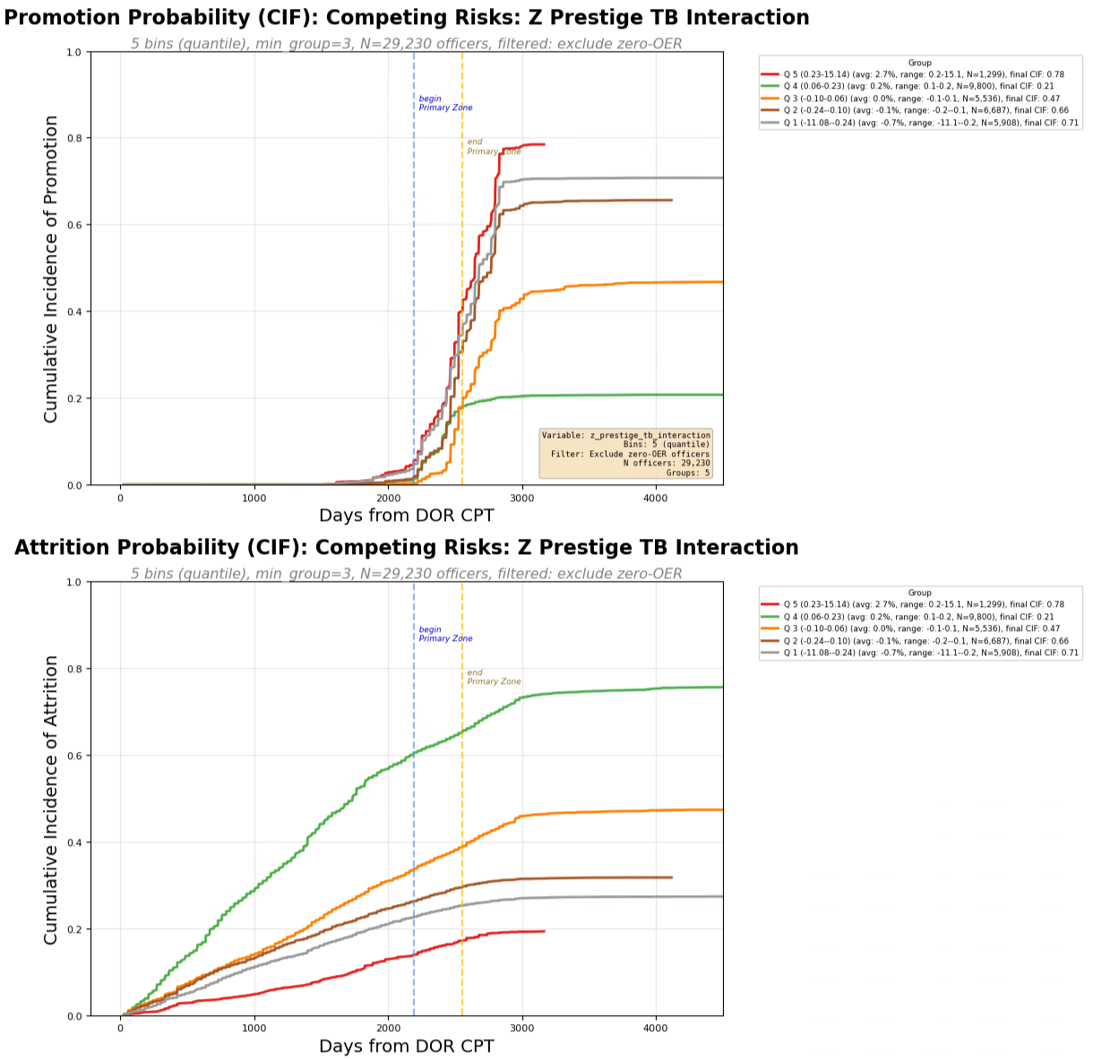
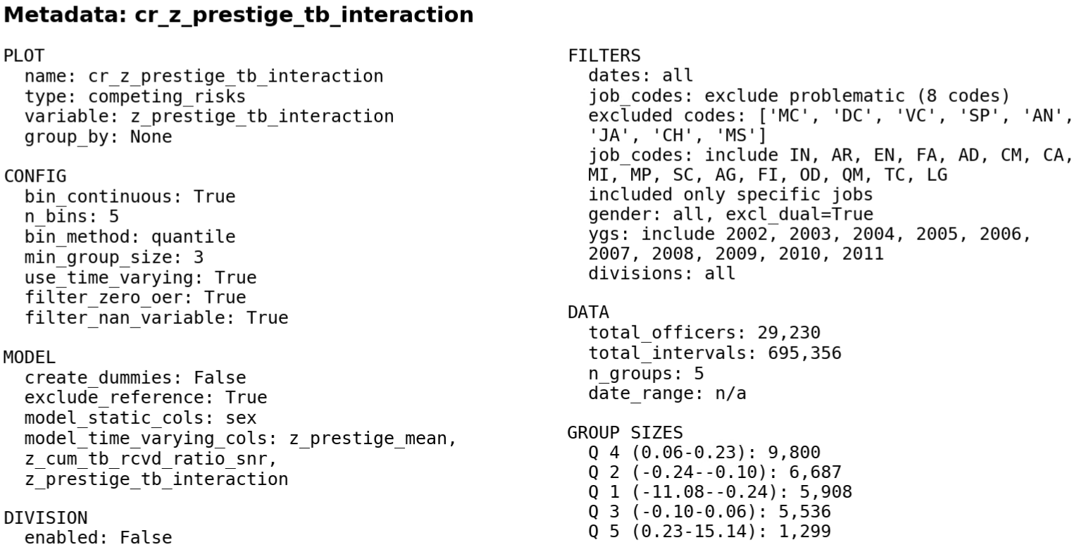

Slide 8
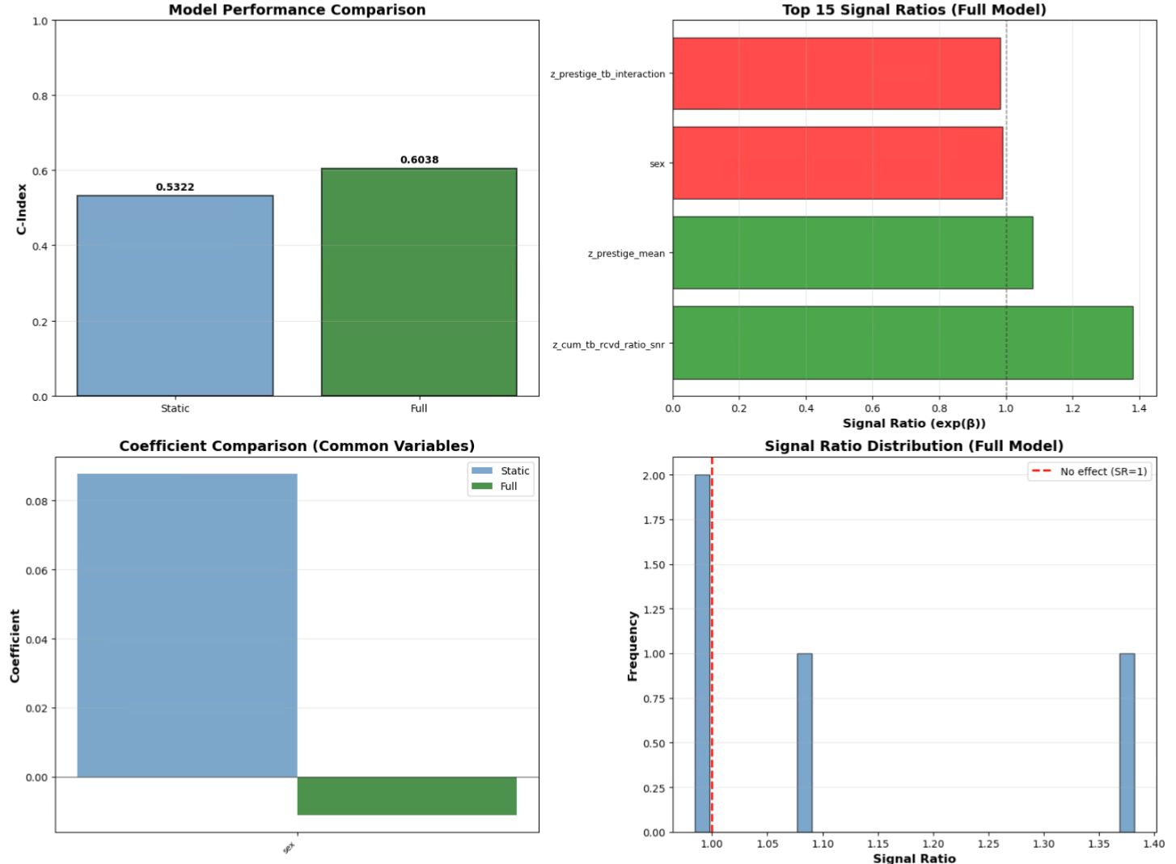

Slide 9
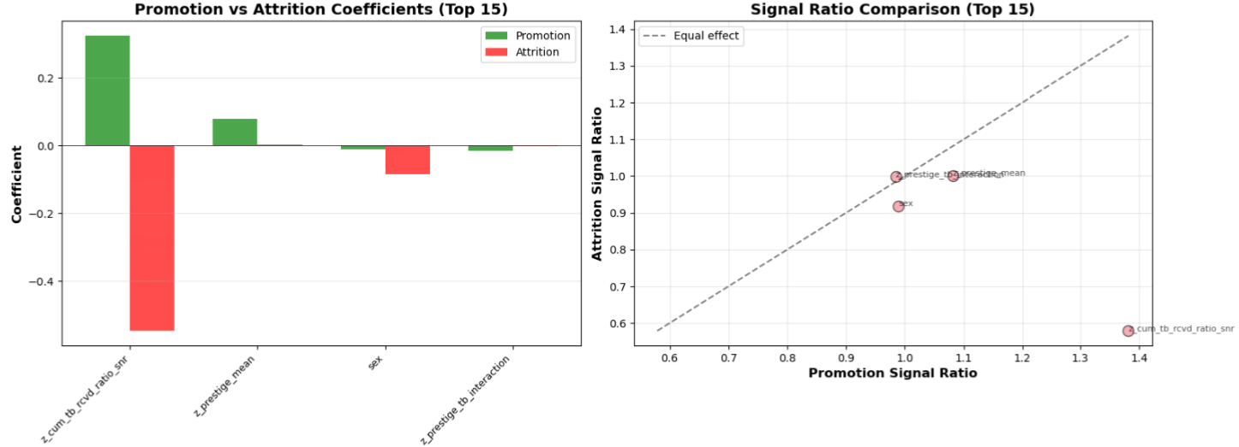

Slide 10
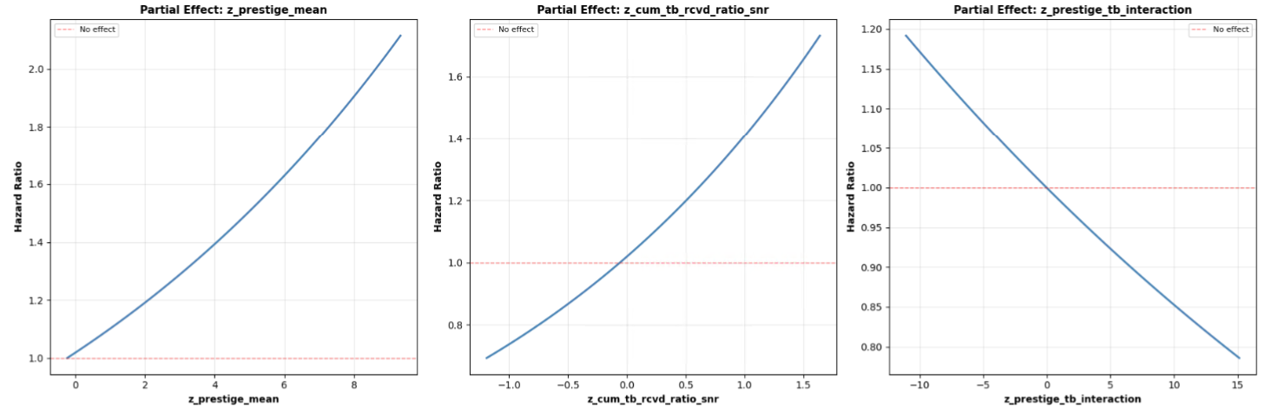

Slide 11
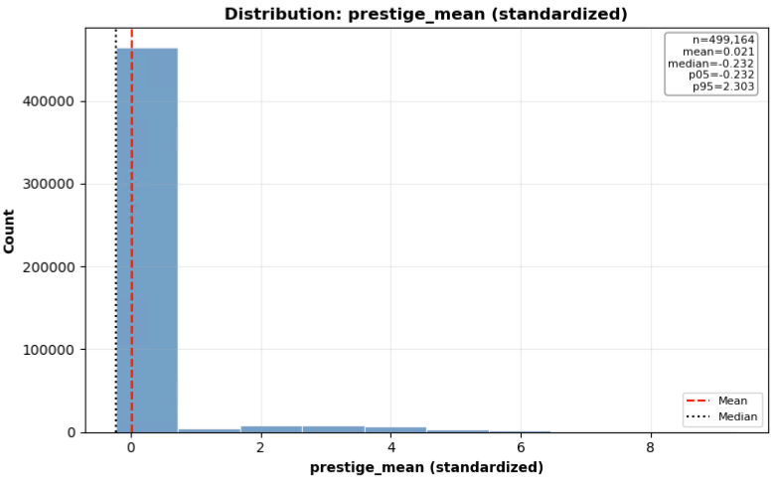
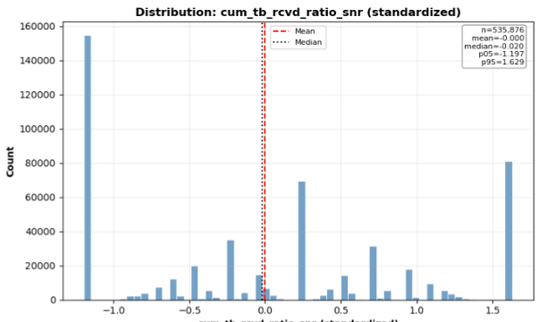
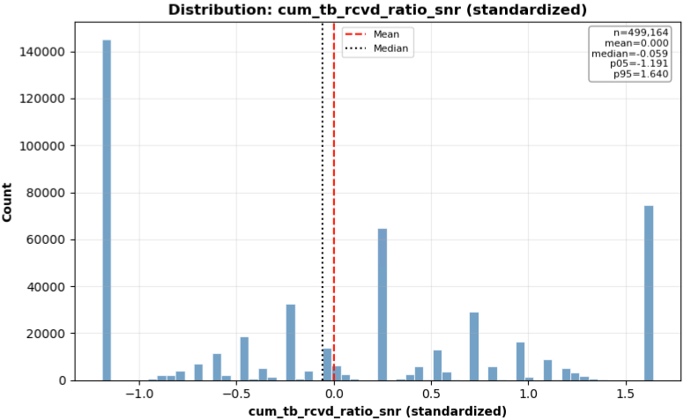

Slide 12
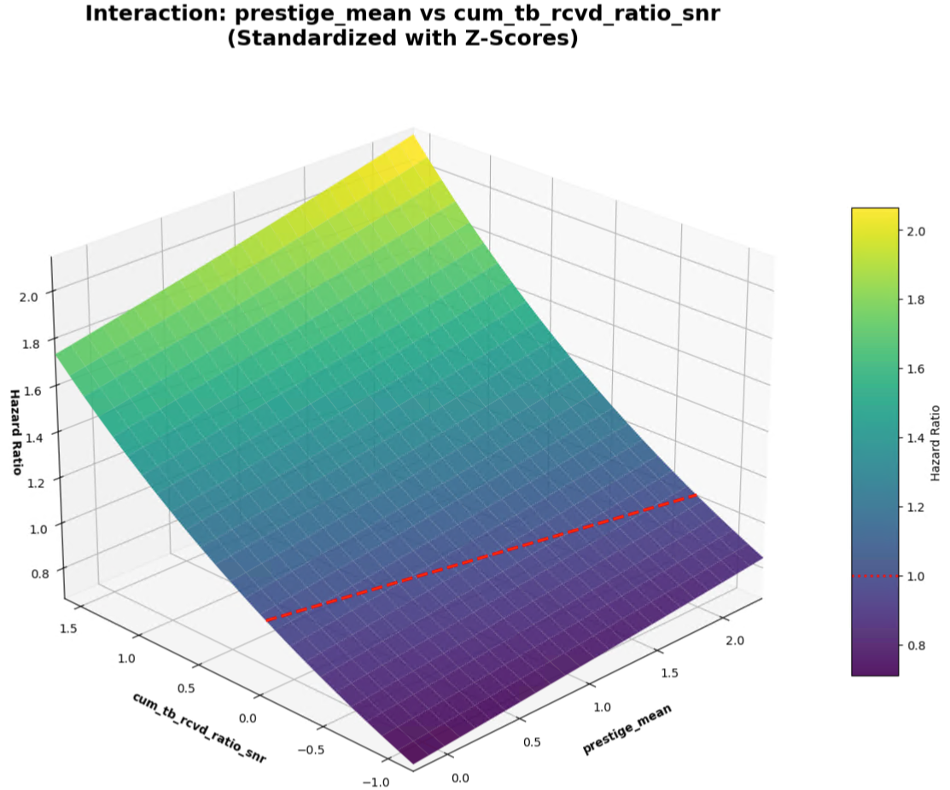

Slide 13
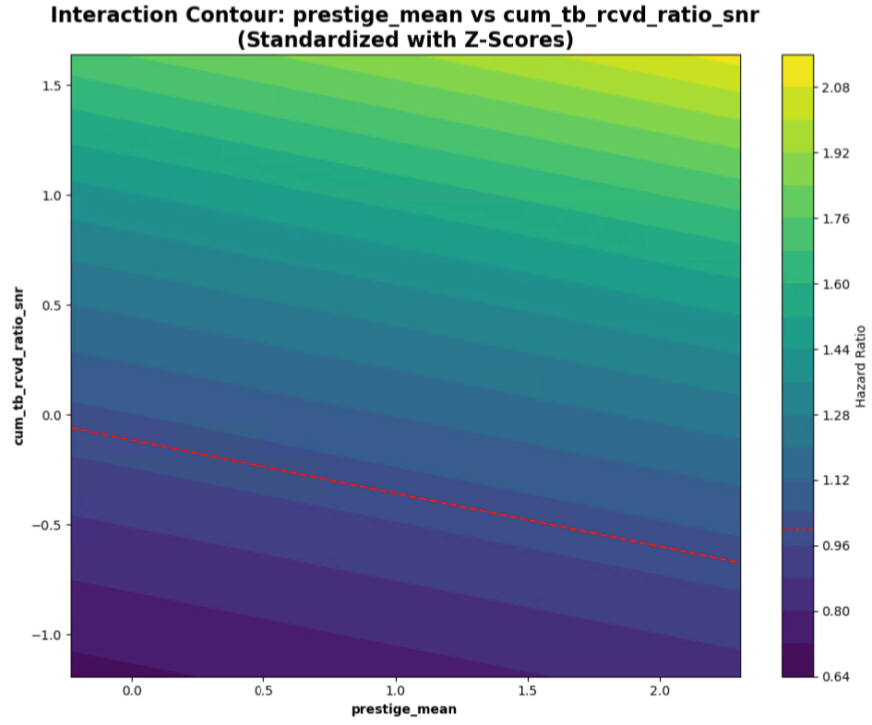
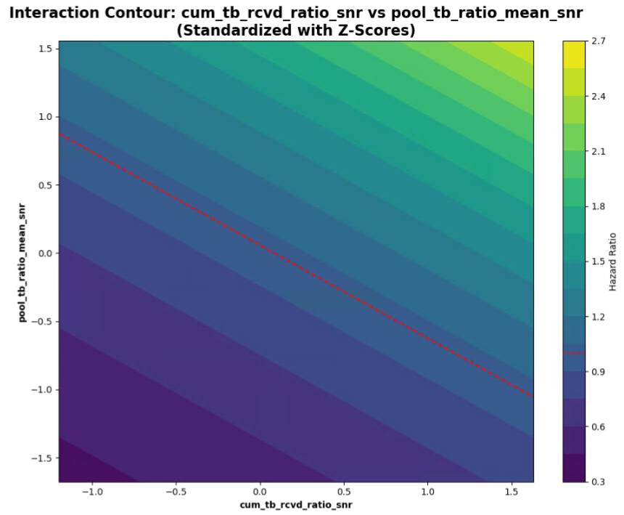

Slide 14
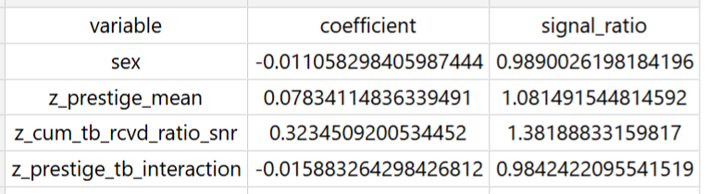


Slide 15
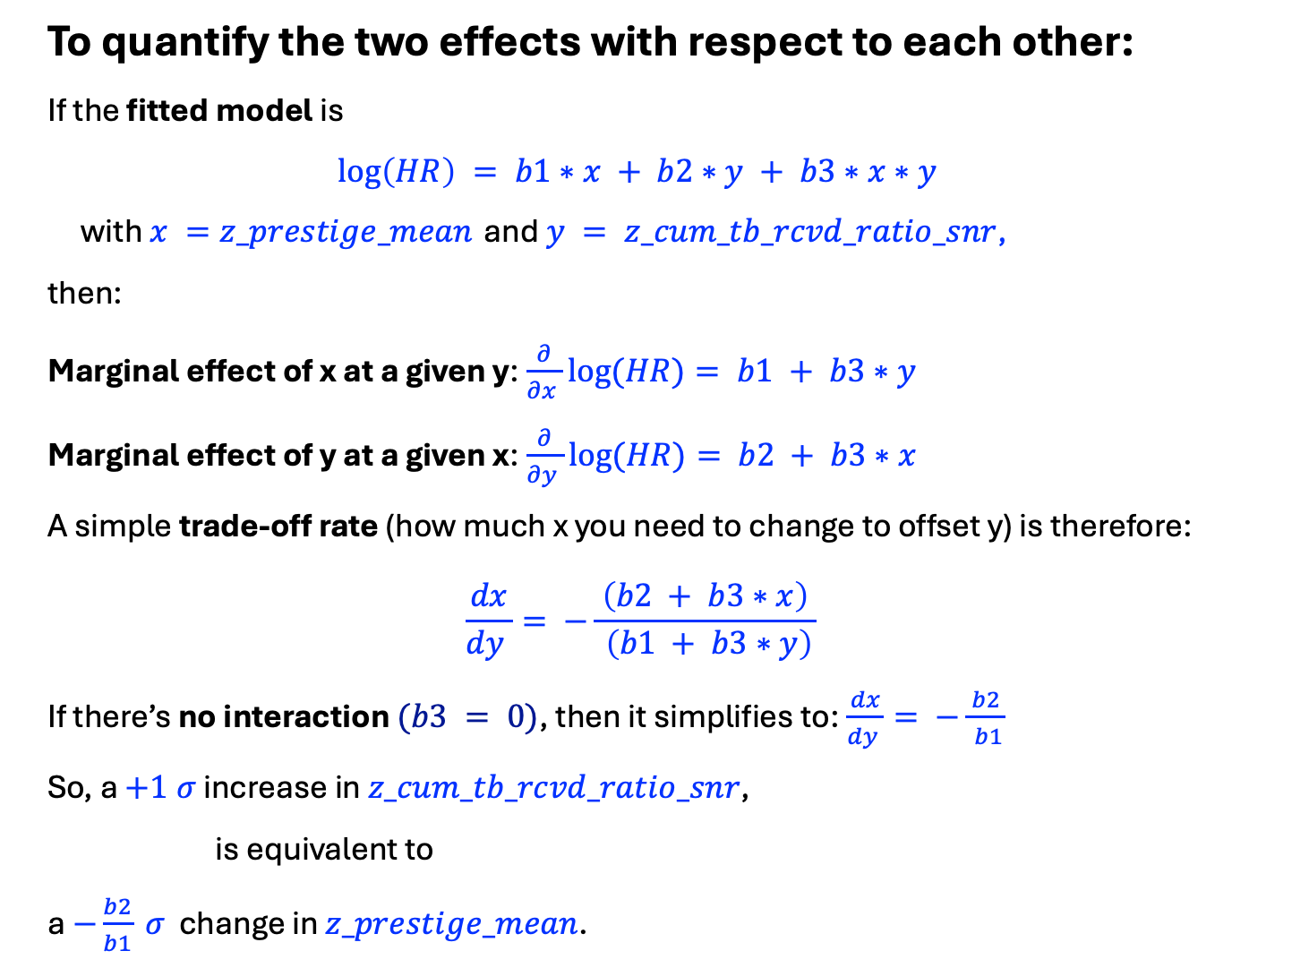
To quantify the two effects with respect to each other:
If the fitted model is
$$\log\left(HR\right) = b1∗x + b2∗y + b3∗x∗y$$
with $x =z_prestige_mean$ and $y = z_cum_tb_rcvd_ratio_snr$,
then:
Marginal effect of x at a given y:$\frac{∂}{∂x }log⁡(HR)= b1 + b3∗y$
Marginal effect of y at a given x:$\frac{∂}{∂y }log⁡(HR)= b2 + b3∗x$
A simple trade‑off rate (how much x you need to change to offset y) is therefore:
$$\frac{dx}{dy }= −\frac{ \left(b2 + b3∗x\right) }{ \left(b1 + b3∗y\right)}$$
If there’s no interaction $(b3 = 0)$, then it simplifies to:$\frac{dx}{dy }= −\frac{ b2 }{ b1}$
So, a $+1 σ$ increase in $z_cum_tb_rcvd_ratio_snr$,
is equivalent to
a $−\frac{b2}{b1} σ$ change in $z_prestige_mean$.

Slide 16
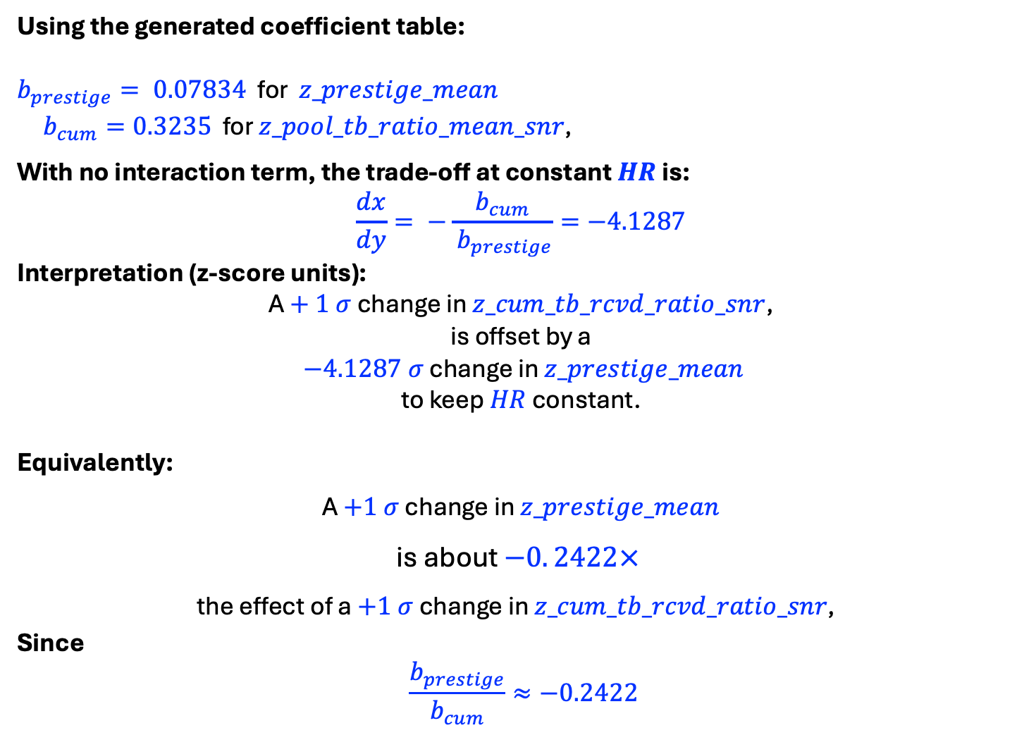
Using the generated coefficient table:
$b_{prestige}= 0.07834$ for $z_prestige_mean$
$b_{cum}=0.3235$ for $z_pool_tb_ratio_mean_snr\text{, }$
With no interaction term, the trade‑off at constant $HR$ is:
$$\frac{dx}{dy}= −\frac{ b_{cum }}{ b_{prestige}}=−4.1287$$
Interpretation (z‑score units):
A $+ 1 σ$ change in $z_cum_tb_rcvd_ratio_snr$,
is offset by a
$−4.1287 σ$ change in $z_prestige_mean$
to keep $HR$ constant.
Equivalently:
A $+1 σ$ change in $z_prestige_mean$
is about $−0. 2422×$
the effect of a $+1 σ$ change in $z_cum_tb_rcvd_ratio_snr\text{, }$
Since
$$\frac{b_{prestige}}{b_{cum}}≈−0.2422$$

Slide 17
RUN 9 - Using
z_prestige_mean
z_cum_tb_rcvd_ratio_snr
z_prestige_tb_interaction
With Ygs 2002-2011, IN, AR, FA Only

Slide 18
Competing Risks
Cumulative Incidence Function Curve (empirical)
$$z_prestige_mean$$

Slide 19
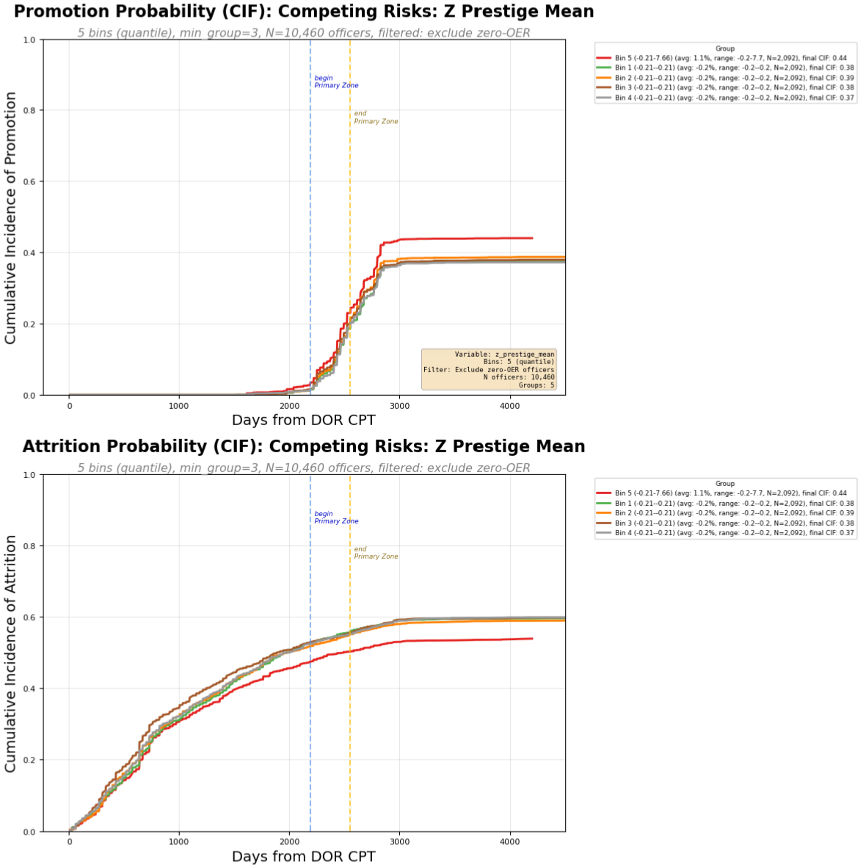
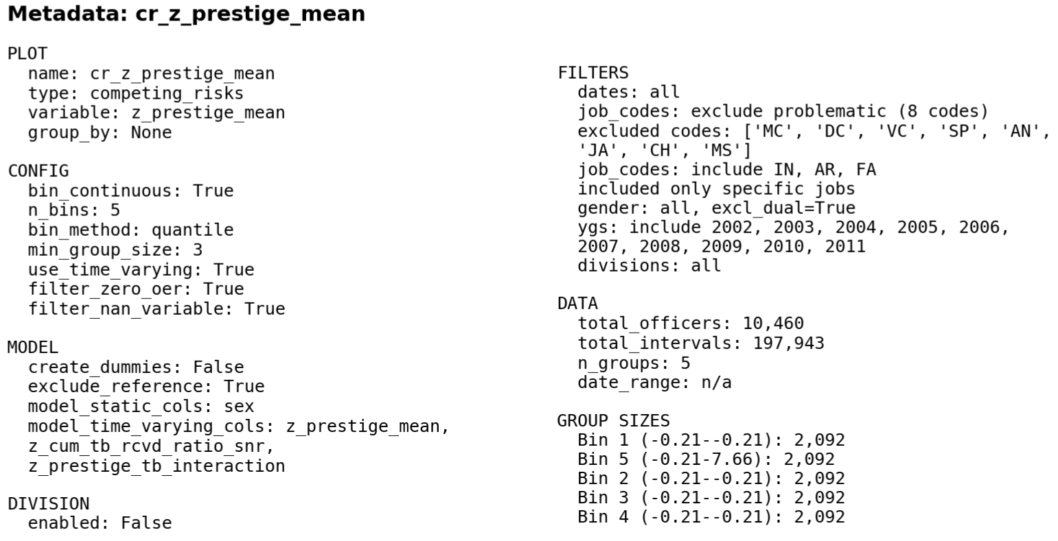

Slide 20
Competing Risks
Cumulative Incidence Function Curve (empirical)
$$z_cum_tb_rcvd_ratio_snr$$

Slide 21
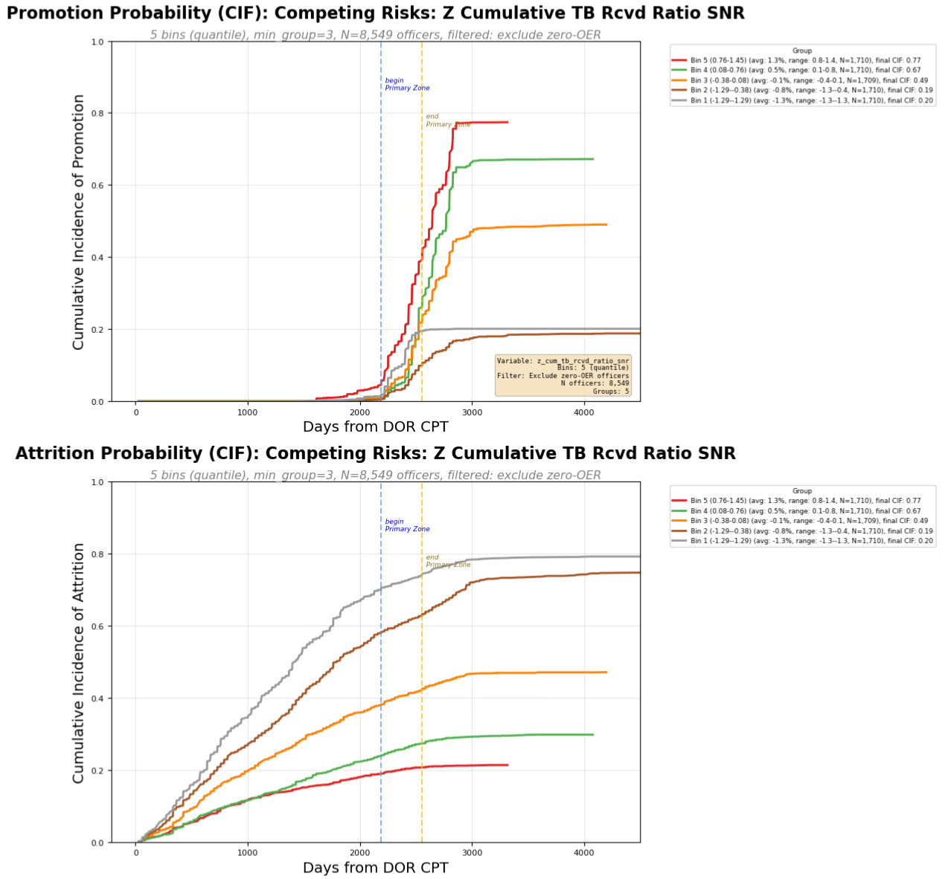
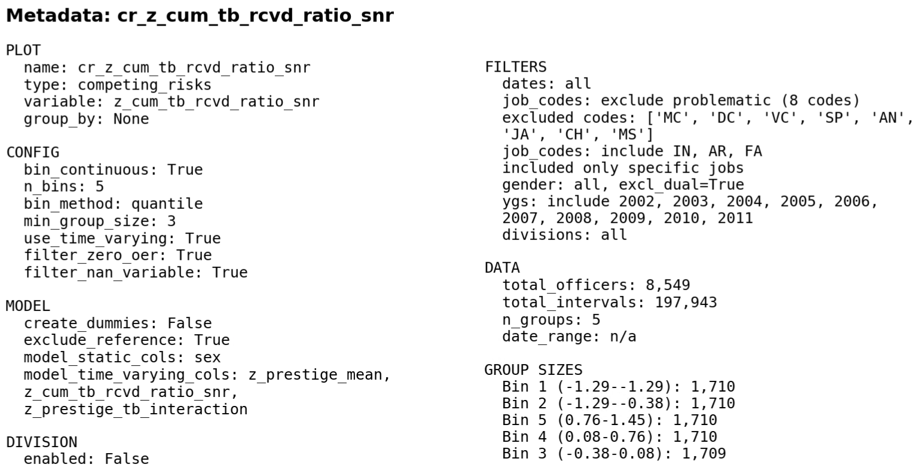

Slide 22
Competing Risks
Cumulative Incidence Function Curve (empirical)
$$z_prestige_tb_interaction$$

Slide 23
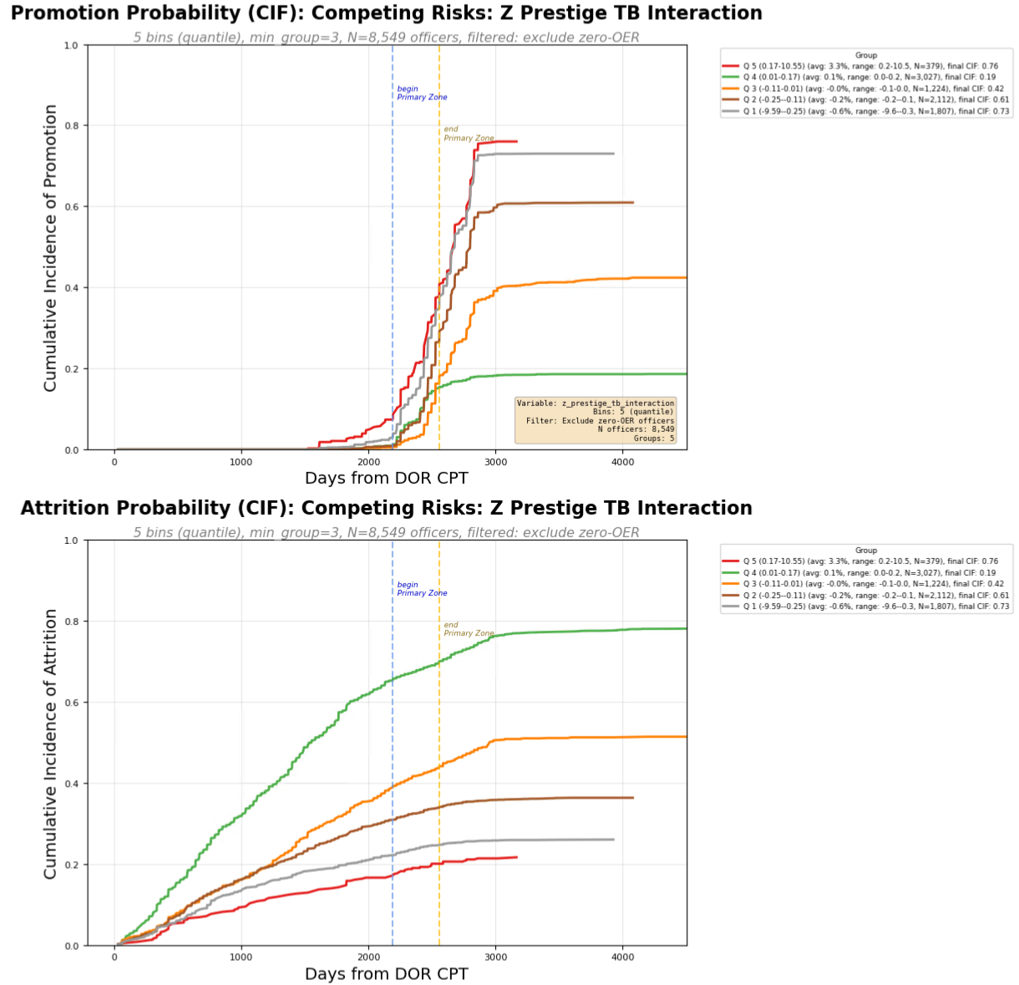
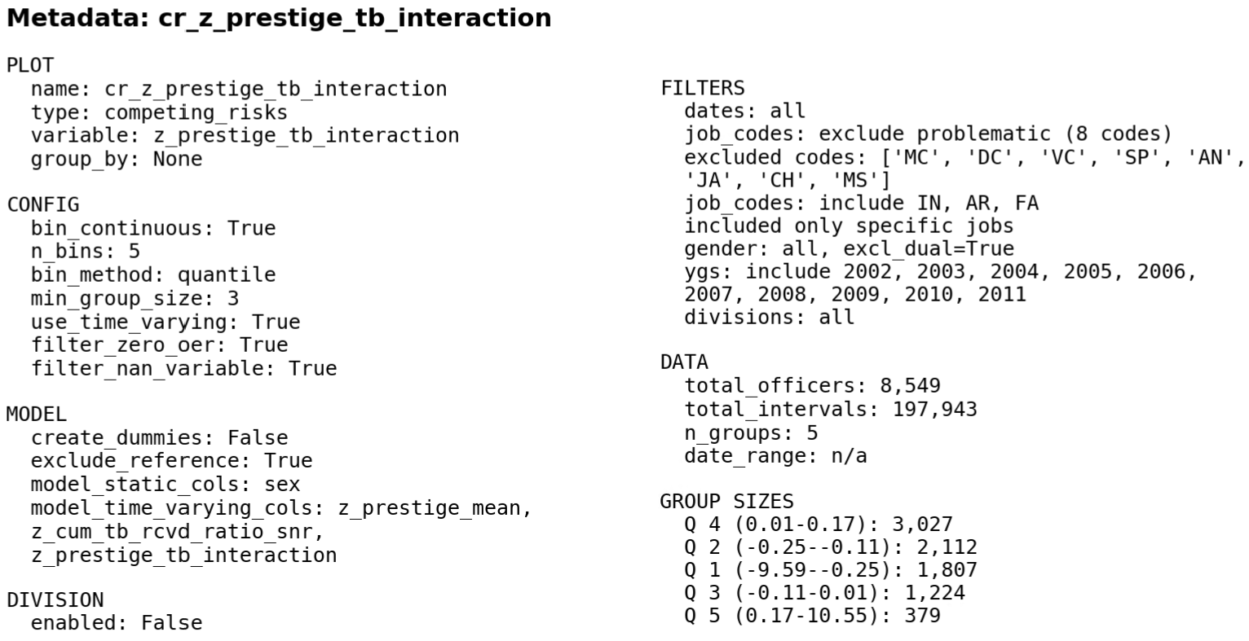

Slide 24
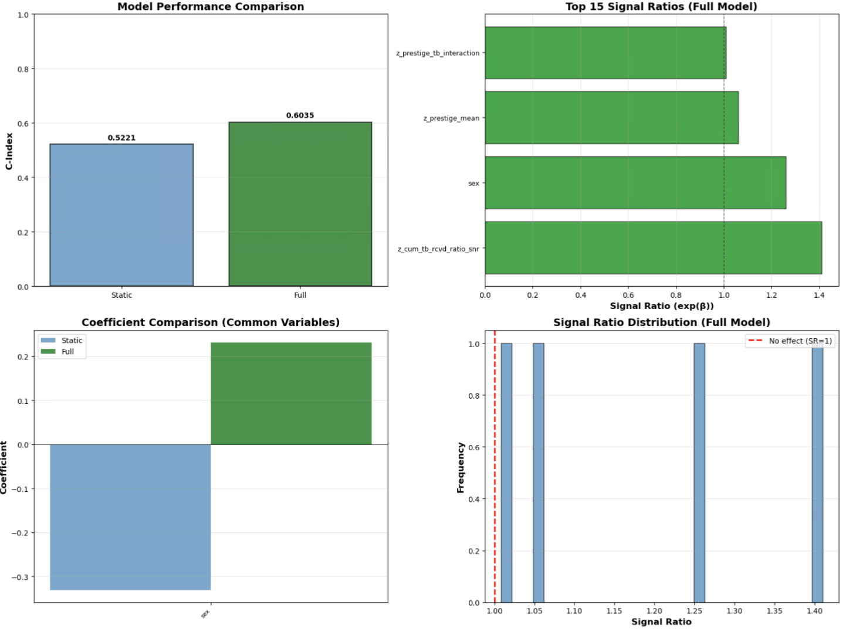

Slide 25
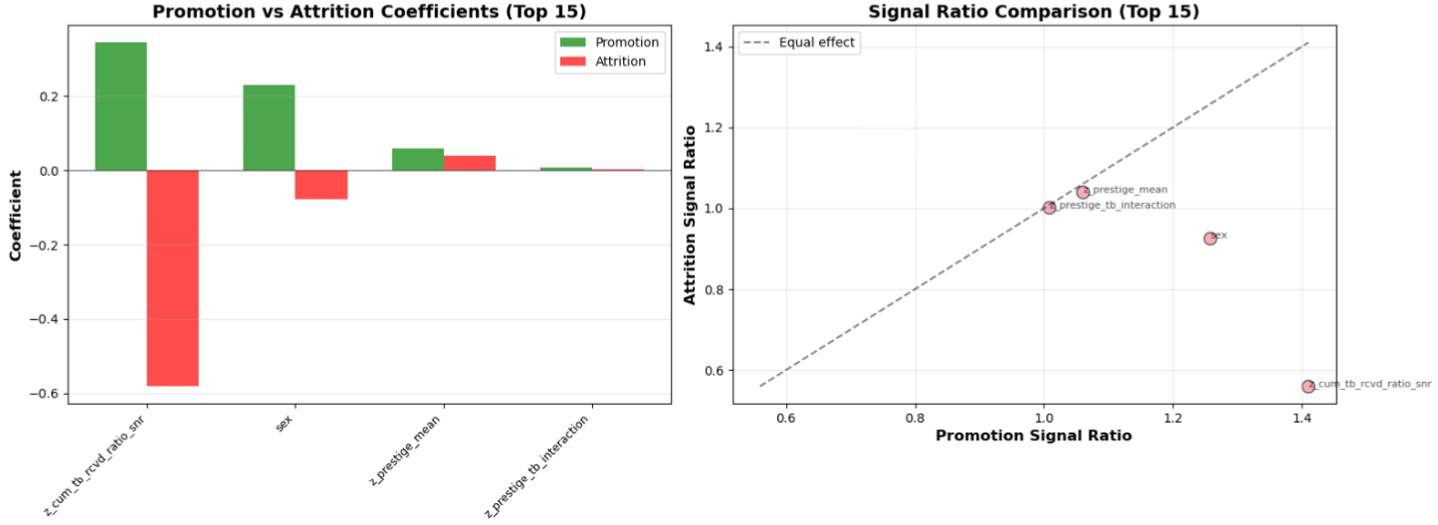

Slide 26
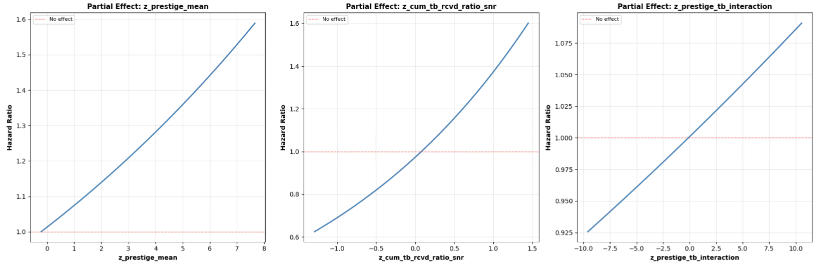

Slide 27
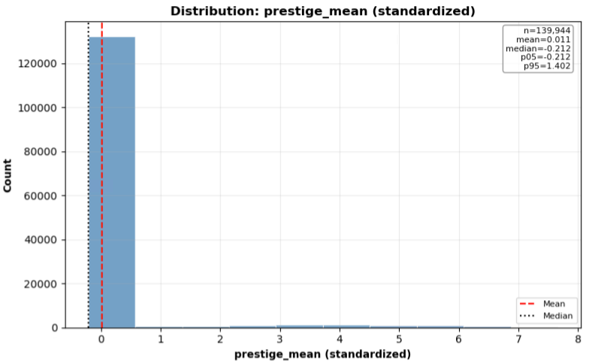
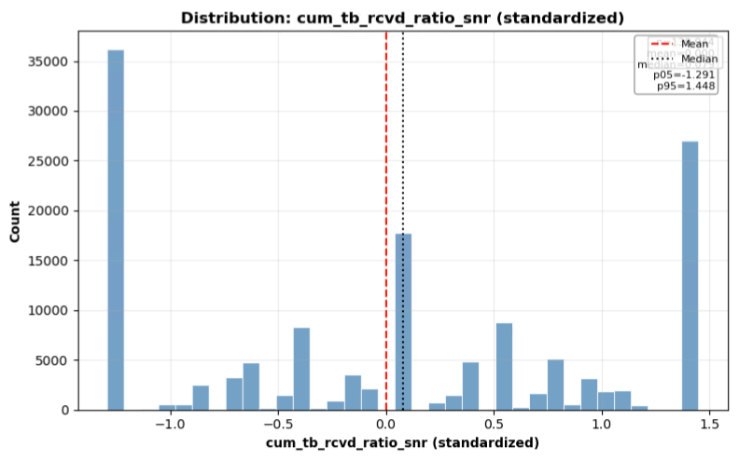

Slide 28
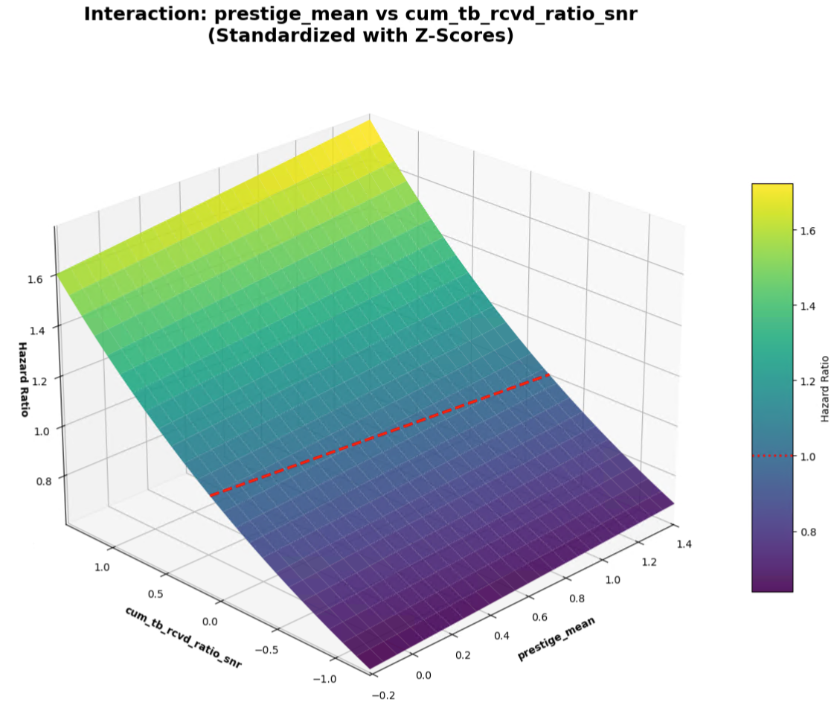

Slide 29
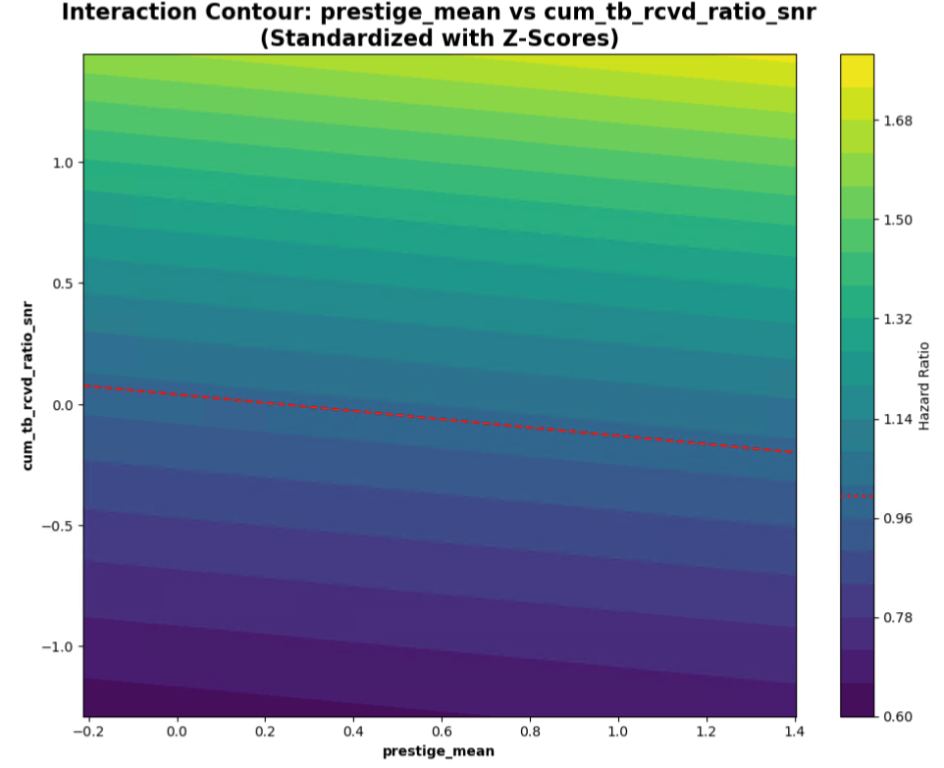

Slide 30
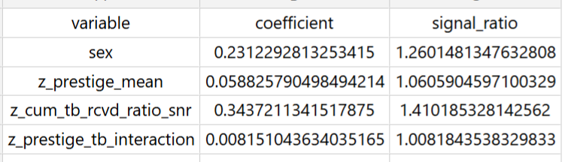


Slide 31
To quantify the two effects with respect to each other:
If the fitted model is
$$\log\left(HR\right) = b1∗x + b2∗y + b3∗x∗y$$
with $x =z_prestige_mean$ and $y = z_cum_tb_rcvd_ratio_snr$,
then:
Marginal effect of x at a given y:$\frac{∂}{∂x }log⁡(HR)= b1 + b3∗y$
Marginal effect of y at a given x:$\frac{∂}{∂y }log⁡(HR)= b2 + b3∗x$
A simple trade‑off rate (how much x you need to change to offset y) is therefore:
$$\frac{dx}{dy }= −\frac{ \left(b2 + b3∗x\right) }{ \left(b1 + b3∗y\right)}$$
If there’s no interaction $(b3 = 0)$, then it simplifies to:$\frac{dx}{dy }= −\frac{ b2 }{ b1}$
So, a $+1 σ$ increase in $z_cum_tb_rcvd_ratio_snr$,
is equivalent to
a $−\frac{b2}{b1} σ$ change in $z_prestige_mean$.

Slide 32

Using the generated coefficient table:
$b_{prestige}= 0.05883$ for $z_prestige_mean$
$b_{cum}=0.3437$ for $z_pool_tb_ratio_mean_snr\text{, }$
With no interaction term, the trade‑off at constant $HR$ is:
$$\frac{dx}{dy}= −\frac{ b_{cum }}{ b_{prestige}}=−5.8430$$
Interpretation (z‑score units):
A $+ 1 σ$ change in $z_cum_tb_rcvd_ratio_snr$,
is offset by a
$−5.8430 σ$ change in $z_prestige_mean$
to keep $HR$ constant.
Equivalently:
A $+1 σ$ change in $z_prestige_mean$
is about $−0. 1711 ×$
the effect of a $+1 σ$ change in $z_cum_tb_rcvd_ratio_snr\text{, }$
Since
$$\frac{b_{prestige}}{b_{cum}}≈−0.1711$$

Slide 33
RUN 1 - Using
z_cum_tb_rcvd_ratio_snr
z_pool_tb_ratio_mean_snr
z_star_pool_interaction

Slide 34
Competing Risks
Cumulative Incidence Function Curve (empirical)
$$z_cum_tb_rcvd_ratio_snr$$

Slide 35
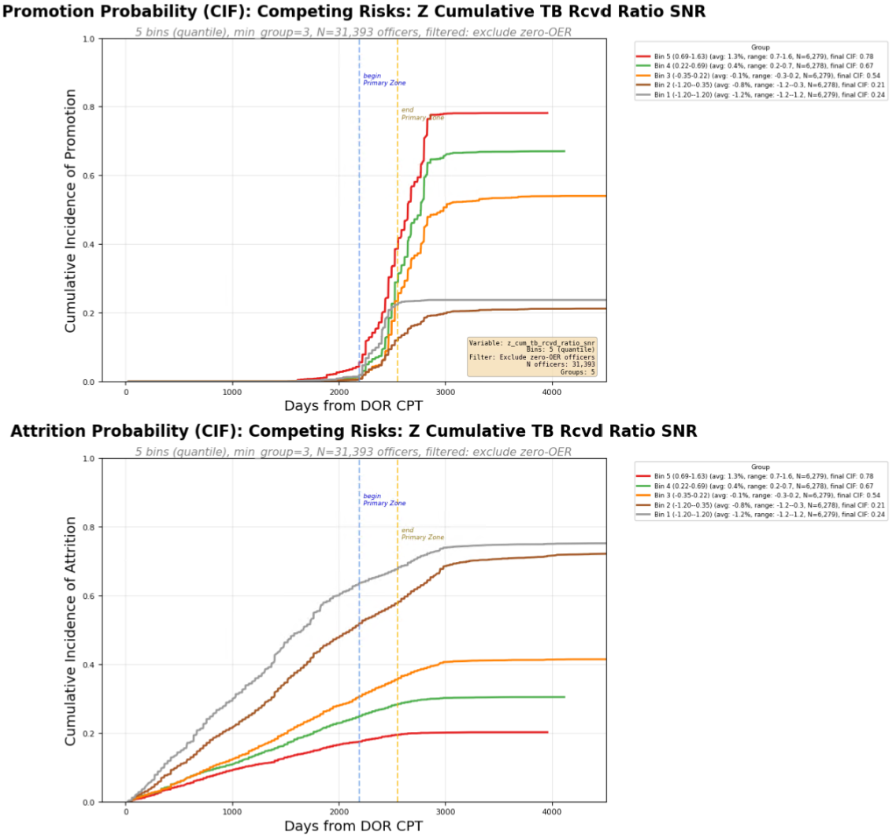
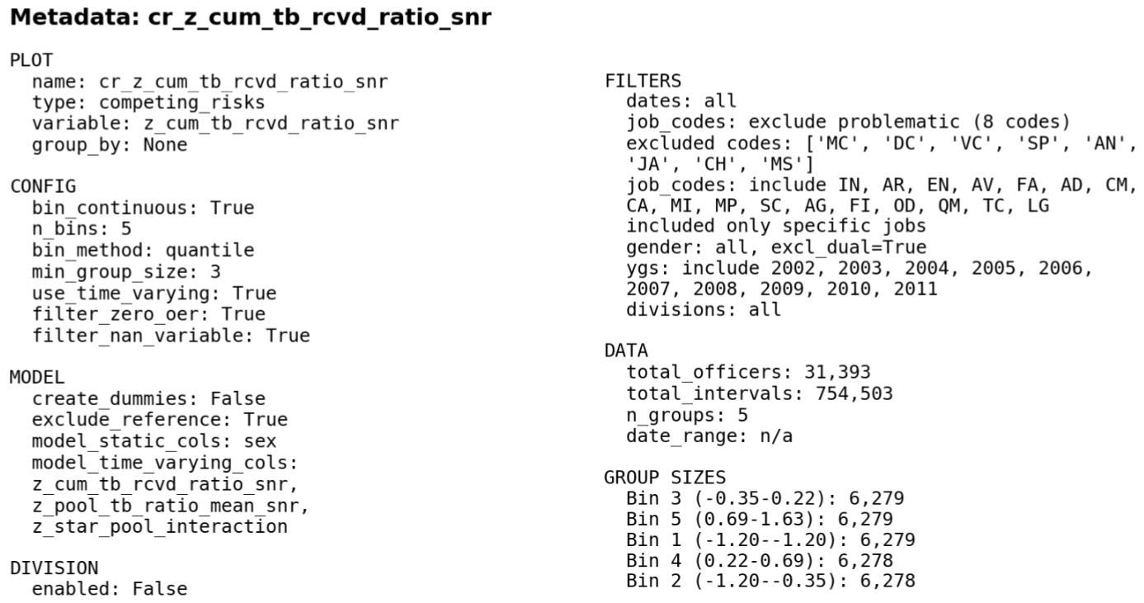

Slide 36
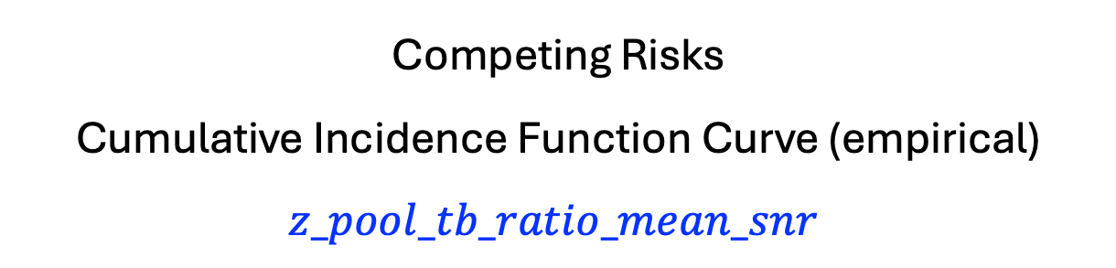
Competing Risks
Cumulative Incidence Function Curve (empirical)
$$z_pool_tb_ratio_mean_snr$$

Slide 37
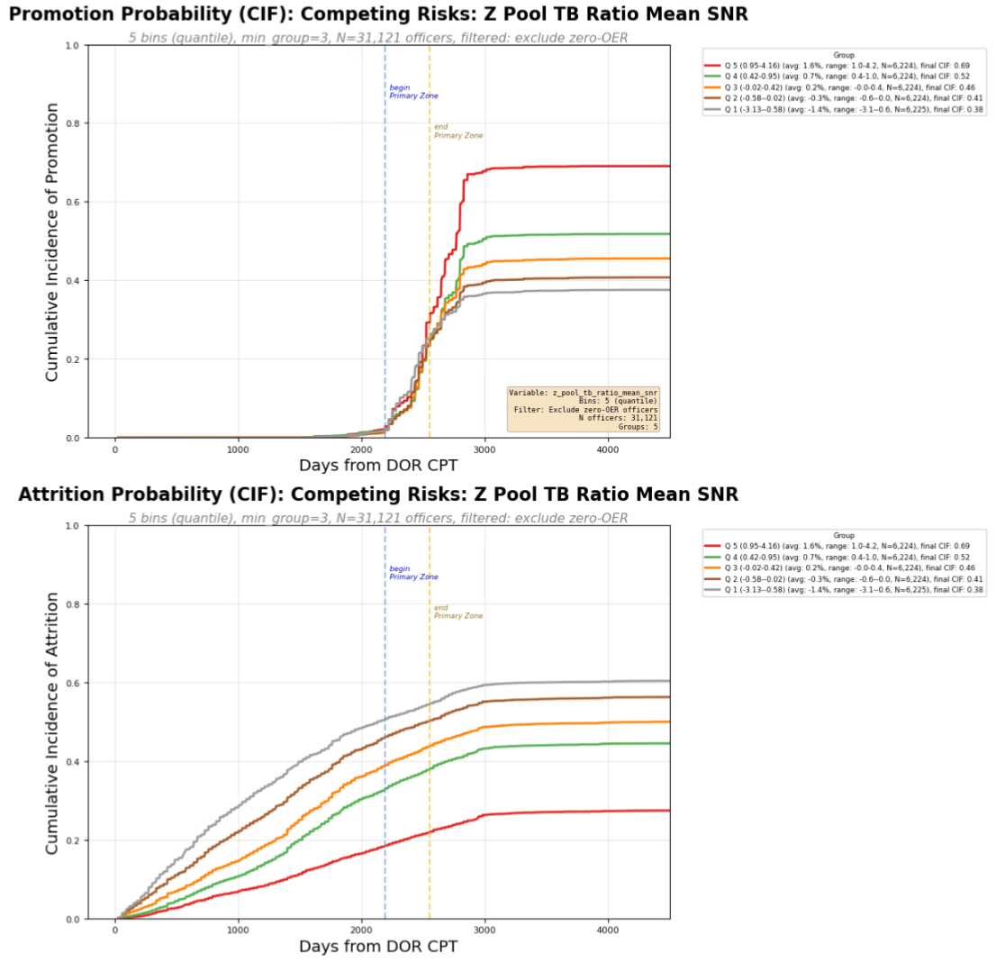
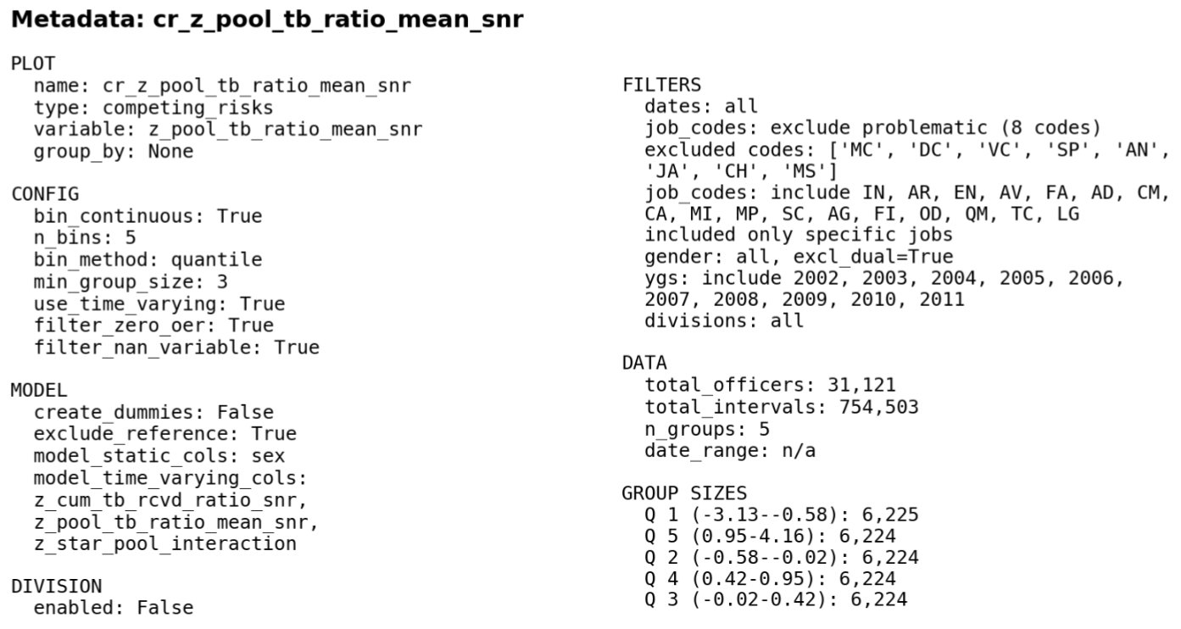

Slide 38
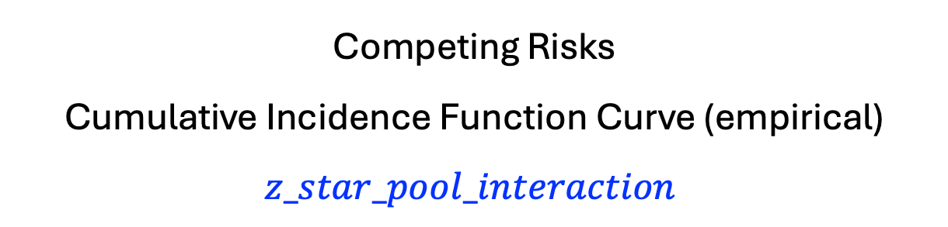
Competing Risks
Cumulative Incidence Function Curve (empirical)
$$z_star_pool_interaction$$

Slide 39
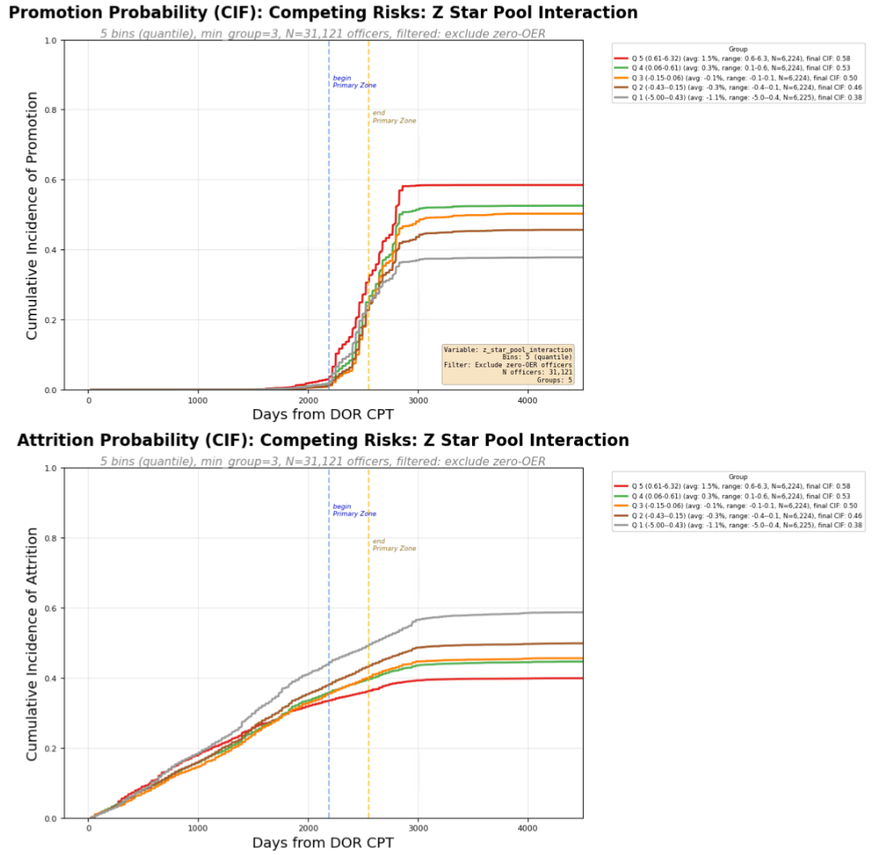
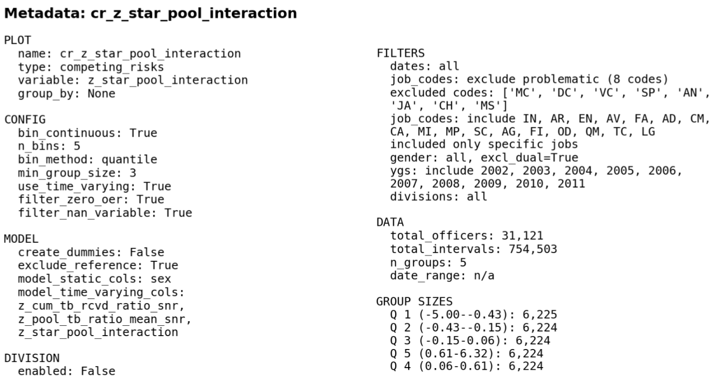

Slide 40
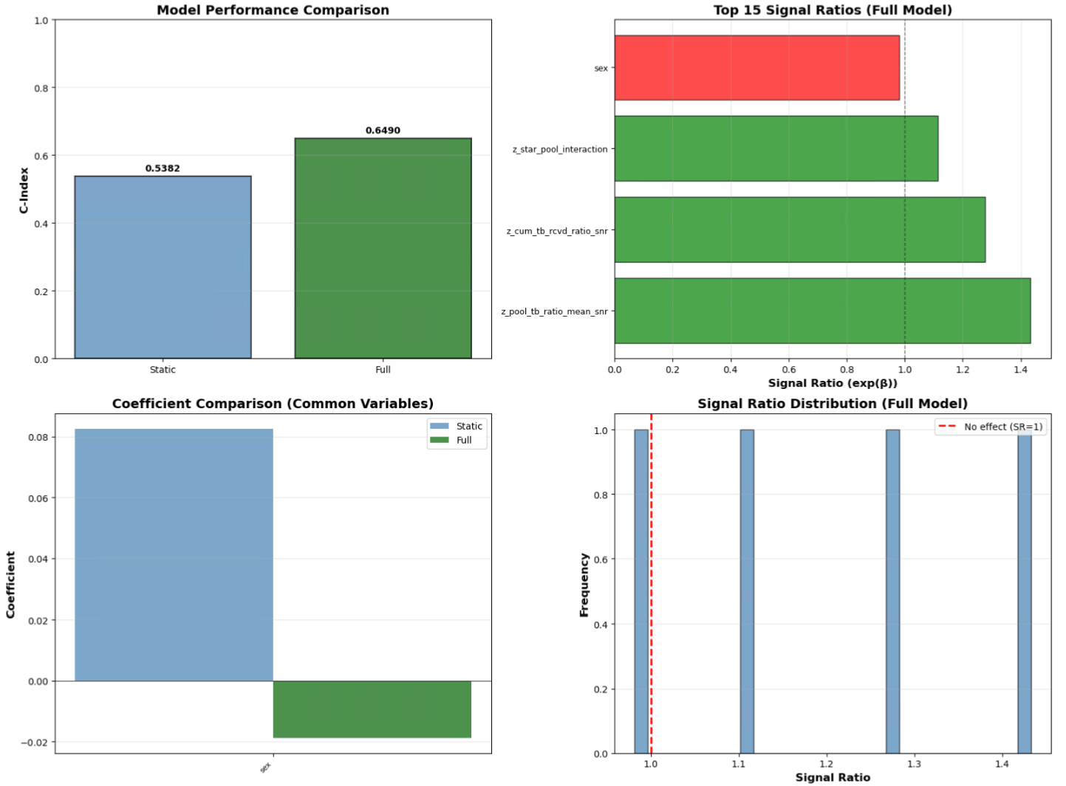

Slide 41
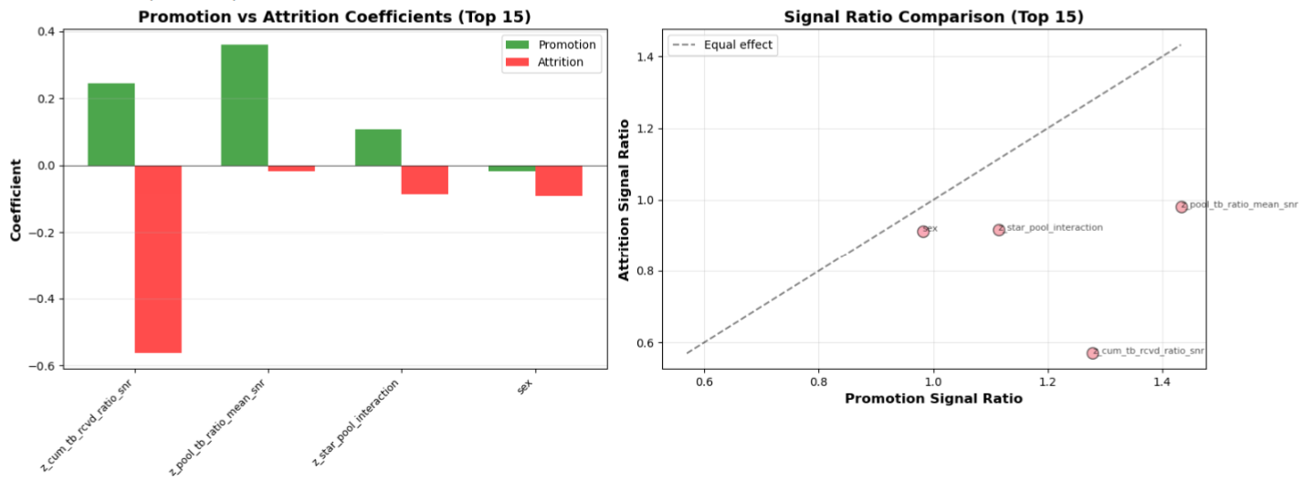

Slide 42
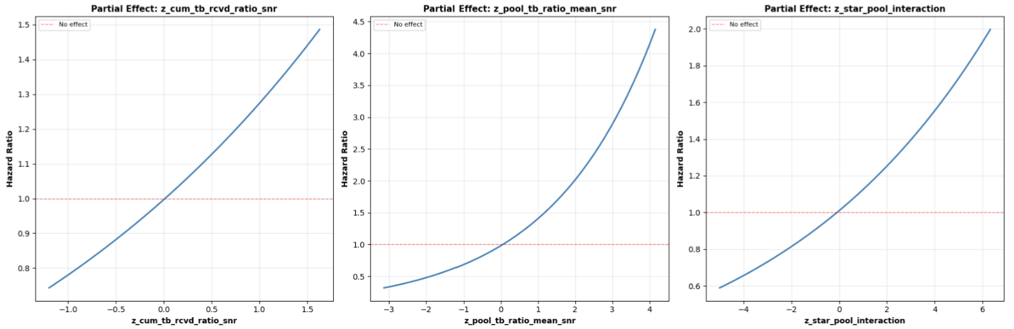

Slide 43
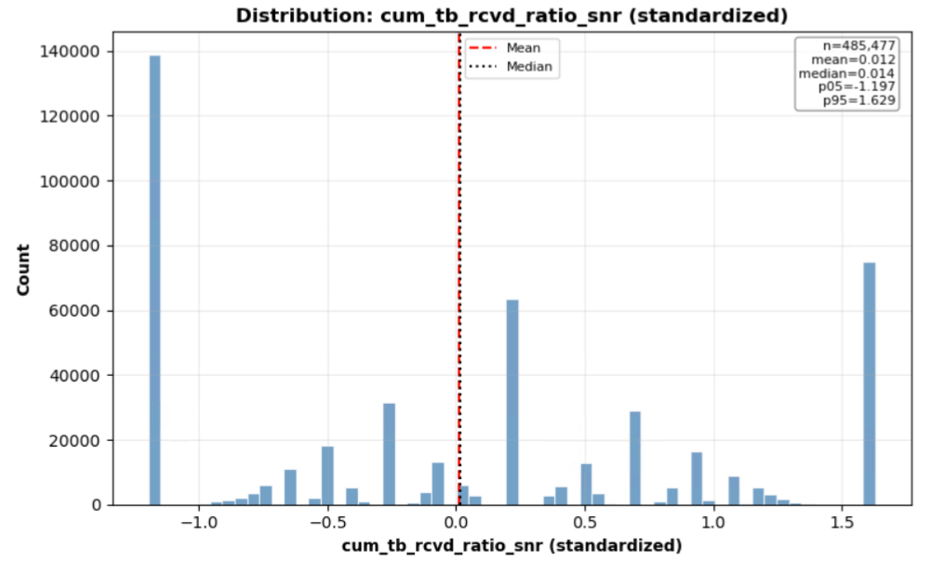
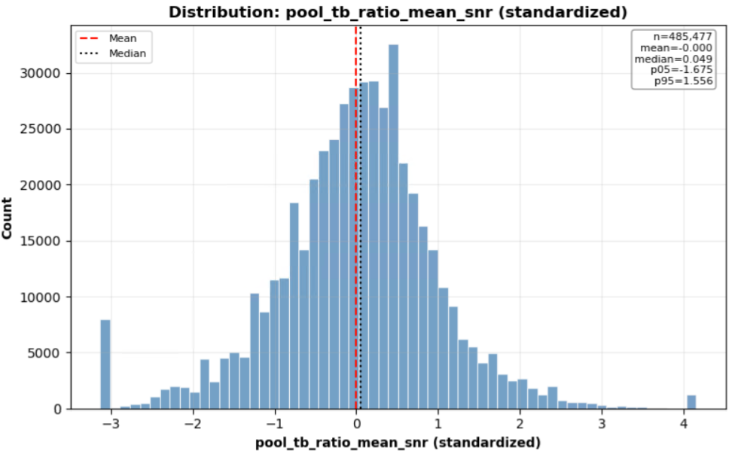

Slide 44
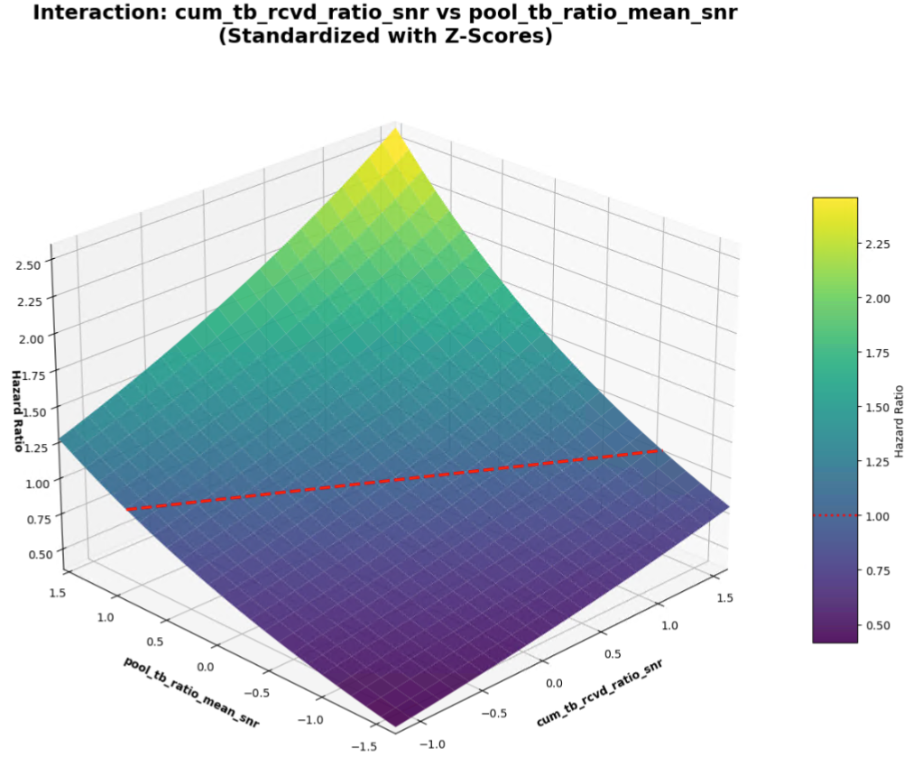

Slide 46
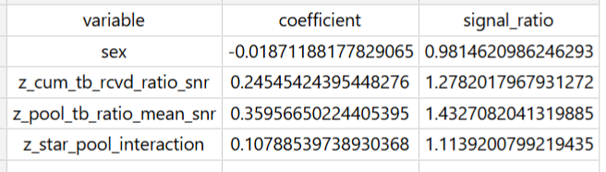


Slide 47

To quantify the two effects with respect to each other:
If the fitted model is
$$\log\left(HR\right) = b1∗x + b2∗y + b3∗x∗y$$
with $x = z_cum_tb_rcvd_ratio_snr$ and $y = z_pool_tb_ratio_mean_snr$,
then:
Marginal effect of x at a given y:$\frac{∂}{∂x }log⁡(HR)= b1 + b3∗y$
Marginal effect of y at a given x:$\frac{∂}{∂y }log⁡(HR)= b2 + b3∗x$
A simple trade‑off rate (how much x you need to change to offset y) is therefore:
$$\frac{dx}{dy }= −\frac{ \left(b2 + b3∗x\right) }{ \left(b1 + b3∗y\right)}$$
If there’s no interaction $(b3 = 0)$, then it simplifies to:$\frac{dx}{dy }= −\frac{ b2 }{ b1}$
So, a $+1 σ$ increase in $z_pool_tb_ratio_mean_snr$,
is equivalent to a
$−\frac{b2}{b1} σ$ change in $z_cum_tb_rcvd_ratio_snr$.

Slide 48


Using the generated coefficient table:
$b_{cum}= 0.2455$ for $z_cum_tb_rcvd_ratio_snr$
$b_{pool}=0.3596$ for $z_pool_tb_ratio_mean_snr\text{, }$
With no interaction term, the trade‑off at constant $HR$ is:
$$\frac{dx}{dy}= −\frac{ b_{pool }}{ b_{cum}}=−1.4649$$
Interpretation (z‑score units):
A $+ 1 σ$ change in $z_pool_tb_ratio_mean_snr$,
is offset by a
$−1.4649 σ$ change in $z_cum_tb_rcvd_ratio_snr$
to keep $HR$ constant.
Equivalently:
A $+1 σ$ change in $z_cum_tb_rcvd_ratio_snr$
is about $−0.6826 ×$
the effect of a $+1 σ$ change in $z_pool_tb_ratio_mean_snr\text{, }$
Since
$$\frac{b_{cum}}{b_{pool}}≈−0.6826$$

Slide 49
RUN 2 - Using
z_tb_ratio_rank_norm_snr
z_pool_tb_ratio_mean_snr
z_rank_pool_interaction

Slide 50

Competing Risks
Cumulative Incidence Function Curve (empirical)
$$z_tb_ratio_rank_norm_snr$$

Slide 51



Slide 52
Competing Risks
Cumulative Incidence Function Curve (empirical)
$$z_pool_tb_ratio_mean_snr$$

Slide 53



Slide 54

Competing Risks
Cumulative Incidence Function Curve (empirical)
$$z_rank_pool_interaction$$

Slide 55



Slide 56


Slide 57


Slide 58


Slide 59



Slide 60


Slide 61


Slide 62



Slide 63

To quantify the two effects with respect to each other:
If the fitted model is
$$\log\left(HR\right) = b1∗x + b2∗y + b3∗x∗y$$
with $x = z_tb_ratio_rank_norm_snr$ and $y = z_pool_tb_ratio_mean_snr$,
then:
Marginal effect of x at a given y:$\frac{∂}{∂x }log⁡(HR)= b1 + b3∗y$
Marginal effect of y at a given x:$\frac{∂}{∂y }log⁡(HR)= b2 + b3∗x$
A simple trade‑off rate (how much x you need to change to offset y) is therefore:
$$\frac{dx}{dy }= −\frac{ \left(b2 + b3∗x\right) }{ \left(b1 + b3∗y\right)}$$
If there’s no interaction $(b3 = 0)$, then it simplifies to:$\frac{dx}{dy }= −\frac{ b2 }{ b1}$
So, a $+1 σ$ increase in $z_pool_tb_ratio_mean_snr$,
is equivalent to a
$−\frac{b2}{b1} σ$ change in $z_tb_ratio_rank_norm_snr$.

Slide 64


Using the generated coefficient table:
$b_{rank}= 0.3620$ for $z_tb_ratio_rank_norm_snr$
$b_{pool}=0.5123$ for $z_pool_tb_ratio_mean_snr\text{, }$
With no interaction term, the trade‑off at constant $HR$ is:
$$\frac{dx}{dy}= −\frac{ b_{pool }}{ b_{rank}}=−1.4152$$
Interpretation (z‑score units):
A $+ 1 σ$ change in $z_pool_tb_ratio_mean_snr$,
is offset by a
$−1.4152 σ$ change in $z_tb_ratio_rank_norm_snr$
to keep $HR$ constant.
Equivalently:
A $+1 σ$ change in $z_tb_ratio_rank_norm_snr$
is about $−0.7066×$
the effect of a $+1 σ$ change in $z_pool_tb_ratio_mean_snr\text{, }$
Since
$$\frac{b_{rank}}{b_{pool}}≈−0.7066$$

Slide 65
RUN 3 - Using
z_prestige_mean
z_cum_tb_rcvd_ratio_snr
z_prestige_tb_interaction

Slide 66
Competing Risks
Cumulative Incidence Function Curve (empirical)
$$z_prestige_mean$$

Slide 67



Slide 68
Competing Risks
Cumulative Incidence Function Curve (empirical)
$$z_cum_tb_rcvd_ratio_snr$$

Slide 69



Slide 70
Competing Risks
Cumulative Incidence Function Curve (empirical)
$$z_prestige_tb_interaction$$

Slide 71



Slide 72


Slide 73


Slide 74


Slide 75


Slide 76


Slide 77


Slide 78



Slide 79
To quantify the two effects with respect to each other:
If the fitted model is
$$\log\left(HR\right) = b1∗x + b2∗y + b3∗x∗y$$
with $x =z_prestige_mean$ and $y = z_cum_tb_rcvd_ratio_snr$,
then:
Marginal effect of x at a given y:$\frac{∂}{∂x }log⁡(HR)= b1 + b3∗y$
Marginal effect of y at a given x:$\frac{∂}{∂y }log⁡(HR)= b2 + b3∗x$
A simple trade‑off rate (how much x you need to change to offset y) is therefore:
$$\frac{dx}{dy }= −\frac{ \left(b2 + b3∗x\right) }{ \left(b1 + b3∗y\right)}$$
If there’s no interaction $(b3 = 0)$, then it simplifies to:$\frac{dx}{dy }= −\frac{ b2 }{ b1}$
So, a $+1 σ$ increase in $z_cum_tb_rcvd_ratio_snr$,
is equivalent to
a $−\frac{b2}{b1} σ$ change in $z_prestige_mean$.

Slide 80


Using the generated coefficient table:
$b_{prestige}= 0.08717$ for $z_prestige_mean$
$b_{cum}=0.3186$ for $z_pool_tb_ratio_mean_snr\text{, }$
With no interaction term, the trade‑off at constant $HR$ is:
$$\frac{dx}{dy}= −\frac{ b_{cum }}{ b_{prestige}}=−3.6548$$
Interpretation (z‑score units):
A $+ 1 σ$ change in $z_cum_tb_rcvd_ratio_snr$,
is offset by a
$−3.6548 σ$ change in $z_prestige_mean$
to keep $HR$ constant.
Equivalently:
A $+1 σ$ change in $z_prestige_mean$
is about $−0. 2736×$
the effect of a $+1 σ$ change in $z_cum_tb_rcvd_ratio_snr\text{, }$
Since
$$\frac{b_{prestige}}{b_{cum}}≈−0.2736$$

Slide 81
RUN 4 - Using
z_prestige_mean
z_cum_tb_rcvd_ratio_snr
z_prestige_tb_interaction
With just YGs 2002-2006

Slide 82
Competing Risks
Cumulative Incidence Function Curve (empirical)
$$z_prestige_mean$$

Slide 84
Competing Risks
Cumulative Incidence Function Curve (empirical)
$$z_cum_tb_rcvd_ratio_snr$$

Slide 86
Competing Risks
Cumulative Incidence Function Curve (empirical)
$$z_prestige_tb_interaction$$

Slide 94


Slide 95
To quantify the two effects with respect to each other:
If the fitted model is
$$\log\left(HR\right) = b1∗x + b2∗y + b3∗x∗y$$
with $x =z_prestige_mean$ and $y = z_cum_tb_rcvd_ratio_snr$,
then:
Marginal effect of x at a given y:$\frac{∂}{∂x }log⁡(HR)= b1 + b3∗y$
Marginal effect of y at a given x:$\frac{∂}{∂y }log⁡(HR)= b2 + b3∗x$
A simple trade‑off rate (how much x you need to change to offset y) is therefore:
$$\frac{dx}{dy }= −\frac{ \left(b2 + b3∗x\right) }{ \left(b1 + b3∗y\right)}$$
If there’s no interaction $(b3 = 0)$, then it simplifies to:$\frac{dx}{dy }= −\frac{ b2 }{ b1}$
So, a $+1 σ$ increase in $z_cum_tb_rcvd_ratio_snr$,
is equivalent to
a $−\frac{b2}{b1} σ$ change in $z_prestige_mean$.

Slide 96
Using the generated coefficient table:
$b_{prestige}= 0.08717$ for $z_prestige_mean$
$b_{cum}=0.3186$ for $z_pool_tb_ratio_mean_snr\text{, }$
With no interaction term, the trade‑off at constant $HR$ is:
$$\frac{dx}{dy}= −\frac{ b_{cum }}{ b_{prestige}}=−3.6548$$
Interpretation (z‑score units):
A $+ 1 σ$ change in $z_cum_tb_rcvd_ratio_snr$,
is offset by a
$−3.6548 σ$ change in $z_prestige_mean$
to keep $HR$ constant.
Equivalently:
A $+1 σ$ change in $z_prestige_mean$
is about $−0. 2736×$
the effect of a $+1 σ$ change in $z_cum_tb_rcvd_ratio_snr\text{, }$
Since
$$\frac{b_{prestige}}{b_{cum}}≈−0.2736$$

