Slide 1
RUN 1A
Individual TB Ratio
vs
Senior Rater Pool Mean
tb_ratio_1wd_snr
pool_minus_mean_snr_fwd
star_pool_interaction

Slide 2
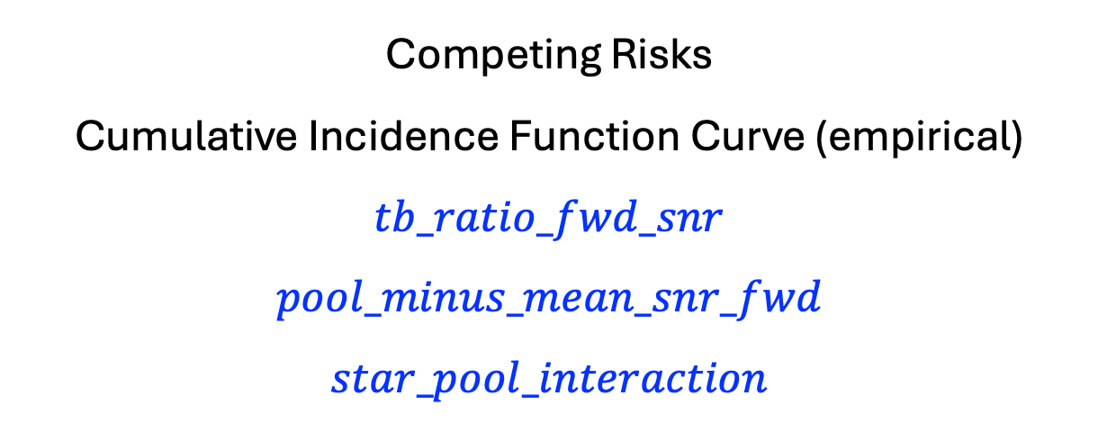
Competing Risks
Cumulative Incidence Function Curve (empirical)
$$tb_ratio_fwd_snr$$
$$pool_minus_mean_snr_fwd$$
$$star_pool_interaction$$

Slide 3
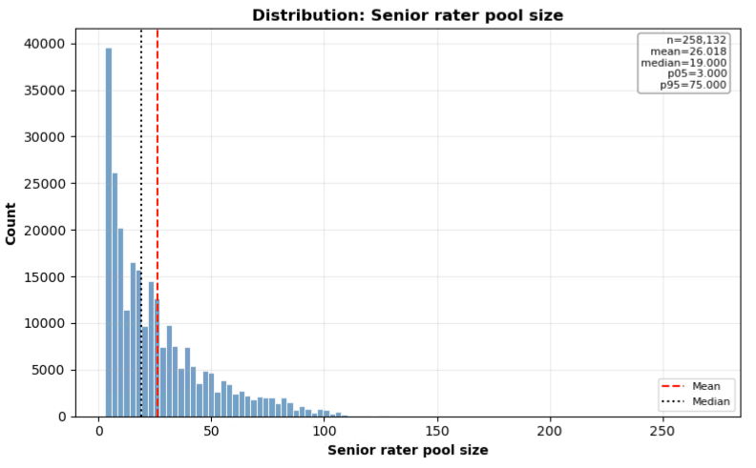
Senior Rater Pool

Slide 4
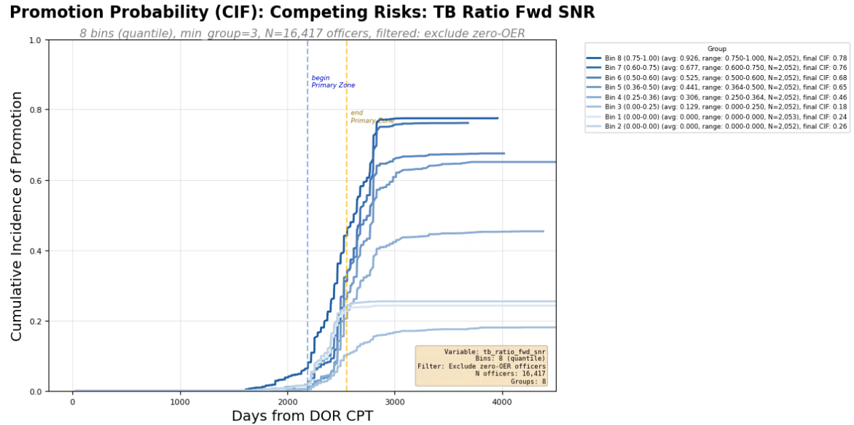
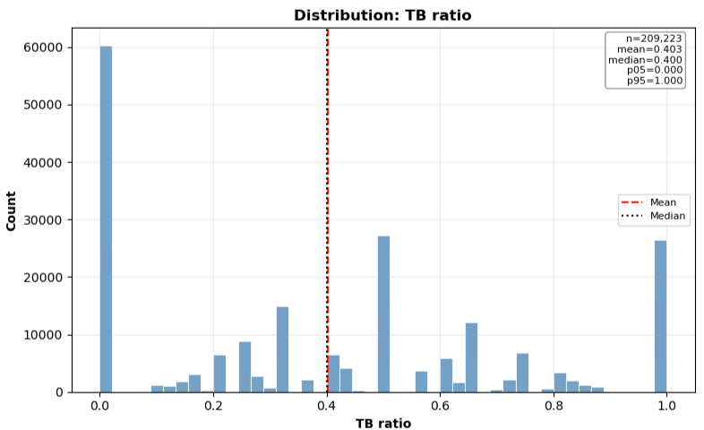
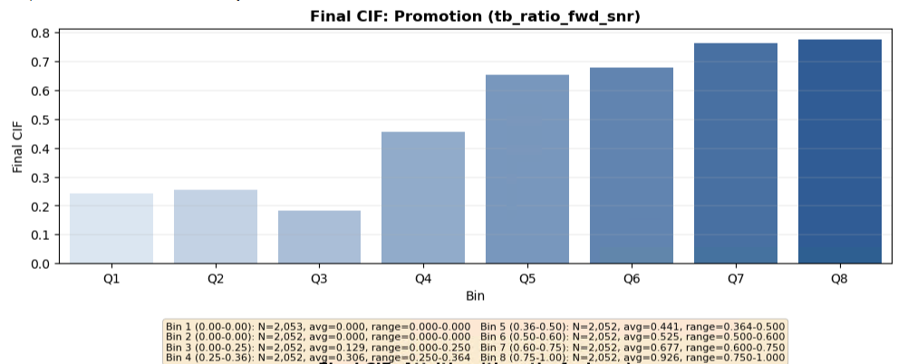
Individual Metrics

Slide 5
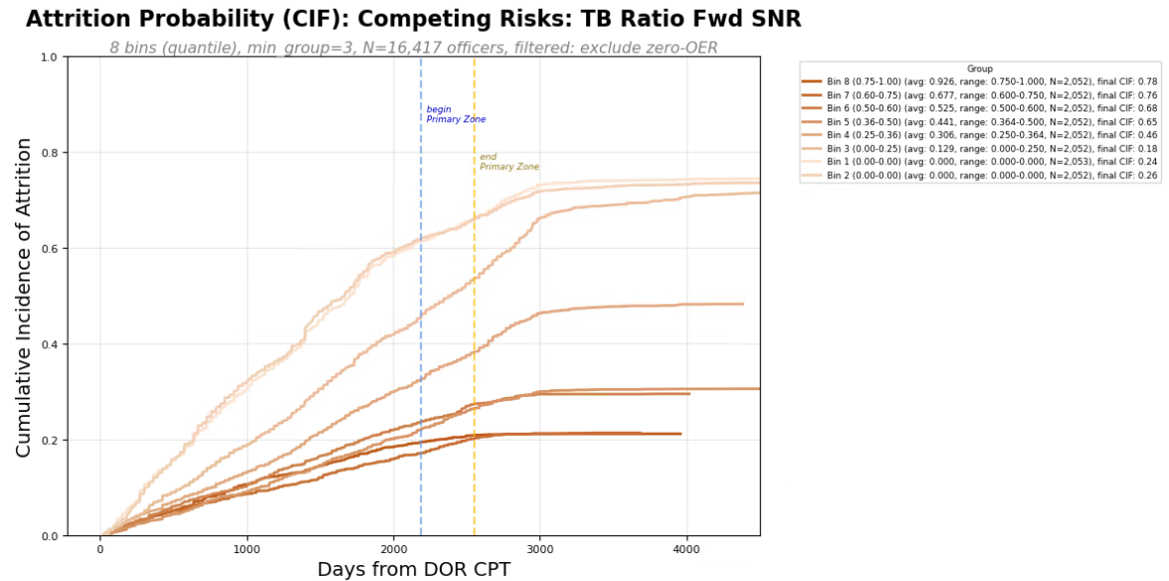
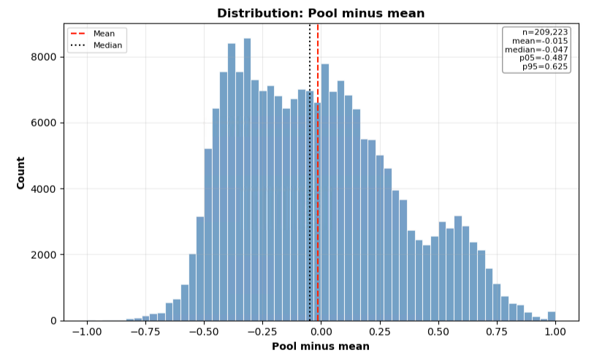
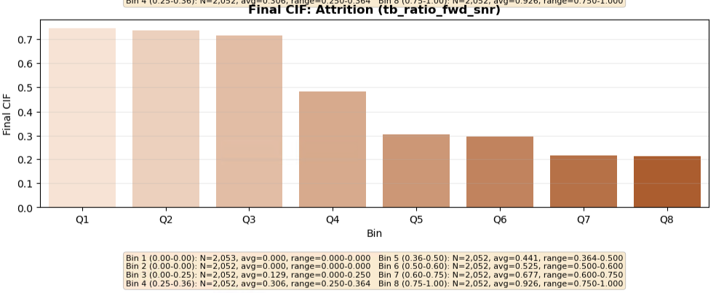
Individual Metrics

Slide 6
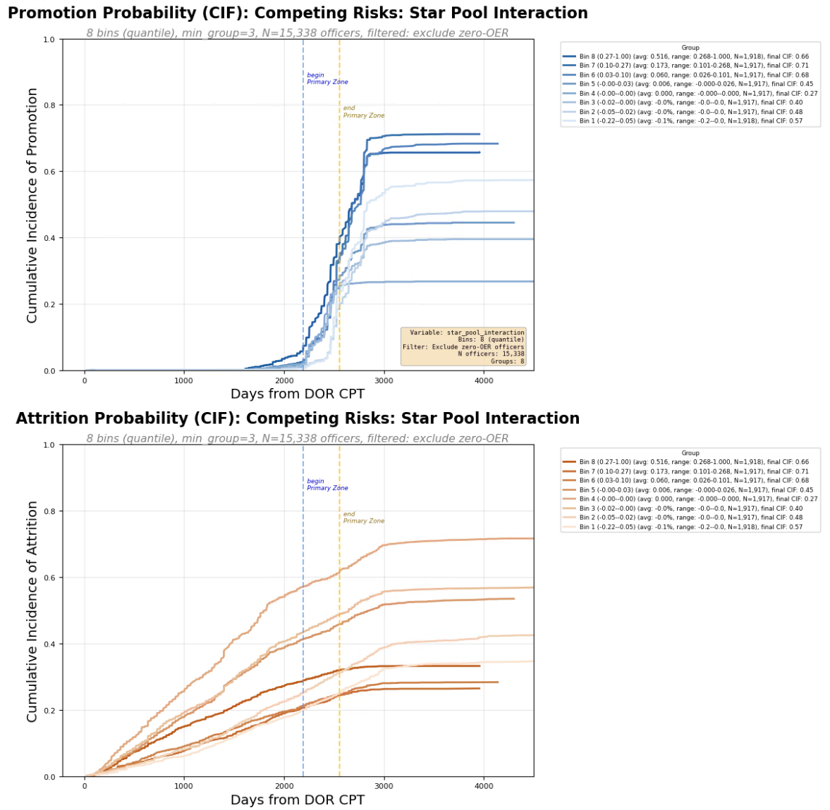
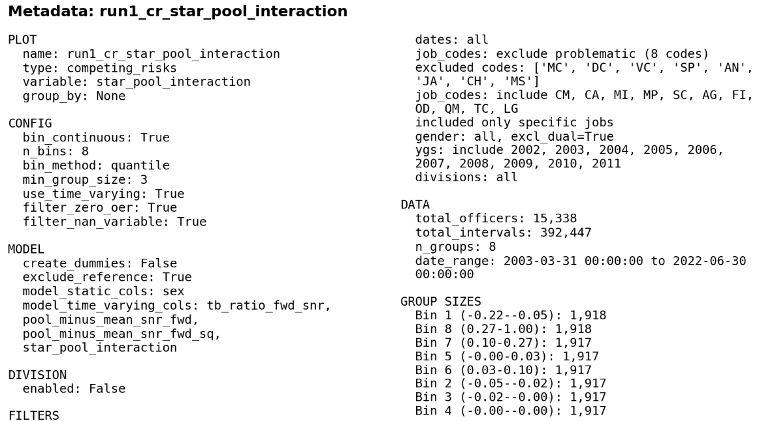

Slide 7
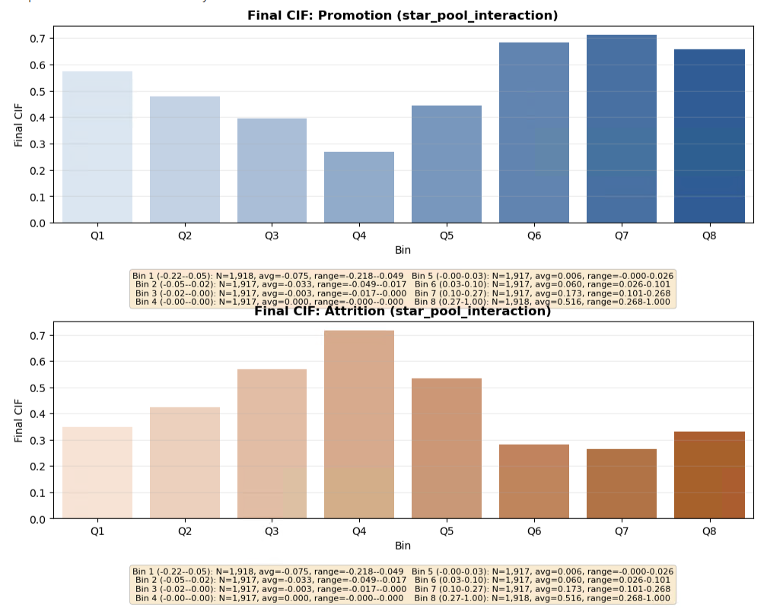

Slide 8
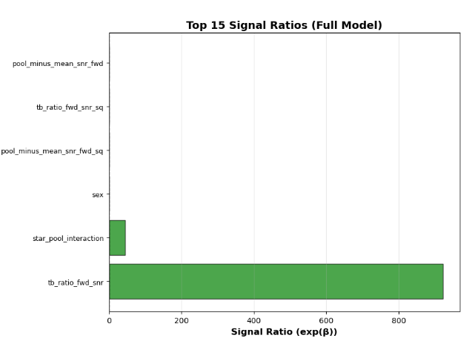

Slide 9
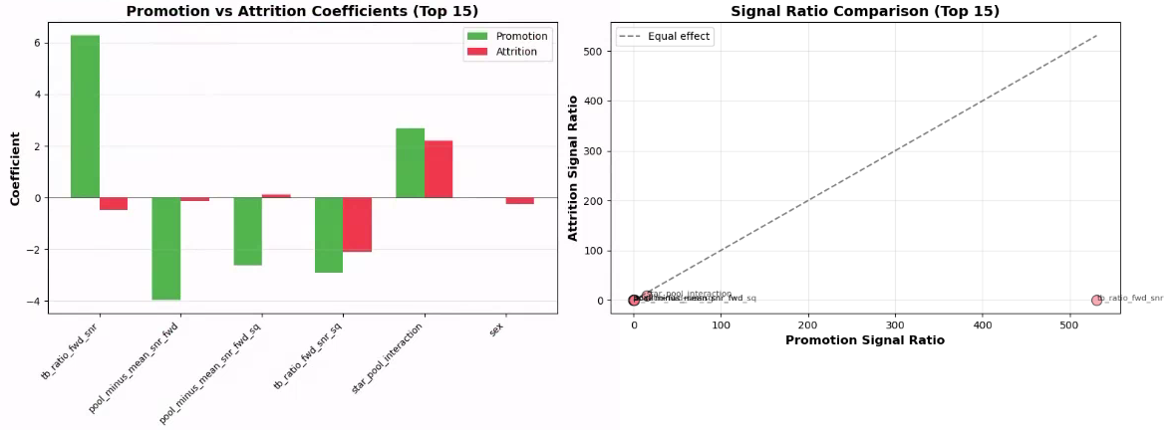

Slide 10
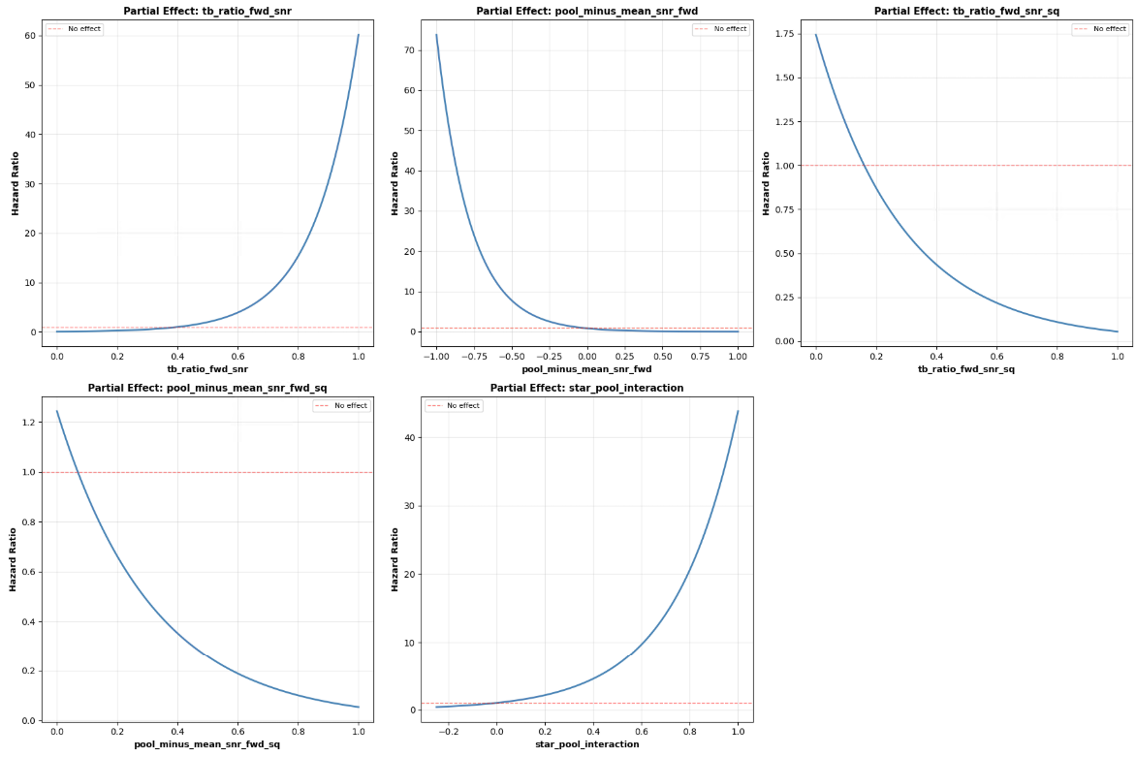

Slide 11
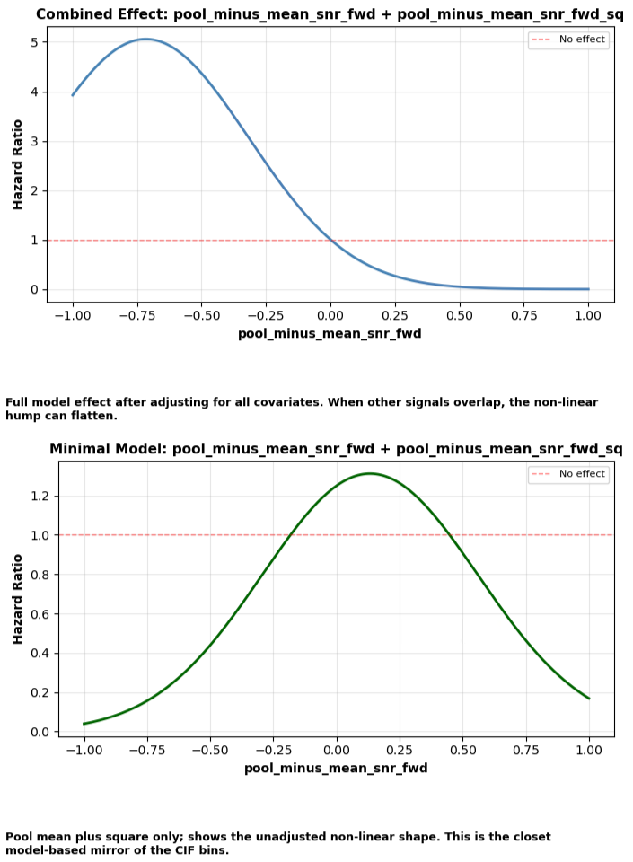
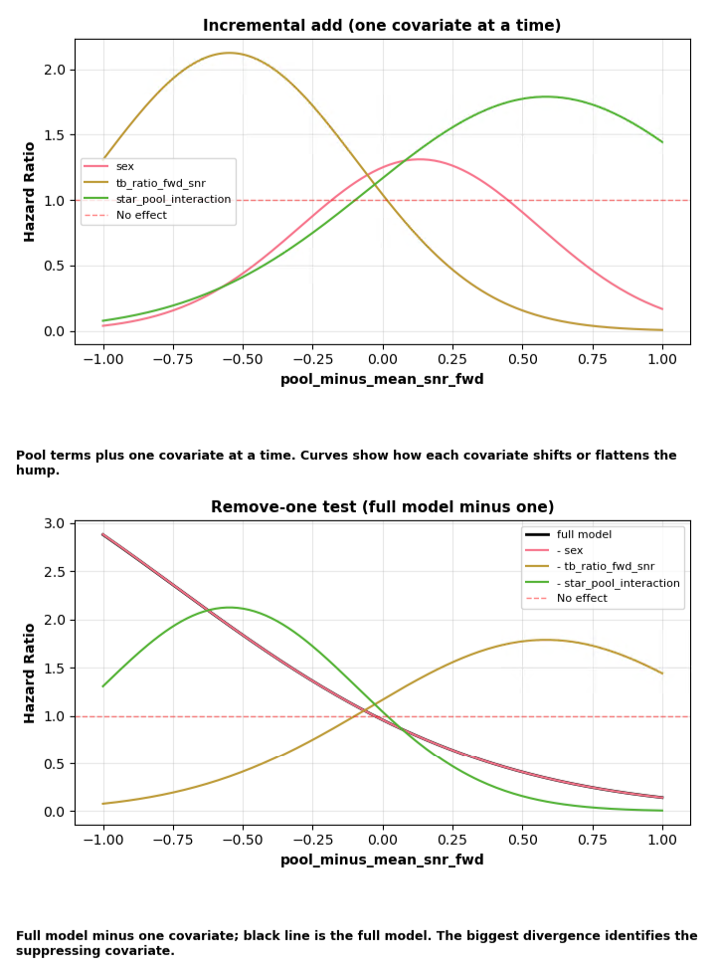

Slide 12
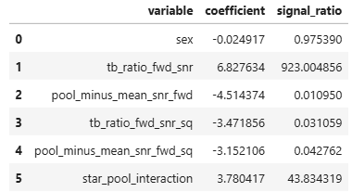


Slide 13
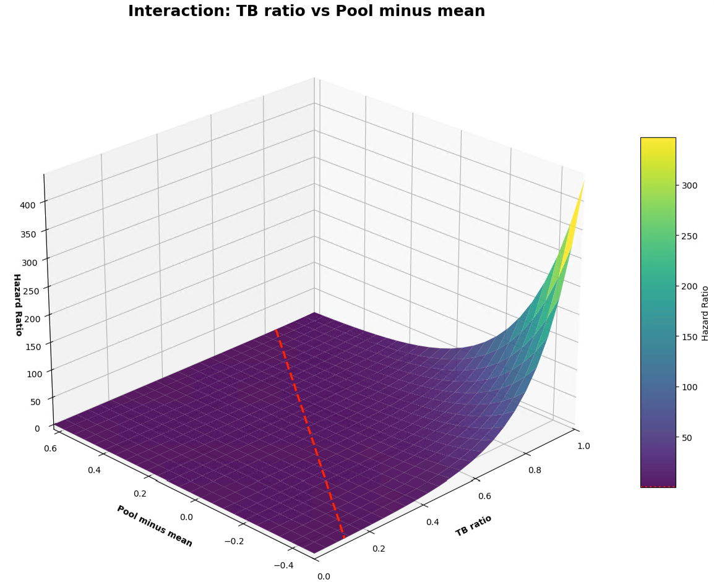

Slide 14
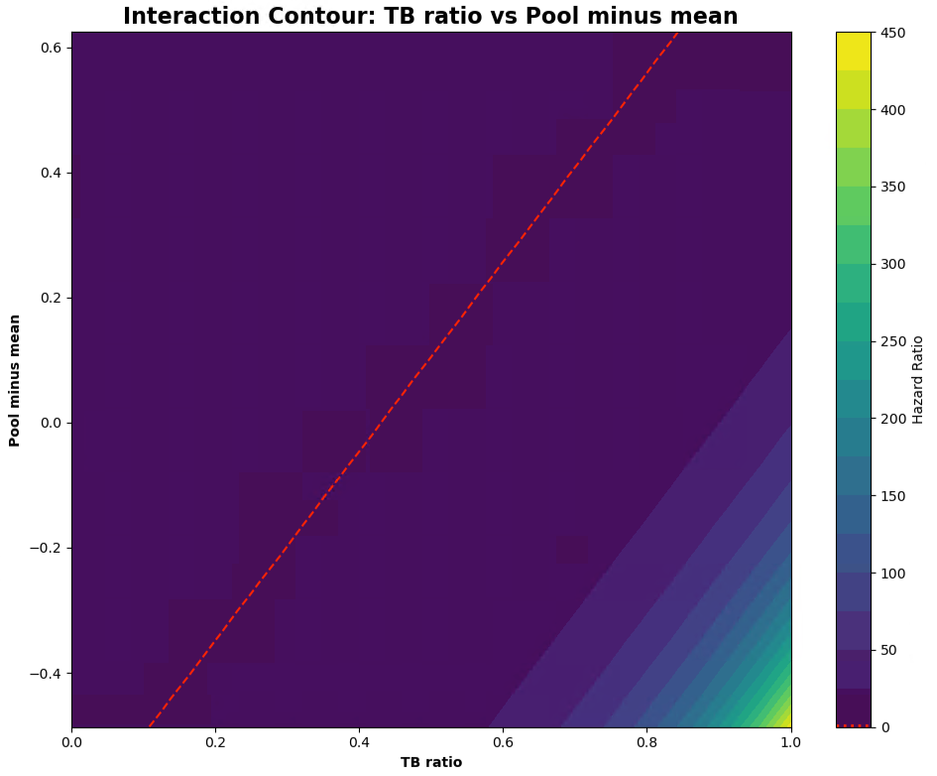

Slide 15
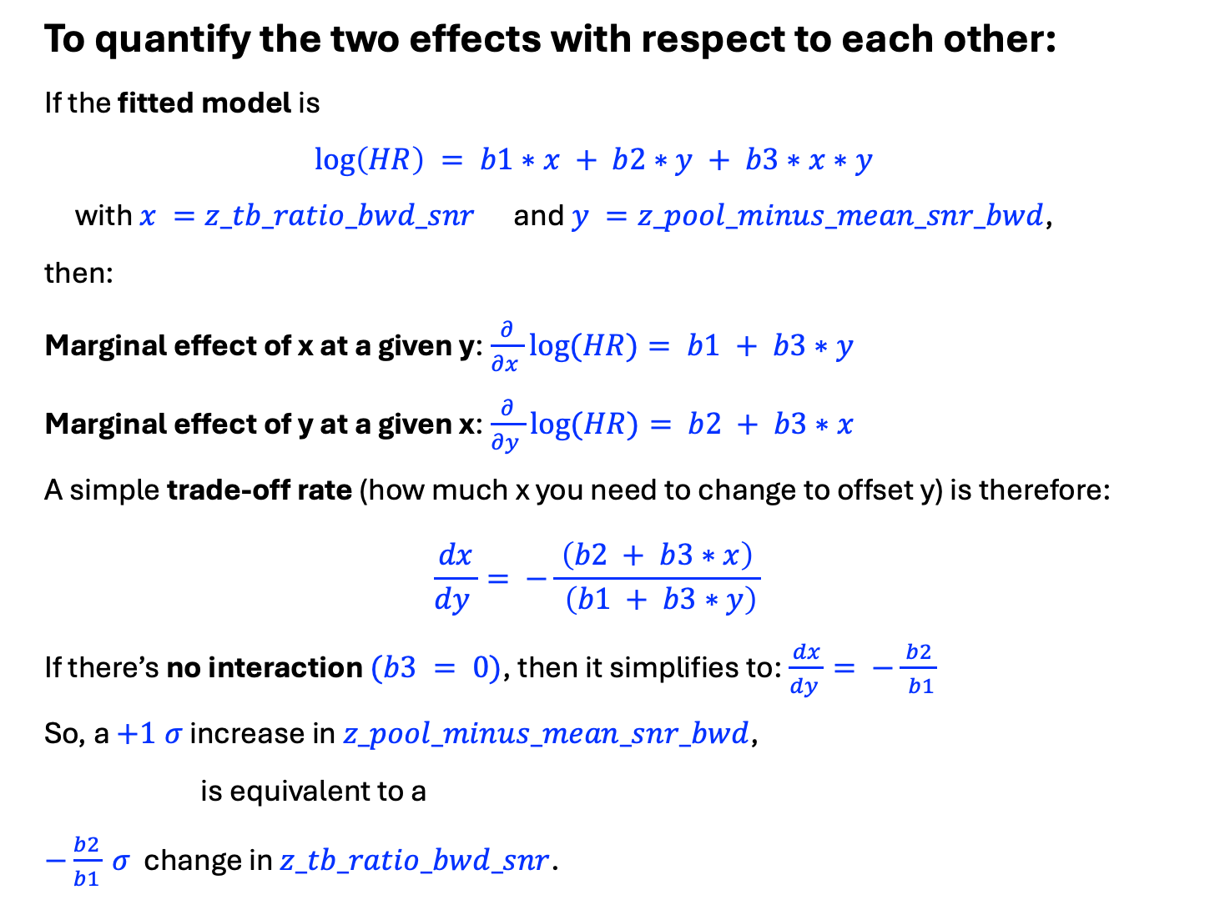
To quantify the two effects with respect to each other:
If the fitted model is
$$\log\left(HR\right) = b1∗x + b2∗y + b3∗x∗y$$
with $x =z_tb_ratio_bwd_snr$ and $y =z_pool_minus_mean_snr_bwd$,
then:
Marginal effect of x at a given y:$\frac{∂}{∂x }log⁡(HR)= b1 + b3∗y$
Marginal effect of y at a given x:$\frac{∂}{∂y }log⁡(HR)= b2 + b3∗x$
A simple trade‑off rate (how much x you need to change to offset y) is therefore:
$$\frac{dx}{dy }= −\frac{ \left(b2 + b3∗x\right) }{ \left(b1 + b3∗y\right)}$$
If there’s no interaction $(b3 = 0)$, then it simplifies to:$\frac{dx}{dy }= −\frac{ b2 }{ b1}$
So, a $+1 σ$ increase in $z_pool_minus_mean_snr_bwd$,
is equivalent to a
$−\frac{b2}{b1} σ$ change in $z_tb_ratio_bwd_snr$.

Slide 16
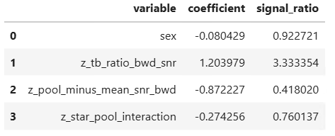
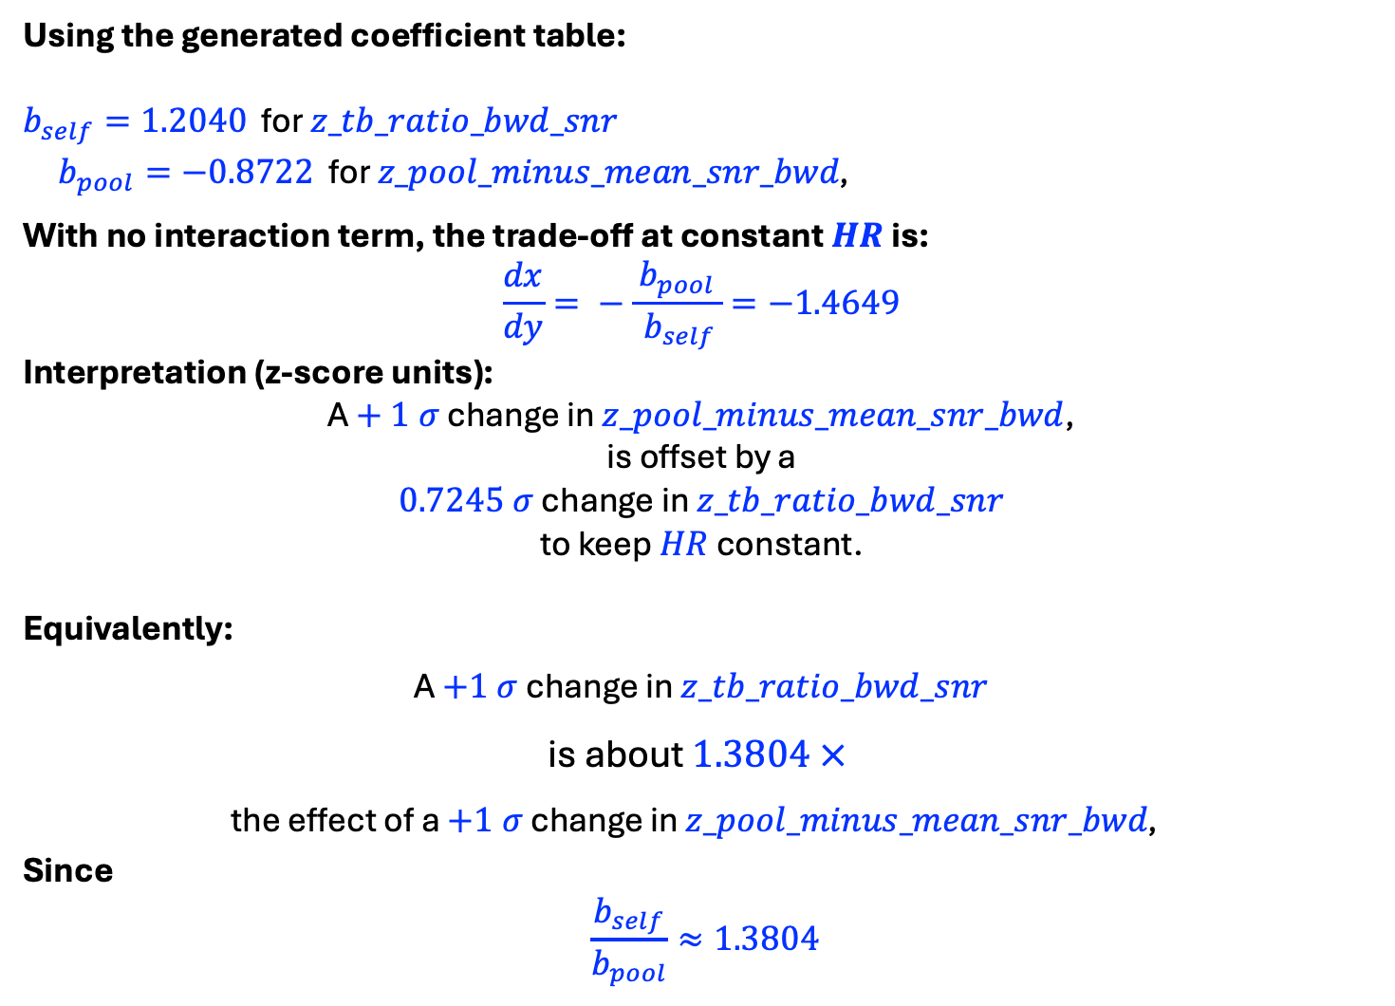
Using the generated coefficient table:
$b_{self}=1.2040$ for $z_tb_ratio_bwd_snr$
$b_{pool}=−0.8722$ for $z_pool_minus_mean_snr_bwd\text{, }$
With no interaction term, the trade‑off at constant $HR$ is:
$$\frac{dx}{dy}= −\frac{ b_{pool }}{ b_{self}}=−1.4649$$
Interpretation (z‑score units):
A $+ 1 σ$ change in $z_pool_minus_mean_snr_bwd$,
is offset by a
$0.7245 σ$ change in $z_tb_ratio_bwd_snr$
to keep $HR$ constant.
Equivalently:
A $+1 σ$ change in $z_tb_ratio_bwd_snr$
is about $1.3804 ×$
the effect of a $+1 σ$ change in $z_pool_minus_mean_snr_bwd\text{, }$
Since
$$\frac{b_{self}}{b_{pool}}≈1.3804$$

Slide 17
RUN 1
Individual TB Ratio
vs
Senior Rater Pool Mean
z_tb_ratio_1wd_snr
z_pool_minus_mean_snr_fwd
z_star_pool_interaction

Slide 18
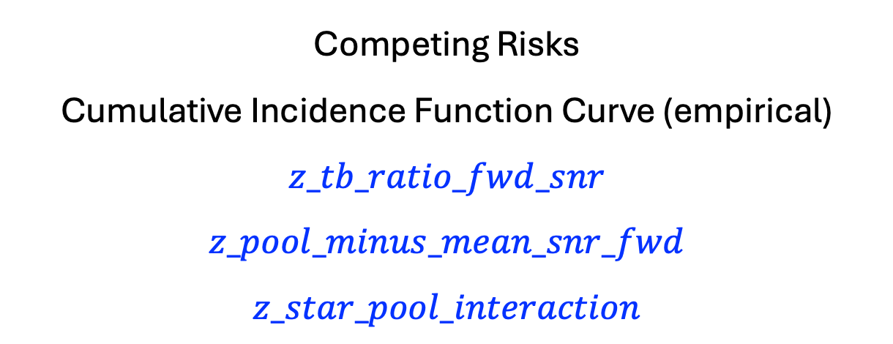
Competing Risks
Cumulative Incidence Function Curve (empirical)
$$z_tb_ratio_fwd_snr$$
$$z_pool_minus_mean_snr_fwd$$
$$z_star_pool_interaction$$

Slide 19
Senior Rater Pool

Slide 20
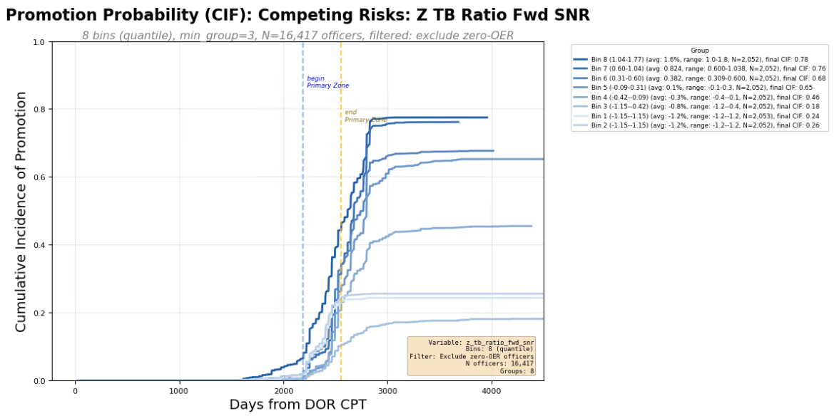
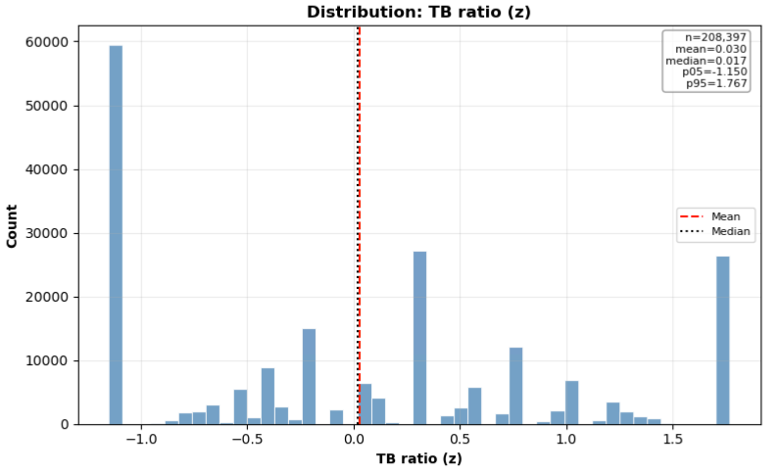
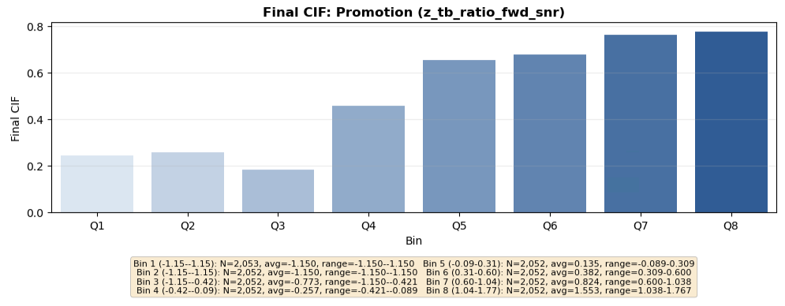
Individual Metrics

Slide 21
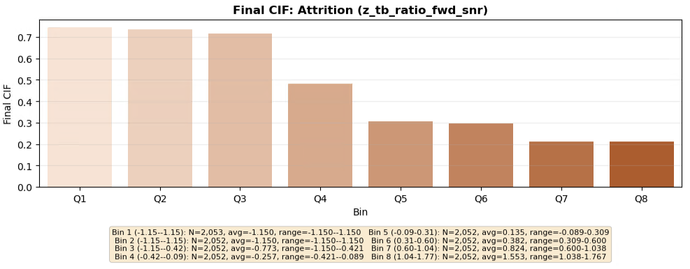
Individual Metrics

Slide 22
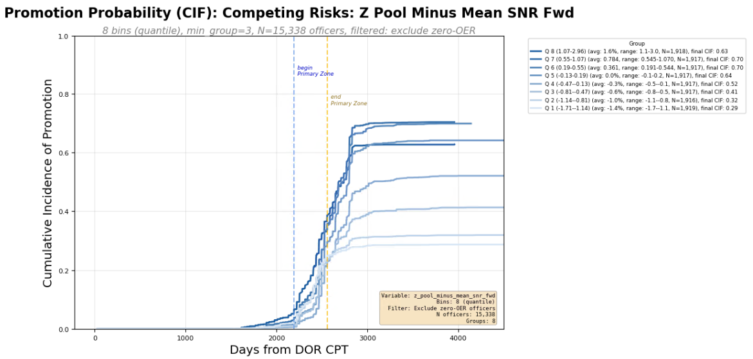
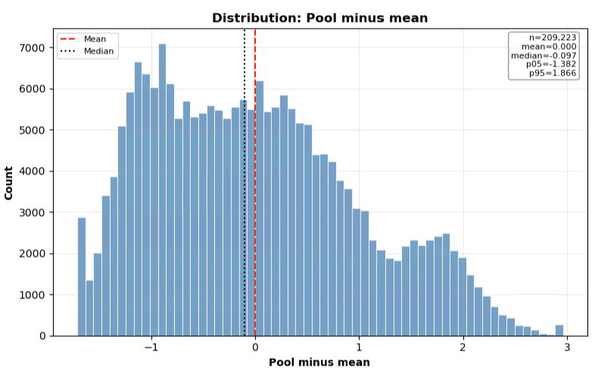
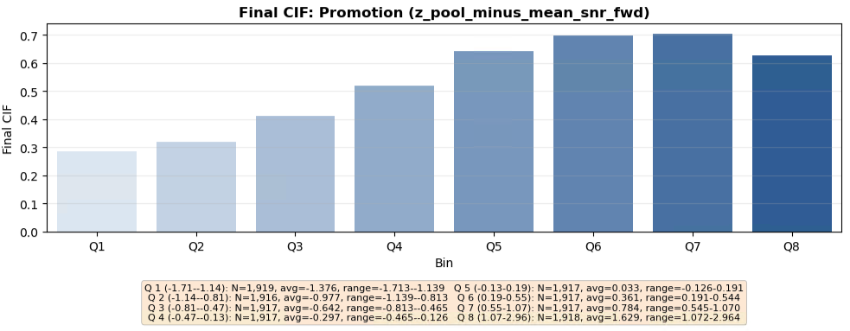
Pool Metrics

Slide 23
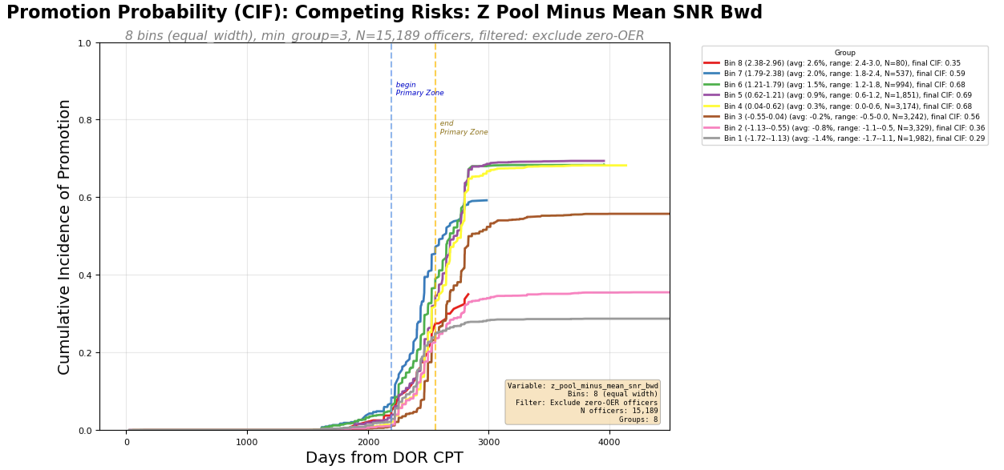
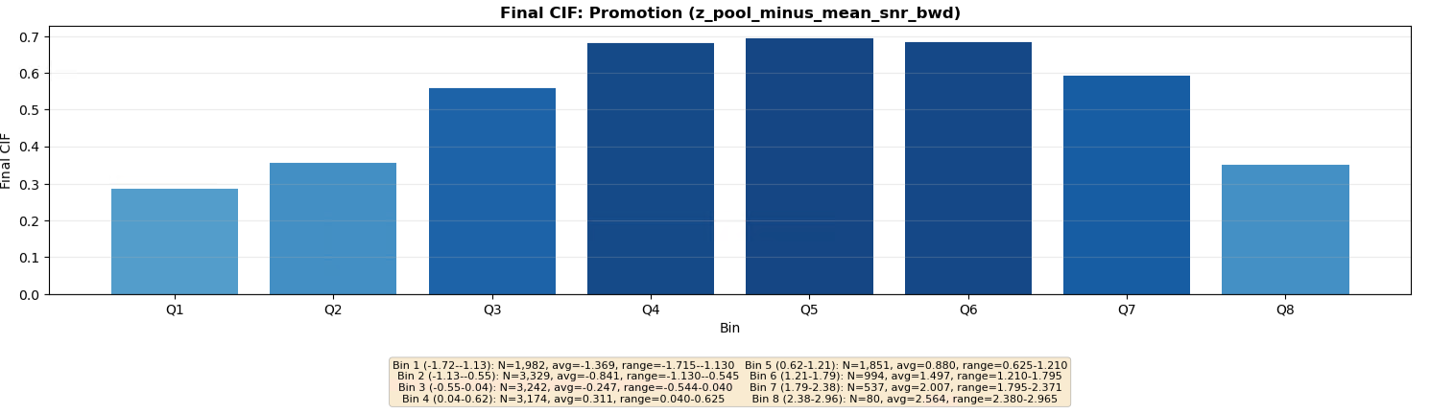

Slide 24
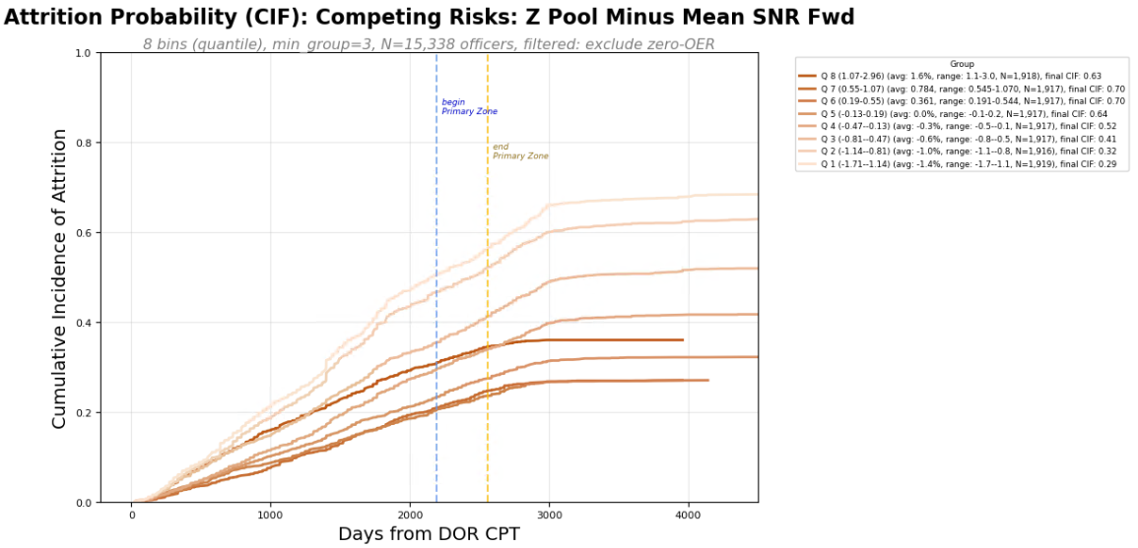
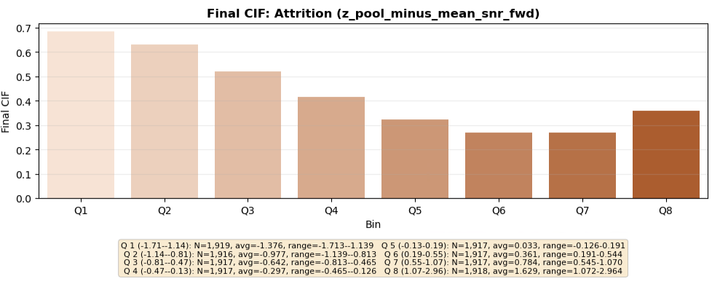
Pool Metrics

Slide 25
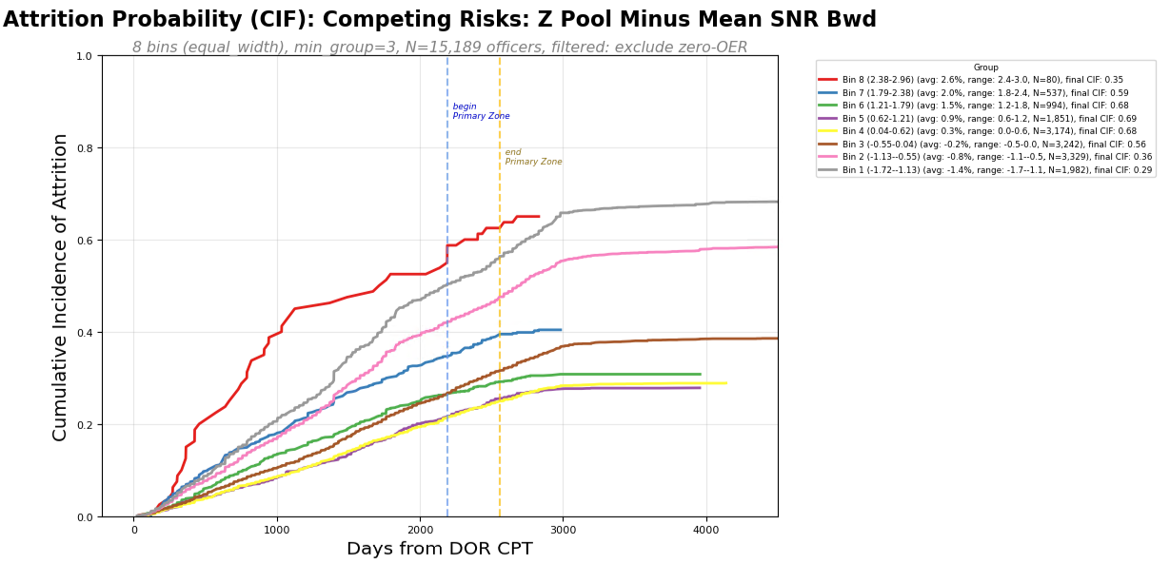
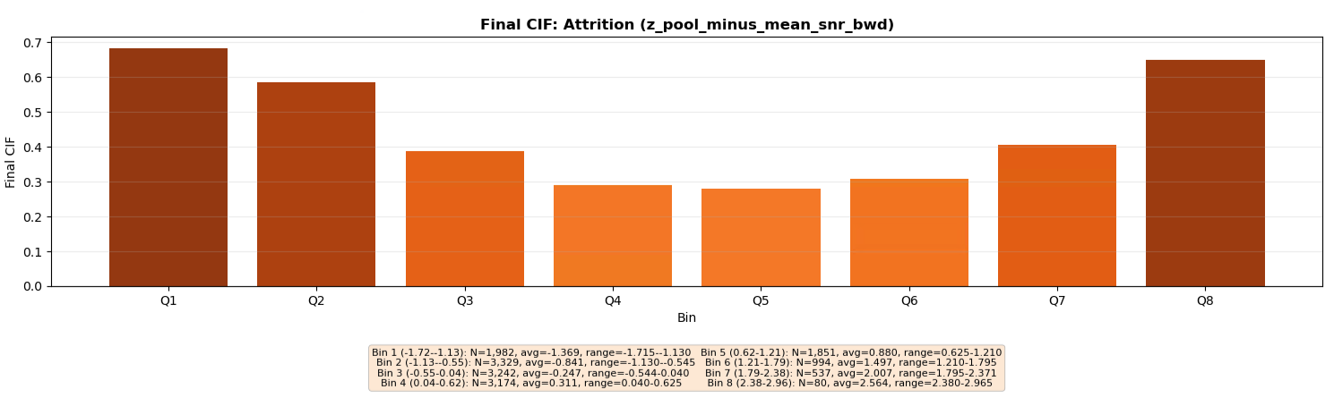

Slide 26
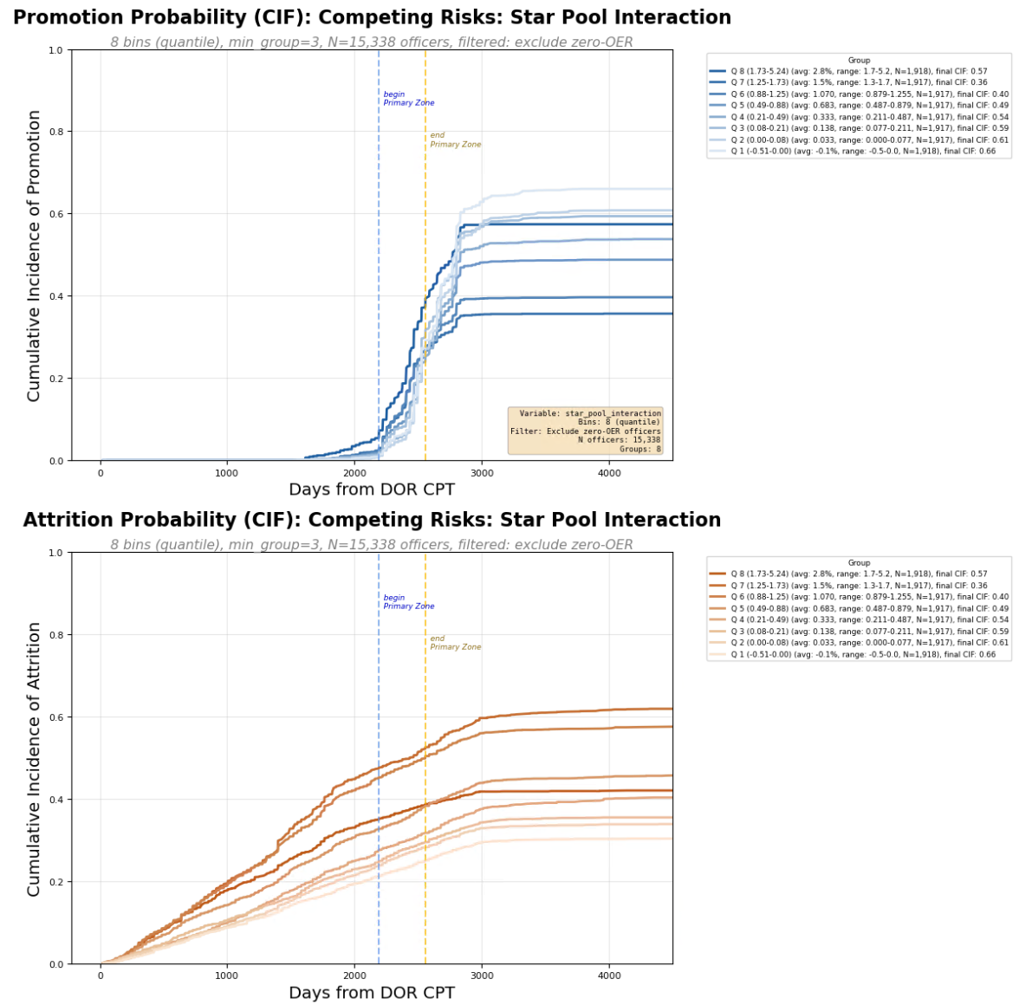
Interaction Metrics

Slide 27
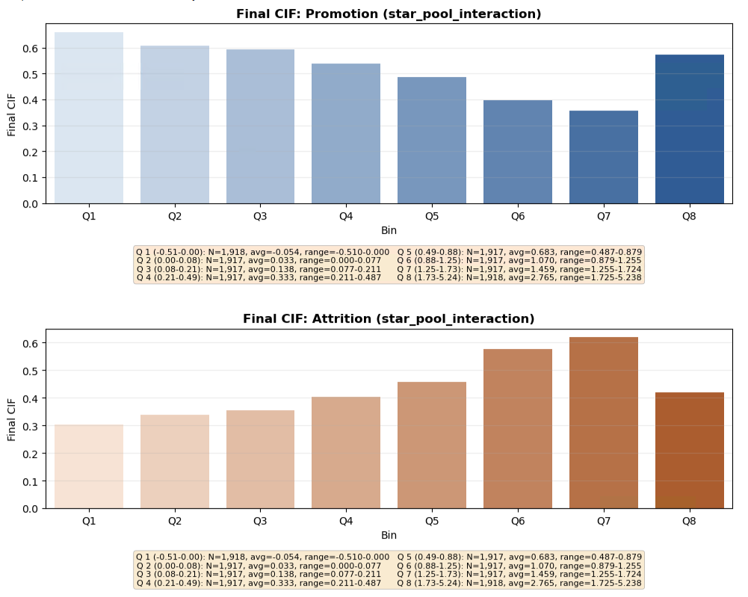
Interaction Metrics

Slide 28
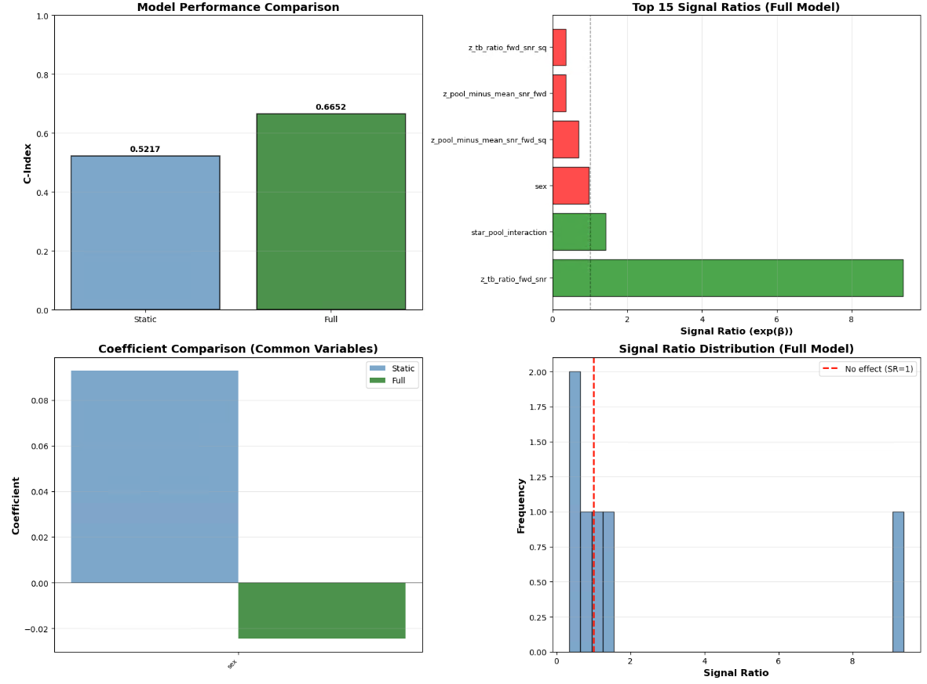

Slide 29
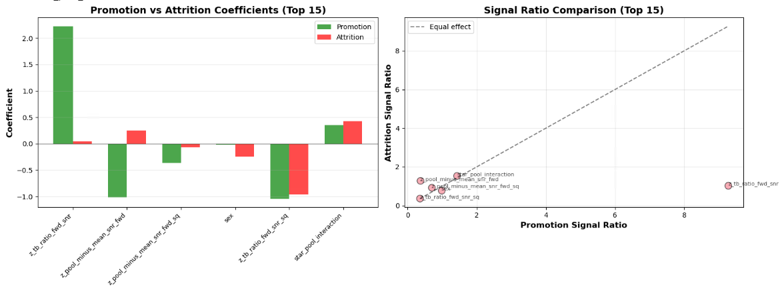

Slide 30
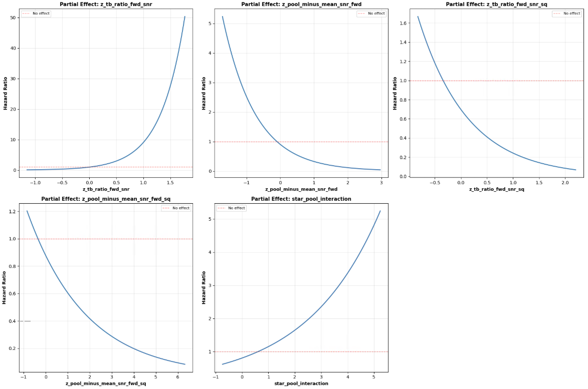

Slide 31
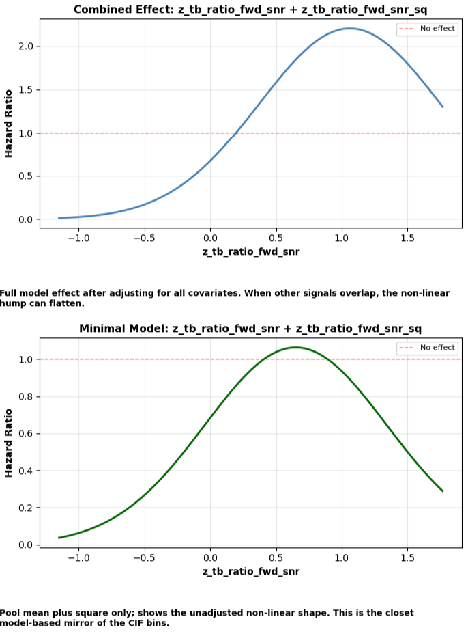
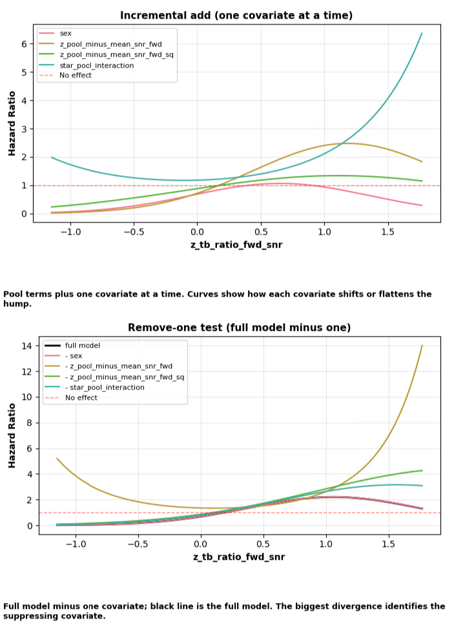
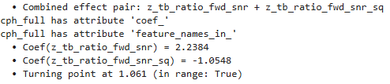

Slide 32
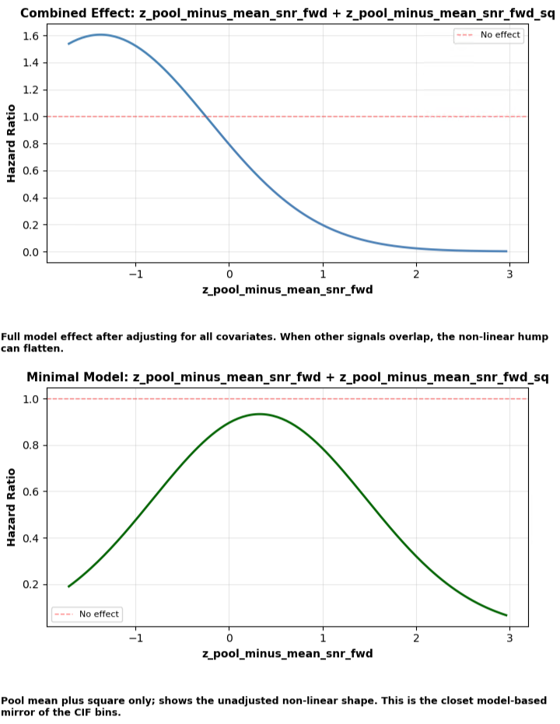
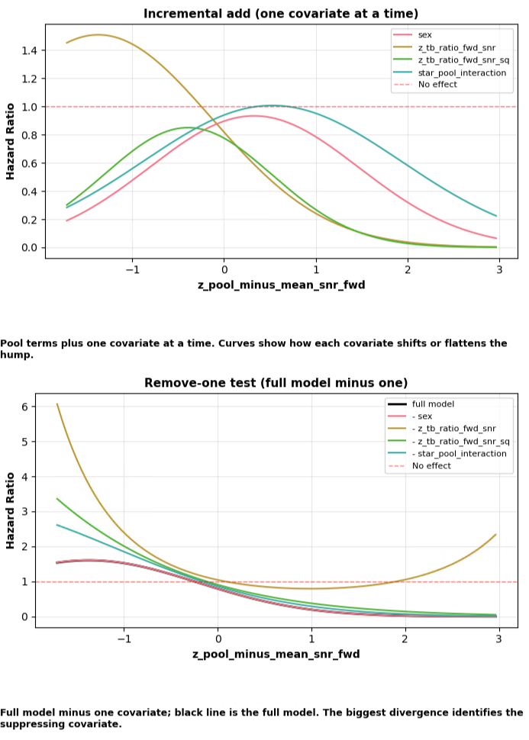


Slide 33
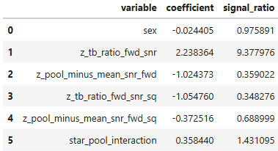


Slide 34
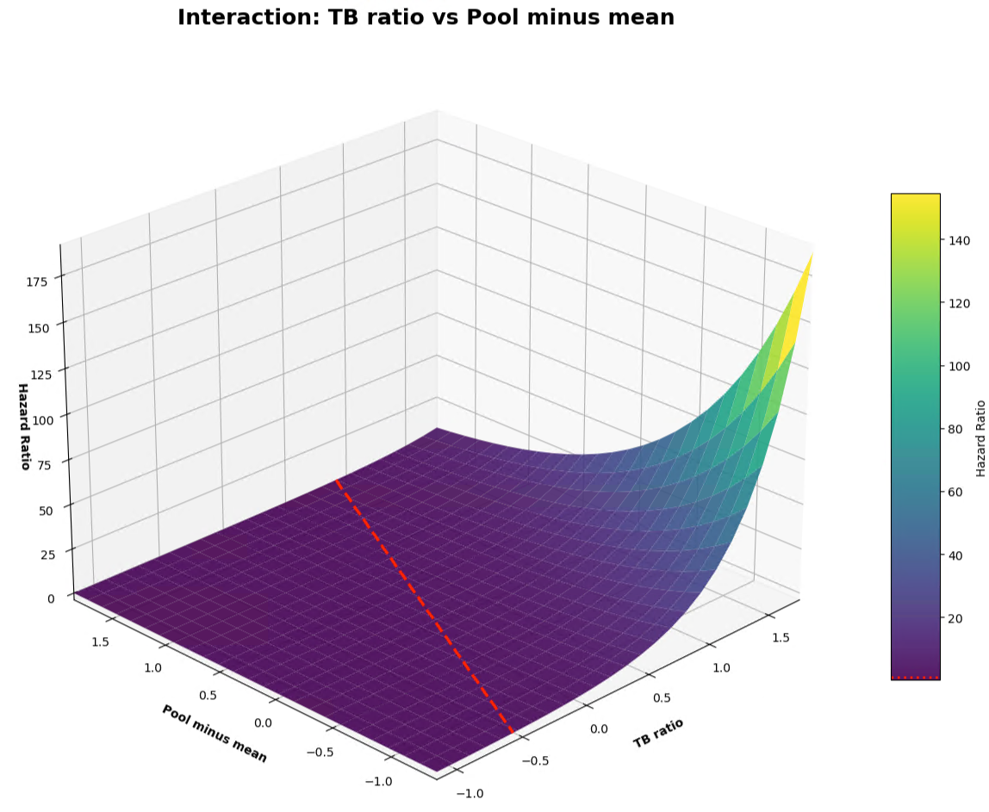

Slide 35
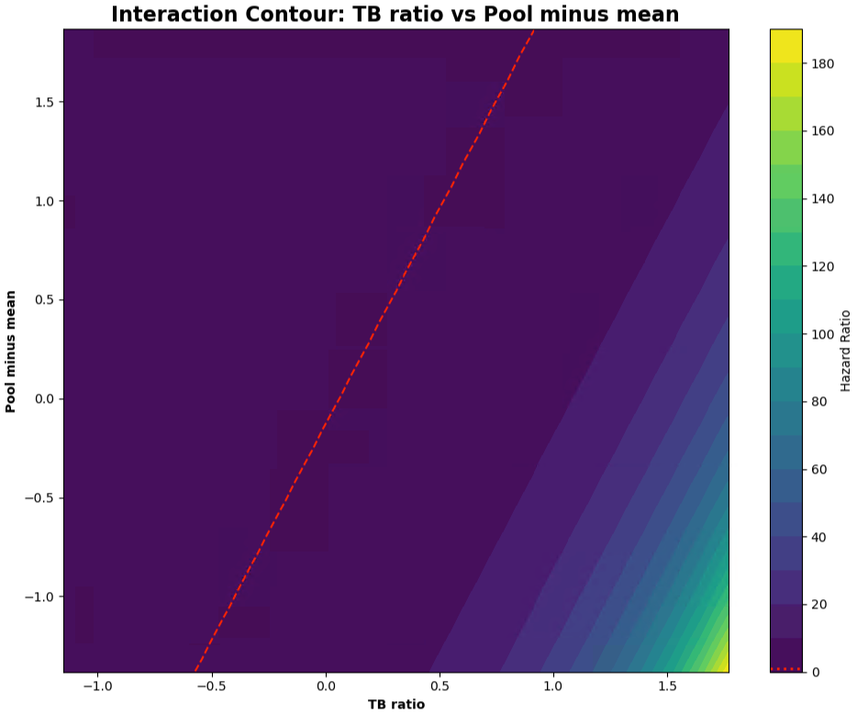

Slide 36
To quantify the two effects with respect to each other:
If the fitted model is
$$\log\left(HR\right) = b1∗x + b2∗y + b3∗x∗y$$
with $x =z_tb_ratio_bwd_snr$ and $y =z_pool_minus_mean_snr_bwd$,
then:
Marginal effect of x at a given y:$\frac{∂}{∂x }log⁡(HR)= b1 + b3∗y$
Marginal effect of y at a given x:$\frac{∂}{∂y }log⁡(HR)= b2 + b3∗x$
A simple trade‑off rate (how much x you need to change to offset y) is therefore:
$$\frac{dx}{dy }= −\frac{ \left(b2 + b3∗x\right) }{ \left(b1 + b3∗y\right)}$$
If there’s no interaction $(b3 = 0)$, then it simplifies to:$\frac{dx}{dy }= −\frac{ b2 }{ b1}$
So, a $+1 σ$ increase in $z_pool_minus_mean_snr_bwd$,
is equivalent to a
$−\frac{b2}{b1} σ$ change in $z_tb_ratio_bwd_snr$.

Slide 37
Using the generated coefficient table:
$b_{self}=1.2040$ for $z_tb_ratio_bwd_snr$
$b_{pool}=−0.8722$ for $z_pool_minus_mean_snr_bwd\text{, }$
With no interaction term, the trade‑off at constant $HR$ is:
$$\frac{dx}{dy}= −\frac{ b_{pool }}{ b_{self}}=−1.4649$$
Interpretation (z‑score units):
A $+ 1 σ$ change in $z_pool_minus_mean_snr_bwd$,
is offset by a
$0.7245 σ$ change in $z_tb_ratio_bwd_snr$
to keep $HR$ constant.
Equivalently:
A $+1 σ$ change in $z_tb_ratio_bwd_snr$
is about $1.3804 ×$
the effect of a $+1 σ$ change in $z_pool_minus_mean_snr_bwd\text{, }$
Since
$$\frac{b_{self}}{b_{pool}}≈1.3804$$

Slide 38
RUN 3
Individual TB Ratio
vs
Senior Rater Pool Rank
z_tb_ratio_bwd_snr
z_pool_tb_ratio_rank_pct_snr_bwd
z_standing_pool_interaction

Slide 39
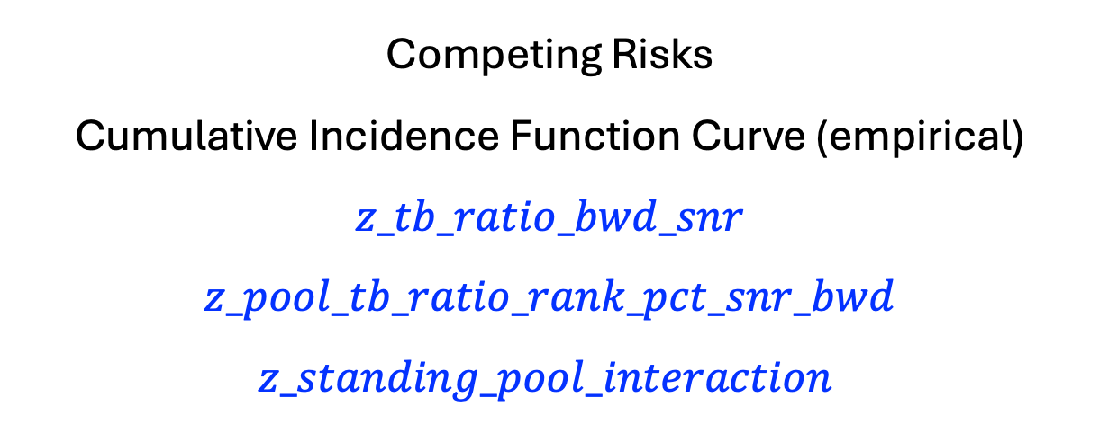
Competing Risks
Cumulative Incidence Function Curve (empirical)
$$z_tb_ratio_bwd_snr$$
$$z_pool_tb_ratio_rank_pct_snr_bwd$$
$$z_standing_pool_interaction$$

Slide 40
Senior Rater Pool

Slide 41

Individual Metrics

Slide 42
Individual Metrics

Slide 43



Pool Metrics

Slide 44


Pool Metrics

Slide 45

Interaction Metrics

Slide 46

Interaction Metrics

Slide 47


Slide 48


Slide 49


Slide 50




Slide 51




Slide 53


Slide 54


Slide 55
To quantify the two effects with respect to each other:
If the fitted model is
$$\log\left(HR\right) = b1∗x + b2∗y + b3∗x∗y$$
with $x =z_tb_ratio_bwd_snr$ and $y =z_pool_minus_mean_snr_bwd$,
then:
Marginal effect of x at a given y:$\frac{∂}{∂x }log⁡(HR)= b1 + b3∗y$
Marginal effect of y at a given x:$\frac{∂}{∂y }log⁡(HR)= b2 + b3∗x$
A simple trade‑off rate (how much x you need to change to offset y) is therefore:
$$\frac{dx}{dy }= −\frac{ \left(b2 + b3∗x\right) }{ \left(b1 + b3∗y\right)}$$
If there’s no interaction $(b3 = 0)$, then it simplifies to:$\frac{dx}{dy }= −\frac{ b2 }{ b1}$
So, a $+1 σ$ increase in $z_pool_minus_mean_snr_bwd$,
is equivalent to a
$−\frac{b2}{b1} σ$ change in $z_tb_ratio_bwd_snr$.

Slide 56
Using the generated coefficient table:
$b_{self}=1.2040$ for $z_tb_ratio_bwd_snr$
$b_{pool}=−0.8722$ for $z_pool_minus_mean_snr_bwd\text{, }$
With no interaction term, the trade‑off at constant $HR$ is:
$$\frac{dx}{dy}= −\frac{ b_{pool }}{ b_{self}}=−1.4649$$
Interpretation (z‑score units):
A $+ 1 σ$ change in $z_pool_minus_mean_snr_bwd$,
is offset by a
$0.7245 σ$ change in $z_tb_ratio_bwd_snr$
to keep $HR$ constant.
Equivalently:
A $+1 σ$ change in $z_tb_ratio_bwd_snr$
is about $1.3804 ×$
the effect of a $+1 σ$ change in $z_pool_minus_mean_snr_bwd\text{, }$
Since
$$\frac{b_{self}}{b_{pool}}≈1.3804$$

Slide 57

Senior Rater Pool

Slide 58





Slide 60



Slide 61


Slide 62


Slide 63


Slide 64



Slide 65


Slide 66


Slide 67

To quantify the two effects with respect to each other:
If the fitted model is
$$\log\left(HR\right) = b1∗x + b2∗y + b3∗x∗y$$
with $x =z_tb_ratio_bwd_snr$ and $y =z_pool_tb_ratio_rank_pct_snr_bwd$,
then:
Marginal effect of x at a given y:$\frac{∂}{∂x }log⁡(HR)= b1 + b3∗y$
Marginal effect of y at a given x:$\frac{∂}{∂y }log⁡(HR)= b2 + b3∗x$
A simple trade‑off rate (how much x you need to change to offset y) is therefore:
$$\frac{dx}{dy }= −\frac{ \left(b2 + b3∗x\right) }{ \left(b1 + b3∗y\right)}$$
If there’s no interaction $(b3 = 0)$, then it simplifies to:$\frac{dx}{dy }= −\frac{ b2 }{ b1}$
So, a $+1 σ$ increase in $z_pool_tb_ratio_rank_pct_snr_bwd$,
is equivalent to a
$−\frac{b2}{b1} σ$ change in $z_tb_ratio_bwd_snr$.

Slide 68

Using the generated coefficient table:
$b_{self}= 0.7867$ for $z_tb_ratio_bwd_snr$
$b_{rank}=−0.4534$ for $z_pool_tb_ratio_rank_pct_snr_bwd\text{, }$
With no interaction term, the trade‑off at constant $HR$ is:
$$\frac{dx}{dy}= −\frac{b_{rank}}{b_{self}}=0.5775$$
Interpretation (z‑score units):
A $+ 1 σ$ change in $z_pool_tb_ratio_rank_pct_snr_bwd$,
is offset by a
$0.5775 σ$ change in $z_tb_ratio_bwd_snr$
to keep $HR$ constant.
Equivalently:
A $+1 σ$ change in $z_tb_ratio_bwd_snr$
is about $1.7317×$
the effect of a $+1 σ$ change in $z_pool_tb_ratio_rank_pct_snr_bwd\text{, }$
Since
$$\frac{b_{self}}{b_{rank}}≈1.7317$$

Slide 69



Slide 70



Slide 73


Slide 74



Slide 75



Slide 76



Slide 77



Slide 78


Slide 79


Slide 80


Slide 81


Slide 82


Slide 83


Slide 84


Slide 85


Slide 86


