Slide 1
RUN 1 - Using
z_tb_ratio_bwd_snr
z_pool_minus_mean_snr_bwd
z_star_pool_interaction

Slide 2
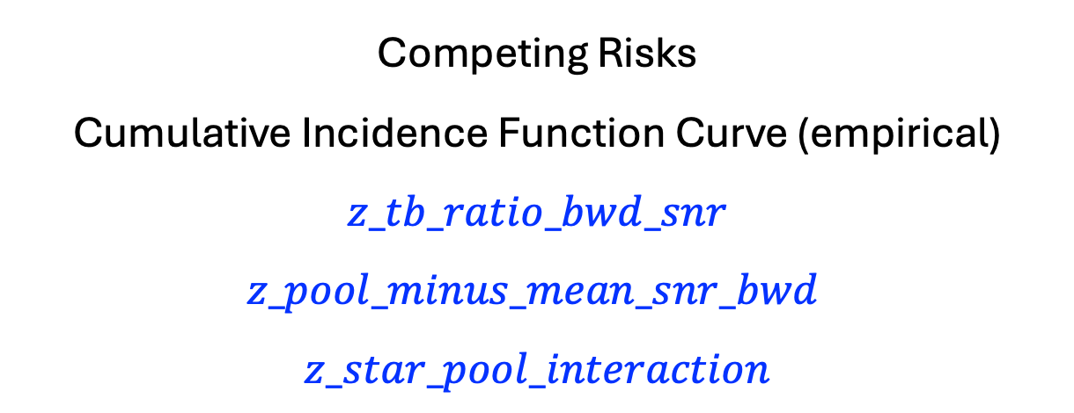
Competing Risks
Cumulative Incidence Function Curve (empirical)
$$z_tb_ratio_bwd_snr \\ z_pool_minus_mean_snr_bwd$$
$$z_star_pool_interaction$$

Slide 3
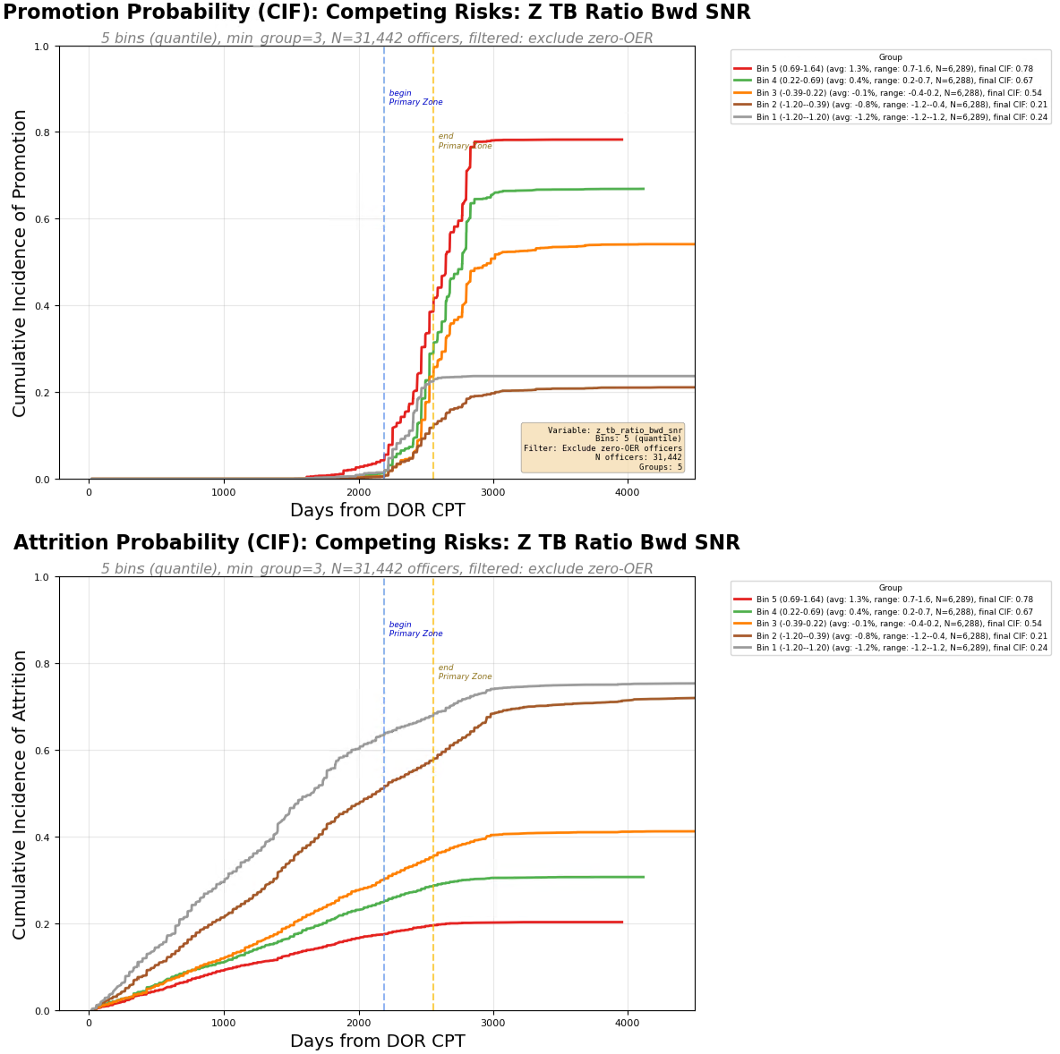

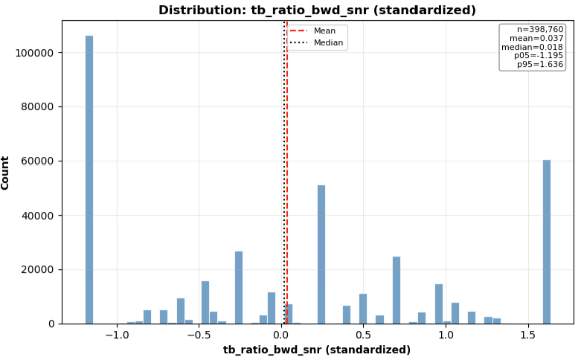

Slide 4
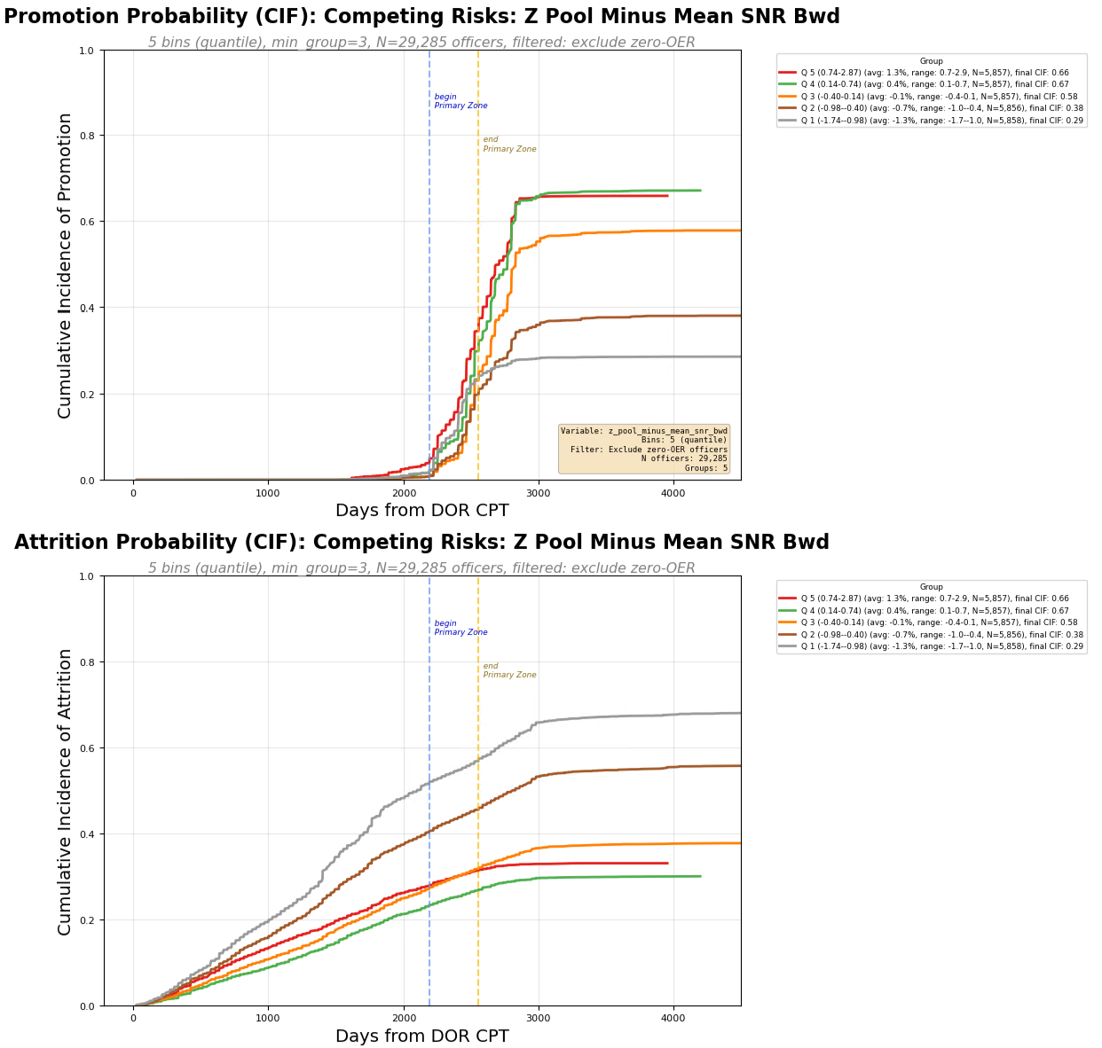
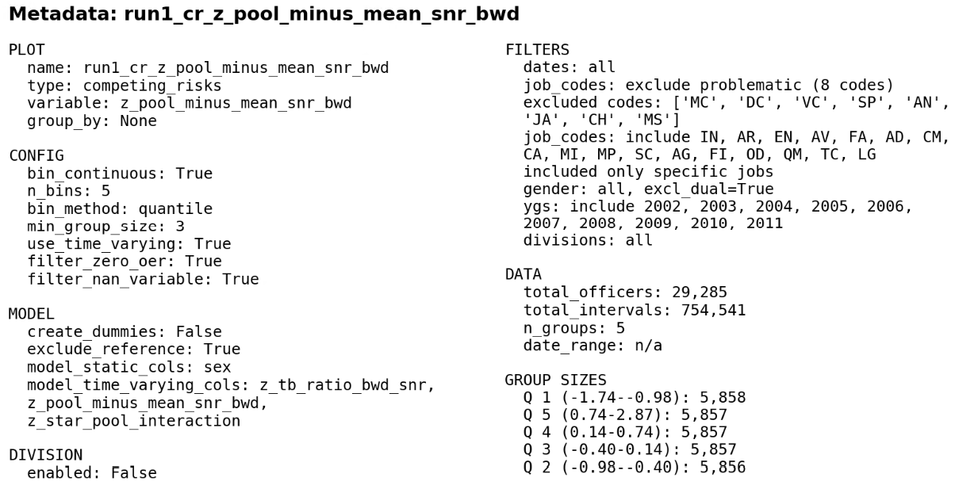
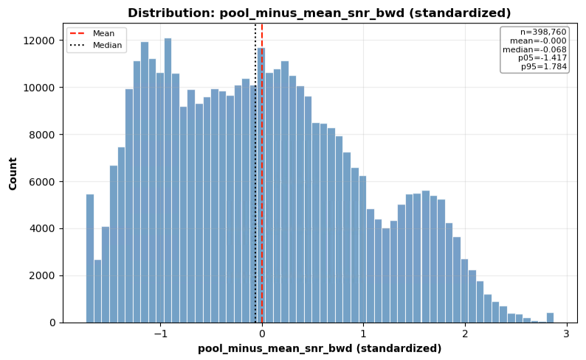

Slide 5
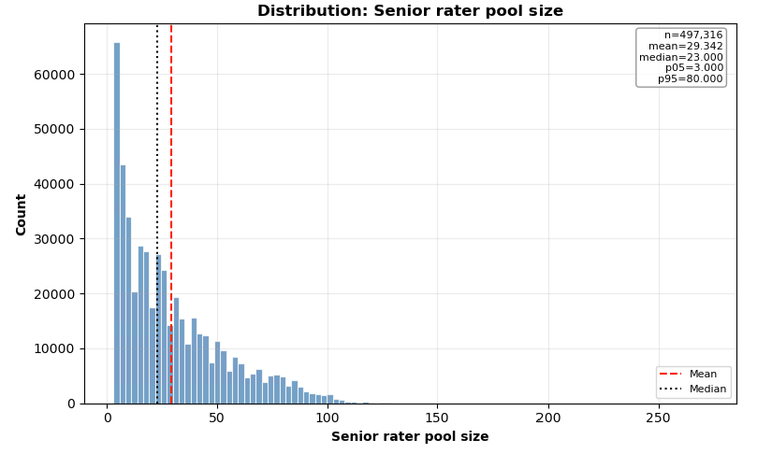

Slide 6
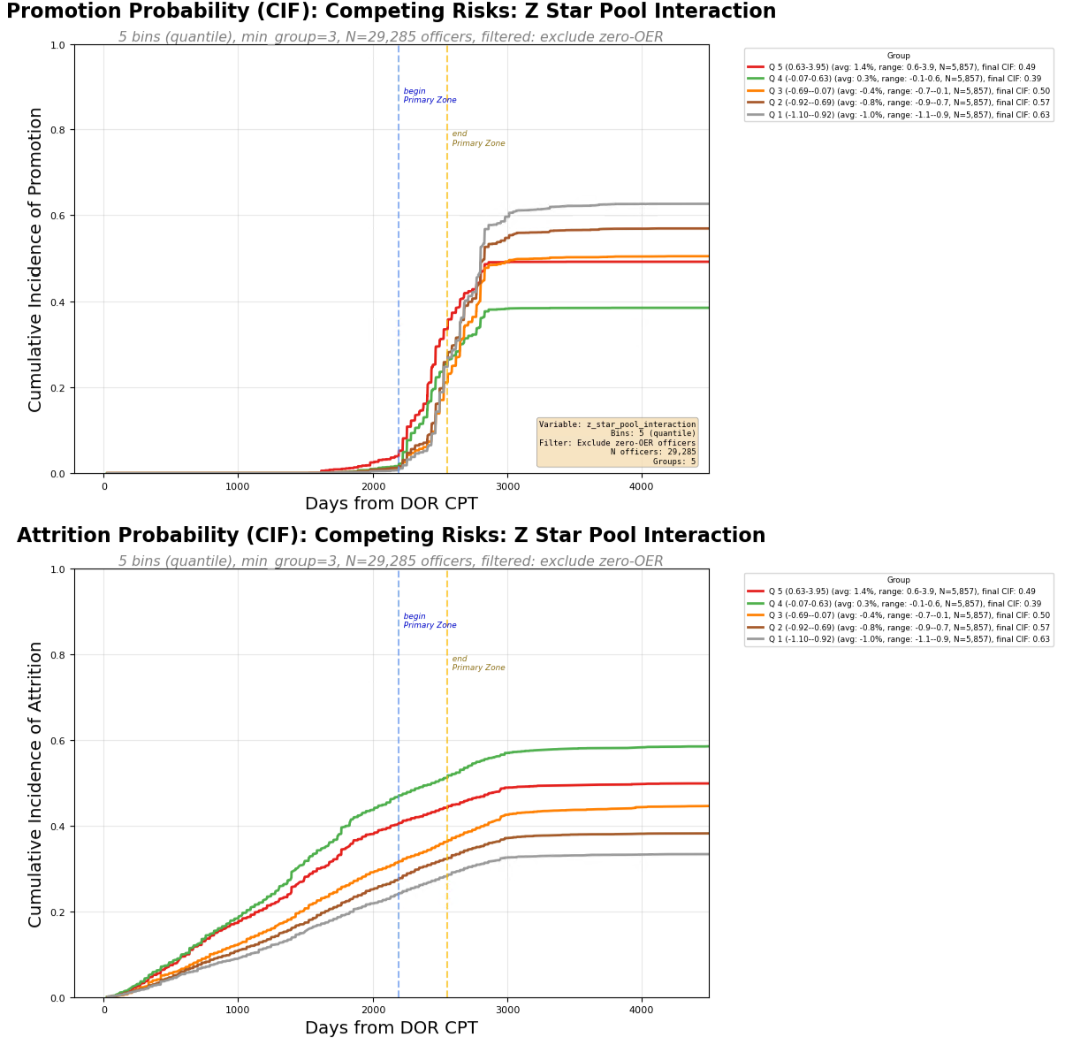


Slide 7
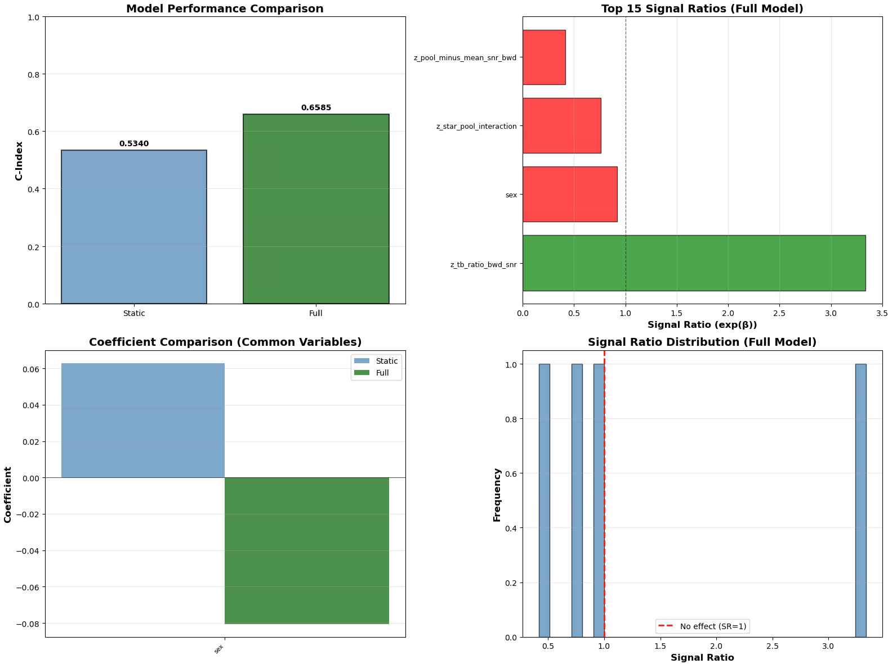

Slide 8
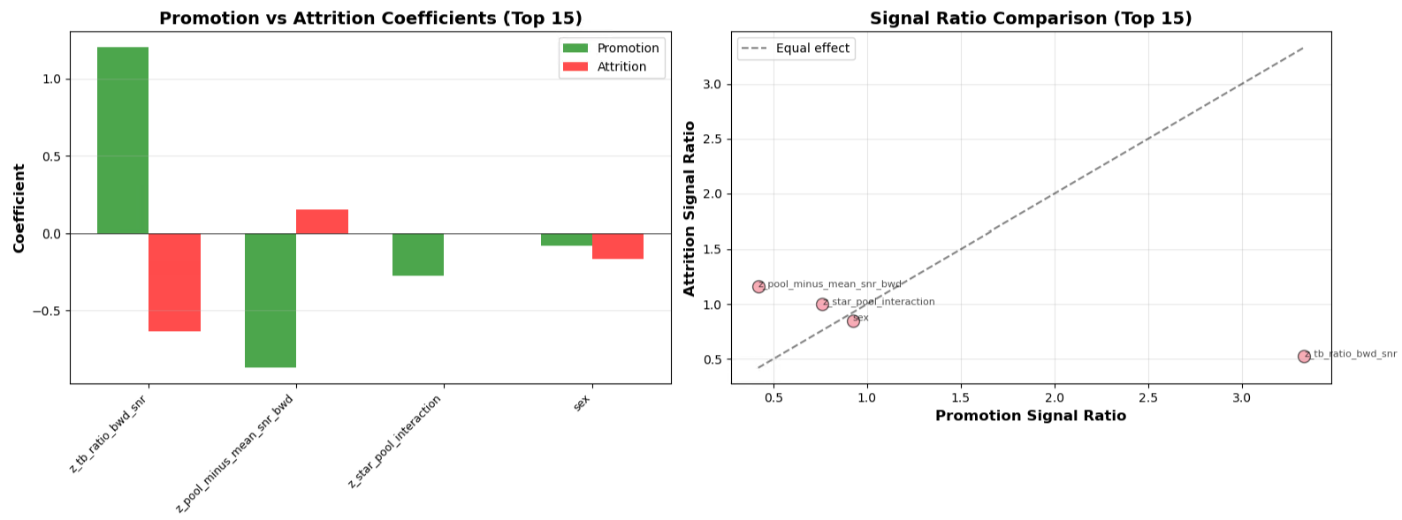

Slide 9
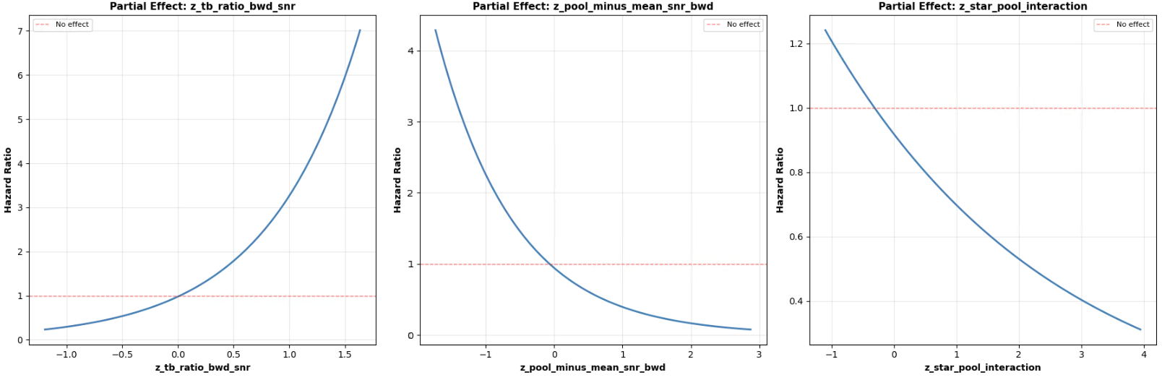

Slide 10
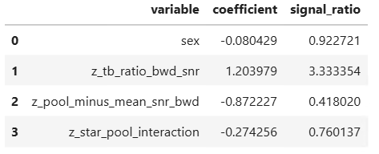


Slide 11
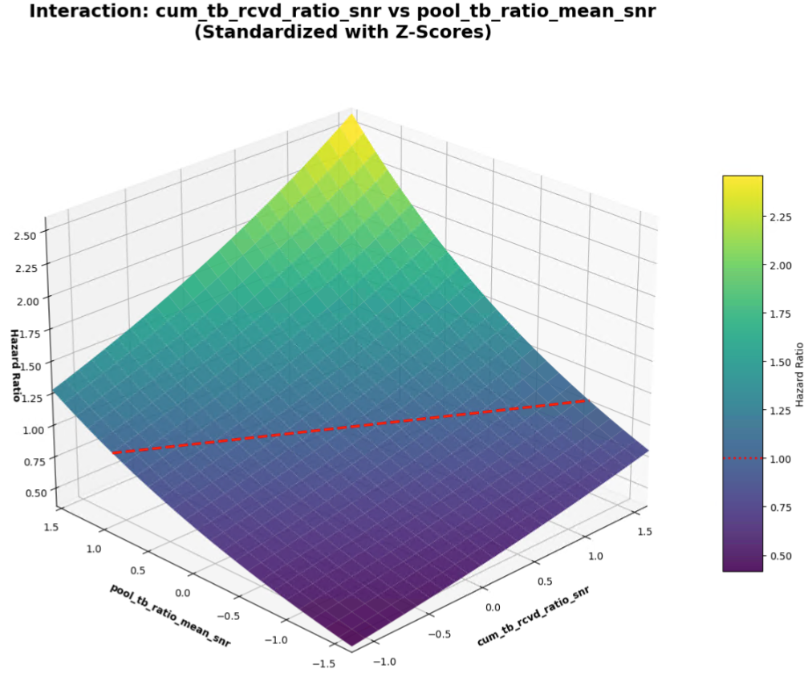

Slide 12
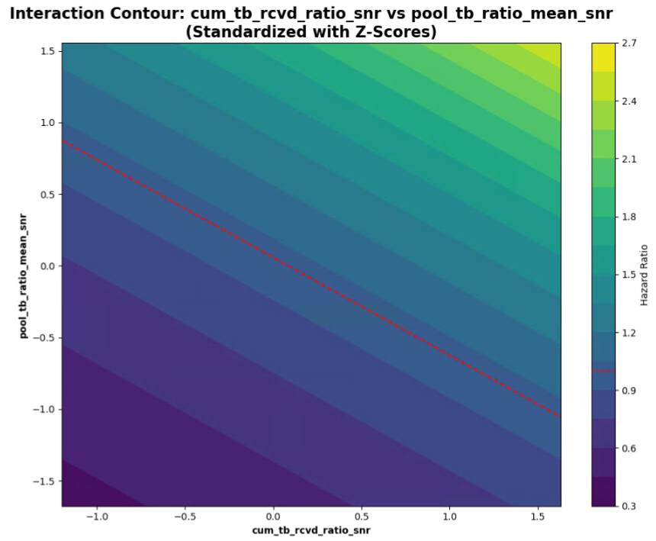

Slide 13
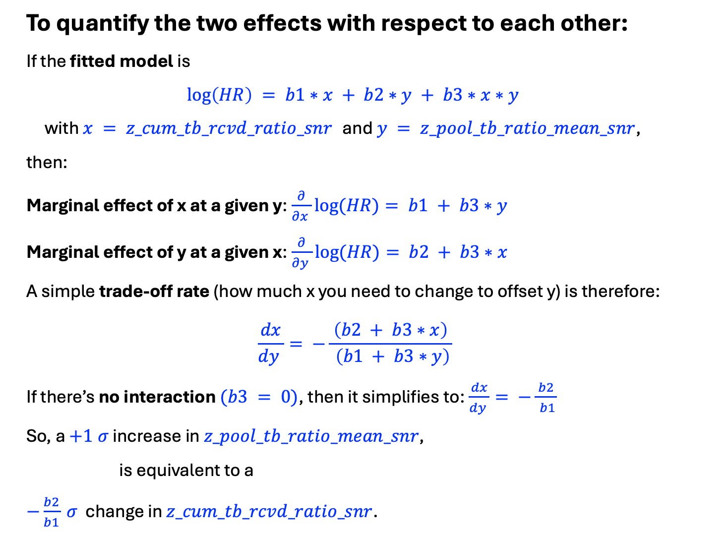
To quantify the two effects with respect to each other:
If the fitted model is
$$\log\left(HR\right) = b1∗x + b2∗y + b3∗x∗y$$
with $x = z_cum_tb_rcvd_ratio_snr$ and $y = z_pool_tb_ratio_mean_snr$,
then:
Marginal effect of x at a given y:$\frac{∂}{∂x }log⁡(HR)= b1 + b3∗y$
Marginal effect of y at a given x:$\frac{∂}{∂y }log⁡(HR)= b2 + b3∗x$
A simple trade‑off rate (how much x you need to change to offset y) is therefore:
$$\frac{dx}{dy }= −\frac{ \left(b2 + b3∗x\right) }{ \left(b1 + b3∗y\right)}$$
If there’s no interaction $(b3 = 0)$, then it simplifies to:$\frac{dx}{dy }= −\frac{ b2 }{ b1}$
So, a $+1 σ$ increase in $z_pool_tb_ratio_mean_snr$,
is equivalent to a
$−\frac{b2}{b1} σ$ change in $z_cum_tb_rcvd_ratio_snr$.

Slide 14
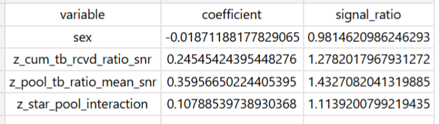
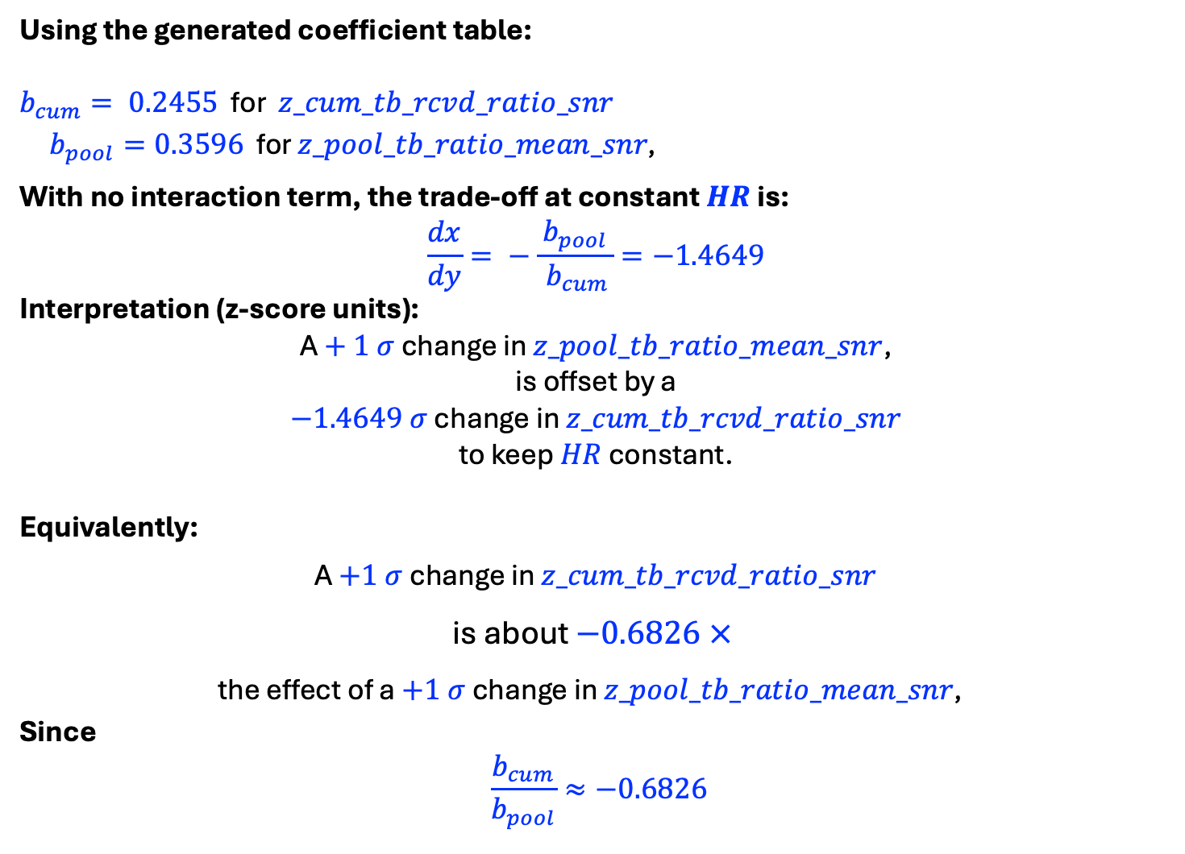
Using the generated coefficient table:
$b_{cum}= 0.2455$ for $z_cum_tb_rcvd_ratio_snr$
$b_{pool}=0.3596$ for $z_pool_tb_ratio_mean_snr\text{, }$
With no interaction term, the trade‑off at constant $HR$ is:
$$\frac{dx}{dy}= −\frac{ b_{pool }}{ b_{cum}}=−1.4649$$
Interpretation (z‑score units):
A $+ 1 σ$ change in $z_pool_tb_ratio_mean_snr$,
is offset by a
$−1.4649 σ$ change in $z_cum_tb_rcvd_ratio_snr$
to keep $HR$ constant.
Equivalently:
A $+1 σ$ change in $z_cum_tb_rcvd_ratio_snr$
is about $−0.6826 ×$
the effect of a $+1 σ$ change in $z_pool_tb_ratio_mean_snr\text{, }$
Since
$$\frac{b_{cum}}{b_{pool}}≈−0.6826$$

Slide 15
RUN 2 - Using
z_tb_ratio_rank_norm_snr
z_pool_tb_ratio_mean_snr
z_rank_pool_interaction

Slide 16
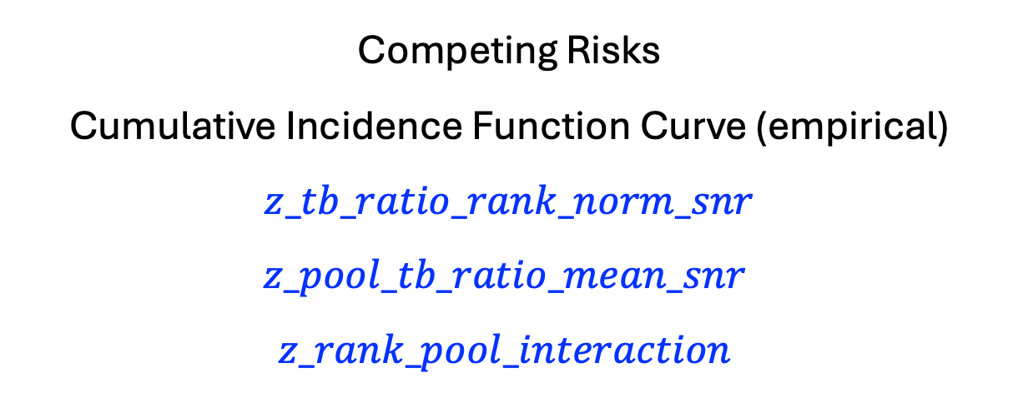
Competing Risks
Cumulative Incidence Function Curve (empirical)
$$z_tb_ratio_rank_norm_snr$$
$$z_pool_tb_ratio_mean_snr$$
$$z_rank_pool_interaction$$

Slide 17
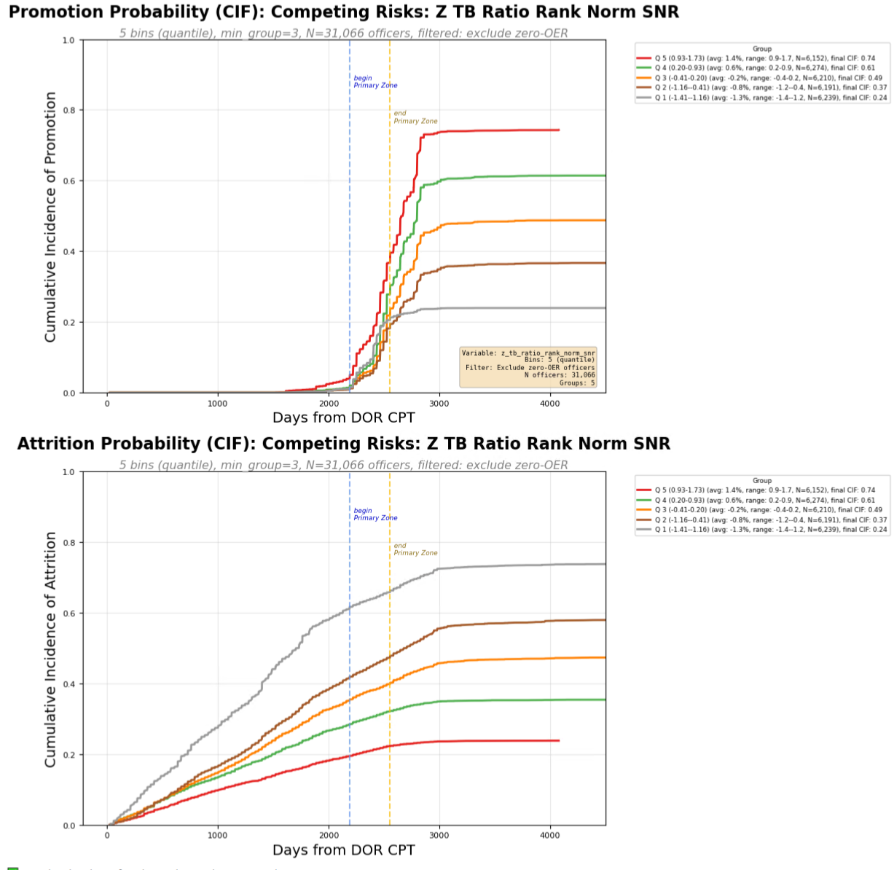
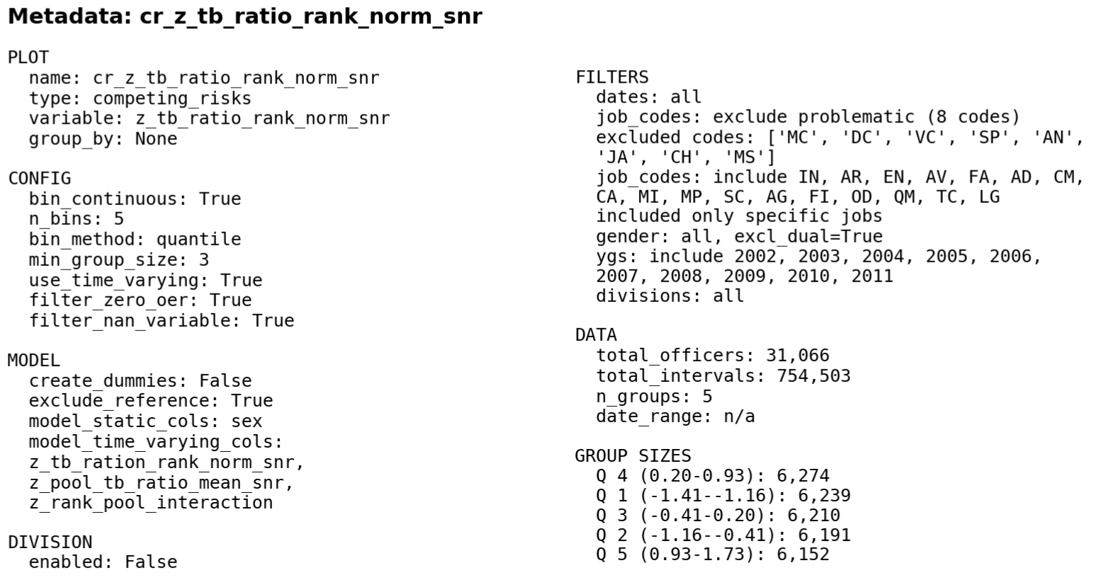
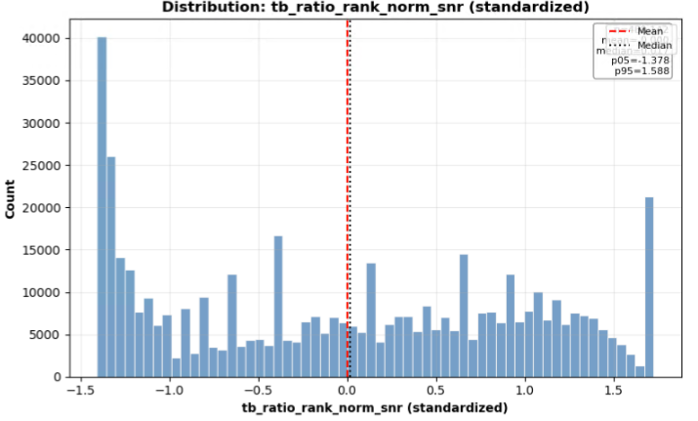

Slide 18
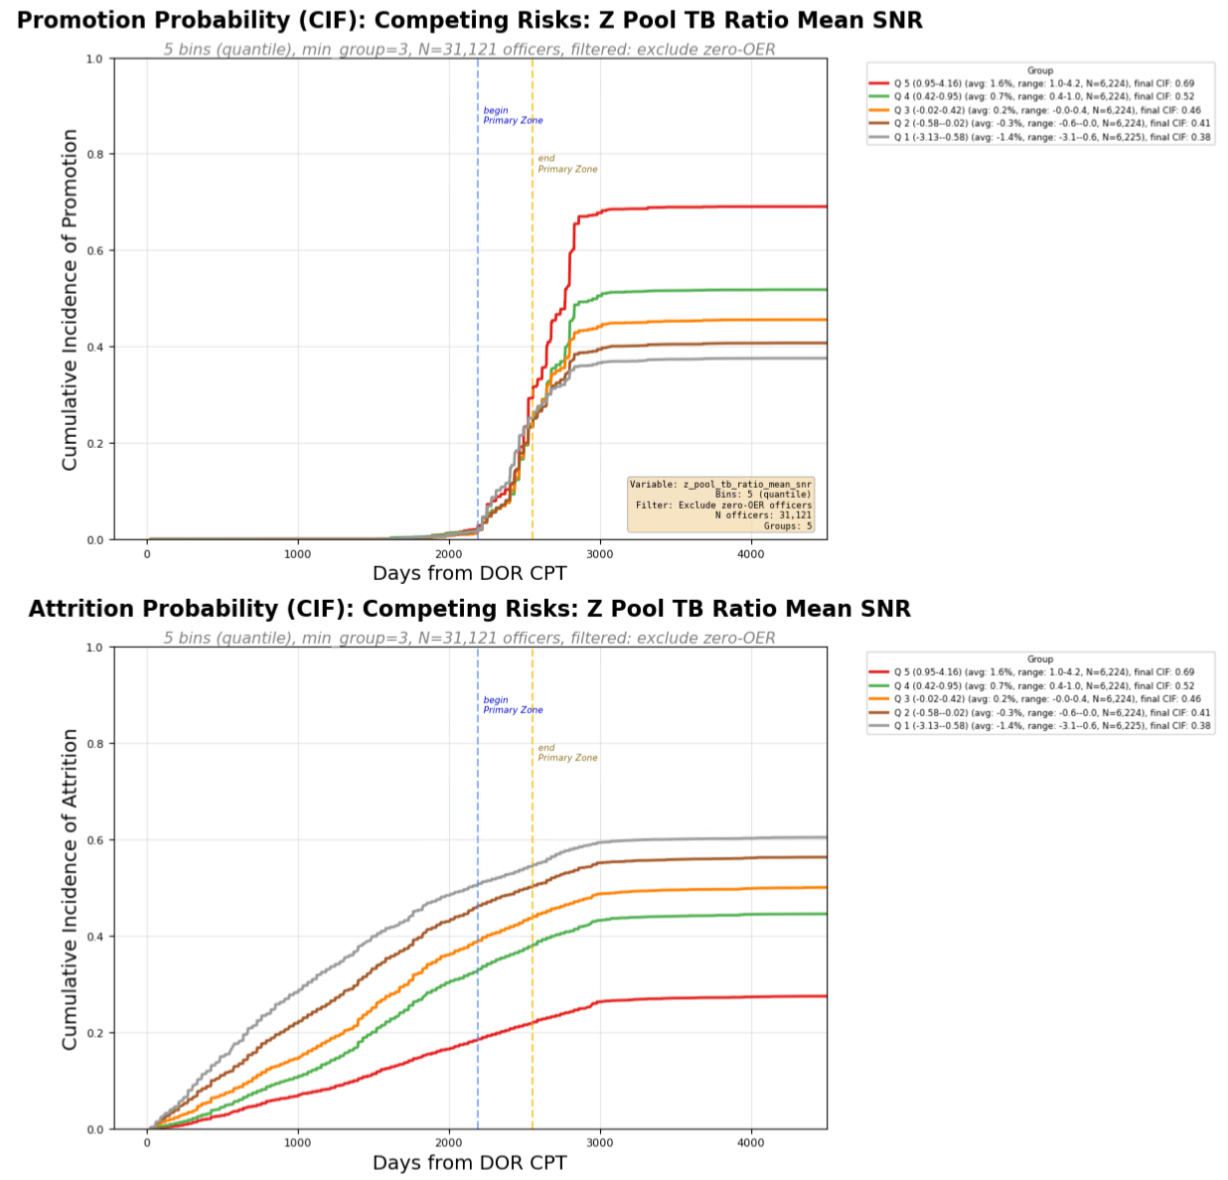
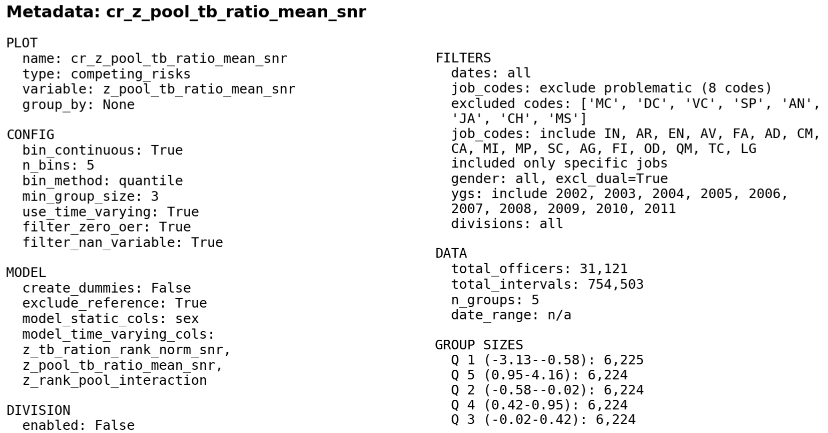
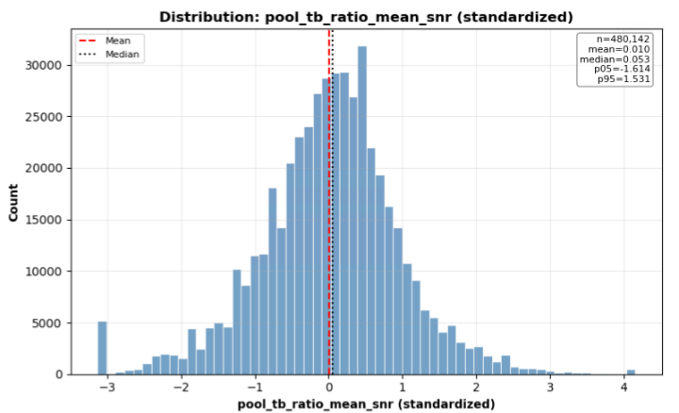

Slide 19
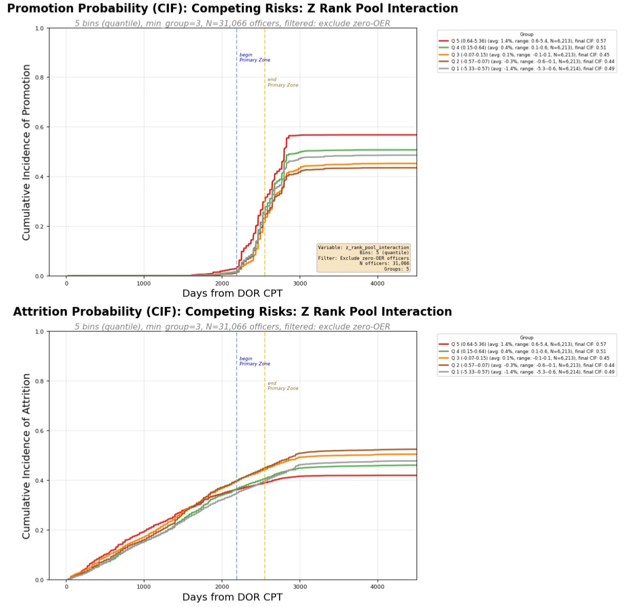
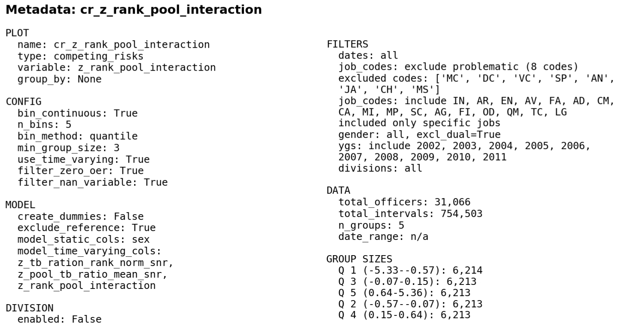

Slide 20
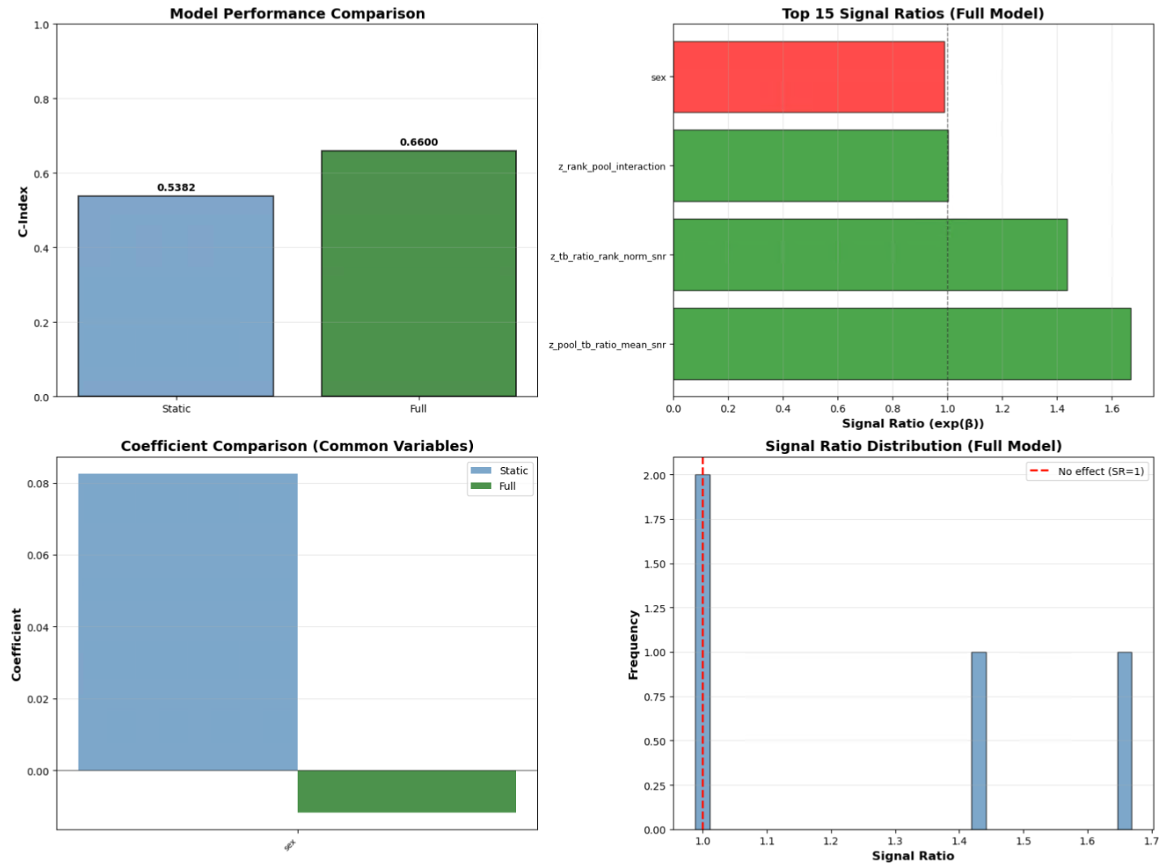

Slide 21
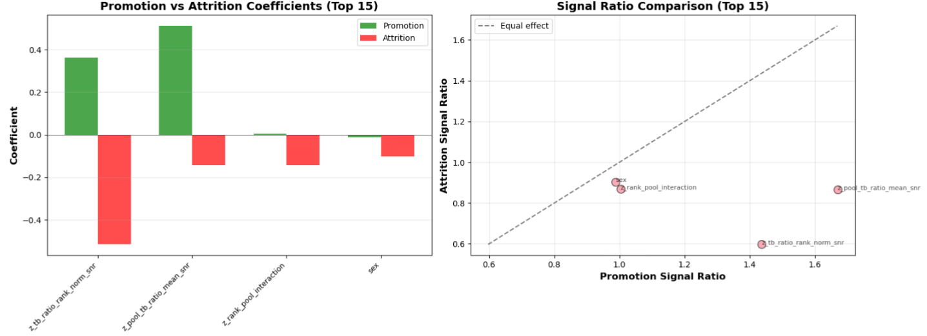

Slide 22
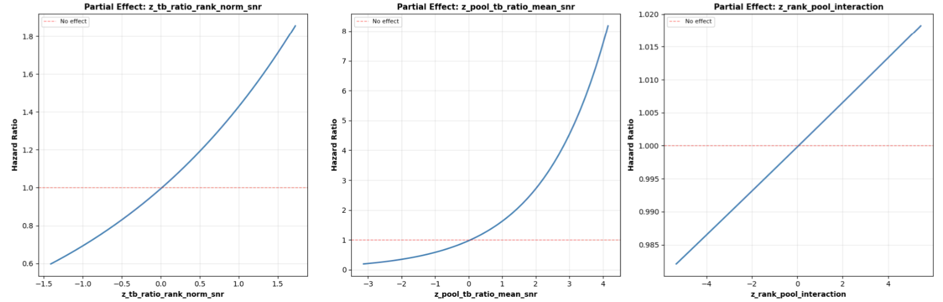

Slide 24
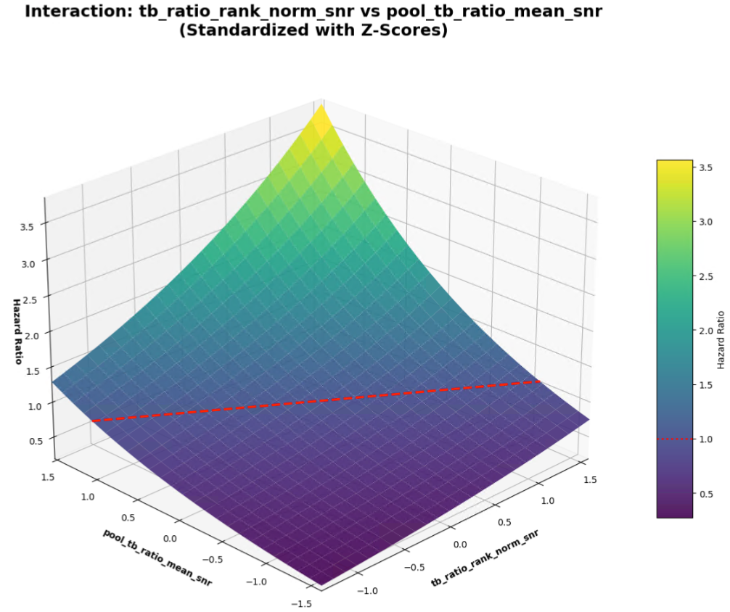

Slide 25
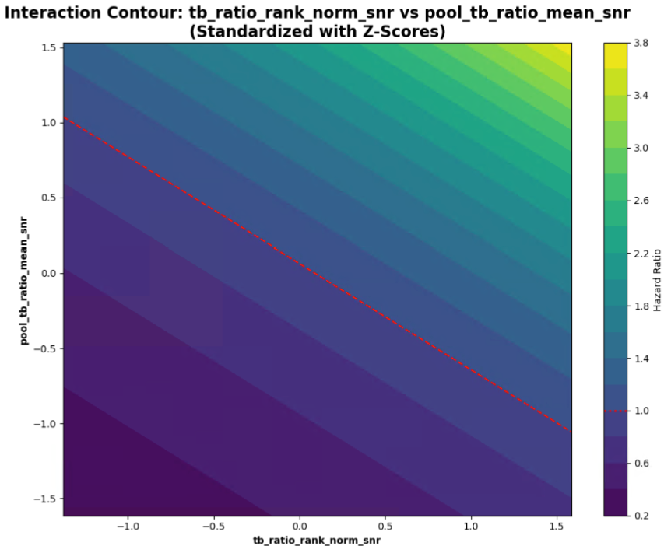

Slide 26
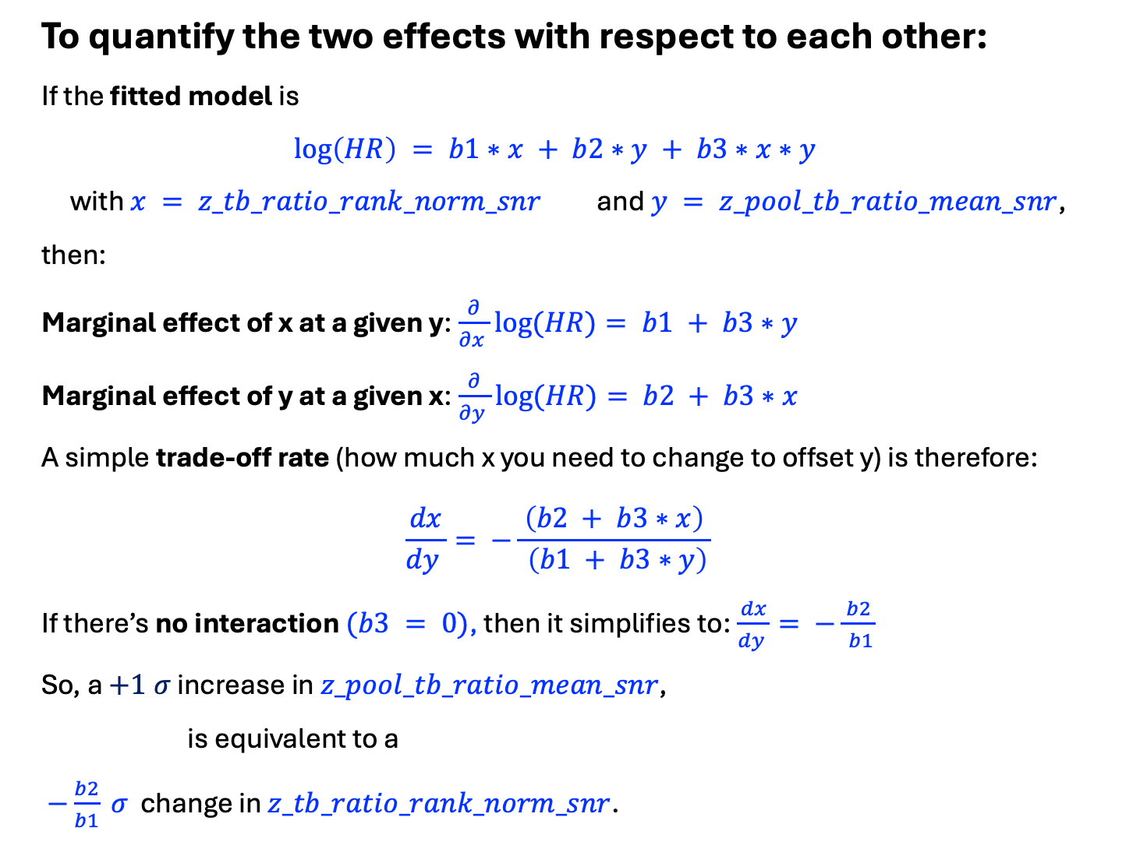
To quantify the two effects with respect to each other:
If the fitted model is
$$\log\left(HR\right) = b1∗x + b2∗y + b3∗x∗y$$
with $x = z_tb_ratio_rank_norm_snr$ and $y = z_pool_tb_ratio_mean_snr$,
then:
Marginal effect of x at a given y:$\frac{∂}{∂x }log⁡(HR)= b1 + b3∗y$
Marginal effect of y at a given x:$\frac{∂}{∂y }log⁡(HR)= b2 + b3∗x$
A simple trade‑off rate (how much x you need to change to offset y) is therefore:
$$\frac{dx}{dy }= −\frac{ \left(b2 + b3∗x\right) }{ \left(b1 + b3∗y\right)}$$
If there’s no interaction $(b3 = 0)$, then it simplifies to:$\frac{dx}{dy }= −\frac{ b2 }{ b1}$
So, a $+1 σ$ increase in $z_pool_tb_ratio_mean_snr$,
is equivalent to a
$−\frac{b2}{b1} σ$ change in $z_tb_ratio_rank_norm_snr$.

Slide 27
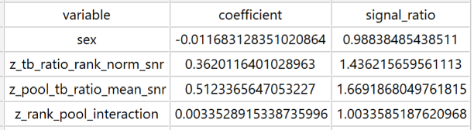
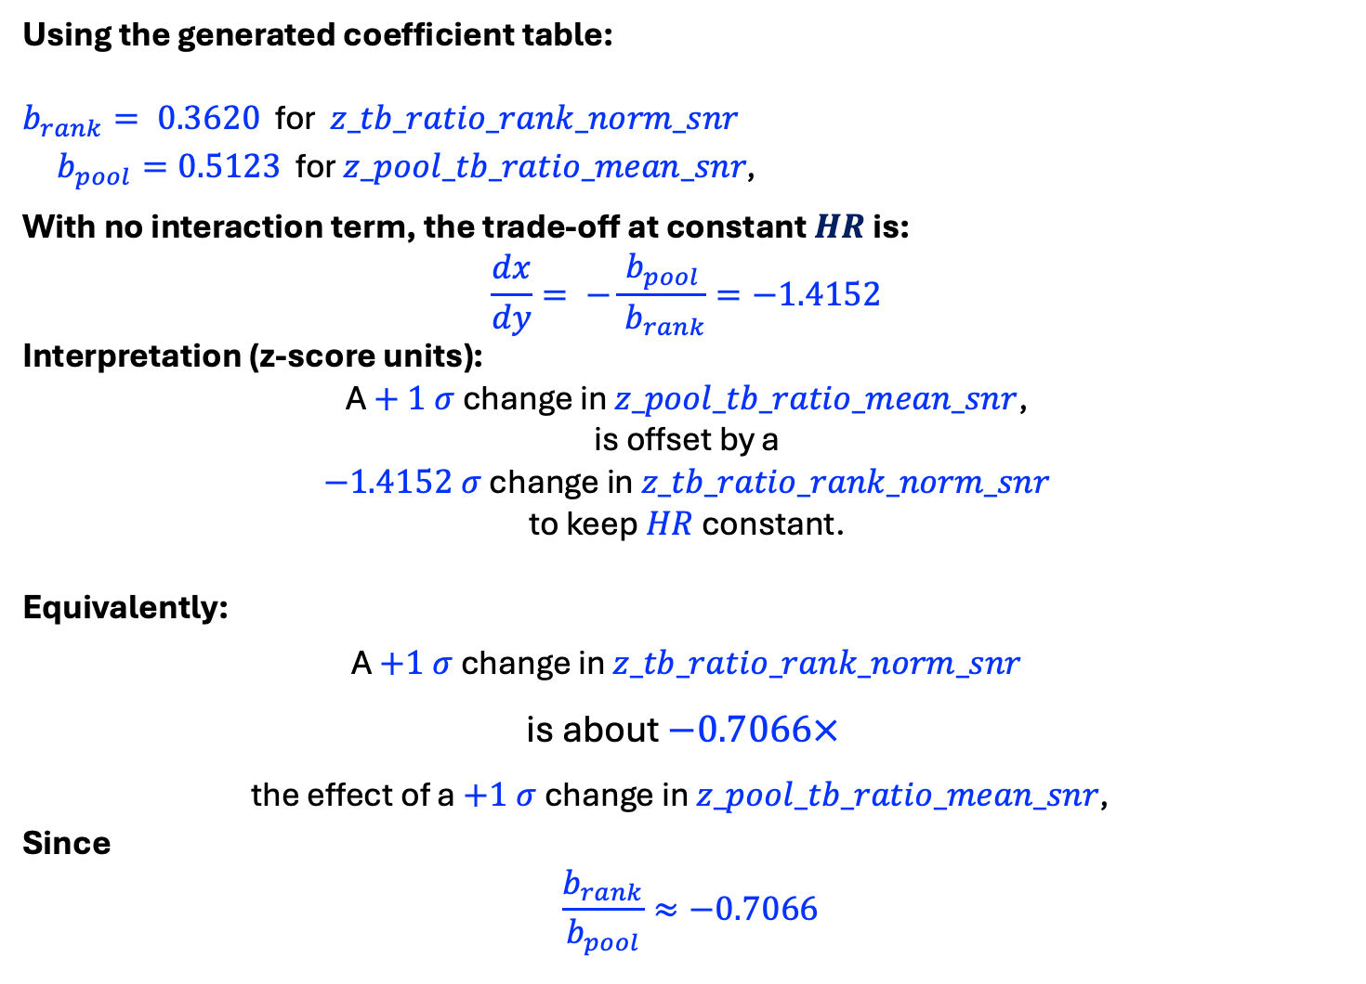
Using the generated coefficient table:
$b_{rank}= 0.3620$ for $z_tb_ratio_rank_norm_snr$
$b_{pool}=0.5123$ for $z_pool_tb_ratio_mean_snr\text{, }$
With no interaction term, the trade‑off at constant $HR$ is:
$$\frac{dx}{dy}= −\frac{ b_{pool }}{ b_{rank}}=−1.4152$$
Interpretation (z‑score units):
A $+ 1 σ$ change in $z_pool_tb_ratio_mean_snr$,
is offset by a
$−1.4152 σ$ change in $z_tb_ratio_rank_norm_snr$
to keep $HR$ constant.
Equivalently:
A $+1 σ$ change in $z_tb_ratio_rank_norm_snr$
is about $−0.7066×$
the effect of a $+1 σ$ change in $z_pool_tb_ratio_mean_snr\text{, }$
Since
$$\frac{b_{rank}}{b_{pool}}≈−0.7066$$

Slide 28
RUN 9 - Using
z_prestige_mean
z_cum_tb_rcvd_ratio_snr
z_prestige_tb_interaction
With Ygs 2002-2011, IN, AR, FA Only

Slide 29
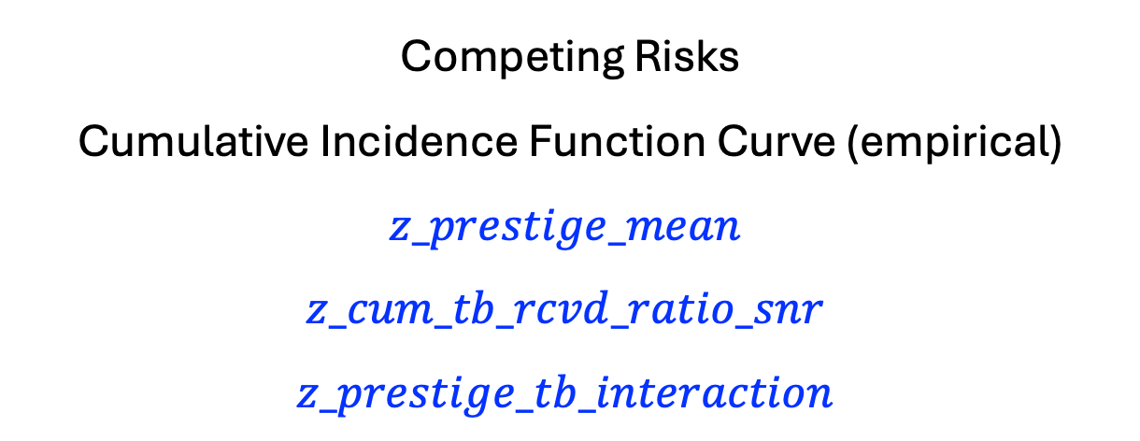
Competing Risks
Cumulative Incidence Function Curve (empirical)
$$z_prestige_mean$$
$$z_cum_tb_rcvd_ratio_snr$$
$$z_prestige_tb_interaction$$

Slide 30
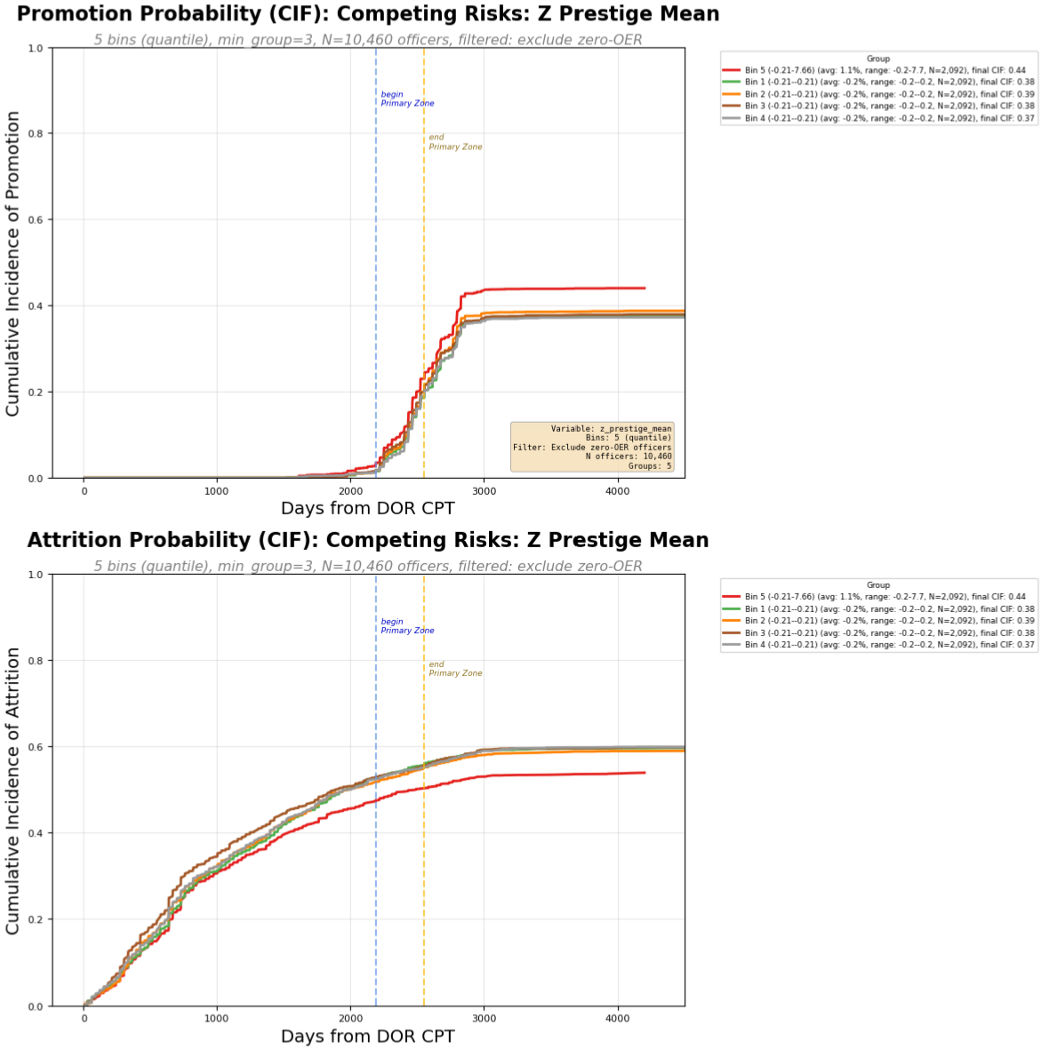
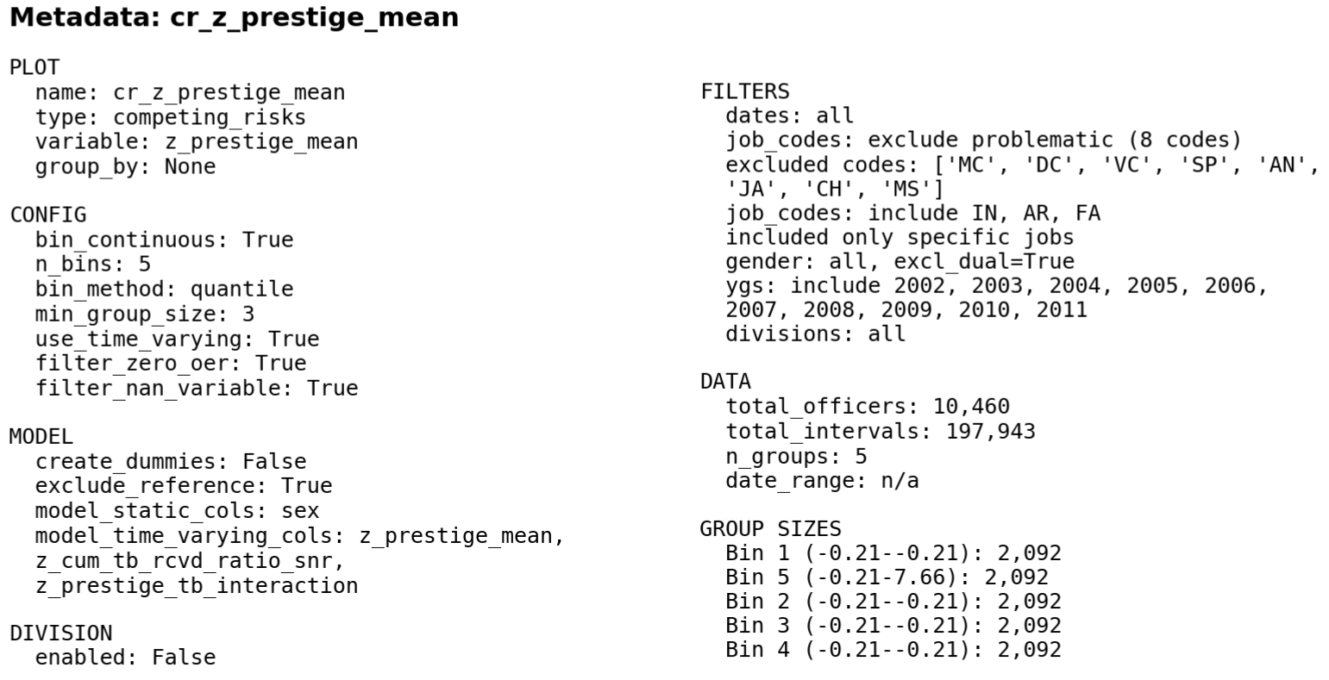
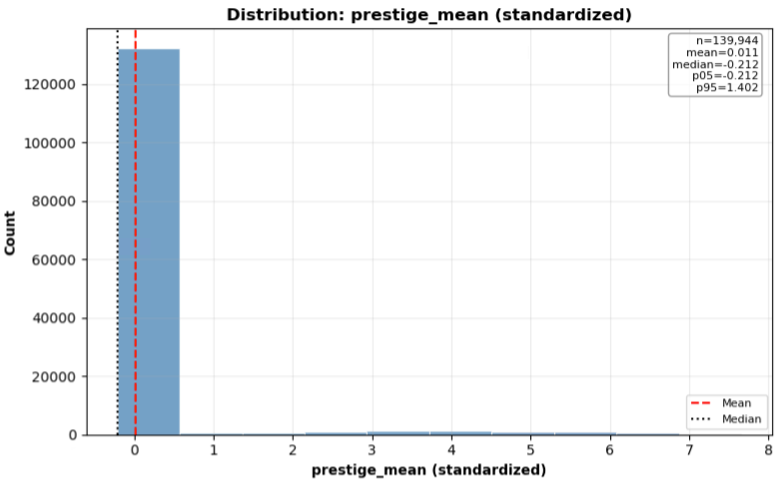

Slide 31
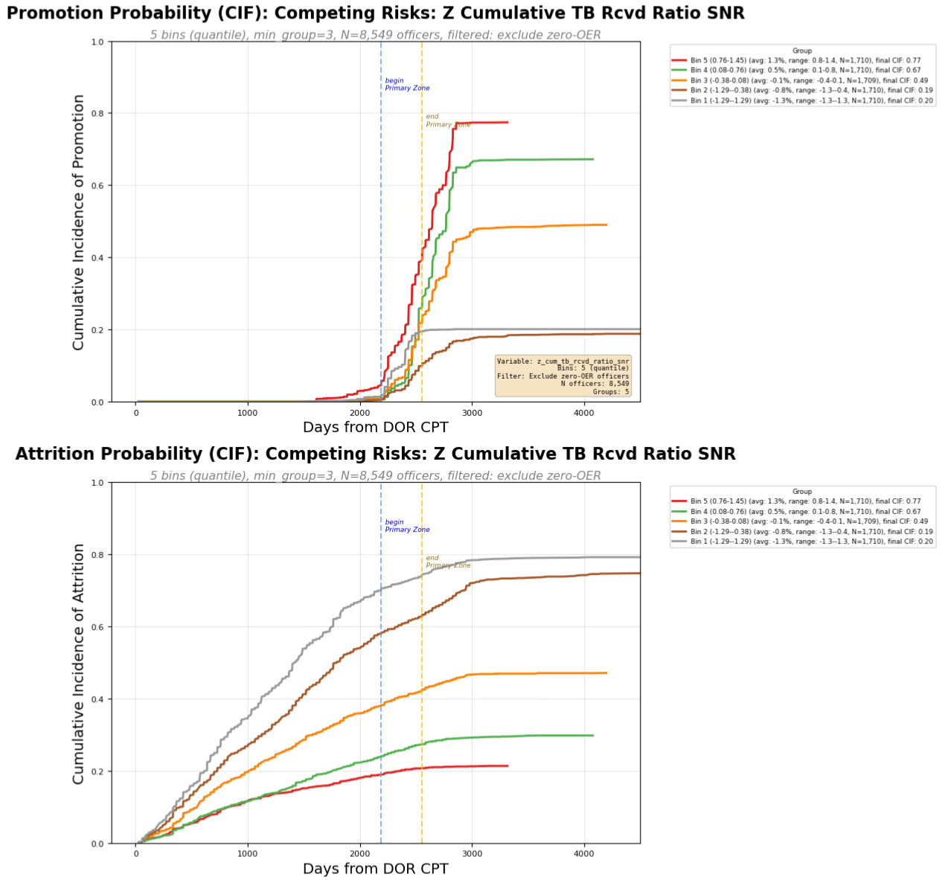
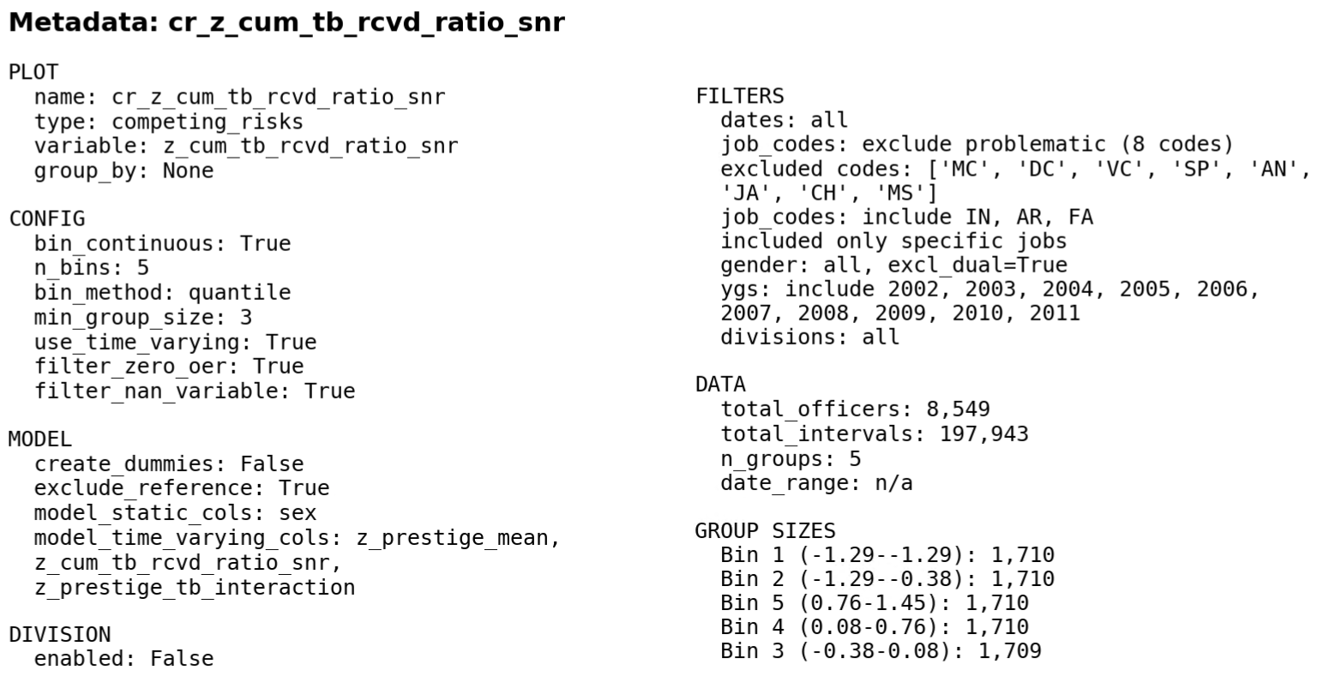
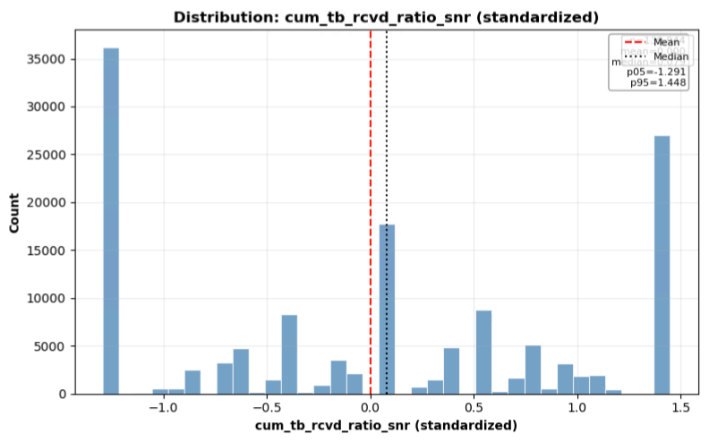

Slide 32
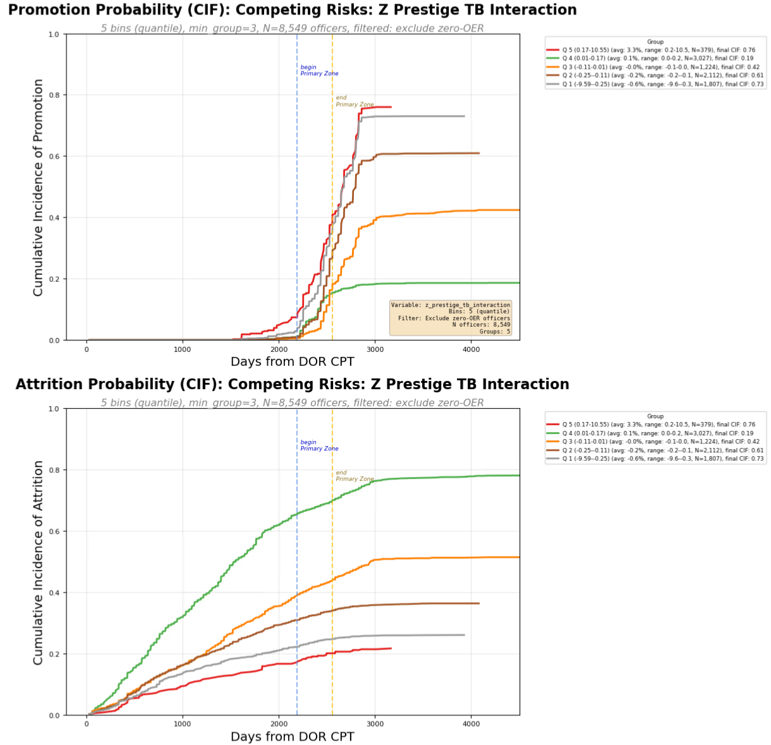
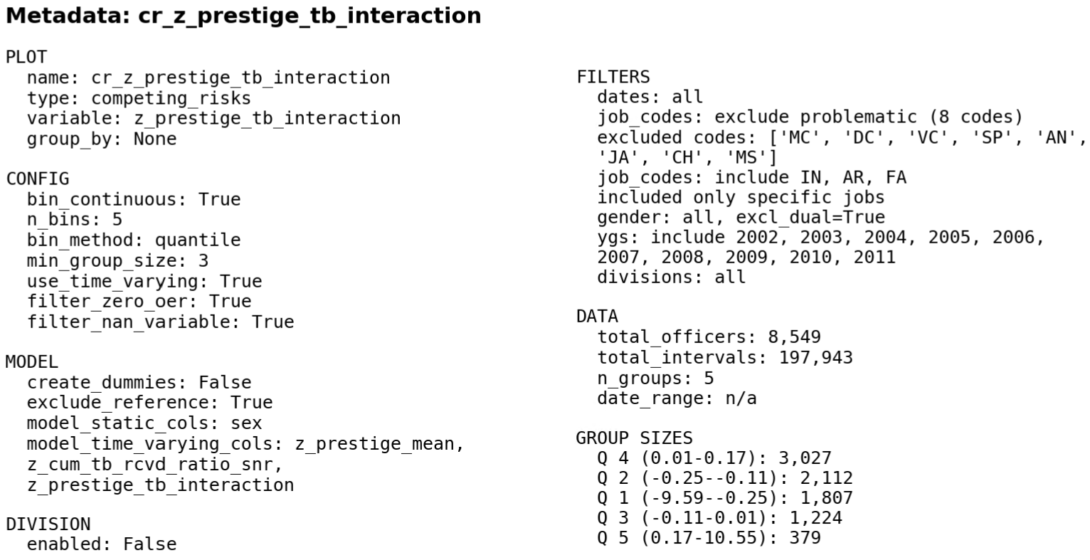

Slide 33
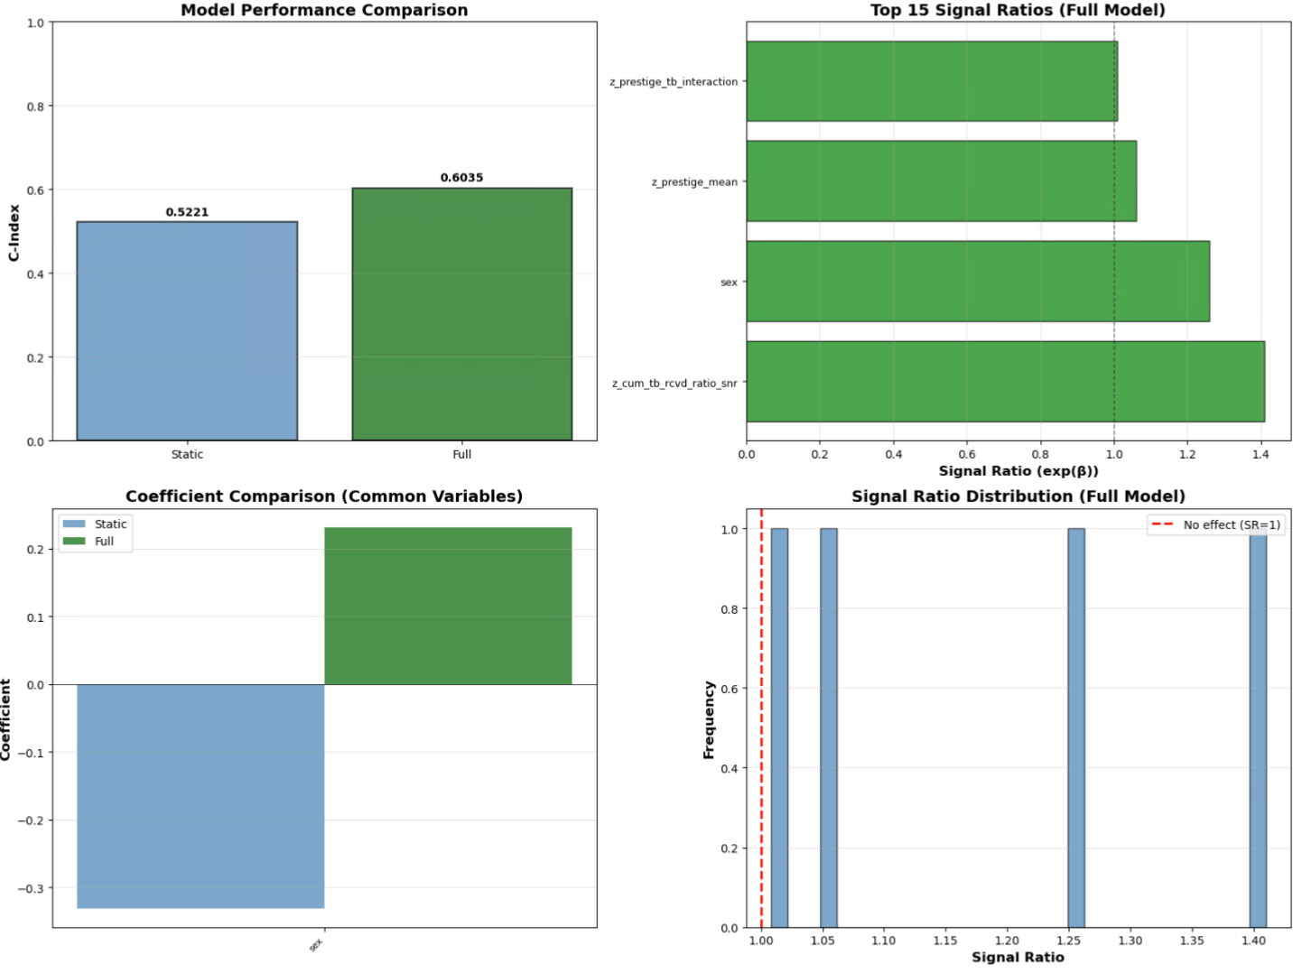

Slide 34
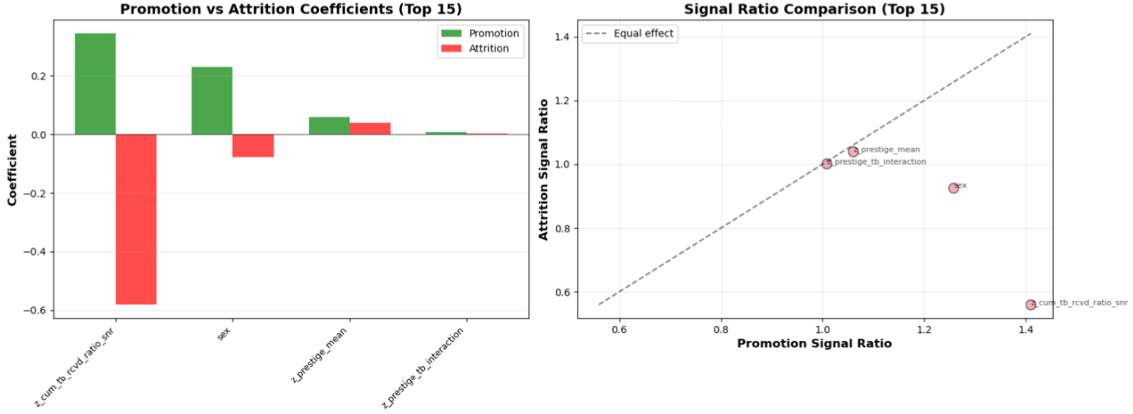

Slide 35
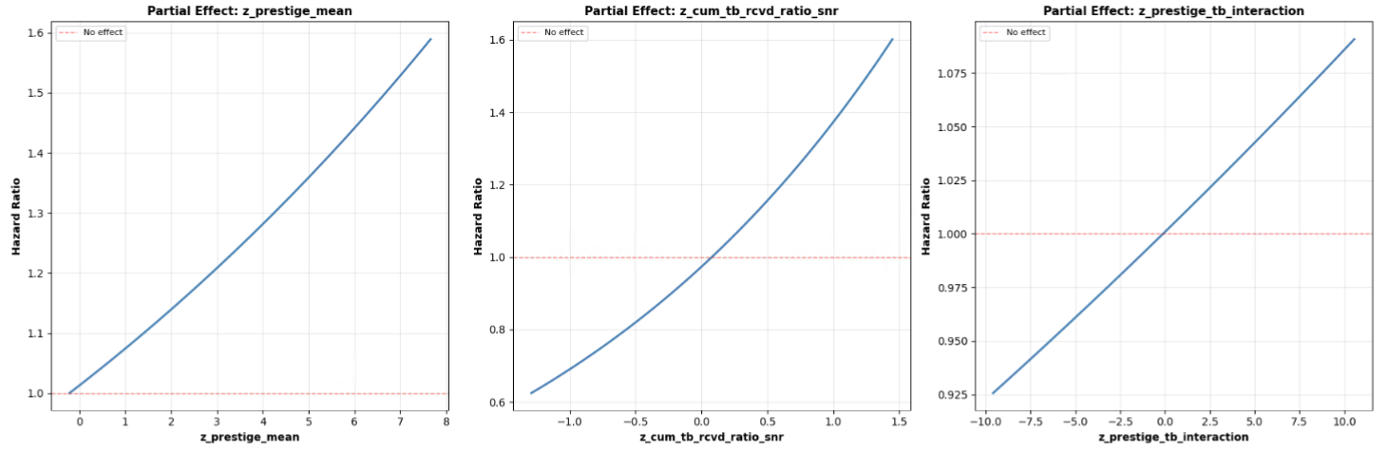

Slide 36
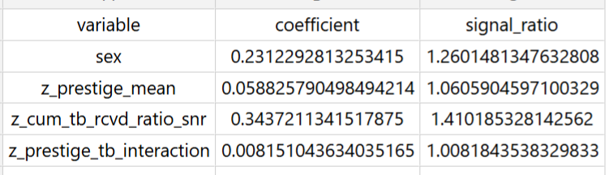


Slide 37
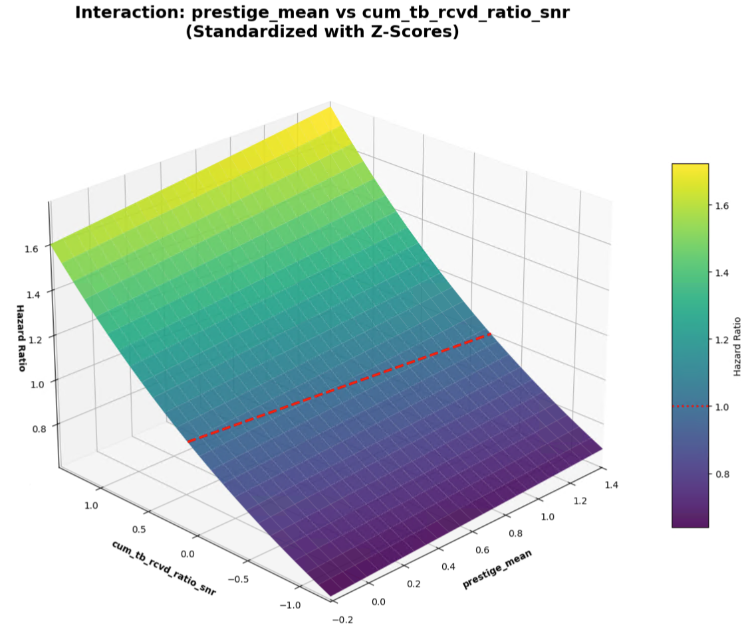

Slide 38
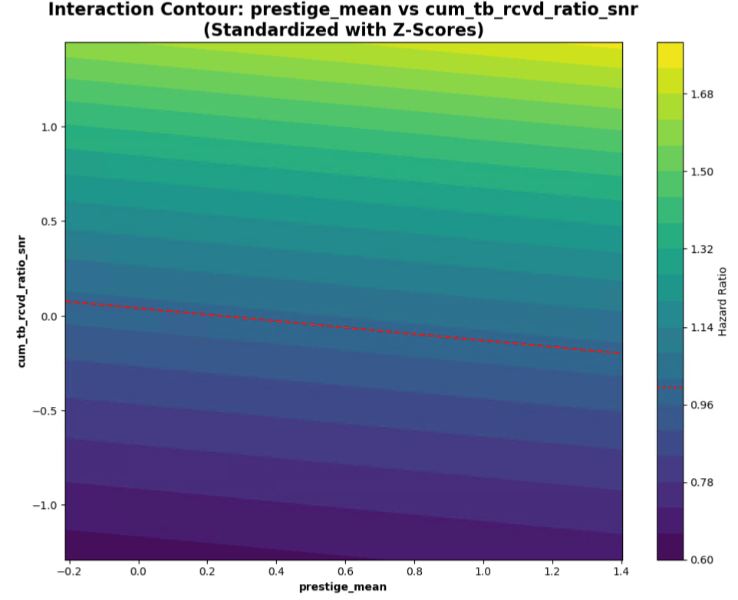

Slide 39
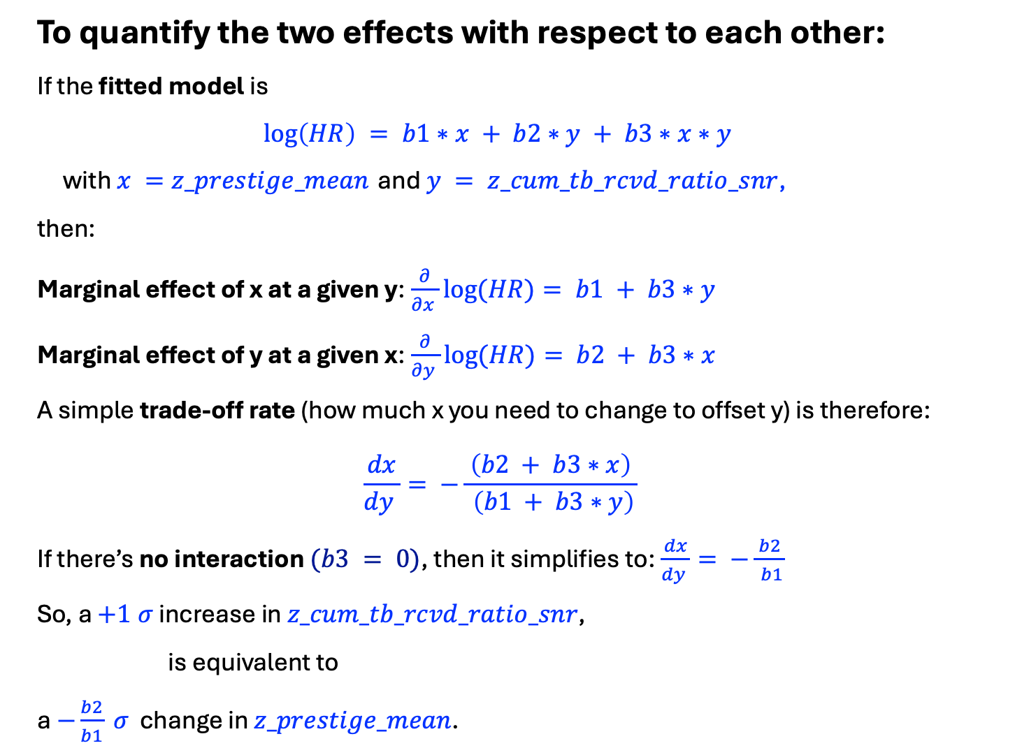
To quantify the two effects with respect to each other:
If the fitted model is
$$\log\left(HR\right) = b1∗x + b2∗y + b3∗x∗y$$
with $x =z_prestige_mean$ and $y = z_cum_tb_rcvd_ratio_snr$,
then:
Marginal effect of x at a given y:$\frac{∂}{∂x }log⁡(HR)= b1 + b3∗y$
Marginal effect of y at a given x:$\frac{∂}{∂y }log⁡(HR)= b2 + b3∗x$
A simple trade‑off rate (how much x you need to change to offset y) is therefore:
$$\frac{dx}{dy }= −\frac{ \left(b2 + b3∗x\right) }{ \left(b1 + b3∗y\right)}$$
If there’s no interaction $(b3 = 0)$, then it simplifies to:$\frac{dx}{dy }= −\frac{ b2 }{ b1}$
So, a $+1 σ$ increase in $z_cum_tb_rcvd_ratio_snr$,
is equivalent to
a $−\frac{b2}{b1} σ$ change in $z_prestige_mean$.

Slide 40

Using the generated coefficient table:
$b_{prestige}= 0.05883$ for $z_prestige_mean$
$b_{cum}=0.3437$ for $z_pool_tb_ratio_mean_snr\text{, }$
With no interaction term, the trade‑off at constant $HR$ is:
$$\frac{dx}{dy}= −\frac{ b_{cum }}{ b_{prestige}}=−5.8430$$
Interpretation (z‑score units):
A $+ 1 σ$ change in $z_cum_tb_rcvd_ratio_snr$,
is offset by a
$−5.8430 σ$ change in $z_prestige_mean$
to keep $HR$ constant.
Equivalently:
A $+1 σ$ change in $z_prestige_mean$
is about $−0. 1711 ×$
the effect of a $+1 σ$ change in $z_cum_tb_rcvd_ratio_snr\text{, }$
Since
$$\frac{b_{prestige}}{b_{cum}}≈−0.1711$$

Slide 41
RUN 3 - Using
z_prestige_mean
z_cum_tb_rcvd_ratio_snr
z_prestige_tb_interaction

Slide 42

Competing Risks
Cumulative Incidence Function Curve (empirical)
$$z_prestige_mean$$
$$z_cum_tb_rcvd_ratio_snr$$
$$z_prestige_tb_interaction$$

Slide 43




Slide 44




Slide 45



Slide 46


Slide 47


Slide 48


Slide 49



Slide 50


Slide 51


Slide 52
To quantify the two effects with respect to each other:
If the fitted model is
$$\log\left(HR\right) = b1∗x + b2∗y + b3∗x∗y$$
with $x =z_prestige_mean$ and $y = z_cum_tb_rcvd_ratio_snr$,
then:
Marginal effect of x at a given y:$\frac{∂}{∂x }log⁡(HR)= b1 + b3∗y$
Marginal effect of y at a given x:$\frac{∂}{∂y }log⁡(HR)= b2 + b3∗x$
A simple trade‑off rate (how much x you need to change to offset y) is therefore:
$$\frac{dx}{dy }= −\frac{ \left(b2 + b3∗x\right) }{ \left(b1 + b3∗y\right)}$$
If there’s no interaction $(b3 = 0)$, then it simplifies to:$\frac{dx}{dy }= −\frac{ b2 }{ b1}$
So, a $+1 σ$ increase in $z_cum_tb_rcvd_ratio_snr$,
is equivalent to
a $−\frac{b2}{b1} σ$ change in $z_prestige_mean$.

Slide 53


Using the generated coefficient table:
$b_{prestige}= 0.08717$ for $z_prestige_mean$
$b_{cum}=0.3186$ for $z_pool_tb_ratio_mean_snr\text{, }$
With no interaction term, the trade‑off at constant $HR$ is:
$$\frac{dx}{dy}= −\frac{ b_{cum }}{ b_{prestige}}=−3.6548$$
Interpretation (z‑score units):
A $+ 1 σ$ change in $z_cum_tb_rcvd_ratio_snr$,
is offset by a
$−3.6548 σ$ change in $z_prestige_mean$
to keep $HR$ constant.
Equivalently:
A $+1 σ$ change in $z_prestige_mean$
is about $−0. 2736×$
the effect of a $+1 σ$ change in $z_cum_tb_rcvd_ratio_snr\text{, }$
Since
$$\frac{b_{prestige}}{b_{cum}}≈−0.2736$$

Slide 54
RUN 4 - Using
z_prestige_mean
z_cum_tb_rcvd_ratio_snr
z_prestige_tb_interaction
With just YGs 2002-2006

Slide 55
Competing Risks
Cumulative Incidence Function Curve (empirical)
$$z_prestige_mean$$
$$z_cum_tb_rcvd_ratio_snr$$
$$z_prestige_tb_interaction$$

Slide 62


Slide 65
To quantify the two effects with respect to each other:
If the fitted model is
$$\log\left(HR\right) = b1∗x + b2∗y + b3∗x∗y$$
with $x =z_prestige_mean$ and $y = z_cum_tb_rcvd_ratio_snr$,
then:
Marginal effect of x at a given y:$\frac{∂}{∂x }log⁡(HR)= b1 + b3∗y$
Marginal effect of y at a given x:$\frac{∂}{∂y }log⁡(HR)= b2 + b3∗x$
A simple trade‑off rate (how much x you need to change to offset y) is therefore:
$$\frac{dx}{dy }= −\frac{ \left(b2 + b3∗x\right) }{ \left(b1 + b3∗y\right)}$$
If there’s no interaction $(b3 = 0)$, then it simplifies to:$\frac{dx}{dy }= −\frac{ b2 }{ b1}$
So, a $+1 σ$ increase in $z_cum_tb_rcvd_ratio_snr$,
is equivalent to
a $−\frac{b2}{b1} σ$ change in $z_prestige_mean$.

Slide 66
Using the generated coefficient table:
$b_{prestige}= 0.08717$ for $z_prestige_mean$
$b_{cum}=0.3186$ for $z_pool_tb_ratio_mean_snr\text{, }$
With no interaction term, the trade‑off at constant $HR$ is:
$$\frac{dx}{dy}= −\frac{ b_{cum }}{ b_{prestige}}=−3.6548$$
Interpretation (z‑score units):
A $+ 1 σ$ change in $z_cum_tb_rcvd_ratio_snr$,
is offset by a
$−3.6548 σ$ change in $z_prestige_mean$
to keep $HR$ constant.
Equivalently:
A $+1 σ$ change in $z_prestige_mean$
is about $−0. 2736×$
the effect of a $+1 σ$ change in $z_cum_tb_rcvd_ratio_snr\text{, }$
Since
$$\frac{b_{prestige}}{b_{cum}}≈−0.2736$$

Slide 67



2002-2011 IN only
2002-2011 CS + CSS only
2002-2011 IN only
2002-2011 IN only

