Slide 1
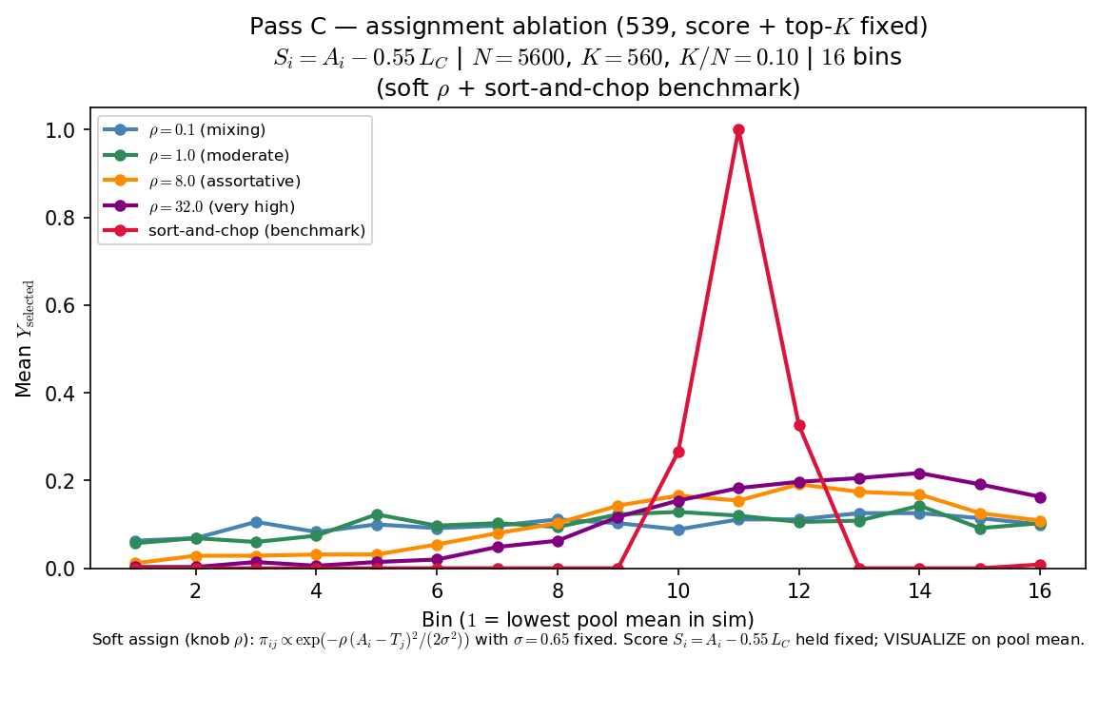
Phase B — Characterize ρ (assignment assortativity) — sort-and-chop shown
Characterize ρ — one-at-a-time at 539 baseline (score + top-K fixed)
ASSIGN (knob ρ) — LaTeX:
\pi_{ij} \propto \exp\left(-\rho \cdot \frac{(A_i-T_j)^2}{2\sigma^2}\right)
σ=0.65 fixed
arms: ρ ∈ {0.1, 1, 8, 32} + sort-and-chop
S_{i} = A_{i} - 0.55 · L_{C} (crowding in score held constant across arms)
top-K by S_{i}
VISUALIZE = mean Y_{selected} vs pool mean (16 bins)
OAT: one draw of A_{i}, T_{j} (seed 42); only ASSIGN changes across arms.
Low ρ: players mix across teams — selection vs pool mean stays nearly flat.
High ρ: assortative matching — peer environments concentrate; inverted-U emerges.
Sort-and-chop benchmark: hard rank match (same score rule as soft arms).
Claim: at fixed score and top-K, ρ in assignment matters — low-ρ mixing yields a nearly flat curve; high-ρ assortativity delivers the peer-pressure inverted-U readout.

Slide 2
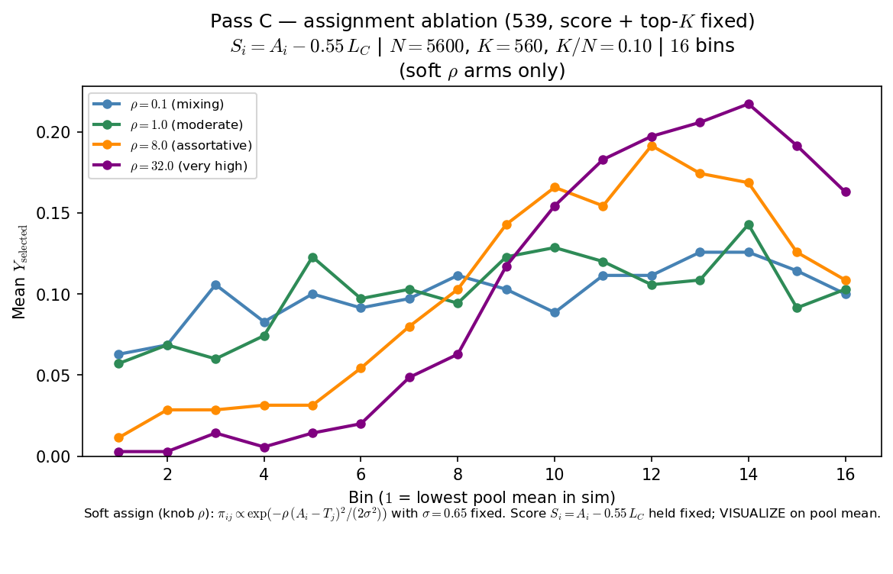
Phase B — Characterize ρ (assignment assortativity) — sort-and-chop suppressed
Characterize ρ — one-at-a-time at 539 baseline (score + top-K fixed)
ASSIGN (knob ρ) — LaTeX:
\pi_{ij} \propto \exp\left(-\rho \cdot \frac{(A_i-T_j)^2}{2\sigma^2}\right)
σ=0.65 fixed
arms: ρ ∈ {0.1, 1, 8, 32}
S_{i} = A_{i} - 0.55 · L_{C} (crowding in score held constant across arms)
top-K by S_{i}
VISUALIZE = mean Y_{selected} vs pool mean (16 bins)
OAT: one draw of A_{i}, T_{j} (seed 42); only ASSIGN changes across arms.
Low ρ: players mix across teams — selection vs pool mean stays nearly flat.
High ρ: assortative matching — peer environments concentrate; inverted-U emerges.
Sort-and-chop arm omitted from plot (still in CSV bundle; toggle restores it).
Claim: at fixed score and top-K, ρ in assignment matters — low-ρ mixing yields a nearly flat curve; high-ρ assortativity delivers the peer-pressure inverted-U readout.

