Slide 1
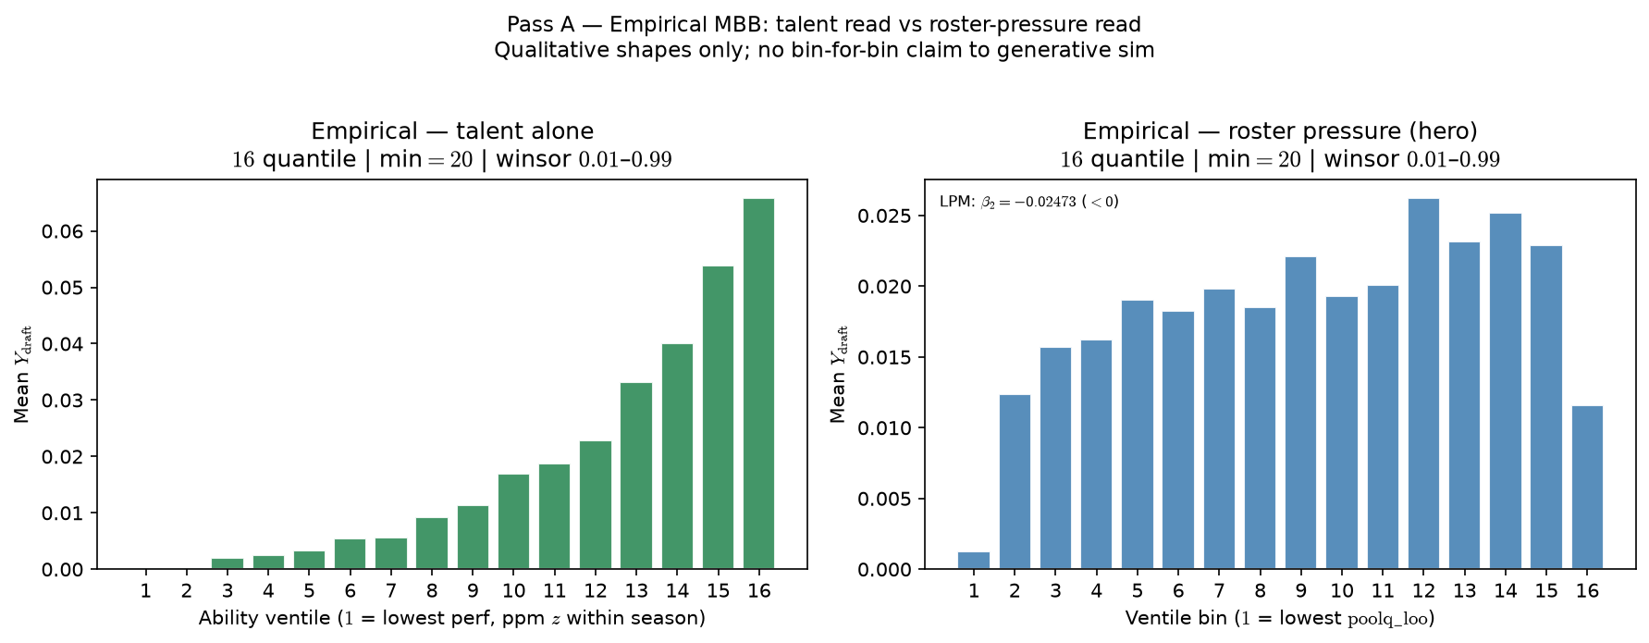
Pass A — Empirical MBB: Roster Pressure in the Data
Real NCAA panel (2011–2021): mean NBA draft rate by ventile.
Left — talent alone: ability (ppm z within season). Monotone up.
Right — roster context: leave-one-out teammate quality (poolq\_{l}oo). Inverted-U.
No λ in the empirical story — stylized fact Pass B/C echo.
Pipeline: VISUALIZE only (bin real Y_{draft} on ability | poolq\_{l}oo).
Assign arrow Score arrow Select in the real world; we read outcomes only.

Slide 2
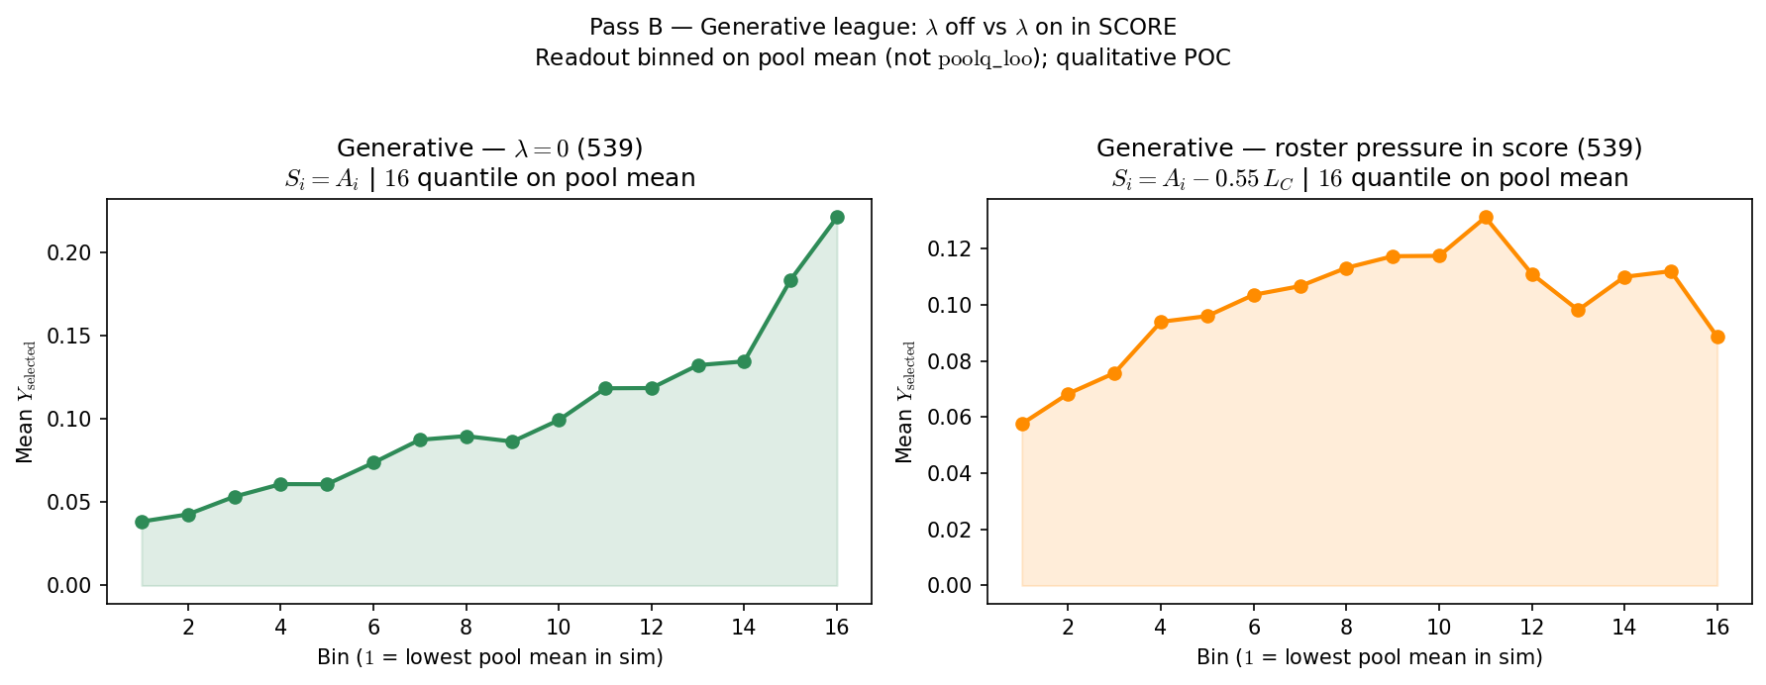
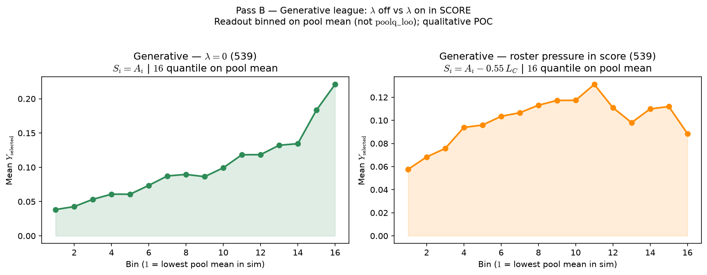
Pass B — Generative: Congestion in Score Bends the Curve
Synthetic league: ASSIGN arrow SCORE arrow SELECT arrow VISUALIZE (539 preset).
Left — λ = 0: score S_{i} = A_{i} only (talent-only ranking). Roughly monotone.
Right — λ > 0: score S_{i} = A_{i} - w · L_{C} (viable-peer congestion in SCORE).
VISUALIZE on pool mean (team ability, includes self) — not poolq\_{l}oo.
Claim: roster pressure in the advancement rule bends the curve (qualitative POC).
Pass B knob: λ / w in SCORE. Does not vary assignment ρ.

Slide 3
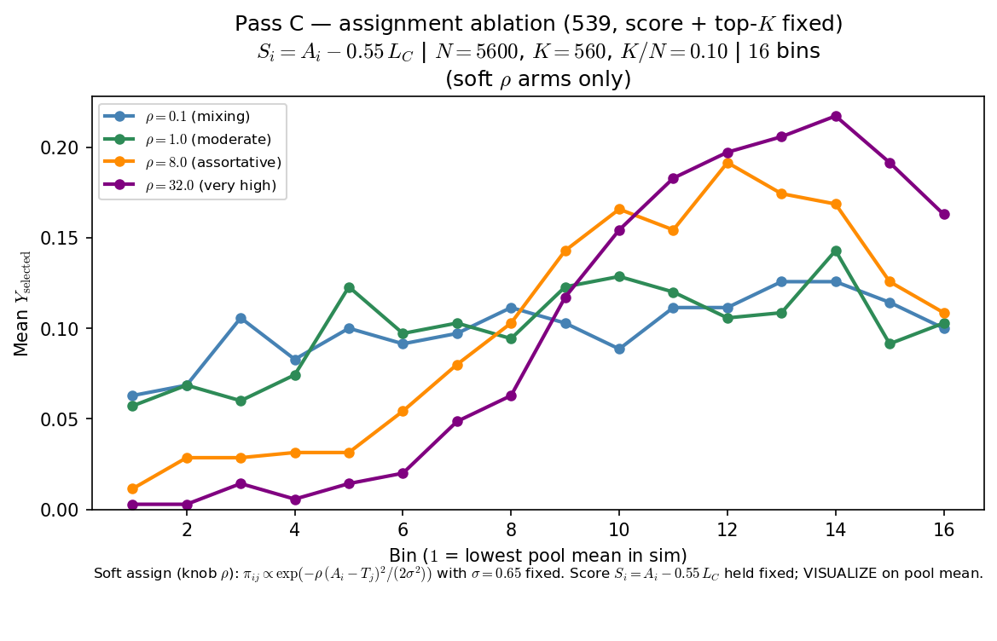
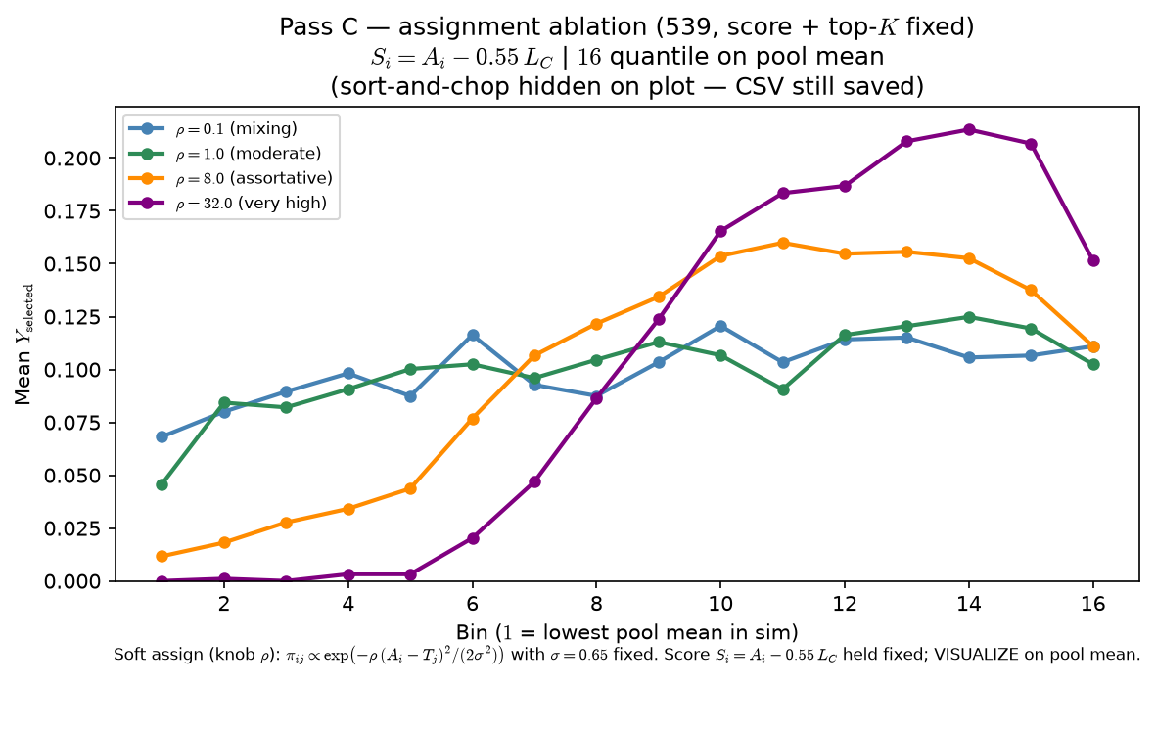
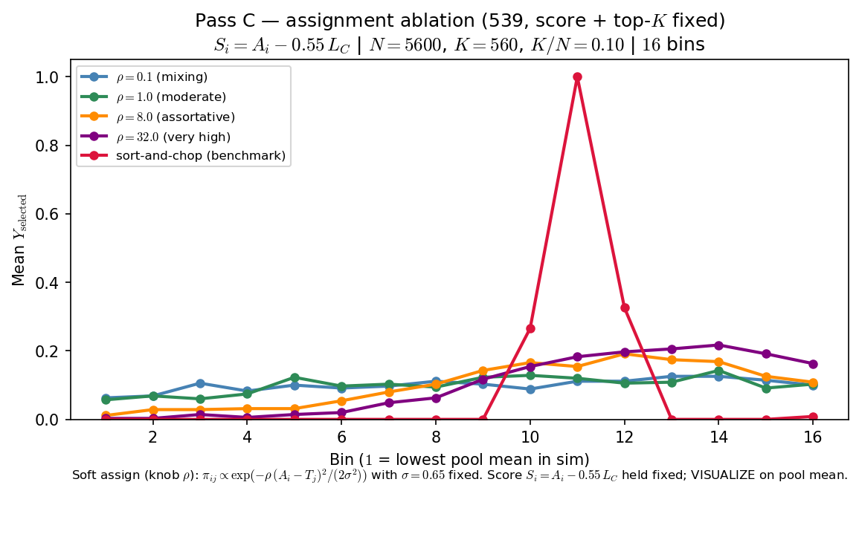
Pass C — Generative: Assortativity Shapes the Sorted World
Same 539 score as Pass B right arm — S_{i} = A_{i} - w · L_{C} held fixed.
One draw of talent; only ASSIGN changes (soft ρ ladder + sort-and-chop).
ρ controls how sharply players match team targets — roster sorting.
VISUALIZE on pool mean: assortativity moves the inverted-U readout.
Story: λ puts roster pressure in score; ρ delivers pressured environments.
Pass C knob: ρ in ASSIGN. Score + top-K fixed across arms.

Slide 4
MODEL FOUR STEP PROCESS:
Assignment to pools $(ρ, A_{i})$.
Selection Scoring $\left(S_{i}\right)$
Selection - select top $K$.
Visualize – bin and plot.
1. Soft Assignment
3. Selection
$$π_{ij}∝ e^{\left(−ρ∙\frac{{\left(A_{i}−T_{j}\right)}^{2}}{2σ^{2}}\right)}$$
$π_{ij}→$ Soft preference of player $i$ for team $j$ before we normalize to probabilities and fill seats
$T_{j}→$ Team target PoolQ, \rho ->. Assortativity knob
$σ →$ Fixed length-scale in ability units (default$\sim 0.65$)
The current trivial method is just to choose the top $K$ players by $S_{i}$
Future methods could introduce stochastic noise $S_{i}+ δ$
4. Visualize
TALENT vs SELECTION
2. Unified Selection Score Equation
$S_{i}=A_{i}+λ(B−D)$
$S_{i}=$selection score
$A_{i}=$individual performance metric
$λ=$ environmental weight
environmental impact
$L_{net}=B−D$ ($B≈$ benefits, $D≈$ drawbacks)
Naïve (empirical)
HERO (empirical)
$$P(Y_{i}=1|A_{i})$$
$$P(Y_{i}=1|A_{i})$$
$$A_{i}$$
$$PoolQ LOO$$
Congestion Equation v1
$\left(B−D\right)=−L_{C}$ (congestion)
$$S_{i}=A_{i}−λ L_{C}$$
Knockout (sim): $λ = 0 ⇒S_{i}=A_{i}$ (congestion out of selection)
$L_{C}$(hard) $→$ count with $A_{j}>θ$
$θ=\operatorname{med}\left({\text{A}}_{i}∣Y_{i}=1\right)$
$L_{C}$ (smooth, sim default) $→$ LOO mean of $σ\left(γ\left(A_{j}−θ\right)\right)$ $j≠i$
Empirical (real panel)
Naïve: $P\left(Y_{i}=1|A_{i}\right) →$ $≈$ monotone Hero: $P\left(Y_{i}=1|PoolQ_LOO\right) →$ tail dip

