Slide 1
Phase B — Fake-league characterization (not curve fitting)
Knobs (mini glossary)
How to read this deck
Symbol | Plain name | What it controls
A_{i} | Player ability | Innate talent draw — Beta(2,2) on [0,1] (539 preset)
T_{j^*} | Sim assignment target | Synthetic iid Uniform[0,1] per team; soft-assign attractor — not realized roster talent
T_{j} | Realized team talent | Mean A_{i} on team j roster after ASSIGN (not T_{j^*})
\rho | Assignment assortativity | Soft match strength: players \rightarrow teams with T_{j^*} \approx A_{i}
L_C | Team congestion | Team-level mean \sigma(\gamma(A_{j}-\theta)) on roster — same L_C for all players on team j
\lambda | Congestion weight in score | How hard L_C penalizes ranking — not congestion itself
\theta | Viability cutline | Center of the sigmoid (F_A^{-1}(1-K/N) in k_over_n mode)
\gamma | Sigmoid sharpness | Steepness of viability step around \theta
K/N | Selectivity | Fraction of league selected (K \div N)
Not curve fitting: which rules bend synthetic selection curves — not NCAA fit yet.
Three steps: ASSIGN (\rho) \rightarrow SCORE (S_i = A_i - \lambda L_C) \rightarrow SELECT (top-K); then VISUALIZE by pool-mean bin.
L_C in this deck: team smooth (crowding_smooth_team) — mean peer viability over the full roster.
One-at-a-time (OAT): each slide moves one knob; other settings stay at benchmark values.
Seed 42 on stochastic steps: draw A_i, T_{j^*}; soft-\rho assignment. Score, top-K, bins are deterministic.
League: N=5600, K=560, K/N=10% (539 preset).
Benchmark values (while sweeping other knobs)
A_i: Beta(2,2) on [0,1] — SELECTION_539_ABILITY_DRAW
T_{j^*}: Uniform[0,1] iid per team — draw_target_means; synthetic targets, not NCAA data
T_j: realized roster mean after ASSIGN — not drawn; Sketch A 2D y-axis
\lambda=0.55 — tier1_539_reference_settings.json / playground default
\theta=0.804 — F_A^{-1}(1-K/N) (naive draft on sim draw)
\gamma=10 — 539 placeholder until lock on real rosters
\rho=8 — gallery fixed assign for \lambda / \theta slides (moderate-high mixing)
K/N=10% — characterization default (MBB draft \approx 1% is a separate calibration point)
Empirical data (Layer A) vs this deck (Layer C)
Real hero (Layer A): draft rate vs teammate-quality ventiles — bend at the top bins (Pass A / So_Far_).
This deck: fraction selected vs pool mean in a fake league — same kind of question, different axis and league.
Benchmarks anchor to the Alex 539 playground track; not re-fit to NCAA data in Phase B.
Claim: Phase B maps which generative knobs move who gets selected — prerequisite before Phase C calibration to the hero.

Slide 2
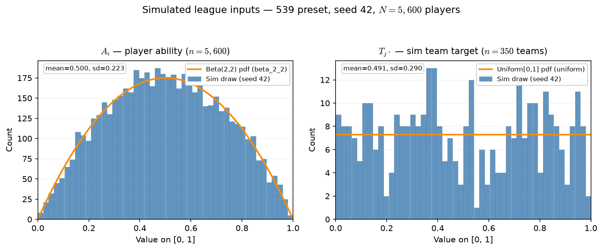
Phase B — Simulated league inputs: actual A_{i} and T_{j^*} draws
539 preset · seed 42 · N=5,600 players · 350 teams × roster 16
One draw reused across all OAT arms — only placement / score rules change.
Left: A_{i} ∼ Beta(2,2) on [0,1] — unimodal, mean ≈ 0.5.
Right: T_{j^*} ∼ iid Uniform[0,1] per team — sim assignment targets.
Orange curve = theoretical pdf scaled to histogram bin width.
This run: mean A_{i}=0.500, mean T_{j^*}=0.491 (sd 0.223 / 0.290).
Not NCAA data — fake league inputs for characterization.
Claim: Phase B fixes one stochastic league draw (seed 42) — A_{i} and T_{j^*} are the inputs every OAT arm reuses; only ASSIGN / SCORE knobs change across slides.

Slide 3
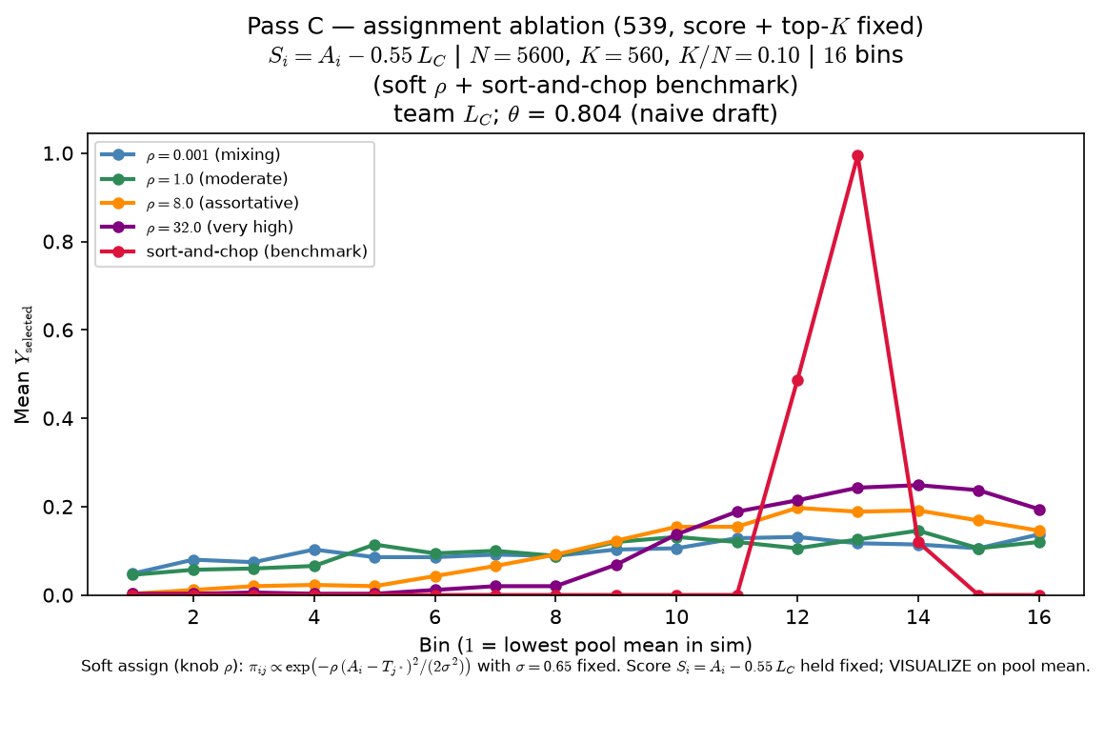
Phase B — Characterize ρ (assignment assortativity) — sort-and-chop shown
Characterize ρ — one-at-a-time at 539 baseline (score + top-K fixed)
ASSIGN (knob ρ) — LaTeX:
\pi_{ij} \propto \exp\left(-\rho \cdot \frac{(A_i-T_{j^*})^2}{2\sigma^2}\right)
σ=0.65 fixed
arms: ρ ∈ {0.001, 1, 8, 32} + sort-and-chop
S_{i} = A_{i} - 0.55 · L_{C} (crowding in score held constant across arms)
top-K by S_{i}
VISUALIZE = mean Y_{selected} vs pool mean (16 bins)
OAT: one draw of A_{i}, T_{j^*} (seed 42); only ASSIGN changes across arms.
Low ρ: players mix across teams — selection vs pool mean stays nearly flat.
High ρ: assortative matching — peer environments concentrate; inverted-U emerges.
Sort-and-chop benchmark: hard rank match (same score rule as soft arms).
Why ρ matters here: assignment assortativity sets how spread out team L_{C} is across the league — at ρ ≈ 0 (arm 0.001) rosters mix and peer pressure looks the same everywhere; at high ρ weak teams pile up near L_{C} ≈ 0 while elite rosters face real congestion.
Claim: at fixed score and top-K, ρ in assignment matters — low-ρ mixing yields a nearly flat curve; high-ρ assortativity delivers the peer-pressure inverted-U readout.

Slide 4
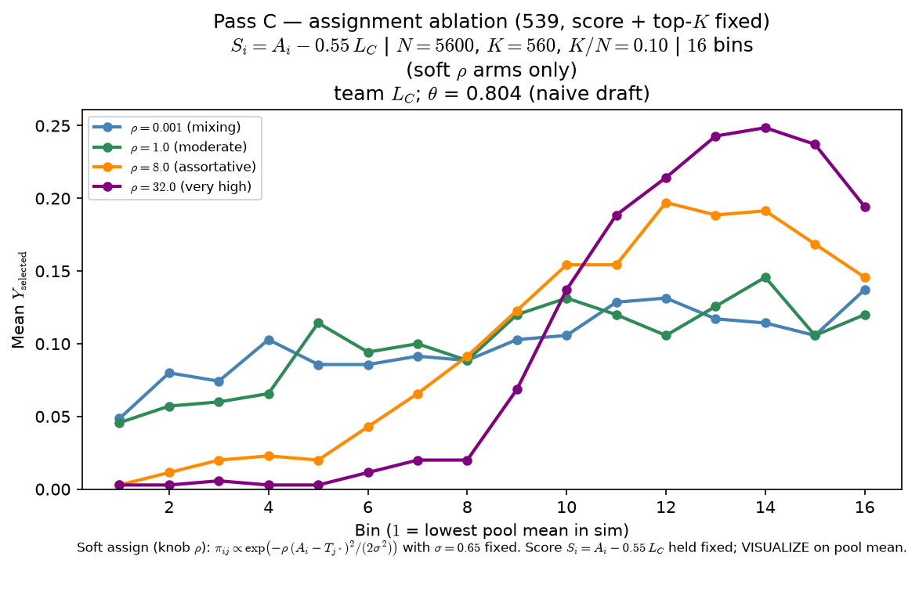
Phase B — Characterize ρ (assignment assortativity) — sort-and-chop suppressed
Characterize ρ — one-at-a-time at 539 baseline (score + top-K fixed)
ASSIGN (knob ρ) — LaTeX:
\pi_{ij} \propto \exp\left(-\rho \cdot \frac{(A_i-T_{j^*})^2}{2\sigma^2}\right)
σ=0.65 fixed
arms: ρ ∈ {0.001, 1, 8, 32}
S_{i} = A_{i} - 0.55 · L_{C} (crowding in score held constant across arms)
top-K by S_{i}
VISUALIZE = mean Y_{selected} vs pool mean (16 bins)
OAT: one draw of A_{i}, T_{j^*} (seed 42); only ASSIGN changes across arms.
Low ρ: players mix across teams — selection vs pool mean stays nearly flat.
High ρ: assortative matching — peer environments concentrate; inverted-U emerges.
Sort-and-chop arm omitted from plot (still in CSV bundle; toggle restores it).
Why ρ matters here: assignment assortativity sets how spread out team L_{C} is across the league — at ρ ≈ 0 (arm 0.001) rosters mix and peer pressure looks the same everywhere; at high ρ weak teams pile up near L_{C} ≈ 0 while elite rosters face real congestion.
Claim: at fixed score and top-K, ρ in assignment matters — low-ρ mixing yields a nearly flat curve; high-ρ assortativity delivers the peer-pressure inverted-U readout.

Slide 5
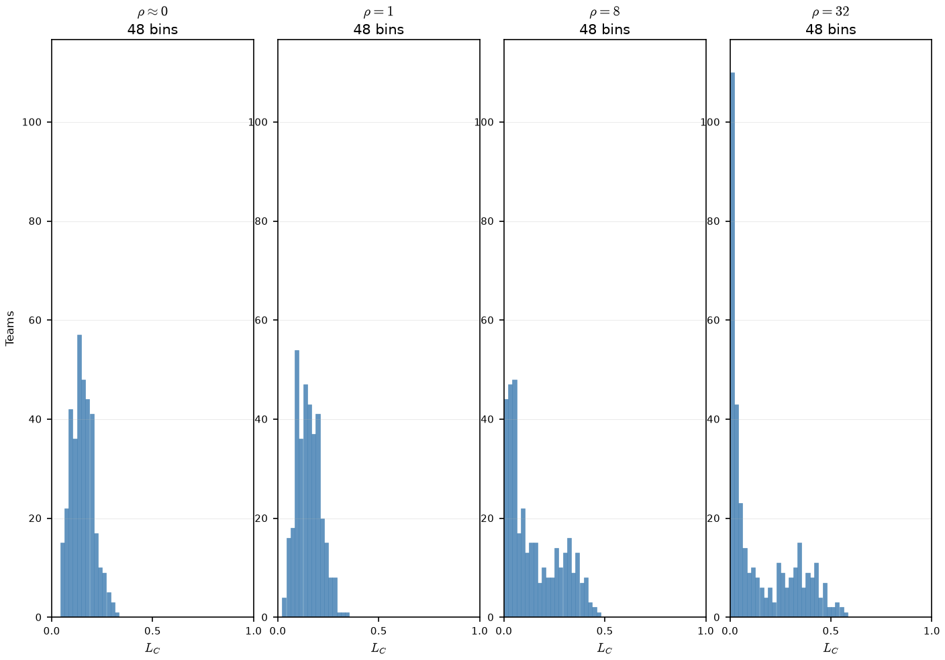
Phase B — Team L_{C} vs ρ (PD16 Sketch A) -- How Congestion alone (L_{C}) varies with change in ρ
team L_{C}; \theta = 0.804 (naive draft) · 48 bins · 350 teams · seed 42
Claim: ρ stratifies team congestion across the league — low-ρ mixing yields one narrow L_{C} hump; high-ρ assortativity piles weak teams at L_{C}≈ 0 and elite rosters at higher L_{C}.
low ρ (ρ=0.001, 1) = one narrow spike near L_{C}≈ 0.15
High ρ = mass at L_{C}≈ 0 (weak rosters) + second hump at elite L_{C}
At ρ=32: 48\% of teams below L_{C}=0.05 - weak rosters - almost no peer pressure.
Of Note: The mean L_{C} is almost identical for all plots, hovering ≈ .15

Slide 6
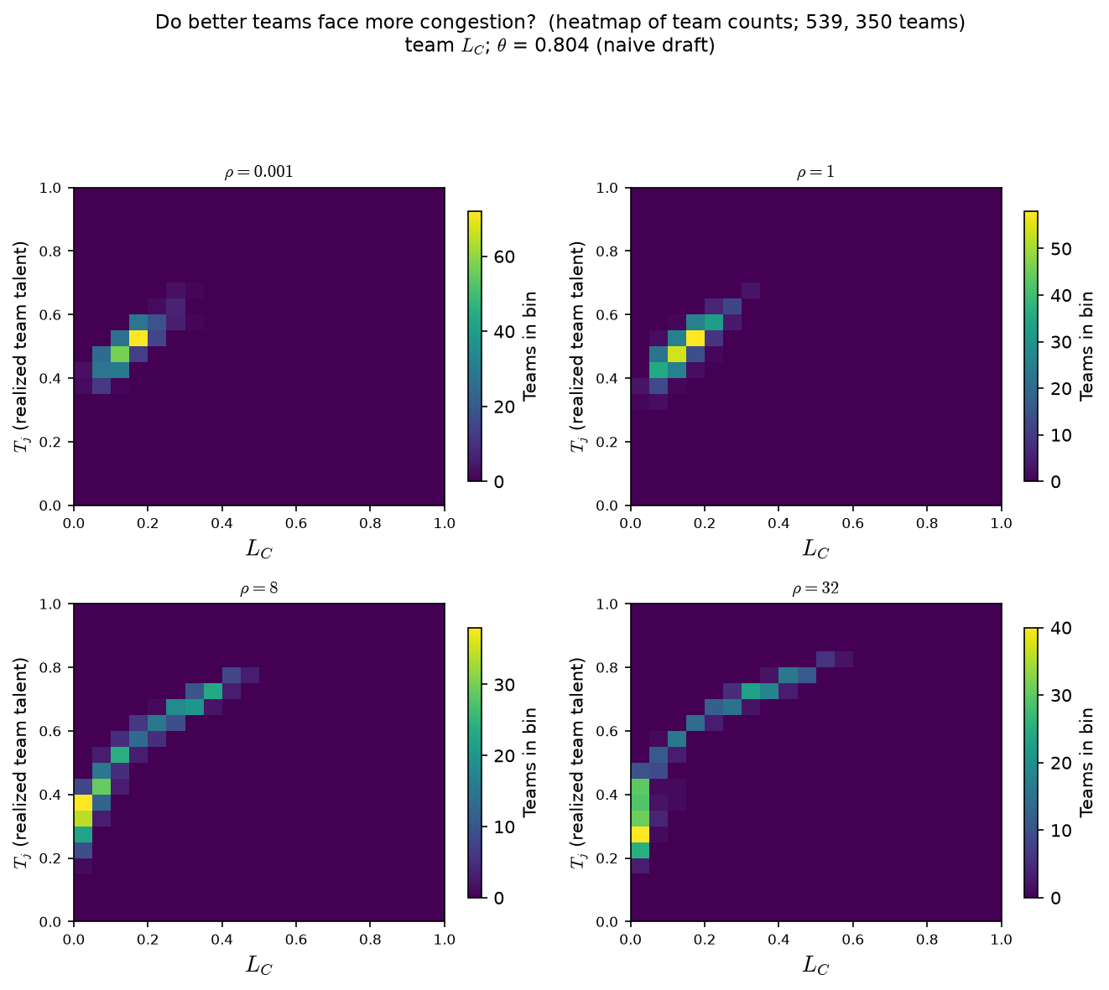
Phase B — Realized T_{j} vs L_{C} (PD16 Sketch A — co-movement) -- Team talent T_{j} vs congestion (L_{C}) as ρ varies.
team L_{C}; \theta = 0.804 (naive draft) · 48 bins · 350 teams · seed 42
Claim: at high ρ, better teams systematically face more peer pressure — the upward cloud in realized T_{j} vs L_{C}. That gives ρ a model-internal read beyond “the Pass C selection plot moved.”
Each cell: # teams at (realized T_{j}, team L_{C}).
Color = count.
Low ρ: compact blob — T_{j} and congestion barely co-vary.
High ρ: upward tail — as T_{j} rises, L_{C} rises.
Weak rosters at high ρ: low T_{j} + low L_{C}
Elite rosters: high T_{j} + high L_{C}.

Slide 7
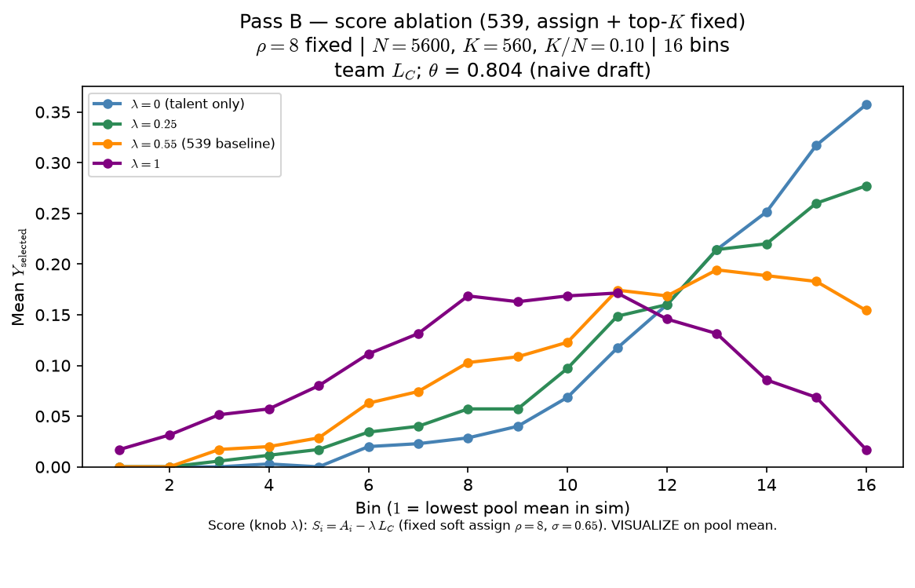
Phase B — Characterize λ (weight on L_{C} in score)
Characterize λ — one-at-a-time at 539 baseline (assign + top-K fixed)
S_{i} = A_{i} - λ · L_{C}
ρ=8 fixed (soft assign; same roster all arms)
σ=0.65 fixed
arms: λ ∈ {0, 0.25, 0.55, 1}
top-K by S_{i}
VISUALIZE = mean Y_{selected} vs pool mean (16 bins)
OAT: one draw of A_{i}, T_{j^*} + one assignment (seed 42); only SCORE changes.
λ=0: S_{i} = A_{i} only — selection vs pool mean stays roughly monotone.
λ>0: congestion in score — inverted-U / roster-pressure readout emerges.
Pairs with Pass C: λ bends score; ρ shapes the sorted roster world.
Claim: at fixed ρ and top-K, λ in score matters — λ=0 yields a roughly monotone talent ladder; λ>0 puts roster pressure in the advancement rule and bends the curve.

Slide 8
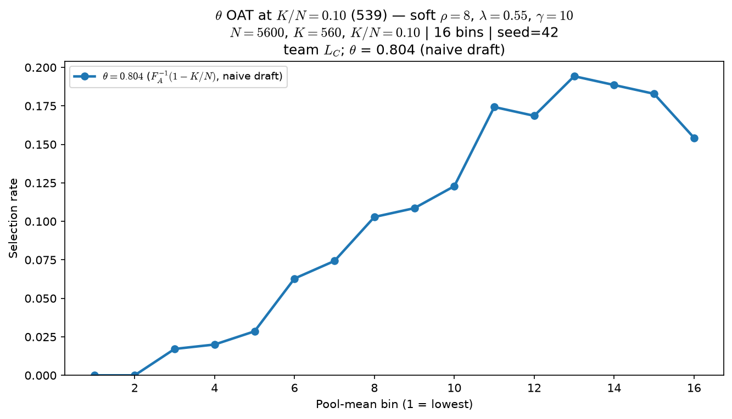
Phase B — Characterize \theta (viability cutline) — OAT at K/N=10\%
Characterize \theta — one-at-a-time at 539 baseline (assign + score + top-K fixed)
L_{C} = mean_{j \neq i}·σ\big(\gamma(A_{j} - \theta)\big)
ρ=8, λ=0.55, \gamma=10 fixed
arms: \theta ∈ {0.50, 0.72, 0.90}
K/N = 10\% (K=560, N=5600)
L_{C} mode: \texttt{crowding\_smooth} (hard \texttt{crowding} also in code)
VISUALIZE = mean Y_{selected} vs pool mean (16 bins)
OAT: soft ρ=8, λ=0.55, \gamma=10 fixed; only \theta in σ(\gamma(A-\theta)) changes.
\theta=0.50: mid-pool hump (peak bin ≈ 13).
\theta=0.72 (539 default): similar hump, slightly higher peak rate.
\theta=0.90: top bins dominate — curve becomes monotone-increasing at the elite edge.
Claim: at fixed ρ, λ, and K/N=10\%, \theta (viability cutline) moves the readout — low \theta keeps a mid-pool hump; high \theta top-saturates the curve.

Slide 9
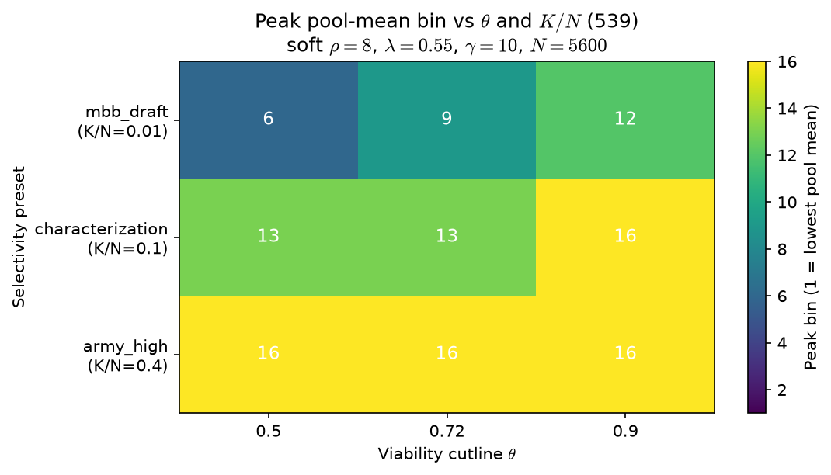
Phase B — Characterize \theta — panel with K/N (selectivity)
Characterize \theta — one-at-a-time at 539 baseline (K/N varies; assign + score rule fixed)
L_{C} = mean_{j \neq i}·σ\big(\gamma(A_{j} - \theta)\big)
ρ=8, λ=0.55, \gamma=10 fixed
\theta ∈ {0.50, 0.72, 0.90}
K/N ∈ {1\%, 10\%, 40\%} — heatmap = peak pool-mean bin
Readout: where the inverted-U peak sits vs selectivity
Grid: \theta ∈ {0.50, 0.72, 0.90} \times K/N ∈ {1\%, 10\%, 40\%} on N=5600.
At K/N=1\%: peak bin rises 6 \to 9 \to 12 as \theta increases.
At K/N=10\%: \theta=0.90 pushes peak to bin 16 (top saturation).
At K/N=40\%: all arms peak at bin 16 — selectivity dominates \theta.
Do not fix \theta = f(K/N) without Alex — panel is descriptive.
Claim: \theta and K/N co-vary — at MBB-like selectivity (1\%) raising \theta shifts peak bin up the pool ladder; at 40\% selectivity curves are top-saturated regardless of \theta.

Slide 10
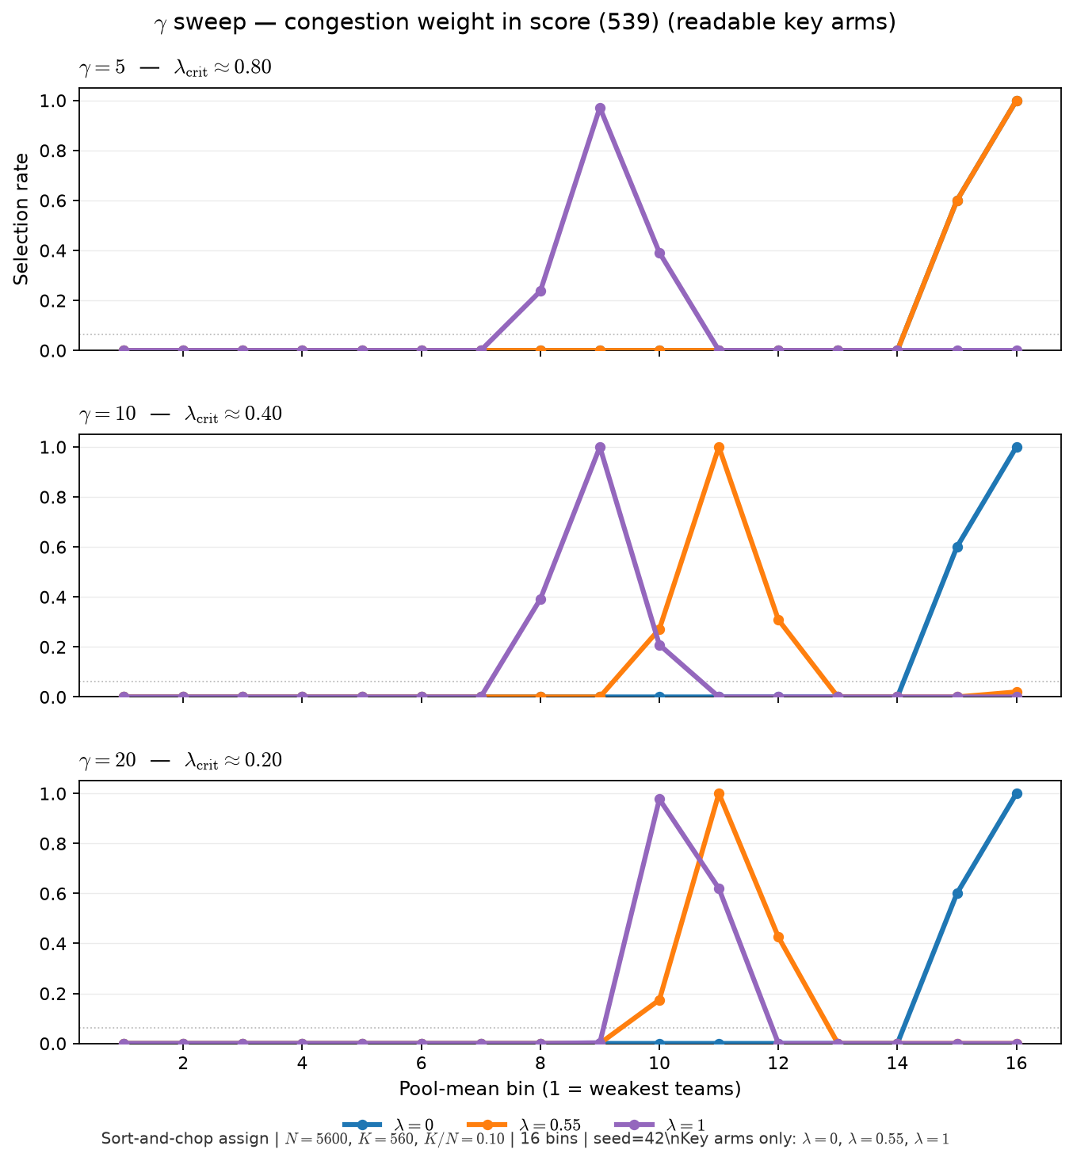
Phase B — Characterize \gamma (viability sharpness) — selection curves
Characterize \gamma — one-at-a-time (539 sort-and-chop benchmark)
σ(x) = 1/(1+e^{-x}), x = \gamma(A-\theta)
\theta=0.72 fixed; sort-and-chop assign
arms: \gamma ∈ {5, 10, 20}
within each \gamma: λ ∈ {0, 0.25, 0.55, 0.75, 1.0}
VISUALIZE = mean Y_{selected} vs pool mean (16 bins)
Sort-and-chop benchmark: same rosters per \gamma; only \gamma and λ in score change.
Figure uses key arms λ ∈ {0, 0.55, 1.0} — full five-arm grid in \texttt{GAMMA\_sweep\_lambda\_curves.png}.
\gamma=5: λ_{crit}≈ 0.8 — hump needs larger λ.
\gamma=10 (539): λ_{crit}≈ 0.4 — curve morph near λ \gtrsim 0.4.
Below crit: monotone elite-edge shape; above crit: inverted-U / hump.
Claim: \gamma (sigmoid slope in L_{C}) shifts when congestion bites — higher \gamma lowers λ_{crit} ≈ 4/\gamma on sort-and-chop; below crit, λ arms can look identical.

Slide 11
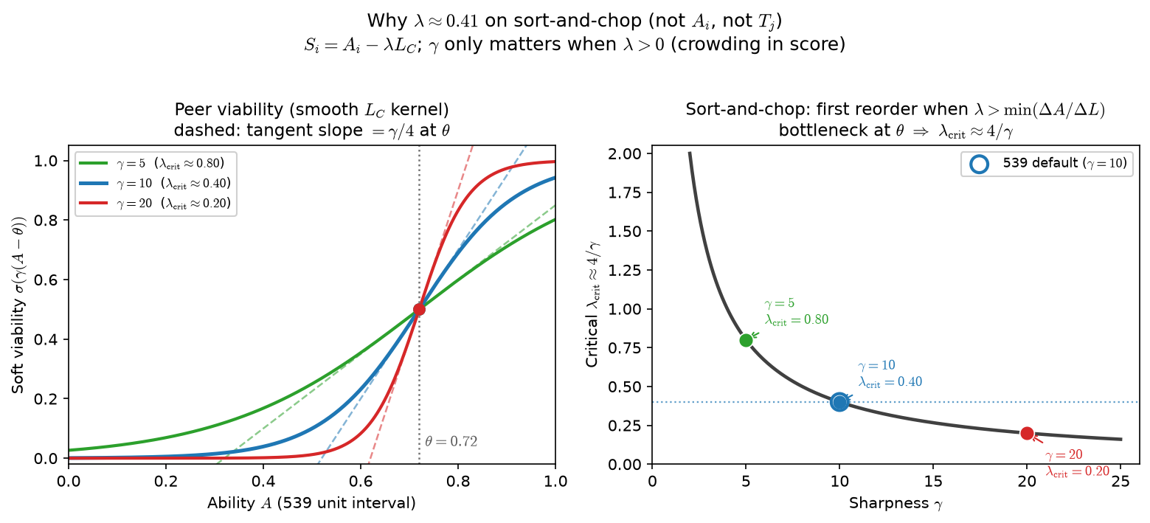
Phase B — λ_{crit} ≈ 4/\gamma (sort-and-chop algebra)
Characterize \gamma — one-at-a-time (539 sort-and-chop benchmark)
σ(x) = 1/(1+e^{-x}), x = \gamma(A-\theta)
Educational: how \gamma shapes L_{C} along ability axis
vertical lines: λ_{crit} = 4/\gamma for each \gamma
539 defaults: \theta=0.72, \gamma=10 → crit = 0.4
Pairs with sort-and-chop λ threshold memo (doc 06)
Soft viability: σ(\gamma(A-\theta)) — not a hard step; \gamma sets knee steepness.
On sort-and-chop, A_{i} \parallel L_{C} within teams → small λ may not reorder top-K.
λ_{crit}: first λ where S_{i} = A_{i} - λ L_{C} changes who gets selected.
Visual curve departure in 16 bins can lag λ_{crit} — use finer bins or check reorder.
Ties to Alex Q: why λ=0 and λ=0.25 match until λ \gtrsim 4/\gamma.
Claim: λ_{crit} ≈ 4/\gamma is the first λ where score reorder beats talent-only on sort-and-chop — not when the curve visually departs from λ=0 in coarse bins.

