Slide 1
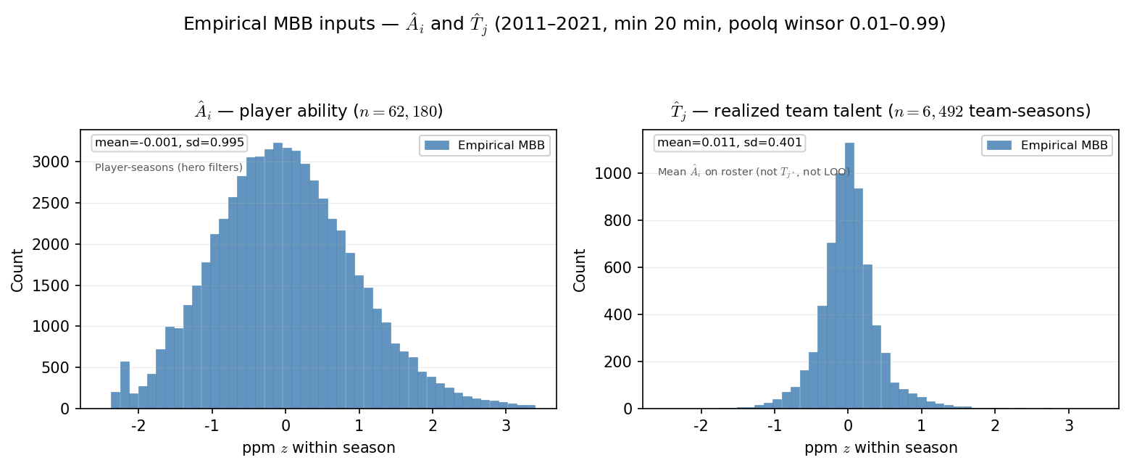
PD17 — Empirical MBB inputs: \hat{A}_{i} and \hat{T}_{j}
MBB 2011-2021 · PPM z within season · min 20 min · poolq winsor 0.01–0.99
Realized rosters — descriptive inputs, not sim draws.
Left: \hat{A}_{i} — player ability (one value per player-season).
Right: \hat{T}_{j} — mean \hat{A}_{i} on roster (team-season; not LOO).
\hat{T}_{j} is tighter than \hat{A}_{i} (averaging shrinks spread).
This run: mean \hat{A}_{i}=-0.001, mean \hat{T}_{j}=0.011 (sd 0.995 / 0.401).
PD17 \theta proxy: K/N=0.0182 (1,134 drafted / 62,180 player-seasons).
Claim (PD17): World-first inputs from the real MBB panel — \hat{A}_{i} per player-season and \hat{T}_{j} per team-season. Not T_{j^*} (sim assignment targets).

