Slide 1
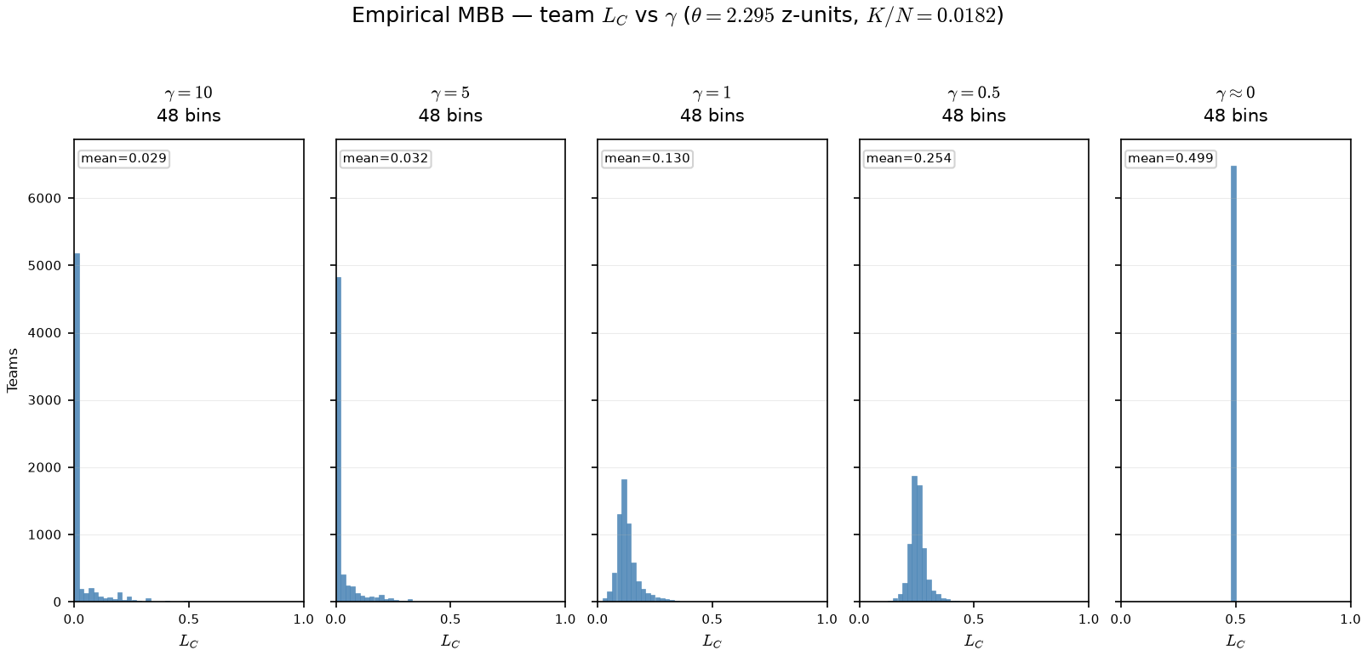
PD17 — Empirical \gamma sweep: team L_C on real rosters
MBB 2011-2021 · team smooth L_C · PPM z · min 20 min · \theta = 2.295 z-units (K/N=0.0182) fixed across \gamma arms
OAT on real panel: fixed \theta (K/N cutline on PPM z); only \gamma in \sigma(\gamma(\hat{A}-\theta)) changes.
Arms: \gamma \in {10, 5, 1, 0.5, 0.001} — same team-seasons, same rosters.
At \gamma=10: mean L_C=0.029, 84\% teams below 0.05.
At \gamma \approx 0: mean L_C=0.499, max L_C=0.500 — spread opens on z-scale.
Claim (PD17): On real rosters, γ reshapes team L_C — high γ compresses viability near 0 on the PPM-z scale; low γ spreads L_C into the interior of [0,1].

