Slide 1
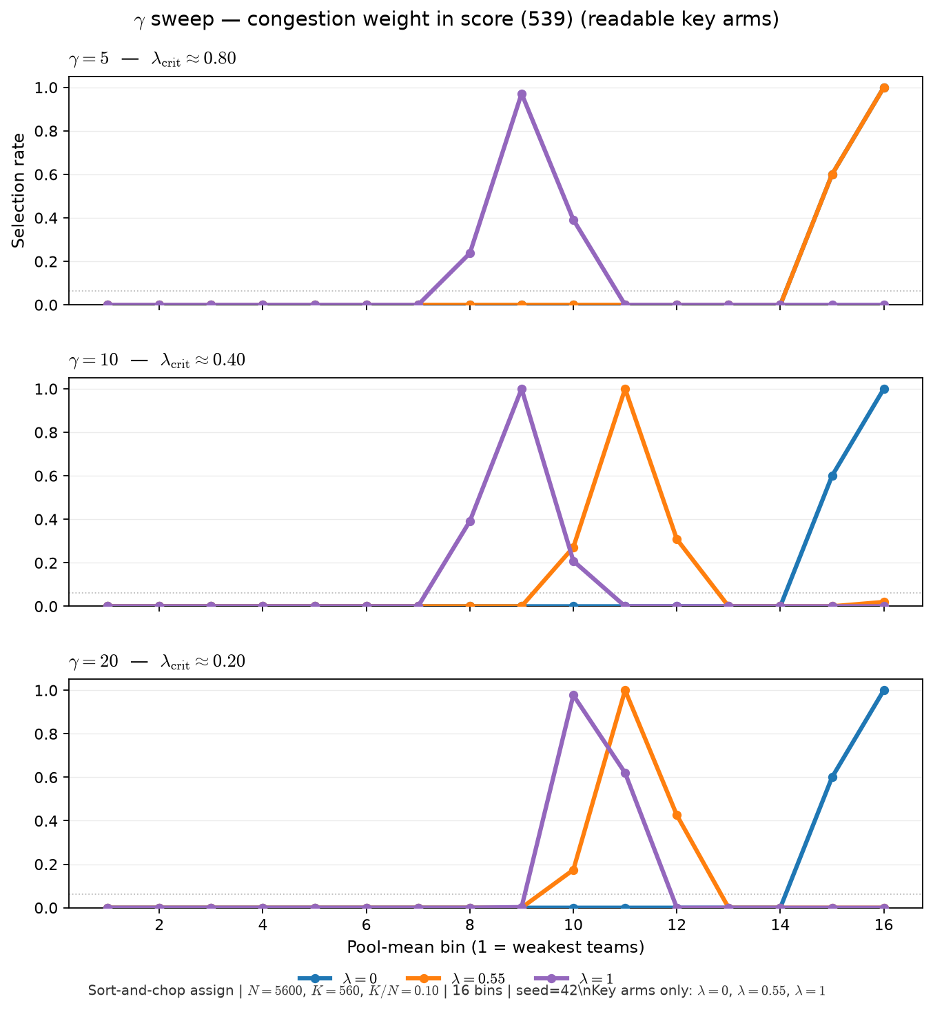
Phase B — Characterize \gamma (viability sharpness) — selection curves
Characterize \gamma — one-at-a-time (539 sort-and-chop benchmark)
σ(x) = 1/(1+e^{-x}), x = \gamma(A-\theta)
\theta=0.72 fixed; sort-and-chop assign
arms: \gamma ∈ {5, 10, 20}
within each \gamma: λ ∈ {0, 0.25, 0.55, 0.75, 1.0}
VISUALIZE = mean Y_{selected} vs pool mean (16 bins)
Sort-and-chop benchmark: same rosters per \gamma; only \gamma and λ in score change.
Figure uses key arms λ ∈ {0, 0.55, 1.0} — full five-arm grid in \texttt{GAMMA\_sweep\_lambda\_curves.png}.
\gamma=5: λ_{crit}≈ 0.8 — hump needs larger λ.
\gamma=10 (539): λ_{crit}≈ 0.4 — curve morph near λ \gtrsim 0.4.
Below crit: monotone elite-edge shape; above crit: inverted-U / hump.
Claim: \gamma (sigmoid slope in L_{C}) shifts when congestion bites — higher \gamma lowers λ_{crit} ≈ 4/\gamma on sort-and-chop; below crit, λ arms can look identical.

Slide 2
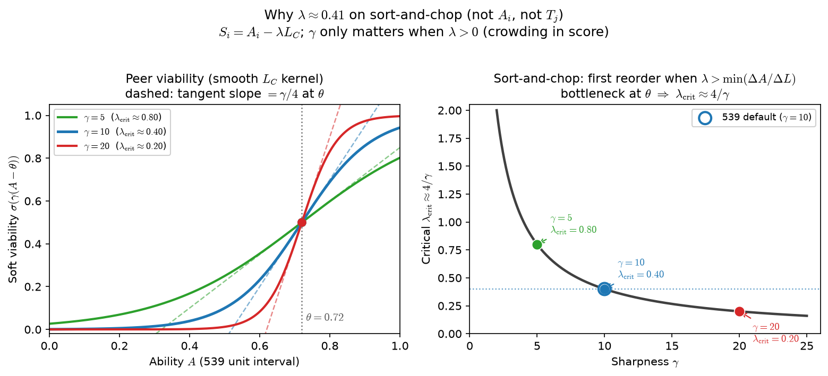
Phase B — λ_{crit} ≈ 4/\gamma (sort-and-chop algebra)
Characterize \gamma — one-at-a-time (539 sort-and-chop benchmark)
σ(x) = 1/(1+e^{-x}), x = \gamma(A-\theta)
Educational: how \gamma shapes L_{C} along ability axis
vertical lines: λ_{crit} = 4/\gamma for each \gamma
539 defaults: \theta=0.72, \gamma=10 → crit = 0.4
Pairs with sort-and-chop λ threshold memo (doc 06)
Soft viability: σ(\gamma(A-\theta)) — not a hard step; \gamma sets knee steepness.
On sort-and-chop, A_{i} \parallel L_{C} within teams → small λ may not reorder top-K.
λ_{crit}: first λ where S_{i} = A_{i} - λ L_{C} changes who gets selected.
Visual curve departure in 16 bins can lag λ_{crit} — use finer bins or check reorder.
Ties to Alex Q: why λ=0 and λ=0.25 match until λ \gtrsim 4/\gamma.
Claim: λ_{crit} ≈ 4/\gamma is the first λ where score reorder beats talent-only on sort-and-chop — not when the curve visually departs from λ=0 in coarse bins.

