Slide 1
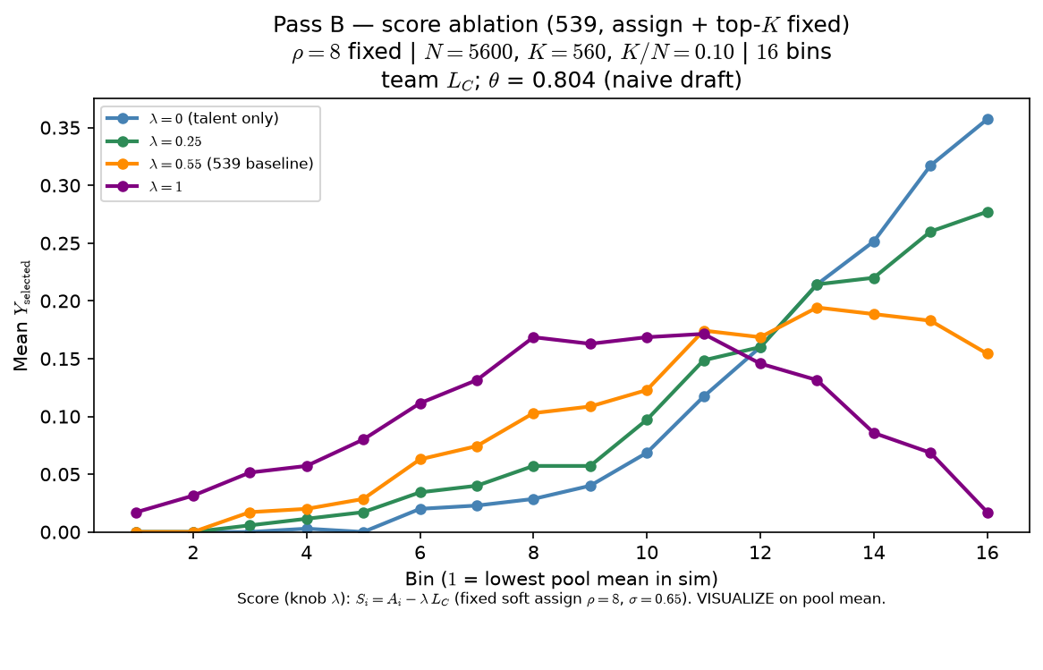
Phase B — Characterize λ (weight on L_{C} in score)
Characterize λ — one-at-a-time at 539 baseline (assign + top-K fixed)
S_{i} = A_{i} - λ · L_{C}
ρ=8 fixed (soft assign; same roster all arms)
σ=0.65 fixed
arms: λ ∈ {0, 0.25, 0.55, 1}
top-K by S_{i}
VISUALIZE = mean Y_{selected} vs pool mean (16 bins)
OAT: one draw of A_{i}, T_{j^*} + one assignment (seed 42); only SCORE changes.
λ=0: S_{i} = A_{i} only — selection vs pool mean stays roughly monotone.
λ>0: congestion in score — inverted-U / roster-pressure readout emerges.
Pairs with Pass C: λ bends score; ρ shapes the sorted roster world.
Claim: at fixed ρ and top-K, λ in score matters — λ=0 yields a roughly monotone talent ladder; λ>0 puts roster pressure in the advancement rule and bends the curve.

