Slide 1
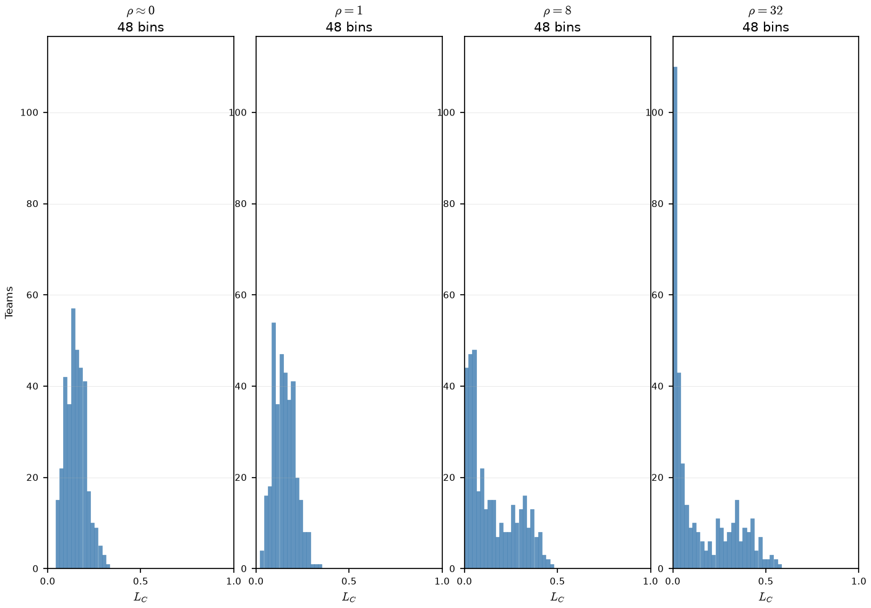
Phase B — Team L_{C} vs ρ (PD16 Sketch A) -- How Congestion alone (L_{C}) varies with change in ρ
team L_{C}; \theta = 0.804 (naive draft) · 48 bins · 350 teams · seed 42
Claim: ρ stratifies team congestion across the league — low-ρ mixing yields one narrow L_{C} hump; high-ρ assortativity piles weak teams at L_{C}≈ 0 and elite rosters at higher L_{C}.
low ρ (ρ=0.001, 1) = one narrow spike near L_{C}≈ 0.15
High ρ = mass at L_{C}≈ 0 (weak rosters) + second hump at elite L_{C}
At ρ=32: 48\% of teams below L_{C}=0.05 - weak rosters - almost no peer pressure.
Of Note: The mean L_{C} is almost identical for all plots, hovering ≈ .15

Slide 2
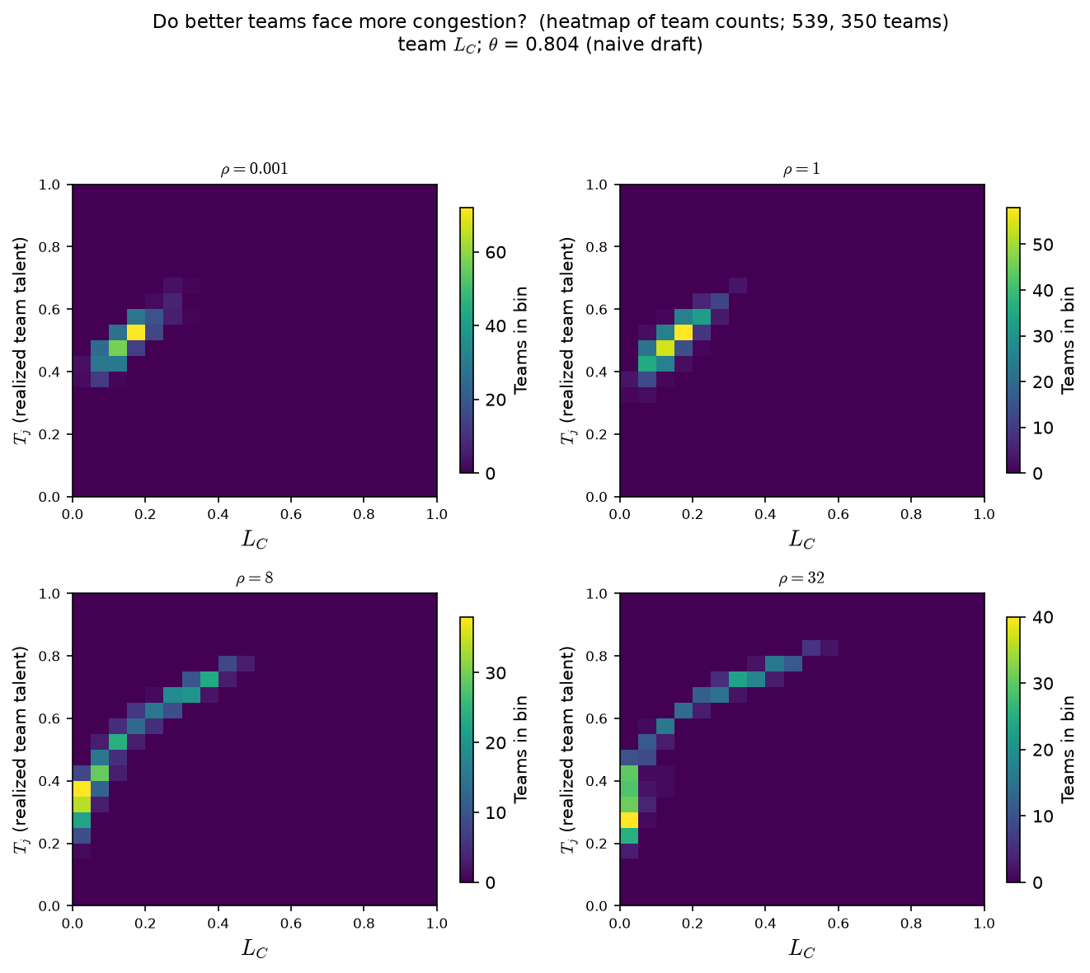
Phase B — Realized T_{j} vs L_{C} (PD16 Sketch A — co-movement) -- Team talent T_{j} vs congestion (L_{C}) as ρ varies.
team L_{C}; \theta = 0.804 (naive draft) · 48 bins · 350 teams · seed 42
Claim: at high ρ, better teams systematically face more peer pressure — the upward cloud in realized T_{j} vs L_{C}. That gives ρ a model-internal read beyond “the Pass C selection plot moved.”
Each cell: # teams at (realized T_{j}, team L_{C}).
Color = count.
Low ρ: compact blob — T_{j} and congestion barely co-vary.
High ρ: upward tail — as T_{j} rises, L_{C} rises.
Weak rosters at high ρ: low T_{j} + low L_{C}
Elite rosters: high T_{j} + high L_{C}.

