Slide 1
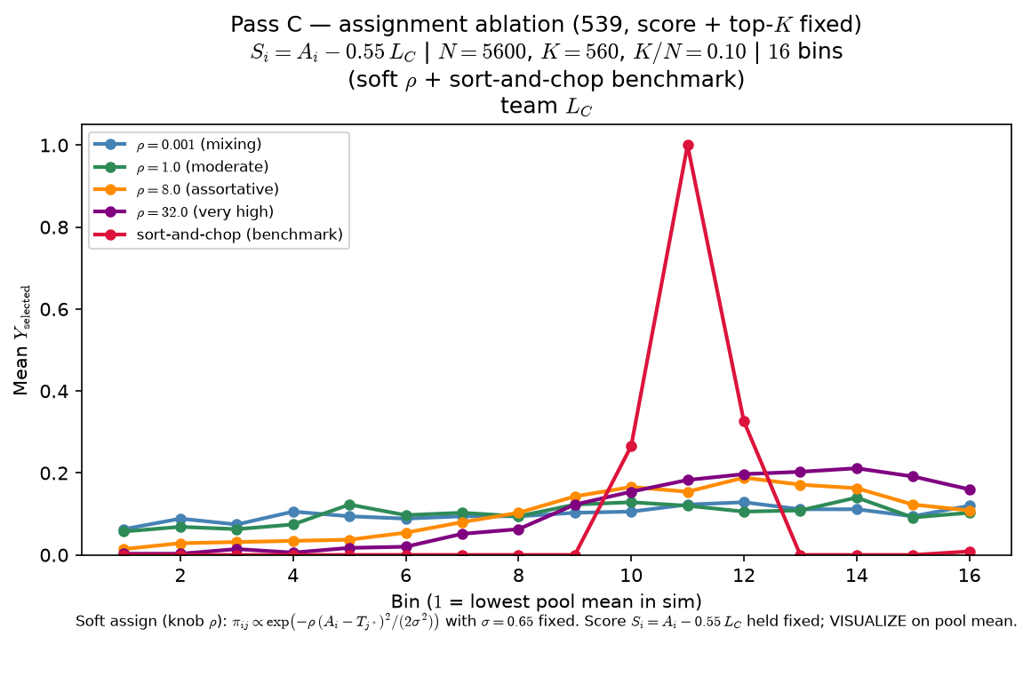
Phase B — Characterize ρ (assignment assortativity) — sort-and-chop shown
Characterize ρ — one-at-a-time at 539 baseline (score + top-K fixed)
ASSIGN (knob ρ) — LaTeX:
\pi_{ij} \propto \exp\left(-\rho \cdot \frac{(A_i-T_{j^*})^2}{2\sigma^2}\right)
σ=0.65 fixed
arms: ρ ∈ {0.001, 1, 8, 32} + sort-and-chop
S_{i} = A_{i} - 0.55 · L_{C} (crowding in score held constant across arms)
top-K by S_{i}
VISUALIZE = mean Y_{selected} vs pool mean (16 bins)
OAT: one draw of A_{i}, T_{j^*} (seed 42); only ASSIGN changes across arms.
Low ρ: rosters mix — L_{C} nearly uniform; curve tilts up weakly (no inverted-U).
High ρ: assortative matching — flat bottom bins, interior peak, top-bin dip.
Sort-and-chop benchmark: hard rank match (same score rule as soft arms).
Why ρ matters here: assignment assortativity sets how spread out team L_{C} is across the league — at ρ ≈ 0 (arm 0.001) rosters mix and L_{C} is nearly uniform; selection still tilts up pool-mean bins because global top-K favors better players on stronger teams (see doc 08). At high ρ weak teams pile up near L_{C} ≈ 0 while elite rosters face real congestion — the inverted-U emerges.
Claim: at fixed score and top-K, ρ in assignment matters — low-ρ mixing yields a weak monotone tilt (no inverted-U); high-ρ assortativity delivers the peer-pressure inverted-U readout.

Slide 2
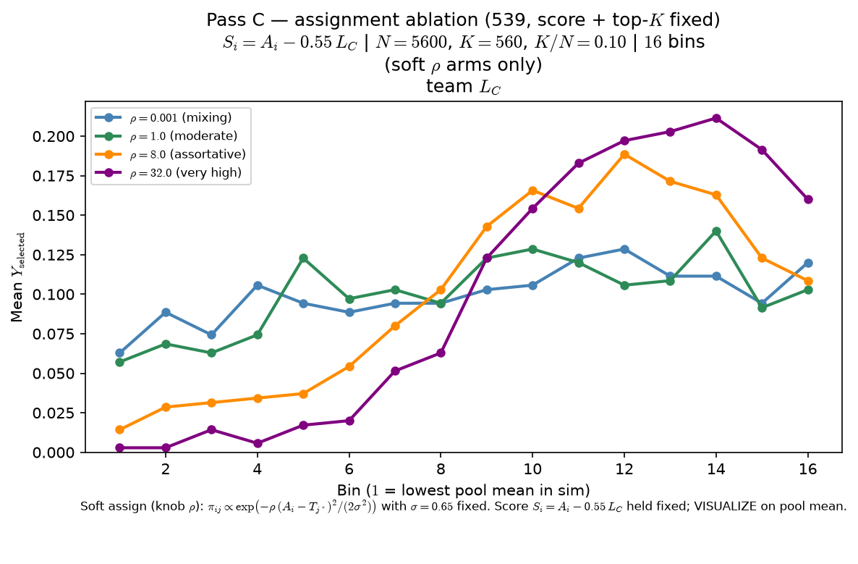
Phase B — Characterize ρ (assignment assortativity) — sort-and-chop suppressed
Characterize ρ — one-at-a-time at 539 baseline (score + top-K fixed)
ASSIGN (knob ρ) — LaTeX:
\pi_{ij} \propto \exp\left(-\rho \cdot \frac{(A_i-T_{j^*})^2}{2\sigma^2}\right)
σ=0.65 fixed
arms: ρ ∈ {0.001, 1, 8, 32}
S_{i} = A_{i} - 0.55 · L_{C} (crowding in score held constant across arms)
top-K by S_{i}
VISUALIZE = mean Y_{selected} vs pool mean (16 bins)
OAT: one draw of A_{i}, T_{j^*} (seed 42); only ASSIGN changes across arms.
Low ρ: rosters mix — L_{C} nearly uniform; curve tilts up weakly (no inverted-U).
High ρ: assortative matching — flat bottom bins, interior peak, top-bin dip.
Sort-and-chop arm omitted from plot (still in CSV bundle; toggle restores it).
Why ρ matters here: assignment assortativity sets how spread out team L_{C} is across the league — at ρ ≈ 0 (arm 0.001) rosters mix and L_{C} is nearly uniform; selection still tilts up pool-mean bins because global top-K favors better players on stronger teams (see doc 08). At high ρ weak teams pile up near L_{C} ≈ 0 while elite rosters face real congestion — the inverted-U emerges.
Claim: at fixed score and top-K, ρ in assignment matters — low-ρ mixing yields a weak monotone tilt (no inverted-U); high-ρ assortativity delivers the peer-pressure inverted-U readout.

