Slide 1
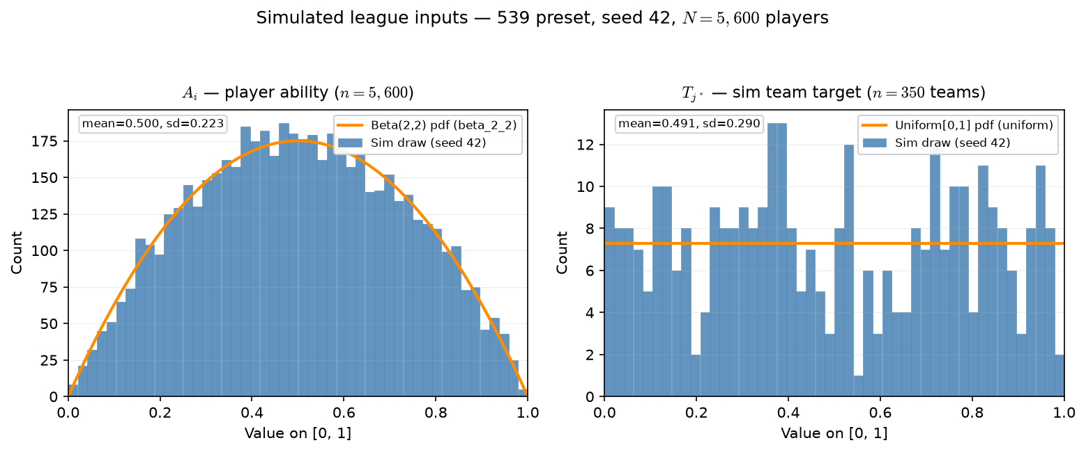
Phase B — Simulated league inputs: actual A_{i} and T_{j^*} draws
539 preset · seed 42 · N=5,600 players · 350 teams × roster 16
One draw reused across all OAT arms — only placement / score rules change.
Left: A_{i} ∼ Beta(2,2) on [0,1] — unimodal, mean ≈ 0.5.
Right: T_{j^*} ∼ iid Uniform[0,1] per team — sim assignment targets.
Orange curve = theoretical pdf scaled to histogram bin width.
This run: mean A_{i}=0.500, mean T_{j^*}=0.491 (sd 0.223 / 0.290).
Not NCAA data — fake league inputs for characterization.
Claim: Phase B fixes one stochastic league draw (seed 42) — A_{i} and T_{j^*} are the inputs every OAT arm reuses; only ASSIGN / SCORE knobs change across slides.

