Slide 1
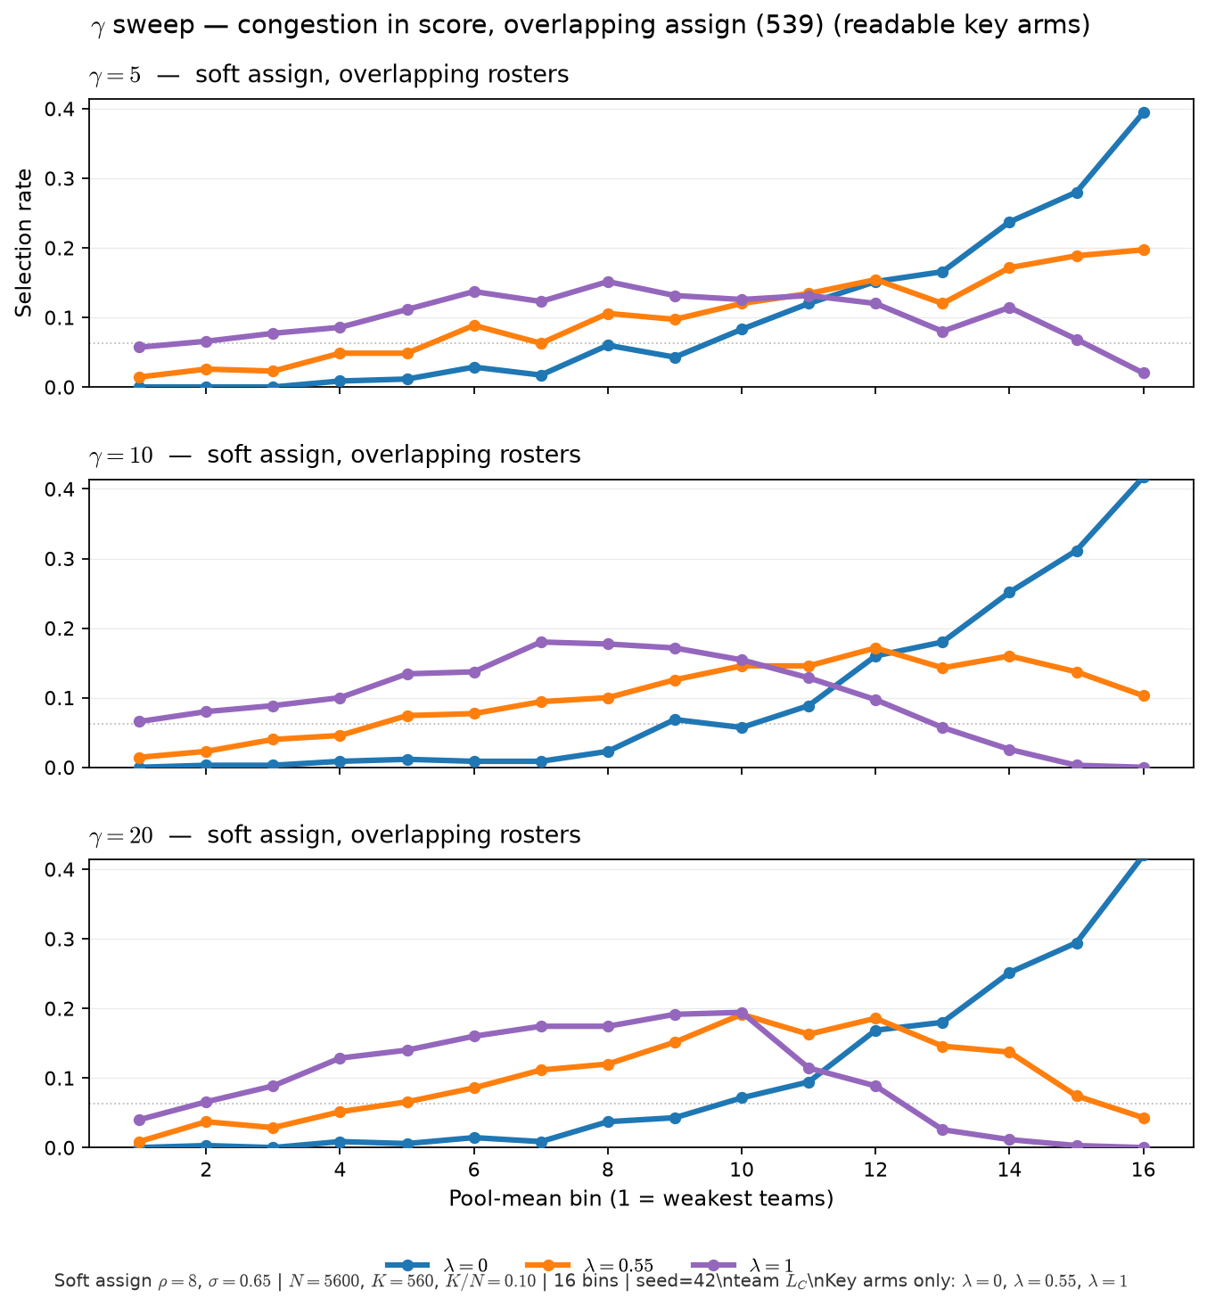
Phase B — \gamma \times \lambda sweep (soft assign, overlapping rosters)
Overlap regime — same readout as sort-and-chop grid, different ASSIGN world
Soft assign at fixed \rho — overlapping talent windows (not sort-and-chop).
\rho=8 fixed; same roster per \gamma row; team L_C; \theta(K/N) on sim draw.
\theta = 0.720 z-units (F_A^{-1}(1-K/N) on Beta draw).
Arms: \gamma \in \{5, 10, 20\}; within each panel \lambda \in \{0, 0.25, 0.55, 0.75, 1\}.
Figure: key \lambda arms only; full grid in GAMMA_sweep_soft_assign_lambda_curves.png.
Pairs with sort-and-chop \gamma slides (benchmark) — keep both in HAND deck.
Claim: under soft assign (overlapping rosters), \gamma reshapes team L_C and \lambda in score bends selection — the regime where we will pin \lambda on data. No \lambda_{\mathrm{crit}} \approx 4/\gamma law here (sort-and-chop only).

