Slide 1
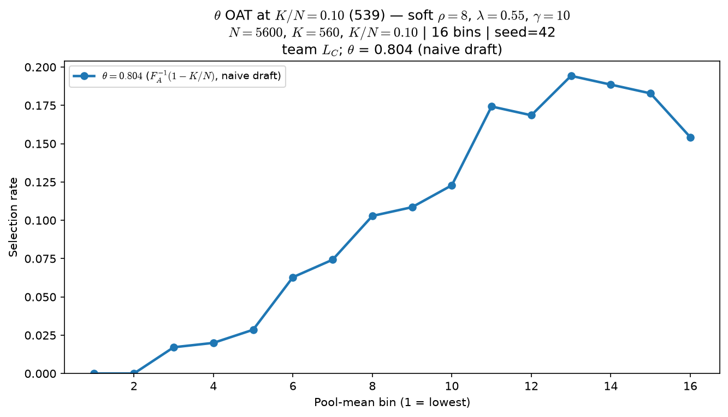
Phase B — Characterize \theta (viability cutline) — OAT at K/N=10\%
Characterize \theta — one-at-a-time at 539 baseline (assign + score + top-K fixed)
L_{C} = mean_{j \neq i}·σ\big(\gamma(A_{j} - \theta)\big)
ρ=8, λ=0.55, \gamma=10 fixed
arms: \theta ∈ {0.50, 0.72, 0.90}
K/N = 10\% (K=560, N=5600)
L_{C} mode: \texttt{crowding\_smooth} (hard \texttt{crowding} also in code)
VISUALIZE = mean Y_{selected} vs pool mean (16 bins)
OAT: soft ρ=8, λ=0.55, \gamma=10 fixed; only \theta in σ(\gamma(A-\theta)) changes.
\theta=0.50: mid-pool hump (peak bin ≈ 13).
\theta=0.72 (539 default): similar hump, slightly higher peak rate.
\theta=0.90: top bins dominate — curve becomes monotone-increasing at the elite edge.
Claim: at fixed ρ, λ, and K/N=10\%, \theta (viability cutline) moves the readout — low \theta keeps a mid-pool hump; high \theta top-saturates the curve.

Slide 2
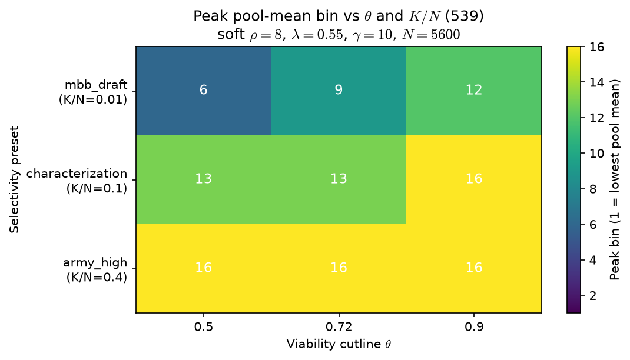
Phase B — Characterize \theta — panel with K/N (selectivity)
Characterize \theta — one-at-a-time at 539 baseline (K/N varies; assign + score rule fixed)
L_{C} = mean_{j \neq i}·σ\big(\gamma(A_{j} - \theta)\big)
ρ=8, λ=0.55, \gamma=10 fixed
\theta ∈ {0.50, 0.72, 0.90}
K/N ∈ {1\%, 10\%, 40\%} — heatmap = peak pool-mean bin
Readout: where the inverted-U peak sits vs selectivity
Grid: \theta ∈ {0.50, 0.72, 0.90} \times K/N ∈ {1\%, 10\%, 40\%} on N=5600.
At K/N=1\%: peak bin rises 6 \to 9 \to 12 as \theta increases.
At K/N=10\%: \theta=0.90 pushes peak to bin 16 (top saturation).
At K/N=40\%: all arms peak at bin 16 — selectivity dominates \theta.
Do not fix \theta = f(K/N) without Alex — panel is descriptive.
Claim: \theta and K/N co-vary — at MBB-like selectivity (1\%) raising \theta shifts peak bin up the pool ladder; at 40\% selectivity curves are top-saturated regardless of \theta.

