Slide 1
HERO permutation sweep
Tier core · 8 slides · 2026-08-25
Purpose: compare roster-x × Y-mode × panel-rows (and optional +DFT / EW20).
Three knobs are orthogonal:
• roster-x: poolq_loo (LOO teammates) vs poolq (team mean, incl. self)
• y-draft-mode: ever (Y=1 all PS for draftees) vs season (Y=1 last PS only)
• panel-rows: all-ps vs last-ps (cross-section)
Slide 2 = FIXED HERO baseline. Later slides = other combinations.
Command box on each slide = exact CLI to reproduce.
Regenerate: python sports/scripts/hero_permutation_sweep.py --tier core
Rebuild deck: python sports/scripts/build_hero_permutation_slides.py

Slide 2
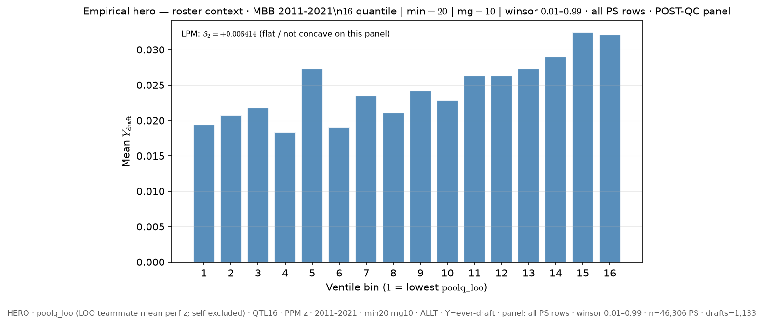
Slide 1 — FIXED HERO — canonical deck
Baseline — canonical deck HERO
python sports/scripts/pass_a_empirical_bundle.py \ --y-draft-mode ever \ --panel-rows all-ps \ --roster-x poolq_loo \ --n-bins 16 \ --poolq-binning quantile \ --output-tag FIXED_HERO \ --output-root 3-Master_Plan/re_entry/HEROs_and_PASSes/population_sandbox/hero
Shape: bin1=0.035% · peak=ventile 16 @ 11.126% · last=11.126%

Slide 3
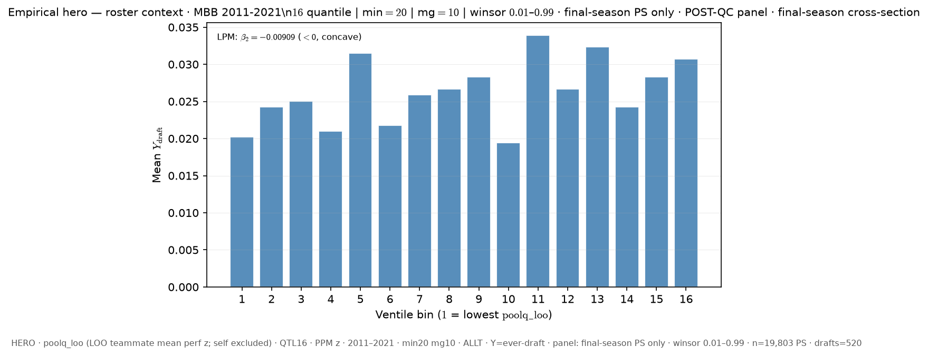
Slide 2 — LOO poolq_loo · ever-draft · last PS only (cross-section) · QTL16 ALLT
Δ vs FIXED HERO: panel_rows: all-ps → last-ps
python sports/scripts/pass_a_empirical_bundle.py \ --y-draft-mode ever \ --panel-rows last-ps \ --roster-x poolq_loo \ --n-bins 16 \ --poolq-binning quantile \ --output-tag perm_loo_ever_lastps_q16 \ --output-root 3-Master_Plan/re_entry/HEROs_and_PASSes/population_sandbox/hero
Shape: bin1=0.0% · peak=ventile 16 @ 15.602% · last=15.602%

Slide 4
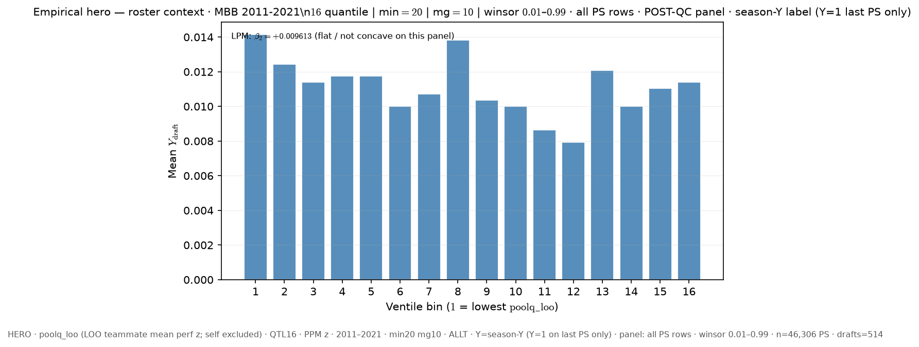
Slide 3 — LOO poolq_loo · season-Y label · all PS rows · QTL16 ALLT
Δ vs FIXED HERO: y_draft_mode: ever → season
python sports/scripts/pass_a_empirical_bundle.py \ --y-draft-mode season \ --panel-rows all-ps \ --roster-x poolq_loo \ --n-bins 16 \ --poolq-binning quantile \ --output-tag perm_loo_seasony_allps_q16 \ --output-root 3-Master_Plan/re_entry/HEROs_and_PASSes/population_sandbox/hero
Shape: bin1=0.0% · peak=ventile 16 @ 7.498% · last=7.498%

Slide 5
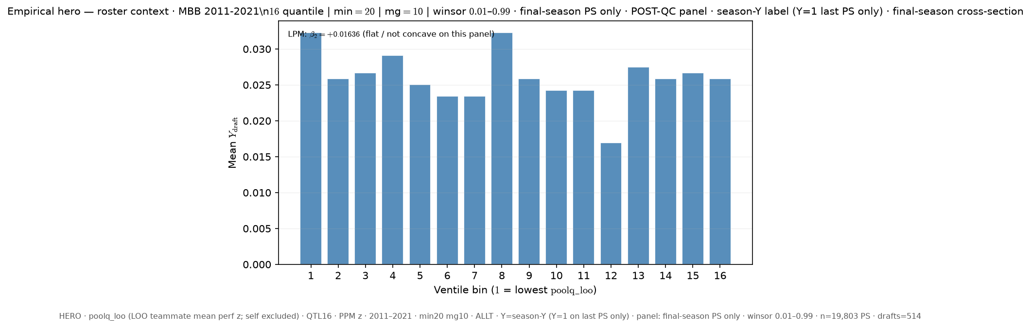
Slide 4 — LOO poolq_loo · season-Y label · last PS only (cross-section) · QTL16 ALLT
Δ vs FIXED HERO: y_draft_mode: ever → season; panel_rows: all-ps → last-ps
python sports/scripts/pass_a_empirical_bundle.py \ --y-draft-mode season \ --panel-rows last-ps \ --roster-x poolq_loo \ --n-bins 16 \ --poolq-binning quantile \ --output-tag perm_loo_seasony_lastps_q16 \ --output-root 3-Master_Plan/re_entry/HEROs_and_PASSes/population_sandbox/hero
Shape: bin1=0.0% · peak=ventile 16 @ 15.198% · last=15.198%

Slide 6
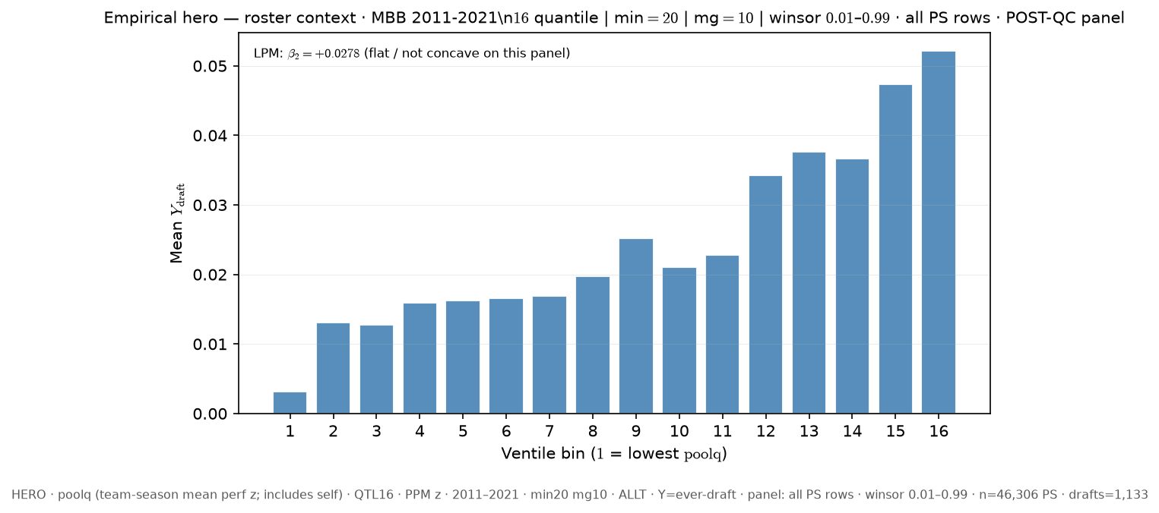
Slide 5 — team poolq (incl. self) · ever-draft · all PS rows · QTL16 ALLT
Δ vs FIXED HERO: roster_x: poolq_loo → poolq
python sports/scripts/pass_a_empirical_bundle.py \ --y-draft-mode ever \ --panel-rows all-ps \ --roster-x poolq \ --n-bins 16 \ --poolq-binning quantile \ --output-tag perm_poolq_ever_allps_q16 \ --output-root 3-Master_Plan/re_entry/HEROs_and_PASSes/population_sandbox/hero
Shape: bin1=0.035% · peak=ventile 16 @ 11.126% · last=11.126%

Slide 7
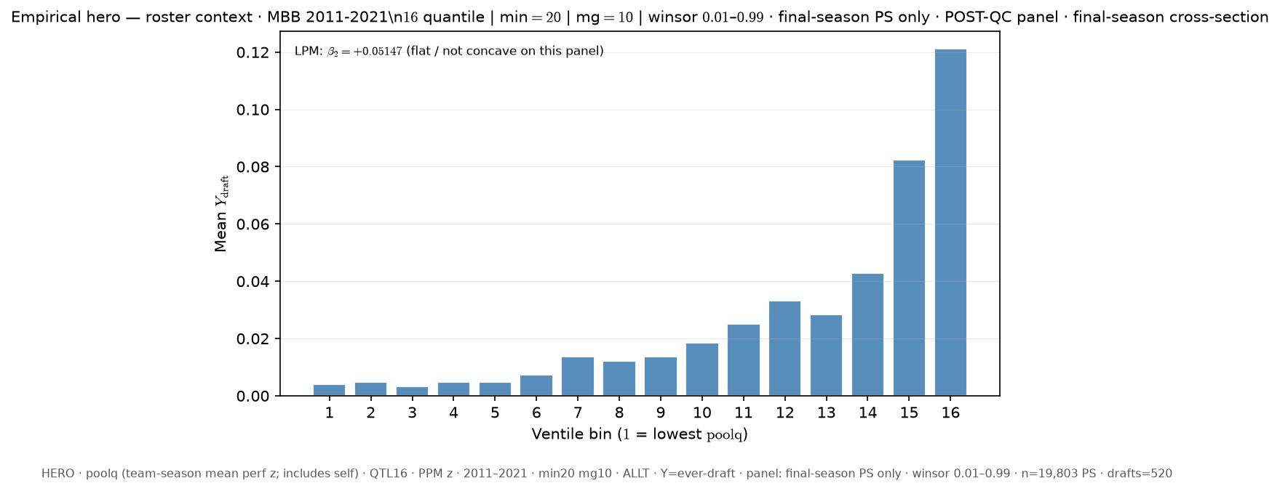
Slide 6 — team poolq (incl. self) · ever-draft · last PS only (cross-section) · QTL16 ALLT
Δ vs FIXED HERO: roster_x: poolq_loo → poolq; panel_rows: all-ps → last-ps
python sports/scripts/pass_a_empirical_bundle.py \ --y-draft-mode ever \ --panel-rows last-ps \ --roster-x poolq \ --n-bins 16 \ --poolq-binning quantile \ --output-tag perm_poolq_ever_lastps_q16 \ --output-root 3-Master_Plan/re_entry/HEROs_and_PASSes/population_sandbox/hero
Shape: bin1=0.0% · peak=ventile 16 @ 15.602% · last=15.602%

Slide 8
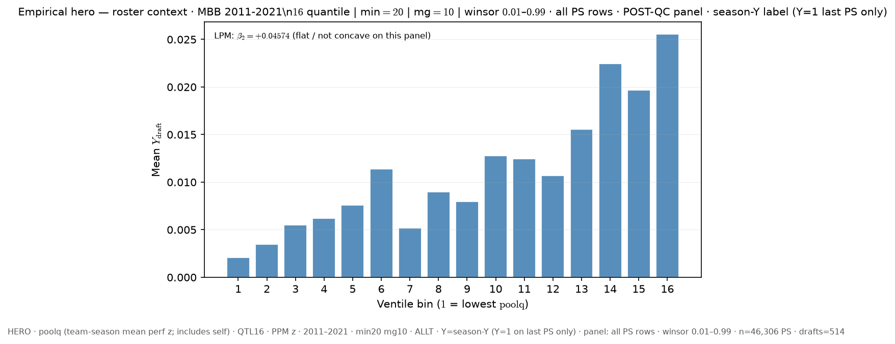
Slide 7 — team poolq (incl. self) · season-Y label · all PS rows · QTL16 ALLT
Δ vs FIXED HERO: roster_x: poolq_loo → poolq; y_draft_mode: ever → season
python sports/scripts/pass_a_empirical_bundle.py \ --y-draft-mode season \ --panel-rows all-ps \ --roster-x poolq \ --n-bins 16 \ --poolq-binning quantile \ --output-tag perm_poolq_seasony_allps_q16 \ --output-root 3-Master_Plan/re_entry/HEROs_and_PASSes/population_sandbox/hero
Shape: bin1=0.0% · peak=ventile 16 @ 7.498% · last=7.498%

Slide 9
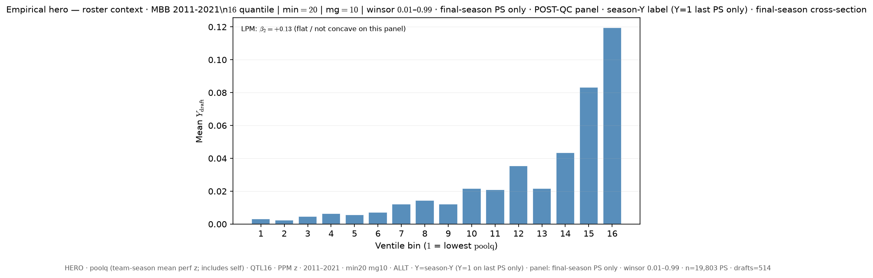
Slide 8 — team poolq (incl. self) · season-Y label · last PS only (cross-section) · QTL16 ALLT
Δ vs FIXED HERO: roster_x: poolq_loo → poolq; y_draft_mode: ever → season; panel_rows: all-ps → last-ps
python sports/scripts/pass_a_empirical_bundle.py \ --y-draft-mode season \ --panel-rows last-ps \ --roster-x poolq \ --n-bins 16 \ --poolq-binning quantile \ --output-tag perm_poolq_seasony_lastps_q16 \ --output-root 3-Master_Plan/re_entry/HEROs_and_PASSes/population_sandbox/hero
Shape: bin1=0.0% · peak=ventile 16 @ 15.198% · last=15.198%

