Slide 1
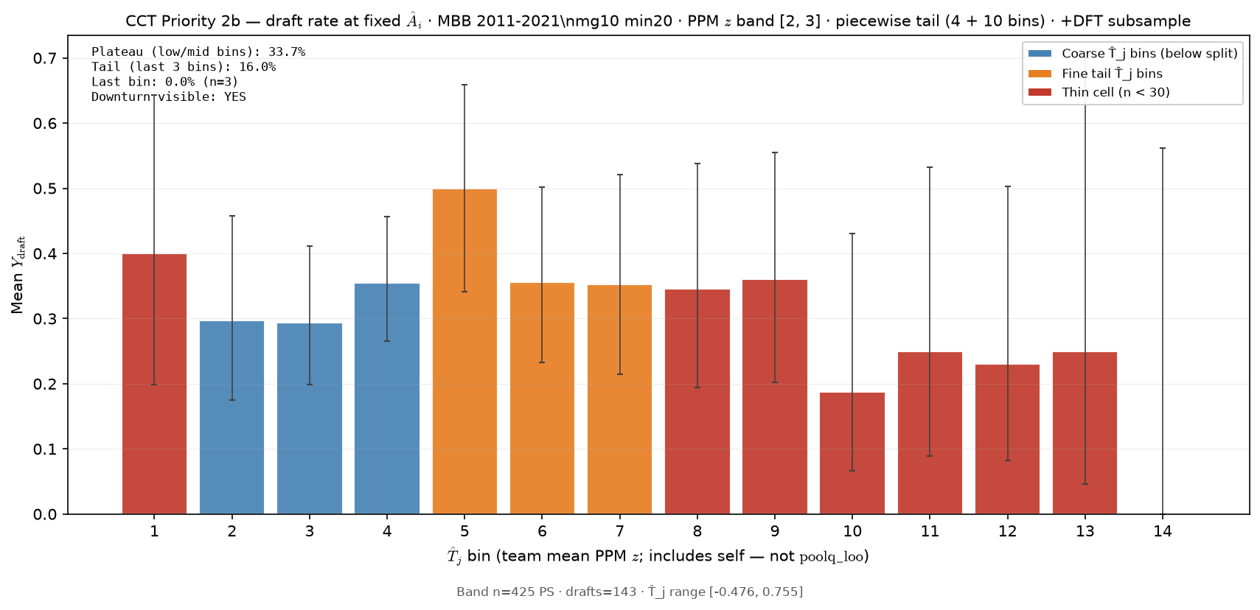
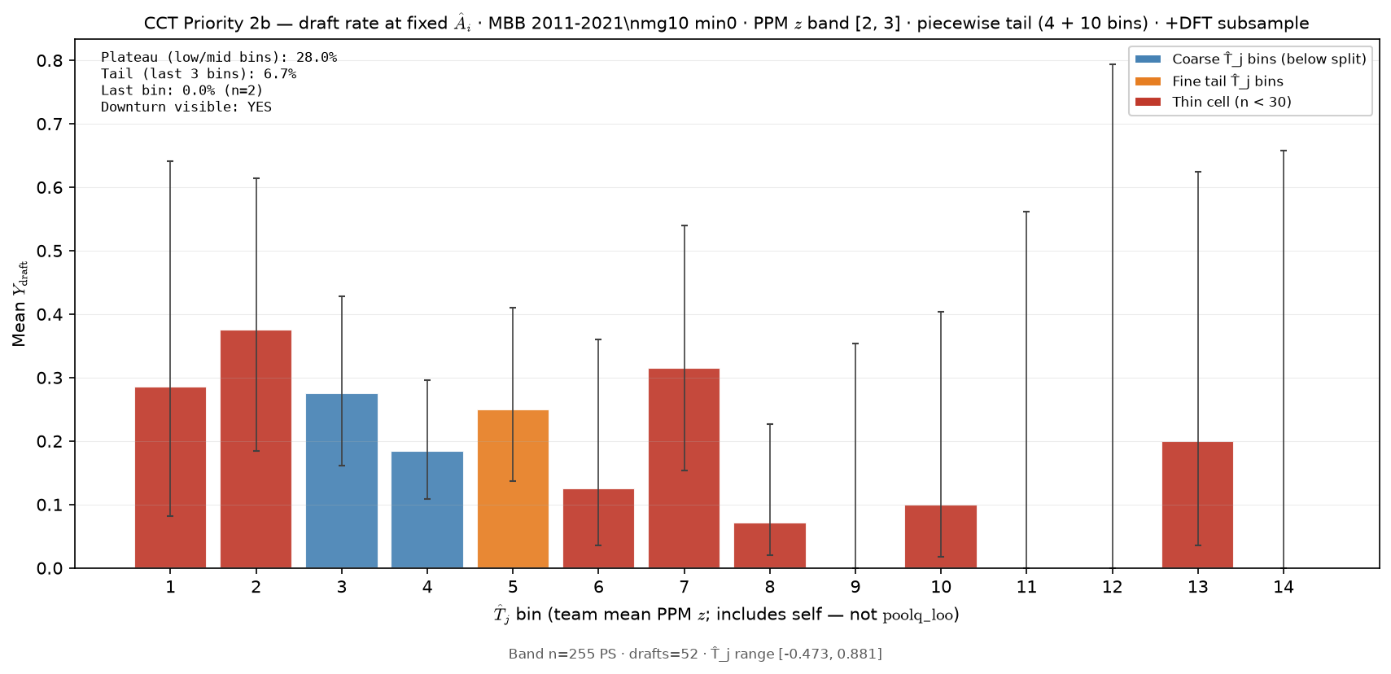
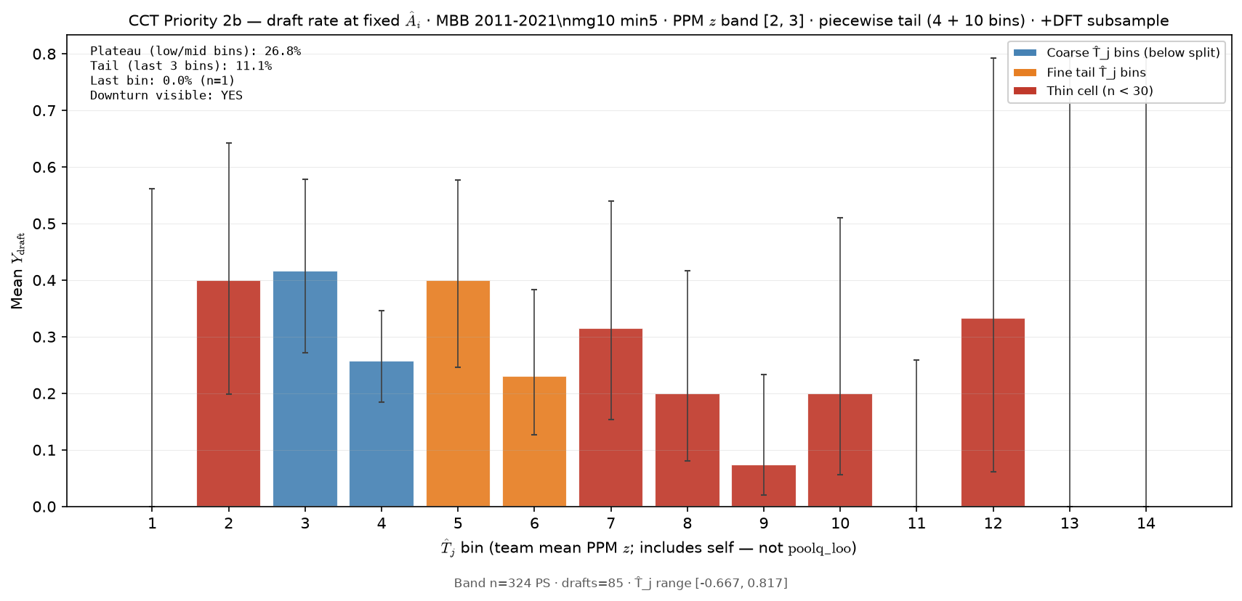
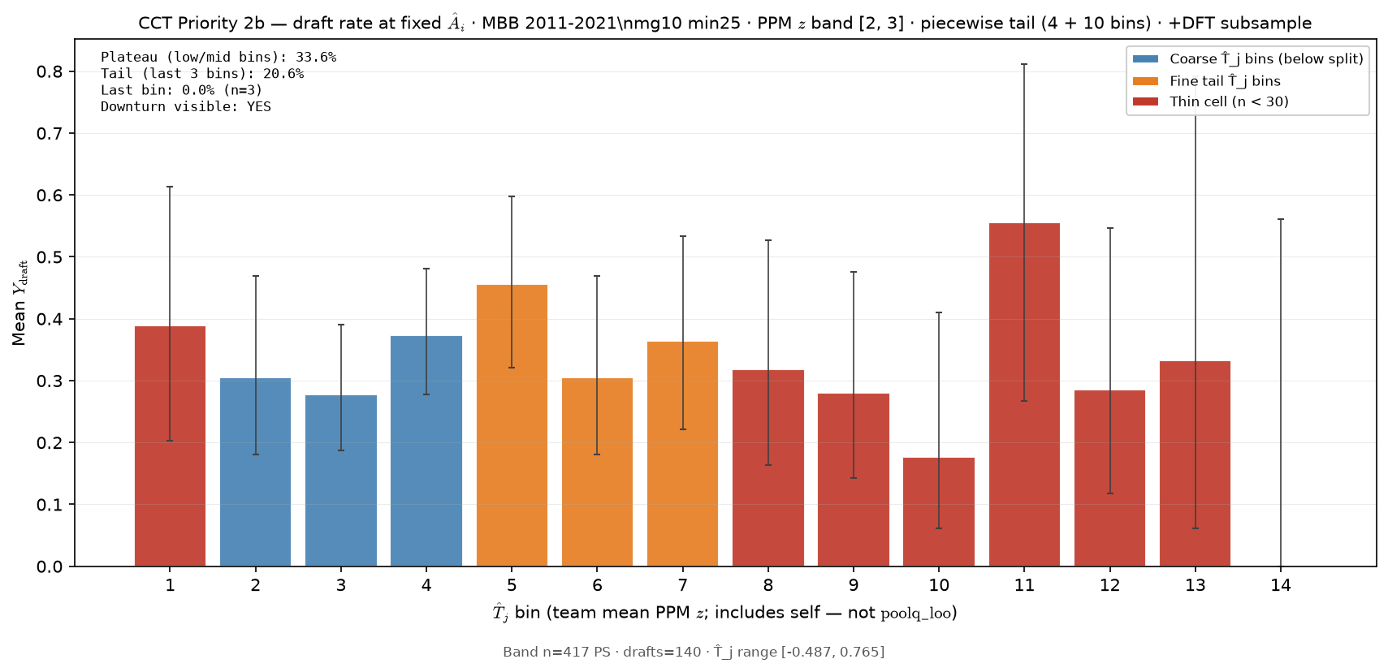
Min20, Z 2-3, 143 Drafts
Min0, Z 2-3, 52 Drafts
Min5, Z 2-3, 85 Drafts
Min25, Z 2-3, 140 Drafts

Slide 2
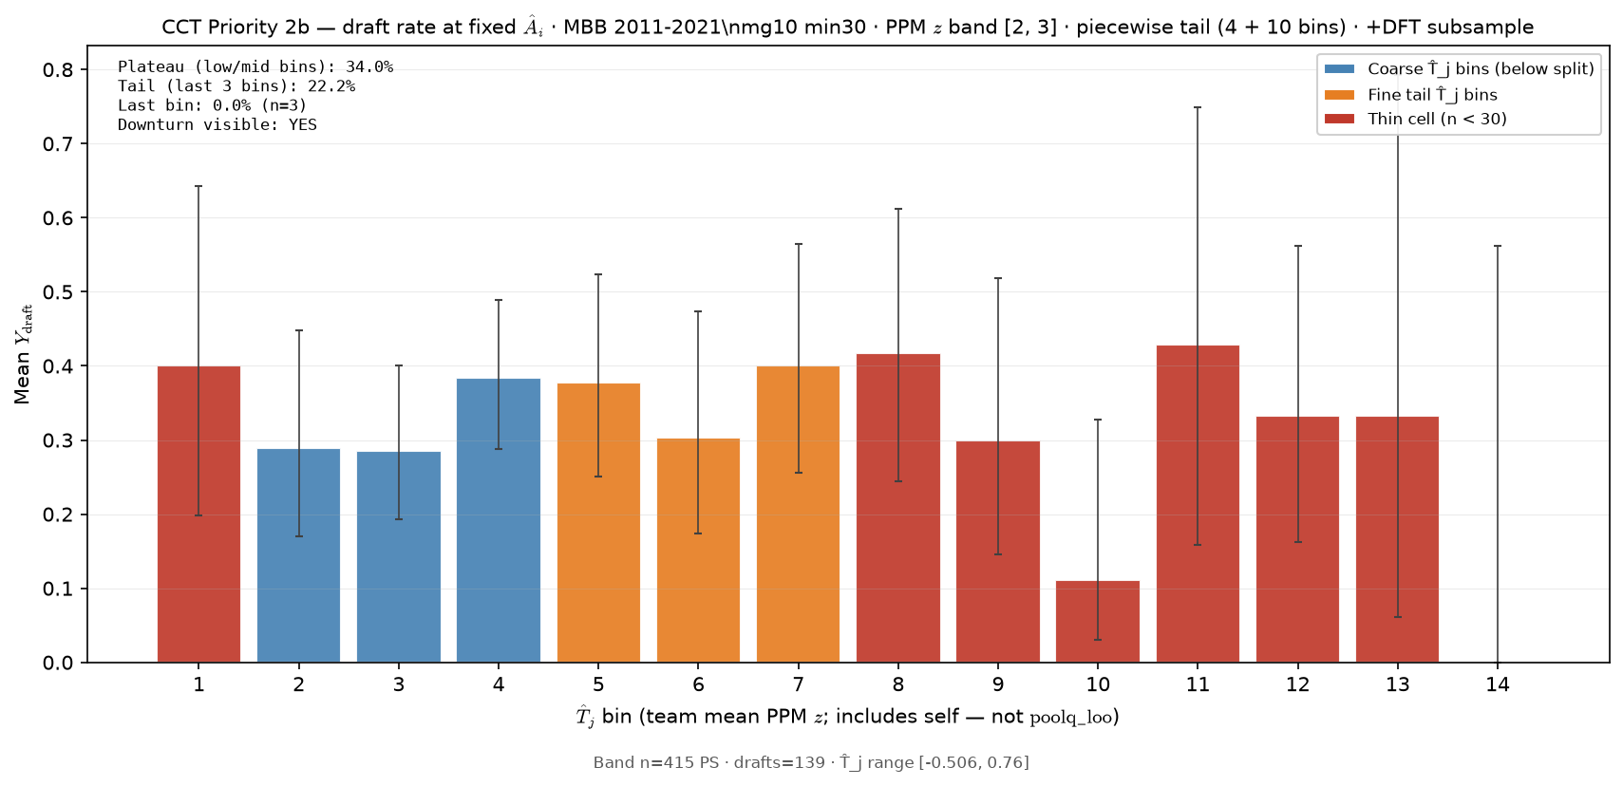
Min20, Z 2-3, 143 Drafts
Min30, Z 2-3, 139 Drafts

Slide 3
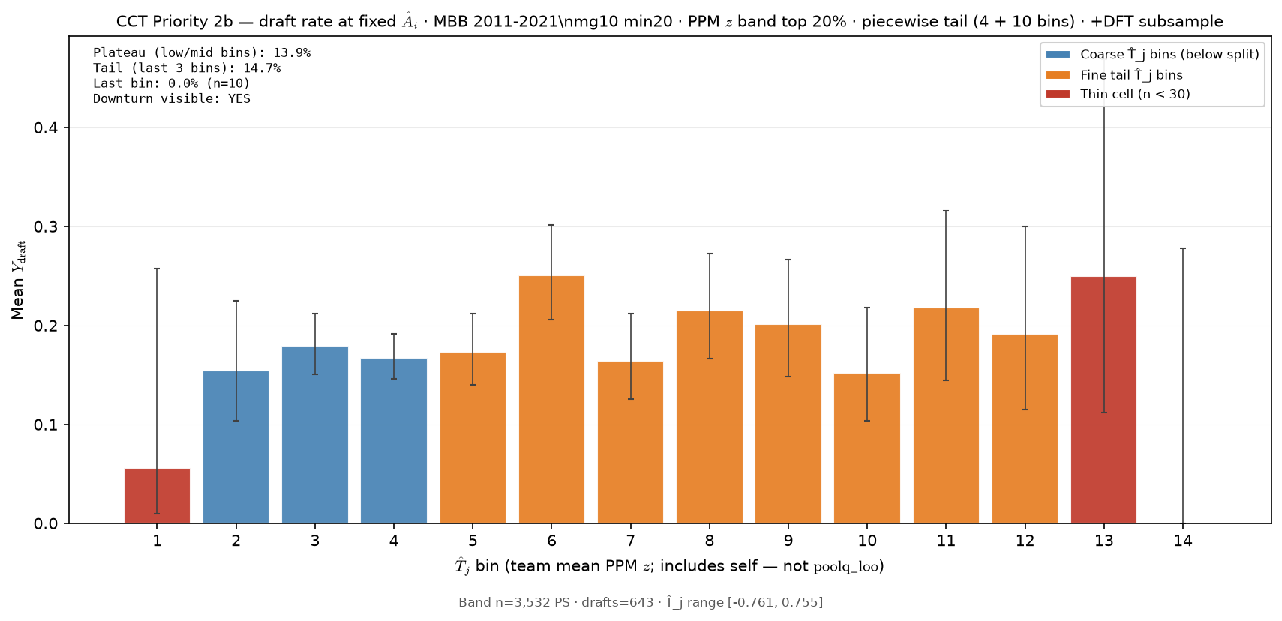
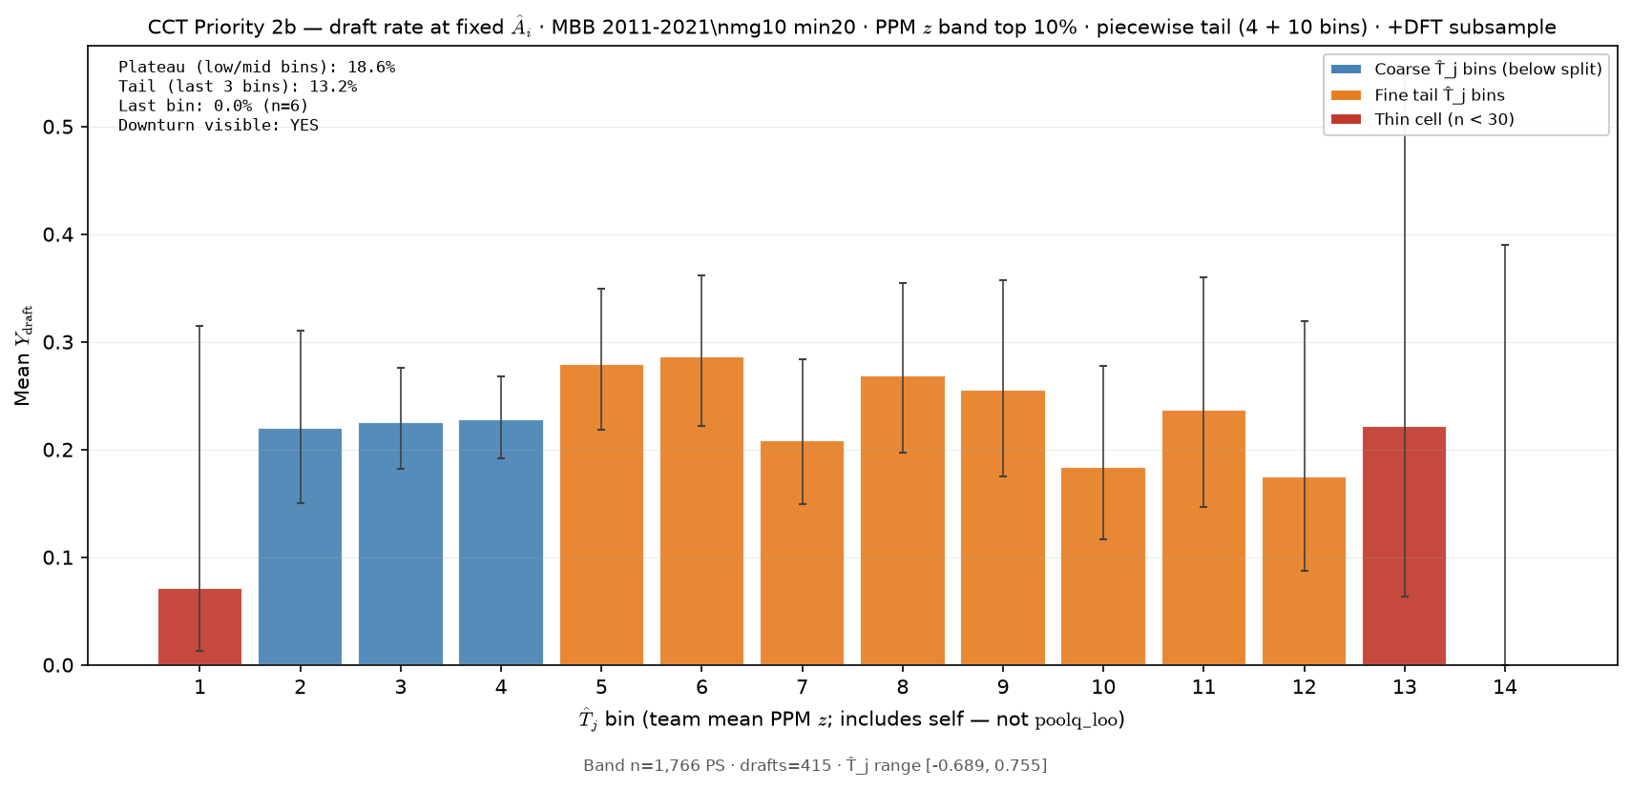
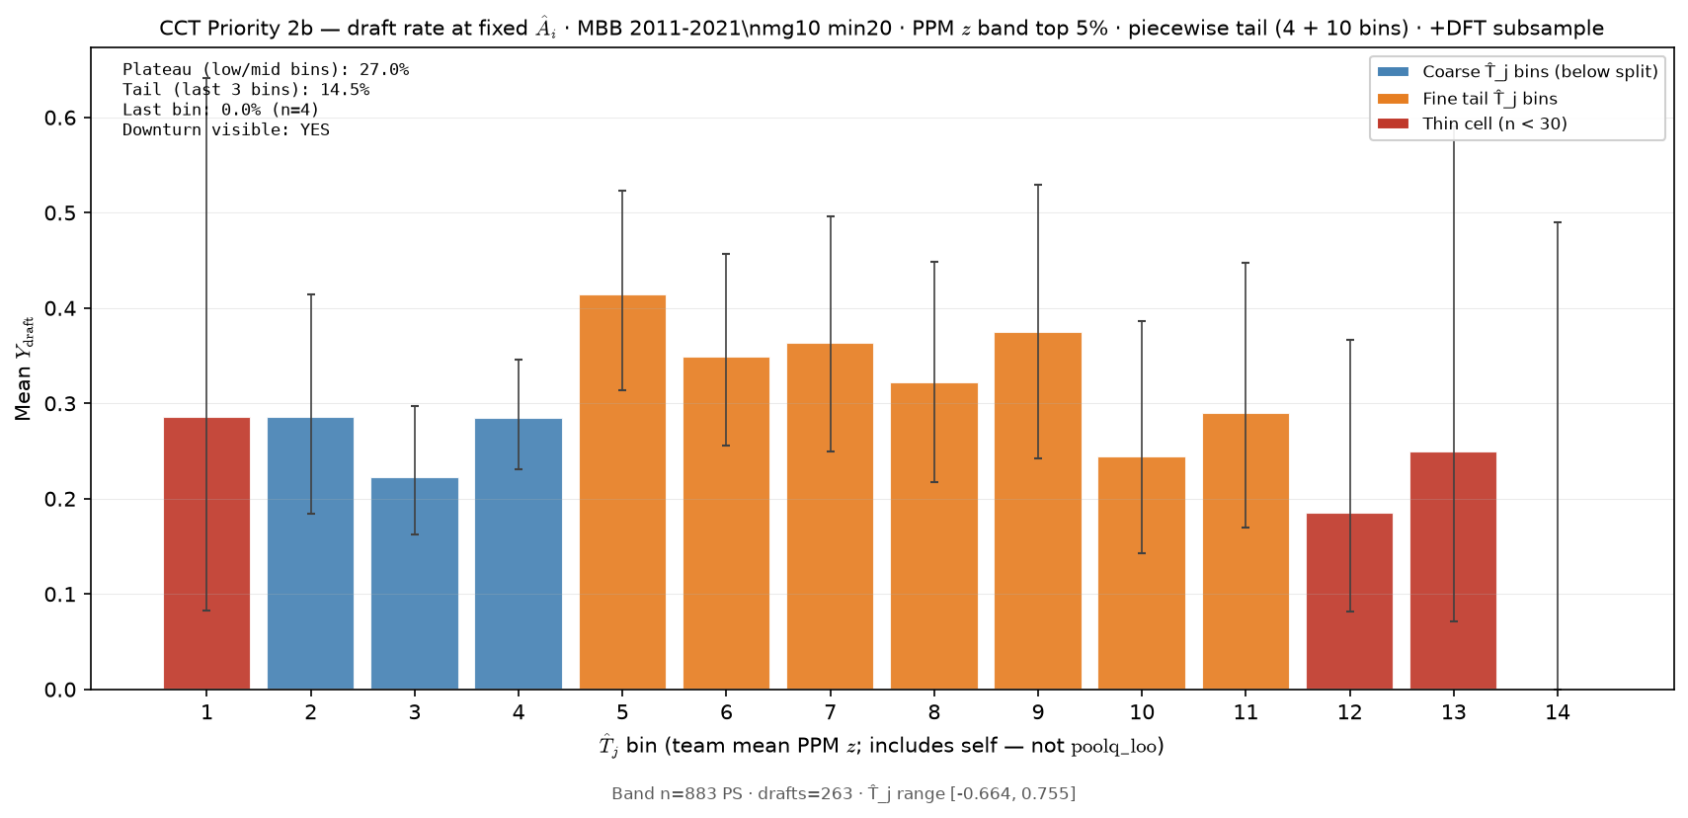
Min20, Z 2-3, 143 Drafts
Min20, T20%, 643 Drafts
Min20, T10%, 415 Drafts
Min20, T5%, 263 Drafts

Slide 4
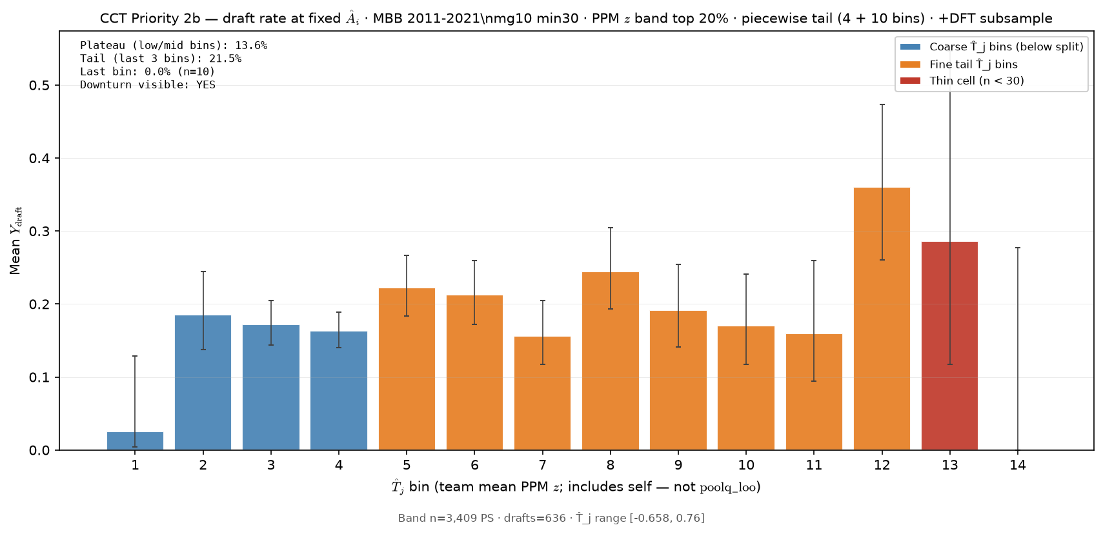
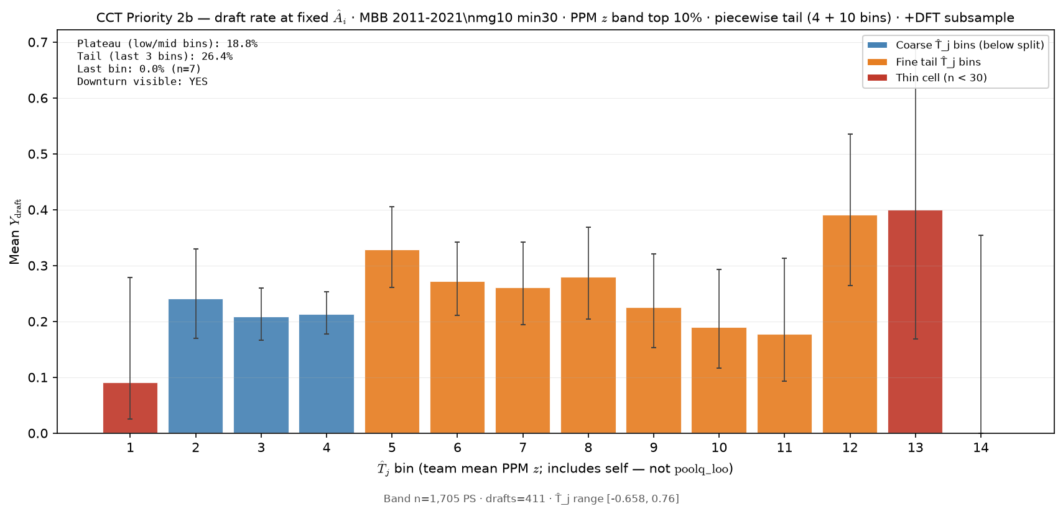
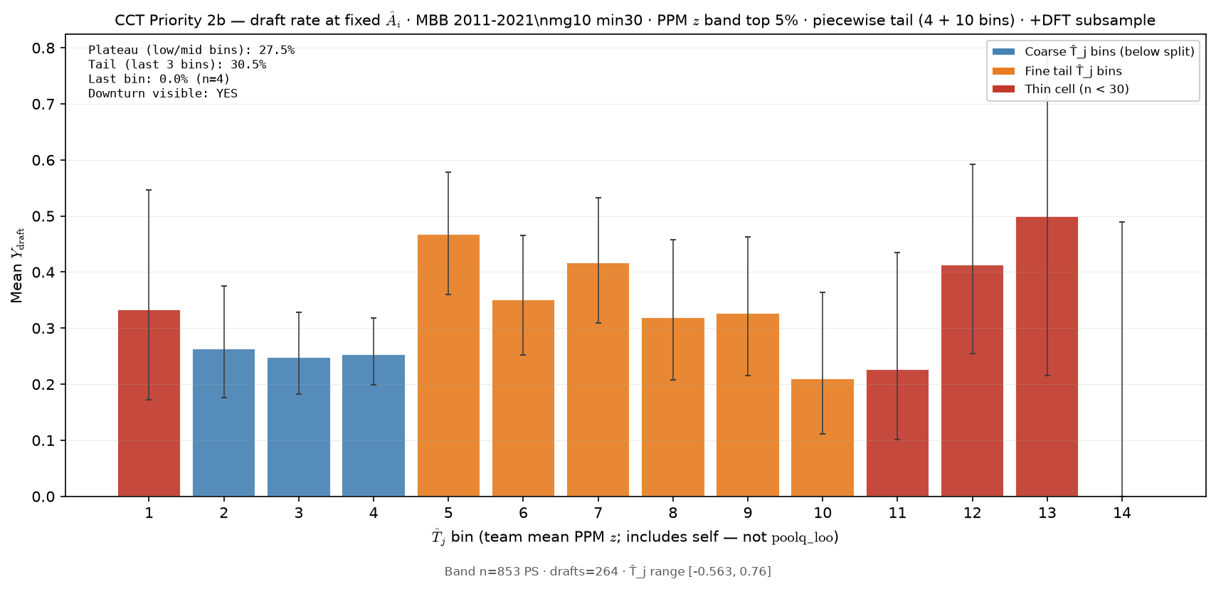
Min20, Z 2-3, 143 Drafts
Min30, T20%, 636 Drafts
Min30, T10%, 411 Drafts
Min30, T5%, 264 Drafts

Slide 5
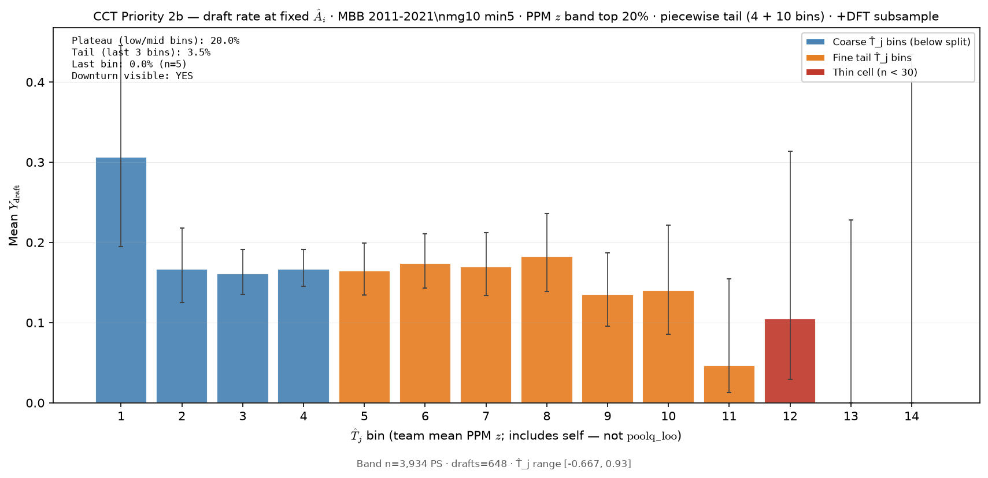
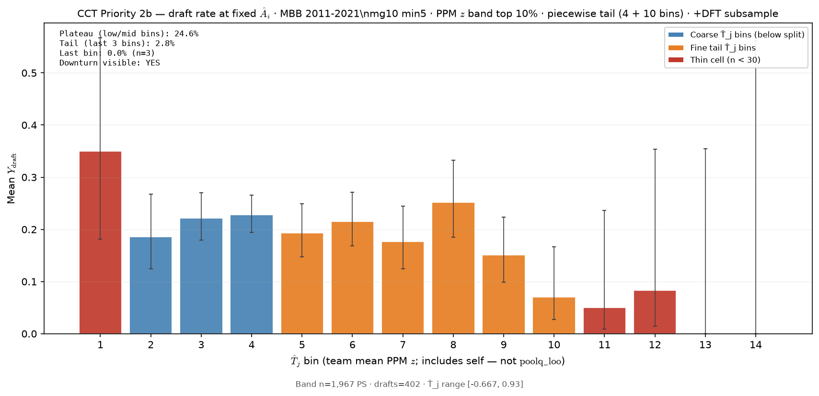
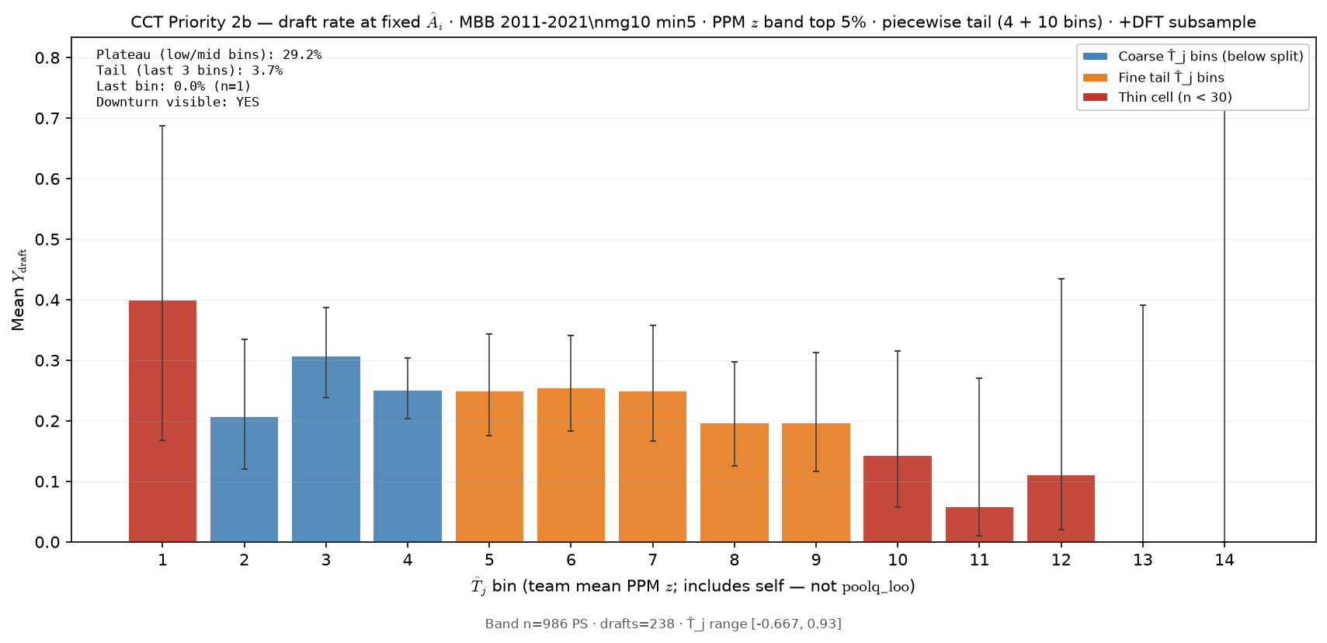
Min20, Z 2-3, 143 Drafts
Min5, T20%, 648 Drafts
Min5, T10%, 402 Drafts
Min5, T5%, 238 Drafts

Slide 6
Why does lowering the min cum playing time decrease drafts?
Min20, Z 2-3, 143 Drafts
Min0, Z 2-3, 52 Drafts
Because adding all those other players COMPRESSES the P2-3 band

Slide 7
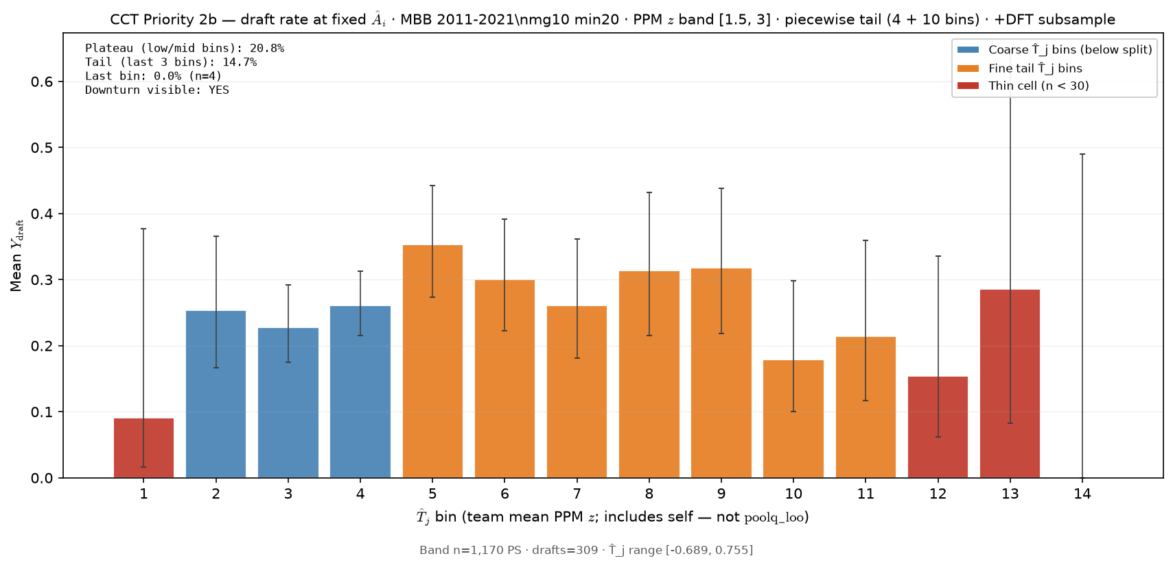
So, let’s increase the band from Z2-3 to Z1.5-3
Min20, Z 2-3, 143 Drafts
Min20, Z 1.5-3, 309 Drafts

Slide 8
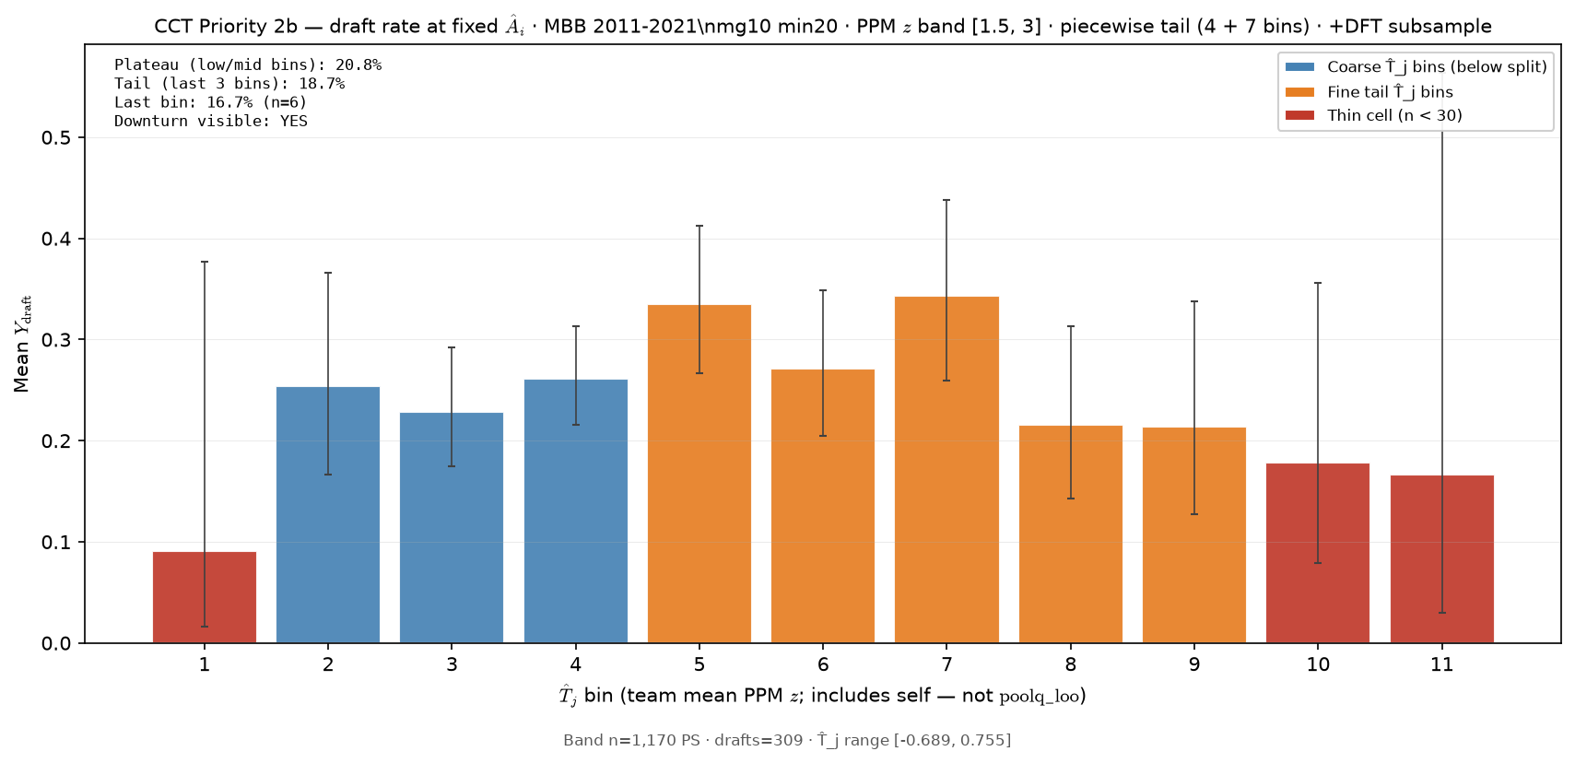
And let’s compress the high bins from 10 to 7
That plot on the right is a CANDIDATE!
Min20, Z 2-3, 143 Drafts
Min20, Z 1.5-3, 309 Drafts

Slide 9
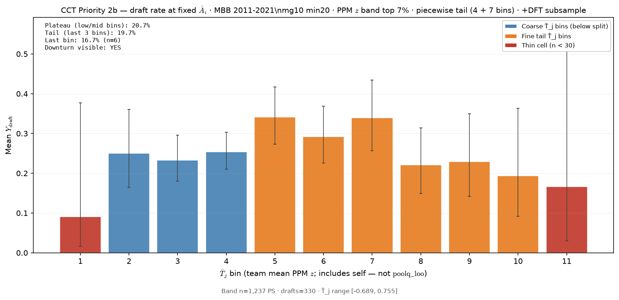
OK that CANDIDATE looks great on the left!
But now instead of Z scores, let's look at top X%.
Based on slide 3, let’s try to 7%
Min20, Z 1.5-3, 309 Drafts
Min20, T 7%, 330 Drafts
OK, That plot on the right is our new Fixed-$A_{i}$ Hero (F-HERO)

Slide 10
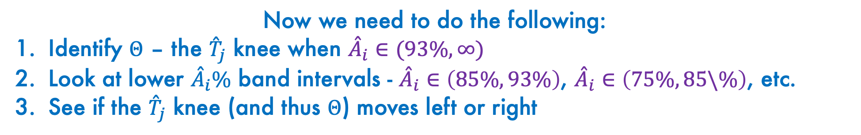
OK SO there’s our F-HERO
Min20, T 7%, L4-H7, 330 Drafts
Now we need to do the following:
Identify $Θ$ – the ${\overset{ˆ}{T}}_{j}$ knee when ${\overset{ˆ}{A}}_{i}∈(93\%,∞)$
Look at lower ${\overset{ˆ}{A}}_{i}\%$ band intervals - ${\overset{ˆ}{A}}_{i}∈\left(85\%,93\%\right)$, ${\overset{ˆ}{A}}_{i}∈\left(75\%,85\backslash \%\right)$, etc.
See if the ${\overset{ˆ}{T}}_{j}$ knee (and thus $Θ$) moves left or right

Slide 11
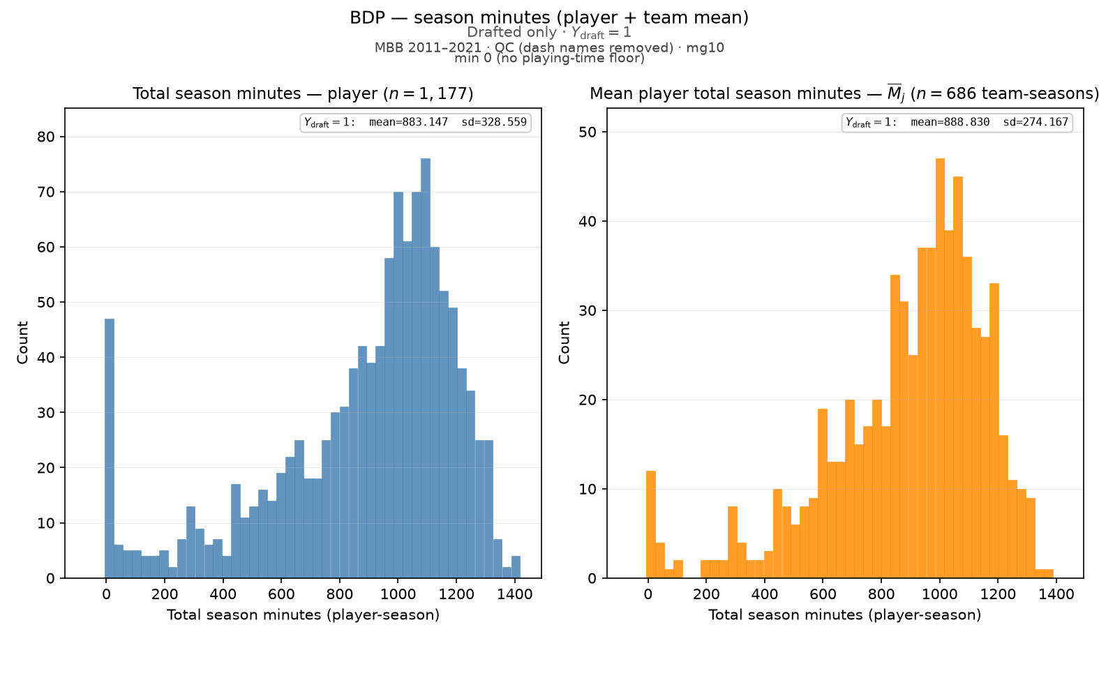
Distribution of total season minutes – Drafted Players Only

Slide 12
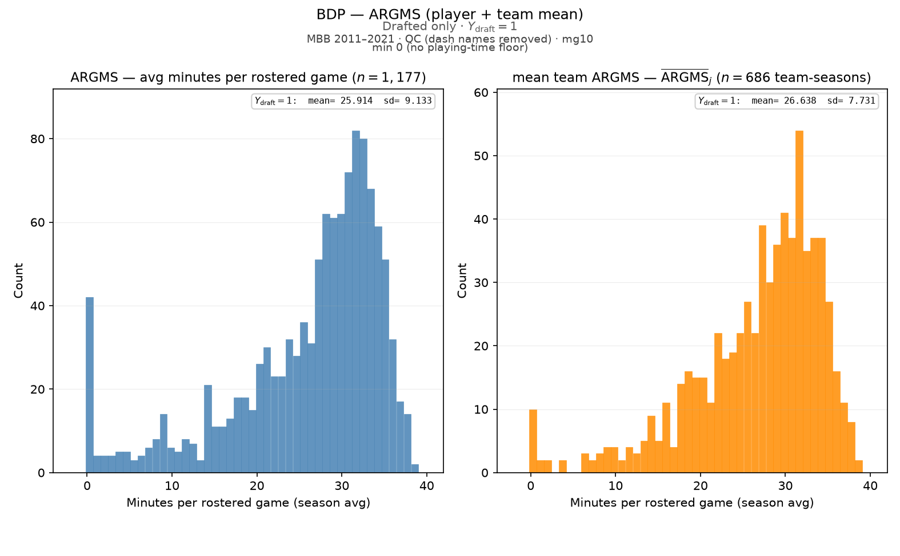
Distribution of ARGMS – Drafted Players Only

Slide 13
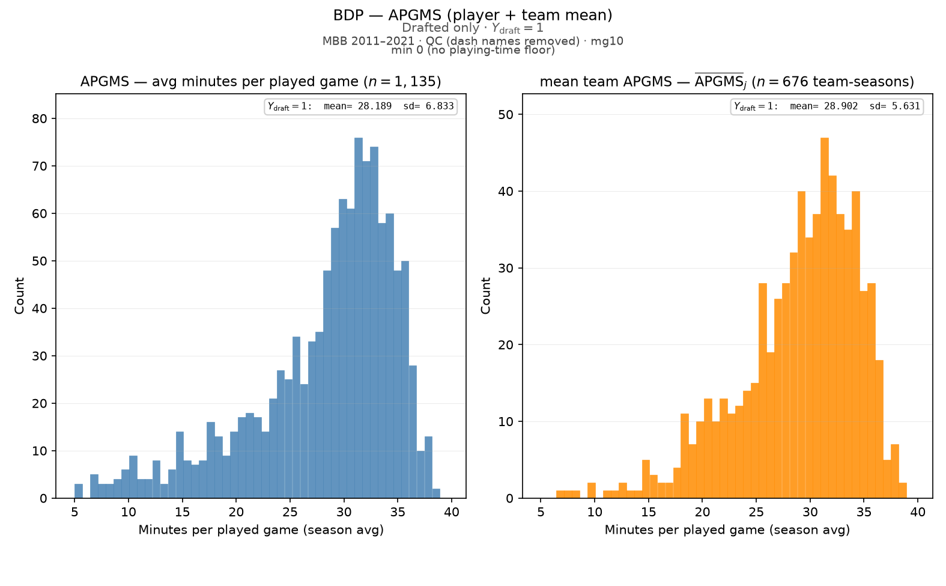
Distribution of APGMS – Drafted Players Only

Slide 14
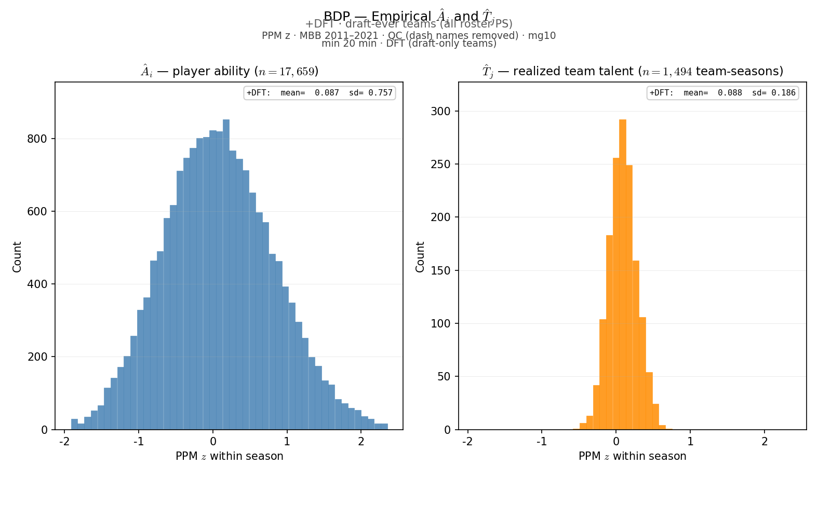
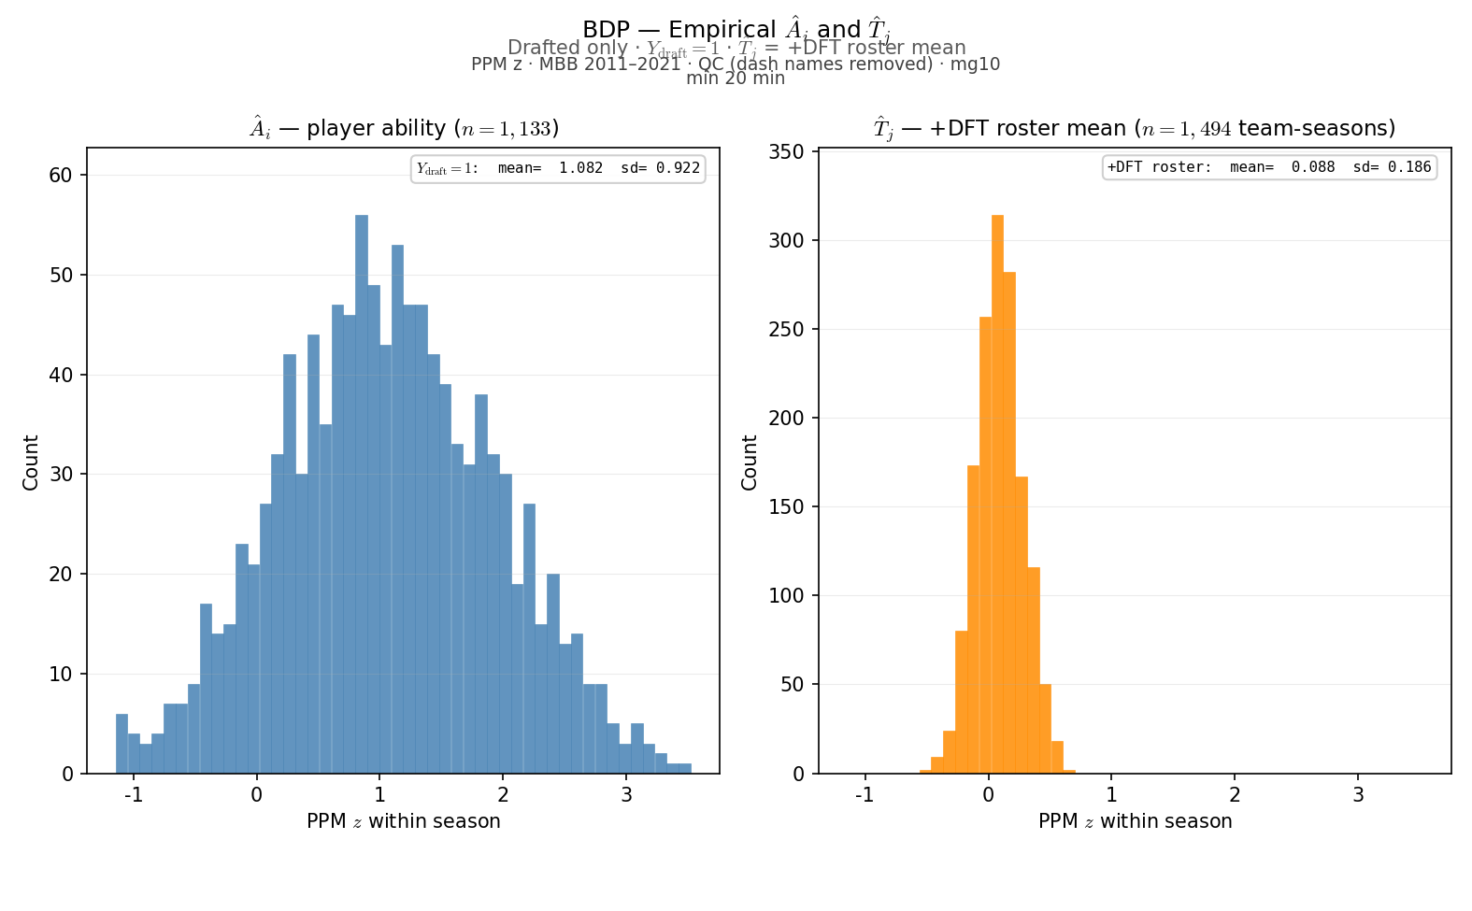
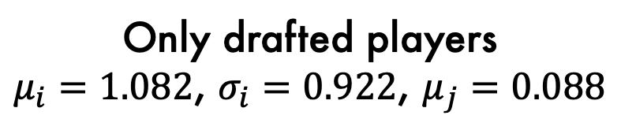
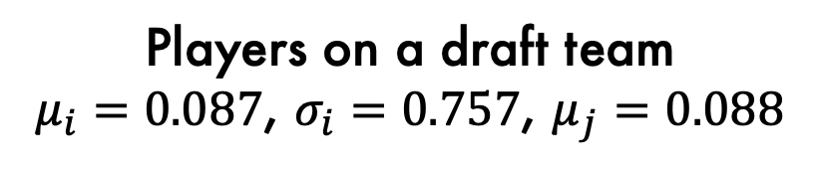
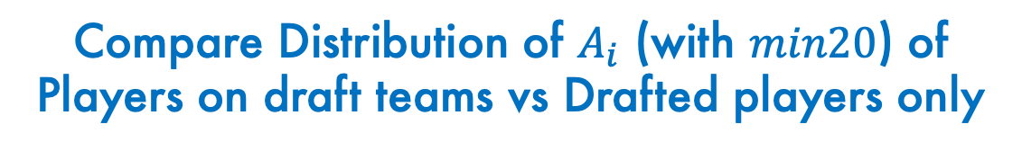
Compare Distribution of $A_{i}$ (with $min20$) of
Players on draft teams vs Drafted players only
Players on a draft team
$μ_{i}=0.087$, $σ_{i}=0.757$, $μ_{j}=0.088$
Only drafted players
$μ_{i}=1.082$, $σ_{i}=0.922$, $μ_{j}=0.088$

Slide 15
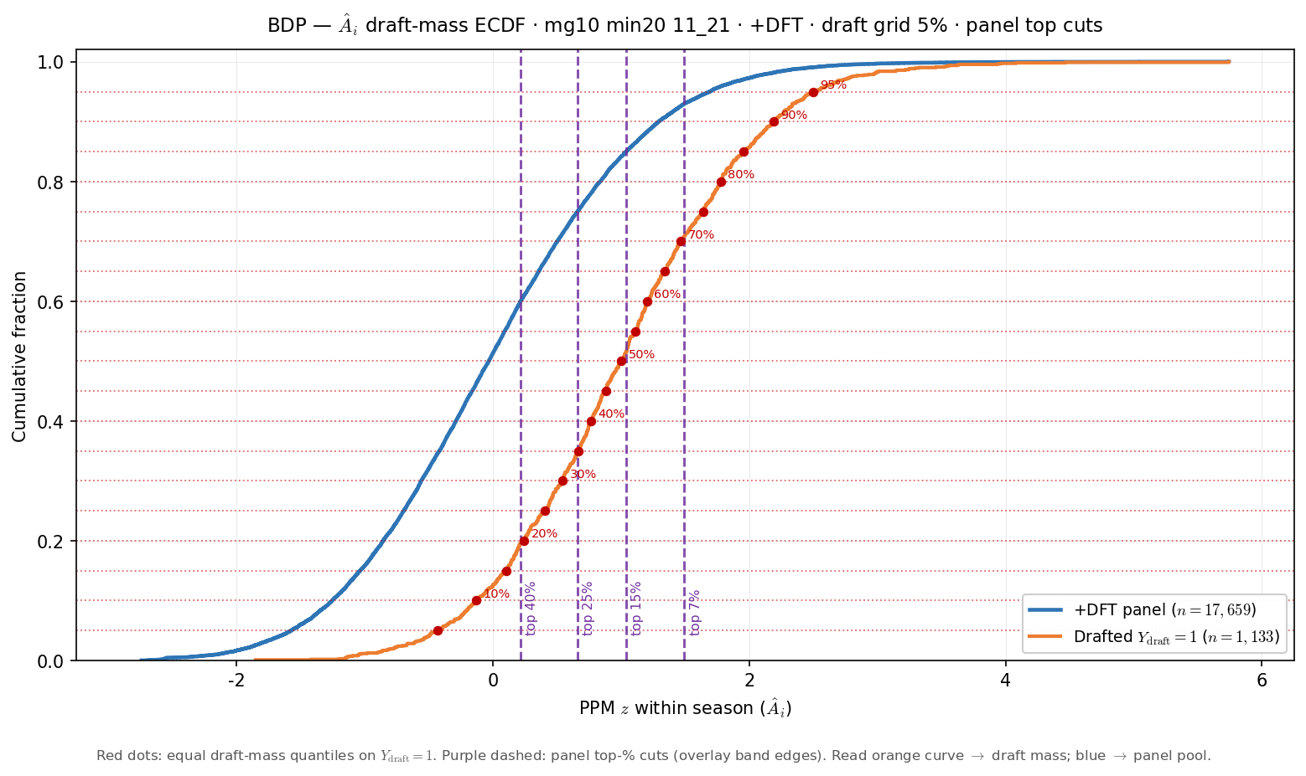
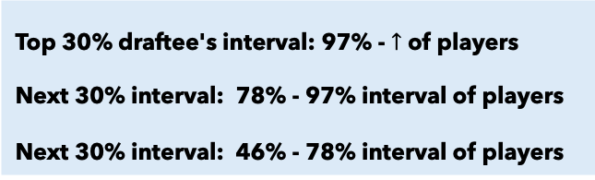
Use the CDF’s for both draft teams and drafted players to estimate 30% intervals
93%
78%
Top 30% draftee's interval: 97% - $↑$ of players
Next 30% interval: 78% - 97% interval of players
Next 30% interval: 46% - 78% interval of players
46%

Slide 16
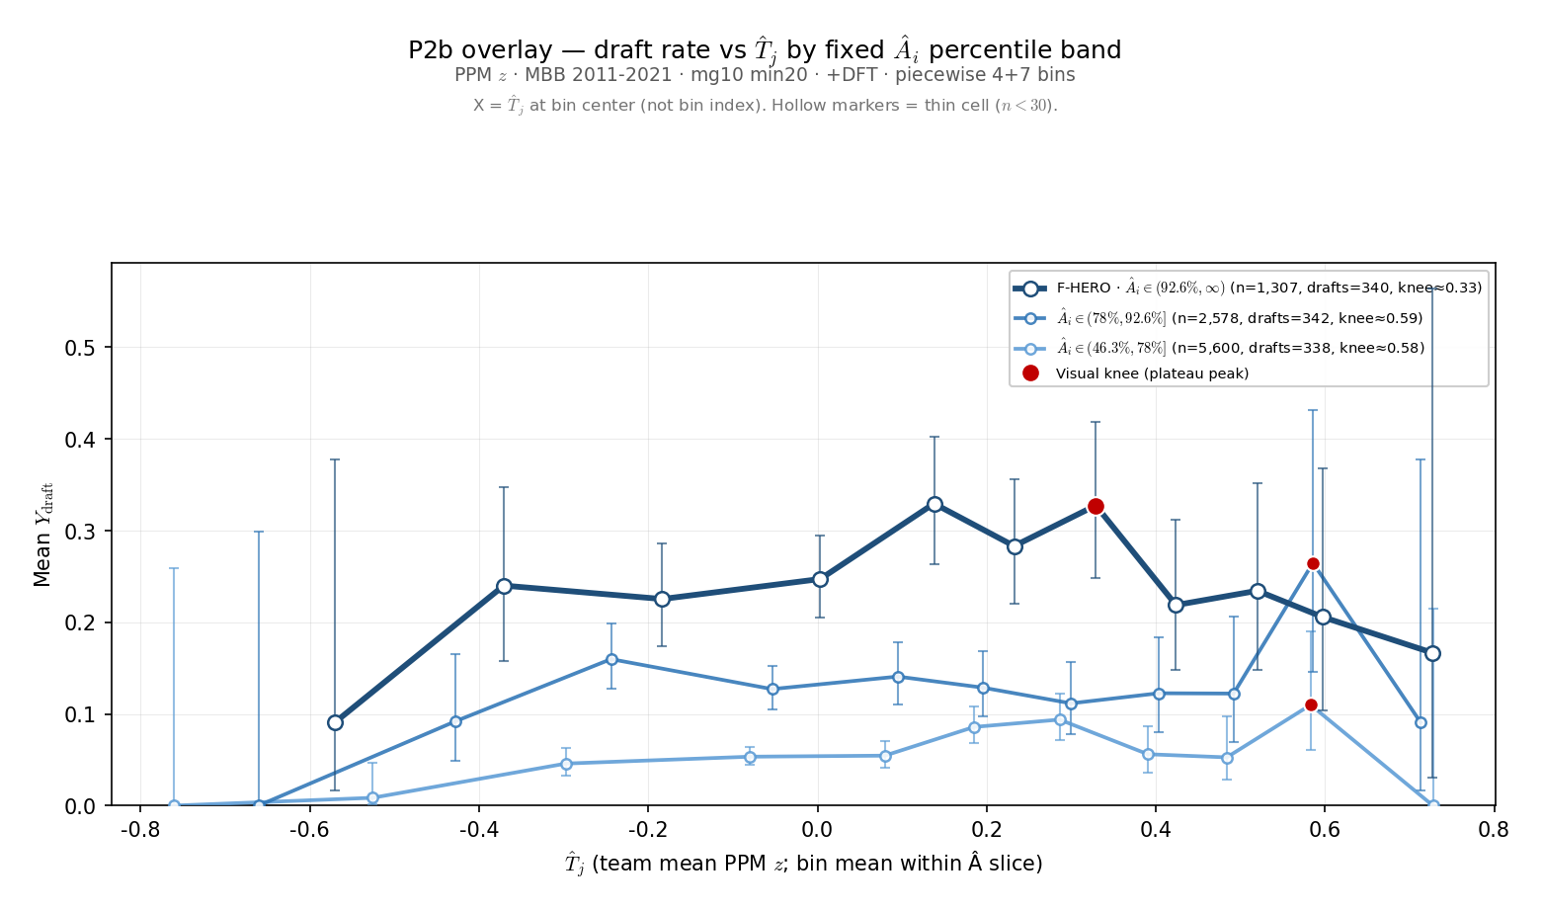
Using the intervals, convert bar charts to line plots and look for the ${\overset{ˆ}{T}}_{i}$ “knees”

