Slide 1
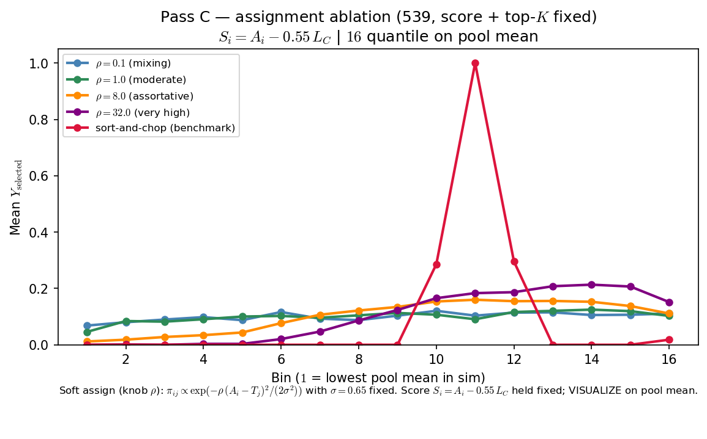
Phase B — Characterize ρ (assignment assortativity) — sort-and-chop shown
Characterize ρ — one-at-a-time at 539 baseline (score + top-K fixed)
πij ∝ exp\left(-ρ\,\frac{(Ai-Tj)2}{2σ2}\right)
σ=0.65 fixed arms: ρ \in {0.1, 1, 8, 32} + sort-and-chop
Si = Ai - 0.55\,LC (crowding in score held constant across arms)
top-K by Si
VISUALIZE = mean Yselected vs pool mean (16 bins)
OAT: one draw of Ai, Tj (seed 42); only ASSIGN changes across arms.
Low ρ: players mix across teams — selection vs pool mean stays nearly flat.
High ρ: assortative matching — peer environments concentrate; inverted-U emerges.
Sort-and-chop benchmark: hard rank match (same score rule as soft arms).
Claim: at fixed score and top-K, ρ in assignment matters — low-ρ mixing yields a nearly flat curve; high-ρ assortativity delivers the peer-pressure inverted-U readout.

Slide 2
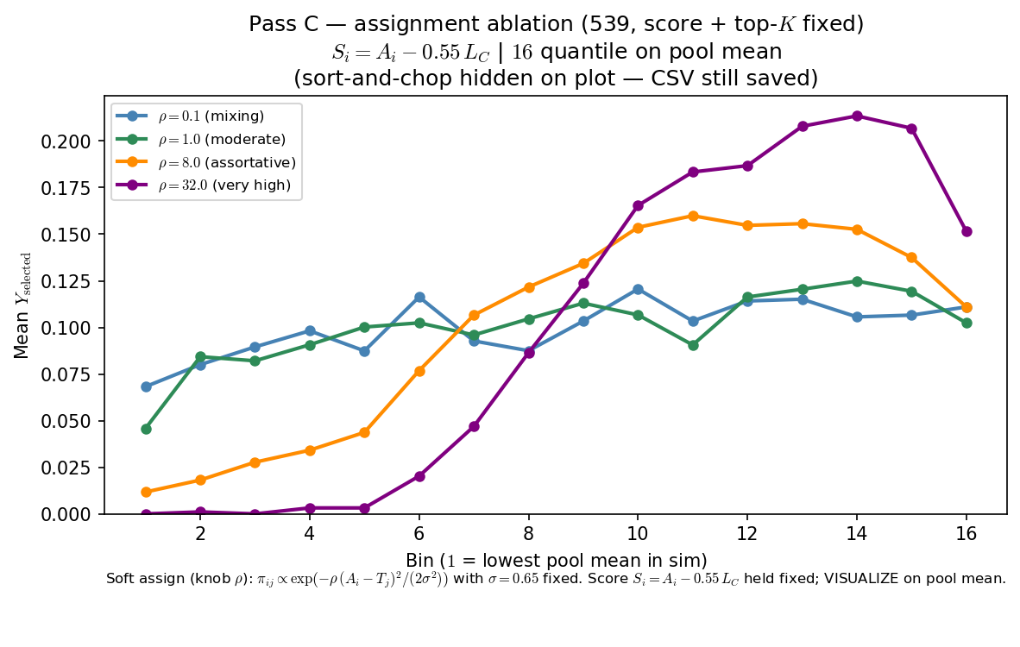
Phase B — Characterize ρ (assignment assortativity) — sort-and-chop suppressed
Characterize ρ — one-at-a-time at 539 baseline (score + top-K fixed)
πij ∝ exp\left(-ρ\,\frac{(Ai-Tj)2}{2σ2}\right)
σ=0.65 fixed arms: ρ \in {0.1, 1, 8, 32}
Si = Ai - 0.55\,LC (crowding in score held constant across arms)
top-K by Si
VISUALIZE = mean Yselected vs pool mean (16 bins)
OAT: one draw of Ai, Tj (seed 42); only ASSIGN changes across arms.
Low ρ: players mix across teams — selection vs pool mean stays nearly flat.
High ρ: assortative matching — peer environments concentrate; inverted-U emerges.
Sort-and-chop arm omitted from plot (still in CSV bundle; toggle restores it).
Claim: at fixed score and top-K, ρ in assignment matters — low-ρ mixing yields a nearly flat curve; high-ρ assortativity delivers the peer-pressure inverted-U readout.

