Slide 1
Tenure basic data plots — inference porch
2026-09-02
• Tenure porch BDP: HIGH + MEDIUM OpenAlex inference · LOO computable.
• v0 section: ASST-PS uni×year assistant pools (exploratory lock).
• PD29 section: decision cohort · asst_time · pubs_per_career_year · dept pond LOO.
• HERO rate plots: TENURE_HERO_slides_AUTO.pptx (decision dept LOO = primary).
python tenure/scripts/tenure_basic_plots.py python tenure/scripts/build_tenure_basic_plots_slides.py

Slide 2
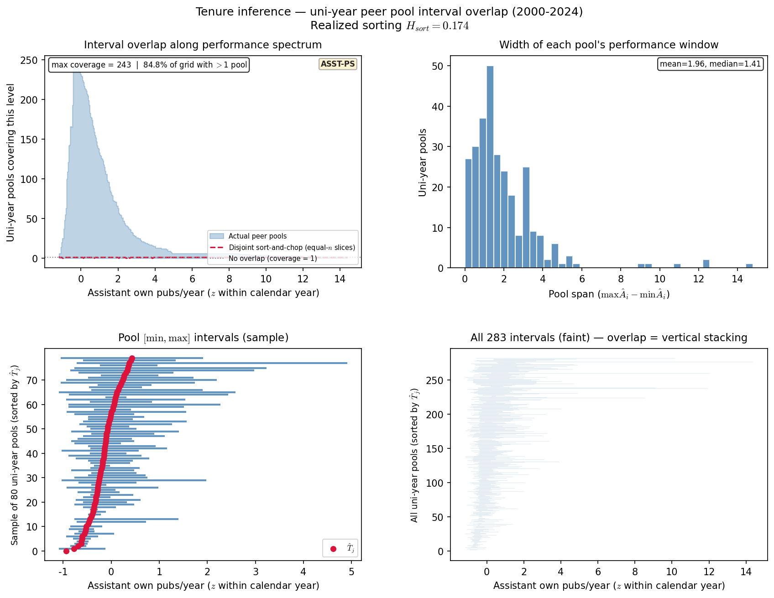
Slide 1 — Uni-year peer pool interval overlap
ASST-PS · MBB PD17 / reigning overlap analog · pubs_year z within year
• Pool unit = university × year (OpenAlex assistant peer pool).
• Each interval = [min, max] own pubs (z within year) across OA assistants in pool.
• Overlap along the spectrum motivates LOO vs full-pool pressure (F-HERO later).
python tenure/scripts/tenure_basic_plots.py --only overlap
uni-year pools=283 · asst-years=2,373 · max coverage=243 · H_sort=0.174

Slide 3
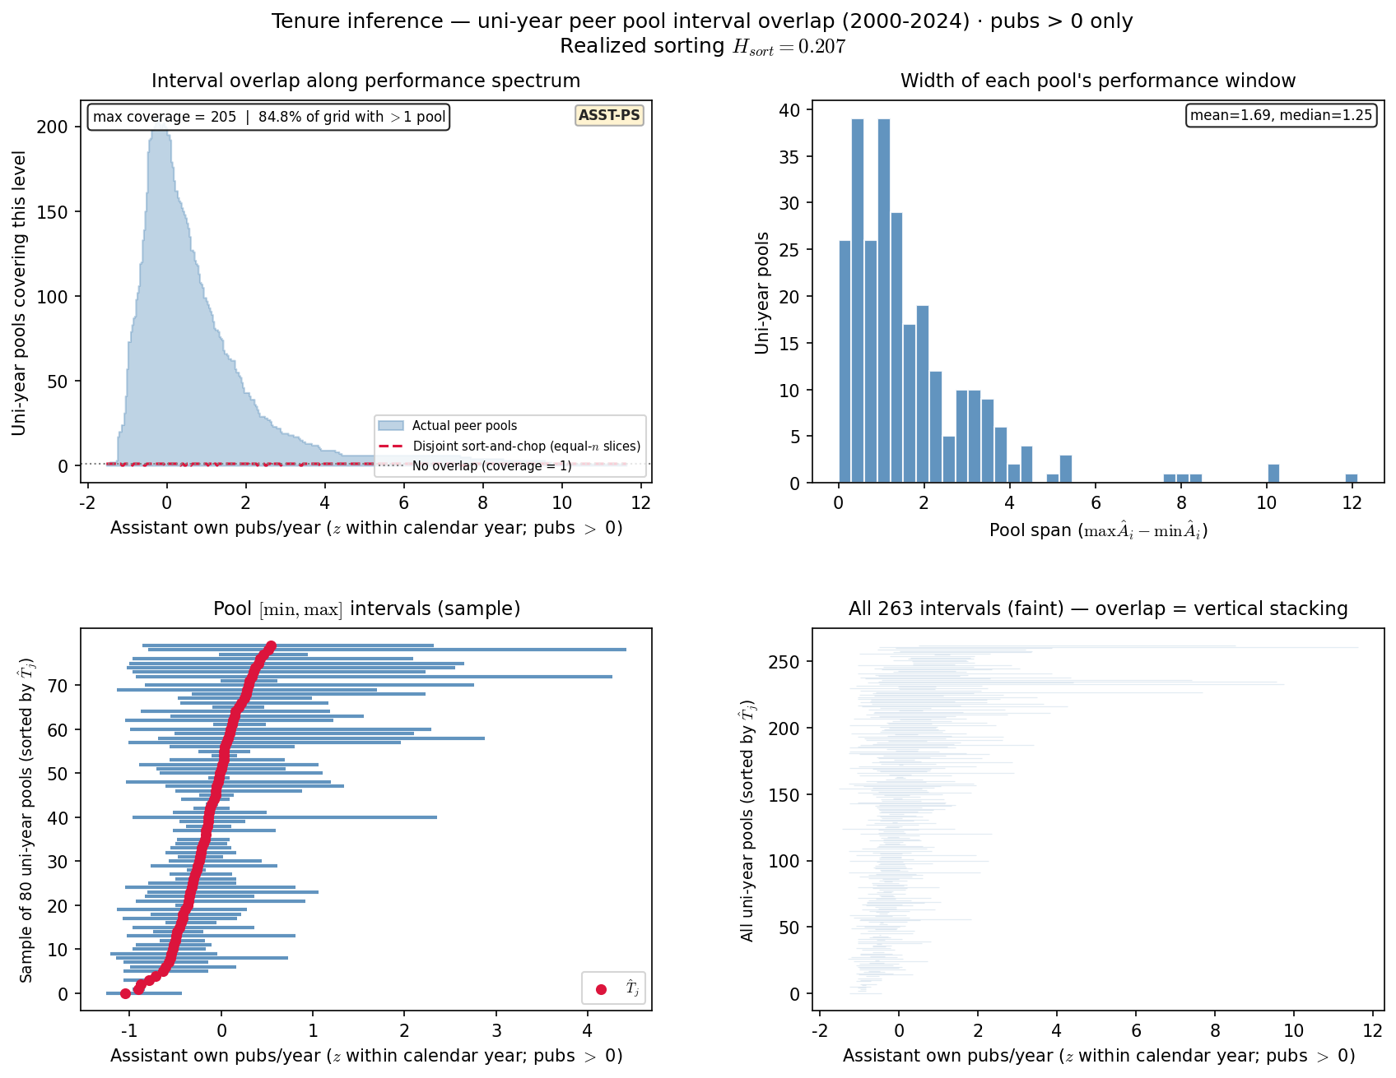
Slide 2 — Uni-year peer pool interval overlap (pubs > 0)
ASST-PS · Sensitivity — intensive margin only · compare to prior slide
• Same pool unit; assistant-years with pubs_year = 0 dropped before z and intervals.
• z within year recomputed on pubs > 0 rows only (not identical to full-panel z).
• Compare H_sort and coverage to full-panel slide — zeros inflate overlap mass at bottom.
python tenure/scripts/tenure_basic_plots.py --only overlap_gt0
uni-year pools=263 · asst-years=1,526 · max coverage=205 · H_sort=0.207

Slide 4
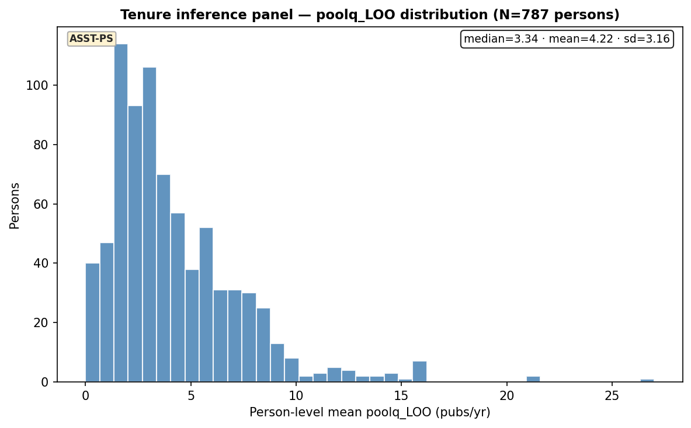
Slide 3 — poolq_LOO distribution (HERO grain)
ASST-PS · Person-level mean · N≈796 matches Q16/Q20 HERO
• Same collapse as tenure_pass_a_hero: mean poolq_loo_mean over assistant years.
• Right-skew drives equal-width bin sparsity at high LOO.
python tenure/scripts/tenure_basic_plots.py --only poolq_loo
n=787 · median=3.34 · mean=4.22 · sd=3.16

Slide 5
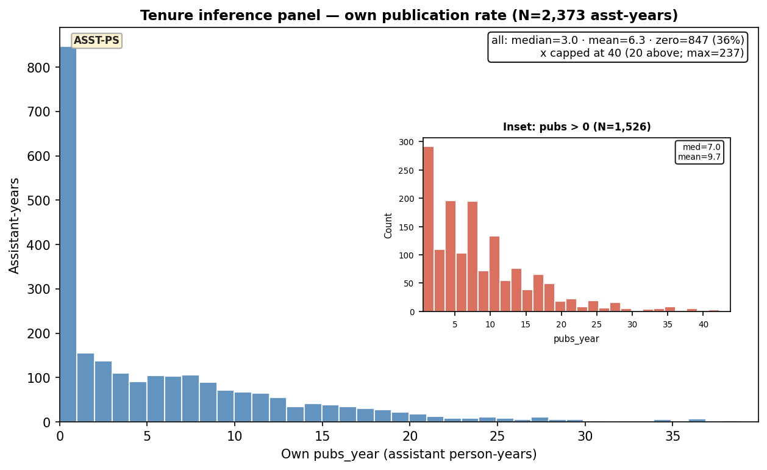
Slide 4 — Own pubs_year distribution
ASST-PS · Unconditional + inset (pubs > 0) · inference panel
• Main: all assistant-years (36% zero pub years in OpenAlex count).
• Inset: intensive margin — shape among those with ≥1 pub (N≈1,544).
• Main x-axis capped near p99; tail max=237 noted in legend box.
python tenure/scripts/tenure_basic_plots.py --only pubs_year
all n=2,373 (36% zero) · inset n=1,526 · med=7.0 · mean=9.7

Slide 6
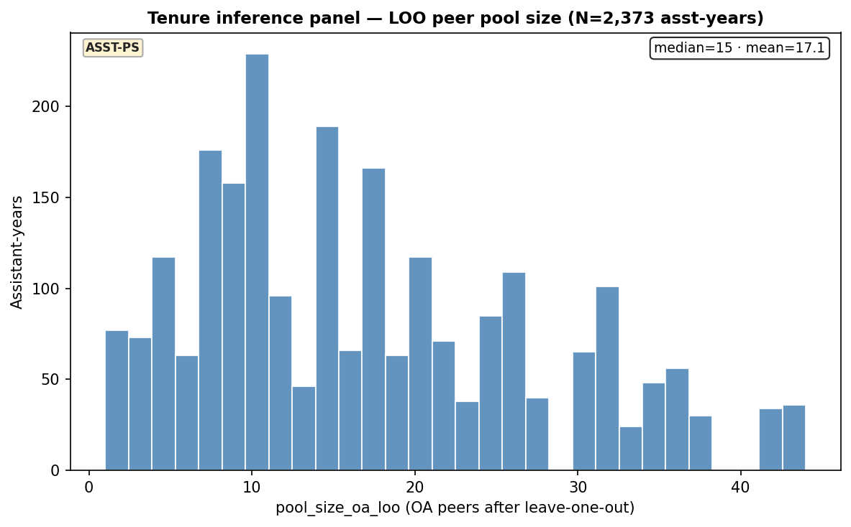
Slide 5 — LOO peer pool size distribution
ASST-PS · pool_size_oa_loo on assistant person-years
• Count of OA-matched co-assistants after leave-one-out.
• Thin pools → noisy LOO; complements overlap slide.
python tenure/scripts/tenure_basic_plots.py --only pool_size
n=2,373 · median=15.00 · mean=17.12 · sd=10.36

Slide 7
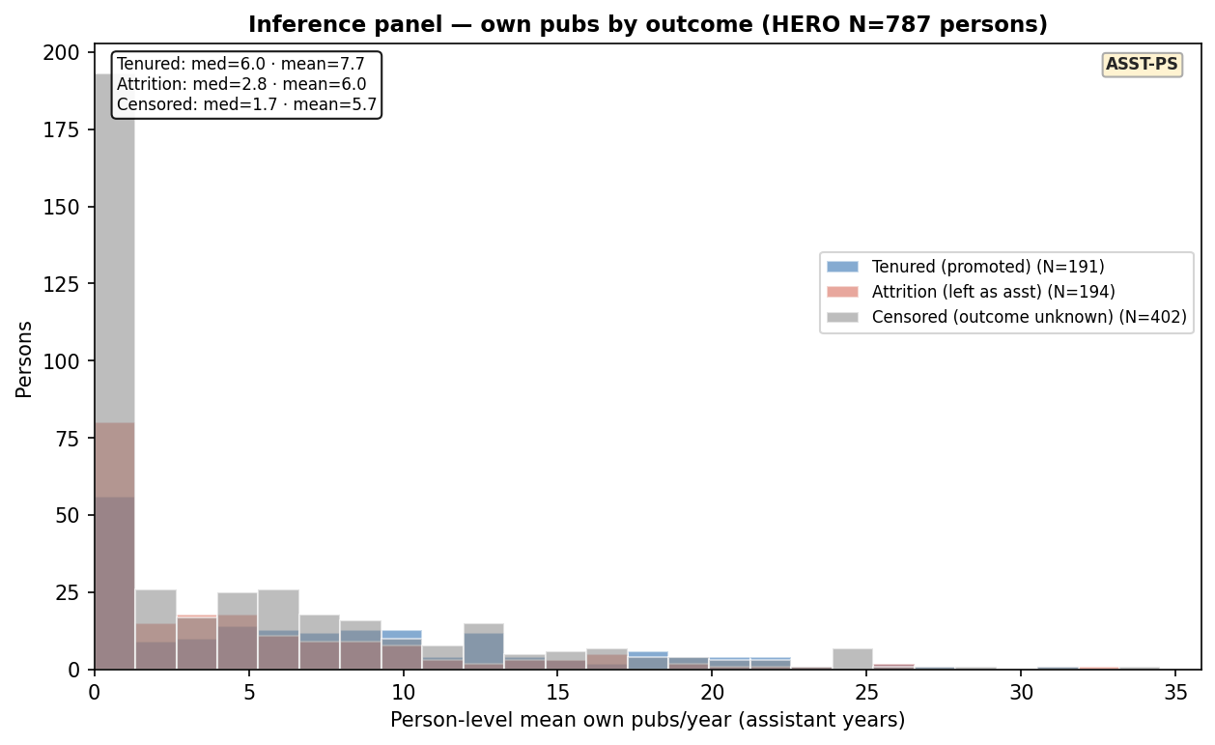
Slide 6 — Own pubs by outcome (person-level)
ASST-PS · Tenured vs attrition vs censored · same HERO N
• Person-level mean pubs_year over assistant spell — descriptive, not HERO.
• Blue = promoted (tenure_event); orange = left as assistant; gray = still asst ≈ 2024.
• Compares own output to the LOO environment HERO bins on.
python tenure/scripts/tenure_basic_plots.py --only pubs_by_outcome
tenured n=191 med=6.0 · attrition n=194 med=2.8 · censored n=402 med=1.7

Slide 8
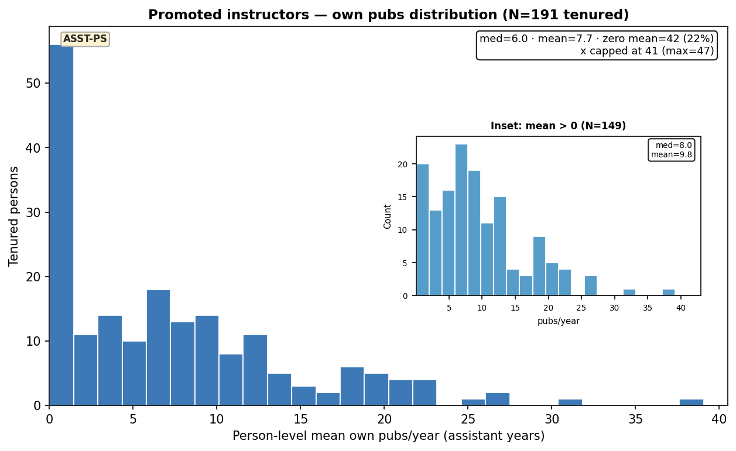
Slide 7 — Promoted instructors — own pubs
ASST-PS · Tenured only · person-level mean + inset (mean > 0)
• Subset to tenure_event = True (N≈174 on inference panel).
• Mean annual pubs over assistant years — not cumulative career total.
• Pairs with HERO high-bin tenure rates; inset drops zero-mean spells.
python tenure/scripts/tenure_basic_plots.py --only pubs_tenured
tenured n=191 · med=6.0 · mean=7.7 · inset n=149

Slide 9
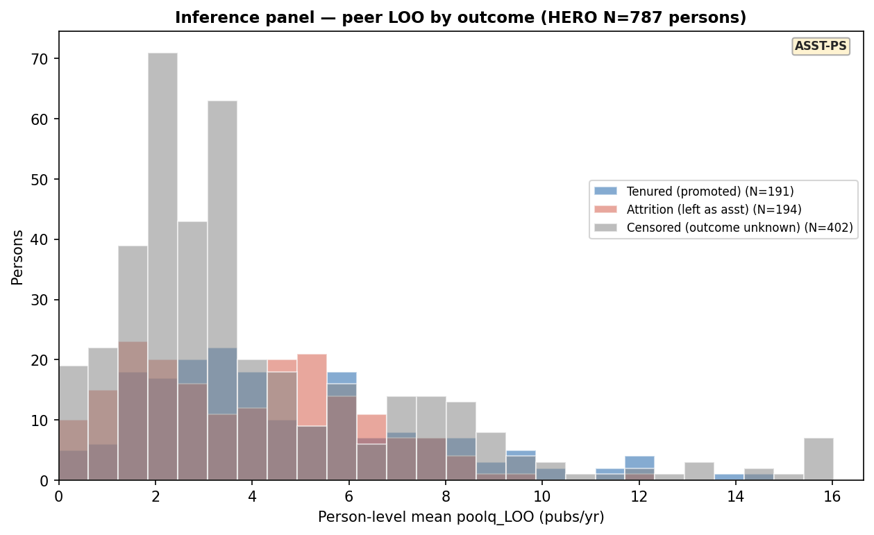
Slide 8 — poolq_LOO by outcome (person-level)
ASST-PS · Peer environment split · complements HERO x-axis
• Same outcome colors as pubs-by-outcome slide.
• Shows whether promoted faculty carried higher LOO peer pressure on average.
• HERO asks rate(T|LOO bin); this is marginal LOO by outcome.
python tenure/scripts/tenure_basic_plots.py --only loo_by_outcome
tenured n=191 med=3.8 · attrition n=194 med=3.7 · censored n=402 med=3.1

Slide 10
Decision cohort — basic data plots (PD29)
2026-09-02 · rebuilt panel · new metrics
• Resolved = tenure or attrition (incl. off_tenure_track). Excl. censored + transferred.
• Metrics: asst_time · own pubs_per_career_year · dept pond LOO (whole dept, you excluded).
• Reference band asst_time 5–6 shaded on timing plot only — not an inclusion filter.

Slide 11
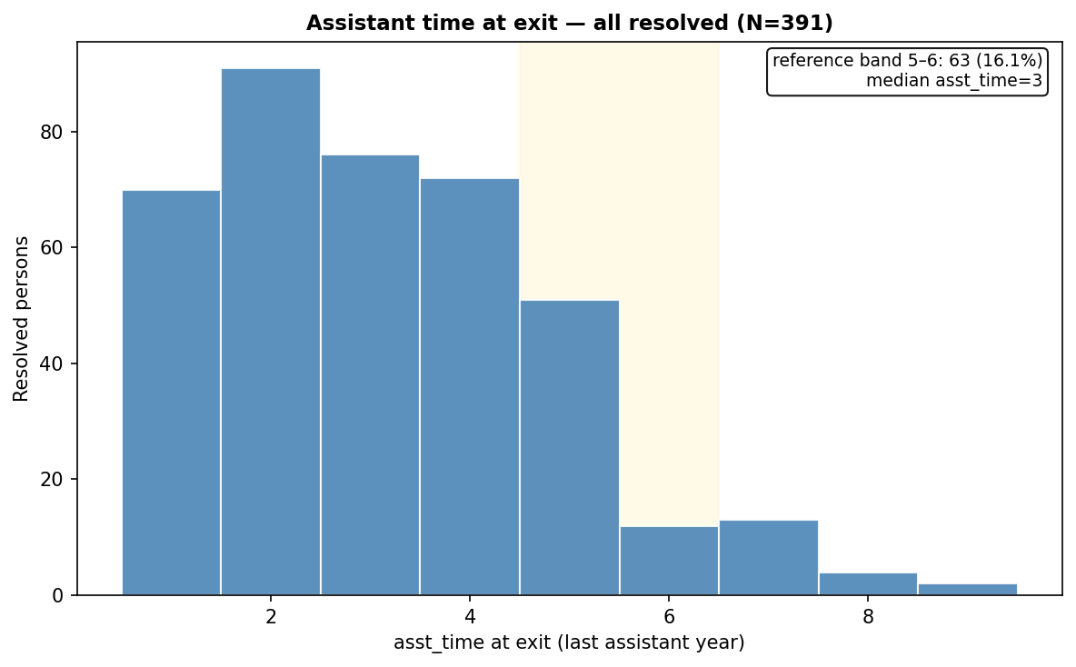
Slide 9 — Assistant time at exit (all resolved)
exit cross-section · Reference band asst_time 5–6 shaded · not a filter
• 391 resolved infHM at last assistant year (excl. transferred).
• Dept-year censoring + off-tenure-track attrition on rebuilt panel.
• Most exits early (asst_time 1–4); band 5–6 = Alex expected clock (63 people, 16%).
python tenure/scripts/tenure_basic_plots.py --mode pd29 --only decision_asst_time
resolved=391 · in reference band=63

Slide 12
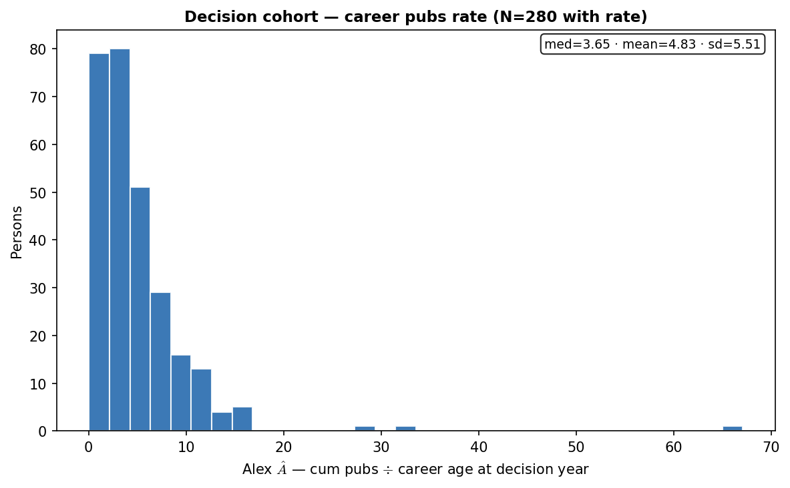
Slide 10 — Own career pubs rate at decision (Alex Â)
DECISION · cum ÷ career age · ability slice
• pubs_per_career_year from career master at decision calendar year.
• 280/391 with computable rate (OpenAlex coverage gap).
• Pairs with own-career HERO slide — not the peer-context X.
python tenure/scripts/tenure_basic_plots.py --mode pd29 --only career_rate
n=280 · median=3.65 · mean=4.83 · sd=5.51

Slide 13
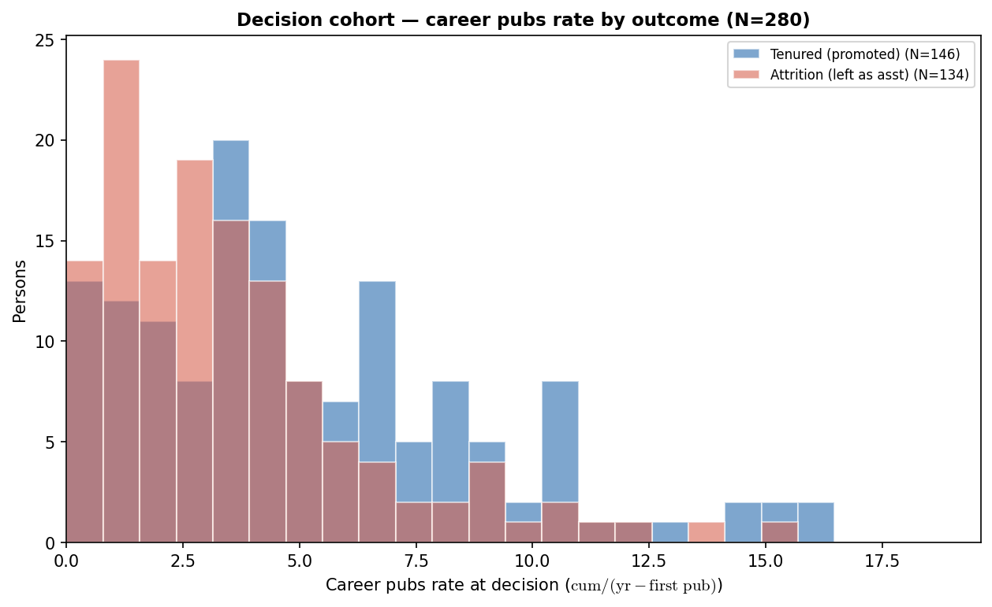
Slide 11 — Own career pubs rate by outcome
DECISION · Tenured vs attrition · ability slice
• Same career-rate metric split by tenure vs attrition (incl. OTT).
• Descriptive marginals — HERO bins on dept pond LOO, not own Â.
python tenure/scripts/tenure_basic_plots.py --mode pd29 --only career_rate_by_outcome
tenured n=146 med=4.4 · attrition n=134 med=3.0

Slide 14
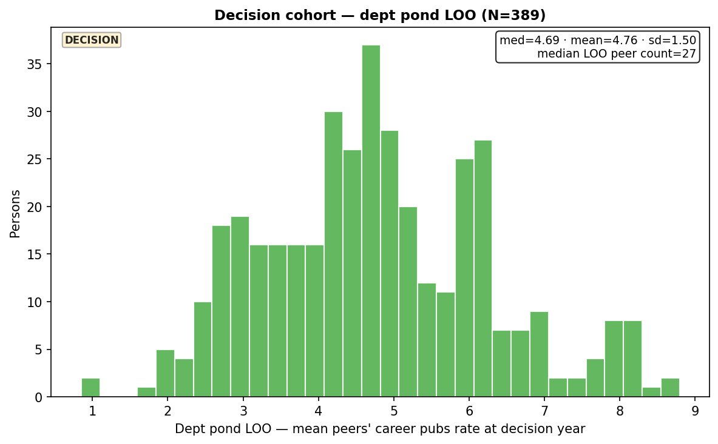
Slide 12 — Dept pond LOO career rate
DECISION · Whole dept at decision year · HERO peer-context X
• LOO mean of all other faculty's pubs_per_career_year in department.
• 389/391 with computable dept LOO — primary HERO x-axis.
• Includes senior faculty, not assistant-only uni×year pool.
python tenure/scripts/tenure_basic_plots.py --mode pd29 --only dept_loo
n=389 · med=4.69 · mean=4.76

Slide 15
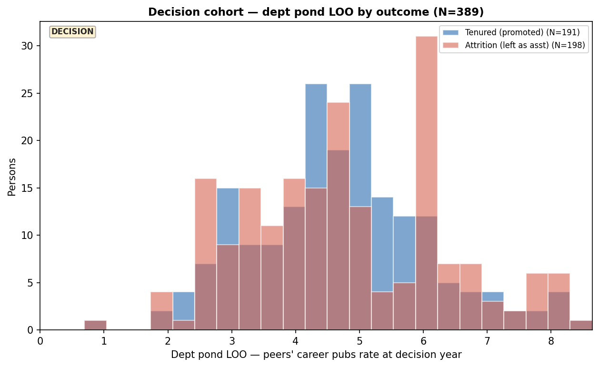
Slide 13 — Dept pond LOO by outcome
DECISION · Peer environment split · complements decision HERO
• Marginal dept LOO by tenure vs attrition — not binned rates.
• Ask: did promoted faculty sit in stronger department ponds on average?
python tenure/scripts/tenure_basic_plots.py --mode pd29 --only dept_loo_by_outcome
tenured n=191 med=4.7 · attrition n=198 med=4.8

Slide 16
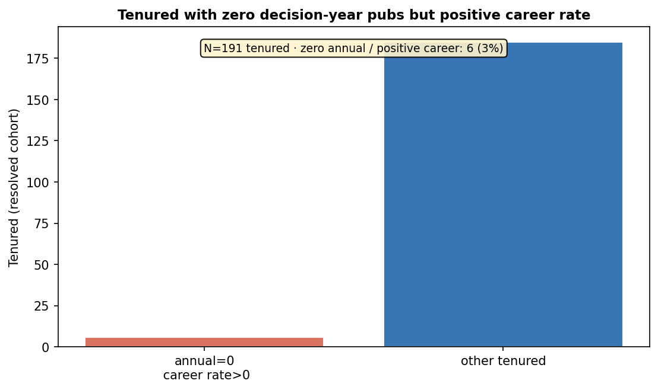
Slide 14 — Zero annual pubs but positive career rate (tenured)
DECISION · Wrong lens if you use pubs_year only
• Tenured with pubs_year=0 at decision but pubs_per_career_year > 0.
• Motivates cumulative / career-rate lock vs single-year annual count.
python tenure/scripts/tenure_basic_plots.py --mode pd29 --only annual_zero_tenured
tenured=191 · zero annual / +career=6 (3.14%)

