Slide 1
Tenure empirical HERO — inference panel
2026-09-02 · infHM · MBB slide format
• Tenure HERO: HIGH + MEDIUM OpenAlex inference.
• ASST-PS · mean · peer LOO (annum) = v0 default · N≈796.
• LAST-PS · cum · peer LOO = final assistant year (MBB exit cross-section) · N≈732–805.
• Rates among resolved only (Option A); yellow badge = window on each plot.
python tenure/scripts/tenure_pass_a_hero.py … python tenure/scripts/build_tenure_hero_slides.py

Slide 2
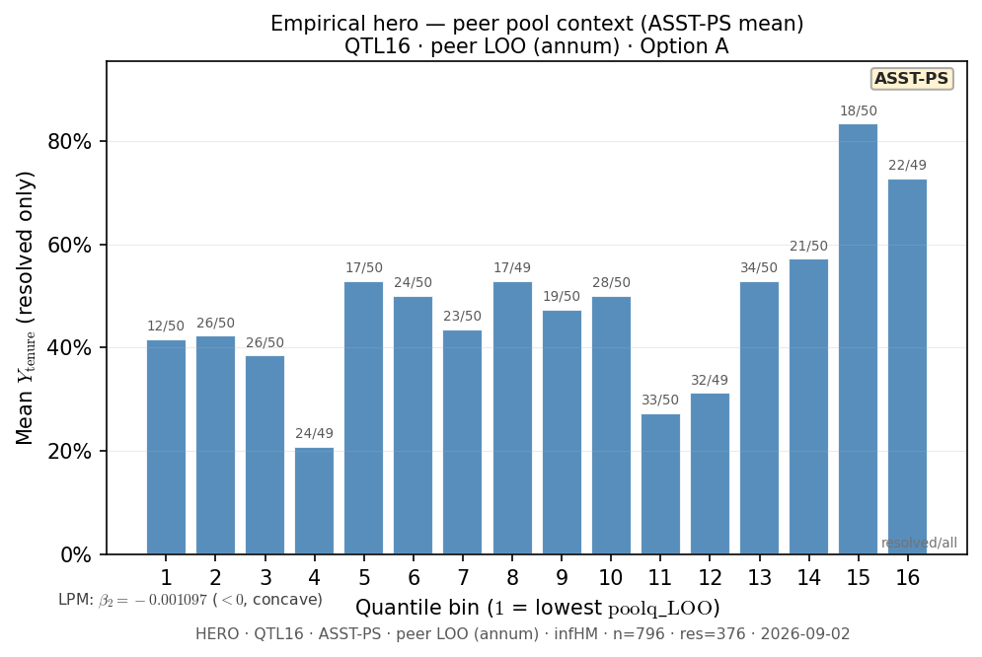
Slide 1 — Tenure HERO v0 — Q16 ASST-PS mean peer LOO
ASST-PS · peer LOO (annum) · N=796 · res=376
python tenure/scripts/tenure_pass_a_hero.py --output-tag q16_infHM_resolved_v0
Shape: bin1=41.667% · peak=ventile 15 @ 83.333% · last=72.727% · LPM β₂=-0.001097

Slide 3
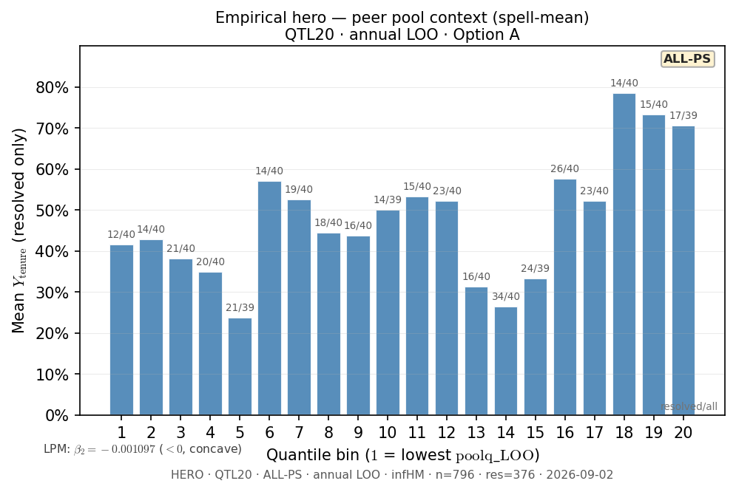
Slide 2 — Tenure HERO — Q20 ASST-PS mean (dip robustness)
ASST-PS · peer LOO (annum) · N=796 · res=376
python tenure/scripts/tenure_pass_a_hero.py --n-bins 20 --output-tag q20_loo_infHM
Shape: bin1=41.667% · peak=ventile 18 @ 78.571% · last=70.588% · LPM β₂=-0.001097

Slide 4
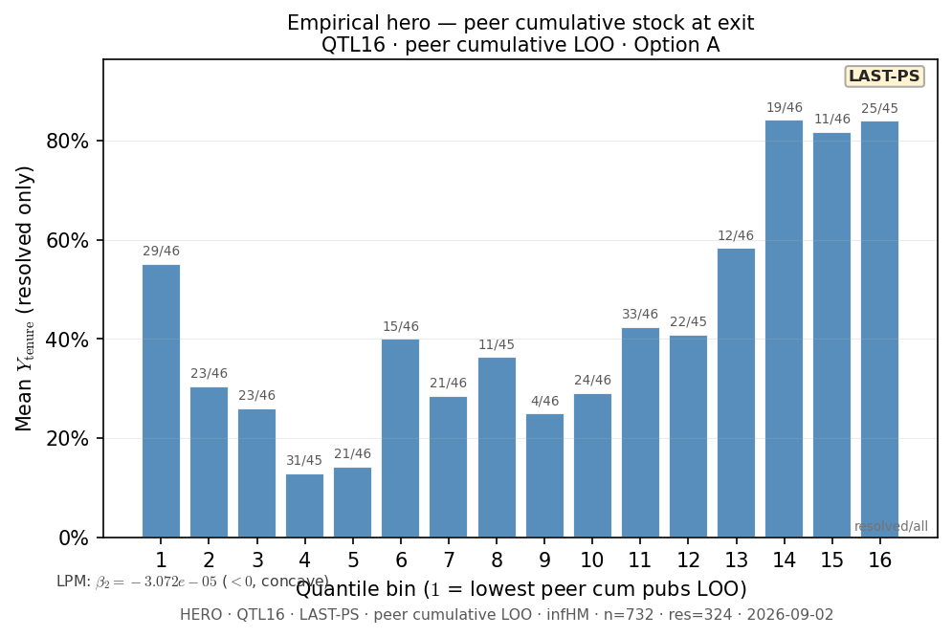
Slide 3 — Tenure HERO — Q16 LAST-PS cum peer LOO
LAST-PS · peer cumulative LOO · N=732 · res=324
python tenure/scripts/tenure_pass_a_hero.py --window last_ps --stat cum --output-tag q16_lastps_loo_cum_infHM
Shape: bin1=55.172% · peak=ventile 14 @ 84.21% · last=84.0% · LPM β₂=-3.072e-05

Slide 5
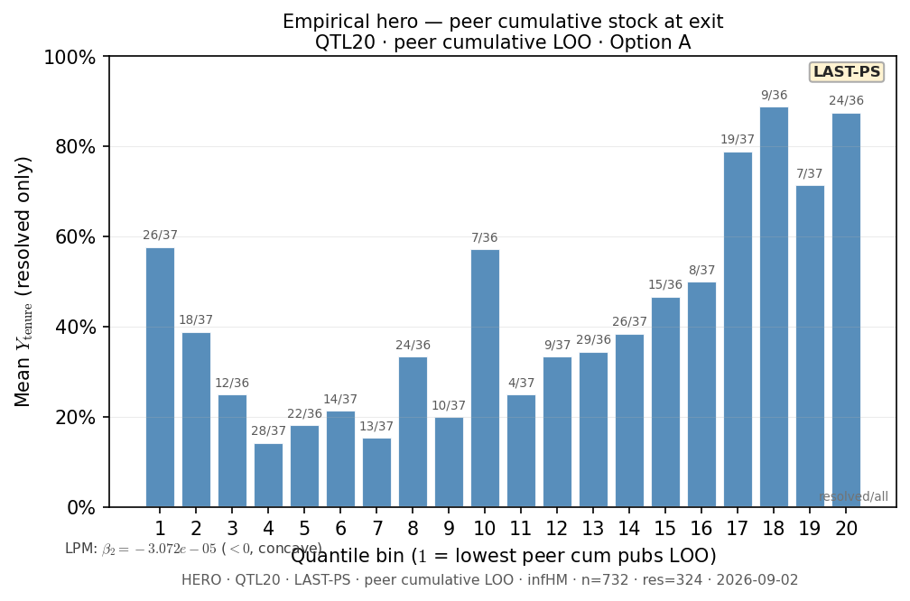
Slide 4 — Tenure HERO — Q20 LAST-PS cum peer LOO
LAST-PS · peer cumulative LOO · N=732 · res=324
python tenure/scripts/tenure_pass_a_hero.py --window last_ps --stat cum --n-bins 20 --output-tag q20_lastps_loo_cum_infHM
Shape: bin1=57.692% · peak=ventile 18 @ 88.889% · last=87.5% · LPM β₂=-3.072e-05

Slide 6
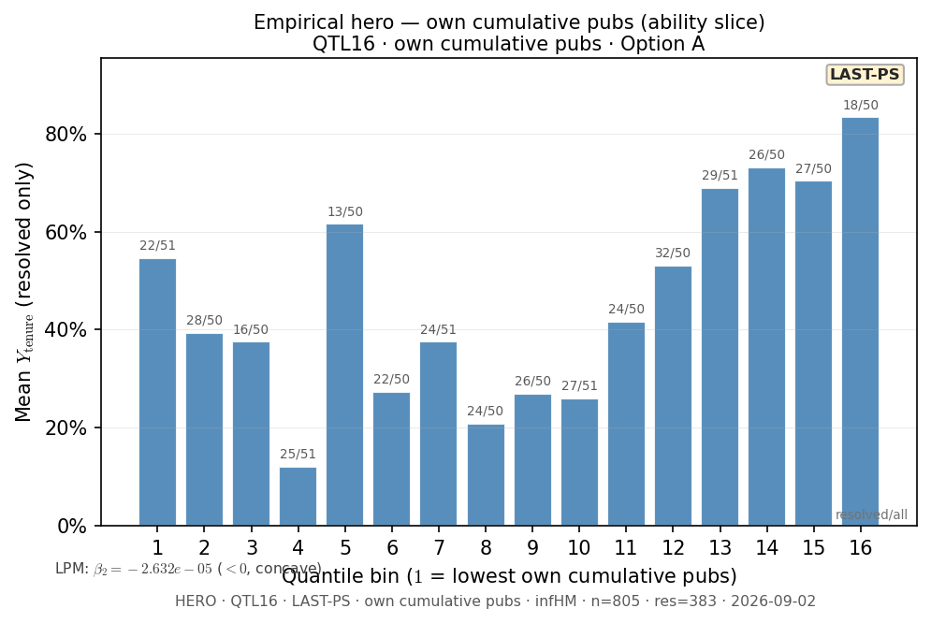
Slide 5 — Tenure HERO — Q16 LAST-PS own cum pubs
LAST-PS · own cumulative pubs · N=805 · res=383
python tenure/scripts/tenure_pass_a_hero.py --window last_ps --x-metric own_cum --output-tag q16_lastps_own_cum_infHM
Shape: bin1=54.546% · peak=ventile 16 @ 83.333% · last=83.333% · LPM β₂=-2.632e-05

Slide 7
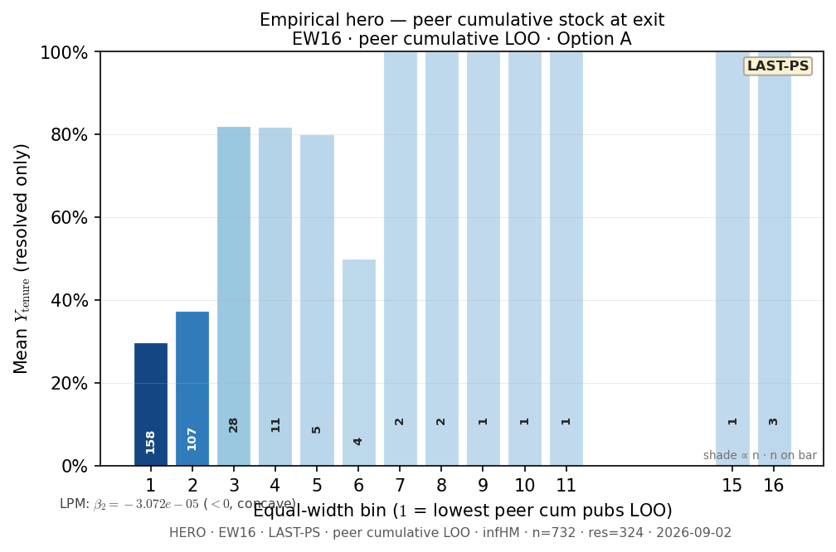
Slide 6 — Tenure HERO — EW16 LAST-PS cum peer LOO
LAST-PS · peer cumulative LOO · N=732 · res=324
python tenure/scripts/tenure_pass_a_hero.py --window last_ps --stat cum --bin-method equal_width --output-tag ew16_lastps_loo_cum_infHM
Shape: bin1=29.747% · peak=ventile 7 @ 100.0% · last=100.0% · LPM β₂=-3.072e-05

Slide 8
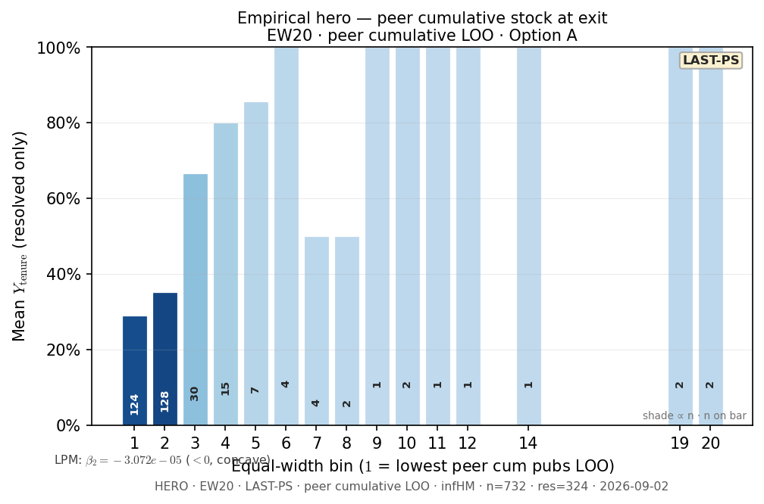
Slide 7 — Tenure HERO — EW20 LAST-PS cum peer LOO
LAST-PS · peer cumulative LOO · N=732 · res=324
python tenure/scripts/tenure_pass_a_hero.py --window last_ps --stat cum --bin-method equal_width --n-bins 20 --output-tag ew20_lastps_loo_cum_infHM
Shape: bin1=29.032% · peak=ventile 6 @ 100.0% · last=100.0% · LPM β₂=-3.072e-05

Slide 9
Decision cohort HERO — dept pond (PD29)
Resolved exits · whole department at decision year
• Peer X = LOO mean pubs_per_career_year among dept faculty at decision year.
• Cohort = all resolved infHM (391); excludes transferred.
• Own-career slide = ability slice (not peer context).

Slide 10
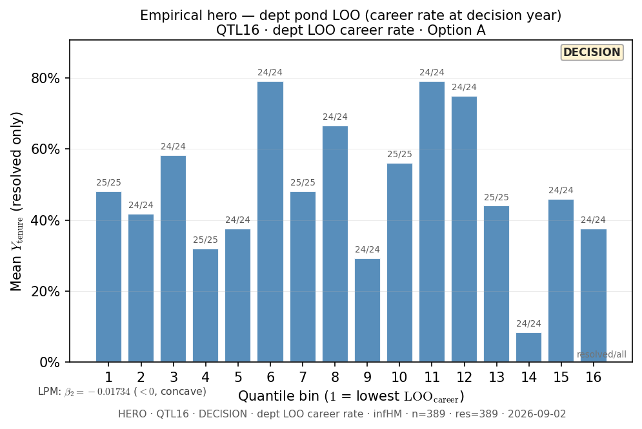
Slide 8 — Decision HERO — Q16 dept pond LOO
DECISION · dept LOO career rate · N=389 · res=389
python tenure/scripts/tenure_pass_a_decision_hero.py
Shape: bin1=48.0% · peak=ventile 6 @ 79.167% · last=37.5% · LPM β₂=-0.01734

Slide 11
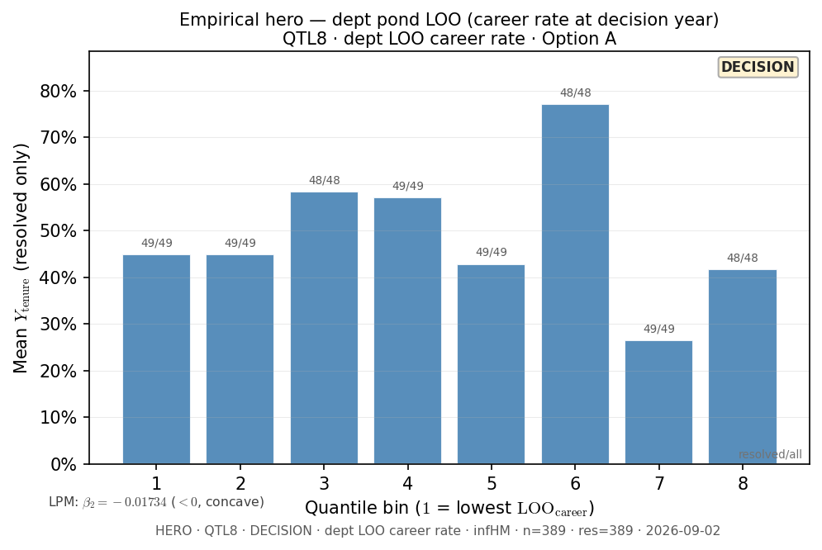
Slide 9 — Decision HERO — Q8 dept pond LOO
DECISION · dept LOO career rate · N=389 · res=389
python tenure/scripts/tenure_pass_a_decision_hero.py --n-bins 8 --output-tag q8_decision_dept_loo_infHM
Shape: bin1=44.898% · peak=ventile 6 @ 77.083% · last=41.667% · LPM β₂=-0.01734

Slide 12
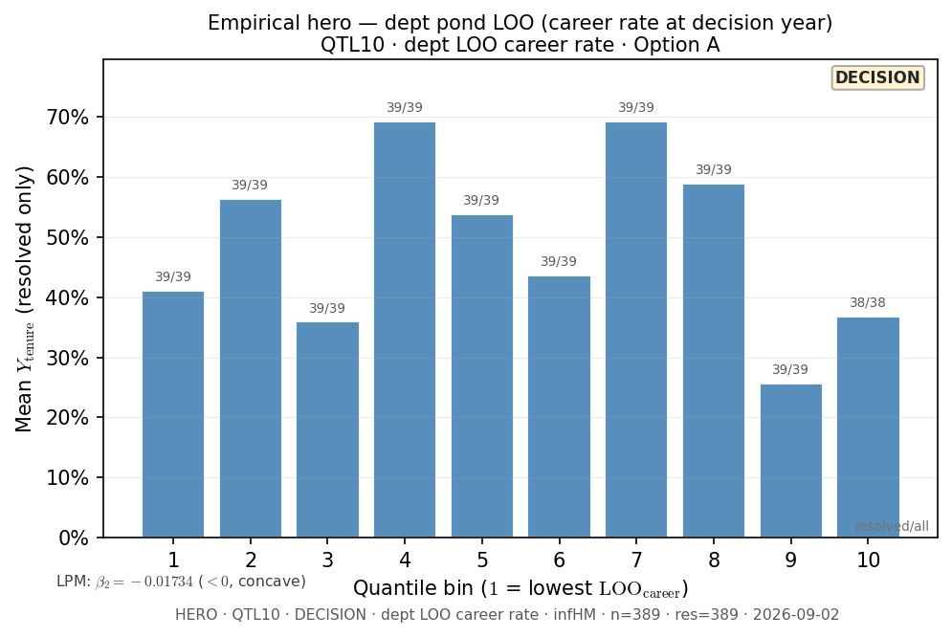
Slide 10 — Decision HERO — Q10 dept pond LOO
DECISION · dept LOO career rate · N=389 · res=389
python tenure/scripts/tenure_pass_a_decision_hero.py --n-bins 10 --output-tag q10_decision_dept_loo_infHM
Shape: bin1=41.026% · peak=ventile 4 @ 69.231% · last=36.842% · LPM β₂=-0.01734

Slide 13
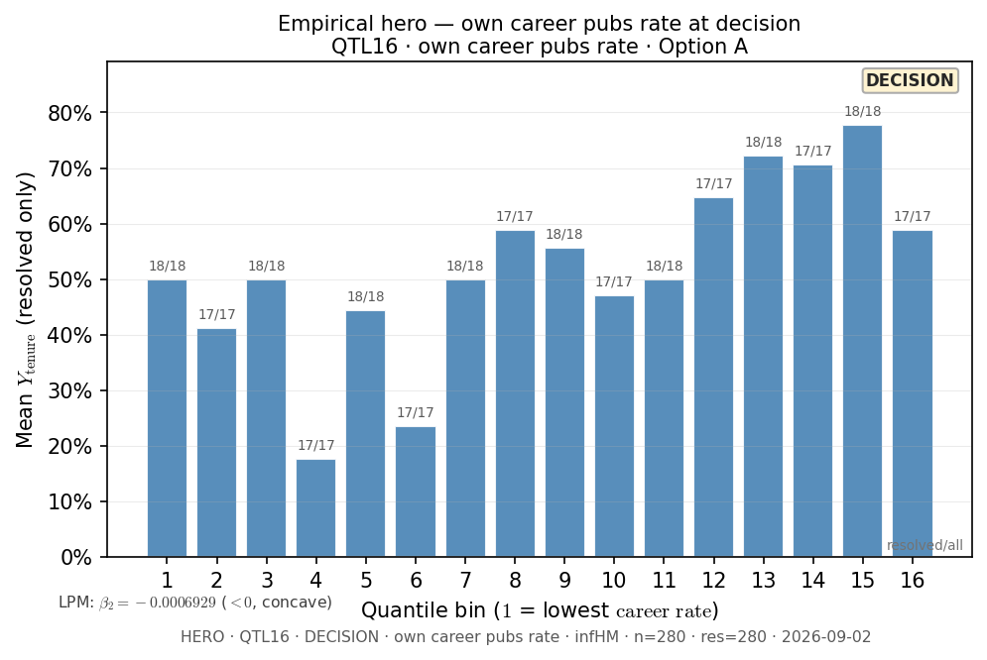
Slide 11 — Decision HERO — Q16 own career rate
DECISION · own career pubs rate · N=280 · res=280
python tenure/scripts/tenure_pass_a_decision_hero.py --x-metric own_career --output-tag q16_decision_own_career_infHM
Shape: bin1=50.0% · peak=ventile 15 @ 77.778% · last=58.823% · LPM β₂=-0.0006929

Slide 14
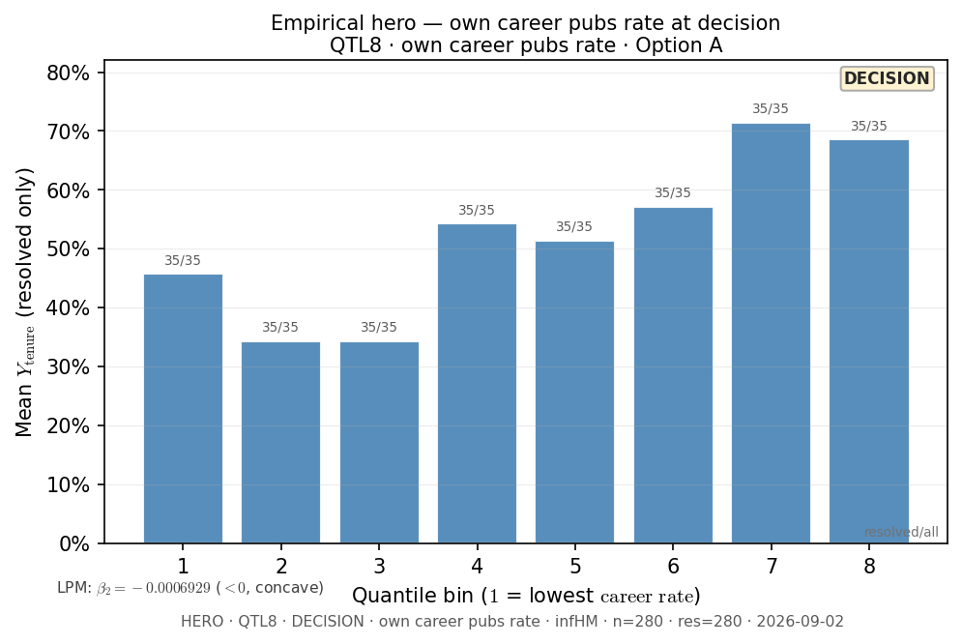
Slide 12 — Decision HERO — Q8 own career rate
DECISION · own career pubs rate · N=280 · res=280
python tenure/scripts/tenure_pass_a_decision_hero.py --x-metric own_career --n-bins 8 --output-tag q8_decision_own_career_infHM
Shape: bin1=45.714% · peak=ventile 7 @ 71.429% · last=68.571% · LPM β₂=-0.0006929

Slide 15
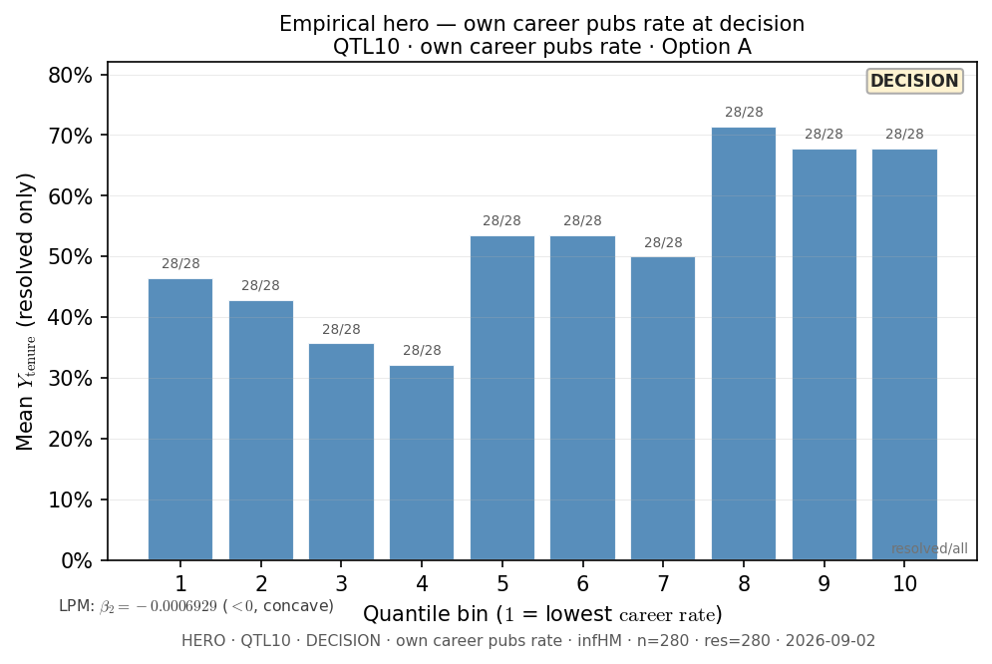
Slide 13 — Decision HERO — Q10 own career rate
DECISION · own career pubs rate · N=280 · res=280
python tenure/scripts/tenure_pass_a_decision_hero.py --x-metric own_career --n-bins 10 --output-tag q10_decision_own_career_infHM
Shape: bin1=46.429% · peak=ventile 8 @ 71.429% · last=67.857% · LPM β₂=-0.0006929

