Slide 1
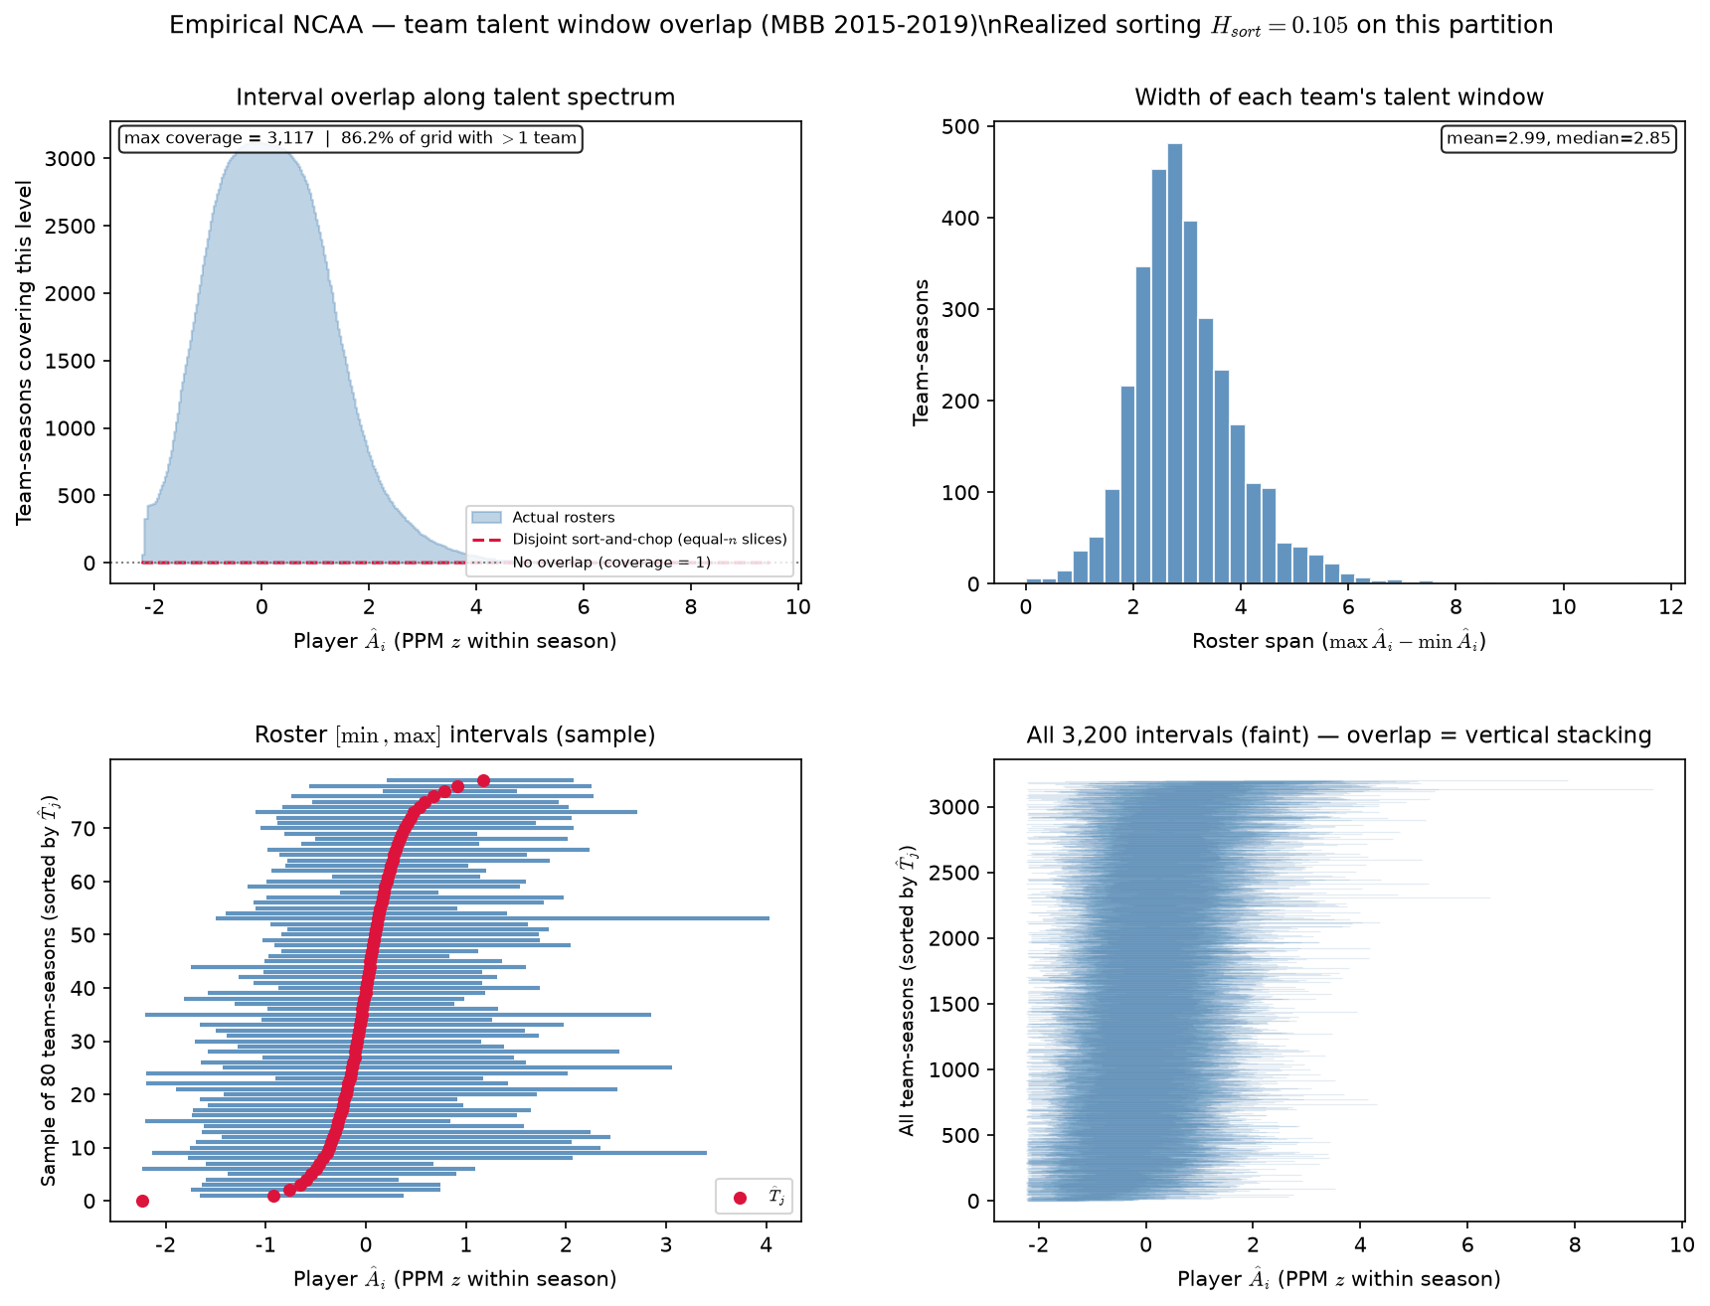
PD17 — NCAA team \hat{A}_{i} interval overlap (2015-2019)
MBB 2015-2019 · PPM z within season · min 20 min · poolq winsor 0.01–0.99 · 3,200 team-seasons (530 CELL 8 port) · H_{sort}=0.105
Each team-season: talent window [\min \hat{A}_{i}, \max \hat{A}_{i}] on PPM z.
Coverage = how many windows cover a point on the spectrum (530 CELL 8).
Red dashed: disjoint sort-and-chop on same player-seasons (537 B analog).
H_{sort} = 1 - \sum_i(\hat{A}_i - \hat{\mu}_{g(i)})^2 / \sum_i(\hat{A}_i - \bar{A})^2 — realized sorting on a fixed partition.
NCAA partition: H_{sort} = 0.105 (0 = none, 1 = full team sorting).
Max coverage=3,117; sort-and-chop max=7. Normalized peak=0.97.
86\% of grid points have >1 team covering.
Roster span: mean=2.99 z, median=2.85 z (3,200 team-seasons).
Paired compare window — match season span to LG sim slide.
VECTOR lock: H_{sort} is realized sorting — not the generative homophily knob \rho.
Claim: NCAA interval overlap on a fixed season window — paired compare to LG ASSIGN sim on the same window.

