Slide 1
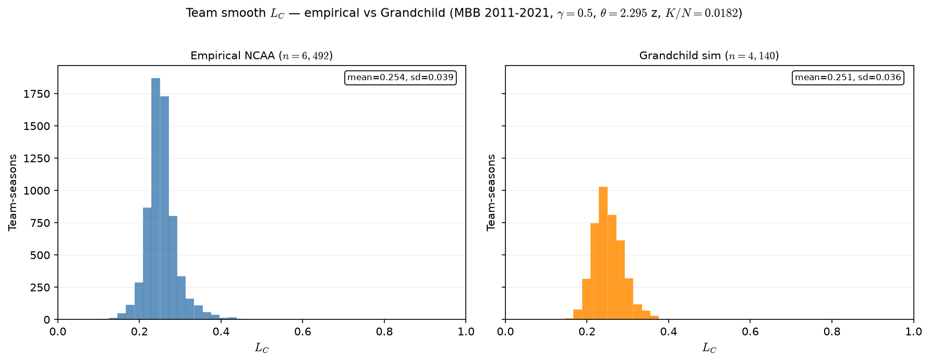
Empirical vs LG — team $L_C$ distribution
MBB 2011-2021 · team smooth L_C · LG \rho=0.5 · \gamma=0.5 · \theta=2.295 z (K/N=0.0182)
Team L_C = mean_{j} \sigma(\gamma(\hat{A}_{j} - \theta)) — team-smooth congestion.
Left panel: empirical NCAA (real rosters). Right: LG ASSIGN sim.
Panel: MBB 2011-2021 · PPM z · min 20 min · poolq winsor 0.01–0.99.
Shared \theta = F^{-1}_{\hat{A}}(1-K/N) = 2.295 z (K/N=0.0182).
\gamma = 0.5 (HAND17 slide-4 default; 539 placeholder).
Empirical: mean L_C=0.254, sd=0.039 (6,492 team-seasons).
LG (\rho=0.5): mean L_C=0.251, sd=0.036 (4,140 team-seasons).
Sim: one LG league per season (J = N/15), stacked team-seasons.
ASSIGN shapes rosters; L_C is score-side input — computed after assign.
Overlay PNG: grandchild_assign/GRANDCHILD_empirical_lc_overlay_2011_2021.png
Normalized side-by-side: grandchild_assign/GRANDCHILD_empirical_lc_compare_normalized_2011_2021.png
Claim (PD17 / LG): Team smooth L_C on real rosters vs LG sim — same $\sigma(\gamma(\hat{A}_j - \theta))$ formula; compare distribution shape before SCORE.

