Slide 1
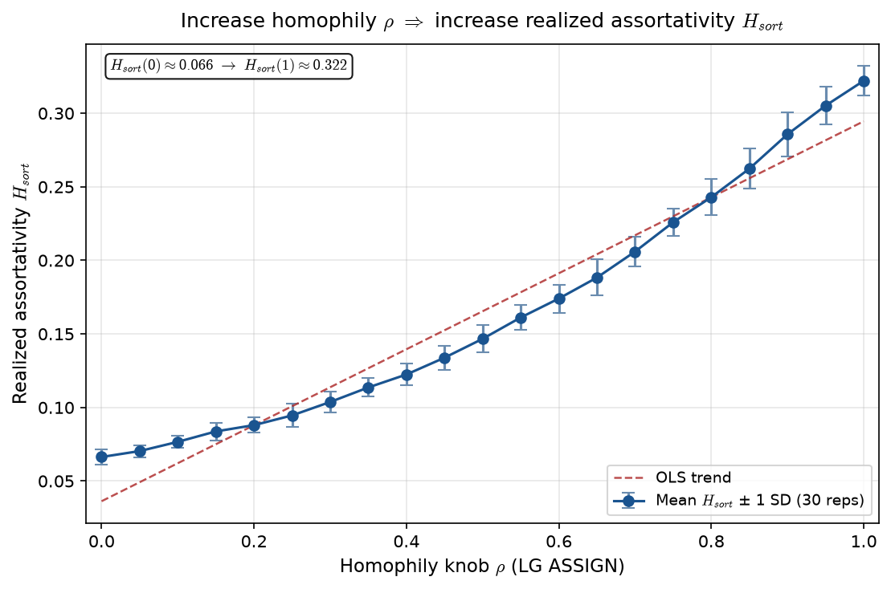
What is $H_{sort}$? Realized assortativity on rosters
Realized sorting index · LG / PD17 · alias \texttt{sorting\_index\_h} in code
H_{sort} = 1 - \sum_i(\hat{A}_i - \hat{\mu}_{g(i)})^2 / \sum_i(\hat{A}_i - \bar{A})^2 — realized sorting on a fixed partition.
Denominator: total Sum of Squares (SS) — spread of \hat{A}_i around \bar{A}.
Numerator: within-team Sum of Squares (SS) — spread around \mu_{g(i)}.
H_{sort} = 1 - (within-team SS)/(total SS); explained-variance / Analysis of Variance (ANOVA)-style.
H_{sort} \approx 0: team label tells you little (random-like partition).
H_{sort} \approx 1: teams are perfectly separated (point-mass rosters).
Alex one-liner: knowing roster explains how much ability deviates from \bar{A}.
Not Newman network assortativity r — partition statistic on abilities.
Complements interval overlap (geometry) — use both in brief.
\rho \uparrow \Rightarrow H_{sort} \uparrow in LG sweep (see inset plot).
VECTOR lock: H_{sort} is realized sorting — not the generative homophily knob \rho.
Memo: grandchild_assign/GRANDCHILD_D_and_H_sort_interpretation.md
Claim: H_{sort} is realized assortativity on a fixed partition — generative homophily \rho is the ASSIGN knob; measure H_{sort} after assign.

