Slide 1
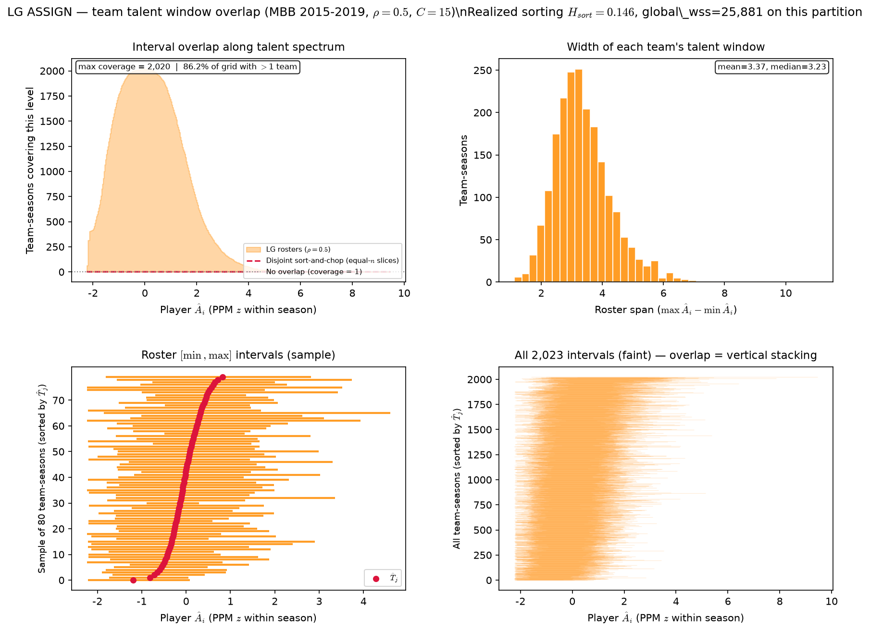
LG sim — team \hat{A}_{i} interval overlap (2015-2019)
MBB 2015-2019 · LG ASSIGN · \rho=0.5 · C=15 · N=30,345, 2,023 team-seasons · H_{sort}=0.146
Each team-season: talent window [\min \hat{A}_{i}, \max \hat{A}_{i}] on PPM z.
Coverage = how many roster windows cover a point (530 CELL 8).
LG ASSIGN: \rho=0.5, endogenous \mu_j — no T_{j^*}.
Red dashed: disjoint sort-and-chop on same player pool (537 B analog).
H_{sort} = 1 - \sum_i(\hat{A}_i - \hat{\mu}_{g(i)})^2 / \sum_i(\hat{A}_i - \bar{A})^2 — realized sorting on a fixed partition.
Assign partition: H_{sort} = 0.146 (0 = none, 1 = full team sorting).
Sim max coverage=2,020; sort-and-chop max=5. Normalized peak=1.00.
86\% of grid points have >1 team covering.
Roster span: mean=3.37 z, median=3.23 z (2,023 team-seasons).
NCAA ref max cov=3,117; NCAA overlap grid=86\%; NCAA H_{sort}=0.105.
VECTOR lock: H_{sort} is realized sorting — not the generative homophily knob \rho.
Claim: LG ASSIGN on the same season window as paired NCAA slide — one realization per season, stacked team-seasons.

