Slide 1
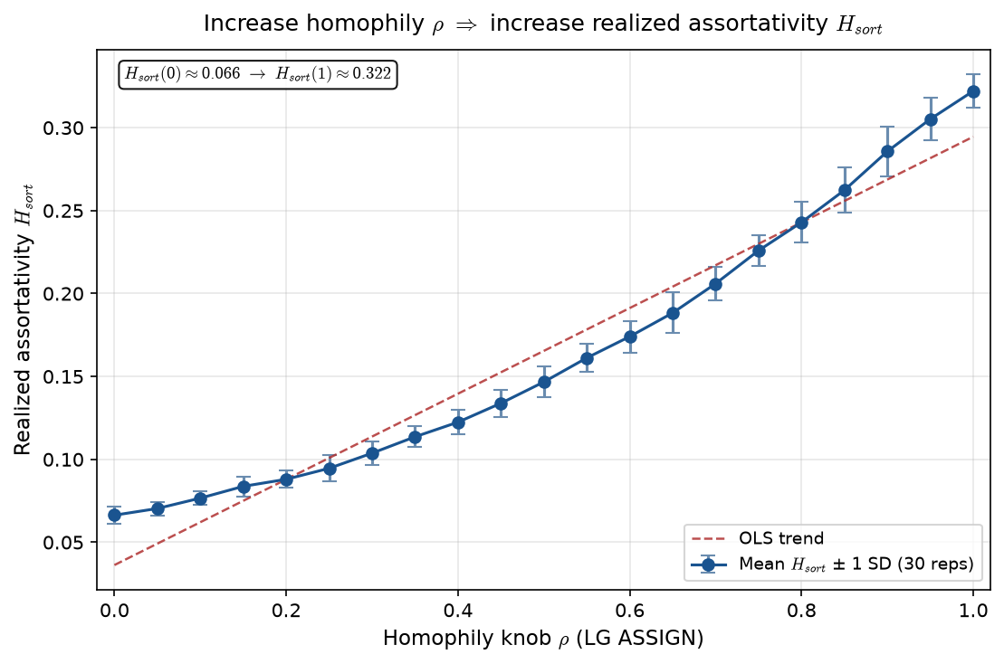
Homophily $\rho$ vs realized assortativity $H_{sort}$ (LG sim)
LG ASSIGN · 2015 PPM z · J=402, C=15 · \rho \in [0, 1] · 30 reps/arm
\rho = LG ASSIGN homophily knob in \exp(-\rho|\hat{A}_i - \mu_j|).
Each point: mean \pm 1 SD of H_{sort} over stochastic LG realizations.
H_{sort} = 1 - \sum_i(\hat{A}_i - \hat{\mu}_{g(i)})^2 / \sum_i(\hat{A}_i - \bar{A})^2 — realized sorting on a fixed partition.
H_{sort} = realized assortativity on the assigned partition (0 none, 1 full).
\rho=0: H_{sort} \approx 0.066 \to \rho=1: H_{sort} \approx 0.322.
2015 empirical PPM z · J=402 · C=15 · 30 reps × 21 \rho arms.
VECTOR lock: \rho is generative (ASSIGN); H_{sort} is measured sorting — not the same object.
VECTOR lock: H_{sort} is realized sorting — not the generative homophily knob \rho.
Claim (Alex): Higher ASSIGN homophily \rho should raise realized assortativity — LG one-shot league on 2015 PPM z shows monotonic H_{sort}(\rho).

