Slide 1
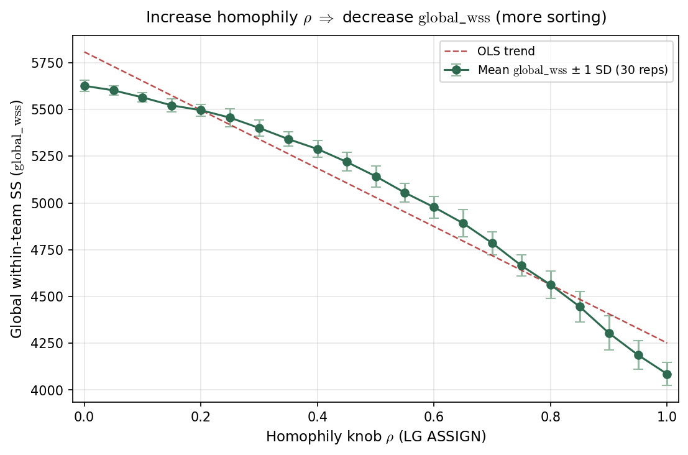
LG ASSIGN — global\_wss vs $\rho$
LG ASSIGN · 2015 PPM z · J=402, C=15 · \rho \in [0, 1] · 30 reps/arm
\rho = LG ASSIGN homophily knob in \exp(-\rho|\hat{A}_i - \mu_j|).
Each point: mean \pm 1 SD of global\_wss over stochastic LG realizations.
global\_wss = \sum_j \sum_{i \in j} (\hat{A}_i - \hat{T}_j)^2 — global within-team SS; $\hat{T}_j$ = realized roster mean.
$H_{sort} = 1 - \mathrm{global\_wss}/\mathrm{SS}_{total}$ on the same partition — global\_wss is raw magnitude; $H_{sort}$ is scale-free explained variance.
\rho=0: global\_wss \approx 5627 \to \rho=1: global\_wss \approx 4085.
2015 empirical PPM z · J=402 · C=15 · 30 reps × 21 \rho arms.
$\rho \uparrow$ sorting $\Rightarrow$ global\_wss $\downarrow$, $H_{sort} \uparrow$ (monotone mirror on a fixed ability pool).
Companion slide: $H_{sort} = 1 - \mathrm{global\_wss}/\mathrm{SS}_{total}$ (scale-free assortativity on the same sweep).
VECTOR lock: H_{sort} is realized sorting — not the generative homophily knob \rho.
Claim (Alex): global\_wss is the within-team SS numerator on the assign partition — $\rho \uparrow$ lowers global\_wss on the same 2015 LG league ($H_{sort}$ is the scale-free companion).

