Slide 1
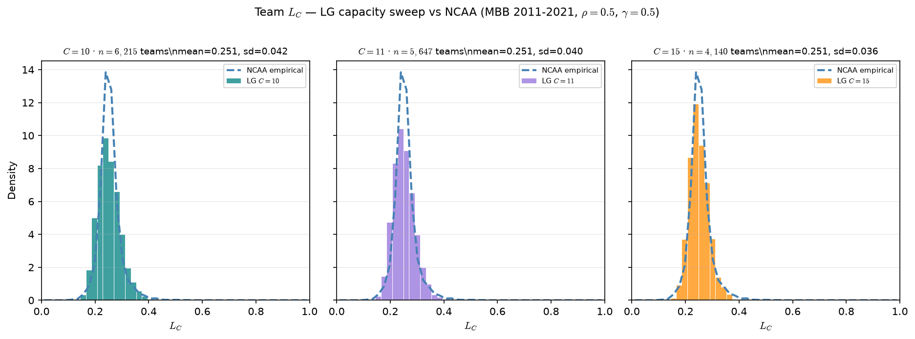
LG capacity sweep — team $L_C$ vs NCAA
MBB 2011-2021 · $C \in {10,11,15}$ · NCAA mean=0.254
Team $L_C$ after ASSIGN — same $\sigma(\gamma(\hat{A}_j-\theta))$ as NCAA.
MBB 2011-2021 · min 20 min panel · $\rho=0.5$, $\gamma=0.5$.
NCAA: $n=6,492$ team-seasons · mean=0.254 · sd=0.039.
$C=10$: $n=6,215$ teams · mean=0.251 · sd=0.042.
$C=11$: $n=5,647$ teams · mean=0.251 · sd=0.040.
$C=15$: $n=4,140$ teams · mean=0.251 · sd=0.036.
$C=10$ closest to NCAA team count (~6.2k vs 6.5k); $C=15$ = gallery default.
L\_C first moment stable across capacity — score-side calibration OK.
Capacity is a labeled sensitivity, not a silent swap for $C=15$.
Talking point: C=10 aligns team counts; L_C mean ~0.251 at every C — capacity mismatch is interpretive, not a broken L_C calibration.

