Slide 1
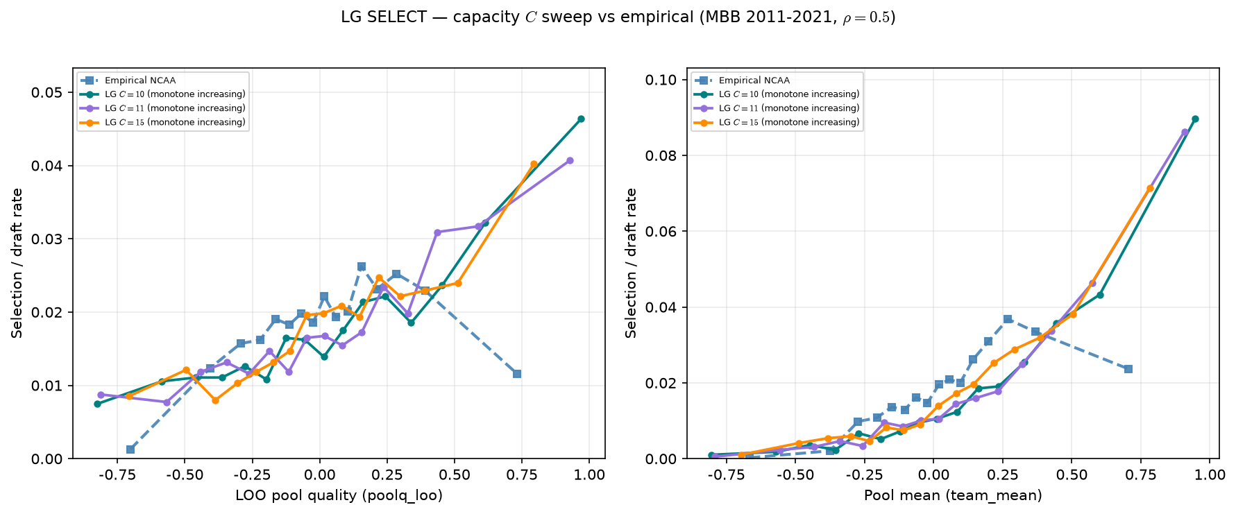
LG capacity sweep — SELECT vs empirical Hero
MBB 2011-2021 · LOO + pool mean · all LG curves monotone
SELECT: draft rate vs LOO peer quality (left) and pool mean (right).
MBB 2011-2021 · fixed $\rho=0.5$ · empirical dashed blue.
Empirical LOO: inverted u like (peak bin 11, 2.62\%).
LG $C=10$: monotone increasing on LOO.
LG $C=11$: monotone increasing on LOO.
LG $C=15$: monotone increasing on LOO.
Lowering $C$ toward rotation-cohort scale does not recover inverted-U.
$\rho$ shapes ASSIGN sorting; selection curvature lives in SCORE ($\lambda$).
Next lever: $\lambda$ sweep on SELECT — not $\rho$ or $C$ alone.
Talking point: C fixes headcount, not selection shape — empirical inverted-U survives; λ is the promising SCORE knob.

