Slide 1
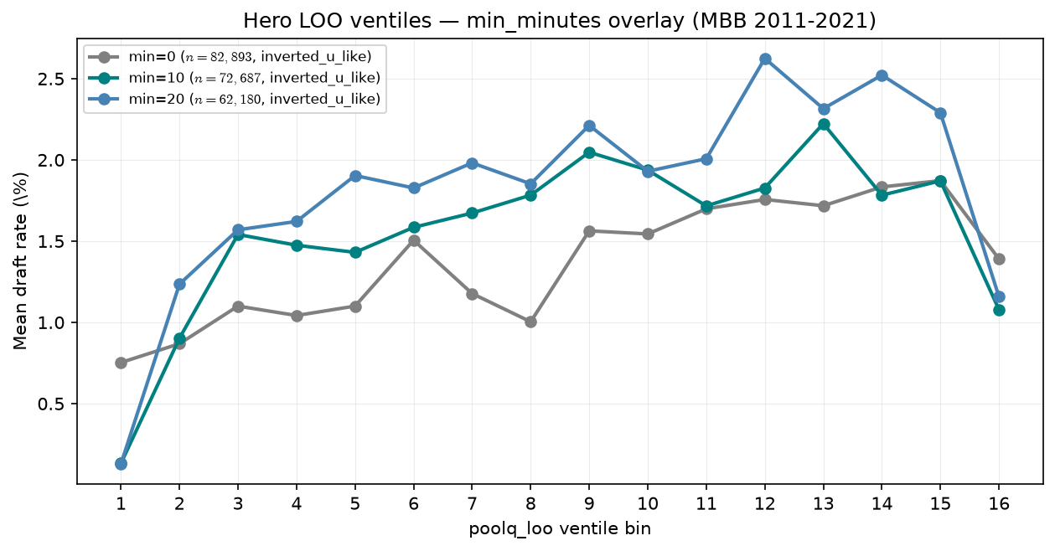
Hero sensitivity — min\_minutes overlay
MBB 2011-2021 · same bins, three floors
Hero x-axis: draft rate vs poolq_loo ventiles · MBB 2011-2021 · 16 quantile.
min\_minutes defines who enters the panel and LOO peer pool — not neutral QC.
min=0: $n=82,893$, drafted=1,136, bin16=1.39\%, inverted_u_like.
min=10: $n=72,687$, drafted=1,136, bin16=1.08\%, inverted_u_like.
min=20: $n=62,180$, drafted=1,134, bin16=1.16\%, inverted_u_like.
Overlay: same estimand, different playing-time floors.
We are not simulating minutes in LG.
Talking point: pattern is not an artifact of one arbitrary cutoff.

