Slide 1
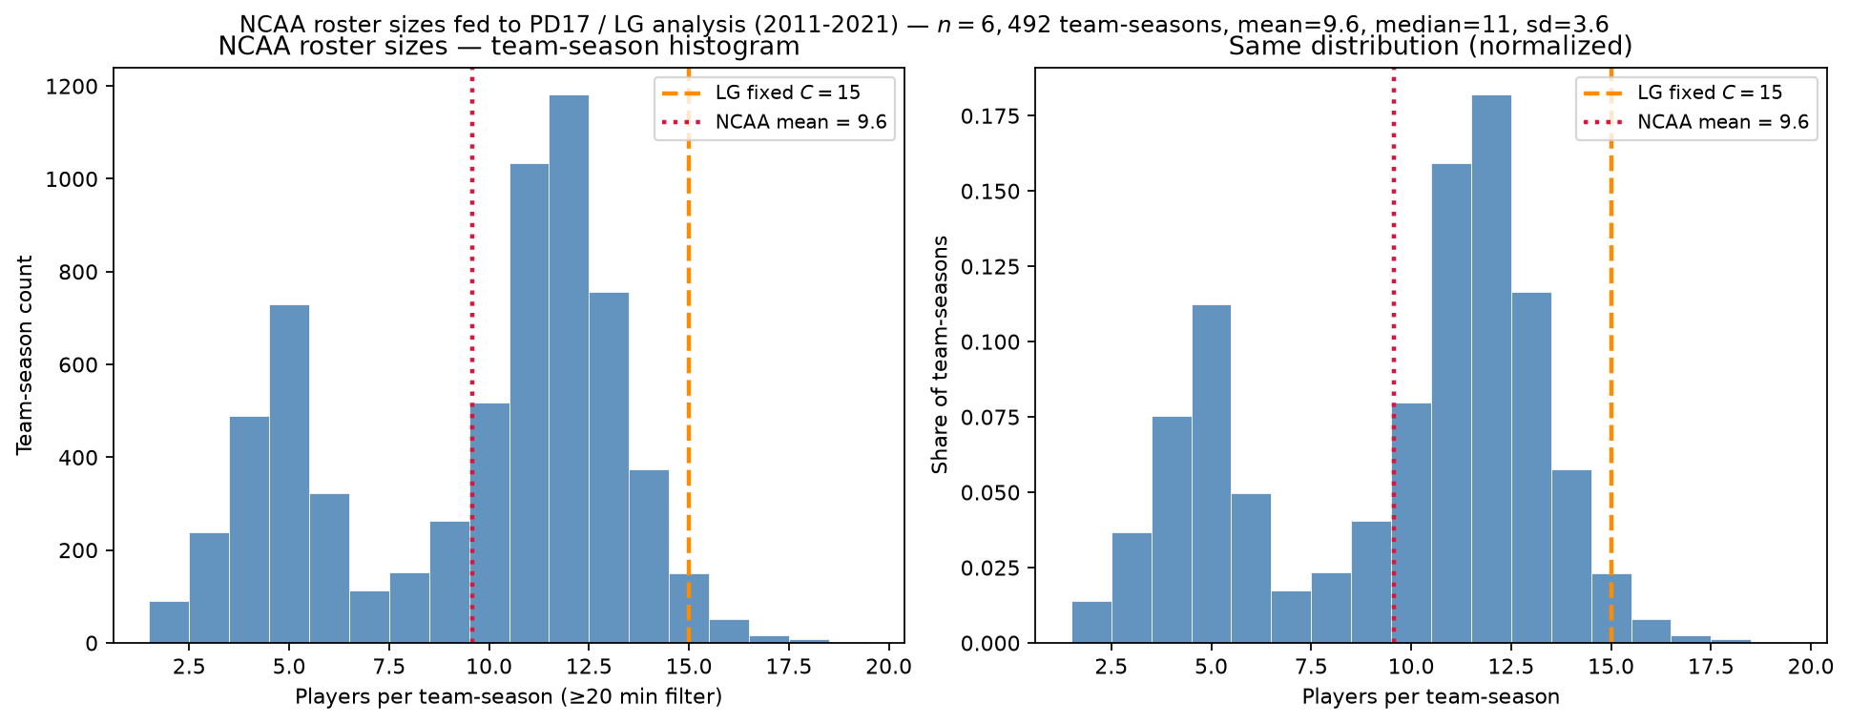
NCAA roster sizes after the minutes filter
MBB 2011-2021 · min 20 min · mean=9.6 vs LG $C=15$
Qualifying players per real NCAA team-season (\geq 20 ESPN minutes).
$n=6,492$ team-seasons · mean=9.6 · median=11 · sd=3.6.
Red dotted = NCAA mean; orange dashed = LG fixed $C=15$.
Only 2.3\% of teams have exactly 15 qualifying players.
Same ability pool ~62k; LG repacks into J=N/15 synthetic 15-man leagues.
Minutes floor shapes peer count — state explicitly in methods.
Talking point: empirical teams are ~10 rotation players; LG uses fixed 15 — comparability is distributional, not headcount.

