Slide 1
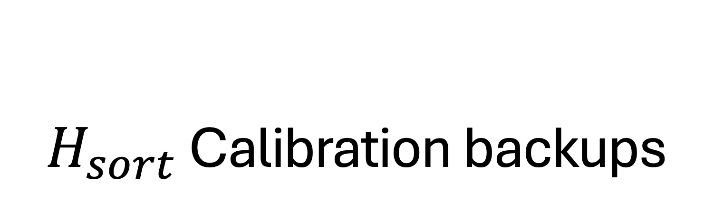
$H_{sort}$ Calibration backups

Slide 2
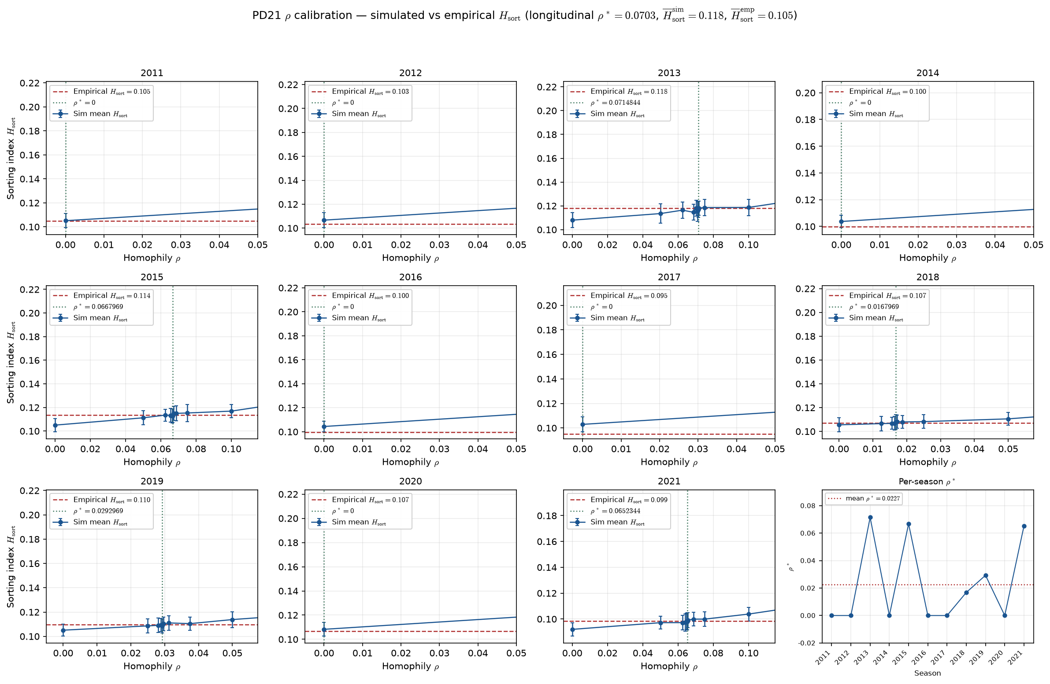
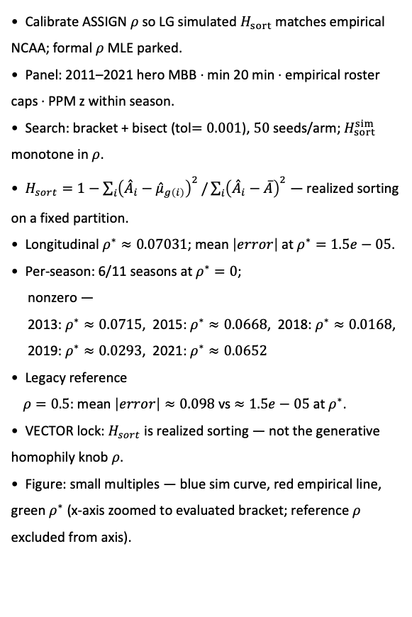
PD21 — Calibrate homophily $ρ$ to empirical sorting index $H_{sort}$ WITH ROSTER CAPS
PD21 · LG ASSIGN calibration · 2011-2021 · 50 seeds · bracket tol $=0.001$ · longitudinal $ρ^{∗}≈0.0703$, ${\overline{H}}_{sort}^{sim}=0.118$ , ${\overline{H}}_{sort}^{emp}=0.105$
Calibrate ASSIGN $ρ$ so LG simulated $H_{sort}$ matches empirical NCAA; formal $ρ$ MLE parked.
Panel: 2011–2021 hero MBB · min 20 min · empirical roster caps · PPM z within season.
Search: bracket + bisect (tol$=0.001$), $50$ seeds/arm; $H_{sort}^{sim}$ monotone in $ρ$.
$H_{sort}=1−\sum_{i}{{\left({\overset{ˆ}{A}}_{i}−{\overset{ˆ}{μ}}_{g\left(i\right)}\right)}^{2}}/\sum_{i}{{\left({\overset{ˆ}{A}}_{i}−\overline{A}\right)}^{2}}$ — realized sorting on a fixed partition.
Longitudinal $ρ^{∗}≈0.07031$; mean $\left|error\right|$ at $ρ^{∗}=1.5e−05$.
Per-season: 6/11 seasons at $ρ^{∗}=0$;
nonzero —
2013: $ρ^{∗}≈0.0715$, 2015: $ρ^{∗}≈0.0668$, 2018: $ρ^{∗}≈0.0168$,
2019: $ρ^{∗}≈0.0293$, 2021: $ρ^{∗}≈0.0652$
Legacy reference
$ρ=0.5$: mean $\left|error\right|≈0.098$ vs $≈1.5e−05$ at $ρ^{∗}$.
VECTOR lock: $H_{sort}$ is realized sorting — not the generative homophily knob $ρ$.
Figure: small multiples — blue sim curve, red empirical line, green $ρ^{∗}$ (x-axis zoomed to evaluated bracket; reference $ρ$ excluded from axis).
Claim (Alex): Near-zero ASSIGN homophily $ρ$ matches empirical $H_{sort}$ on the hero panel — legacy $ρ=0.5$ overshoots simulated sorting by $∼0.10$.

Slide 3
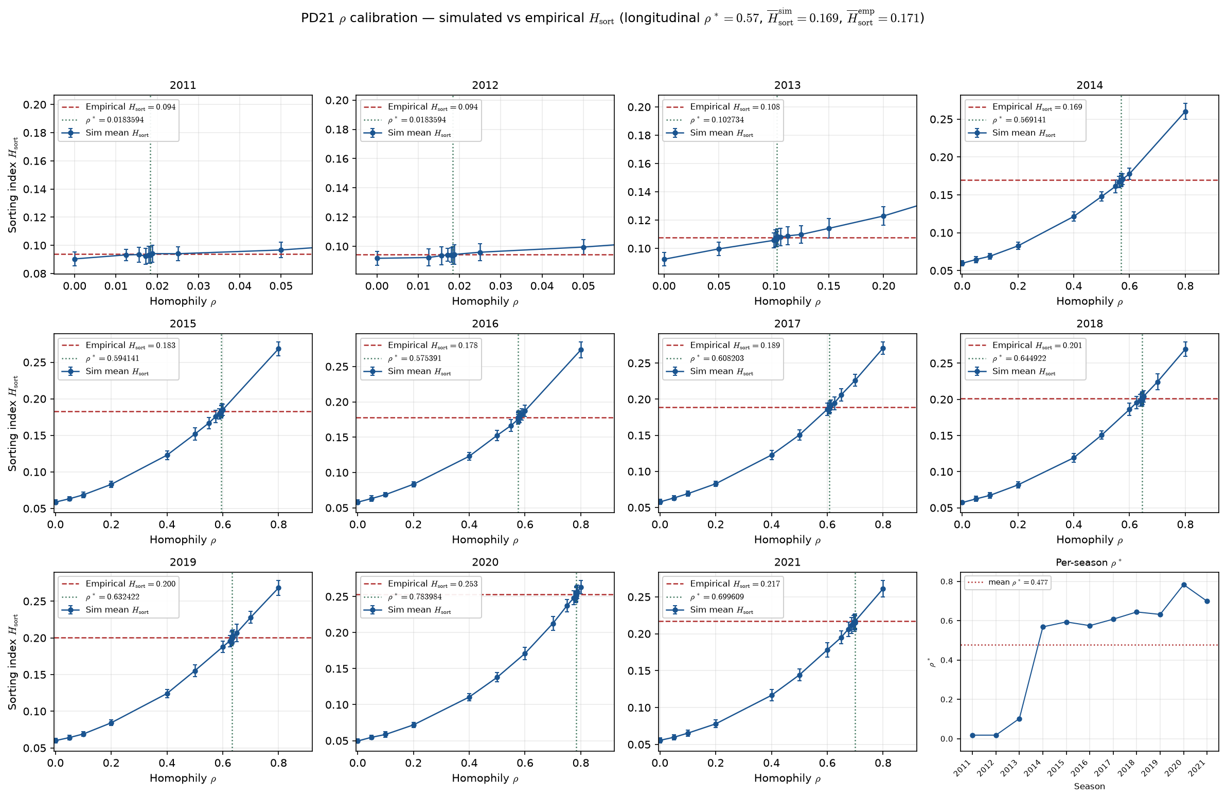
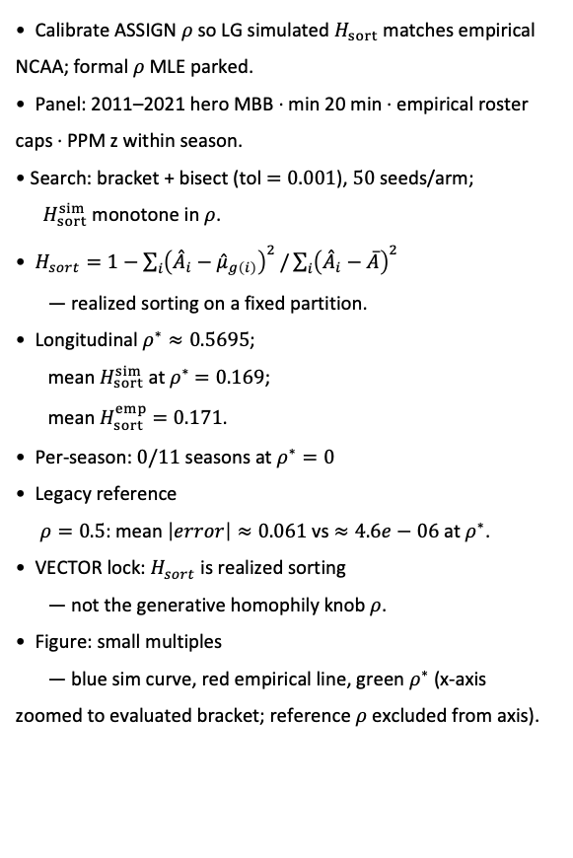
PD21 — Calibrate homophily $ρ$ to empirical sorting index $H_{sort}$ NO ROSTER CAPS BUT PPM=0 if min $<20$
PD21 · LG ASSIGN calibration · 2011-2021 · 50 seeds · bracket tol $=0.001$ · longitudinal $ρ^{∗}≈0.57$ · all roster rows; raw PPM $=0$ if minutes $<20$
Calibrate ASSIGN $ρ$ so LG simulated $H_{sort}$ matches empirical NCAA; formal $ρ$ MLE parked.
Panel: 2011–2021 hero MBB · min 20 min · empirical roster caps · PPM z within season.
Search: bracket + bisect (tol $=0.001$), $50$ seeds/arm;
$H_{sort}^{sim}$ monotone in $ρ$.
$H_{sort}=1−\sum_{i}{{\left({\overset{ˆ}{A}}_{i}−{\overset{ˆ}{μ}}_{g\left(i\right)}\right)}^{2}}/\sum_{i}{{\left({\overset{ˆ}{A}}_{i}−\overline{A}\right)}^{2}}$
— realized sorting on a fixed partition.
Longitudinal $ρ^{∗}≈0.5695$;
mean $H_{sort}^{sim}$ at $ρ^{∗}$ $=0.169$;
mean $H_{sort}^{emp}$ $=0.171$.
Per-season: $0/11$ seasons at $ρ^{∗}=0$
Legacy reference
$ρ=0.5$: mean $\left|error\right|≈0.061$ vs $≈4.6e−06$ at $ρ^{∗}$.
VECTOR lock: $H_{sort}$ is realized sorting
— not the generative homophily knob $ρ$.
Figure: small multiples
— blue sim curve, red empirical line, green $ρ^{∗}$ (x-axis zoomed to evaluated bracket; reference $ρ$ excluded from axis).
Claim (Alex): Near-zero ASSIGN homophily $ρ$ matches empirical $H_{sort}$ on the hero panel — legacy $ρ=0.5$ overshoots simulated sorting by $∼0.10$.

Slide 4
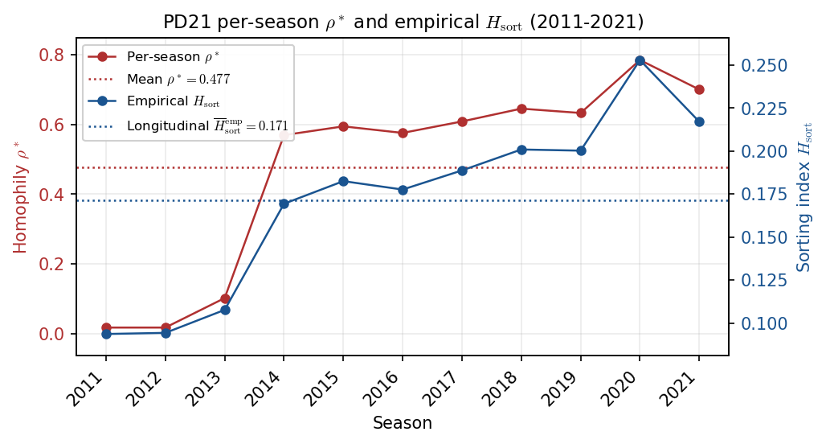
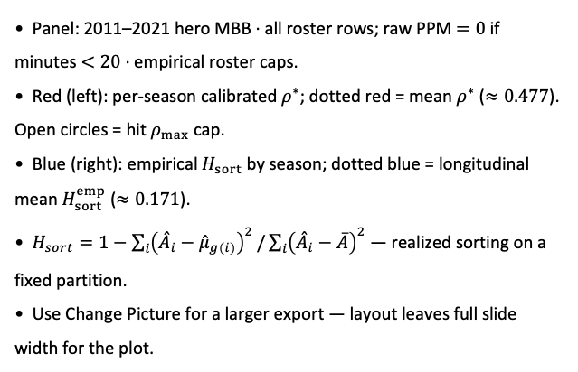
PD21 — Per-season $ρ^{∗}$ and empirical sorting index $H_{sort}$
PD21 · per-season $ρ^{∗}$ vs empirical $H_{sort}$ · 2011-2021 · all roster rows; raw PPM $=0$ if minutes $<20$
Panel: 2011–2021 hero MBB · all roster rows; raw PPM $=0$ if minutes $<20$ · empirical roster caps.
Red (left): per-season calibrated $ρ^{∗}$; dotted red = mean $ρ^{∗}$ ($≈0.477$). Open circles = hit $ρ_{max}$ cap.
Blue (right): empirical $H_{sort}$ by season; dotted blue = longitudinal mean $H_{sort}^{emp}$ ($≈0.171$).
$H_{sort}=1−\sum_{i}{{\left({\overset{ˆ}{A}}_{i}−{\overset{ˆ}{μ}}_{g\left(i\right)}\right)}^{2}}/\sum_{i}{{\left({\overset{ˆ}{A}}_{i}−\overline{A}\right)}^{2}}$ — realized sorting on a fixed partition.
Use Change Picture for a larger export — layout leaves full slide width for the plot.

