Slide 1
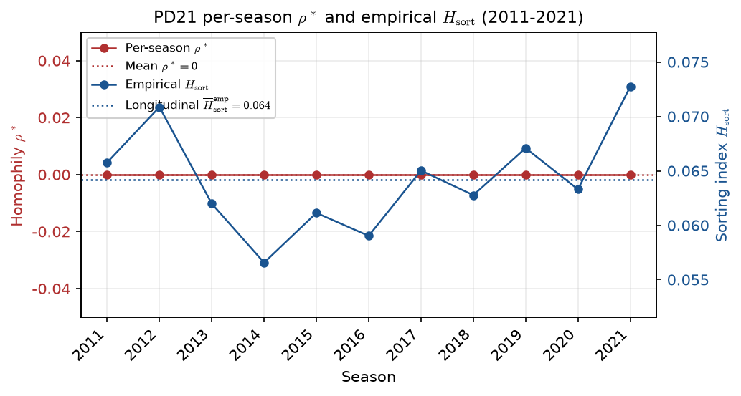
PD21 — Per-season $\rho^*$ and empirical sorting index $H_{\mathrm{sort}}$
PD21 · per-season $\rho^*$ vs empirical $H_{\mathrm{sort}}$ · 2011-2021 · min_minutes>=20 filter; PPM z within season
Panel: 2011–2021 hero MBB · min_minutes>=20 filter; PPM z within season · empirical roster caps.
Red (left): per-season calibrated $\rho^*$; dotted red = mean $\rho^*$ ($\approx 0$). Open circles = hit $\rho_{\max}$ cap.
Blue (right): empirical $H_{\mathrm{sort}}$ by season; dotted blue = longitudinal mean $H_{\mathrm{sort}}^{\mathrm{emp}}$ ($\approx 0.064$).
H_{sort} = 1 - \sum_i(\hat{A}_i - \hat{\mu}_{g(i)})^2 / \sum_i(\hat{A}_i - \bar{A})^2 — realized sorting on a fixed partition.
Use Change Picture for a larger export — layout leaves full slide width for the plot.

