Slide 1
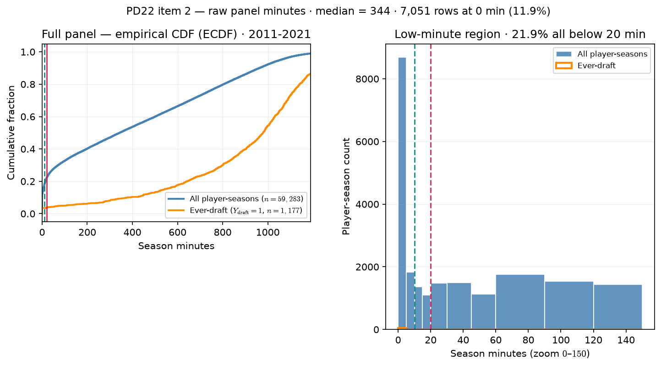
PD22 — Raw panel season-minutes distribution
PD22 · raw panel minutes · 2011-2021 · median = 344 min · 21.9\% below 20 min
PD22 item 2: season-minutes on box-QC panel (min\_minutes=0 rebuild).
Box QC at panel build: drop dash-name placeholders; keep team-seasons with $\geq$11 distinct games in box (frozen CSV untouched).
Panel: 2011-2021 MBB · 59,283 player-seasons · 1,177 ever-draft rows.
Median minutes = 344; 90th percentile = 963.
Zero-minute rows: 7,051 (11.9\% of panel).
Below 10 min: 17.7\%; below 20 min: 21.9\% (hero lock).
Ever-draft below 20 min: 3.7\% (median drafted = 979 min).
Left: empirical cumulative distribution function (ECDF) — all vs ever-draft; teal = 10 min, red = 20 min.
Right: histogram zoom 0–150 min — low-minute mass driving floor choice.
Claim (Alex, PD22): Minutes floor must be grounded in the raw roster distribution — not an arbitrary cut — before we defend min 20 min for $\rho$ / ASSIGN panels.

