Slide 1
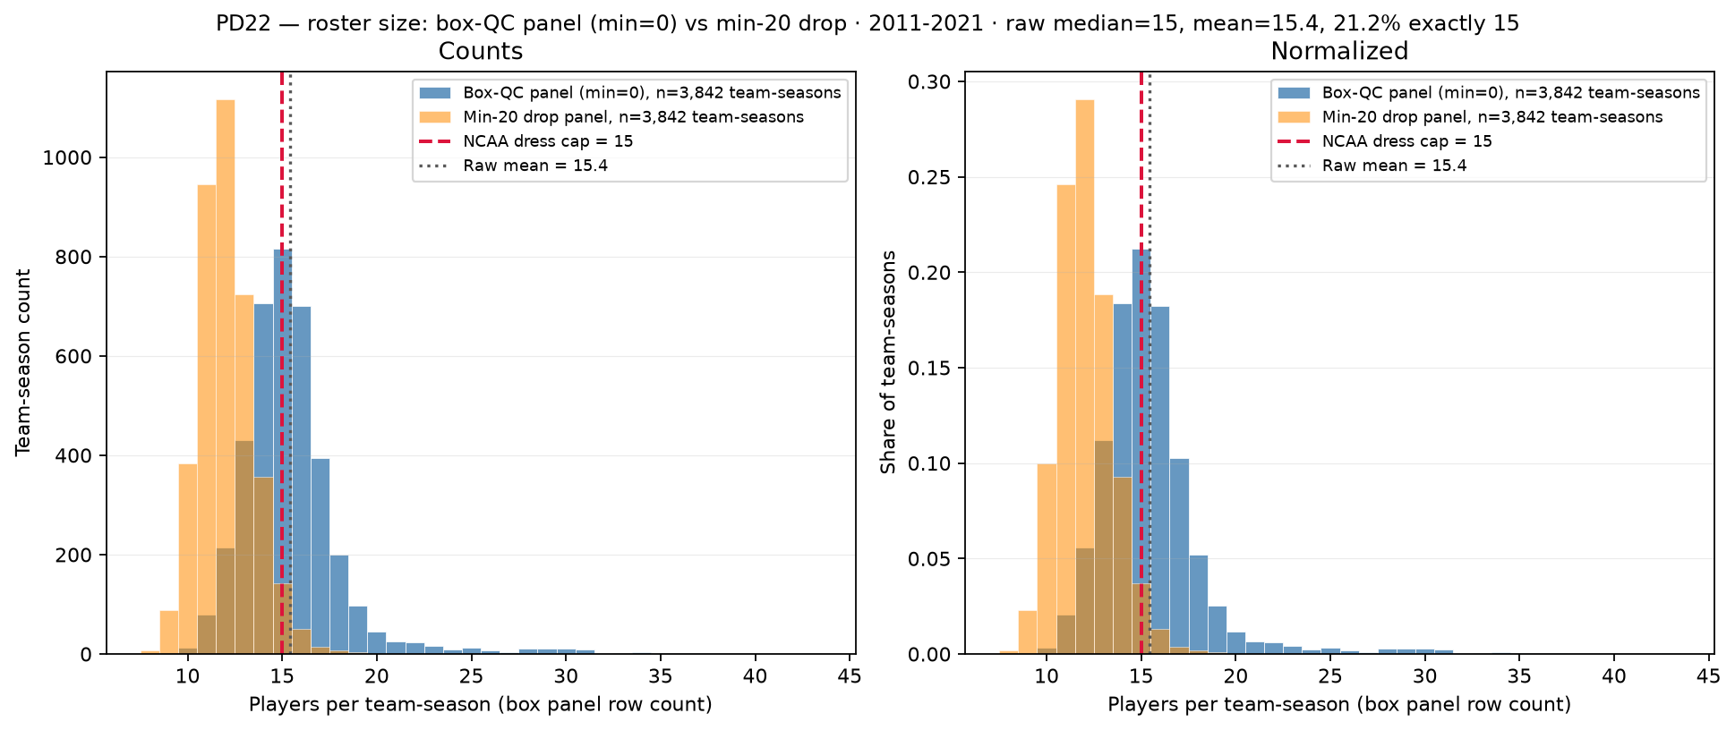
PD22 — Roster size: box-QC panel (min=0) vs min-20 drop
PD22 · roster size · 2011-2021 · raw median = 15 · 21.2\% exactly 15
PD22 backup: players per team-season — box-QC panel (min\_minutes=0) vs min-20 drop.
Box QC at panel build: drop dash-name placeholders; keep team-seasons with $\geq$11 distinct games in box (frozen CSV untouched).
Panel: 2011-2021 MBB · 3,842 team-seasons · 59,283 player-season rows.
Min=0 after QC (blue): median = 15, mean = 15.4; 21.2\% exactly 15, 62.4\% $\geq$ 15, 41.2\% $>$ 15.
Min-20 drop (orange): median = 12, mean = 12.1; only 3.7\% exactly 15 — rotation-minute survivors, not dress cap.
Tail: max = 43 (team\_id 2655 2019); 115 BYU spike gone — dash rows dropped at panel build (SCOUT Aug 2026).
Red dashed = NCAA dress cap 15; empirical caps in PD21 use min-20 multiset.
Left: team-season counts; right: normalized — bulk mass sits 14–17 after box QC.
Claim (PD22 backup): After box QC, team-season roster counts cluster near NCAA dress cap 15; empirical hero caps (min $\geq$ 20) count rotation-minute contributors — not game-day dress lists.

