Slide 1
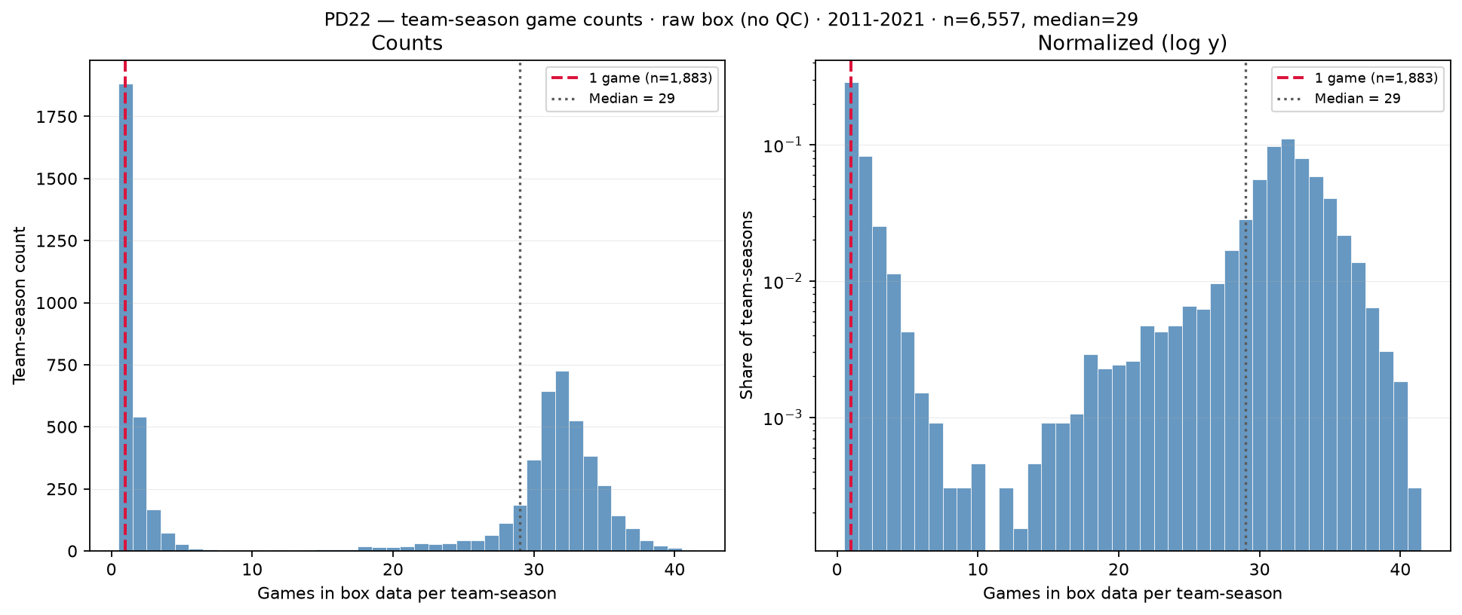
PD22 — Games per team-season in raw box data (before QC)
PD22 · team-season games · 2011–2021 · 1,883 with 1 game · median = 29
PD22 backup: distinct game\_ids per (team\_id, season) in raw box (2011–2021).
Panel: 6,557 team-seasons · median = 29 games · mean = 19.1 · max = 41.
Bimodal: 1,883 team-seasons (28.7\%) with only 1 game (red line) vs cluster near 30–32 (full seasons).
$\leq$10 games: 2,715 (41.4\%); $>$10 games: 3,842 — sparse tail is partial coverage / small-school noise.
Default box QC (panel\_rebuild): min\_team\_season\_games=10 drops team-seasons with $\leq$ 10 games (keep $\geq$ 11).
Left: linear counts; right: log $y$ — gap between spikes is low-frequency partial seasons, not hero-panel mass.
Pairs with roster-size backup: low-game team-seasons often inflate per-game roster anomalies (SCOUT ESPN dash rows).
Claim (PD22 backup): Box panel mixes full D-I seasons ($\sim$30 games) with sparse one-game team-seasons — default min\_team\_season\_games=10 drops team-seasons with $\leq$10 games (keep $\geq$11) before player-season aggregation.

