Slide 1
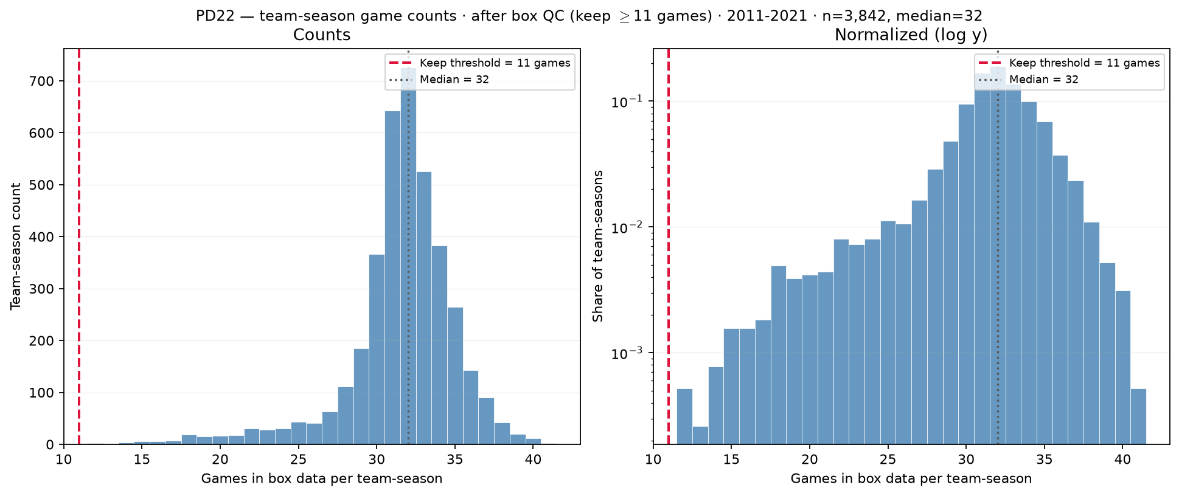
PD22 — Games per team-season after box QC
PD22 · games after box QC · 2011–2021 · 3,842 team-seasons · median = 32 · min $\geq$ 11
PD22 backup (after filter): distinct game\_ids per (team\_id, season) surviving box QC.
Box QC at panel build: drop dash-name placeholders; keep team-seasons with $\geq$11 distinct games in box (frozen CSV untouched).
Panel: 3,842 team-seasons kept · median = 32 games · mean = 31.6 · min = 12 (all $\geq$ 11).
Removed by min\_team\_season\_games=10: 2,715 team-seasons with $\leq$ 10 games (see raw games-count slide).
Dropped dash rows: 175 game rows before game-count tally.
No one-game spike — bulk mass sits near 28–32 games (normal D-I seasons).
Left: linear counts; right: log $y$ — post-QC panel is what roster-size and minutes diagnostics use.
Claim (PD22 backup): After box QC, team-season game counts are full-season D-I coverage ($\geq$11 games) — low-game tail ($\leq$10 games) removed before panel build.

