Slide 1
PD20 — Gibbs SELECT (temperature $t$)
MBB empirical caps · $\rho=0.5$ · inverted-U before MLE
PD20: replace deterministic top-$K$ SELECT with Gibbs rule on $S_i$.
Lock: $P_i \propto \exp(S_i/t)$ with $t$ in the denominator (stat-phys).
Sim bridge: rule D = Gibbs weights + $K$ draws without replacement.
SCORE unchanged: $S_i = \hat{A}_i - \lambda L_{C,g(i)}$; $\rho$ still in ASSIGN only.
Priority: sweep $\log_{10} t$ — prove inverted-U survives **before** MLE.
ASSIGN $\rightarrow$ SCORE $\rightarrow$ SELECT — score $\neq$ select (binding).
Goal: soft SELECT must not erase the phenomenological inverted-U on LOO pool quality.

Slide 2
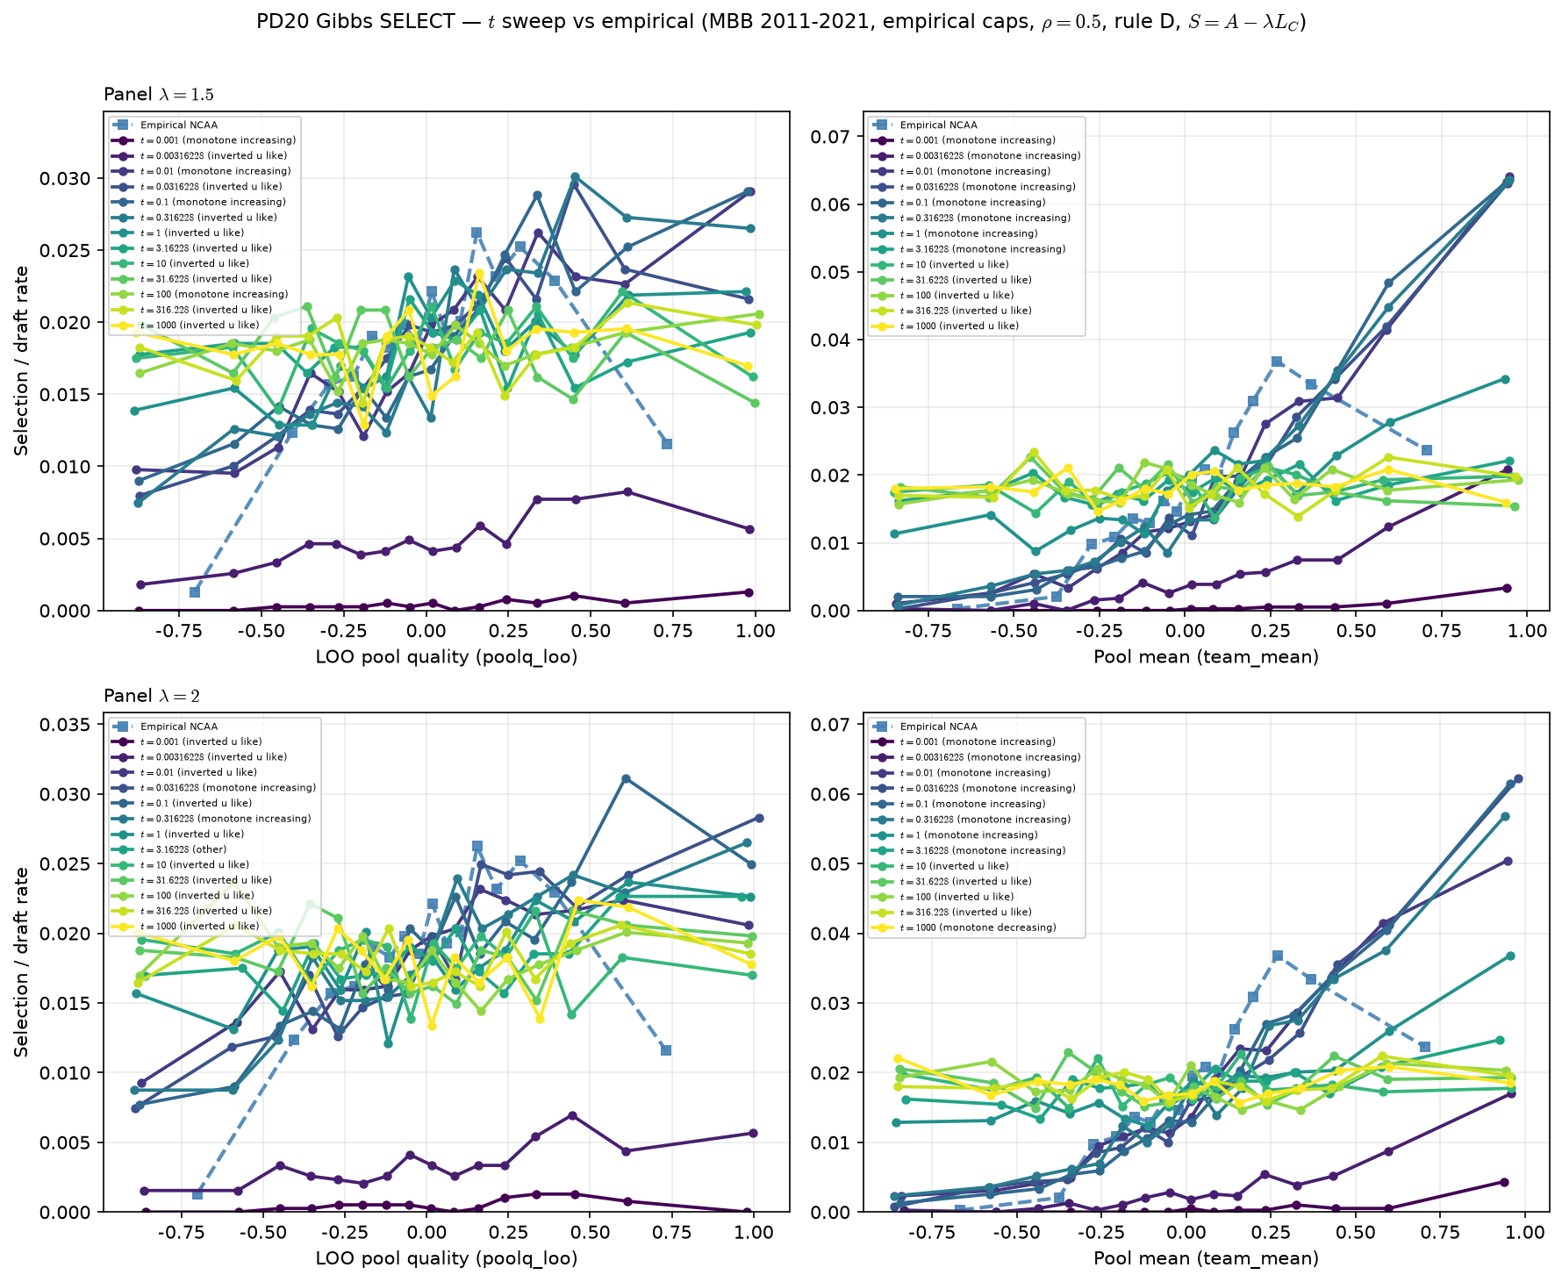
Temperature sweep — rule D (Gibbs + $K$ draws)
MBB 2011-2021 · $\lambda \in \{1.5, 2\}$ · $\log_{10} t \in [-3,3]$
SELECT: draft rate vs LOO (left) and pool mean (right) — Hero axes.
MBB 2011-2021 · empirical caps · $\rho=0.5$ · rule D · $\lambda$ panels 1.5, 2
Empirical LOO: inverted u like.
$\lambda=1.5$: inverted-U-like on LOO for 9/13 $t$ arms.
$\lambda=2$: inverted-U-like on LOO for 10/13 $t$ arms.
Cold $t$: near hard cut; hot $t$: flattens toward uniform $K$-draws.
Pool mean often stays monotone — same PD17 readout limitation.
Talking point: check LOO panels at $\lambda=1.5$–$2$ — does a $t$ window preserve inverted-U vs empirical?

Slide 3
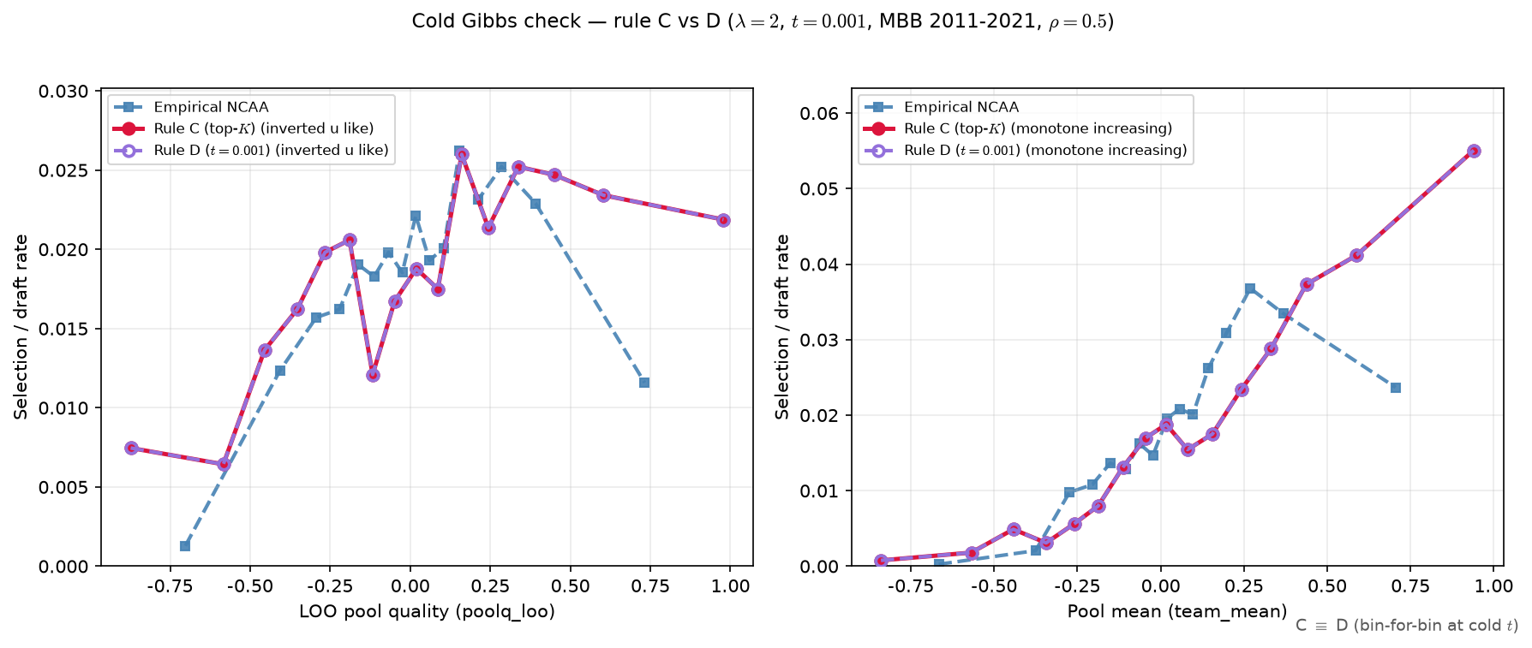
Cold limit — rule C vs rule D
$\lambda=2$ · $t=0.001$ · same seeds
Same ASSIGN seeds; only SELECT rule differs (C = top-$K$, D = cold Gibbs).
Fixed $\lambda=2$, $t=0.001$ ($\log_{10} t = -3$).
Max bin gap C vs D: LOO = 0.00e+00, pool mean = 0.00e+00.
LOO curvature: C = inverted u like; D = inverted u like.
Expect overlay coincidence at cold $t$ (Gibbs $\to$ hard ranking).
Numerical match flag: True (gap $< 10^{-9}$ on binned curves).
Talking point: rule D at cold $t$ reproduces rule C bin-for-bin — Gibbs SELECT nests the old top-$K$ limit.

Slide 4
PD20 takeaways
MBB 2011-2021 · empirical caps · rule D
PD20 gate (LOO): inverted-U survives Gibbs SELECT at breakpoint $\lambda$.
Full panel: $\lambda=1.5$ → 9/13 $t$ arms U-like; $\lambda=2$ → 10/13 $t$ arms U-like.
Cold $t$ ≈ top-$K$ (slide 3); mid $t$ still shows hump on LOO.
Hot $t$ → uniform-$K$ limit (flattening) — different failure mode.
Open for Alex: K-draw vs literal softmax Bernoulli for MLE.
Next: MLE for $\lambda^*, t^*$ (and $\gamma$); $\rho^*$ via $H_{\mathrm{sort}}$ separately.
PD20 step 4 cleared on LOO: proceed to MLE design once K-draw semantics are confirmed with Alex.

