Slide 1
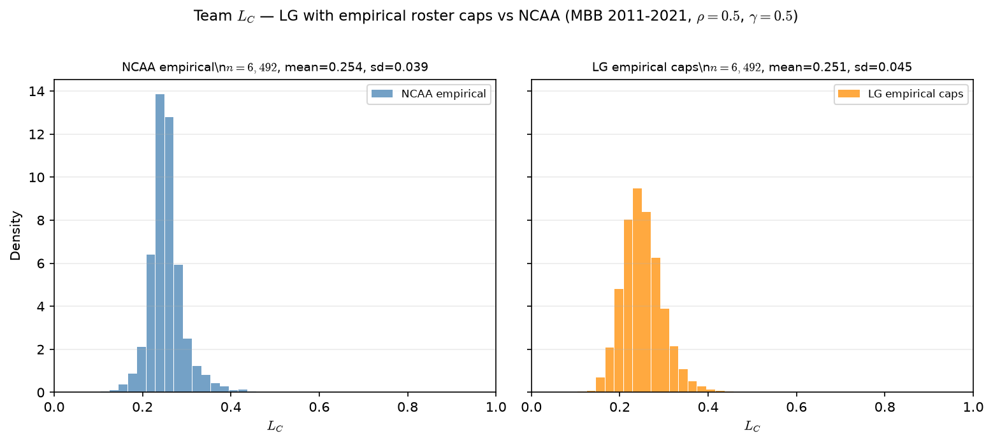
Empirical caps — team $L_C$ vs NCAA
MBB 2011-2021 · 6,492 team-seasons · NCAA mean=0.254
Team $L_C$ after empirical-cap ASSIGN vs real NCAA rosters.
MBB 2011-2021 · $\rho=0.5$, $\gamma=0.5$.
NCAA: $n=6,492$ · mean=0.254 · sd=0.039.
LG empirical caps: $n=6,492$ · mean=0.251 · sd=0.045.
Team count now aligned (6,492) — fixed $C=15$ had only 4,140 teams.
L\_C first moment still matches; slightly wider LG tail (assign noise).
Input comparability fixed; SCORE/SELECT shape is a separate question.
Talking point: comparability achieved — same team count and L_C mean; assignment layer is now apples-to-apples on roster geometry.

