Slide 1
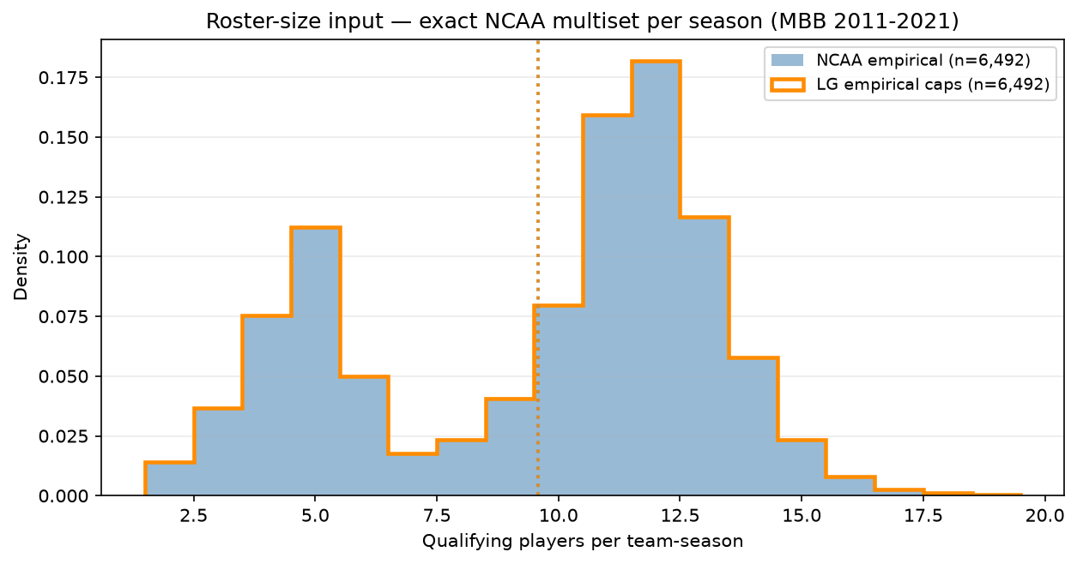
LG input — empirical roster-size multiset
MBB 2011-2021 · mean=9.6 vs old fixed $C=15$
Alex ask: LG stub capacities = exact NCAA filtered roster-size multiset.
MBB 2011-2021 · min 20 min · one capacity per real team-season per year.
NCAA / LG: $n=6,492$ team-seasons · mean=9.6 · median=11 · sd=3.6.
Range 2–19 qualifying players per team.
Replaces fixed $C=15$ repack ($J=N/15$, every roster exactly 15).
Same player pool (~62k); ASSIGN homophily unchanged — only input geometry.
LG realized roster sizes match NCAA by construction (overlay).
Talking point: Alex's fix — LG teams get the exact filtered NCAA roster-size distribution, not a synthetic 15-man league.

