Slide 1
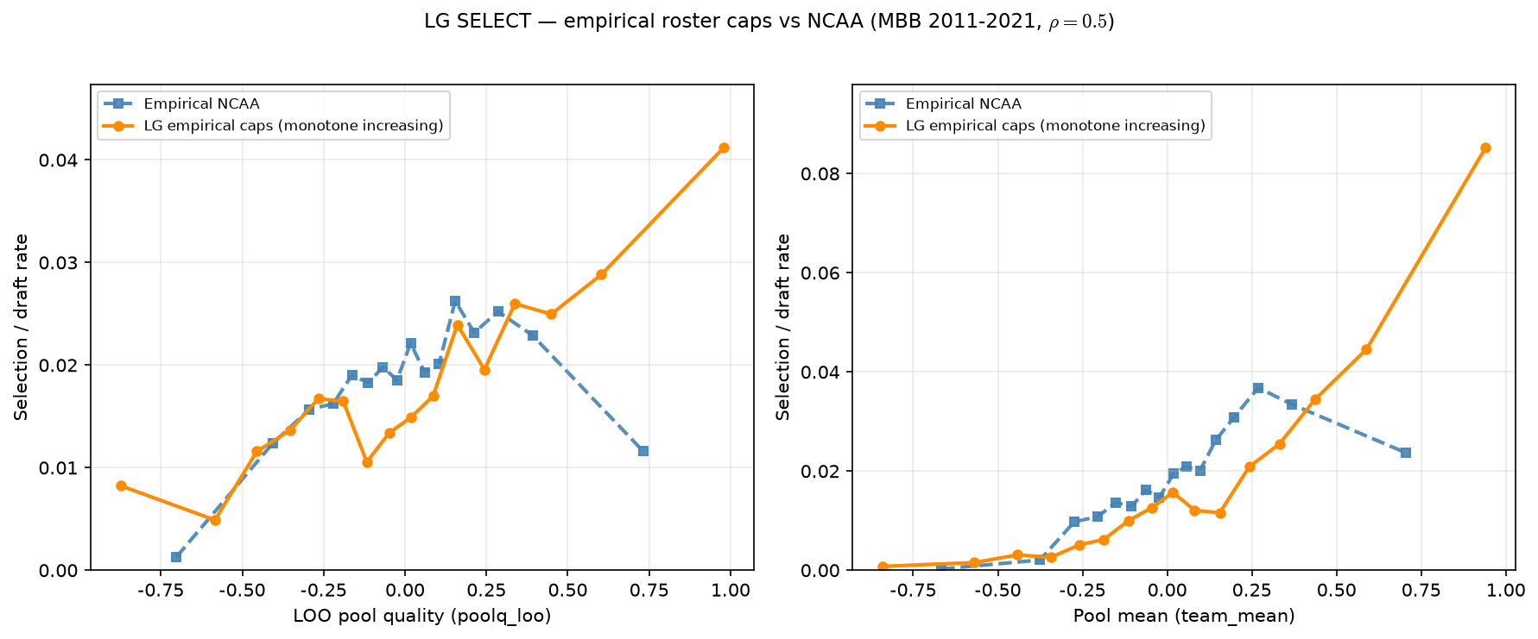
Empirical caps — SELECT vs Hero
MBB 2011-2021 · LOO still monotone · empirical inverted-U
SELECT: draft rate vs LOO peer quality (left) and pool mean (right).
MBB 2011-2021 · empirical caps · $\rho=0.5$ · default $\lambda$.
Empirical LOO: inverted u like (peak bin 11, 2.62\%).
LG empirical caps: monotone increasing on LOO.
Roster-size alignment does not recover Hero inverted-U alone.
$\rho$ = ASSIGN sorting; $\lambda$ = SCORE congestion penalty — next sweep.
C sweep and exact caps both monotone — shape gap is not headcount.
Talking point: input fix necessary but not sufficient — λ sweep on SELECT is the next experiment.

