Slide 1
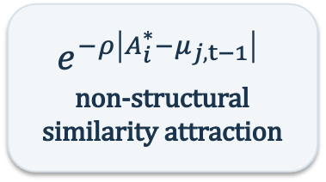
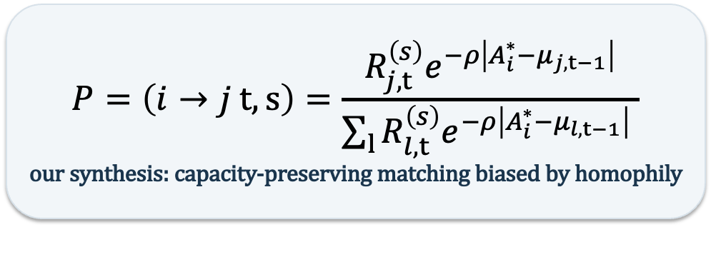
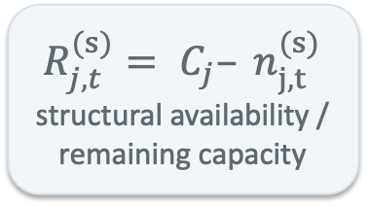
ASSIGN Parent Model: Constrained Homophilic Bipartite Formation
Two established ideas supply the ingredients; the synthesis is our assignment mechanism.
Configuration-model logic
Give each team a fixed number of stubs. Rⱼ is our notation for the number of unmatched team stubs remaining.
Quayle-style homophily
Similarity is a generative preference. Closer individual–team states receive greater attachment weight.
$$P=\left(i→j t,s\right)=\frac{R_{j,t}^{\left(s\right)}e^{−ρ\left|A_{i}^{∗}−μ_{j,t−1}\right|}}{\sum_{l}{R_{l,t}^{\left(s\right)}e^{−ρ\left|A_{i}^{∗}−μ_{l,t−1}\right|}} }$$
our synthesis: capacity-preserving matching biased by homophily
$$R_{j,t}^{(s)}= C_{j}– n_{j,t}^{(s)}$$
structural availability / remaining capacity
$$e^{−ρ\left|A_{i}^{∗}−μ_{j,t−1}\right|}$$
non-structural similarity attraction
After each assignment
If i joins team j: Rⱼ,ₜ⁽ˢ⁺¹⁾ = Rⱼ,ₜ⁽ˢ⁾ − 1 Full team therefore has 0 remaining stubs.
After each period
Recalculate the team centroid μⱼ,ₜ from the new roster. That state can guide the next formation period.
Dynamic extension
μⱼ,ₜ₋₁ → ASSIGN at t → roster at t → μⱼ,ₜ → ASSIGN at t+1
Structural lineage: Fosdick et al. (2018), SIAM Review 60(2), 315–355. Homophily lineage: Quayle et al. (2006), EPJ B 50, 617–630.

Slide 2
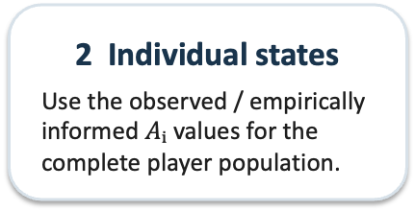
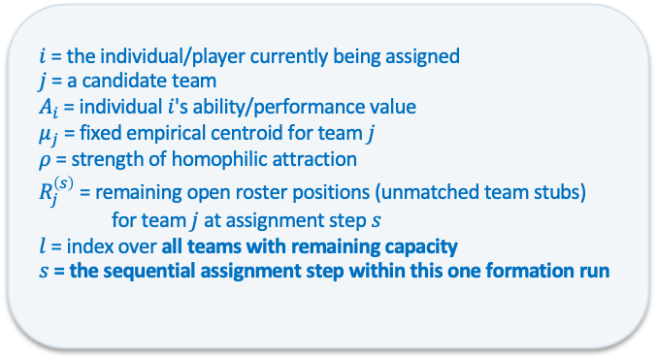
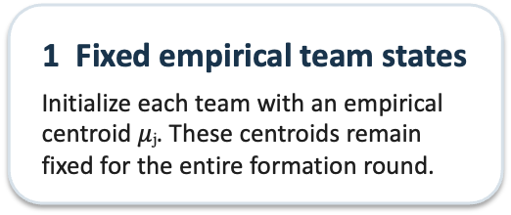
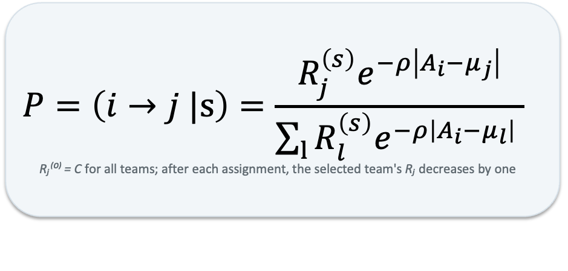
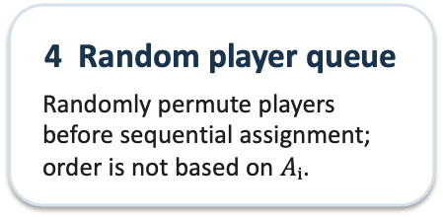
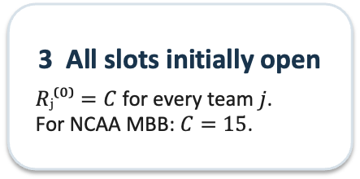
Child Model: One-Shot Homophilic Initial-League Generator
We derive the smallest model needed for the paper—no longitudinal updating.
1 Fixed empirical team states
Initialize each team with an empirical centroid $μⱼ$. These centroids remain fixed for the entire formation round.
2 Individual states
Use the observed / empirically informed $Aᵢ$ values for the complete player population.
3 All slots initially open
$Rⱼ⁽⁰⁾=C$ for every team $j$. For NCAA MBB: $C=15$.
4 Random player queue
Randomly permute players before sequential assignment; order is not based on $Aᵢ$.
$$P=\left(i→j |s\right)=\frac{R_{j}^{\left(s\right)}e^{−ρ\left|A_{i}−μ_{j}\right|}}{\sum_{l}{R_{l}^{\left(s\right)}e^{−ρ\left|A_{i}−μ_{l}\right|}} }$$
Rⱼ⁽⁰⁾ = C for all teams; after each assignment, the selected team's Rⱼ decreases by one
$i$ = the individual/player currently being assigned
$j$ = a candidate team
$A_{i}$​ = individual $i$'s ability/performance value
$μ_{j}$​ = fixed empirical centroid for team $j$
$ρ$ = strength of homophilic attraction
$R_{j}^{\left(s\right)}​$ = remaining open roster positions (unmatched team stubs)
for team $j$ at assignment step $s$
$l$ = index over all teams with remaining capacity
$s$ = the sequential assignment step within this one formation run
ρ = 0 → random baseline
P(i→j|s) = Rⱼ⁽ˢ⁾ / ΣₗRₗ⁽ˢ⁾ Uniform matching over all remaining team stubs.
ρ > 0 → homophilic bias
The same capacity-preserving process increasingly favors teams with μⱼ close to Aᵢ.
One run = one realization
Repeat from the same initial conditions to obtain an ensemble of possible leagues—not longitudinal iterations.
The combined probability rule is our synthesis; Fosdick supports the stub/configuration logic and Quayle supports the similarity-weighted homophily logic.

Slide 3
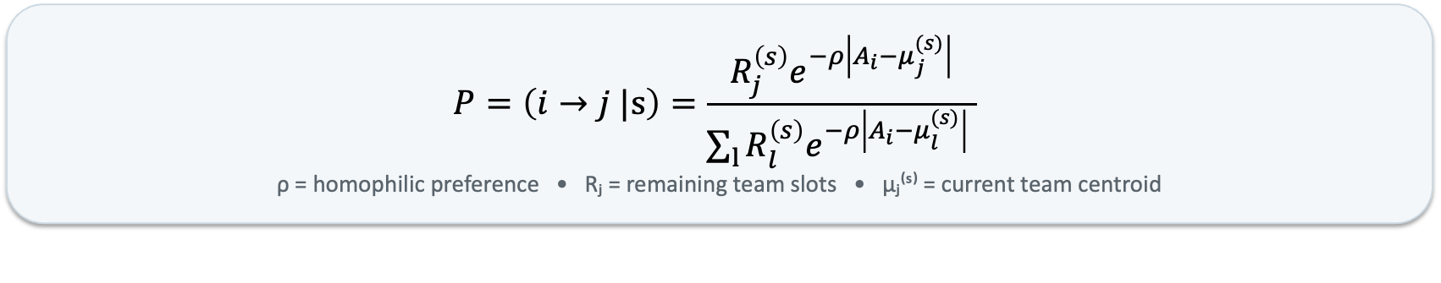
ASSIGN Grandchild: Endogenous Team Centroids Within One Formation Run
Same capacity-constrained homophily rule — but teams begin identical and μⱼ updates after every attachment.
1 Identical initial teams
μⱼ⁽⁰⁾ = μ₀ = Ā for every j Rⱼ⁽⁰⁾ = C for every j No initial between-team differentiation.
2 Random player entrance
Randomly permute the Aᵢ population. s = sequential entrance/assignment event. One full queue = one stochastic realization.
3 Homophilic attachment
At each event, open teams compete using remaining capacity × similarity to the team's current centroid.
$$P=\left(i→j |s\right)=\frac{R_{j}^{\left(s\right)}e^{−ρ\left|A_{i}−μ_{j}^{(s)}\right|}}{\sum_{l}{R_{l}^{\left(s\right)}e^{−ρ\left|A_{i}−μ_{l}^{(s)}\right|}} }$$
ρ = homophilic preference • Rⱼ = remaining team slots • μⱼ⁽ˢ⁾ = current team centroid
4 Attach + consume a slot
If player i joins team j: Rⱼ⁽ˢ⁺¹⁾ = Rⱼ⁽ˢ⁾ − 1 A full team automatically leaves the choice set.
5 Immediately update μⱼ
First member: μⱼ = Aᵢ Thereafter μⱼ is the mean of actual attached players. μ₀ is NOT a pseudo-player.
6 Emergent differentiation
Repeat until all C slots are filled. Teams began identical; final μⱼ differences emerge from stochastic arrivals + homophily + capacity.
TEST: ρ ↑ → within-team dispersion D ↓ ? • normalized sorting H ↑ ? • what is the functional shape?
Grandchild preserves the Parent/Child weighted-stub + Quayle-style homophily logic; only the within-run centroid rule changes.

