Slide 1
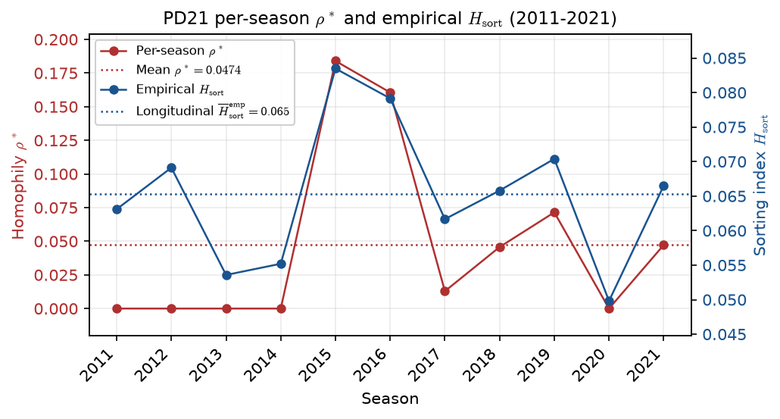
PD21 — Per-season $\rho^*$ and empirical $H_{\mathrm{sort}}$ (contrast: ppm0lt20 — not for calibration)
PD21 · per-season $\rho^*$ vs empirical $H_{\mathrm{sort}}$ · 2011-2021 · contrast ppm0lt20
PD21 contrast (Aug 2026): ppm0lt20 panel — illustrative only; do not use for locked longitudinal $\rho$ calibration.
Panel: 2011–2021 MBB · all roster rows kept · raw PPM$=0$ if minutes$<20$ · no roster caps — contrast / legacy estimand only.
Red (left): per-season calibrated $\rho^*$; dotted red = mean $\rho^*$ ($\approx 0.0474$). Open circles = hit $\rho_{\max}$ cap.
Blue (right): empirical $H_{\mathrm{sort}}$ by season; dotted blue = longitudinal mean $H_{\mathrm{sort}}^{\mathrm{emp}}$ ($\approx 0.065$).
H_{sort} = 1 - \sum_i(\hat{A}_i - \hat{\mu}_{g(i)})^2 / \sum_i(\hat{A}_i - \bar{A})^2 — realized sorting on a fixed partition.
2014$\rightarrow$2015 per-season $\rho^*$: $0.000\rightarrow0.184$ — mid-decade spike co-moves with empirical $H_{\mathrm{sort}}$; not used for locked calibration.
Pair with PD22 ESPN coverage (HAND20 slide 9) — roster-depth context for ppm0lt20; mid-decade $\rho^*$ spike is not the locked calibration estimand.
Claim (PD21 contrast): ppm0lt20 mid-decade per-season $\rho^*$ spike (2014$\rightarrow$2015) co-moves with empirical $H_{\mathrm{sort}}$ — hero min-20 panel gives flat $\rho^*$; see PD22 ESPN coverage (HAND20 slide 9).

