Slide 1
HERO permutation sweep
Tier real_full · season both · 64 run slides · 2026-08-25
Purpose: compare roster-x × Y-mode × panel-rows (and optional +DFT / EW20).
Three knobs are orthogonal:
• roster-x: poolq_loo (LOO teammates) vs poolq (team mean, incl. self)
• y-draft-mode: ever (Y=1 all PS for draftees) vs season (Y=1 last PS only)
• panel-rows: all-ps vs last-ps (cross-section)
Slide 2 = FIXED HERO baseline. Later slides = other combinations.
Command box on each slide = exact CLI to reproduce.
Regenerate: python sports/scripts/hero_permutation_sweep.py --tier core|extended|full|real_full …
Rebuild deck: python sports/scripts/build_hero_permutation_slides.py

Slide 2
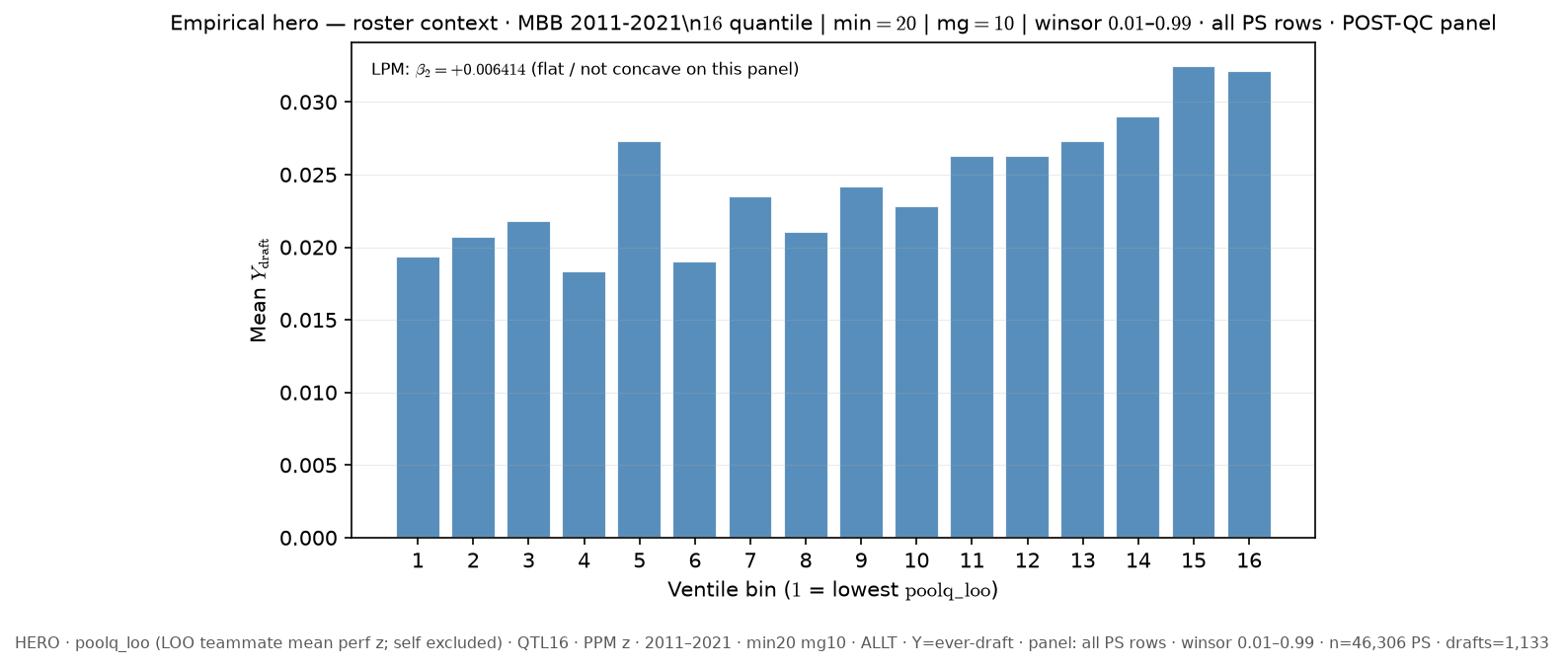
Slide 1 — FIXED HERO — canonical deck (11–21)
Baseline — canonical deck HERO
python sports/scripts/pass_a_empirical_bundle.py \ --season-min 2011 \ --season-max 2021 \ --y-draft-mode ever \ --panel-rows all-ps \ --roster-x poolq_loo \ --n-bins 16 \ --poolq-binning quantile \ --output-tag FIXED_HERO \ --output-root 3-Master_Plan/re_entry/HEROs_and_PASSes/population_sandbox/hero
Shape: bin1=1.934% · peak=ventile 15 @ 3.248% · last=3.214% · LPM β₂=+0.006414

Slide 3
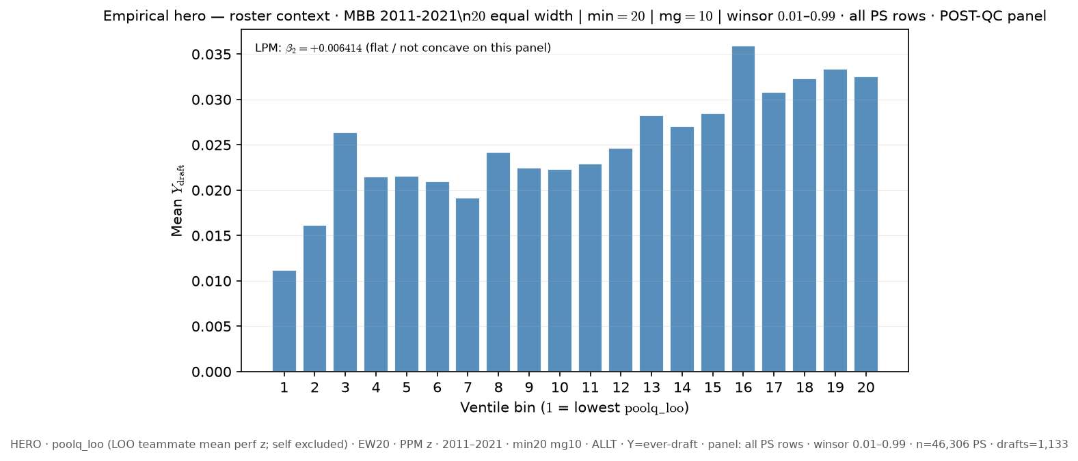
Slide 2 — 11–21 · LOO poolq_loo · ever-draft · all PS rows · EW20 ALLT
Δ vs FIXED HERO: poolq_binning: quantile → equal_width; n_bins: 16 → 20
python sports/scripts/pass_a_empirical_bundle.py \ --season-min 2011 \ --season-max 2021 \ --y-draft-mode ever \ --panel-rows all-ps \ --roster-x poolq_loo \ --n-bins 20 \ --poolq-binning equal_width \ --output-tag perm_loo_ever_allps_ew20 \ --output-root 3-Master_Plan/re_entry/HEROs_and_PASSes/population_sandbox/hero
Shape: bin1=1.121% · peak=ventile 16 @ 3.594% · last=3.252% · LPM β₂=+0.006414

Slide 4
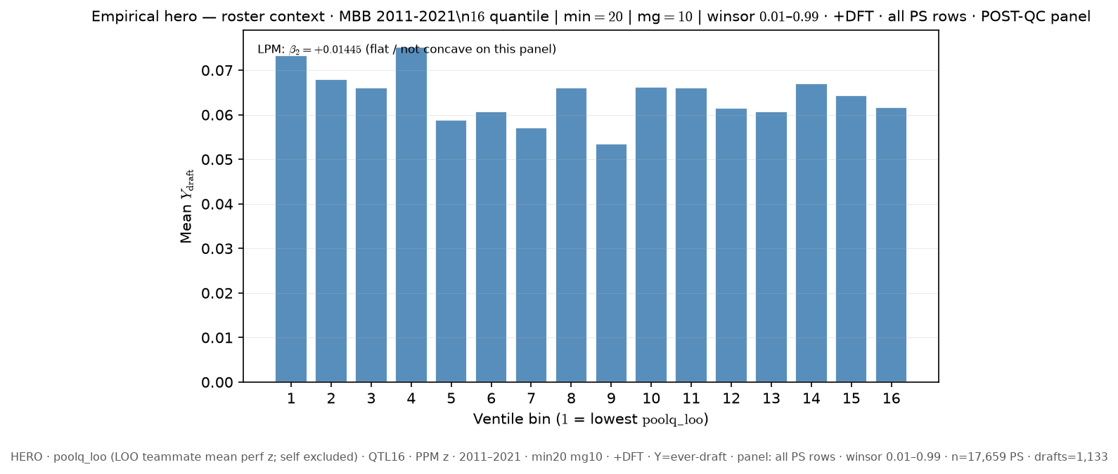
Slide 3 — 11–21 · LOO poolq_loo · ever-draft · all PS rows · QTL16 +DFT
Δ vs FIXED HERO: dft: False → True
python sports/scripts/pass_a_empirical_bundle.py \ --season-min 2011 \ --season-max 2021 \ --y-draft-mode ever \ --panel-rows all-ps \ --roster-x poolq_loo \ --n-bins 16 \ --poolq-binning quantile \ --output-tag perm_loo_ever_allps_q16_dft \ --output-root 3-Master_Plan/re_entry/HEROs_and_PASSes/population_sandbox/hero \ --dft
Shape: bin1=7.337% · peak=ventile 4 @ 7.525% · last=6.165% · LPM β₂=+0.01444

Slide 5
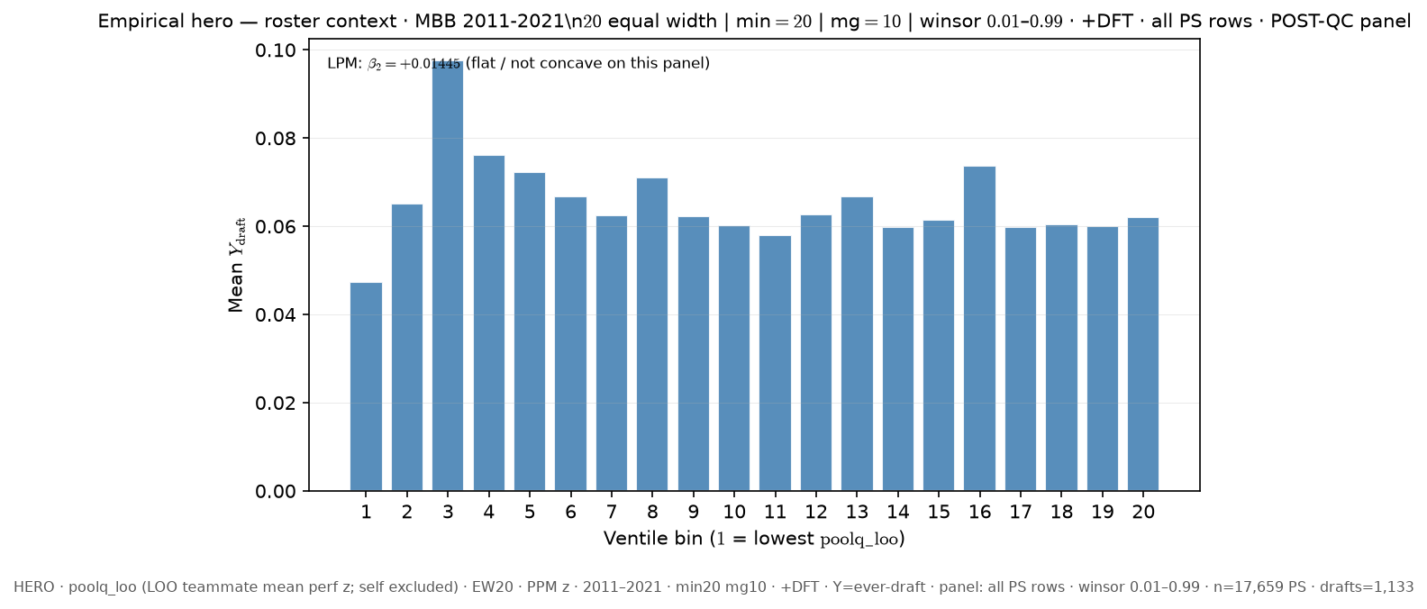
Slide 4 — 11–21 · LOO poolq_loo · ever-draft · all PS rows · EW20 +DFT
Δ vs FIXED HERO: poolq_binning: quantile → equal_width; n_bins: 16 → 20; dft: False → True
python sports/scripts/pass_a_empirical_bundle.py \ --season-min 2011 \ --season-max 2021 \ --y-draft-mode ever \ --panel-rows all-ps \ --roster-x poolq_loo \ --n-bins 20 \ --poolq-binning equal_width \ --output-tag perm_loo_ever_allps_ew20_dft \ --output-root 3-Master_Plan/re_entry/HEROs_and_PASSes/population_sandbox/hero \ --dft
Shape: bin1=4.737% · peak=ventile 3 @ 9.766% · last=6.208% · LPM β₂=+0.01444

Slide 6
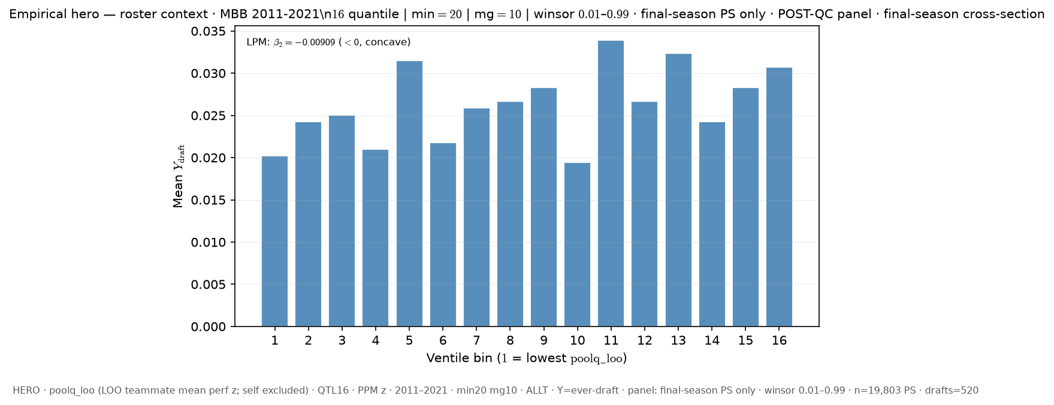
Slide 5 — 11–21 · LOO poolq_loo · ever-draft · last PS only (cross-section) · QTL16 ALLT
Δ vs FIXED HERO: panel_rows: all-ps → last-ps
python sports/scripts/pass_a_empirical_bundle.py \ --season-min 2011 \ --season-max 2021 \ --y-draft-mode ever \ --panel-rows last-ps \ --roster-x poolq_loo \ --n-bins 16 \ --poolq-binning quantile \ --output-tag perm_loo_ever_lastps_q16 \ --output-root 3-Master_Plan/re_entry/HEROs_and_PASSes/population_sandbox/hero
Shape: bin1=2.019% · peak=ventile 11 @ 3.393% · last=3.072% · LPM β₂=-0.00909

Slide 7
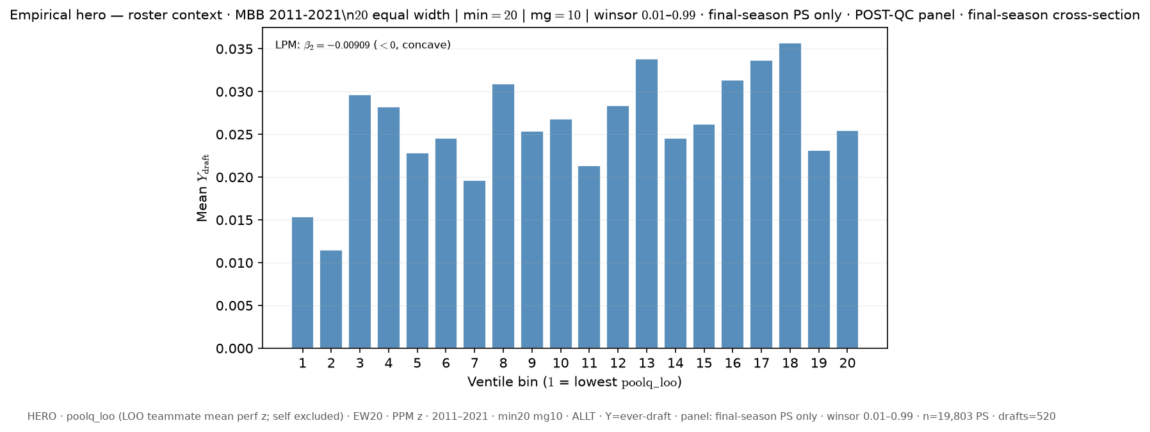
Slide 6 — 11–21 · LOO poolq_loo · ever-draft · last PS only (cross-section) · EW20 ALLT
Δ vs FIXED HERO: panel_rows: all-ps → last-ps; poolq_binning: quantile → equal_width; n_bins: 16 → 20
python sports/scripts/pass_a_empirical_bundle.py \ --season-min 2011 \ --season-max 2021 \ --y-draft-mode ever \ --panel-rows last-ps \ --roster-x poolq_loo \ --n-bins 20 \ --poolq-binning equal_width \ --output-tag perm_loo_ever_lastps_ew20 \ --output-root 3-Master_Plan/re_entry/HEROs_and_PASSes/population_sandbox/hero
Shape: bin1=1.535% · peak=ventile 18 @ 3.571% · last=2.55% · LPM β₂=-0.00909

Slide 8
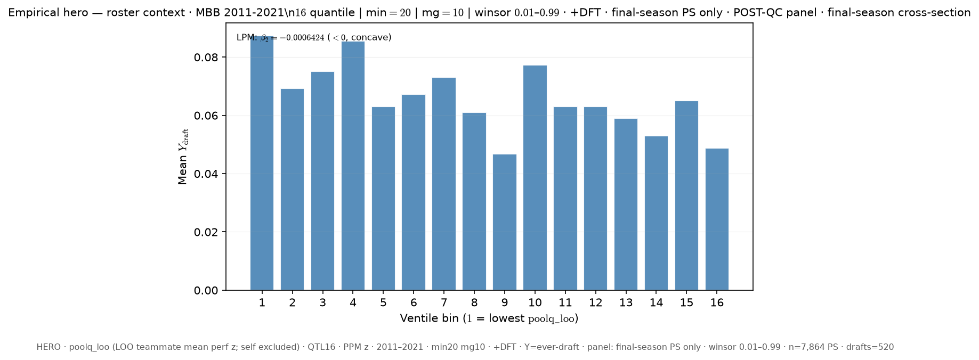
Slide 7 — 11–21 · LOO poolq_loo · ever-draft · last PS only (cross-section) · QTL16 +DFT
Δ vs FIXED HERO: panel_rows: all-ps → last-ps; dft: False → True
python sports/scripts/pass_a_empirical_bundle.py \ --season-min 2011 \ --season-max 2021 \ --y-draft-mode ever \ --panel-rows last-ps \ --roster-x poolq_loo \ --n-bins 16 \ --poolq-binning quantile \ --output-tag perm_loo_ever_lastps_q16_dft \ --output-root 3-Master_Plan/re_entry/HEROs_and_PASSes/population_sandbox/hero \ --dft
Shape: bin1=8.74% · peak=ventile 1 @ 8.74% · last=4.888% · LPM β₂=-0.000642 ⚠ bin1 LOWEST ventile is PEAK

Slide 9
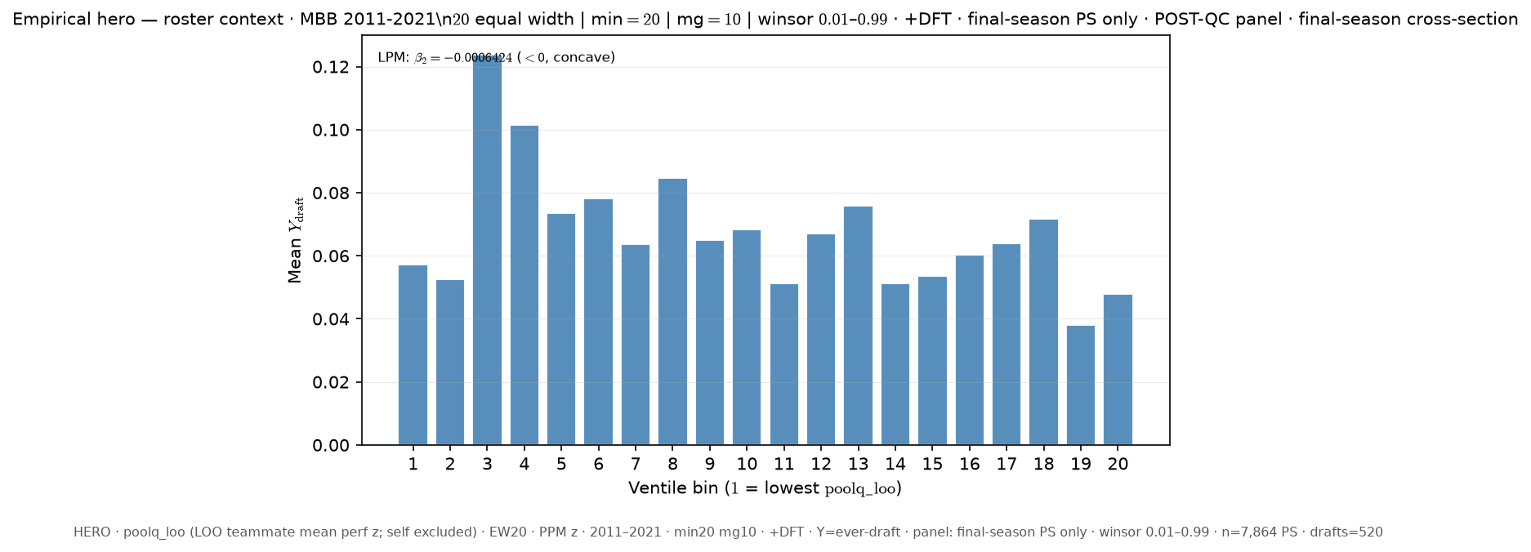
Slide 8 — 11–21 · LOO poolq_loo · ever-draft · last PS only (cross-section) · EW20 +DFT
Δ vs FIXED HERO: panel_rows: all-ps → last-ps; poolq_binning: quantile → equal_width; n_bins: 16 → 20; dft: False → True
python sports/scripts/pass_a_empirical_bundle.py \ --season-min 2011 \ --season-max 2021 \ --y-draft-mode ever \ --panel-rows last-ps \ --roster-x poolq_loo \ --n-bins 20 \ --poolq-binning equal_width \ --output-tag perm_loo_ever_lastps_ew20_dft \ --output-root 3-Master_Plan/re_entry/HEROs_and_PASSes/population_sandbox/hero \ --dft
Shape: bin1=5.714% · peak=ventile 3 @ 12.381% · last=4.787% · LPM β₂=-0.000642

Slide 10
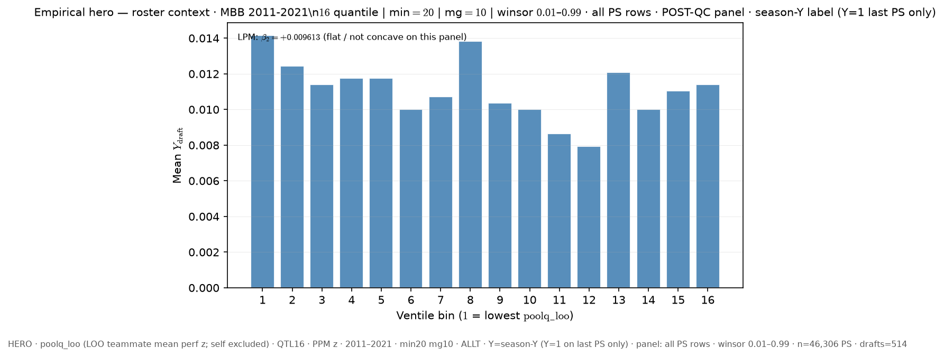
Slide 9 — 11–21 · LOO poolq_loo · season-Y label · all PS rows · QTL16 ALLT
Δ vs FIXED HERO: y_draft_mode: ever → season
python sports/scripts/pass_a_empirical_bundle.py \ --season-min 2011 \ --season-max 2021 \ --y-draft-mode season \ --panel-rows all-ps \ --roster-x poolq_loo \ --n-bins 16 \ --poolq-binning quantile \ --output-tag perm_loo_seasony_allps_q16 \ --output-root 3-Master_Plan/re_entry/HEROs_and_PASSes/population_sandbox/hero
Shape: bin1=1.416% · peak=ventile 1 @ 1.416% · last=1.14% · LPM β₂=+0.009613 ⚠ bin1 LOWEST ventile is PEAK

Slide 11
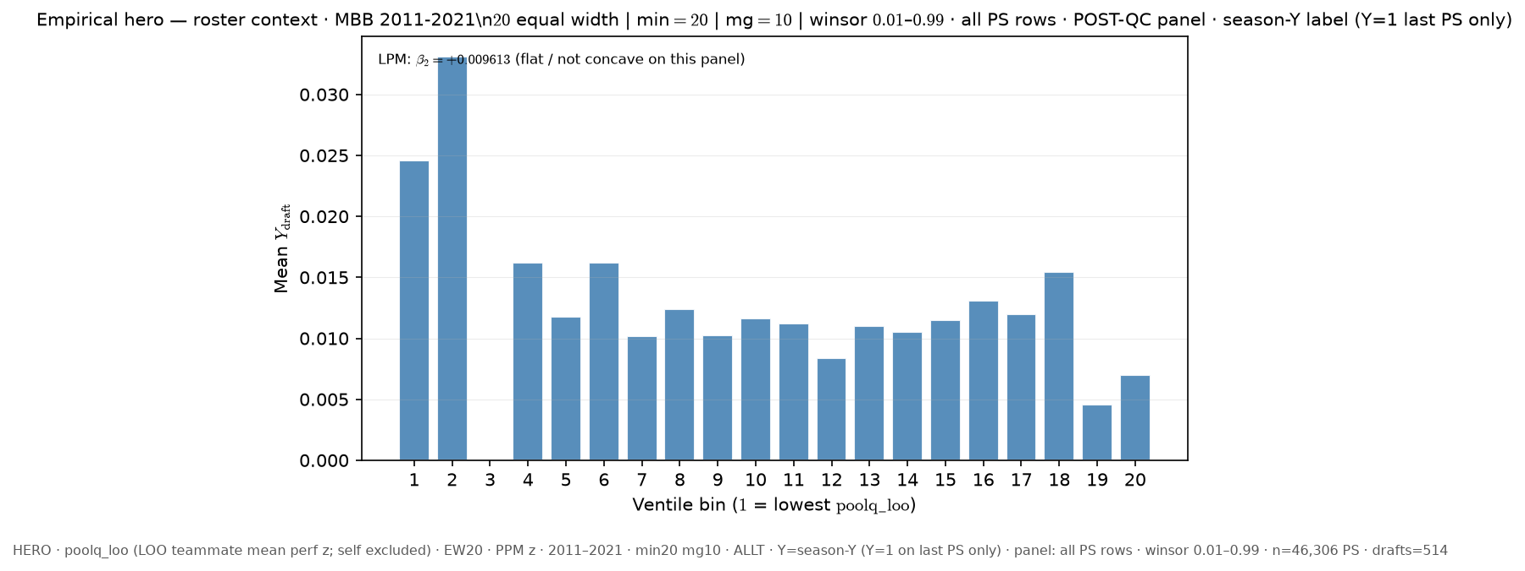
Slide 10 — 11–21 · LOO poolq_loo · season-Y label · all PS rows · EW20 ALLT
Δ vs FIXED HERO: y_draft_mode: ever → season; poolq_binning: quantile → equal_width; n_bins: 16 → 20
python sports/scripts/pass_a_empirical_bundle.py \ --season-min 2011 \ --season-max 2021 \ --y-draft-mode season \ --panel-rows all-ps \ --roster-x poolq_loo \ --n-bins 20 \ --poolq-binning equal_width \ --output-tag perm_loo_seasony_allps_ew20 \ --output-root 3-Master_Plan/re_entry/HEROs_and_PASSes/population_sandbox/hero
Shape: bin1=2.459% · peak=ventile 2 @ 3.311% · last=0.699% · LPM β₂=+0.009613

Slide 12
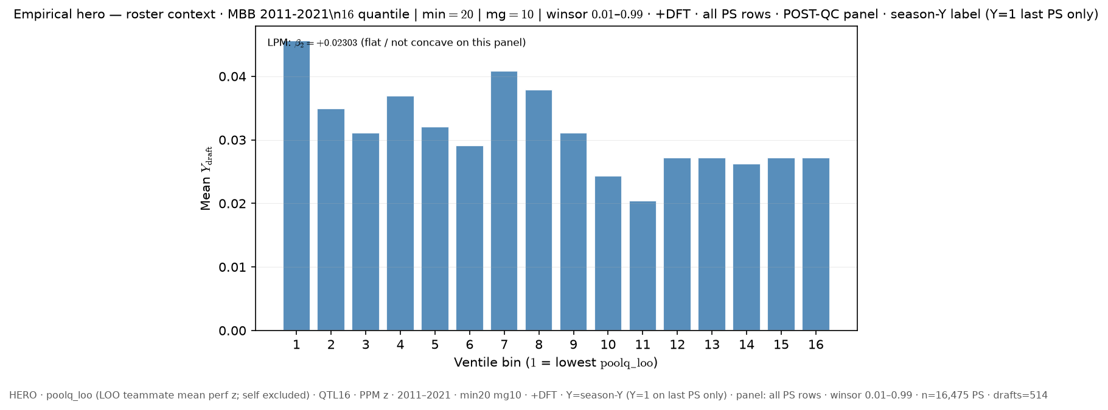
Slide 11 — 11–21 · LOO poolq_loo · season-Y label · all PS rows · QTL16 +DFT
Δ vs FIXED HERO: y_draft_mode: ever → season; dft: False → True
python sports/scripts/pass_a_empirical_bundle.py \ --season-min 2011 \ --season-max 2021 \ --y-draft-mode season \ --panel-rows all-ps \ --roster-x poolq_loo \ --n-bins 16 \ --poolq-binning quantile \ --output-tag perm_loo_seasony_allps_q16_dft \ --output-root 3-Master_Plan/re_entry/HEROs_and_PASSes/population_sandbox/hero \ --dft
Shape: bin1=4.563% · peak=ventile 1 @ 4.563% · last=2.721% · LPM β₂=+0.02303 ⚠ bin1 LOWEST ventile is PEAK

Slide 13
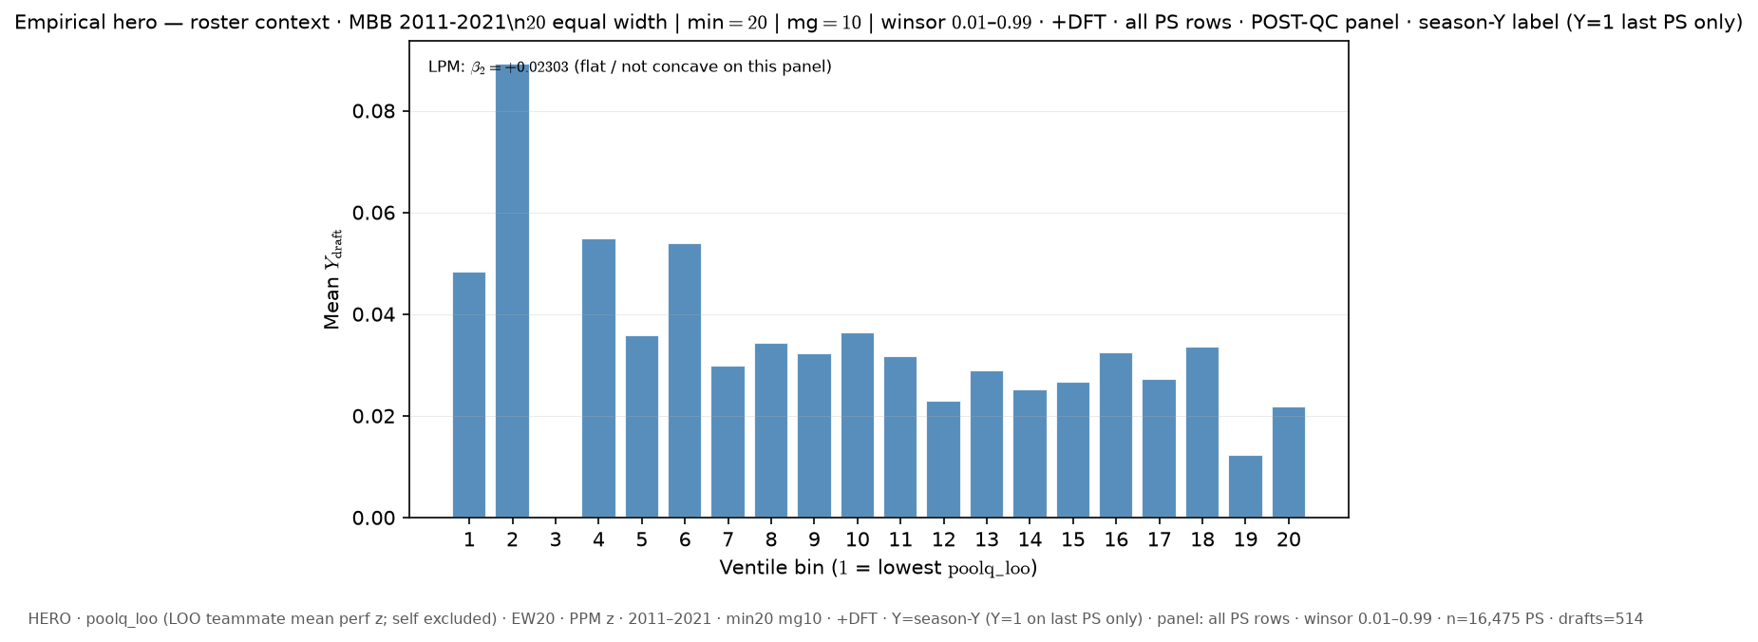
Slide 12 — 11–21 · LOO poolq_loo · season-Y label · all PS rows · EW20 +DFT
Δ vs FIXED HERO: y_draft_mode: ever → season; poolq_binning: quantile → equal_width; n_bins: 16 → 20; dft: False → True
python sports/scripts/pass_a_empirical_bundle.py \ --season-min 2011 \ --season-max 2021 \ --y-draft-mode season \ --panel-rows all-ps \ --roster-x poolq_loo \ --n-bins 20 \ --poolq-binning equal_width \ --output-tag perm_loo_seasony_allps_ew20_dft \ --output-root 3-Master_Plan/re_entry/HEROs_and_PASSes/population_sandbox/hero \ --dft
Shape: bin1=4.839% · peak=ventile 2 @ 8.929% · last=2.174% · LPM β₂=+0.02303

Slide 14
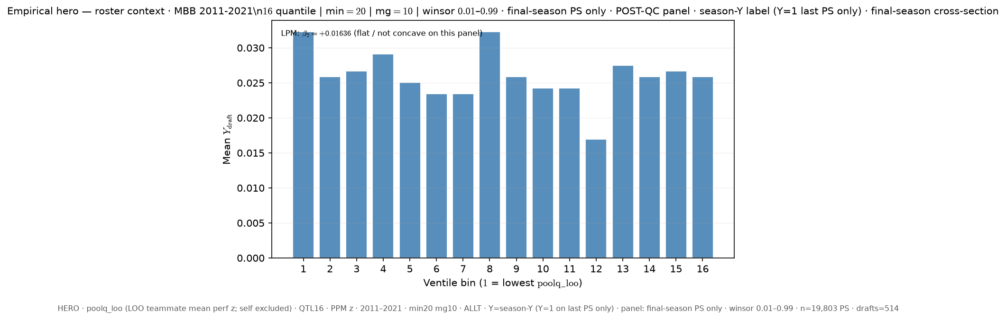
Slide 13 — 11–21 · LOO poolq_loo · season-Y label · last PS only (cross-section) · QTL16 ALLT
Δ vs FIXED HERO: y_draft_mode: ever → season; panel_rows: all-ps → last-ps
python sports/scripts/pass_a_empirical_bundle.py \ --season-min 2011 \ --season-max 2021 \ --y-draft-mode season \ --panel-rows last-ps \ --roster-x poolq_loo \ --n-bins 16 \ --poolq-binning quantile \ --output-tag perm_loo_seasony_lastps_q16 \ --output-root 3-Master_Plan/re_entry/HEROs_and_PASSes/population_sandbox/hero
Shape: bin1=3.231% · peak=ventile 1 @ 3.231% · last=2.587% · LPM β₂=+0.01636 ⚠ bin1 LOWEST ventile is PEAK

Slide 15
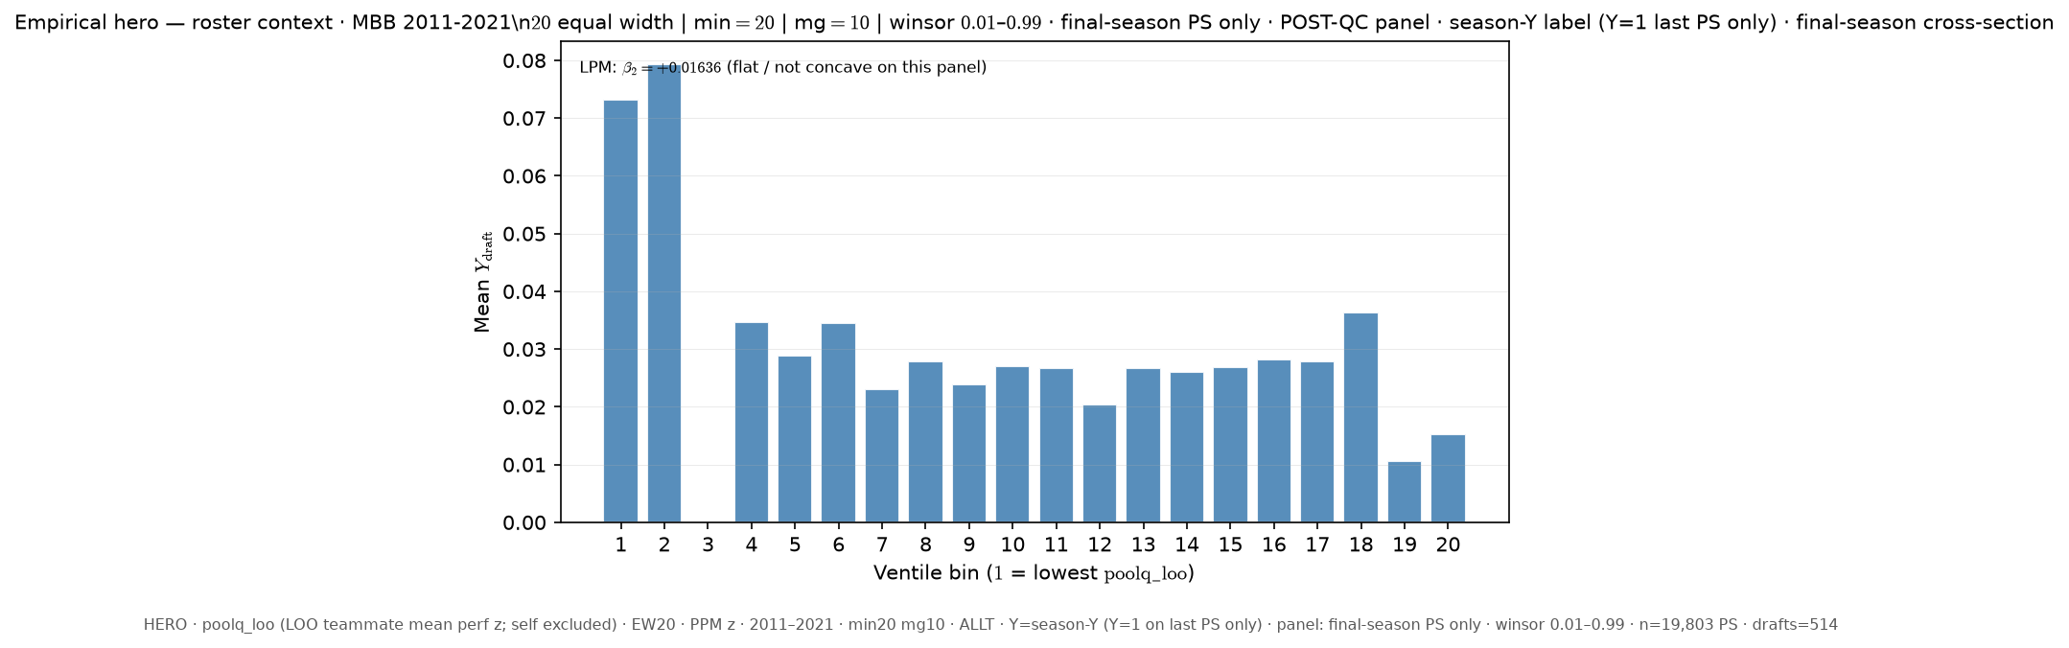
Slide 14 — 11–21 · LOO poolq_loo · season-Y label · last PS only (cross-section) · EW20 ALLT
Δ vs FIXED HERO: y_draft_mode: ever → season; panel_rows: all-ps → last-ps; poolq_binning: quantile → equal_width; n_bins: 16 → 20
python sports/scripts/pass_a_empirical_bundle.py \ --season-min 2011 \ --season-max 2021 \ --y-draft-mode season \ --panel-rows last-ps \ --roster-x poolq_loo \ --n-bins 20 \ --poolq-binning equal_width \ --output-tag perm_loo_seasony_lastps_ew20 \ --output-root 3-Master_Plan/re_entry/HEROs_and_PASSes/population_sandbox/hero
Shape: bin1=7.317% · peak=ventile 2 @ 7.937% · last=1.523% · LPM β₂=+0.01636

Slide 16
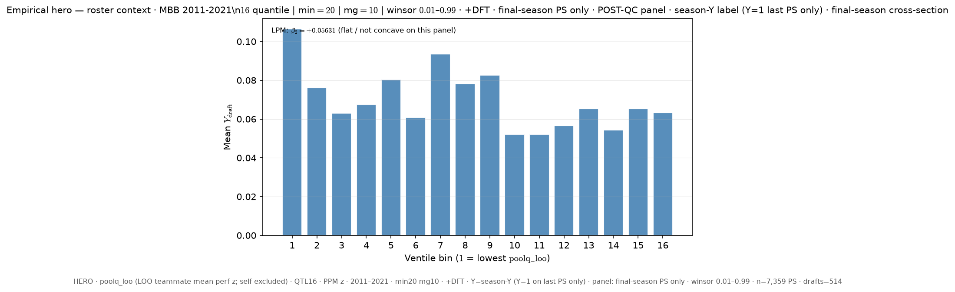
Slide 15 — 11–21 · LOO poolq_loo · season-Y label · last PS only (cross-section) · QTL16 +DFT
Δ vs FIXED HERO: y_draft_mode: ever → season; panel_rows: all-ps → last-ps; dft: False → True
python sports/scripts/pass_a_empirical_bundle.py \ --season-min 2011 \ --season-max 2021 \ --y-draft-mode season \ --panel-rows last-ps \ --roster-x poolq_loo \ --n-bins 16 \ --poolq-binning quantile \ --output-tag perm_loo_seasony_lastps_q16_dft \ --output-root 3-Master_Plan/re_entry/HEROs_and_PASSes/population_sandbox/hero \ --dft
Shape: bin1=10.652% · peak=ventile 1 @ 10.652% · last=6.318% · LPM β₂=+0.05631 ⚠ bin1 LOWEST ventile is PEAK

Slide 17
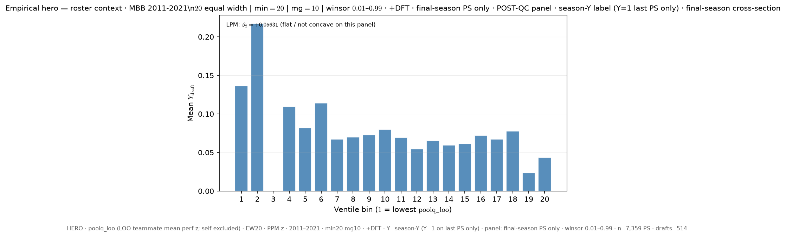
Slide 16 — 11–21 · LOO poolq_loo · season-Y label · last PS only (cross-section) · EW20 +DFT
Δ vs FIXED HERO: y_draft_mode: ever → season; panel_rows: all-ps → last-ps; poolq_binning: quantile → equal_width; n_bins: 16 → 20; dft: False → True
python sports/scripts/pass_a_empirical_bundle.py \ --season-min 2011 \ --season-max 2021 \ --y-draft-mode season \ --panel-rows last-ps \ --roster-x poolq_loo \ --n-bins 20 \ --poolq-binning equal_width \ --output-tag perm_loo_seasony_lastps_ew20_dft \ --output-root 3-Master_Plan/re_entry/HEROs_and_PASSes/population_sandbox/hero \ --dft
Shape: bin1=13.636% · peak=ventile 2 @ 21.739% · last=4.348% · LPM β₂=+0.05631

Slide 18
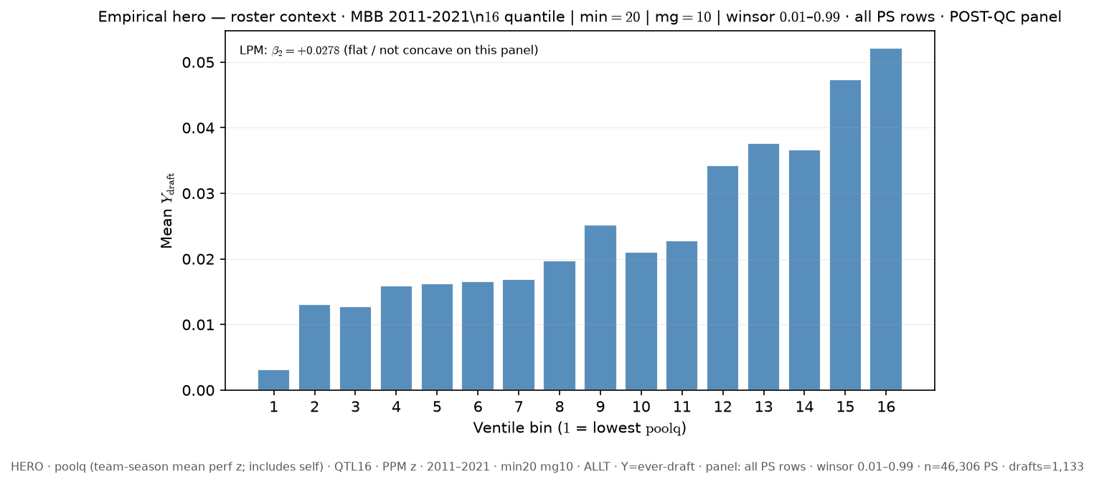
Slide 17 — 11–21 · team poolq (incl. self) · ever-draft · all PS rows · QTL16 ALLT
Δ vs FIXED HERO: roster_x: poolq_loo → poolq
python sports/scripts/pass_a_empirical_bundle.py \ --season-min 2011 \ --season-max 2021 \ --y-draft-mode ever \ --panel-rows all-ps \ --roster-x poolq \ --n-bins 16 \ --poolq-binning quantile \ --output-tag perm_poolq_ever_allps_q16 \ --output-root 3-Master_Plan/re_entry/HEROs_and_PASSes/population_sandbox/hero
Shape: bin1=0.311% · peak=ventile 16 @ 5.218% · last=5.218% · LPM β₂=+0.0278

Slide 19
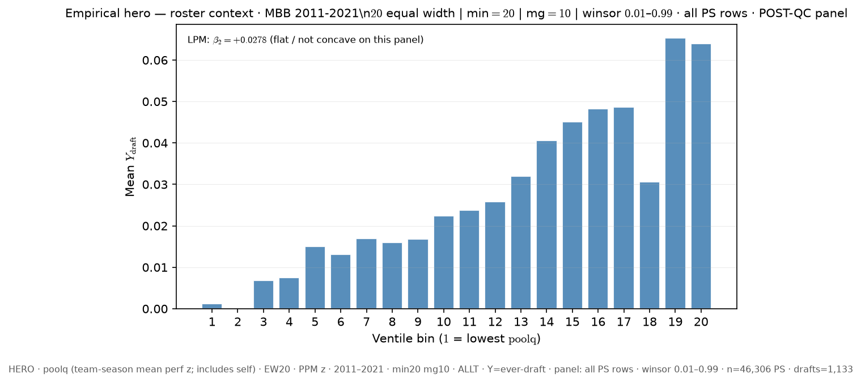
Slide 18 — 11–21 · team poolq (incl. self) · ever-draft · all PS rows · EW20 ALLT
Δ vs FIXED HERO: roster_x: poolq_loo → poolq; poolq_binning: quantile → equal_width; n_bins: 16 → 20
python sports/scripts/pass_a_empirical_bundle.py \ --season-min 2011 \ --season-max 2021 \ --y-draft-mode ever \ --panel-rows all-ps \ --roster-x poolq \ --n-bins 20 \ --poolq-binning equal_width \ --output-tag perm_poolq_ever_allps_ew20 \ --output-root 3-Master_Plan/re_entry/HEROs_and_PASSes/population_sandbox/hero
Shape: bin1=0.118% · peak=ventile 19 @ 6.536% · last=6.4% · LPM β₂=+0.0278

Slide 20
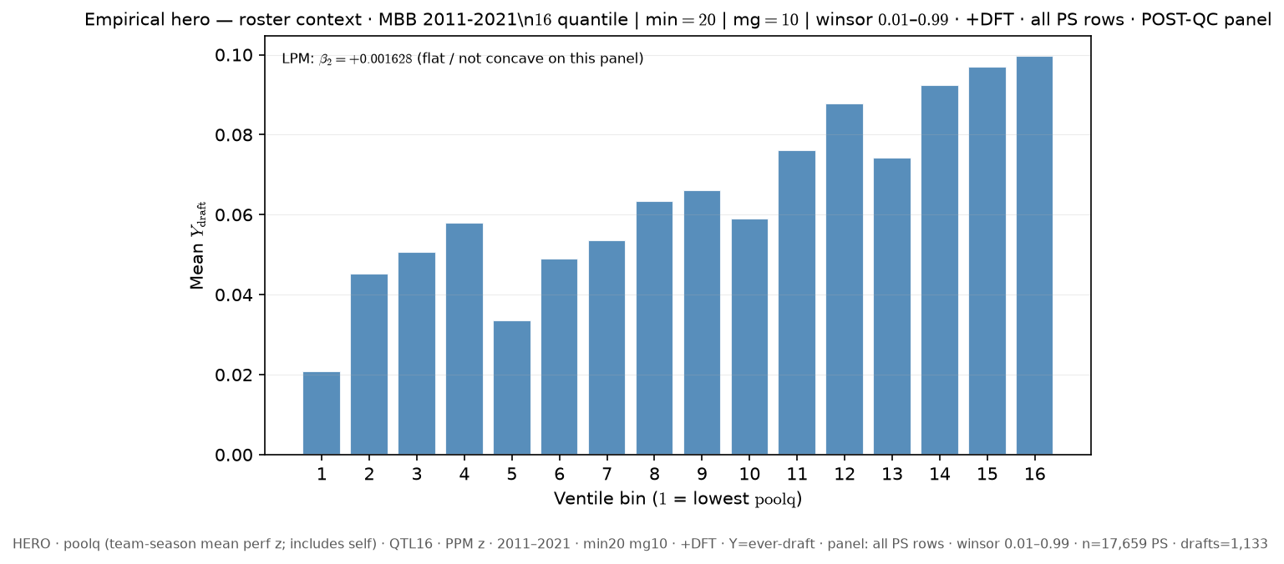
Slide 19 — 11–21 · team poolq (incl. self) · ever-draft · all PS rows · QTL16 +DFT
Δ vs FIXED HERO: roster_x: poolq_loo → poolq; dft: False → True
python sports/scripts/pass_a_empirical_bundle.py \ --season-min 2011 \ --season-max 2021 \ --y-draft-mode ever \ --panel-rows all-ps \ --roster-x poolq \ --n-bins 16 \ --poolq-binning quantile \ --output-tag perm_poolq_ever_allps_q16_dft \ --output-root 3-Master_Plan/re_entry/HEROs_and_PASSes/population_sandbox/hero \ --dft
Shape: bin1=2.083% · peak=ventile 16 @ 9.973% · last=9.973% · LPM β₂=+0.001628

Slide 21
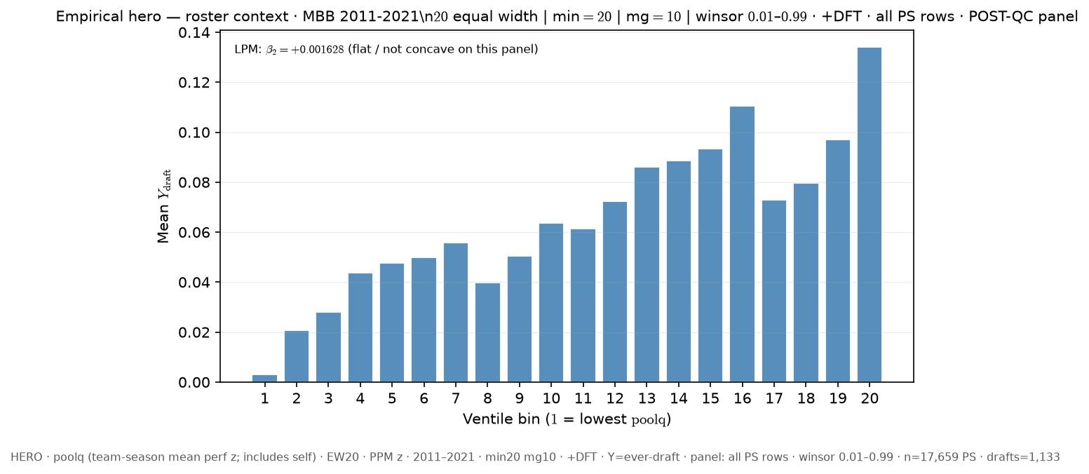
Slide 20 — 11–21 · team poolq (incl. self) · ever-draft · all PS rows · EW20 +DFT
Δ vs FIXED HERO: roster_x: poolq_loo → poolq; poolq_binning: quantile → equal_width; n_bins: 16 → 20; dft: False → True
python sports/scripts/pass_a_empirical_bundle.py \ --season-min 2011 \ --season-max 2021 \ --y-draft-mode ever \ --panel-rows all-ps \ --roster-x poolq \ --n-bins 20 \ --poolq-binning equal_width \ --output-tag perm_poolq_ever_allps_ew20_dft \ --output-root 3-Master_Plan/re_entry/HEROs_and_PASSes/population_sandbox/hero \ --dft
Shape: bin1=0.312% · peak=ventile 20 @ 13.415% · last=13.415% · LPM β₂=+0.001628

Slide 22
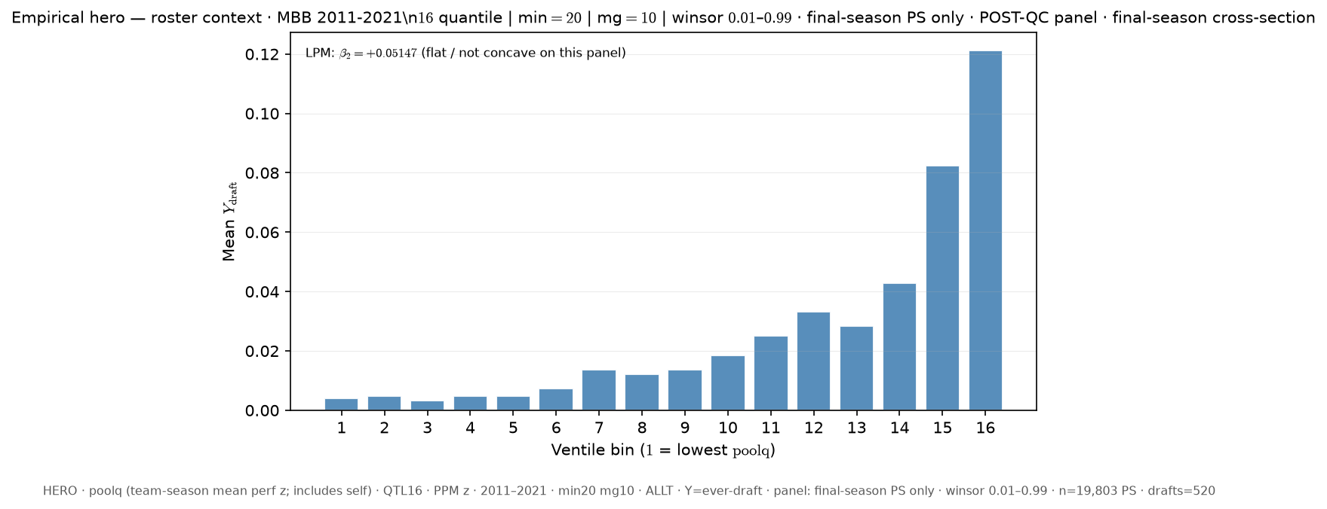
Slide 21 — 11–21 · team poolq (incl. self) · ever-draft · last PS only (cross-section) · QTL16 ALLT
Δ vs FIXED HERO: roster_x: poolq_loo → poolq; panel_rows: all-ps → last-ps
python sports/scripts/pass_a_empirical_bundle.py \ --season-min 2011 \ --season-max 2021 \ --y-draft-mode ever \ --panel-rows last-ps \ --roster-x poolq \ --n-bins 16 \ --poolq-binning quantile \ --output-tag perm_poolq_ever_lastps_q16 \ --output-root 3-Master_Plan/re_entry/HEROs_and_PASSes/population_sandbox/hero
Shape: bin1=0.404% · peak=ventile 16 @ 12.126% · last=12.126% · LPM β₂=+0.05147

Slide 23
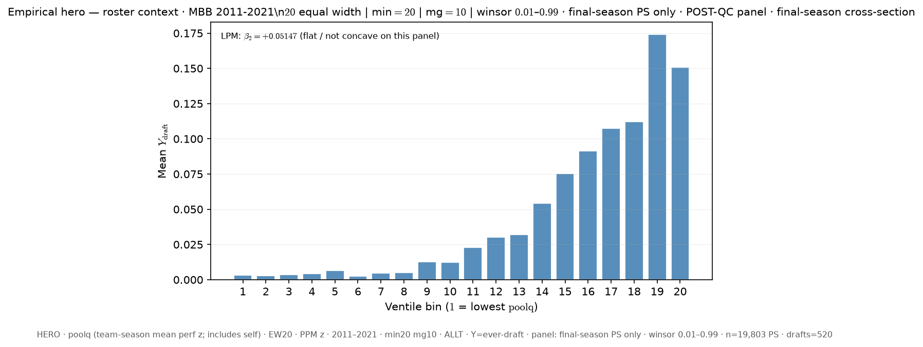
Slide 22 — 11–21 · team poolq (incl. self) · ever-draft · last PS only (cross-section) · EW20 ALLT
Δ vs FIXED HERO: roster_x: poolq_loo → poolq; panel_rows: all-ps → last-ps; poolq_binning: quantile → equal_width; n_bins: 16 → 20
python sports/scripts/pass_a_empirical_bundle.py \ --season-min 2011 \ --season-max 2021 \ --y-draft-mode ever \ --panel-rows last-ps \ --roster-x poolq \ --n-bins 20 \ --poolq-binning equal_width \ --output-tag perm_poolq_ever_lastps_ew20 \ --output-root 3-Master_Plan/re_entry/HEROs_and_PASSes/population_sandbox/hero
Shape: bin1=0.308% · peak=ventile 19 @ 17.419% · last=15.068% · LPM β₂=+0.05147

Slide 24
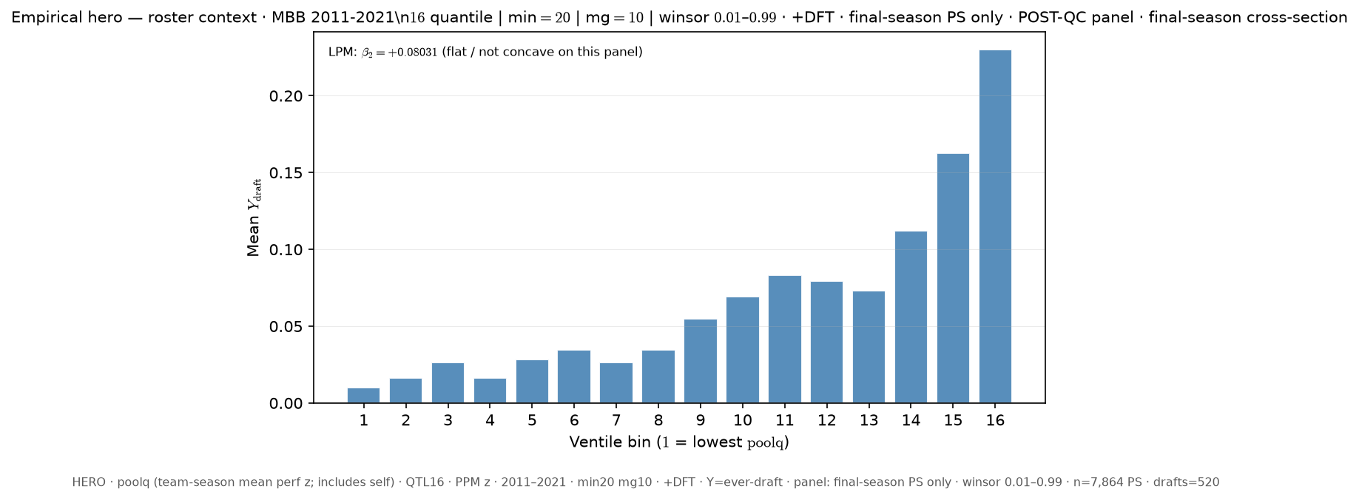
Slide 23 — 11–21 · team poolq (incl. self) · ever-draft · last PS only (cross-section) · QTL16 +DFT
Δ vs FIXED HERO: roster_x: poolq_loo → poolq; panel_rows: all-ps → last-ps; dft: False → True
python sports/scripts/pass_a_empirical_bundle.py \ --season-min 2011 \ --season-max 2021 \ --y-draft-mode ever \ --panel-rows last-ps \ --roster-x poolq \ --n-bins 16 \ --poolq-binning quantile \ --output-tag perm_poolq_ever_lastps_q16_dft \ --output-root 3-Master_Plan/re_entry/HEROs_and_PASSes/population_sandbox/hero \ --dft
Shape: bin1=1.016% · peak=ventile 16 @ 23.014% · last=23.014% · LPM β₂=+0.08031

Slide 25
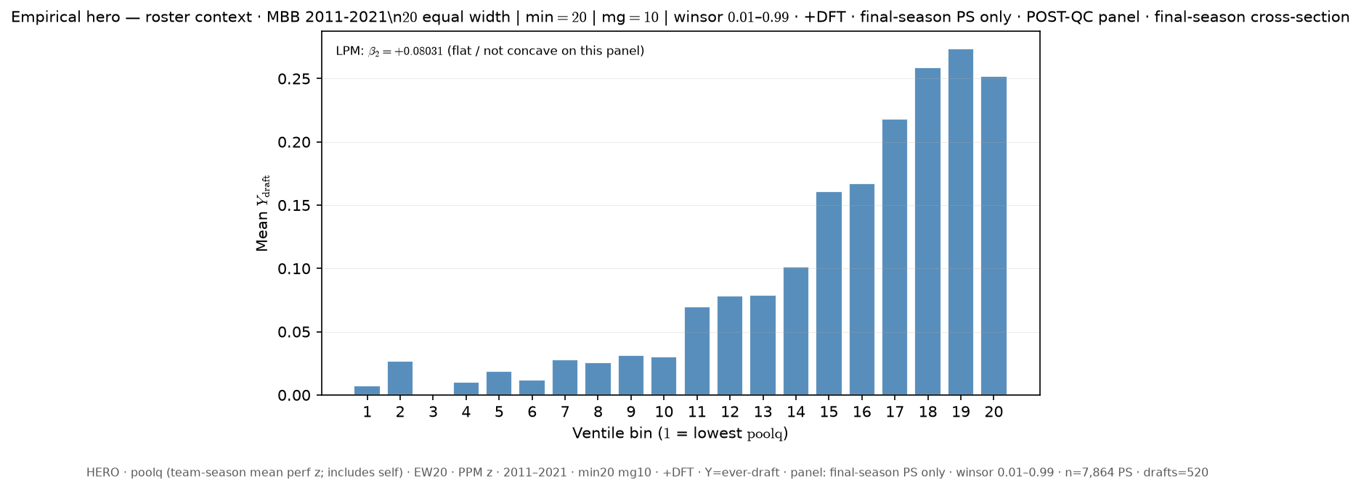
Slide 24 — 11–21 · team poolq (incl. self) · ever-draft · last PS only (cross-section) · EW20 +DFT
Δ vs FIXED HERO: roster_x: poolq_loo → poolq; panel_rows: all-ps → last-ps; poolq_binning: quantile → equal_width; n_bins: 16 → 20; dft: False → True
python sports/scripts/pass_a_empirical_bundle.py \ --season-min 2011 \ --season-max 2021 \ --y-draft-mode ever \ --panel-rows last-ps \ --roster-x poolq \ --n-bins 20 \ --poolq-binning equal_width \ --output-tag perm_poolq_ever_lastps_ew20_dft \ --output-root 3-Master_Plan/re_entry/HEROs_and_PASSes/population_sandbox/hero \ --dft
Shape: bin1=0.735% · peak=ventile 19 @ 27.381% · last=25.21% · LPM β₂=+0.08031

Slide 26
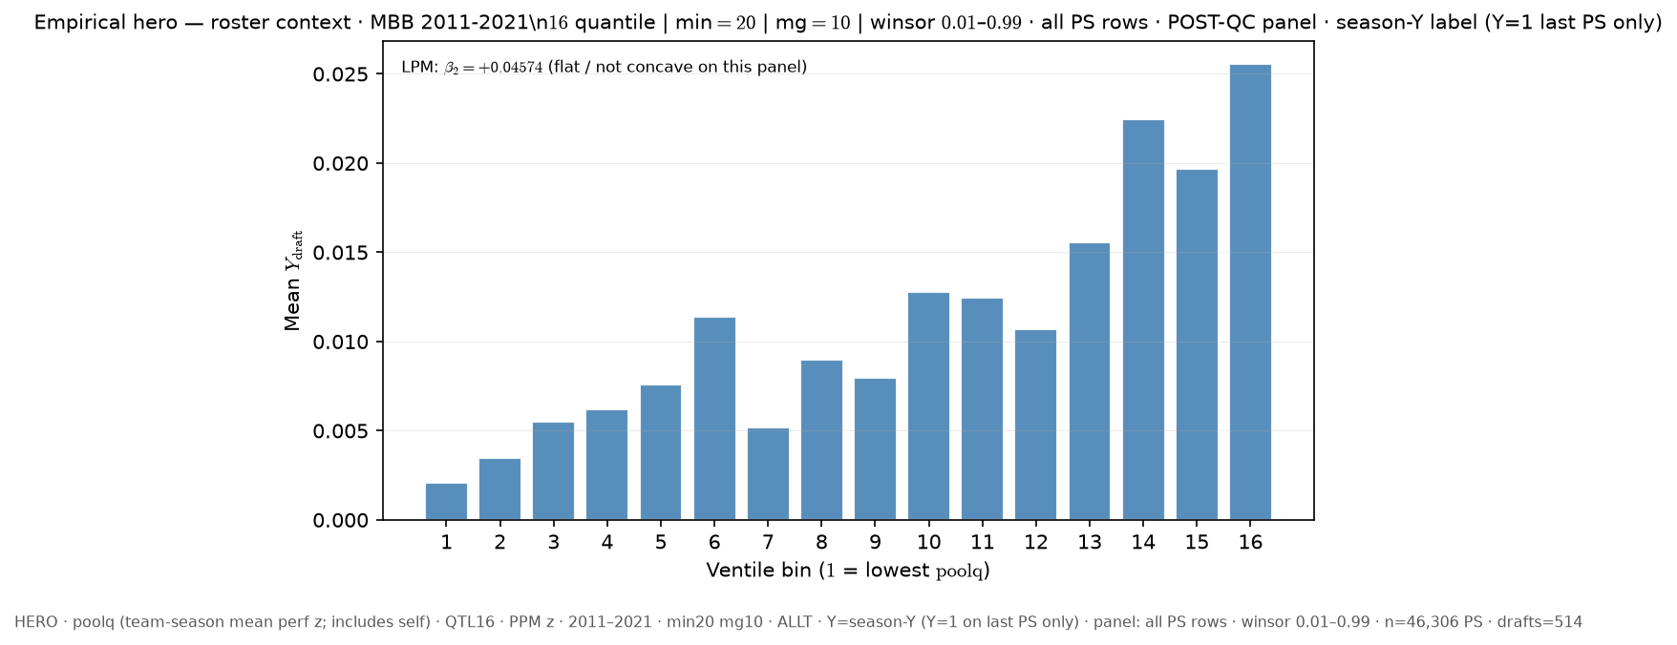
Slide 25 — 11–21 · team poolq (incl. self) · season-Y label · all PS rows · QTL16 ALLT
Δ vs FIXED HERO: roster_x: poolq_loo → poolq; y_draft_mode: ever → season
python sports/scripts/pass_a_empirical_bundle.py \ --season-min 2011 \ --season-max 2021 \ --y-draft-mode season \ --panel-rows all-ps \ --roster-x poolq \ --n-bins 16 \ --poolq-binning quantile \ --output-tag perm_poolq_seasony_allps_q16 \ --output-root 3-Master_Plan/re_entry/HEROs_and_PASSes/population_sandbox/hero
Shape: bin1=0.207% · peak=ventile 16 @ 2.557% · last=2.557% · LPM β₂=+0.04573

Slide 27
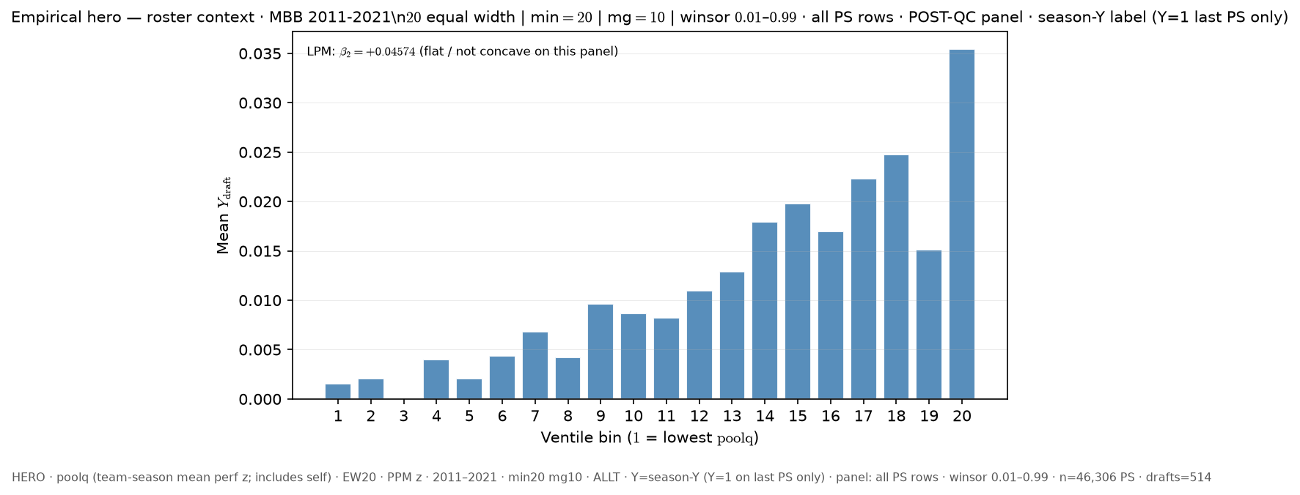
Slide 26 — 11–21 · team poolq (incl. self) · season-Y label · all PS rows · EW20 ALLT
Δ vs FIXED HERO: roster_x: poolq_loo → poolq; y_draft_mode: ever → season; poolq_binning: quantile → equal_width; n_bins: 16 → 20
python sports/scripts/pass_a_empirical_bundle.py \ --season-min 2011 \ --season-max 2021 \ --y-draft-mode season \ --panel-rows all-ps \ --roster-x poolq \ --n-bins 20 \ --poolq-binning equal_width \ --output-tag perm_poolq_seasony_allps_ew20 \ --output-root 3-Master_Plan/re_entry/HEROs_and_PASSes/population_sandbox/hero
Shape: bin1=0.152% · peak=ventile 20 @ 3.545% · last=3.545% · LPM β₂=+0.04573

Slide 28
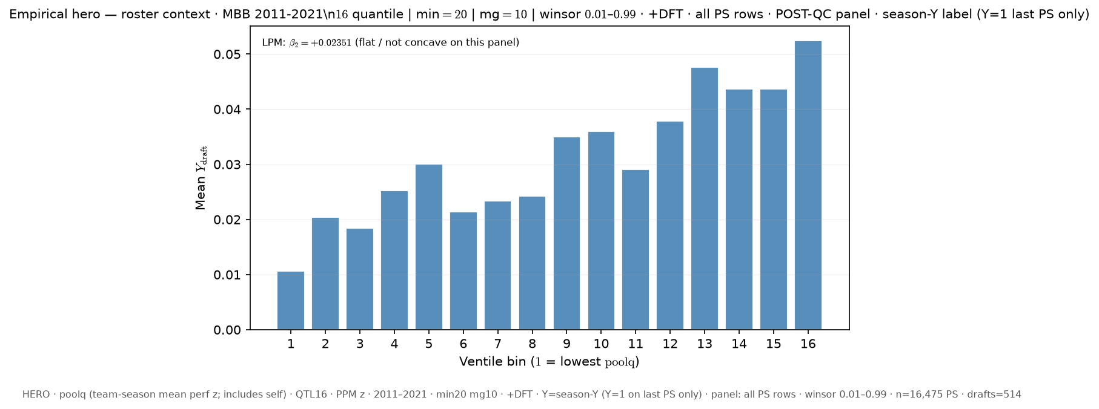
Slide 27 — 11–21 · team poolq (incl. self) · season-Y label · all PS rows · QTL16 +DFT
Δ vs FIXED HERO: roster_x: poolq_loo → poolq; y_draft_mode: ever → season; dft: False → True
python sports/scripts/pass_a_empirical_bundle.py \ --season-min 2011 \ --season-max 2021 \ --y-draft-mode season \ --panel-rows all-ps \ --roster-x poolq \ --n-bins 16 \ --poolq-binning quantile \ --output-tag perm_poolq_seasony_allps_q16_dft \ --output-root 3-Master_Plan/re_entry/HEROs_and_PASSes/population_sandbox/hero \ --dft
Shape: bin1=1.068% · peak=ventile 16 @ 5.248% · last=5.248% · LPM β₂=+0.02351

Slide 29
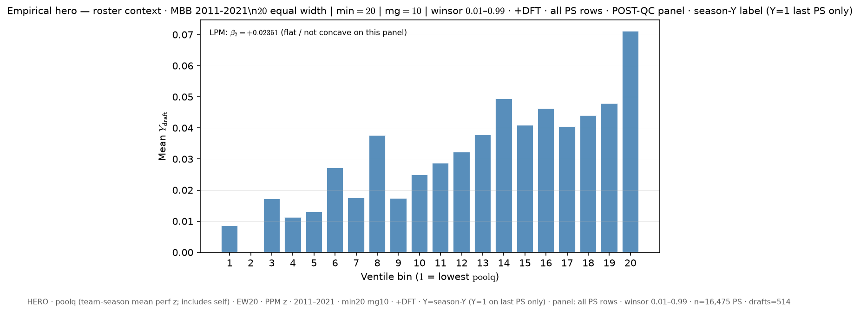
Slide 28 — 11–21 · team poolq (incl. self) · season-Y label · all PS rows · EW20 +DFT
Δ vs FIXED HERO: roster_x: poolq_loo → poolq; y_draft_mode: ever → season; poolq_binning: quantile → equal_width; n_bins: 16 → 20; dft: False → True
python sports/scripts/pass_a_empirical_bundle.py \ --season-min 2011 \ --season-max 2021 \ --y-draft-mode season \ --panel-rows all-ps \ --roster-x poolq \ --n-bins 20 \ --poolq-binning equal_width \ --output-tag perm_poolq_seasony_allps_ew20_dft \ --output-root 3-Master_Plan/re_entry/HEROs_and_PASSes/population_sandbox/hero \ --dft
Shape: bin1=0.862% · peak=ventile 20 @ 7.119% · last=7.119% · LPM β₂=+0.02351

Slide 30
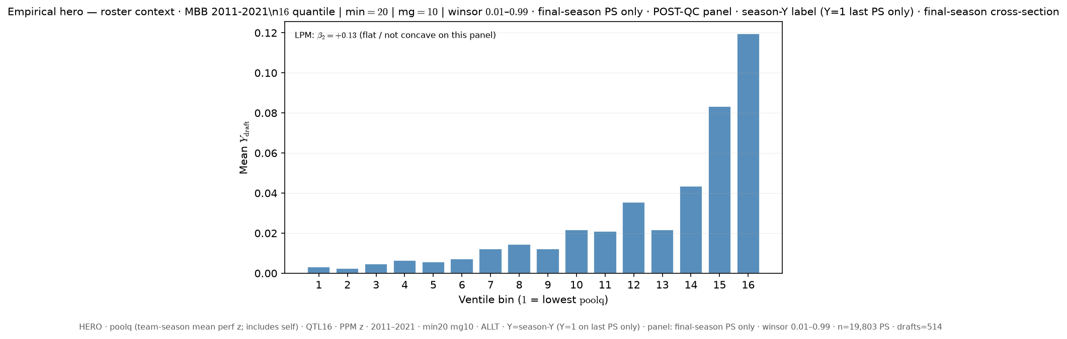
Slide 29 — 11–21 · team poolq (incl. self) · season-Y label · last PS only (cross-section) · QTL16 ALLT
Δ vs FIXED HERO: roster_x: poolq_loo → poolq; y_draft_mode: ever → season; panel_rows: all-ps → last-ps
python sports/scripts/pass_a_empirical_bundle.py \ --season-min 2011 \ --season-max 2021 \ --y-draft-mode season \ --panel-rows last-ps \ --roster-x poolq \ --n-bins 16 \ --poolq-binning quantile \ --output-tag perm_poolq_seasony_lastps_q16 \ --output-root 3-Master_Plan/re_entry/HEROs_and_PASSes/population_sandbox/hero
Shape: bin1=0.323% · peak=ventile 16 @ 11.964% · last=11.964% · LPM β₂=+0.13

Slide 31
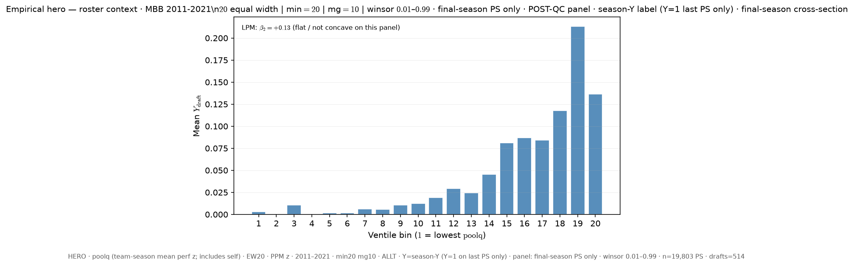
Slide 30 — 11–21 · team poolq (incl. self) · season-Y label · last PS only (cross-section) · EW20 ALLT
Δ vs FIXED HERO: roster_x: poolq_loo → poolq; y_draft_mode: ever → season; panel_rows: all-ps → last-ps; poolq_binning: quantile → equal_width; n_bins: 16 → 20
python sports/scripts/pass_a_empirical_bundle.py \ --season-min 2011 \ --season-max 2021 \ --y-draft-mode season \ --panel-rows last-ps \ --roster-x poolq \ --n-bins 20 \ --poolq-binning equal_width \ --output-tag perm_poolq_seasony_lastps_ew20 \ --output-root 3-Master_Plan/re_entry/HEROs_and_PASSes/population_sandbox/hero
Shape: bin1=0.322% · peak=ventile 19 @ 21.333% · last=13.651% · LPM β₂=+0.13

Slide 32
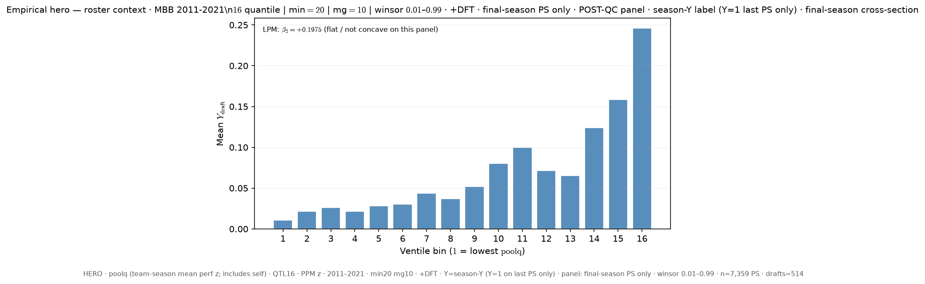
Slide 31 — 11–21 · team poolq (incl. self) · season-Y label · last PS only (cross-section) · QTL16 +DFT
Δ vs FIXED HERO: roster_x: poolq_loo → poolq; y_draft_mode: ever → season; panel_rows: all-ps → last-ps; dft: False → True
python sports/scripts/pass_a_empirical_bundle.py \ --season-min 2011 \ --season-max 2021 \ --y-draft-mode season \ --panel-rows last-ps \ --roster-x poolq \ --n-bins 16 \ --poolq-binning quantile \ --output-tag perm_poolq_seasony_lastps_q16_dft \ --output-root 3-Master_Plan/re_entry/HEROs_and_PASSes/population_sandbox/hero \ --dft
Shape: bin1=1.087% · peak=ventile 16 @ 24.619% · last=24.619% · LPM β₂=+0.1975

Slide 33
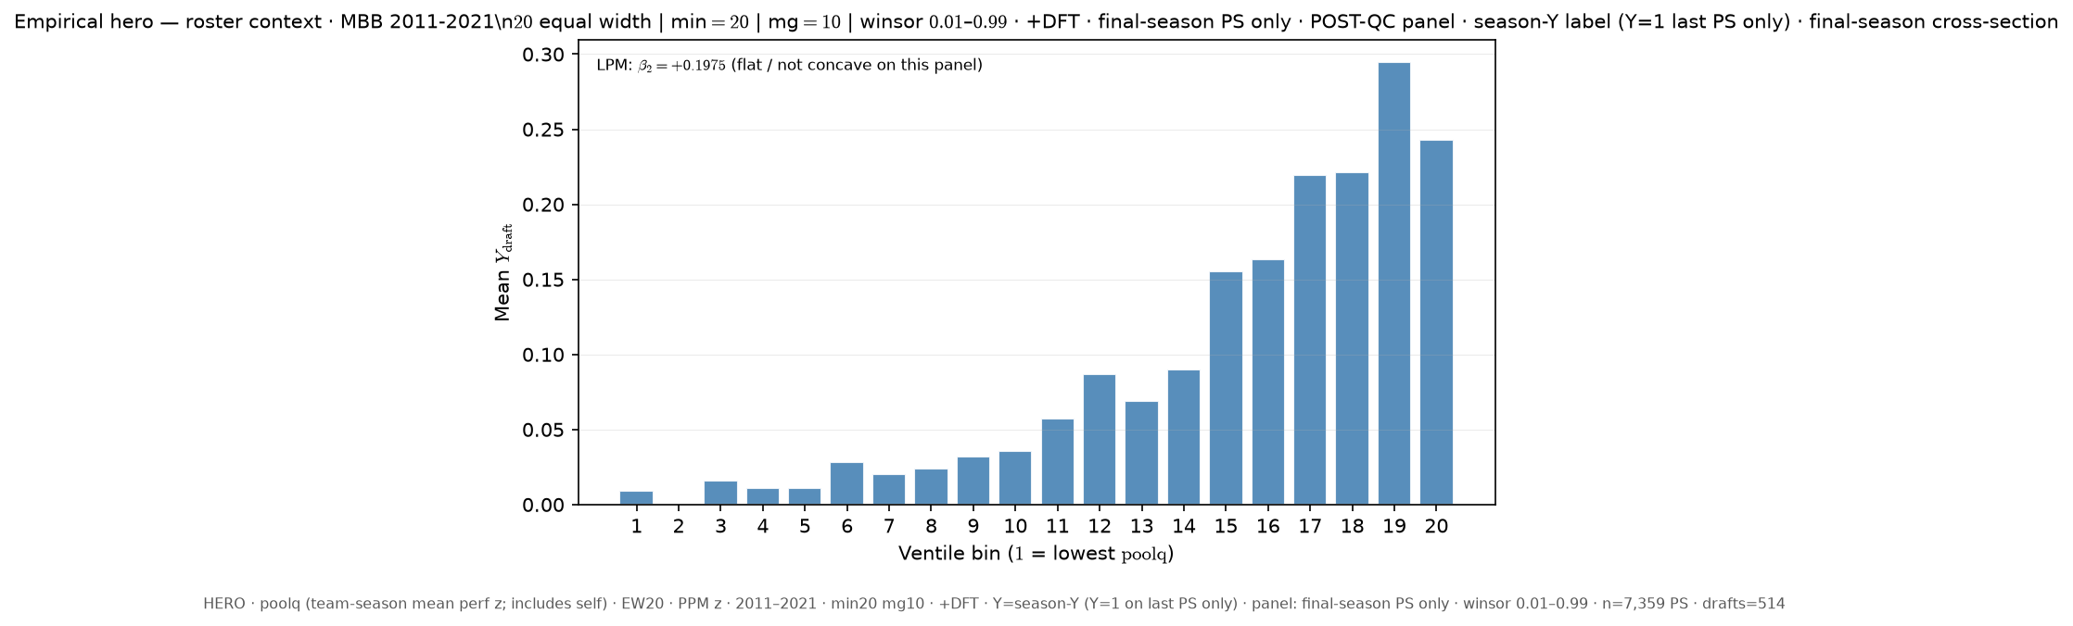
Slide 32 — 11–21 · team poolq (incl. self) · season-Y label · last PS only (cross-section) · EW20 +DFT
Δ vs FIXED HERO: roster_x: poolq_loo → poolq; y_draft_mode: ever → season; panel_rows: all-ps → last-ps; poolq_binning: quantile → equal_width; n_bins: 16 → 20; dft: False → True
python sports/scripts/pass_a_empirical_bundle.py \ --season-min 2011 \ --season-max 2021 \ --y-draft-mode season \ --panel-rows last-ps \ --roster-x poolq \ --n-bins 20 \ --poolq-binning equal_width \ --output-tag perm_poolq_seasony_lastps_ew20_dft \ --output-root 3-Master_Plan/re_entry/HEROs_and_PASSes/population_sandbox/hero \ --dft
Shape: bin1=0.893% · peak=ventile 19 @ 29.487% · last=24.286% · LPM β₂=+0.1975

Slide 34
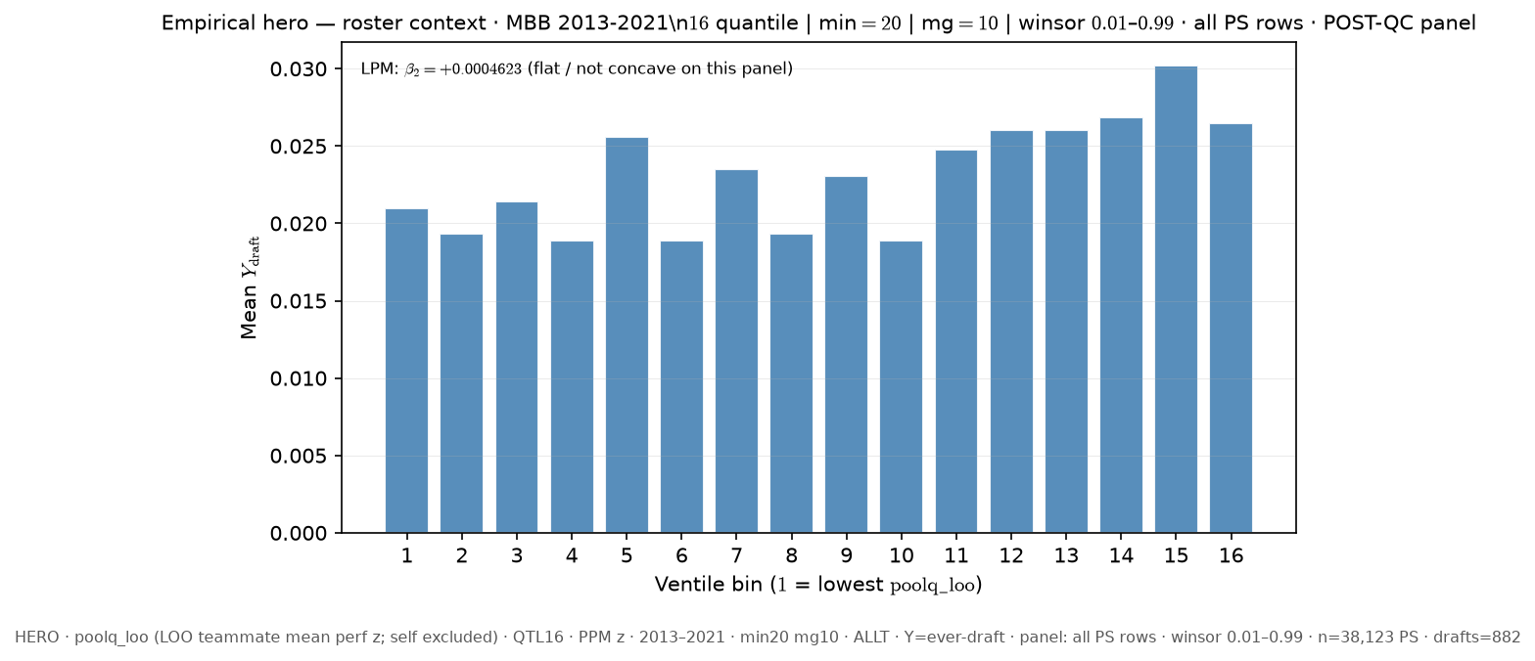
Slide 33 — FIXED HERO — canonical deck (13–21)
Baseline — canonical deck HERO
python sports/scripts/pass_a_empirical_bundle.py \ --season-min 2013 \ --season-max 2021 \ --y-draft-mode ever \ --panel-rows all-ps \ --roster-x poolq_loo \ --n-bins 16 \ --poolq-binning quantile \ --output-tag FIXED_HERO \ --output-root 3-Master_Plan/re_entry/HEROs_and_PASSes/population_sandbox/hero
Shape: bin1=2.098% · peak=ventile 15 @ 3.021% · last=2.645% · LPM β₂=+0.000462

Slide 35
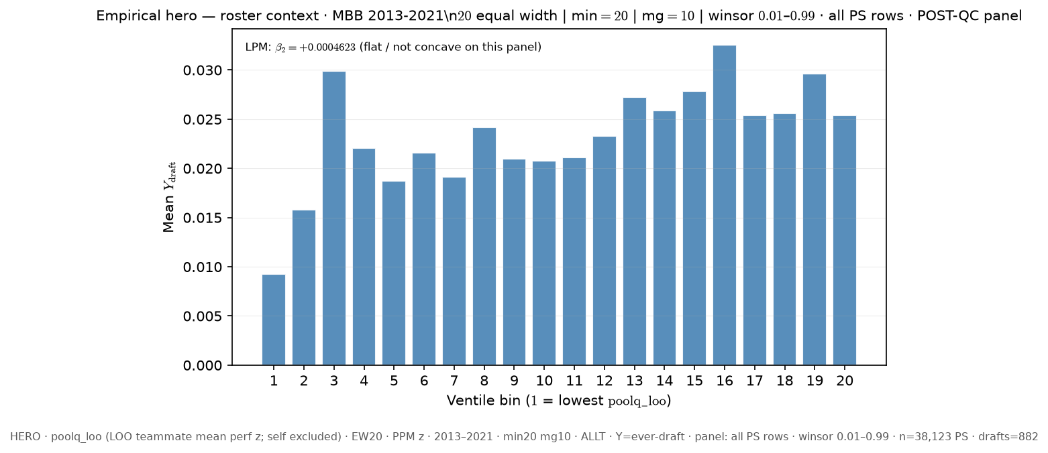
Slide 34 — 13–21 · LOO poolq_loo · ever-draft · all PS rows · EW20 ALLT
Δ vs FIXED HERO: season_window: 11_21 → 13_21; poolq_binning: quantile → equal_width; n_bins: 16 → 20
python sports/scripts/pass_a_empirical_bundle.py \ --season-min 2013 \ --season-max 2021 \ --y-draft-mode ever \ --panel-rows all-ps \ --roster-x poolq_loo \ --n-bins 20 \ --poolq-binning equal_width \ --output-tag perm_loo_ever_allps_ew20 \ --output-root 3-Master_Plan/re_entry/HEROs_and_PASSes/population_sandbox/hero
Shape: bin1=0.927% · peak=ventile 16 @ 3.256% · last=2.537% · LPM β₂=+0.000462

Slide 36
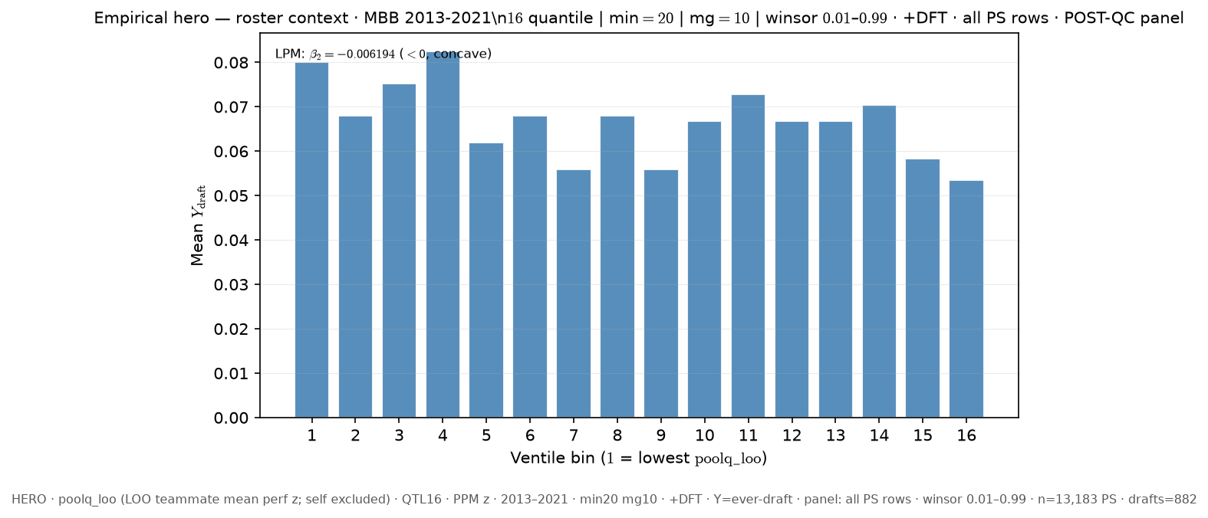
Slide 35 — 13–21 · LOO poolq_loo · ever-draft · all PS rows · QTL16 +DFT
Δ vs FIXED HERO: season_window: 11_21 → 13_21; dft: False → True
python sports/scripts/pass_a_empirical_bundle.py \ --season-min 2013 \ --season-max 2021 \ --y-draft-mode ever \ --panel-rows all-ps \ --roster-x poolq_loo \ --n-bins 16 \ --poolq-binning quantile \ --output-tag perm_loo_ever_allps_q16_dft \ --output-root 3-Master_Plan/re_entry/HEROs_and_PASSes/population_sandbox/hero \ --dft
Shape: bin1=8.01% · peak=ventile 4 @ 8.252% · last=5.346% · LPM β₂=-0.006194

Slide 37
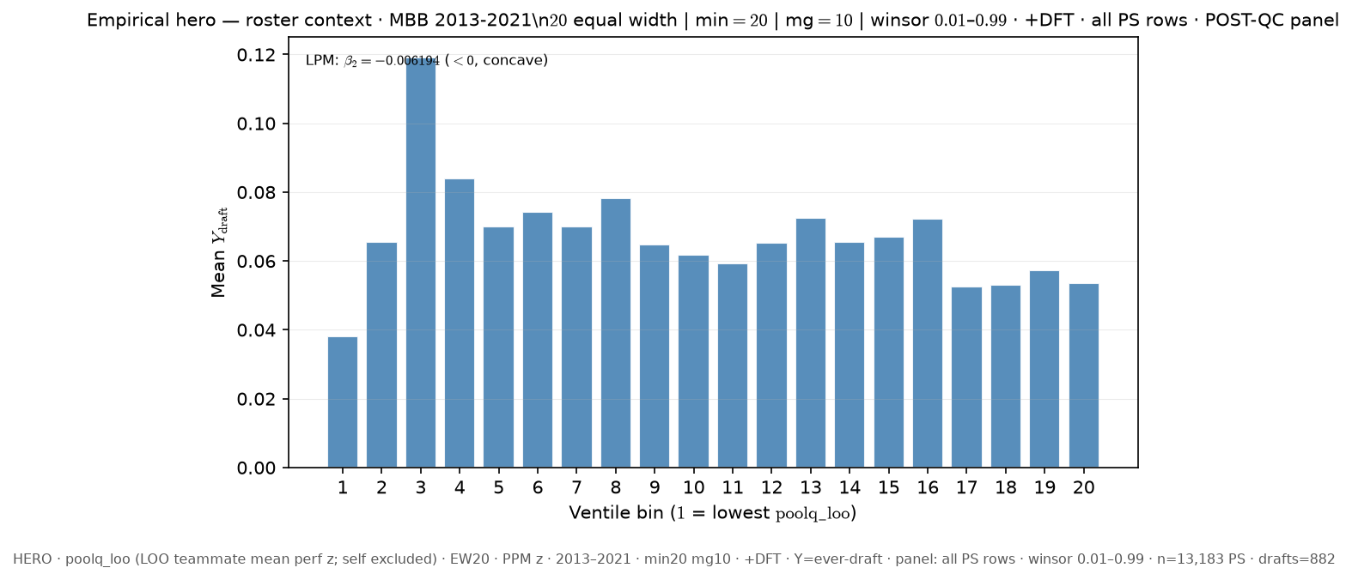
Slide 36 — 13–21 · LOO poolq_loo · ever-draft · all PS rows · EW20 +DFT
Δ vs FIXED HERO: season_window: 11_21 → 13_21; poolq_binning: quantile → equal_width; n_bins: 16 → 20; dft: False → True
python sports/scripts/pass_a_empirical_bundle.py \ --season-min 2013 \ --season-max 2021 \ --y-draft-mode ever \ --panel-rows all-ps \ --roster-x poolq_loo \ --n-bins 20 \ --poolq-binning equal_width \ --output-tag perm_loo_ever_allps_ew20_dft \ --output-root 3-Master_Plan/re_entry/HEROs_and_PASSes/population_sandbox/hero \ --dft
Shape: bin1=3.822% · peak=ventile 3 @ 11.917% · last=5.346% · LPM β₂=-0.006194

Slide 38
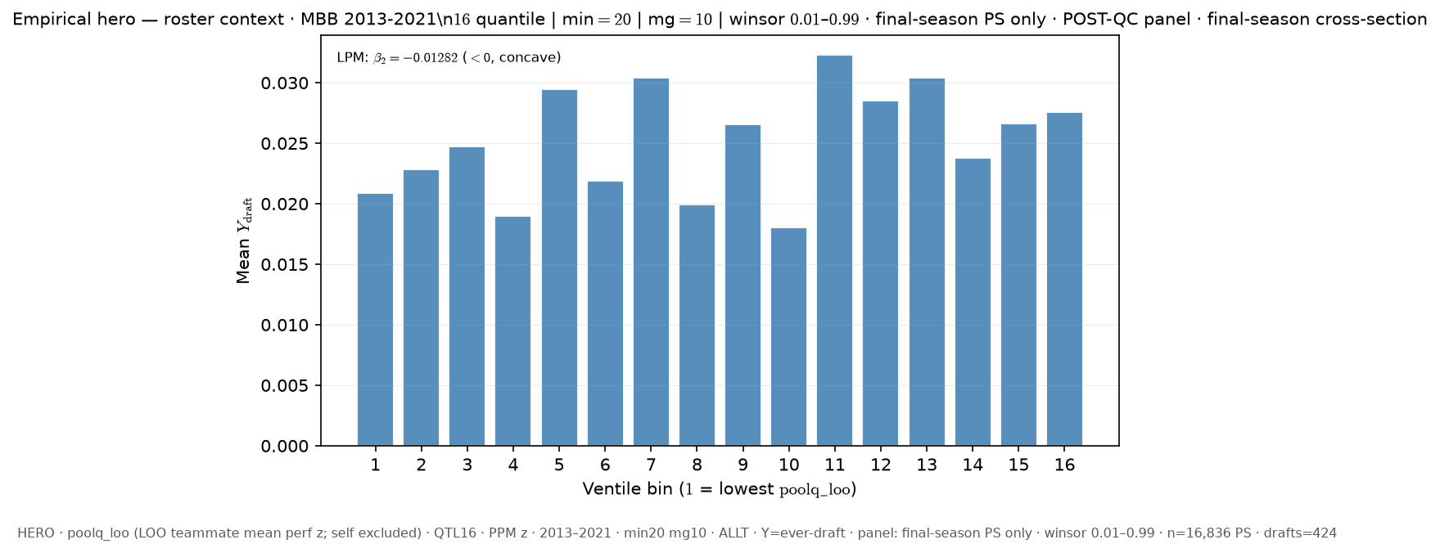
Slide 37 — 13–21 · LOO poolq_loo · ever-draft · last PS only (cross-section) · QTL16 ALLT
Δ vs FIXED HERO: season_window: 11_21 → 13_21; panel_rows: all-ps → last-ps
python sports/scripts/pass_a_empirical_bundle.py \ --season-min 2013 \ --season-max 2021 \ --y-draft-mode ever \ --panel-rows last-ps \ --roster-x poolq_loo \ --n-bins 16 \ --poolq-binning quantile \ --output-tag perm_loo_ever_lastps_q16 \ --output-root 3-Master_Plan/re_entry/HEROs_and_PASSes/population_sandbox/hero
Shape: bin1=2.089% · peak=ventile 11 @ 3.232% · last=2.757% · LPM β₂=-0.01282

Slide 39
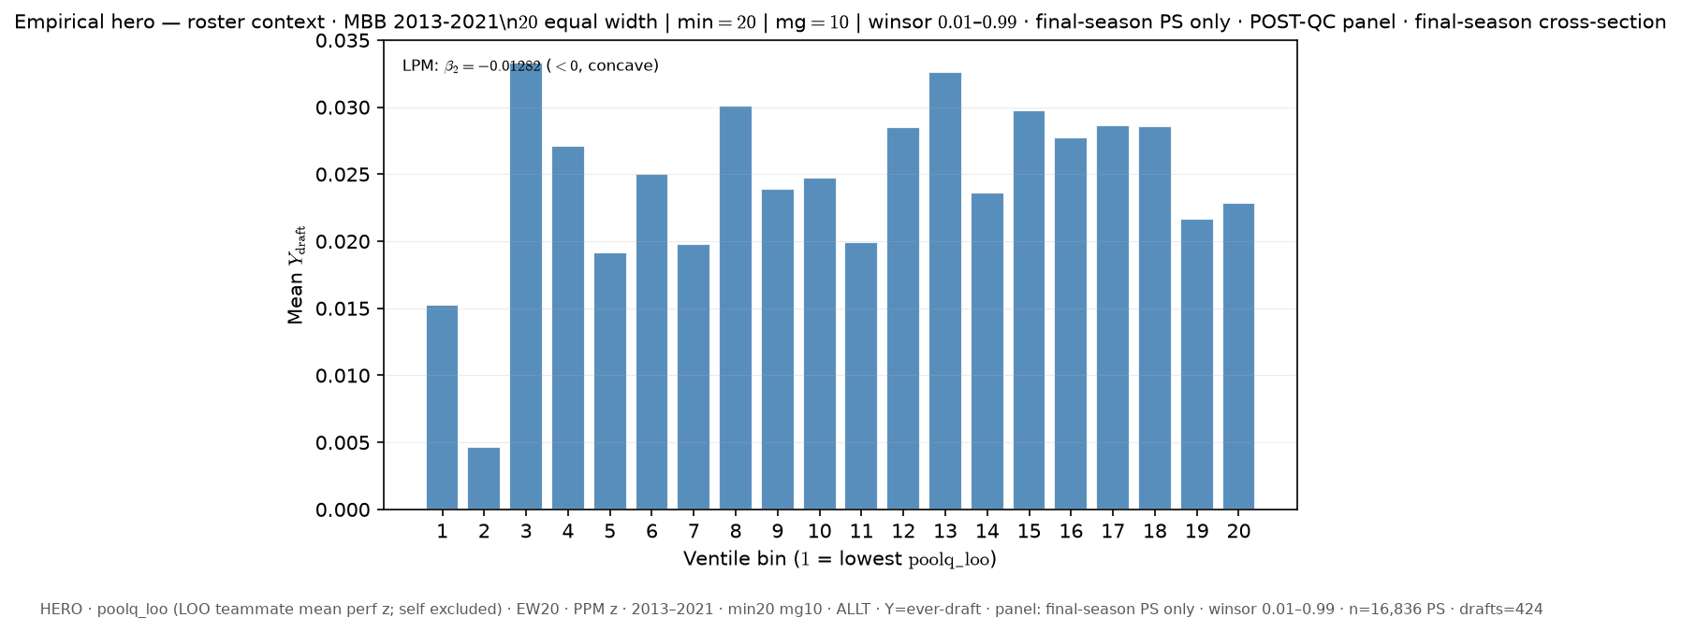
Slide 38 — 13–21 · LOO poolq_loo · ever-draft · last PS only (cross-section) · EW20 ALLT
Δ vs FIXED HERO: season_window: 11_21 → 13_21; panel_rows: all-ps → last-ps; poolq_binning: quantile → equal_width; n_bins: 16 → 20
python sports/scripts/pass_a_empirical_bundle.py \ --season-min 2013 \ --season-max 2021 \ --y-draft-mode ever \ --panel-rows last-ps \ --roster-x poolq_loo \ --n-bins 20 \ --poolq-binning equal_width \ --output-tag perm_loo_ever_lastps_ew20 \ --output-root 3-Master_Plan/re_entry/HEROs_and_PASSes/population_sandbox/hero
Shape: bin1=1.524% · peak=ventile 3 @ 3.333% · last=2.288% · LPM β₂=-0.01282

Slide 40
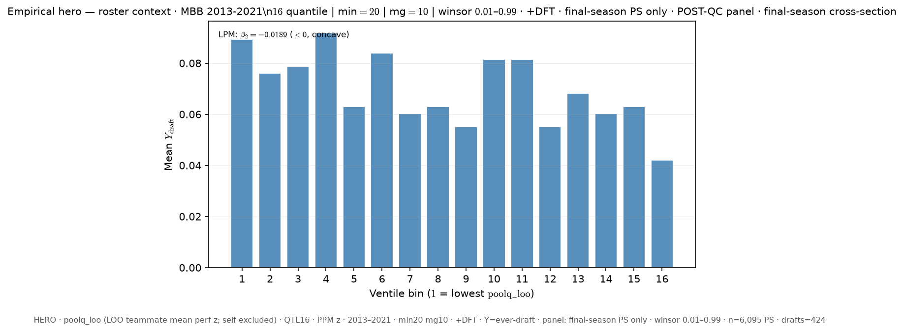
Slide 39 — 13–21 · LOO poolq_loo · ever-draft · last PS only (cross-section) · QTL16 +DFT
Δ vs FIXED HERO: season_window: 11_21 → 13_21; panel_rows: all-ps → last-ps; dft: False → True
python sports/scripts/pass_a_empirical_bundle.py \ --season-min 2013 \ --season-max 2021 \ --y-draft-mode ever \ --panel-rows last-ps \ --roster-x poolq_loo \ --n-bins 16 \ --poolq-binning quantile \ --output-tag perm_loo_ever_lastps_q16_dft \ --output-root 3-Master_Plan/re_entry/HEROs_and_PASSes/population_sandbox/hero \ --dft
Shape: bin1=8.924% · peak=ventile 4 @ 9.186% · last=4.211% · LPM β₂=-0.0189

Slide 41
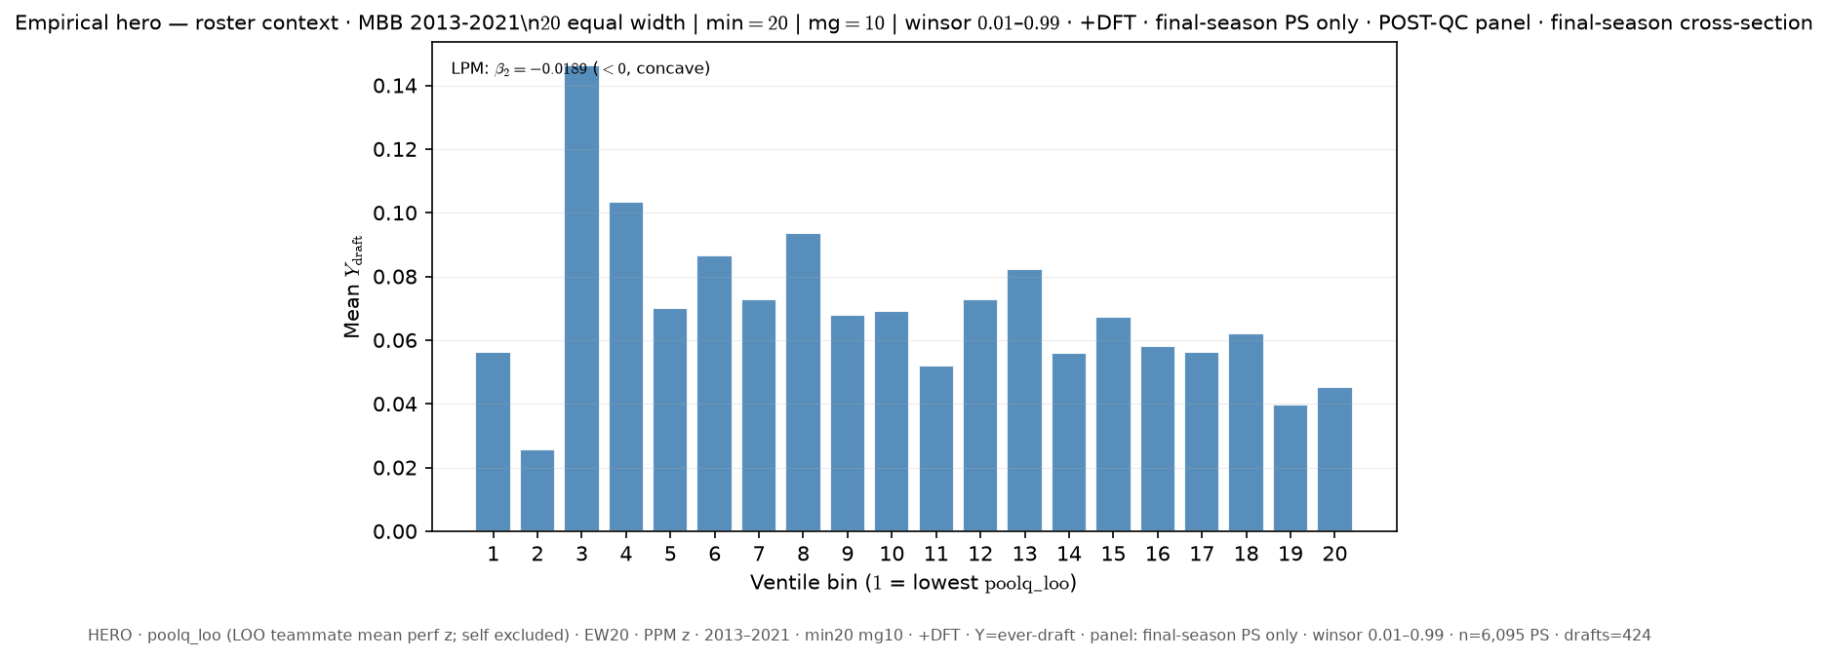
Slide 40 — 13–21 · LOO poolq_loo · ever-draft · last PS only (cross-section) · EW20 +DFT
Δ vs FIXED HERO: season_window: 11_21 → 13_21; panel_rows: all-ps → last-ps; poolq_binning: quantile → equal_width; n_bins: 16 → 20; dft: False → True
python sports/scripts/pass_a_empirical_bundle.py \ --season-min 2013 \ --season-max 2021 \ --y-draft-mode ever \ --panel-rows last-ps \ --roster-x poolq_loo \ --n-bins 20 \ --poolq-binning equal_width \ --output-tag perm_loo_ever_lastps_ew20_dft \ --output-root 3-Master_Plan/re_entry/HEROs_and_PASSes/population_sandbox/hero \ --dft
Shape: bin1=5.618% · peak=ventile 3 @ 14.634% · last=4.516% · LPM β₂=-0.0189

Slide 42
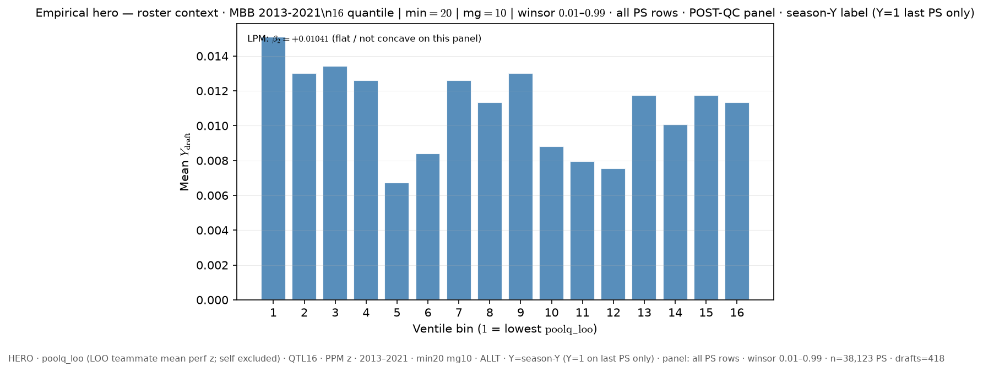
Slide 41 — 13–21 · LOO poolq_loo · season-Y label · all PS rows · QTL16 ALLT
Δ vs FIXED HERO: season_window: 11_21 → 13_21; y_draft_mode: ever → season
python sports/scripts/pass_a_empirical_bundle.py \ --season-min 2013 \ --season-max 2021 \ --y-draft-mode season \ --panel-rows all-ps \ --roster-x poolq_loo \ --n-bins 16 \ --poolq-binning quantile \ --output-tag perm_loo_seasony_allps_q16 \ --output-root 3-Master_Plan/re_entry/HEROs_and_PASSes/population_sandbox/hero
Shape: bin1=1.511% · peak=ventile 1 @ 1.511% · last=1.134% · LPM β₂=+0.01041 ⚠ bin1 LOWEST ventile is PEAK

Slide 43
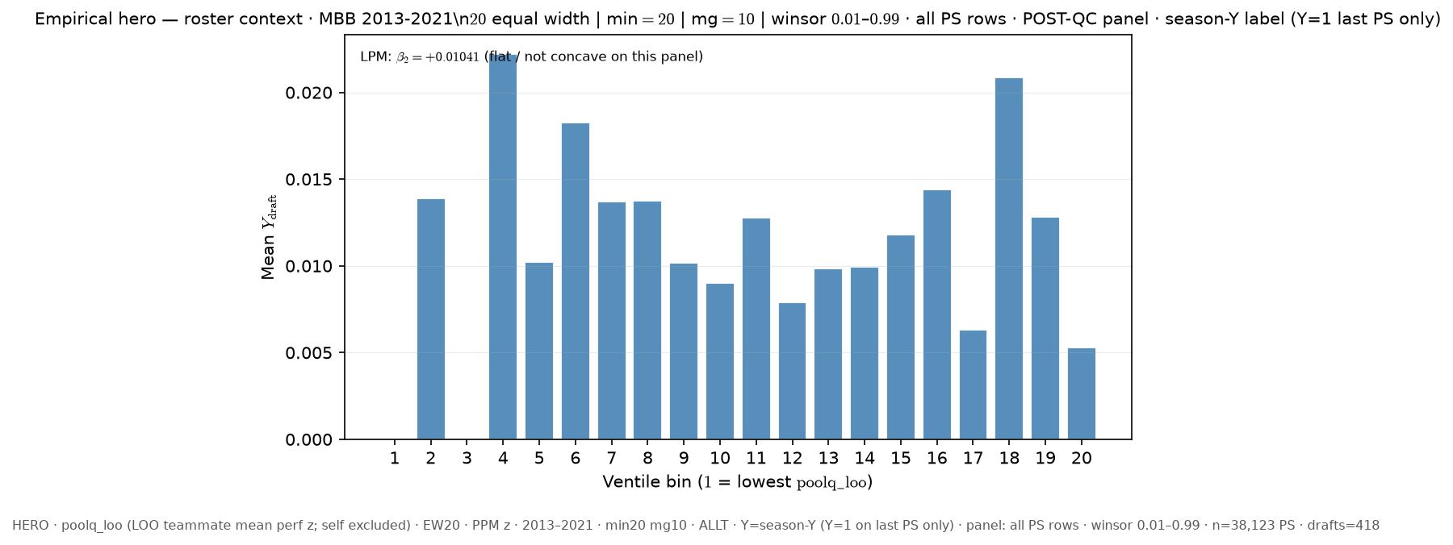
Slide 42 — 13–21 · LOO poolq_loo · season-Y label · all PS rows · EW20 ALLT
Δ vs FIXED HERO: season_window: 11_21 → 13_21; y_draft_mode: ever → season; poolq_binning: quantile → equal_width; n_bins: 16 → 20
python sports/scripts/pass_a_empirical_bundle.py \ --season-min 2013 \ --season-max 2021 \ --y-draft-mode season \ --panel-rows all-ps \ --roster-x poolq_loo \ --n-bins 20 \ --poolq-binning equal_width \ --output-tag perm_loo_seasony_allps_ew20 \ --output-root 3-Master_Plan/re_entry/HEROs_and_PASSes/population_sandbox/hero
Shape: bin1=0.0% · peak=ventile 4 @ 2.222% · last=0.529% · LPM β₂=+0.01041

Slide 44
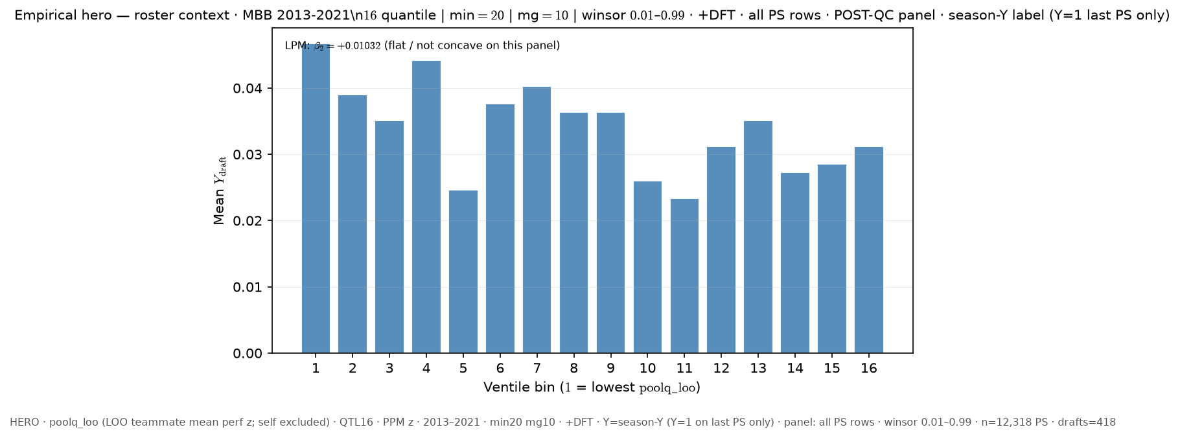
Slide 43 — 13–21 · LOO poolq_loo · season-Y label · all PS rows · QTL16 +DFT
Δ vs FIXED HERO: season_window: 11_21 → 13_21; y_draft_mode: ever → season; dft: False → True
python sports/scripts/pass_a_empirical_bundle.py \ --season-min 2013 \ --season-max 2021 \ --y-draft-mode season \ --panel-rows all-ps \ --roster-x poolq_loo \ --n-bins 16 \ --poolq-binning quantile \ --output-tag perm_loo_seasony_allps_q16_dft \ --output-root 3-Master_Plan/re_entry/HEROs_and_PASSes/population_sandbox/hero \ --dft
Shape: bin1=4.675% · peak=ventile 1 @ 4.675% · last=3.121% · LPM β₂=+0.01032 ⚠ bin1 LOWEST ventile is PEAK

Slide 45
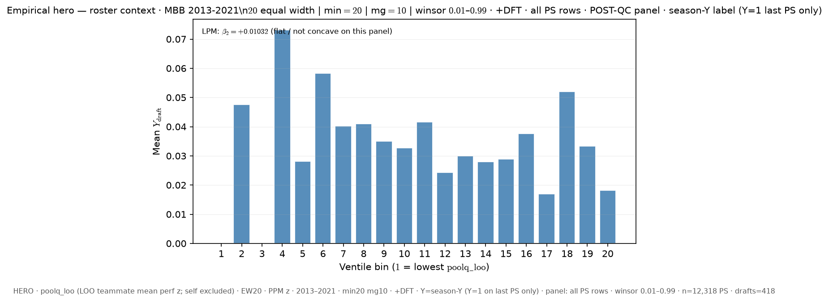
Slide 44 — 13–21 · LOO poolq_loo · season-Y label · all PS rows · EW20 +DFT
Δ vs FIXED HERO: season_window: 11_21 → 13_21; y_draft_mode: ever → season; poolq_binning: quantile → equal_width; n_bins: 16 → 20; dft: False → True
python sports/scripts/pass_a_empirical_bundle.py \ --season-min 2013 \ --season-max 2021 \ --y-draft-mode season \ --panel-rows all-ps \ --roster-x poolq_loo \ --n-bins 20 \ --poolq-binning equal_width \ --output-tag perm_loo_seasony_allps_ew20_dft \ --output-root 3-Master_Plan/re_entry/HEROs_and_PASSes/population_sandbox/hero \ --dft
Shape: bin1=0.0% · peak=ventile 4 @ 7.317% · last=1.818% · LPM β₂=+0.01032

Slide 46
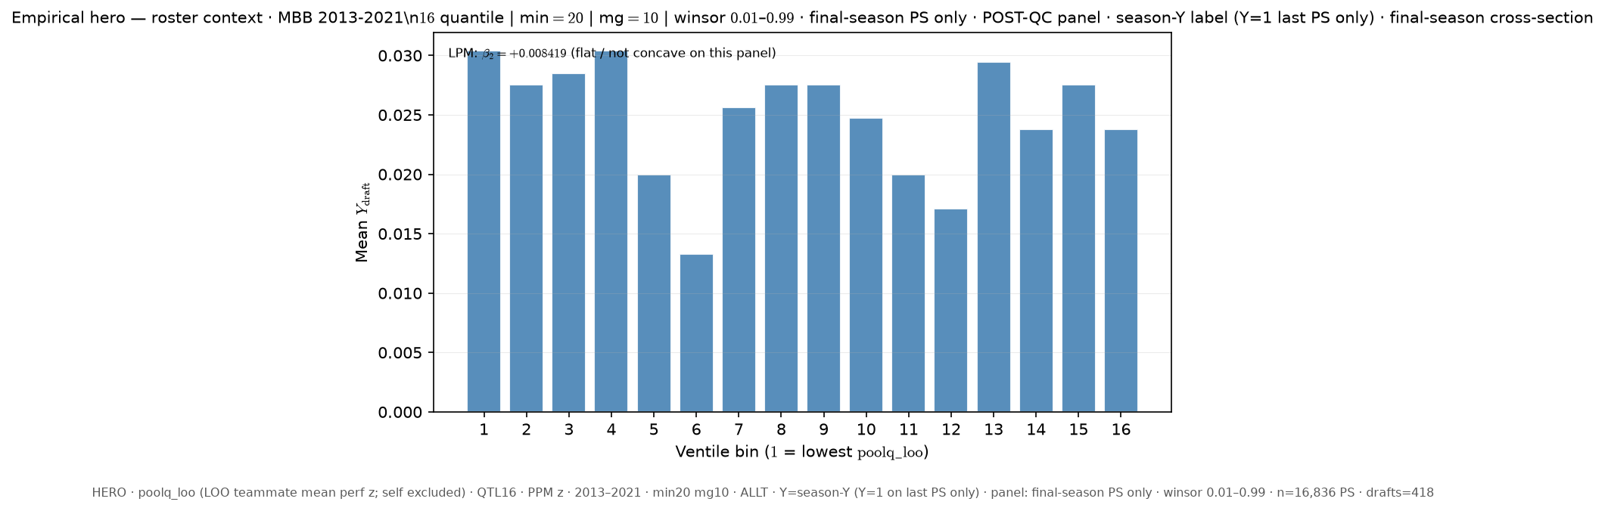
Slide 45 — 13–21 · LOO poolq_loo · season-Y label · last PS only (cross-section) · QTL16 ALLT
Δ vs FIXED HERO: season_window: 11_21 → 13_21; y_draft_mode: ever → season; panel_rows: all-ps → last-ps
python sports/scripts/pass_a_empirical_bundle.py \ --season-min 2013 \ --season-max 2021 \ --y-draft-mode season \ --panel-rows last-ps \ --roster-x poolq_loo \ --n-bins 16 \ --poolq-binning quantile \ --output-tag perm_loo_seasony_lastps_q16 \ --output-root 3-Master_Plan/re_entry/HEROs_and_PASSes/population_sandbox/hero
Shape: bin1=3.039% · peak=ventile 4 @ 3.042% · last=2.376% · LPM β₂=+0.008419

Slide 47
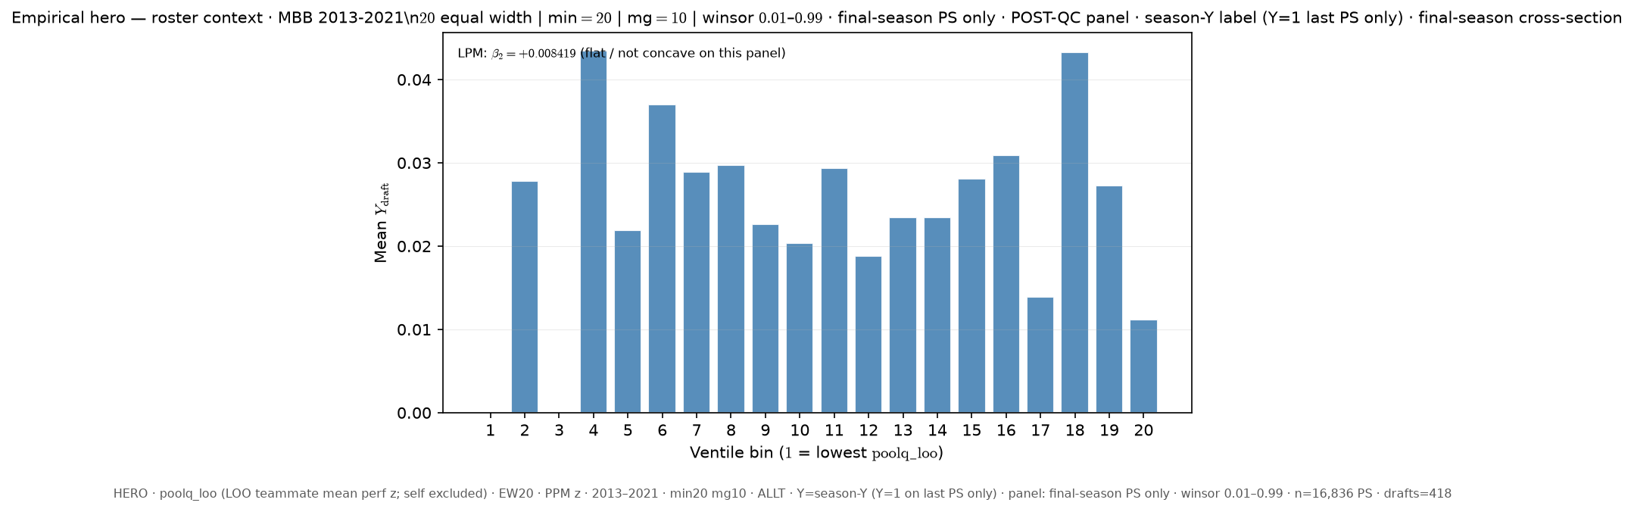
Slide 46 — 13–21 · LOO poolq_loo · season-Y label · last PS only (cross-section) · EW20 ALLT
Δ vs FIXED HERO: season_window: 11_21 → 13_21; y_draft_mode: ever → season; panel_rows: all-ps → last-ps; poolq_binning: quantile → equal_width; n_bins: 16 → 20
python sports/scripts/pass_a_empirical_bundle.py \ --season-min 2013 \ --season-max 2021 \ --y-draft-mode season \ --panel-rows last-ps \ --roster-x poolq_loo \ --n-bins 20 \ --poolq-binning equal_width \ --output-tag perm_loo_seasony_lastps_ew20 \ --output-root 3-Master_Plan/re_entry/HEROs_and_PASSes/population_sandbox/hero
Shape: bin1=0.0% · peak=ventile 4 @ 4.348% · last=1.117% · LPM β₂=+0.008419

Slide 48
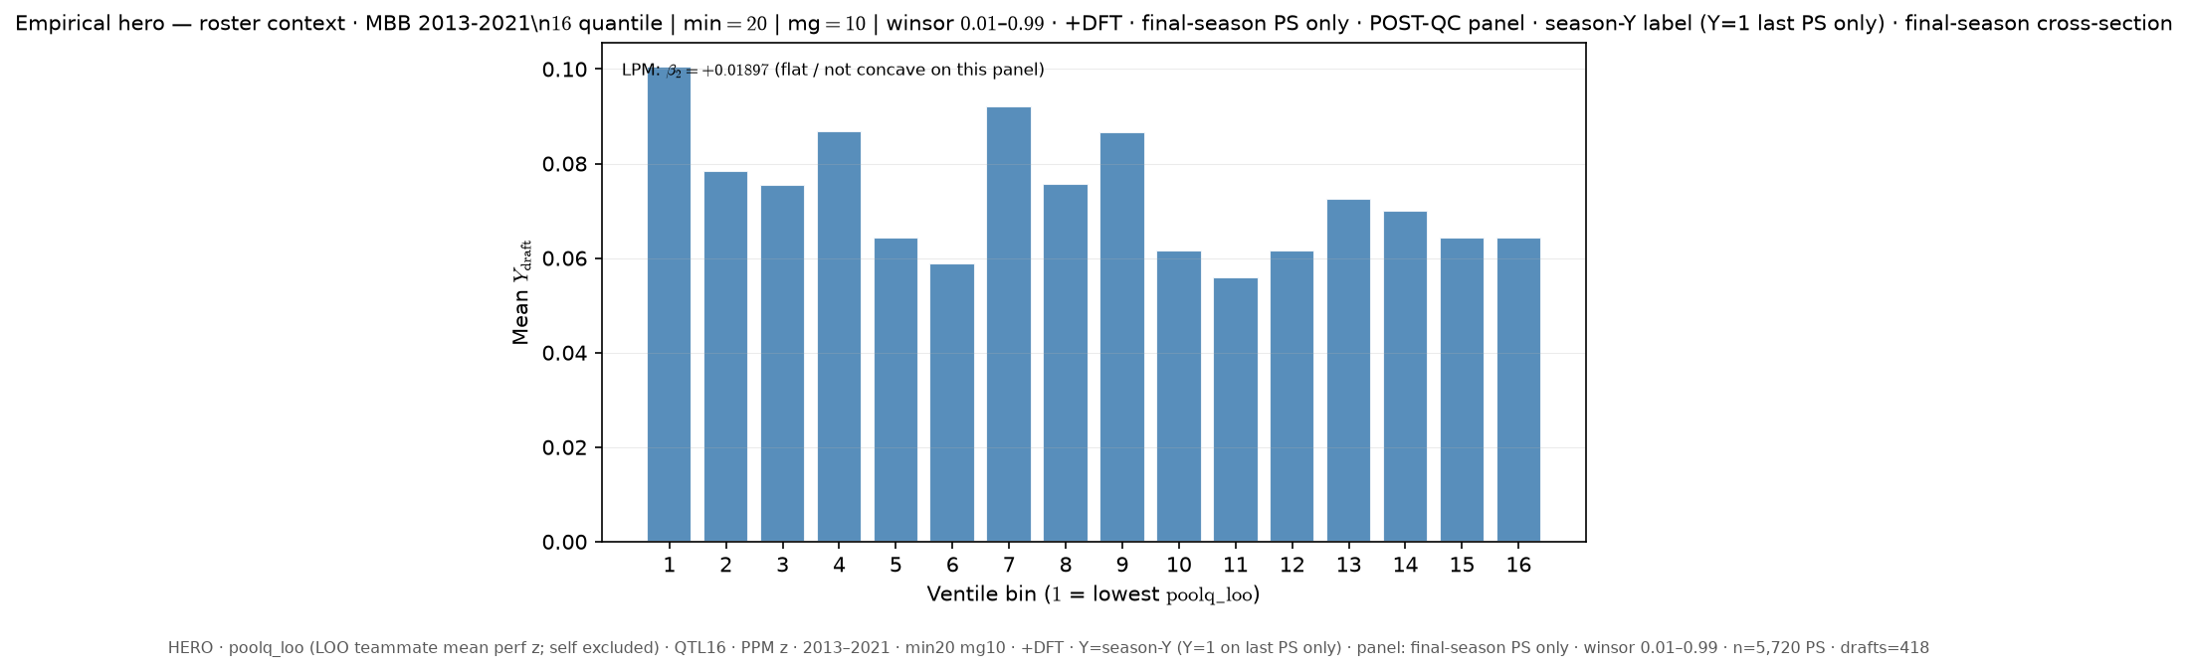
Slide 47 — 13–21 · LOO poolq_loo · season-Y label · last PS only (cross-section) · QTL16 +DFT
Δ vs FIXED HERO: season_window: 11_21 → 13_21; y_draft_mode: ever → season; panel_rows: all-ps → last-ps; dft: False → True
python sports/scripts/pass_a_empirical_bundle.py \ --season-min 2013 \ --season-max 2021 \ --y-draft-mode season \ --panel-rows last-ps \ --roster-x poolq_loo \ --n-bins 16 \ --poolq-binning quantile \ --output-tag perm_loo_seasony_lastps_q16_dft \ --output-root 3-Master_Plan/re_entry/HEROs_and_PASSes/population_sandbox/hero \ --dft
Shape: bin1=10.056% · peak=ventile 1 @ 10.056% · last=6.443% · LPM β₂=+0.01897 ⚠ bin1 LOWEST ventile is PEAK

Slide 49
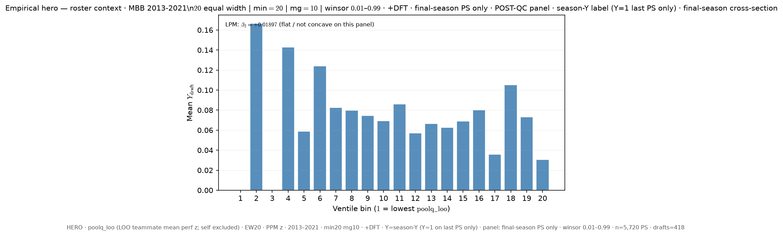
Slide 48 — 13–21 · LOO poolq_loo · season-Y label · last PS only (cross-section) · EW20 +DFT
Δ vs FIXED HERO: season_window: 11_21 → 13_21; y_draft_mode: ever → season; panel_rows: all-ps → last-ps; poolq_binning: quantile → equal_width; n_bins: 16 → 20; dft: False → True
python sports/scripts/pass_a_empirical_bundle.py \ --season-min 2013 \ --season-max 2021 \ --y-draft-mode season \ --panel-rows last-ps \ --roster-x poolq_loo \ --n-bins 20 \ --poolq-binning equal_width \ --output-tag perm_loo_seasony_lastps_ew20_dft \ --output-root 3-Master_Plan/re_entry/HEROs_and_PASSes/population_sandbox/hero \ --dft
Shape: bin1=0.0% · peak=ventile 2 @ 16.667% · last=3.077% · LPM β₂=+0.01897

Slide 50
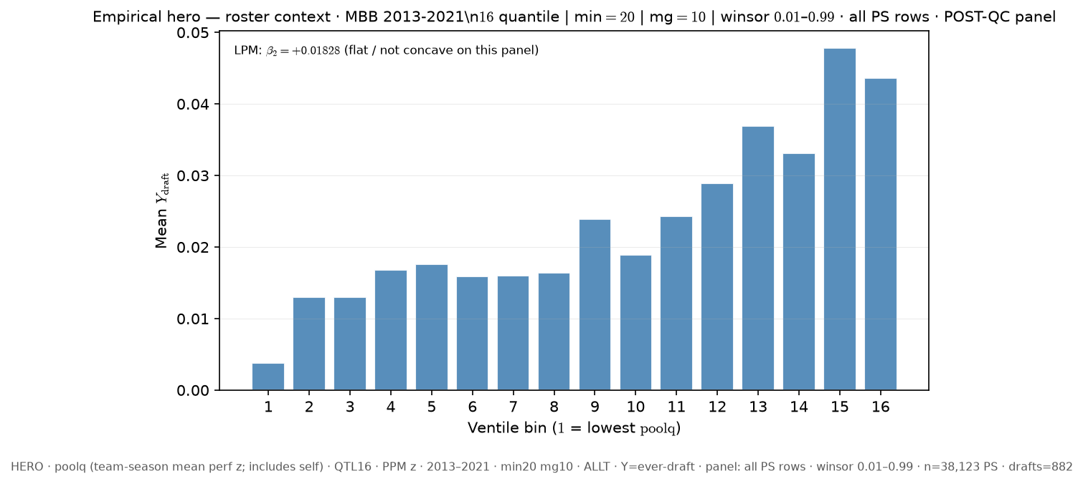
Slide 49 — 13–21 · team poolq (incl. self) · ever-draft · all PS rows · QTL16 ALLT
Δ vs FIXED HERO: season_window: 11_21 → 13_21; roster_x: poolq_loo → poolq
python sports/scripts/pass_a_empirical_bundle.py \ --season-min 2013 \ --season-max 2021 \ --y-draft-mode ever \ --panel-rows all-ps \ --roster-x poolq \ --n-bins 16 \ --poolq-binning quantile \ --output-tag perm_poolq_ever_allps_q16 \ --output-root 3-Master_Plan/re_entry/HEROs_and_PASSes/population_sandbox/hero
Shape: bin1=0.378% · peak=ventile 15 @ 4.784% · last=4.366% · LPM β₂=+0.01828

Slide 51
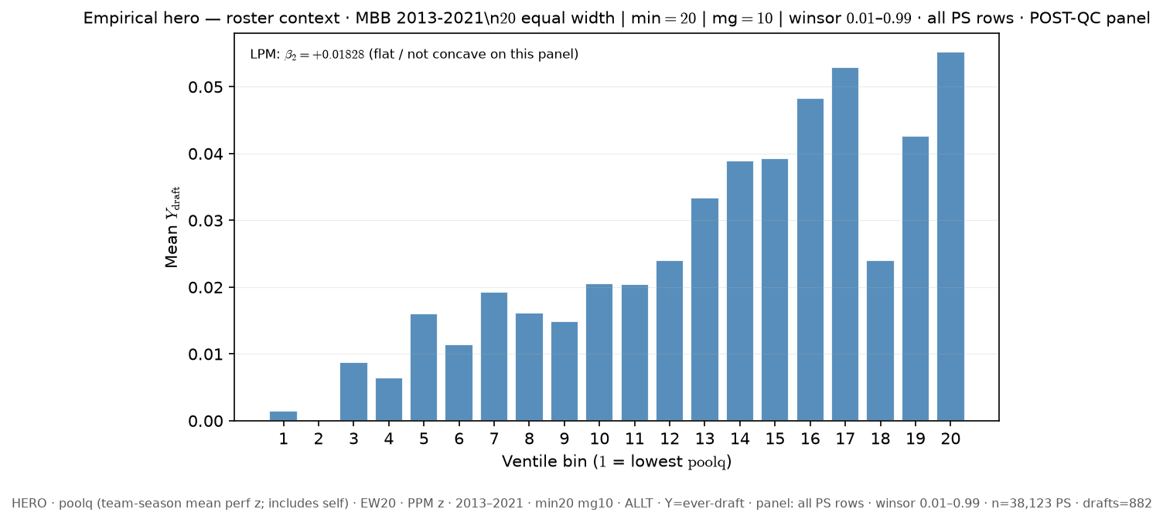
Slide 50 — 13–21 · team poolq (incl. self) · ever-draft · all PS rows · EW20 ALLT
Δ vs FIXED HERO: season_window: 11_21 → 13_21; roster_x: poolq_loo → poolq; poolq_binning: quantile → equal_width; n_bins: 16 → 20
python sports/scripts/pass_a_empirical_bundle.py \ --season-min 2013 \ --season-max 2021 \ --y-draft-mode ever \ --panel-rows all-ps \ --roster-x poolq \ --n-bins 20 \ --poolq-binning equal_width \ --output-tag perm_poolq_ever_allps_ew20 \ --output-root 3-Master_Plan/re_entry/HEROs_and_PASSes/population_sandbox/hero
Shape: bin1=0.144% · peak=ventile 20 @ 5.527% · last=5.527% · LPM β₂=+0.01828

Slide 52

Slide 51 — 13–21 · team poolq (incl. self) · ever-draft · all PS rows · QTL16 +DFT
Δ vs FIXED HERO: season_window: 11_21 → 13_21; roster_x: poolq_loo → poolq; dft: False → True
python sports/scripts/pass_a_empirical_bundle.py \ --season-min 2013 \ --season-max 2021 \ --y-draft-mode ever \ --panel-rows all-ps \ --roster-x poolq \ --n-bins 16 \ --poolq-binning quantile \ --output-tag perm_poolq_ever_allps_q16_dft \ --output-root 3-Master_Plan/re_entry/HEROs_and_PASSes/population_sandbox/hero \ --dft
Shape: bin1=2.063% · peak=ventile 15 @ 10.922% · last=8.141% · LPM β₂=-0.02287

Slide 53

Slide 52 — 13–21 · team poolq (incl. self) · ever-draft · all PS rows · EW20 +DFT
Δ vs FIXED HERO: season_window: 11_21 → 13_21; roster_x: poolq_loo → poolq; poolq_binning: quantile → equal_width; n_bins: 16 → 20; dft: False → True
python sports/scripts/pass_a_empirical_bundle.py \ --season-min 2013 \ --season-max 2021 \ --y-draft-mode ever \ --panel-rows all-ps \ --roster-x poolq \ --n-bins 20 \ --poolq-binning equal_width \ --output-tag perm_poolq_ever_allps_ew20_dft \ --output-root 3-Master_Plan/re_entry/HEROs_and_PASSes/population_sandbox/hero \ --dft
Shape: bin1=0.388% · peak=ventile 20 @ 12.185% · last=12.185% · LPM β₂=-0.02287

Slide 54

Slide 53 — 13–21 · team poolq (incl. self) · ever-draft · last PS only (cross-section) · QTL16 ALLT
Δ vs FIXED HERO: season_window: 11_21 → 13_21; roster_x: poolq_loo → poolq; panel_rows: all-ps → last-ps
python sports/scripts/pass_a_empirical_bundle.py \ --season-min 2013 \ --season-max 2021 \ --y-draft-mode ever \ --panel-rows last-ps \ --roster-x poolq \ --n-bins 16 \ --poolq-binning quantile \ --output-tag perm_poolq_ever_lastps_q16 \ --output-root 3-Master_Plan/re_entry/HEROs_and_PASSes/population_sandbox/hero
Shape: bin1=0.38% · peak=ventile 16 @ 11.787% · last=11.787% · LPM β₂=+0.05195

Slide 55

Slide 54 — 13–21 · team poolq (incl. self) · ever-draft · last PS only (cross-section) · EW20 ALLT
Δ vs FIXED HERO: season_window: 11_21 → 13_21; roster_x: poolq_loo → poolq; panel_rows: all-ps → last-ps; poolq_binning: quantile → equal_width; n_bins: 16 → 20
python sports/scripts/pass_a_empirical_bundle.py \ --season-min 2013 \ --season-max 2021 \ --y-draft-mode ever \ --panel-rows last-ps \ --roster-x poolq \ --n-bins 20 \ --poolq-binning equal_width \ --output-tag perm_poolq_ever_lastps_ew20 \ --output-root 3-Master_Plan/re_entry/HEROs_and_PASSes/population_sandbox/hero
Shape: bin1=0.0% · peak=ventile 19 @ 19.643% · last=14.8% · LPM β₂=+0.05195

Slide 56

Slide 55 — 13–21 · team poolq (incl. self) · ever-draft · last PS only (cross-section) · QTL16 +DFT
Δ vs FIXED HERO: season_window: 11_21 → 13_21; roster_x: poolq_loo → poolq; panel_rows: all-ps → last-ps; dft: False → True
python sports/scripts/pass_a_empirical_bundle.py \ --season-min 2013 \ --season-max 2021 \ --y-draft-mode ever \ --panel-rows last-ps \ --roster-x poolq \ --n-bins 16 \ --poolq-binning quantile \ --output-tag perm_poolq_ever_lastps_q16_dft \ --output-root 3-Master_Plan/re_entry/HEROs_and_PASSes/population_sandbox/hero \ --dft
Shape: bin1=1.312% · peak=ventile 16 @ 22.632% · last=22.632% · LPM β₂=+0.08639

Slide 57

Slide 56 — 13–21 · team poolq (incl. self) · ever-draft · last PS only (cross-section) · EW20 +DFT
Δ vs FIXED HERO: season_window: 11_21 → 13_21; roster_x: poolq_loo → poolq; panel_rows: all-ps → last-ps; poolq_binning: quantile → equal_width; n_bins: 16 → 20; dft: False → True
python sports/scripts/pass_a_empirical_bundle.py \ --season-min 2013 \ --season-max 2021 \ --y-draft-mode ever \ --panel-rows last-ps \ --roster-x poolq \ --n-bins 20 \ --poolq-binning equal_width \ --output-tag perm_poolq_ever_lastps_ew20_dft \ --output-root 3-Master_Plan/re_entry/HEROs_and_PASSes/population_sandbox/hero \ --dft
Shape: bin1=0.0% · peak=ventile 20 @ 28.421% · last=28.421% · LPM β₂=+0.08639

Slide 58

Slide 57 — 13–21 · team poolq (incl. self) · season-Y label · all PS rows · QTL16 ALLT
Δ vs FIXED HERO: season_window: 11_21 → 13_21; roster_x: poolq_loo → poolq; y_draft_mode: ever → season
python sports/scripts/pass_a_empirical_bundle.py \ --season-min 2013 \ --season-max 2021 \ --y-draft-mode season \ --panel-rows all-ps \ --roster-x poolq \ --n-bins 16 \ --poolq-binning quantile \ --output-tag perm_poolq_seasony_allps_q16 \ --output-root 3-Master_Plan/re_entry/HEROs_and_PASSes/population_sandbox/hero
Shape: bin1=0.084% · peak=ventile 16 @ 2.393% · last=2.393% · LPM β₂=+0.04542

Slide 59

Slide 58 — 13–21 · team poolq (incl. self) · season-Y label · all PS rows · EW20 ALLT
Δ vs FIXED HERO: season_window: 11_21 → 13_21; roster_x: poolq_loo → poolq; y_draft_mode: ever → season; poolq_binning: quantile → equal_width; n_bins: 16 → 20
python sports/scripts/pass_a_empirical_bundle.py \ --season-min 2013 \ --season-max 2021 \ --y-draft-mode season \ --panel-rows all-ps \ --roster-x poolq \ --n-bins 20 \ --poolq-binning equal_width \ --output-tag perm_poolq_seasony_allps_ew20 \ --output-root 3-Master_Plan/re_entry/HEROs_and_PASSes/population_sandbox/hero
Shape: bin1=0.173% · peak=ventile 20 @ 3.399% · last=3.399% · LPM β₂=+0.04542

Slide 60

Slide 59 — 13–21 · team poolq (incl. self) · season-Y label · all PS rows · QTL16 +DFT
Δ vs FIXED HERO: season_window: 11_21 → 13_21; roster_x: poolq_loo → poolq; y_draft_mode: ever → season; dft: False → True
python sports/scripts/pass_a_empirical_bundle.py \ --season-min 2013 \ --season-max 2021 \ --y-draft-mode season \ --panel-rows all-ps \ --roster-x poolq \ --n-bins 16 \ --poolq-binning quantile \ --output-tag perm_poolq_seasony_allps_q16_dft \ --output-root 3-Master_Plan/re_entry/HEROs_and_PASSes/population_sandbox/hero \ --dft
Shape: bin1=0.779% · peak=ventile 12 @ 5.584% · last=5.332% · LPM β₂=+0.01064

Slide 61

Slide 60 — 13–21 · team poolq (incl. self) · season-Y label · all PS rows · EW20 +DFT
Δ vs FIXED HERO: season_window: 11_21 → 13_21; roster_x: poolq_loo → poolq; y_draft_mode: ever → season; poolq_binning: quantile → equal_width; n_bins: 16 → 20; dft: False → True
python sports/scripts/pass_a_empirical_bundle.py \ --season-min 2013 \ --season-max 2021 \ --y-draft-mode season \ --panel-rows all-ps \ --roster-x poolq \ --n-bins 20 \ --poolq-binning equal_width \ --output-tag perm_poolq_seasony_allps_ew20_dft \ --output-root 3-Master_Plan/re_entry/HEROs_and_PASSes/population_sandbox/hero \ --dft
Shape: bin1=0.599% · peak=ventile 20 @ 7.386% · last=7.386% · LPM β₂=+0.01064

Slide 62

Slide 61 — 13–21 · team poolq (incl. self) · season-Y label · last PS only (cross-section) · QTL16 ALLT
Δ vs FIXED HERO: season_window: 11_21 → 13_21; roster_x: poolq_loo → poolq; y_draft_mode: ever → season; panel_rows: all-ps → last-ps
python sports/scripts/pass_a_empirical_bundle.py \ --season-min 2013 \ --season-max 2021 \ --y-draft-mode season \ --panel-rows last-ps \ --roster-x poolq \ --n-bins 16 \ --poolq-binning quantile \ --output-tag perm_poolq_seasony_lastps_q16 \ --output-root 3-Master_Plan/re_entry/HEROs_and_PASSes/population_sandbox/hero
Shape: bin1=0.285% · peak=ventile 16 @ 11.217% · last=11.217% · LPM β₂=+0.1429

Slide 63

Slide 62 — 13–21 · team poolq (incl. self) · season-Y label · last PS only (cross-section) · EW20 ALLT
Δ vs FIXED HERO: season_window: 11_21 → 13_21; roster_x: poolq_loo → poolq; y_draft_mode: ever → season; panel_rows: all-ps → last-ps; poolq_binning: quantile → equal_width; n_bins: 16 → 20
python sports/scripts/pass_a_empirical_bundle.py \ --season-min 2013 \ --season-max 2021 \ --y-draft-mode season \ --panel-rows last-ps \ --roster-x poolq \ --n-bins 20 \ --poolq-binning equal_width \ --output-tag perm_poolq_seasony_lastps_ew20 \ --output-root 3-Master_Plan/re_entry/HEROs_and_PASSes/population_sandbox/hero
Shape: bin1=0.0% · peak=ventile 19 @ 22.414% · last=13.953% · LPM β₂=+0.1429

Slide 64

Slide 63 — 13–21 · team poolq (incl. self) · season-Y label · last PS only (cross-section) · QTL16 +DFT
Δ vs FIXED HERO: season_window: 11_21 → 13_21; roster_x: poolq_loo → poolq; y_draft_mode: ever → season; panel_rows: all-ps → last-ps; dft: False → True
python sports/scripts/pass_a_empirical_bundle.py \ --season-min 2013 \ --season-max 2021 \ --y-draft-mode season \ --panel-rows last-ps \ --roster-x poolq \ --n-bins 16 \ --poolq-binning quantile \ --output-tag perm_poolq_seasony_lastps_q16_dft \ --output-root 3-Master_Plan/re_entry/HEROs_and_PASSes/population_sandbox/hero \ --dft
Shape: bin1=1.676% · peak=ventile 16 @ 24.37% · last=24.37% · LPM β₂=+0.2174

Slide 65

Slide 64 — 13–21 · team poolq (incl. self) · season-Y label · last PS only (cross-section) · EW20 +DFT
Δ vs FIXED HERO: season_window: 11_21 → 13_21; roster_x: poolq_loo → poolq; y_draft_mode: ever → season; panel_rows: all-ps → last-ps; poolq_binning: quantile → equal_width; n_bins: 16 → 20; dft: False → True
python sports/scripts/pass_a_empirical_bundle.py \ --season-min 2013 \ --season-max 2021 \ --y-draft-mode season \ --panel-rows last-ps \ --roster-x poolq \ --n-bins 20 \ --poolq-binning equal_width \ --output-tag perm_poolq_seasony_lastps_ew20_dft \ --output-root 3-Master_Plan/re_entry/HEROs_and_PASSes/population_sandbox/hero \ --dft
Shape: bin1=0.0% · peak=ventile 19 @ 35.185% · last=23.762% · LPM β₂=+0.2174

