Slide 1
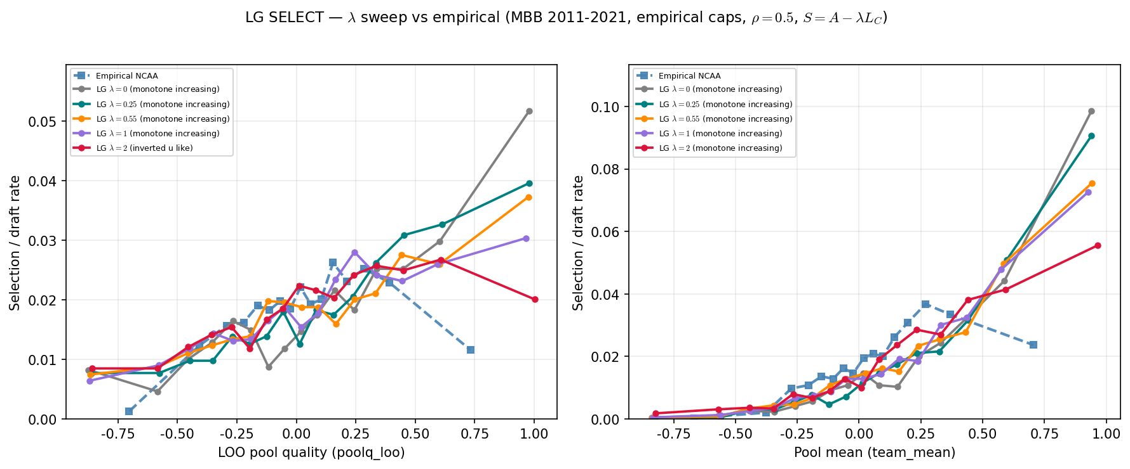
Empirical caps — $\lambda$ sweep on SELECT
MBB 2011-2021 · $\rho=0.5$ · $\lambda \in \{0, 0.25, 0.55, 1, 2\}$ · empirical caps held fixed
SELECT: draft rate vs LOO peer quality (left) and pool mean (right).
MBB 2011-2021 · empirical roster caps · fixed $\rho=0.5$ · sweep $\lambda$ in $S=A-\lambda L_C$.
Empirical LOO: inverted u like (peak bin 11, 2.62\%).
LG $\lambda=0$: monotone increasing on LOO.
LG $\lambda=0.25$: monotone increasing on LOO.
LG $\lambda=0.55$: monotone increasing on LOO.
LG $\lambda=1$: monotone increasing on LOO.
LG $\lambda=2$: inverted u like on LOO.
Input geometry fixed (Alex caps) — only SCORE congestion weight moves.
$\rho$ = ASSIGN; $\lambda$ = SCORE — test whether inverted-U lives in selection.
Compare curvature labels across $\lambda$ arms, not just level shifts.
Talking point: at least one λ arm shows inverted-U-like LOO curvature — SCORE knob can move selection shape after input comparability.

