Slide 1
Quayle: From Similarity Preference to Network Structure
The essential idea before we introduce our bipartite extension
Property
pᵢ, pⱼ
Similarity
xᵢⱼ
Homophily
α
Attachment
Π
Assortativity
r
Community
Q
→
→
→
→
→
Similarity xᵢⱼ
Pairwise: how alike are these two vertices? It is an input to the choice rule.
Homophily α
Generative preference: how strongly does similarity affect attachment?
Assortativity r
Realized network outcome: how strongly do connected vertices mix by property?
xᵢⱼ ≠ α ≠ r
Mechanism and outcome are related — but they are not the same object.
Quayle, Siddiqui & Jones (2006), European Physical Journal B 50, 617–630

Slide 2
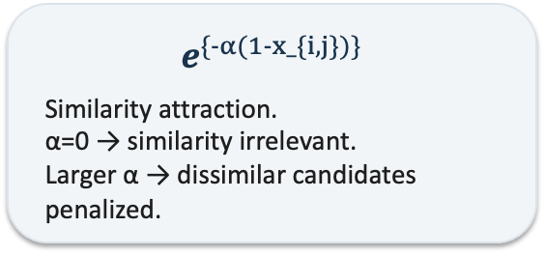

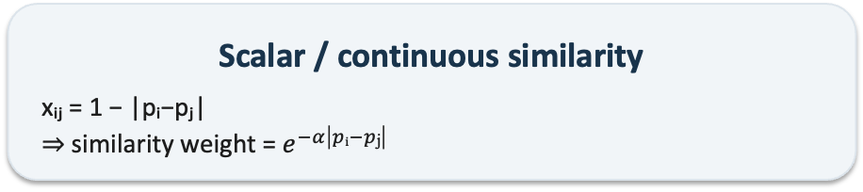
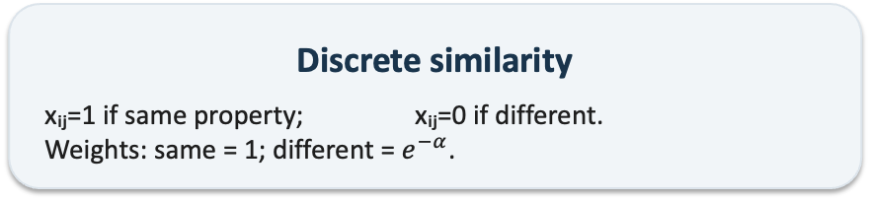
Quayle's Formation Rule
Structural attractiveness × similarity attraction → normalized probability
Equation (4)
$$Π\left(kⱼ,xᵢⱼ\right)= \frac{f\left(kⱼ\right)e^{\left\{−α\left(1−xᵢⱼ\right)\right\}}}{Σₗ f\left(kₗ\right)e^{\left\{−α\left(1−xᵢₗ\right)\right\}}}$$
f(kⱼ)
Structural attractiveness / popularity of candidate j. Standard BA implementation: f(kⱼ)=kⱼ.
$e^{\{-α(1-x_\{i,j\})\}}$
Similarity attraction. α=0 → similarity irrelevant. Larger α → dissimilar candidates penalized.
Σ over l
Normalize against ALL eligible candidates. Numerator = candidate j. Denominator = complete choice set.
Discrete similarity
xᵢⱼ=1 if same property; xᵢⱼ=0 if different. Weights: same = 1; different = $e^{−α}$.
Scalar / continuous similarity
xᵢⱼ = 1 − |pᵢ−pⱼ| ⇒ similarity weight = $e^{−α\left|pᵢ−pⱼ\right|}$
Quayle, Siddiqui & Jones (2006), European Physical Journal B 50, 617–630

Slide 3
What Quayle Establishes — and the Boundary We Cross
Why this is a foundation, not a plug-and-play answer
Microscopic preference → macroscopic assortment
For the symmetric discrete ensemble: r = (1−e^{−α}) / [1+(nₚ−1)e^{−α}]
Inverse calibration is conditional
α = ln[(1+(nₚ−1)r)/(1−r)] Useful only under the assumptions that produced it.
What transfers cleanly
• Explicit pairwise similarity • Preference strength distinct from realized assortment • Normalize over available alternatives • Local stochastic choices can generate macro structure • Similarity metric is a modeling choice
What Quayle does NOT contain
• Bipartite individual → team affiliation • Hard roster / pool capacity • Lagged endogenous team centroids • Repeated turnover / reassignment • A validated α→r map under those constraints
Bridge to our model:
Keep the generative logic; change the candidate from another individual to a finite-capacity team — then re-establish the preference → realized-sorting relationship.
Quayle, Siddiqui & Jones (2006), European Physical Journal B 50, 617–630

