Slide 1
Slide 1 — Reigning hero basic data plots (porch)
19 plots · 2026-08-28 · lock mg10 min20 09_21
Purpose: porch diagnostics for the named reigning hero before star sweep / F-HERO.
Reigning hero (slide 12): poolq_LOO · ever · last-ps · EW16 · ALLT · 2009–2021.
Filters: min20 · mg10 · PPM z · winsor 1–99 on poolq_LOO (LOO plots only).
HERO tag: `perm_loo_ever_lastps_ew16`.
Population split (Charles Aug 2026):
• last-ps: Â, LOO, T̂_j vs LOO — matches HERO scoring cross-section
• all-ps: interval overlap, APGMS/ARGMS, roster size — full panel geometry
Regenerate plots: python sports/scripts/reigning_hero_basic_plots.py
Rebuild deck: python sports/scripts/build_reigning_hero_basic_plots_slides.py

Slide 2
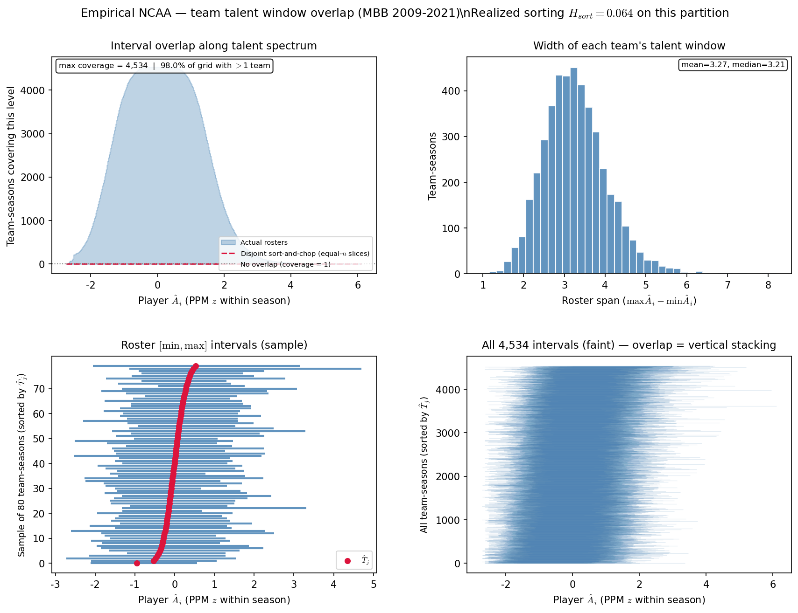
Slide 2 — Team interval overlap
HAND analog ~PD20 slide 21 · all-ps
• Full roster panel (all player-seasons) — needed for team-season interval geometry.
• Same filter chain as lock: mg10 · min20 · 09–21 · PPM z · ALLT.
• Complements last-ps HERO aperture — shows roster spread before LOO cross-section.
python sports/scripts/reigning_hero_basic_plots.py --only overlap
n=4,534 team-seasons · H_sort=0.0644 · coverage mean=1676 · disjoint mean=91.25%
Rows: all-ps · HAND: PD20 ~slide 21

Slide 3
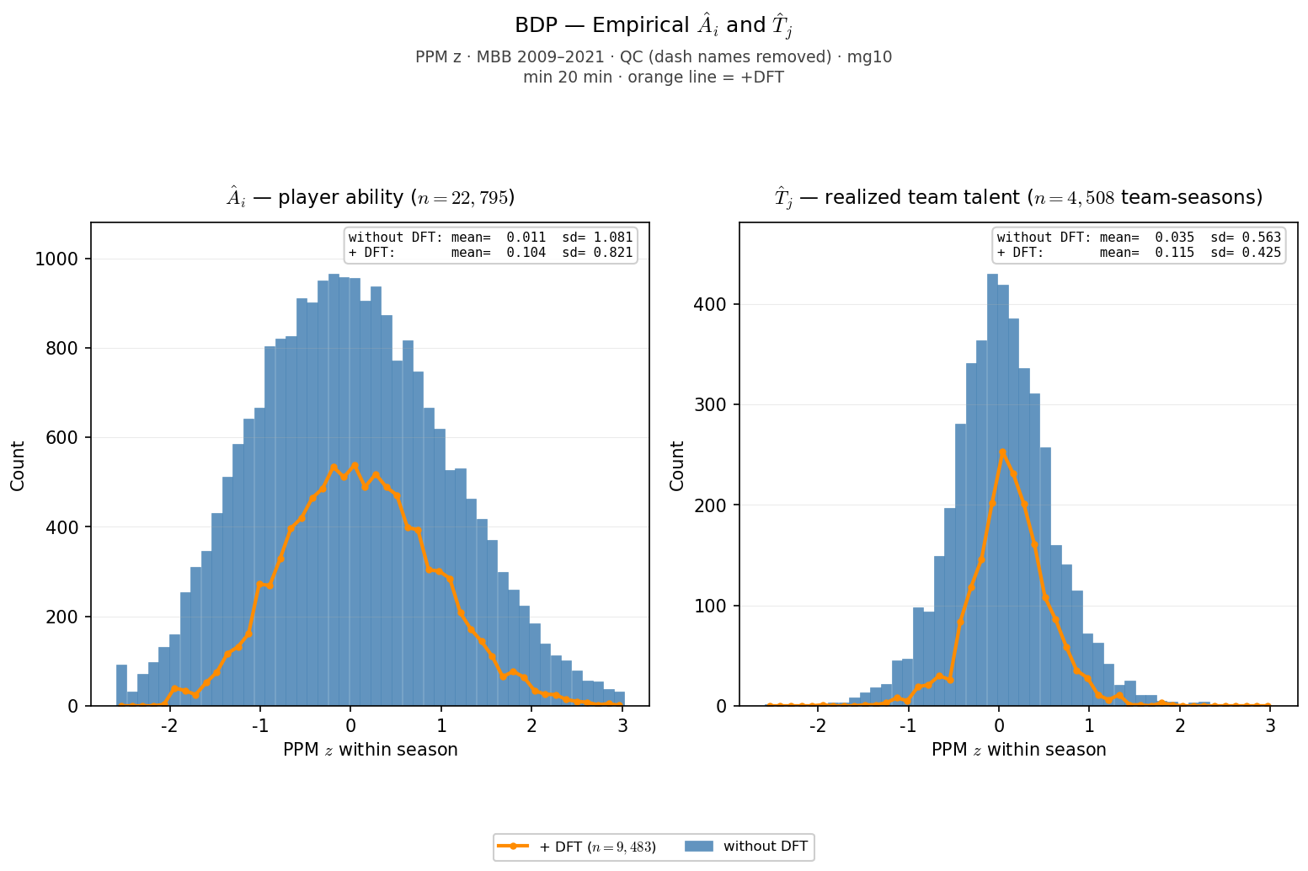
Slide 3 — Â_i and T̂_j distributions
BDP slide 7 analog · last-ps · ALLT + orange +DFT
• Last-ps cross-section (one row per athlete) — matches HERO scoring aperture.
• Left: Â_i (player PPM z). Right: T̂_j (team-season mean). No poolq winsor.
• Orange overlay = +DFT subset (player-seasons on draft-ever teams).
python sports/scripts/reigning_hero_basic_plots.py --only ai_tj
Â: n=22,795 · mean=+0.011 · sd=1.081 · T̂_j: n=4,508 · mean=+0.035 · sd=0.563 · +DFT overlay: n=9,483 player-seasons on draft-ever teams
Rows: last-ps · HAND: BDP slide 7

Slide 4
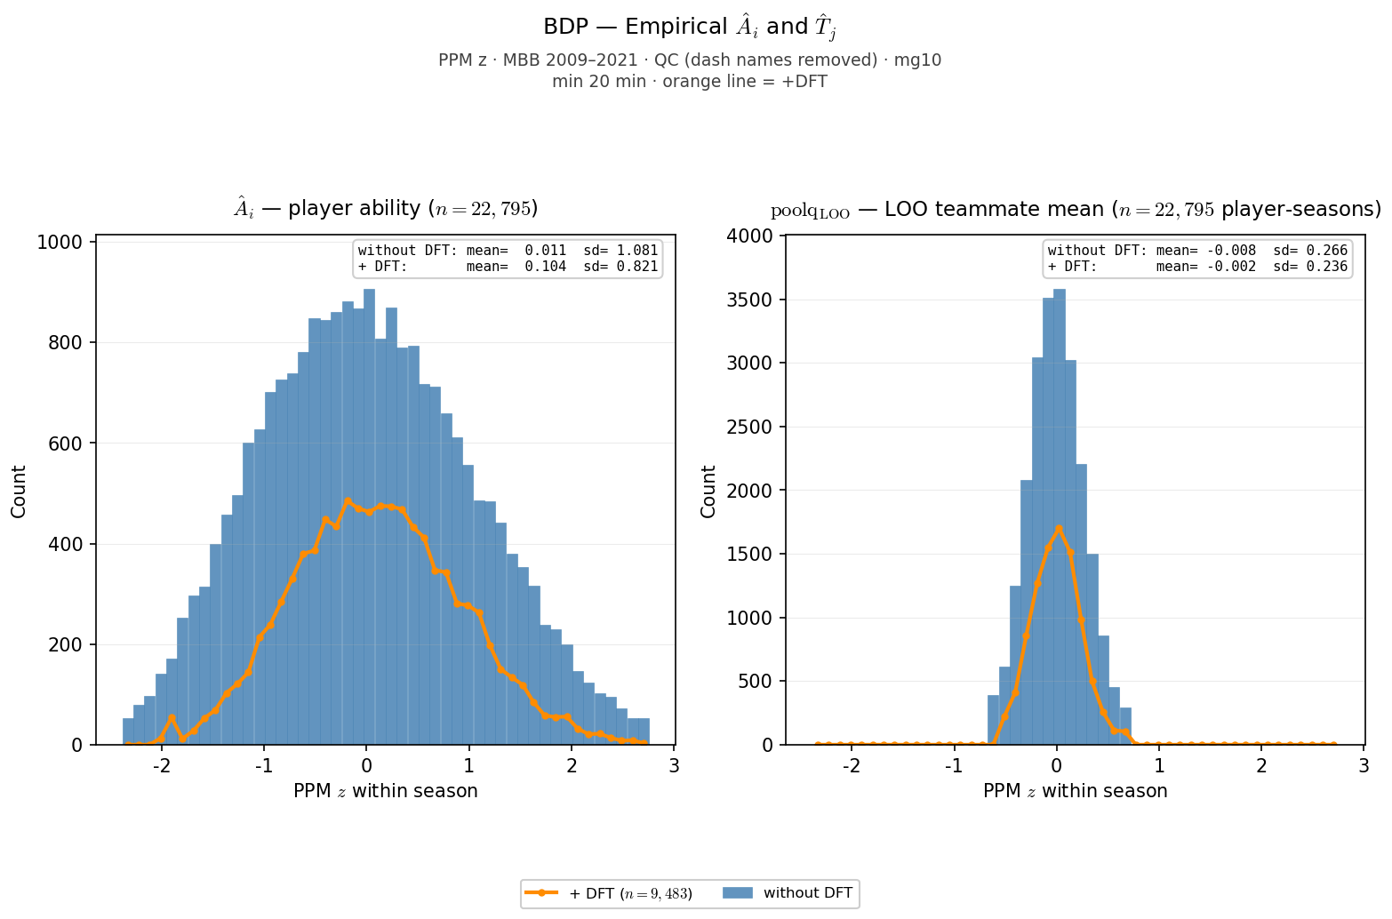
Slide 4 — Â_i and poolq_LOO distributions
Mirror of Â|T̂_j · last-ps · winsor 1–99 on LOO
• Right panel = LOO teammate mean (poolq_LOO) with reigning winsor 1–99.
• Same last-ps aperture as HERO lock; shows individual vs local congestion.
• Tail structure on LOO reflects winsor clip — not LOO algebra.
python sports/scripts/reigning_hero_basic_plots.py --only ai_loo
Â: n=22,795 · sd=1.081 · poolq_LOO: n=22,795 · sd=0.266 · winsor 1%–99%
Rows: last-ps · HAND: BDP slide 7 (LOO variant)

Slide 5
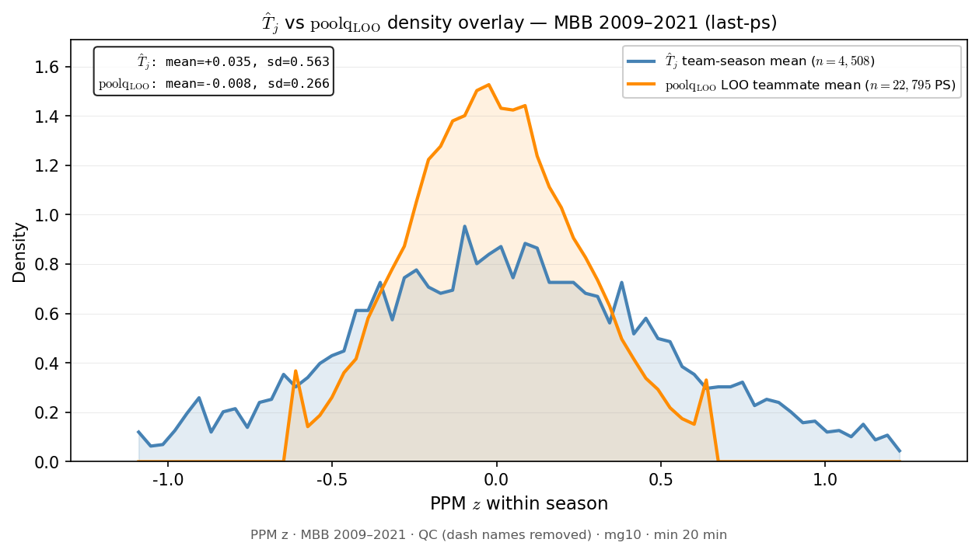
Slide 5 — T̂_j vs poolq_LOO density overlay
New porch diagnostic · last-ps · winsor on LOO only
• Compares team mean T̂_j (broad) vs LOO teammate mean (tight) on shared PPM z axis.
• LOO winsor 1–99 — tail spikes at ±0.6 are clip artifacts, not biology.
• Motivation: visualize gap between team talent and local congestion before HERO bins.
python sports/scripts/reigning_hero_basic_plots.py --only tj_loo
T̂_j: sd=0.563 · poolq_LOO: sd=0.266 · winsor 1%–99% · tail spikes at winsor clip = artifact
Rows: last-ps · HAND: (new)

Slide 6
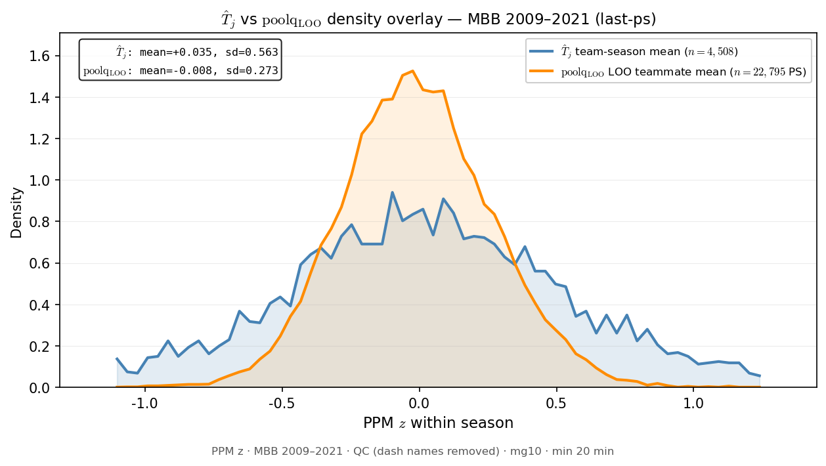
Slide 6 — T̂_j vs poolq_LOO density overlay (no winsor)
Mirror of T̂_j vs LOO · last-ps · raw poolq_LOO
• Same hist-density overlay as prior slide — poolq_LOO winsor 1–99 removed.
• Shows natural LOO tails without clip spikes at ±0.6.
• Reigning HERO lock still uses winsor; this is porch diagnostic only.
python sports/scripts/reigning_hero_basic_plots.py --only tj_loo_nowinsor
T̂_j: sd=0.563 · poolq_LOO: sd=0.273 · no winsor · tail spikes at winsor clip = artifact
Rows: last-ps · HAND: (new)

Slide 7
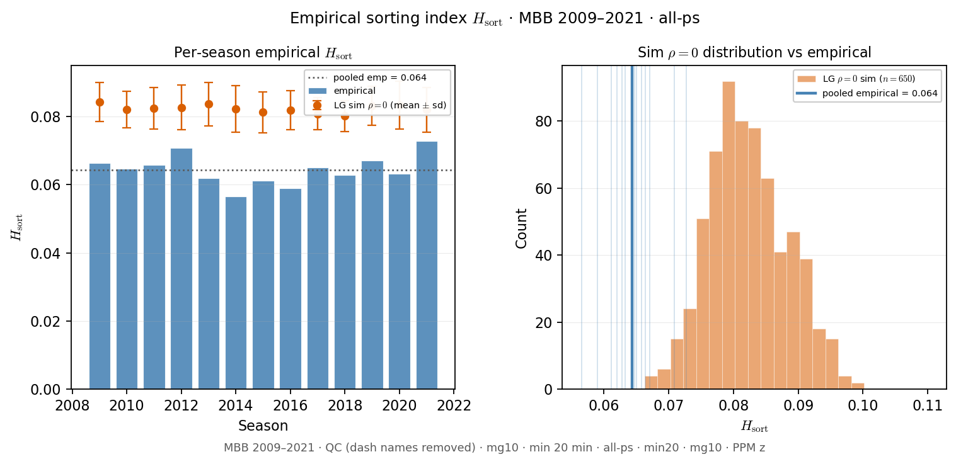
Slide 7 — Empirical $H_{\mathrm{sort}}$ distribution
Realized sorting index · all-ps · vs sim ρ=0 reference
• $H_{\mathrm{sort}}$ = variance explained by team assignment (not interval overlap).
• Per-season empirical bars + pooled line; orange = Grandchild sim ρ=0 distribution.
• Pooled reigning lock ≈ 0.064 — weak homophily on realized rosters.
python sports/scripts/reigning_hero_basic_plots.py --only hsort_dist
pooled empirical H_sort=0.0644 · sim ρ=0 mean=0.0823 (n=650)
Rows: all-ps · HAND: PD17 H_sort readout

Slide 8
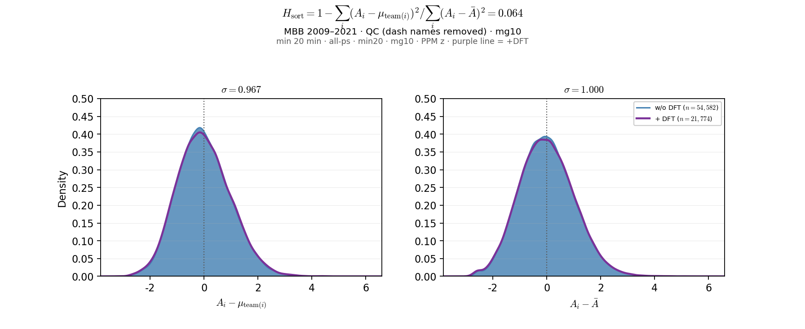
Slide 8 — Ability residuals — team vs grand mean
$H_{\mathrm{sort}}$ decomposition · all-ps · ALLT + purple +DFT
• Left: $A_i - \hat{T}_j$ (within-team demeaned perf — $H_{\mathrm{sort}}$ numerator).
• Right: $A_i - \bar{A}$ (grand-mean demeaned — denominator).
• Pooled over 09–21; purple overlay = +DFT (draft-ever teams).
python sports/scripts/reigning_hero_basic_plots.py --only ability_residuals
n=54,582 · H_sort=0.0644 · σ(team resid)=0.967 · σ(grand resid)=1.000 · +DFT H_sort=0.0605
Rows: all-ps · HAND: BDP H_sort porch

Slide 9
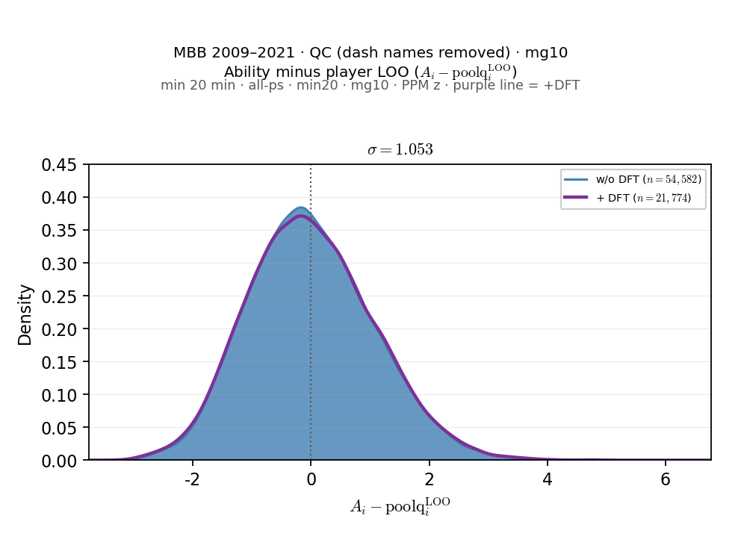
Slide 9 — Ability minus LOO ($A_i - \mathrm{poolq}^{\mathrm{LOO}}_i$)
LOO congestion residual · all-ps · ALLT + purple +DFT
• Histogram + ECDF of $A_i - \mathrm{poolq}^{\mathrm{LOO}}_i$ (teammate mean excl. $i$).
• Analogous to team residual panel but LOO replaces team mean in the decomposition.
• σ ≈ 1.05 > team residual σ — LOO axis carries more player-level spread.
python sports/scripts/reigning_hero_basic_plots.py --only ability_loo_residuals
n=54,582 · σ(LOO resid)=1.053 · frac_var=1.108 · +DFT σ=1.069
Rows: all-ps · HAND: BDP LOO porch

Slide 10
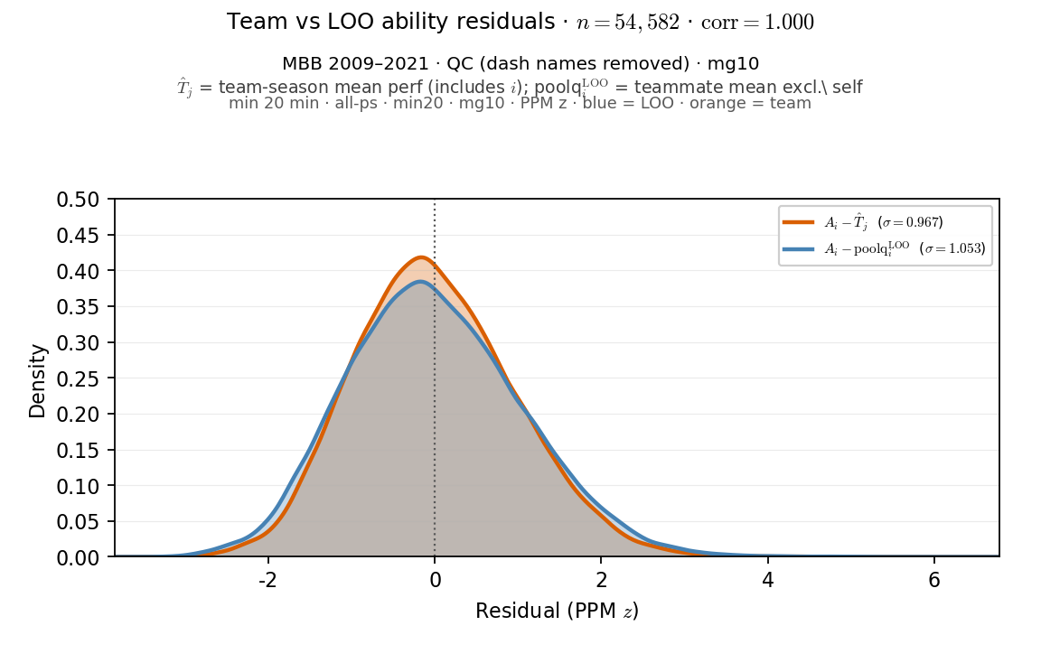
Slide 10 — Team vs LOO ability residuals (overlay)
Superposed KDEs · all-ps · orange team · blue LOO
• Orange: $A_i - \hat{T}_j$ (team mean incl. $i$). Blue: $A_i - \mathrm{poolq}^{\mathrm{LOO}}_i$.
• Same player-rows; corr ≈ 0.9997 — nearly collinear but LOO slightly wider.
• Motivation: visualize self-inclusion gap before T̂_j − LOO slide.
python sports/scripts/reigning_hero_basic_plots.py --only ability_tj_vs_loo_residuals
n=54,582 · σ(team resid)=0.967 · σ(LOO resid)=1.053 · corr=0.9997
Rows: all-ps · HAND: BDP LOO porch

Slide 11
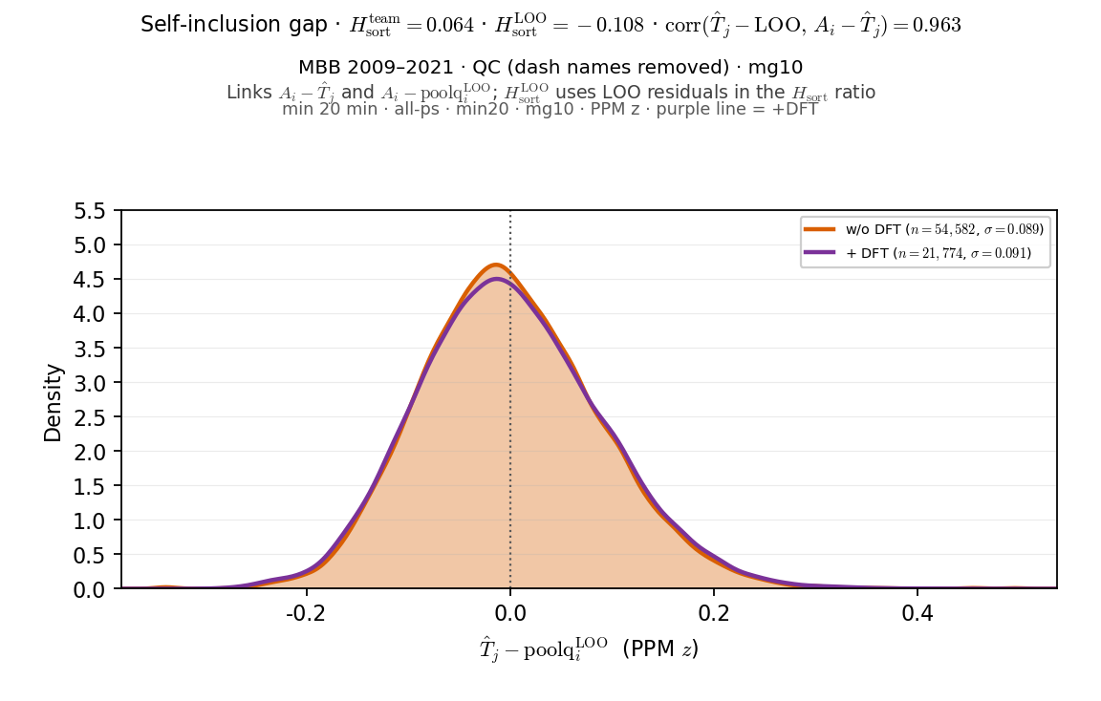
Slide 11 — $\hat{T}_j - \mathrm{poolq}^{\mathrm{LOO}}_i$ (self-inclusion gap)
Team mean minus LOO teammate mean · all-ps · ALLT + purple +DFT
• Distribution of $\hat{T}_j - \mathrm{poolq}^{\mathrm{LOO}}_i$ — how much self pulls team mean above LOO.
• Reports $H_{\mathrm{sort}}^{\mathrm{team}}$ vs $H_{\mathrm{sort}}^{\mathrm{LOO}}$ (LOO can go negative).
• Tight spike near 0 (σ ≈ 0.09); axis-mismatch diagnostic for SCORE vs HERO readout.
python sports/scripts/reigning_hero_basic_plots.py --only tj_minus_loo
n=54,582 · μ(T̂_j−LOO)=+0.0002 · σ=0.089 · H_sort^team=0.0644 · H_sort^LOO=-0.1085 · +DFT σ=0.091
Rows: all-ps · HAND: BDP LOO porch

Slide 12
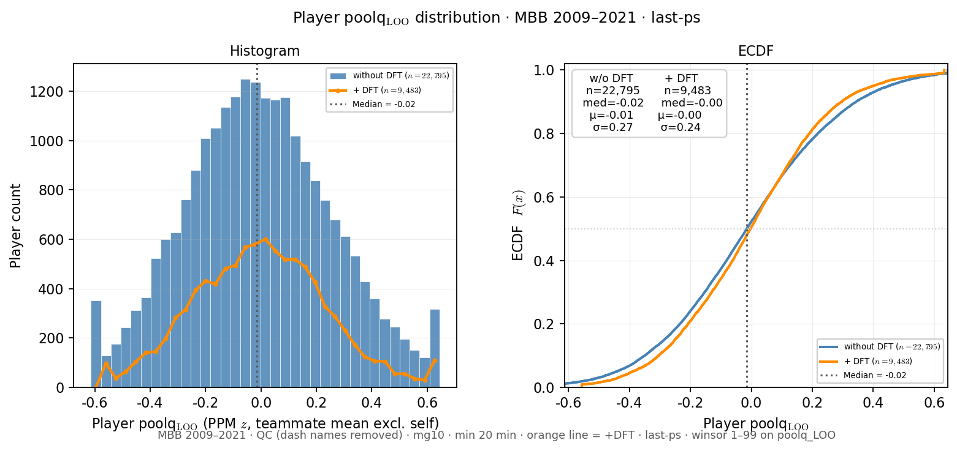
Slide 12 — Player poolq_LOO distribution
Alex Aug 2026 · last-ps · winsor 1–99 · ALLT + orange +DFT
• Standalone distribution of player LOO teammate quality (poolq_LOO).
• Histogram + ECDF on reigning last-ps aperture — not paired with Â_i.
• Orange = +DFT overlay (draft-ever teams).
python sports/scripts/reigning_hero_basic_plots.py --only loo_dist
last-ps n=22,795 · med=-0.015 · μ=-0.008 · winsor 1%–99% · +DFT med=-0.003
Rows: last-ps · HAND: (new · Alex request)

Slide 13
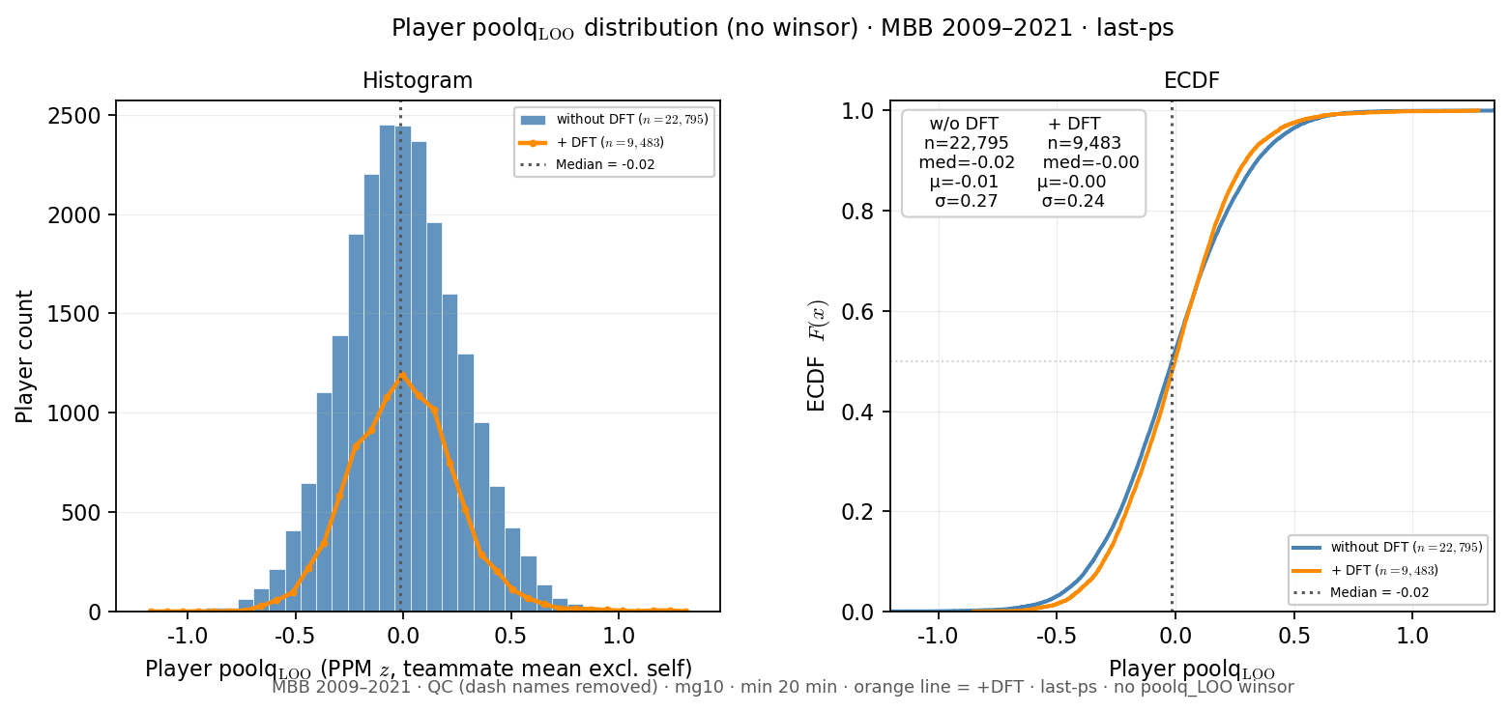
Slide 13 — Player poolq_LOO distribution (no winsor)
Mirror of LOO dist · last-ps · raw poolq_LOO · ALLT + orange +DFT
• Same hist + ECDF pair as prior slide — poolq_LOO winsor 1–99 removed.
• Shows natural LOO tails without clip spikes at ±0.6.
• Reigning HERO lock still uses winsor; this is porch diagnostic only.
python sports/scripts/reigning_hero_basic_plots.py --only loo_dist_nowinsor
last-ps n=22,795 · med=-0.015 · μ=-0.008 · no poolq_LOO winsor · +DFT med=-0.003
Rows: last-ps · HAND: (new · Alex request)

Slide 14
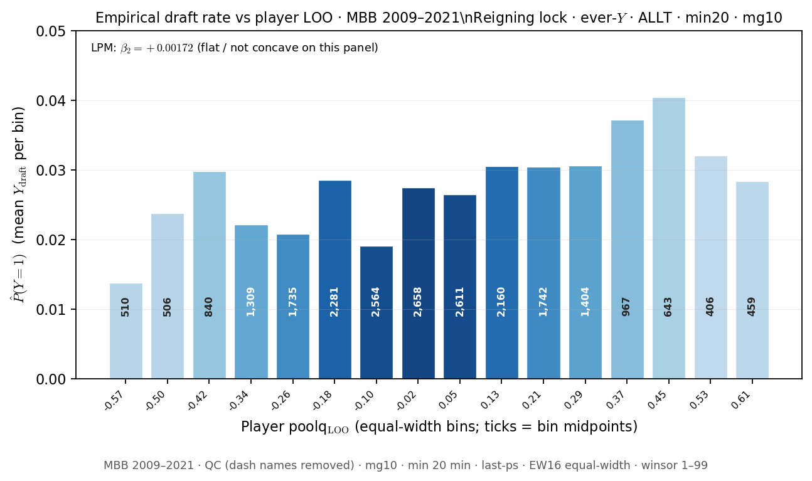
Slide 14 — P(Y=1) vs player poolq_LOO
Reigning lock EW16 · ever-Y · last-ps
• Mean Y_draft by equal-width poolq_LOO bins (16) — same binning as reigning HERO.
• Bar height = empirical draft rate; labels = bin n; LPM β₂ annotation.
• Complements HERO PNG in ../hero/ — porch copy for slide 12 deck.
python sports/scripts/reigning_hero_basic_plots.py --only draft_rate_loo
EW16 · n=22,795 · LPM β₂=+0.00172 · ever-Y · last-ps
Rows: last-ps · HAND: HERO / Pass A roster panel

Slide 15
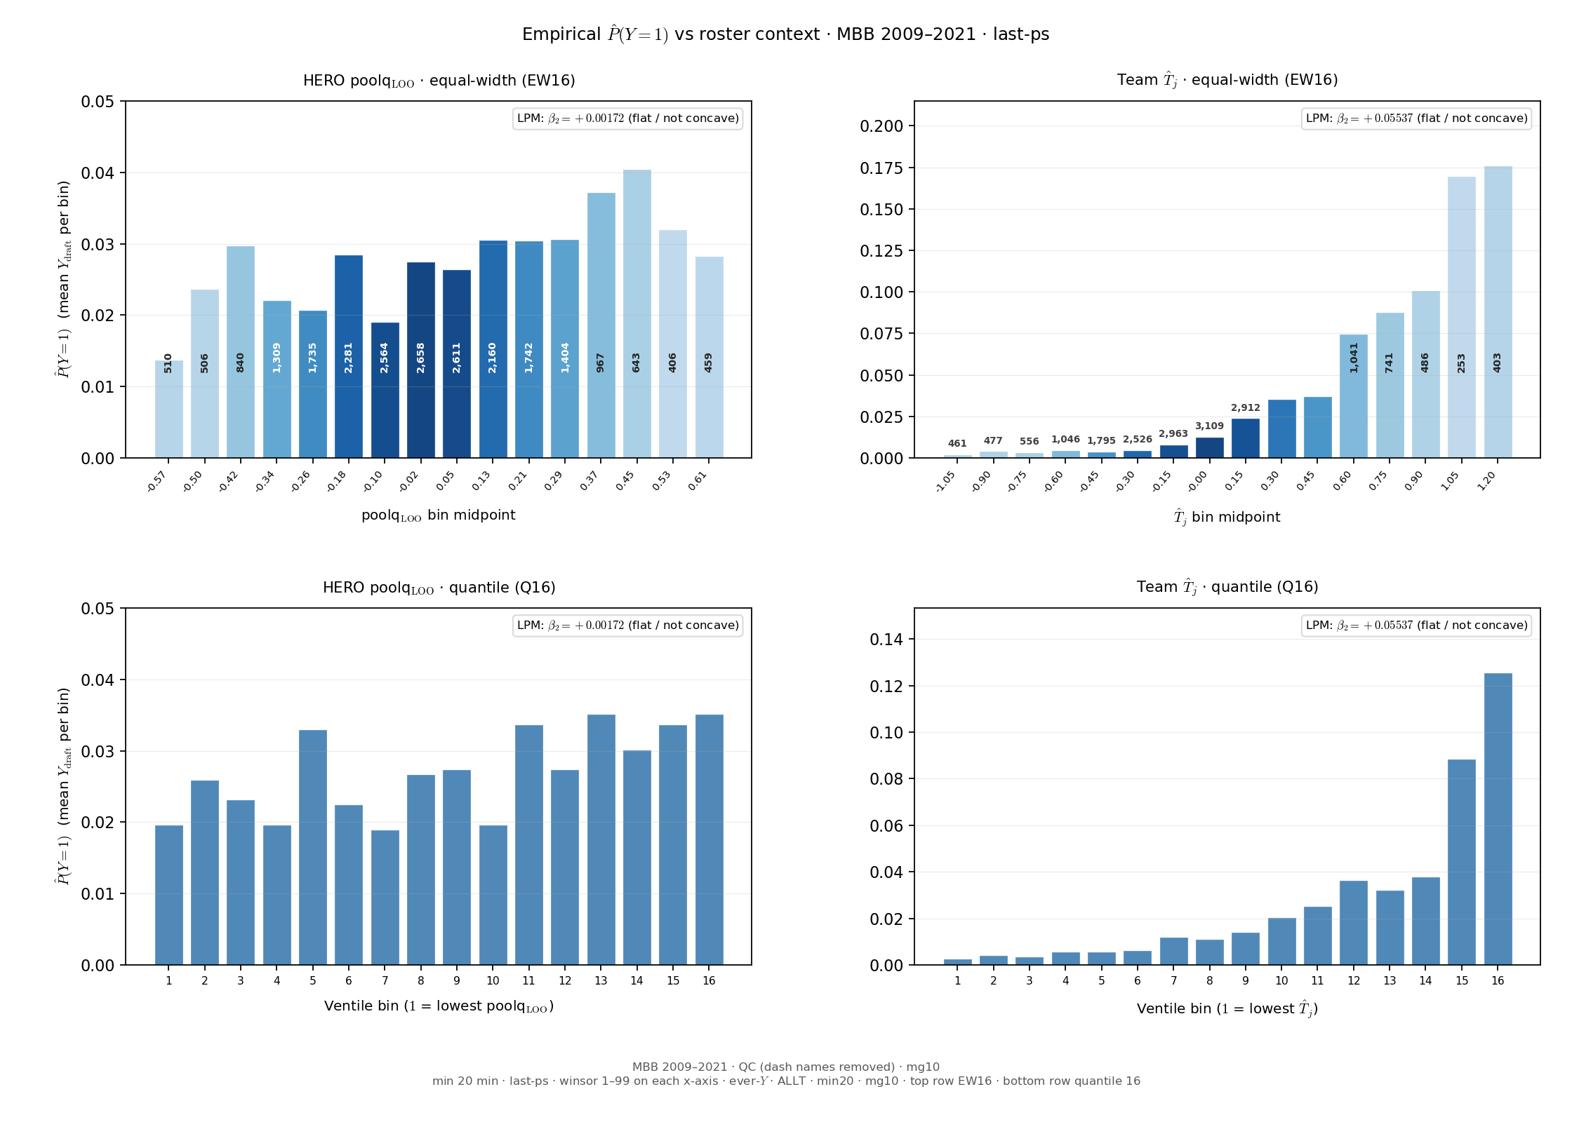
Slide 15 — P(Y=1) — player LOO vs T̂_j (side-by-side)
Reigning lock EW16 · ever-Y · last-ps · same panel both panels
• 2×2: top row EW16 equal-width; bottom row quantile 16 (same n per bin).
• Left: HERO poolq_LOO · Right: team T̂_j — same panel, both binning schemes.
• LPM β₂ on continuous x (not binned); compare shape sensitivity to binning.
python sports/scripts/reigning_hero_basic_plots.py --only draft_rate_loo_tj
EW16 · n=22,795 · LOO β₂=+0.00172 · T̂_j β₂=+0.05537
Rows: last-ps · HAND: HERO vs F-HERO team axis

Slide 16
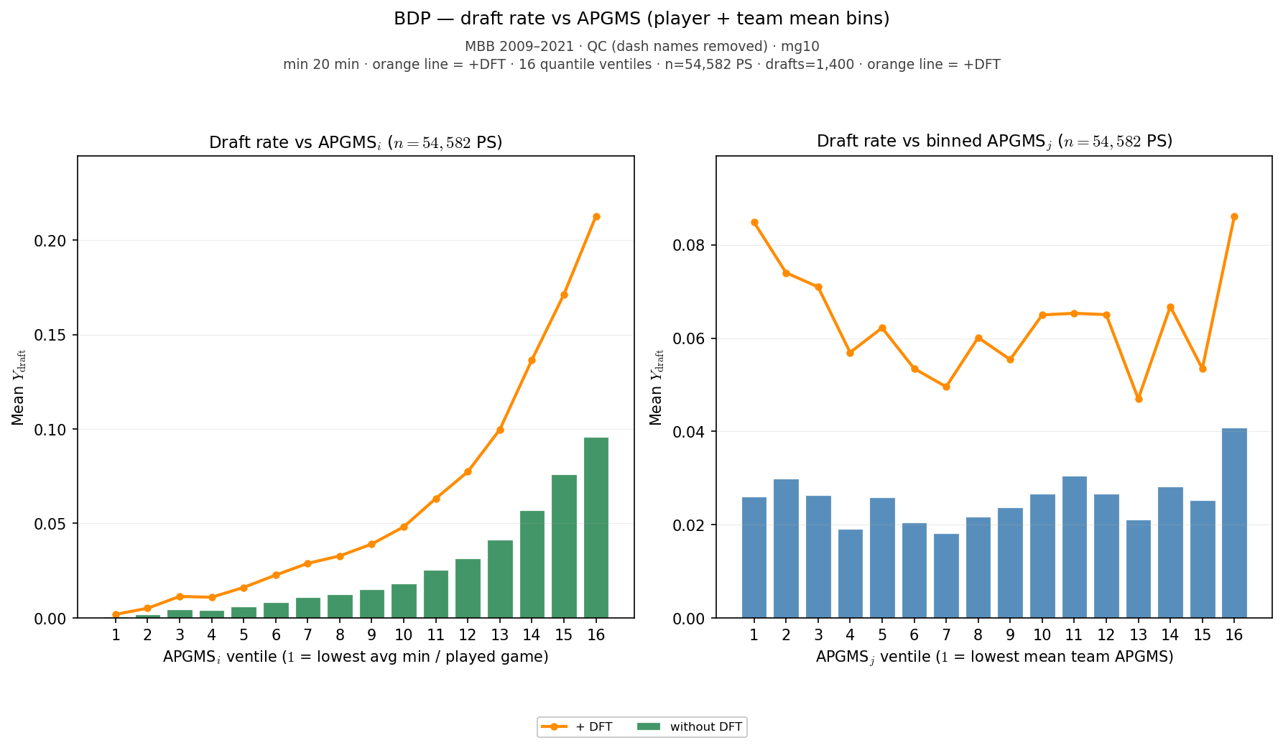
Slide 16 — Draft rate vs APGMS ventiles
Fixed_Ai slides 11–14 analog · all-ps · ALLT + orange +DFT
• Exposure diagnostic: average player-games per season (APGMS) vs draft rate.
• All-ps panel (full minutes exposure) — not last-ps HERO aperture.
• Quantile ventiles on APGMS; independent of HERO poolq_LOO binning.
python sports/scripts/reigning_hero_basic_plots.py --only draft_rate
APGMS · all-ps n=54,582 · draft rate vent1=0.09% · vent16=9.59% · orange=+DFT overlay
Rows: all-ps · HAND: Fixed_Ai 11–14

Slide 17
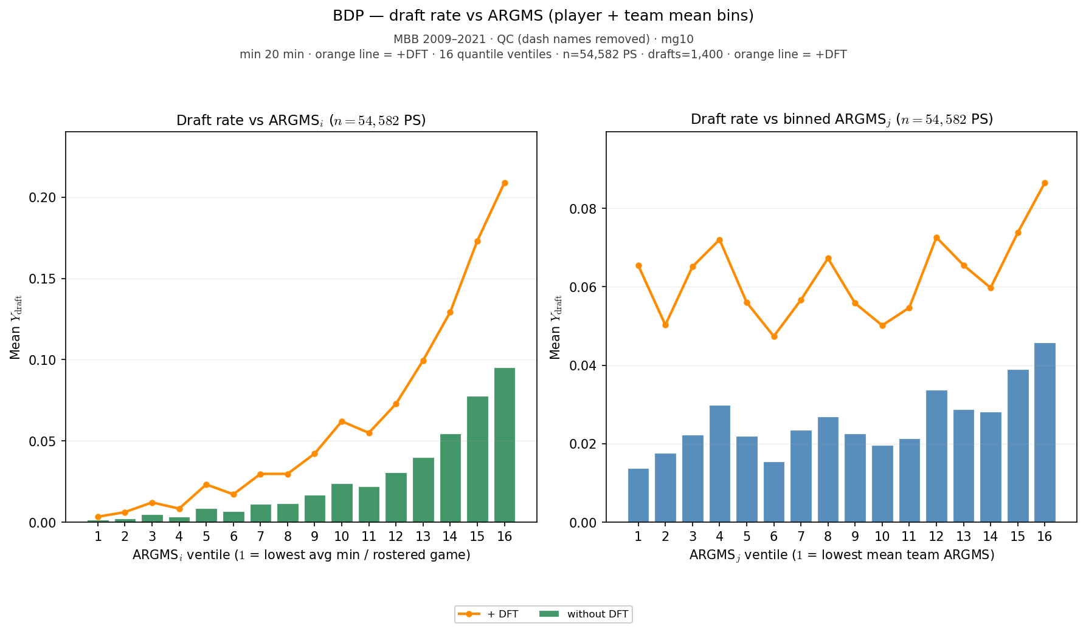
Slide 17 — Draft rate vs ARGMS ventiles
Fixed_Ai slides 11–14 analog · all-ps · ALLT + orange +DFT
• Exposure diagnostic: average roster-games per season (ARGMS) vs draft rate.
• Team-level minutes exposure complement to APGMS player ventiles.
• Same 09–21 lock filters; orange +DFT overlay on draft-ever teams.
python sports/scripts/reigning_hero_basic_plots.py --only draft_rate
ARGMS · all-ps n=54,582 · draft rate vent1=0.15% · vent16=9.53% · orange=+DFT overlay
Rows: all-ps · HAND: Fixed_Ai 11–14

Slide 18
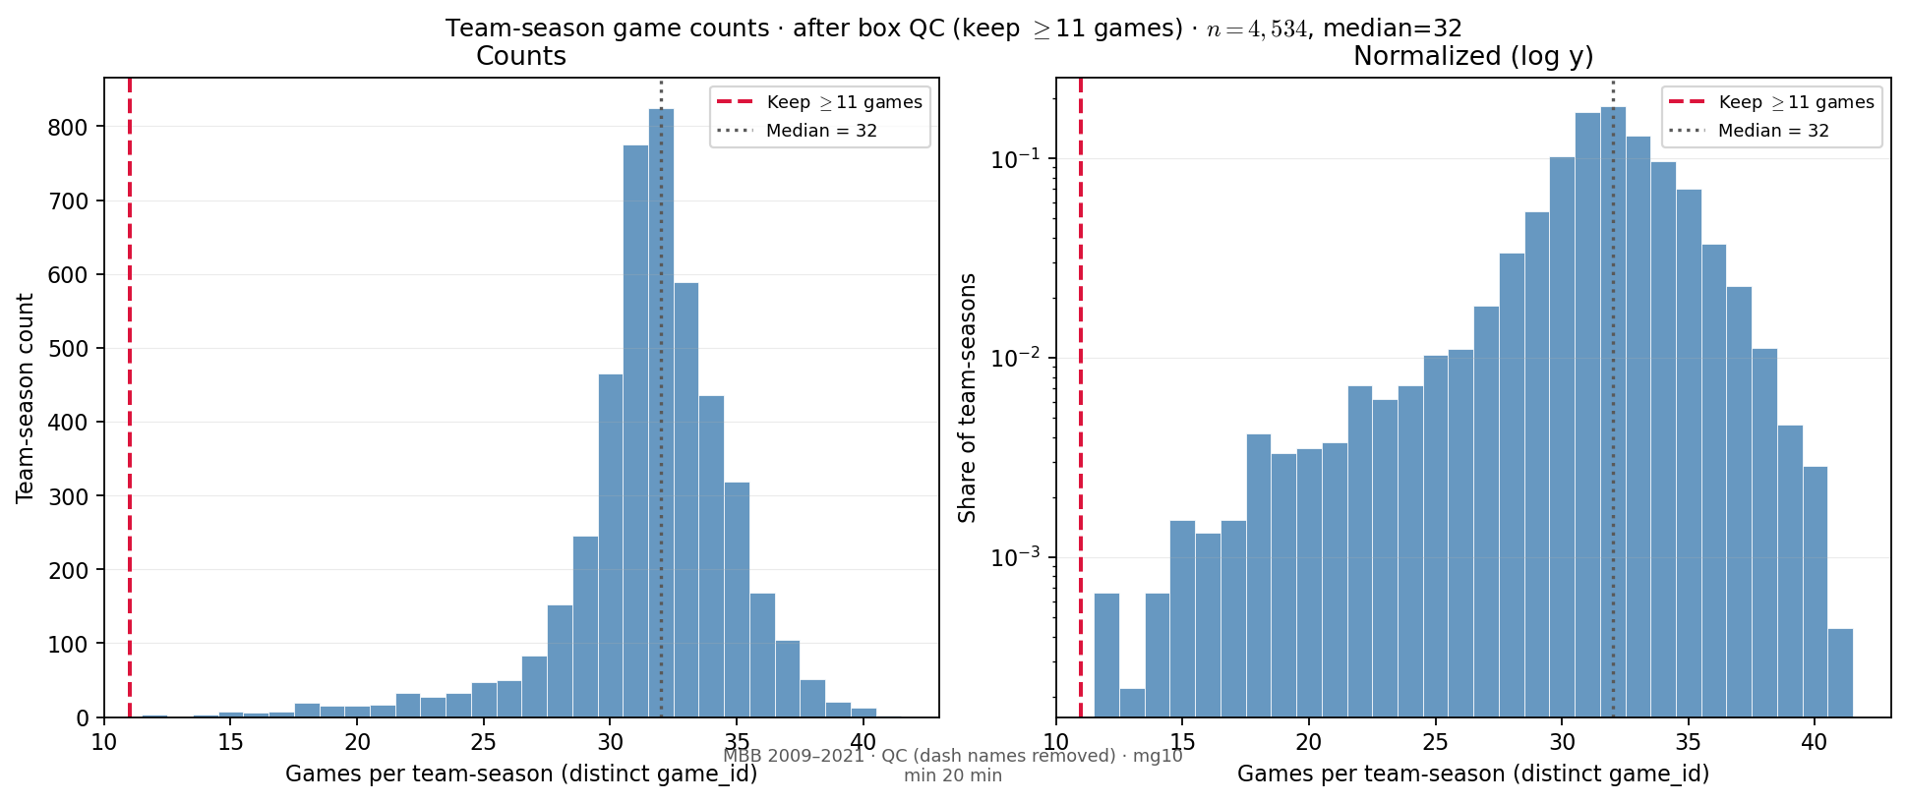
Slide 18 — Team games per season
PD22 memo slide 27 analog · after box QC (mg10)
• Distinct game_id counts per (team_id, season) in ESPN box — after dash-QC and mg10.
• Dual panel: linear counts + log-y share (same layout as PD22 backup slide).
• Sparse one-game team-seasons dropped by mg10; mass clusters near full-season ~30 games.
python sports/scripts/reigning_hero_basic_plots.py --only team_games
n=4,534 team-seasons · median=32 games · mean=31.5 · after box QC
Rows: team-season (box) · HAND: PD22 memo slide 27

Slide 19
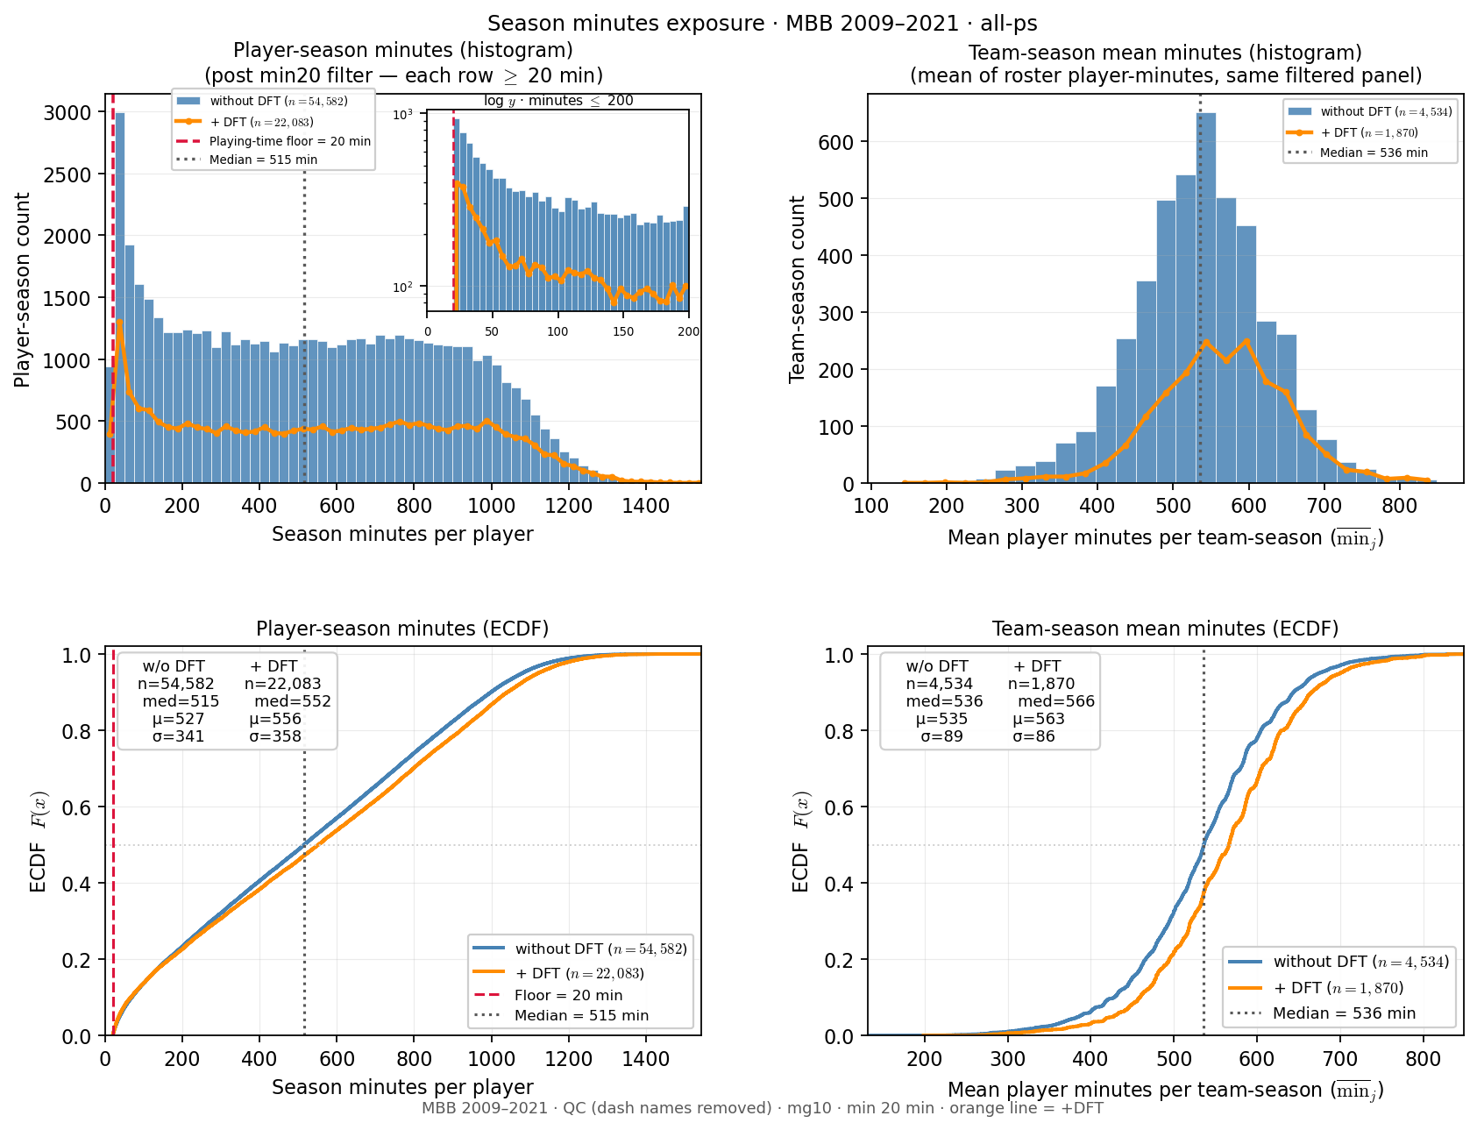
Slide 19 — Season minutes — player vs team mean
Exposure porch · all-ps · min20 floor marked
• 2×2: player histogram (+ log-y inset) and ECDF; team mean ditto.
• Blue = full panel; orange line = +DFT (draft-ever teams only).
• Stats boxes on ECDF panels show w/o DFT and +DFT medians.
python sports/scripts/reigning_hero_basic_plots.py --only minutes
player PS: n=54,582 · med=515 min · team mean: n=4,534 · med=536 min · all-ps post-min20 · +DFT player med=552 min
Rows: all-ps · HAND: PD22 minutes (porch variant)

Slide 20
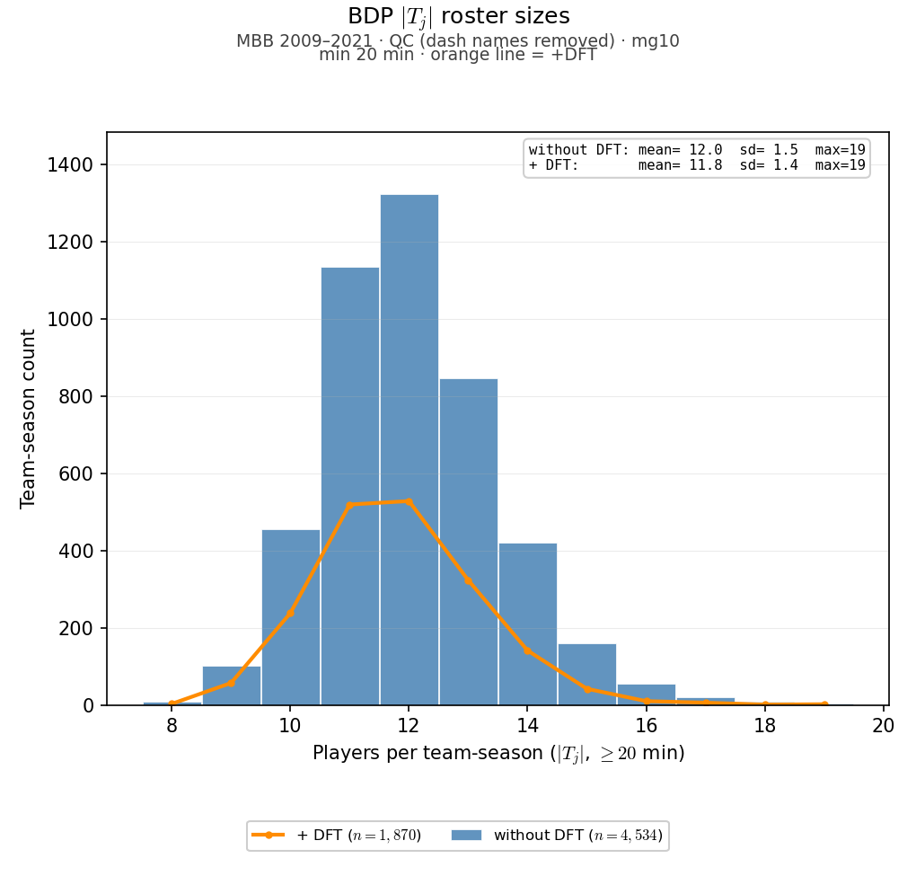
Slide 20 — Team roster size |T_j|
BDP slide 18 analog · all-ps · ALLT + orange +DFT
• Roster depth distribution — full panel (all-ps), not last-ps cross-section.
• Validates team-season cardinality under min20 · mg10 lock filters.
• Orange +DFT overlay: teams with at least one draftee in sample.
python sports/scripts/reigning_hero_basic_plots.py --only team_size
|T_j| mean=12.04 · median=12 · n=4,534 team-seasons · all-ps · orange=+DFT
Rows: all-ps · HAND: BDP slide 18

