Slide 1
REIGNING BDP slides HAND

Slide 2
Slide 1 — Reigning hero basic data plots (porch)
7 plots · 2026-08-27 · lock mg10 min20 09_21
Purpose: porch diagnostics for the named reigning hero before star sweep / F-HERO.
Reigning hero (slide 12): poolq_{LOO} · ever · last-ps · EW16 · ALLT · 2009–2021.
Filters: min20 · mg10 · PPM z · winsor 1–99 on poolq_{LOO} (LOO plots only).
HERO tag: `perm_loo_ever_lastps_ew16`.
Population split (Charles Aug 2026):
• last-ps: Â, LOO, \hat{T}_j vs LOO — matches HERO scoring cross-section
• all-ps: interval overlap, APGMS/ARGMS, roster size — full panel geometry
Regenerate plots: python sports/scripts/reigning_hero_basic_plots.py
Rebuild deck: python sports/scripts/build_reigning_hero_basic_plots_slides.py

Slide 3
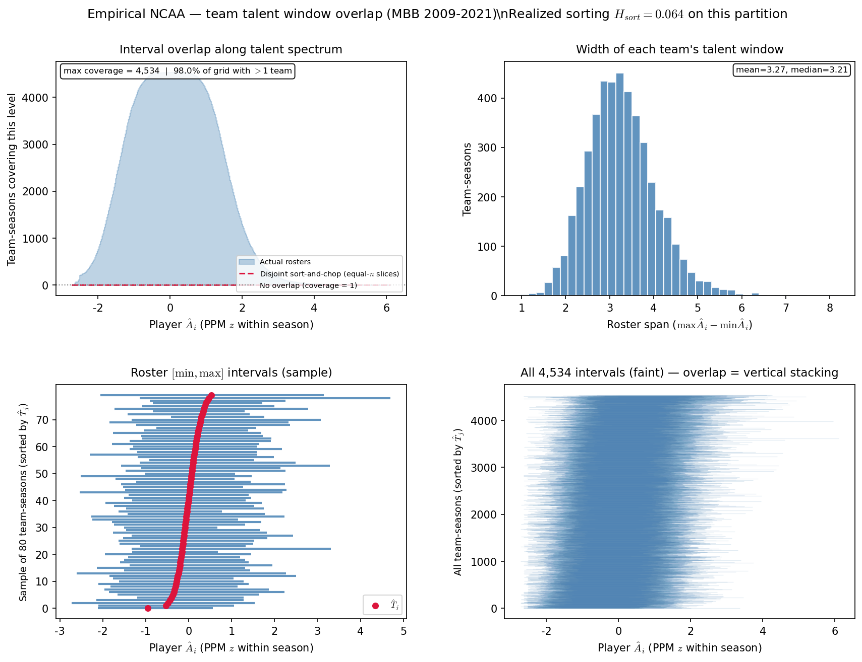
Slide 3 — Team interval overlap
HAND analog ~PD20 slide 21 · all-ps
• Full roster panel (all player-seasons) — needed for team-season interval geometry.
• Same filter chain as lock: mg10 · min20 · 09–21 · PPM z · ALLT.
• Complements last-ps HERO aperture — shows roster spread before LOO cross-section.
python sports/scripts/reigning_hero_basic_plots.py --only overlap
n=4,534 team-seasons · H_{sort}=0.0644 · coverage mean=1676 · disjoint mean=91.25%
Rows: all-ps · HAND: PD20 ~slide 21

Slide 4
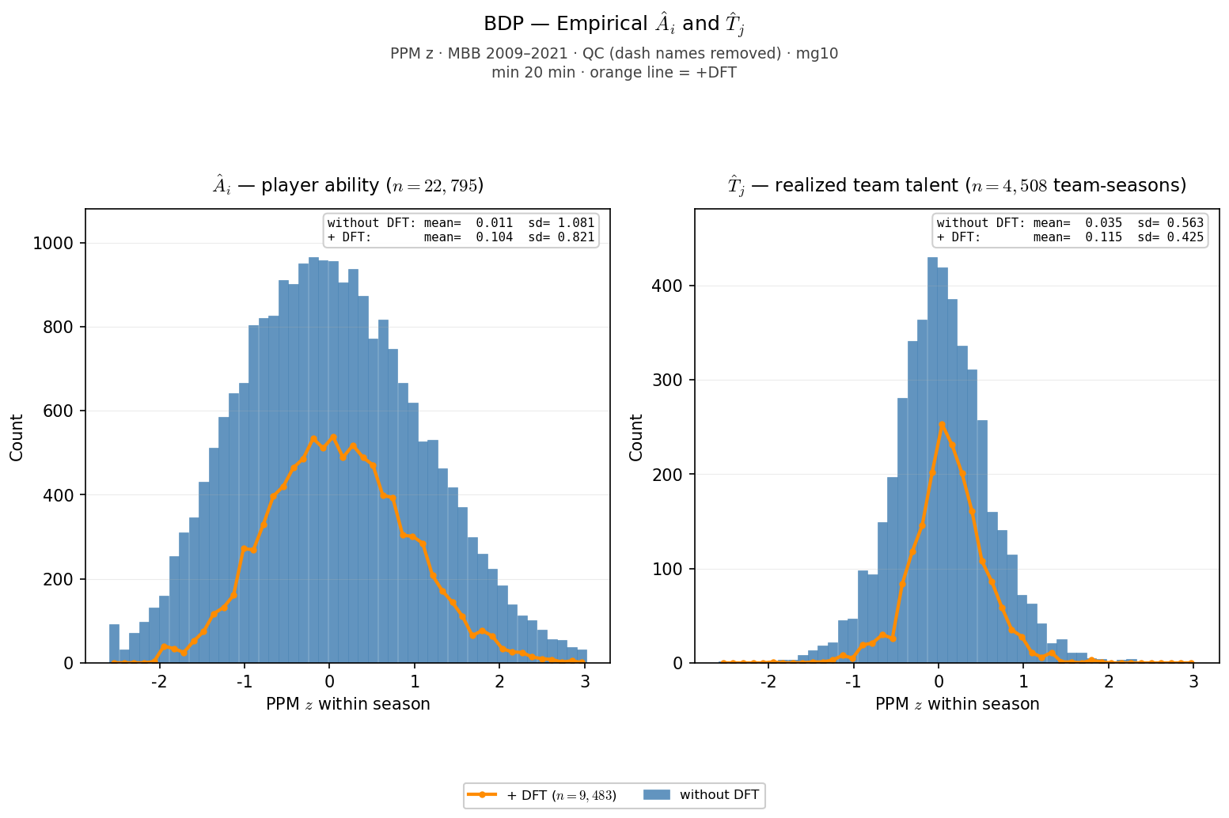
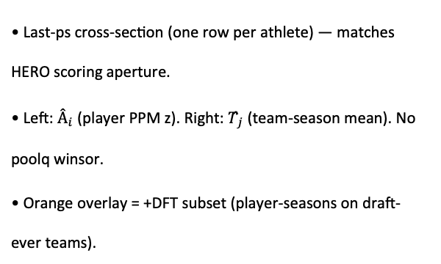
Slide 4 — $Â_{i}$ and $T̂_{j}$ distributions
BDP slide 7 analog · last-ps · ALLT + orange +DFT
• Last-ps cross-section (one row per athlete) — matches HERO scoring aperture.
• Left: $Â_{i}$ (player PPM z). Right: $T̂_{j}$ (team-season mean). No poolq winsor.
• Orange overlay = +DFT subset (player-seasons on draft-ever teams).
python sports/scripts/reigning_hero_basic_plots.py --only ai_tj
Â: $n=22,795$ · $mean=+0.011$ · $sd=1.081$ · $T̂_{j}:n=4,508$ · $mean=+0.035$· $sd=0.563$ · +DFT overlay: $n=9,483$ player-seasons on draft-ever teams
Rows: last-ps · HAND: BDP slide 7

Slide 5
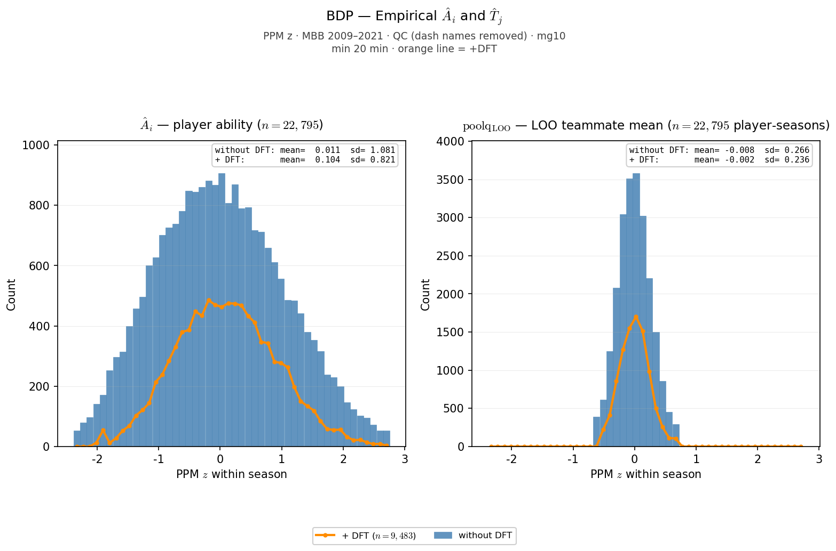
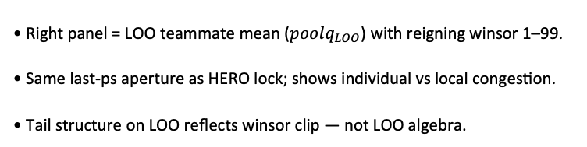
Slide 5 — $Â_{i}$ and $poolq_{LOO}$distributions
Mirror of $Â$|$T̂_{j}$· last-ps · winsor 1–99 on LOO
• Right panel = LOO teammate mean ($poolq_{LOO}$) with reigning winsor 1–99.
• Same last-ps aperture as HERO lock; shows individual vs local congestion.
• Tail structure on LOO reflects winsor clip — not LOO algebra.
python sports/scripts/reigning_hero_basic_plots.py --only ai_loo
Â$:n=22,795$· $sd=1.081$ · $poolq_{LOO}$: $n=22,795$ · $sd=0.266$ · winsor 1%–99%
Rows: last-ps · HAND: BDP slide 7 (LOO variant)

Slide 6
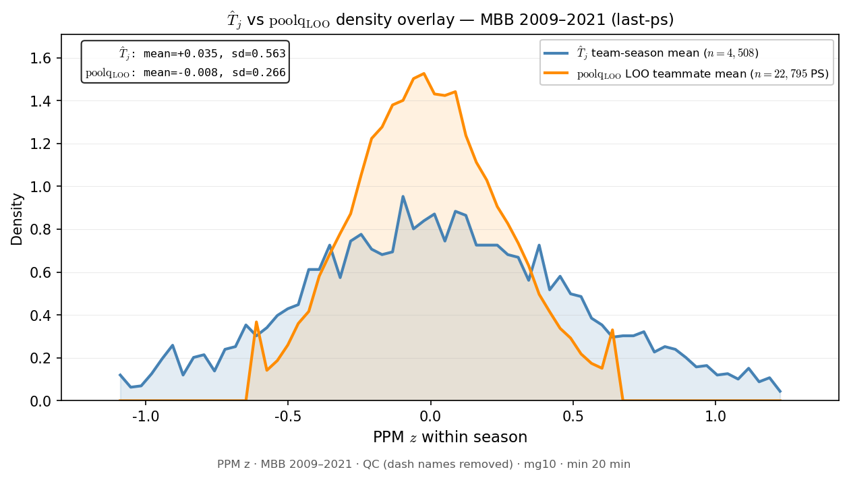
Slide 6 — $T̂_{j}$ vs $poolq_{LOO}$ density overlay
New porch diagnostic · last-ps · winsor on LOO only
• Compares team mean $T̂_{j}$ (broad) vs LOO teammate mean (tight) on shared PPM z axis.
• LOO winsor 1–99 — tail spikes at $±0.6$ are clip artifacts, not biology.
• Motivation: visualize gap between team talent and local congestion before HERO bins.
python sports/scripts/reigning_hero_basic_plots.py --only tj_loo
$T̂_{j}$: $sd=0.563$ · $poolq_{LOO}$: sd=0.266 · winsor 1%–99% · tail spikes at winsor clip = artifact
Rows: last-ps · HAND: (new)

Slide 7
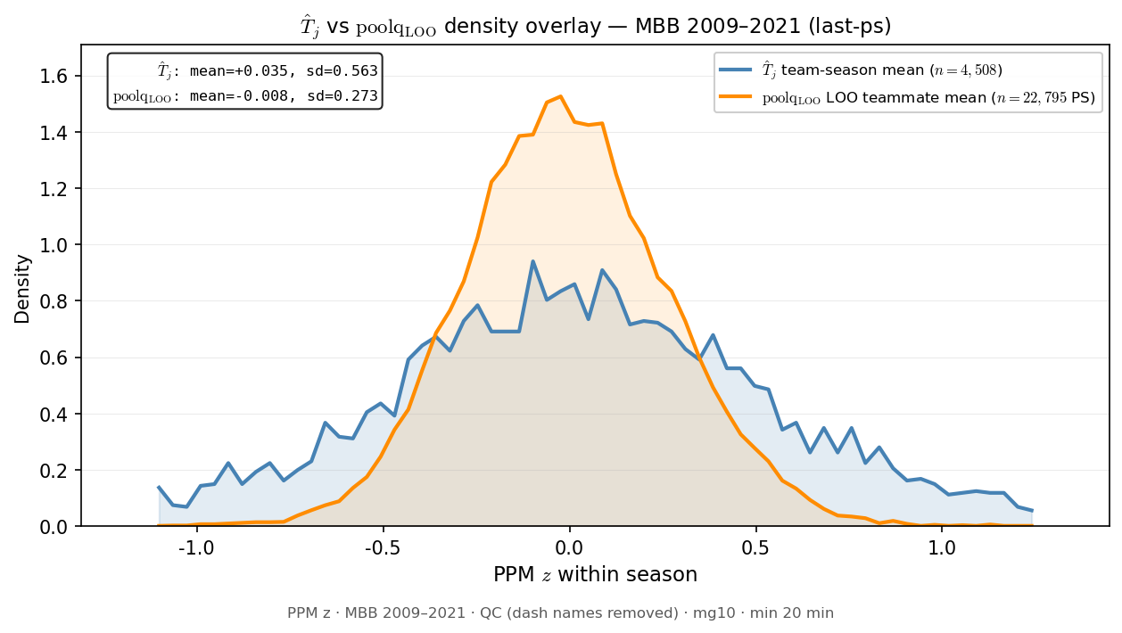
Slide 7 — ${\overset{ˆ}{T}}_{j}$ vs $poolq_{LOO}$ density overlay (no winsor)
Mirror of ${\overset{ˆ}{T}}_{j}$ vs LOO · last-ps · raw $poolq_{LOO}$
• Same hist-density overlay as prior slide — $poolq_{LOO}$ winsor 1–99 removed.
• Shows natural LOO tails without clip spikes at $±0.6$.
• Reigning HERO lock still uses winsor; this is porch diagnostic only.
python sports/scripts/reigning_hero_basic_plots.py --only tj_loo_nowinsor
${\overset{ˆ}{T}}_{j}:sd=0.563$ · $poolq_{LOO}:sd=0.273$ · no winsor · tail spikes at winsor clip = artifact
Rows: last-ps · HAND: (new)

Slide 8
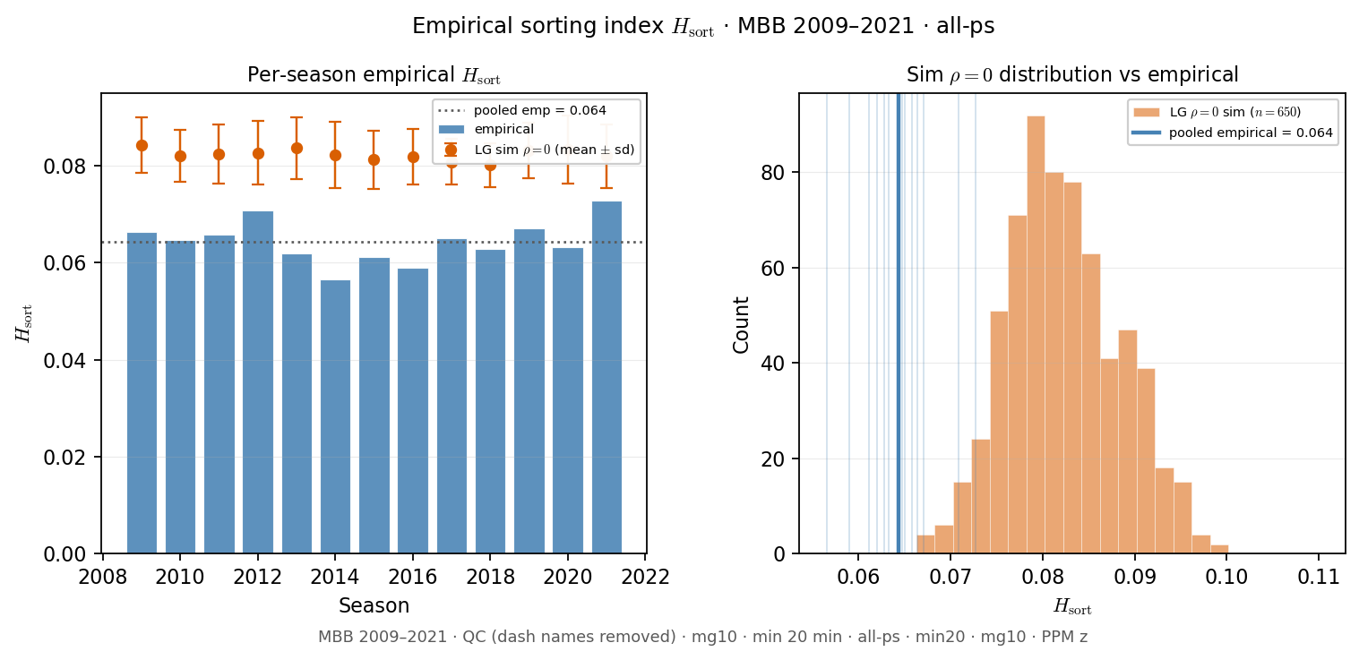
Slide 8 — Empirical $H_{sort}$ distribution
Realized sorting index · all-ps · vs sim $ρ=0$ reference
• $H_{sort}$ = variance explained by team assignment (not interval overlap).
• Per-season empirical bars + pooled line; orange = Grandchild sim $ρ=0$ distribution.
• Pooled reigning lock $≈0.064$ — weak homophily on realized rosters.
python sports/scripts/reigning_hero_basic_plots.py --only hsort_dist
pooled empirical $H_{sort}=0.0644$ · sim $ρ=0$ mean$=0.0823\left(n=650\right)$
Rows: all-ps · HAND: PD17 $H_{sort}$ readout

Slide 9
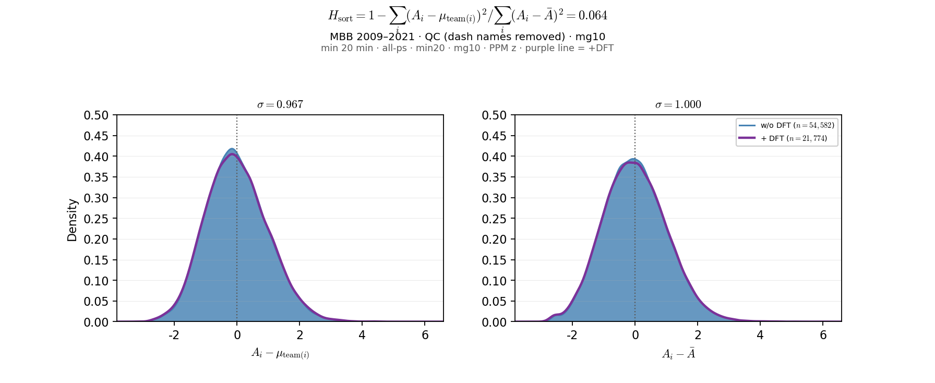
Slide 9 — Ability residuals — team vs grand mean
$H_{\mathrm{sort}}$ decomposition · all-ps · ALLT + purple +DFT
• Left: $A_{i}−{\overset{ˆ}{T}}_{j}$ (within-team demeaned perf — $H_{sort}$ numerator).
• Right: $A_{i}−\overline{A}$ (grand-mean demeaned — denominator).
• Pooled over 09–21; purple overlay = +DFT (draft-ever teams).
python sports/scripts/reigning_hero_basic_plots.py --only ability_residuals
$n=54,582$ · $H_{sort}=0.0644$ · $σ$(team resid)$=0.967$ · $σ$(grand resid)$=1.000$ · +DFT $H_{sort}=0.0605$
Rows: all-ps · HAND: BDP $H_{sort}$ porch

Slide 10
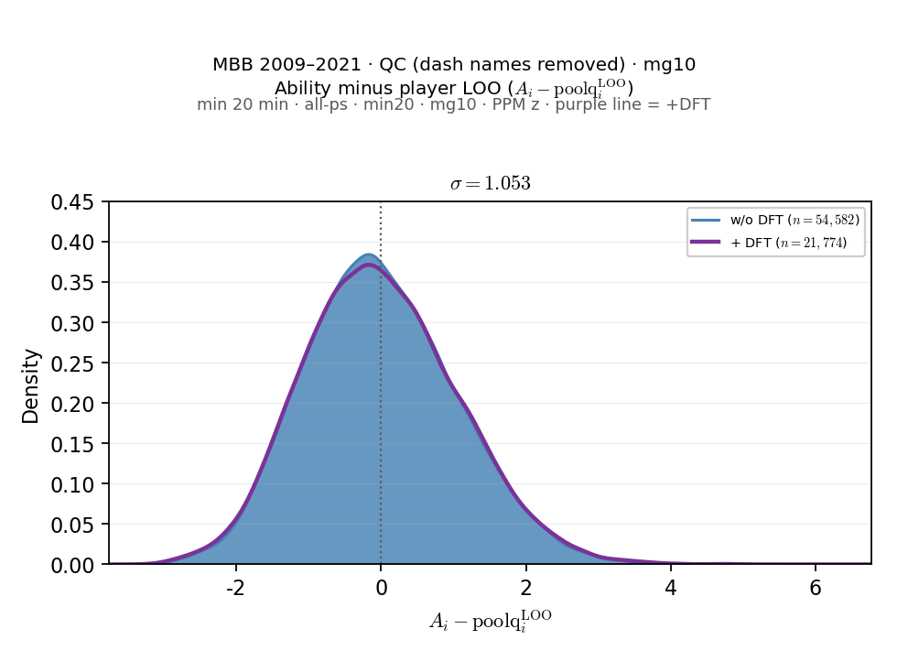
Slide 10 — Ability minus LOO ($A_{i}−{poolq}_{i}^{LOO}$)
LOO congestion residual · all-ps · ALLT + purple +DFT
• Histogram + ECDF of $A_{i}−{poolq}_{i}^{LOO}$ (teammate mean excl. $i$).
• Analogous to team residual panel but LOO replaces team mean in the decomposition.
• $σ≈1.05>$ team residual $σ—$ LOO axis carries more player-level spread.
python sports/scripts/reigning_hero_basic_plots.py --only ability_loo_residuals
$n=54,582$ · $σ$(LOO resid)$=1.053$ · frac_var$=1.108$ · +DFT $σ=1.069$
Rows: all-ps · HAND: BDP LOO porch

Slide 11
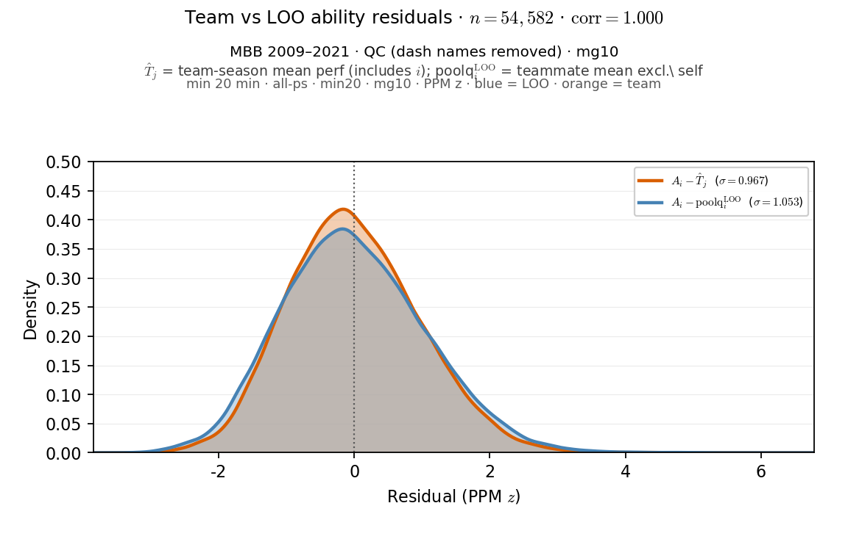
Slide 11 — Team vs LOO ability residuals (overlay)
Superposed KDEs · all-ps · orange team · blue LOO
• Orange: $A_{i}−{\overset{ˆ}{T}}_{j}$ (team mean incl. $i$). Blue: $A_{i}−{poolq}_{i}^{LOO}$.
• Same player-rows; corr $≈0.9997$ — nearly collinear but LOO slightly wider.
• Motivation: visualize self-inclusion gap before ${\overset{ˆ}{T}}_{j}−$LOO slide.
python sports/scripts/reigning_hero_basic_plots.py --only ability_tj_vs_loo_residuals
$n=54,582$ · $σ$(team resid)$=0.967$ · $σ$(LOO resid)$=1.053$ · corr$=0.9997$
Rows: all-ps · HAND: BDP LOO porch

Slide 12
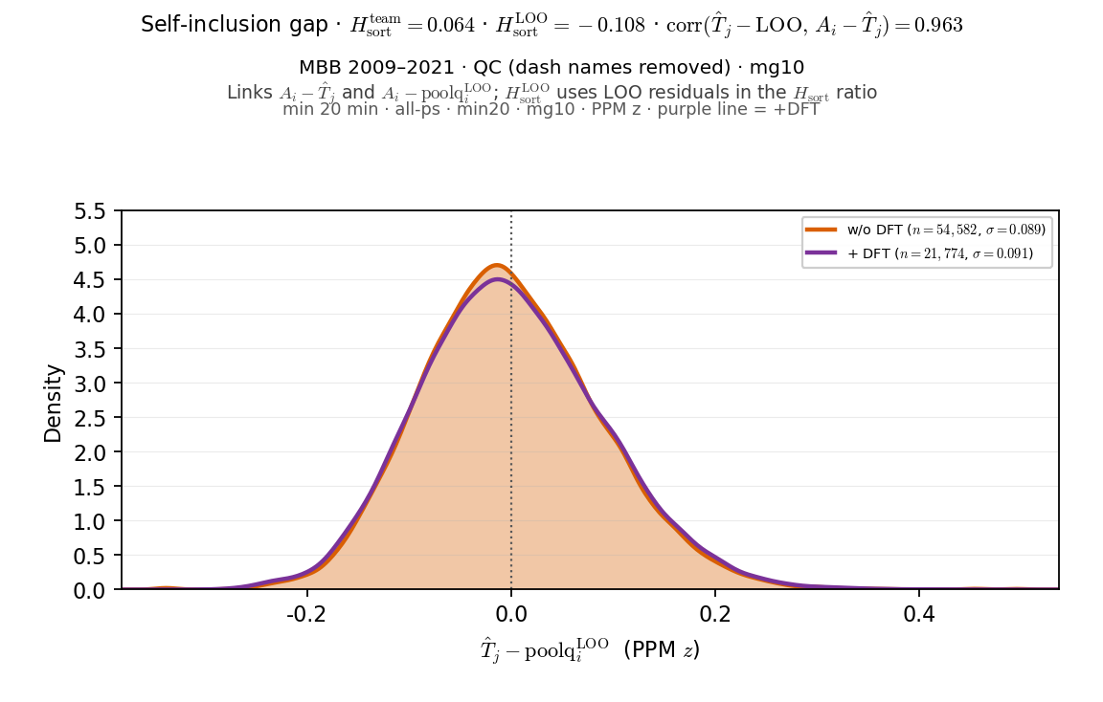
Slide 12 — ${\overset{ˆ}{T}}_{j}−{poolq}_{i}^{LOO}$ (self-inclusion gap)
Team mean minus LOO teammate mean · all-ps · ALLT + purple +DFT
• Distribution of ${\overset{ˆ}{T}}_{j}−{poolq}_{i}^{LOO}$ — how much self pulls team mean above LOO.
• Reports $H_{sort}^{team}$ vs $H_{sort}^{LOO}$ (LOO can go negative).
• Tight spike near $0\left(σ≈0.09\right)$; axis-mismatch diagnostic for SCORE vs HERO readout.
python sports/scripts/reigning_hero_basic_plots.py --only tj_minus_loo
$n=54,582$ · $μ\left({\overset{ˆ}{T}}_{j}−LOO\right)=+0.0002$ · $σ=0.089$ · $H_{sort}^{team}=0.0644$ · $H_{sort}^{LOO}=−0.1085$ · +DFT $σ=0.091$
Rows: all-ps · HAND: BDP LOO porch

Slide 13
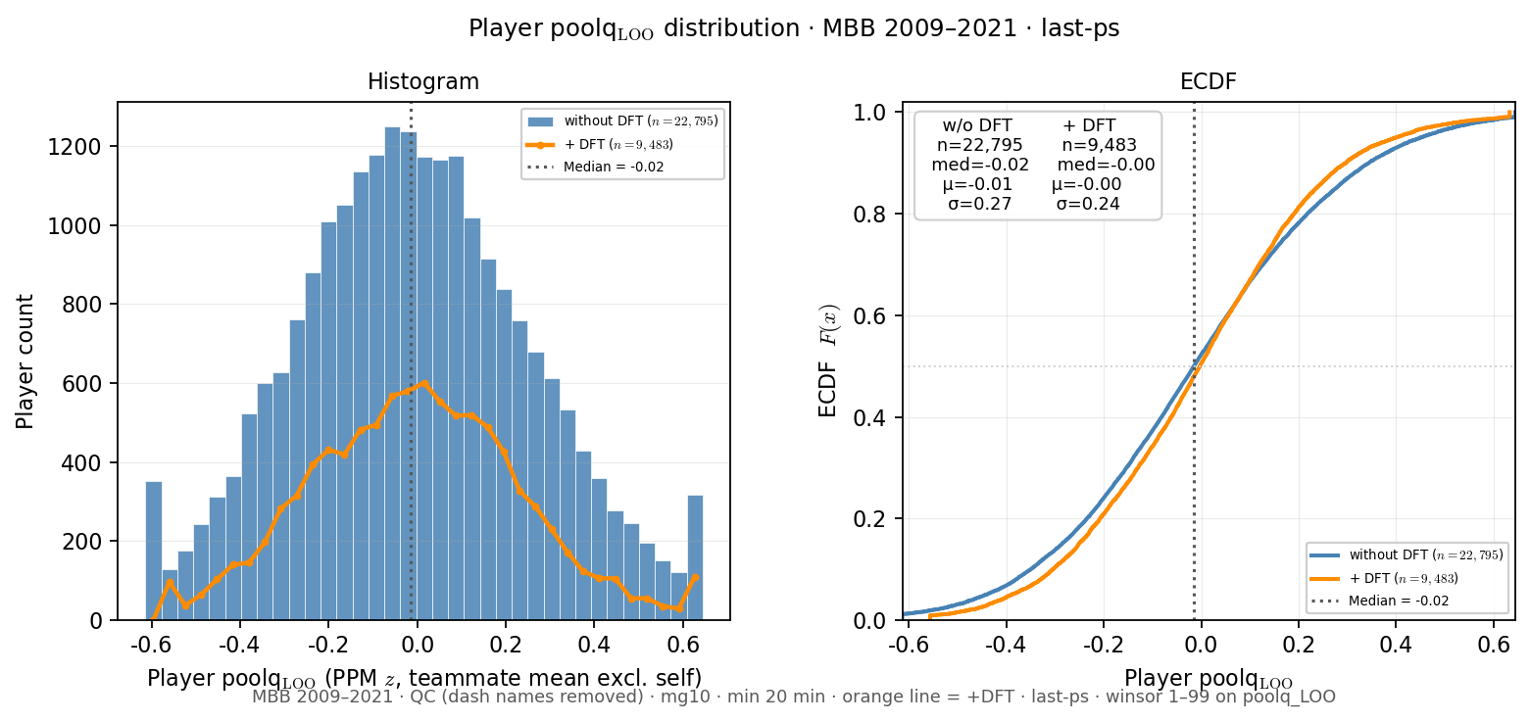
Slide 13 — Player $poolq_{LOO}$ distribution
Alex Aug 2026 · last-ps · winsor 1–99 · ALLT + orange +DFT
• Standalone distribution of player LOO teammate quality ($poolq_{LOO}$).
• Histogram + ECDF on reigning last-ps aperture — not paired with ${\overset{ˆ}{A}}_{i}$.
• Orange = +DFT overlay (draft-ever teams).
python sports/scripts/reigning_hero_basic_plots.py --only loo_dist
last-ps $n=22,795$ · $med=−0.015$ · $μ=−0.008$ · winsor $1\%–99\%$ · +DFT $med=−0.003$
Rows: last-ps · HAND: (new · Alex request)

Slide 14
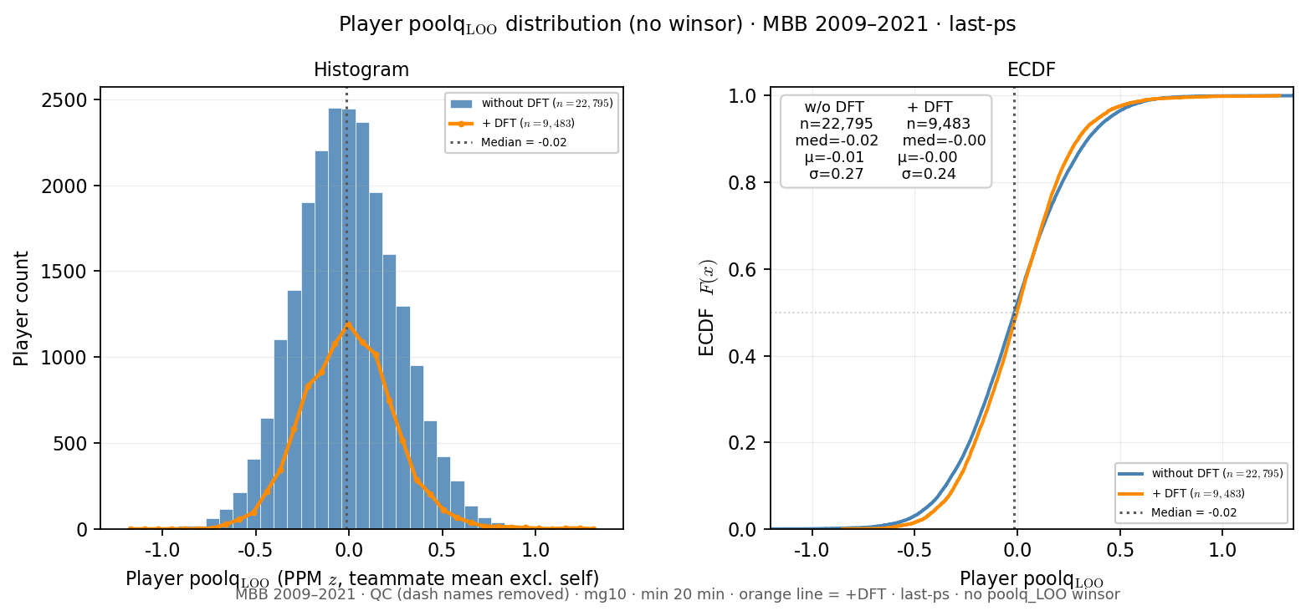
Slide 14 — Player poolq_{LOO} distribution (no winsor)
Mirror of LOO dist · last-ps · raw poolq_{LOO} · ALLT + orange +DFT
• Same hist + ECDF pair as prior slide — $poolq_{LOO}$ winsor 1–99 removed.
• Shows natural LOO tails without clip spikes at $±0.6$.
• Reigning HERO lock still uses winsor; this is porch diagnostic only.
python sports/scripts/reigning_hero_basic_plots.py --only loo_dist_nowinsor
last-ps $n=22,795$ · $med=−0.015$ · $μ=−0.008$ · no $poolq_{LOO}$ winsor · +DFT $med=−0.003$
Rows: last-ps · HAND: (new · Alex request)

Slide 15
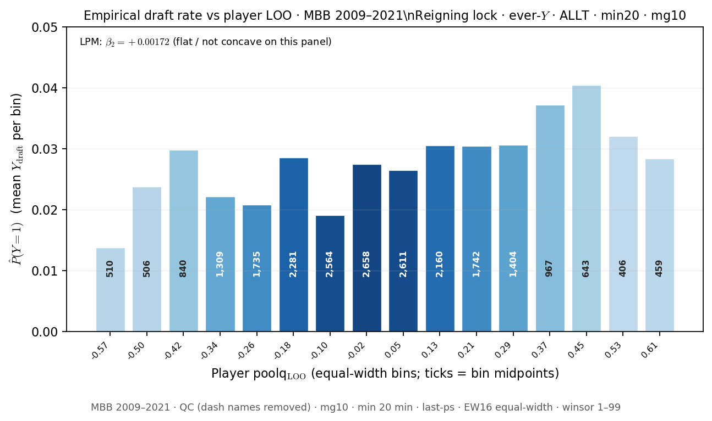
Slide 15 — $P\left(Y=1\right)$ vs player $poolq_{LOO}$
Reigning lock EW16 · ever-Y · last-ps
• Mean Y_draft by equal-width poolq_{LOO} bins (16) — same binning as reigning HERO.
• Bar height = empirical draft rate; labels = bin n; LPM β₂ annotation.
• Complements HERO PNG in ../hero/ — porch copy for slide 12 deck.
python sports/scripts/reigning_hero_basic_plots.py --only draft_rate_loo
EW16 · $n=22,795$ · LPM $β₂=+0.00172$ · ever-$Y$ · last-ps
Rows: last-ps · HAND: HERO / Pass A roster panel

Slide 16
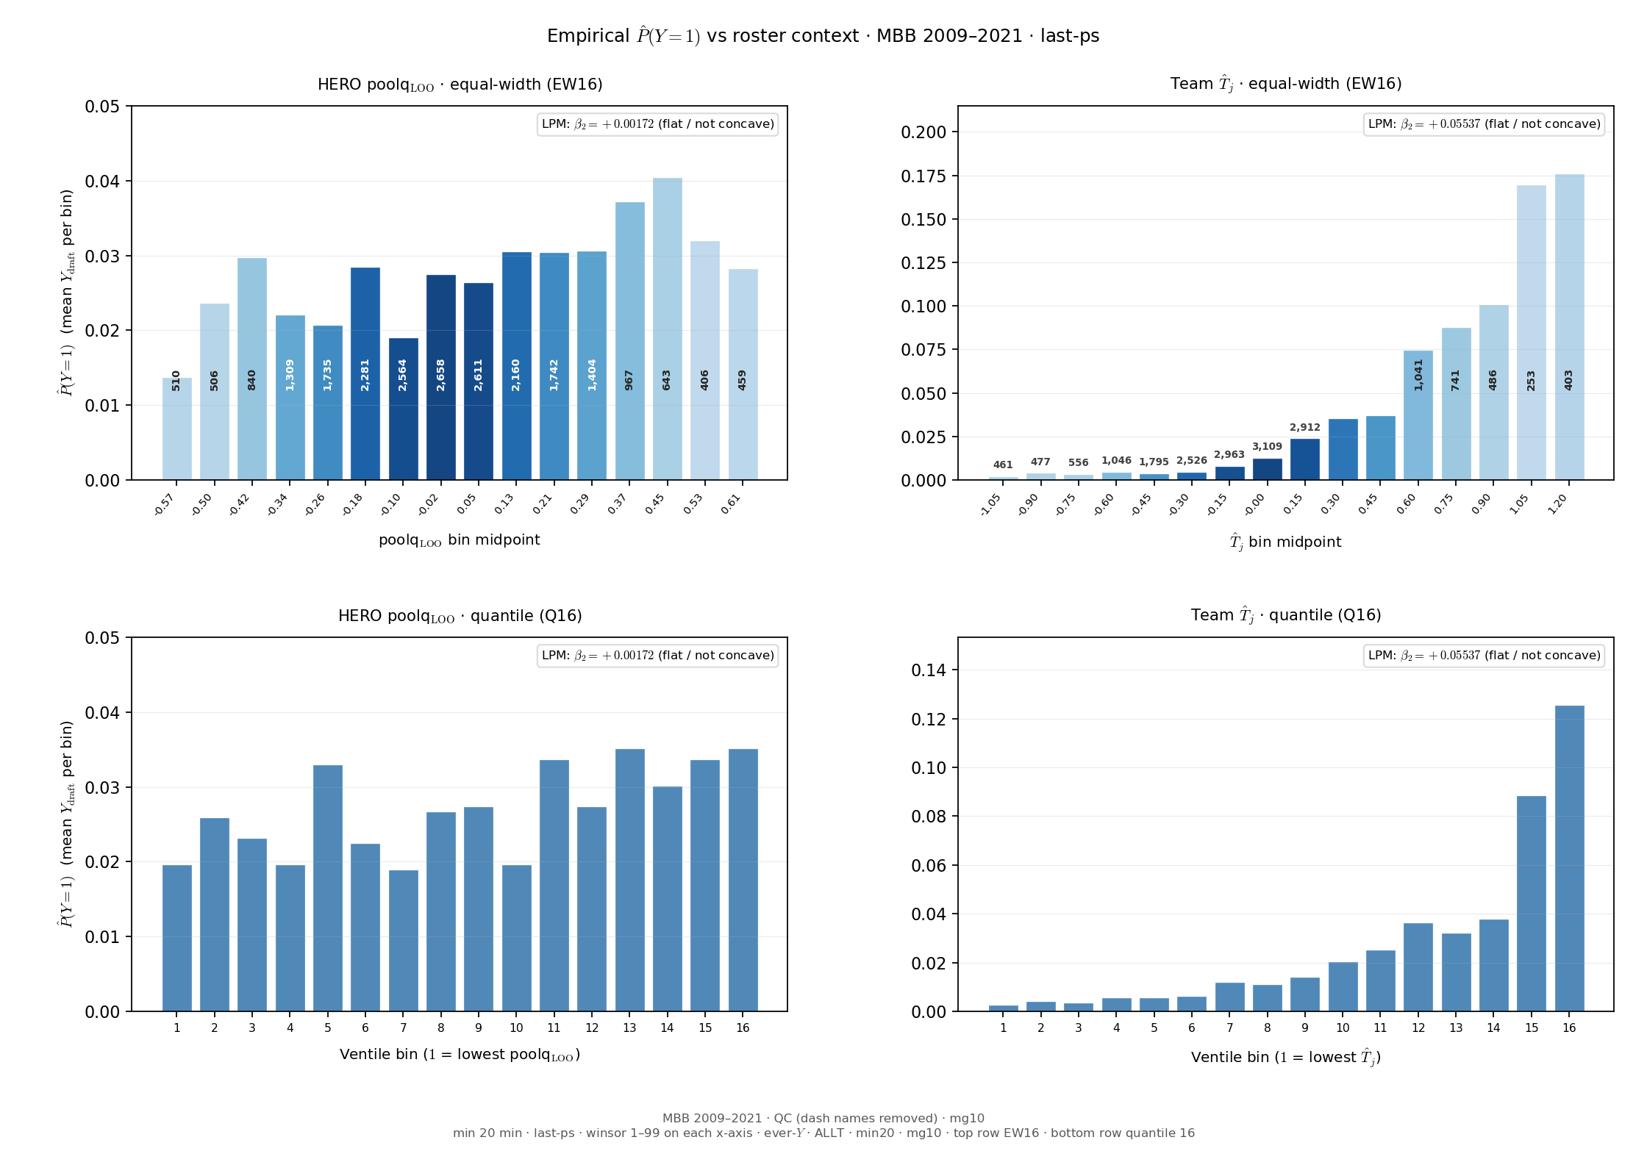
Slide 16 — $P\left(Y=1\right)$ — player LOO vs ${\overset{ˆ}{T}}_{j}$ (side-by-side)
Reigning lock EW16 · ever-Y · last-ps · same panel both panels
• 2×2: top row EW16 equal-width; bottom row quantile 16 (same n per bin).
• Left: HERO $poolq_{LOO}$ · Right: team ${\overset{ˆ}{T}}_{j}$ — same panel, both binning schemes.
• LPM $β₂$ on continuous $x$ (not binned); compare shape sensitivity to binning.
python sports/scripts/reigning_hero_basic_plots.py --only draft_rate_loo_tj
EW16 · $n=22,795$ · LOO $β₂=+0.00172$ · ${\overset{ˆ}{T}}_{j}β₂=+0.05537$
Rows: last-ps · HAND: HERO vs F-HERO team axis

Slide 17
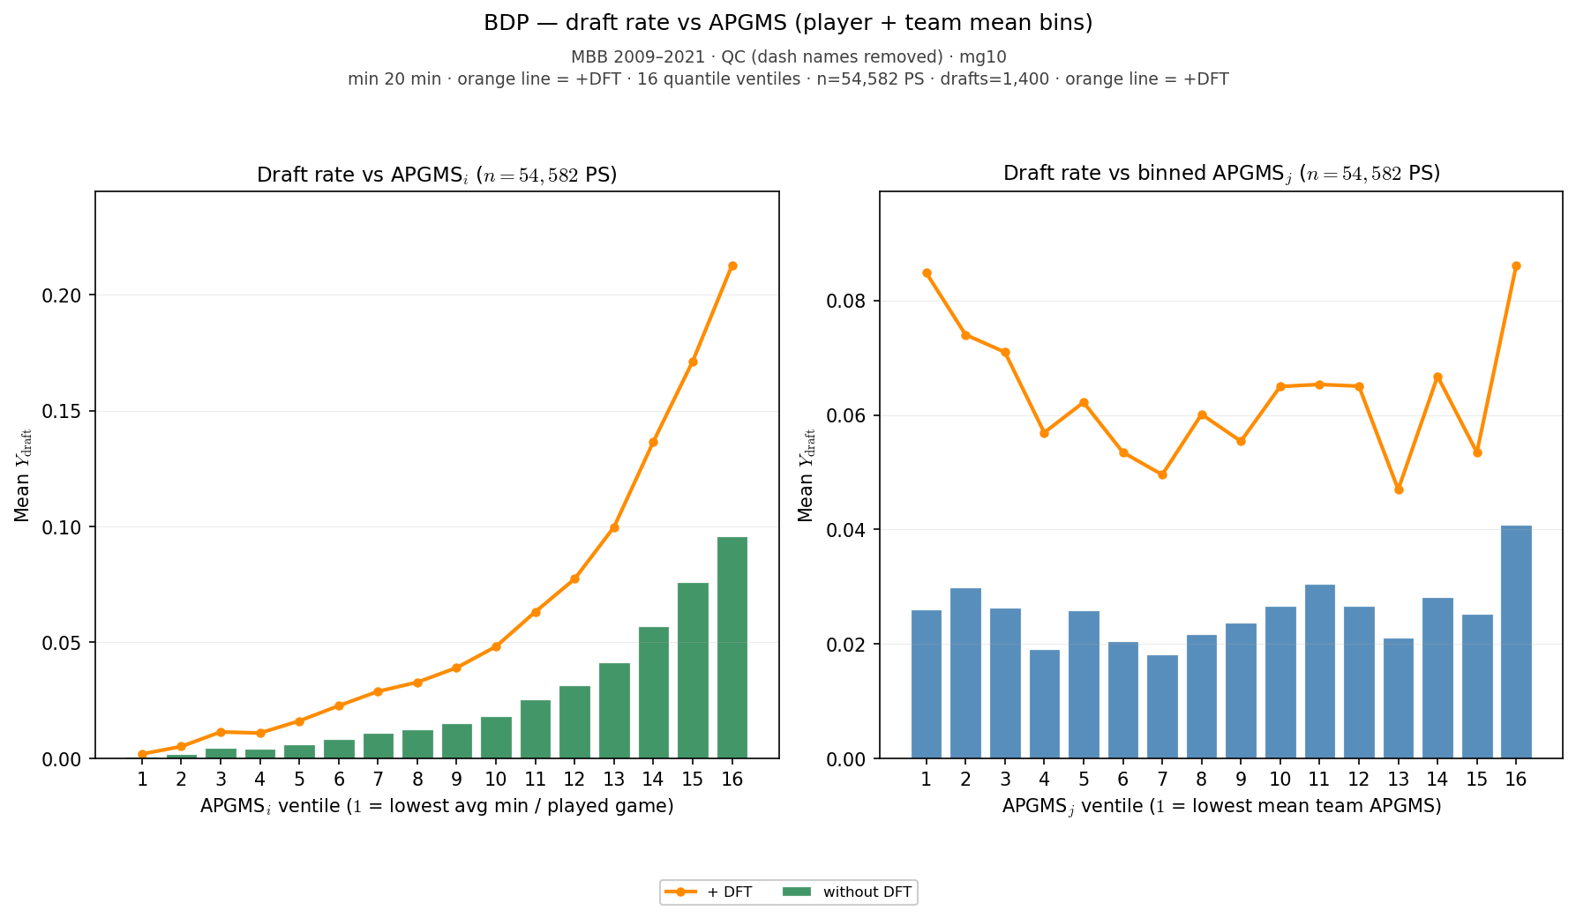
Slide 17 — Draft rate vs APGMS ventiles
Fixed_Ai slides 11–14 analog · all-ps · ALLT + orange +DFT
• Exposure diagnostic: average player-games per season (APGMS) vs draft rate.
• All-ps panel (full minutes exposure) — not last-ps HERO aperture.
• Quantile ventiles on APGMS; independent of HERO $poolq_{LOO}$ binning.
python sports/scripts/reigning_hero_basic_plots.py --only draft_rate
APGMS · all-ps $n=54,582$ · draft rate vent1$=0.09\%$ · vent16=$9.59\%$ · orange=+DFT overlay
Rows: all-ps · HAND: Fixed_Ai 11–14

Slide 18
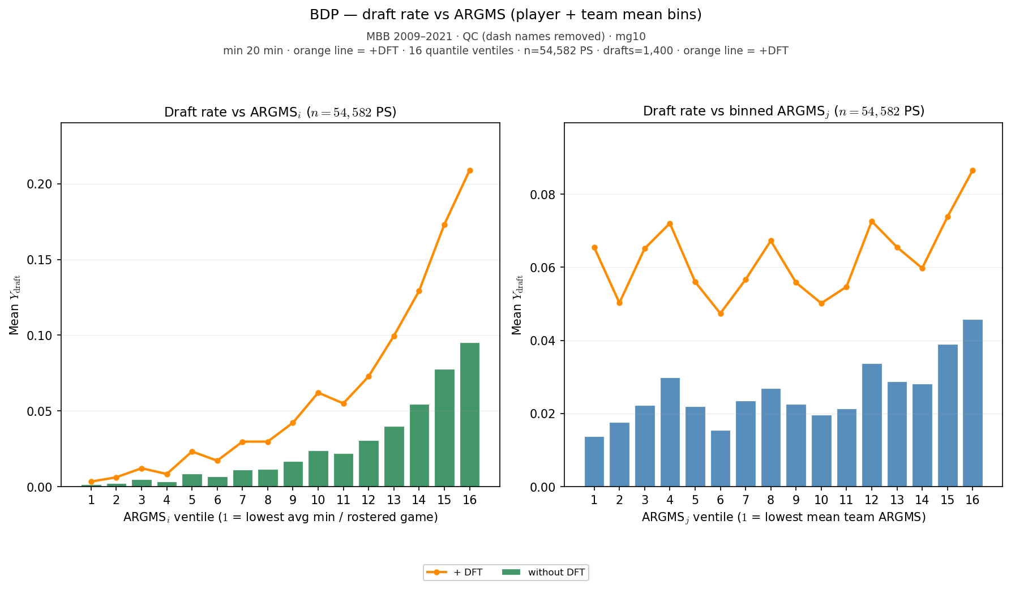
Slide 18 — Draft rate vs ARGMS ventiles
Fixed_Ai slides 11–14 analog · all-ps · ALLT + orange +DFT
• Exposure diagnostic: average roster-games per season (ARGMS) vs draft rate.
• Team-level minutes exposure complement to APGMS player ventiles.
• Same 09–21 lock filters; orange +DFT overlay on draft-ever teams.
python sports/scripts/reigning_hero_basic_plots.py --only draft_rate
ARGMS · all-ps n=54,582 · draft rate vent1=0.15% · vent16=9.53% · orange=+DFT overlay
Rows: all-ps · HAND: Fixed_Ai 11–14

Slide 19
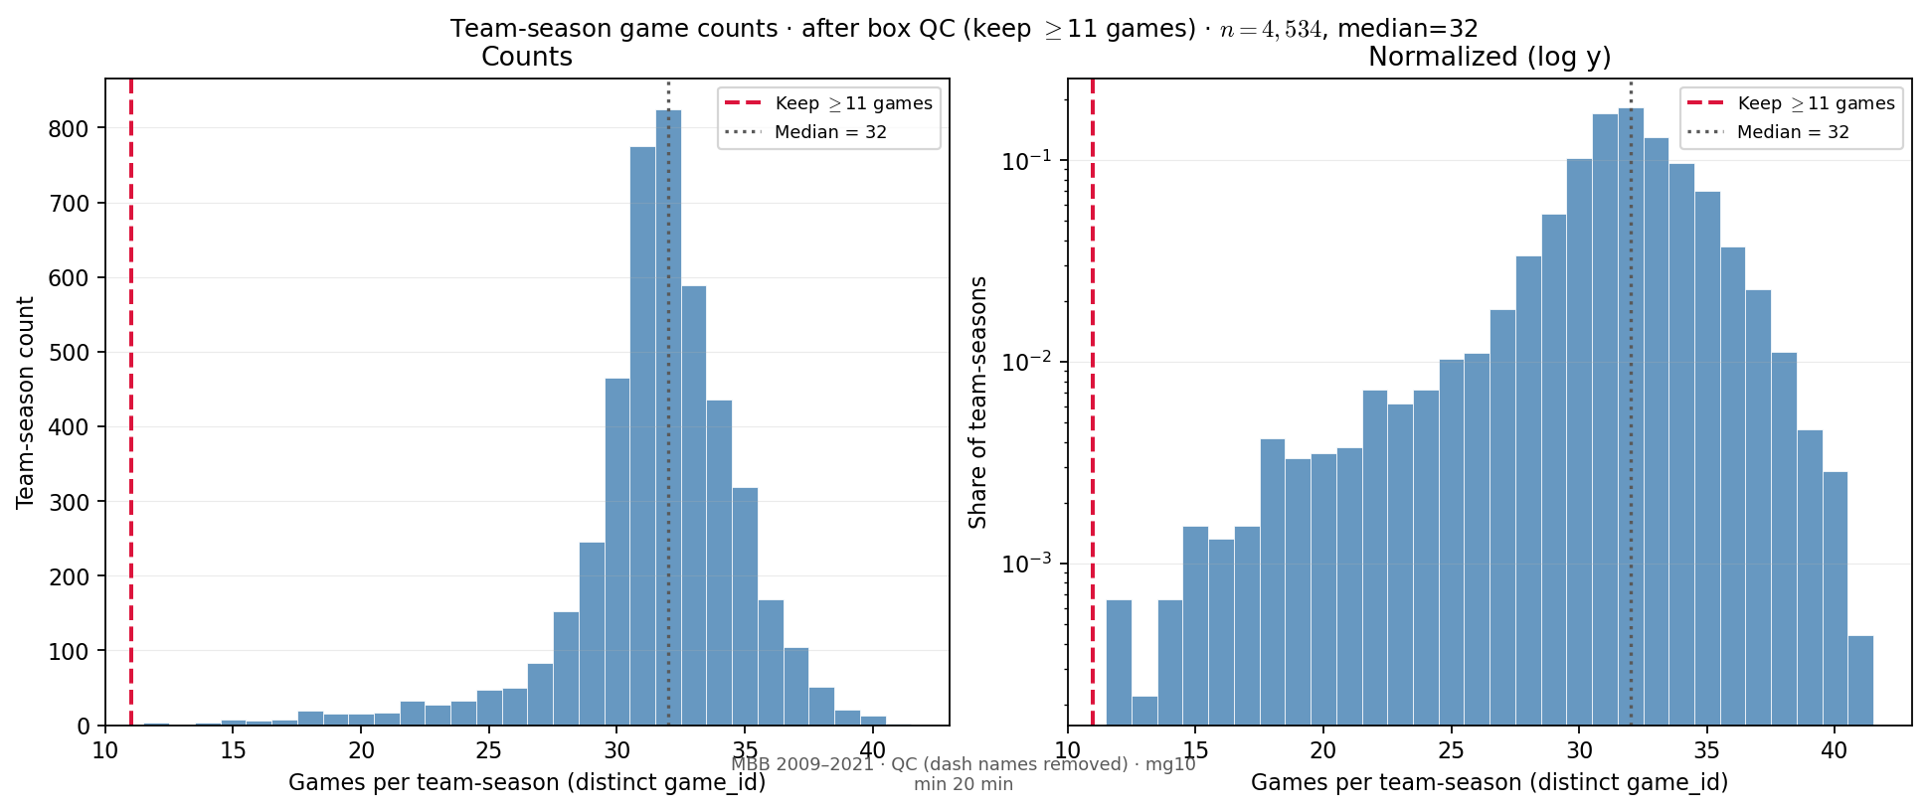
Slide 18 — Team games per season
PD22 memo slide 27 analog · after box QC (mg10)
• Distinct $game_id$ counts per ($team_id, season$) in ESPN box — after dash-QC and mg10.
• Dual panel: linear counts + log-y share (same layout as PD22 backup slide).
• Sparse one-game team-seasons dropped by mg10; mass clusters near full-season $\sim 30$ games.
python sports/scripts/reigning_hero_basic_plots.py --only team_games
$n=4,534$ team-seasons · $med=32$ games · $mean=31.5$ · after box QC
Rows: team-season (box) · HAND: PD22 memo slide 27

Slide 20
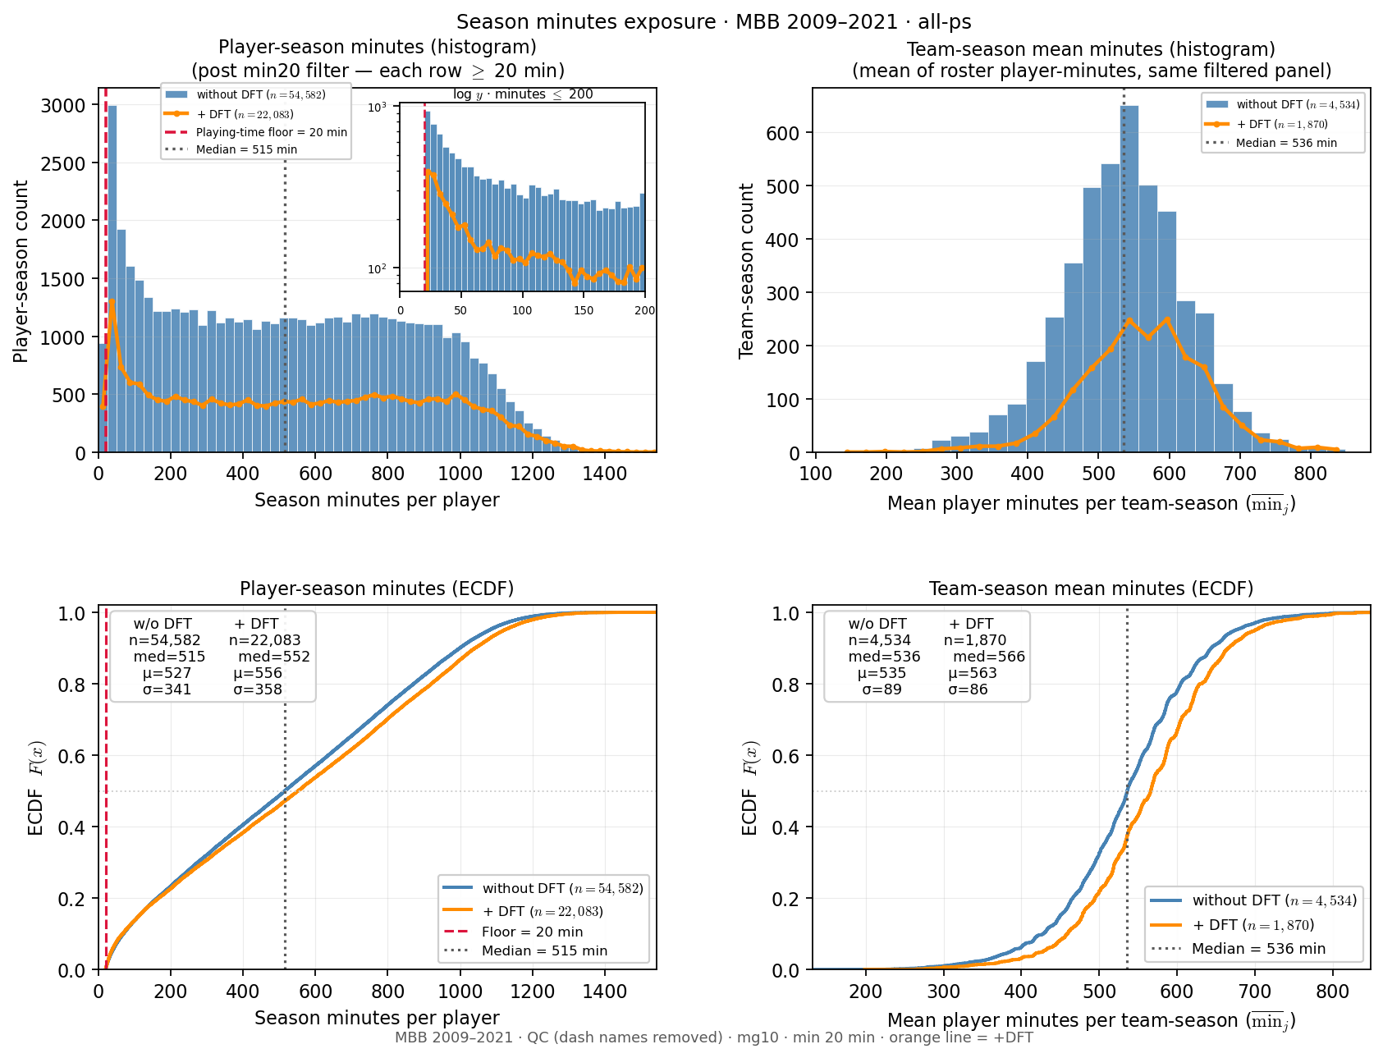
Slide 19 — Season minutes — player vs team mean
Exposure porch · all-ps · min20 floor marked
• 2×2: player histogram (+ log-y inset) and ECDF; team mean ditto.
• Blue = full panel; orange line = +DFT (draft-ever teams only).
• Stats boxes on ECDF panels show w/o DFT and +DFT medians.
python sports/scripts/reigning_hero_basic_plots.py --only minutes
player PS: $n=54,582$ · $med=515$ min · team mean: $n=4,534$ · $med=536$ min · all-ps post-min20 · +DFT player $med=552$ min
Rows: all-ps · HAND: PD22 minutes (porch variant)

Slide 21
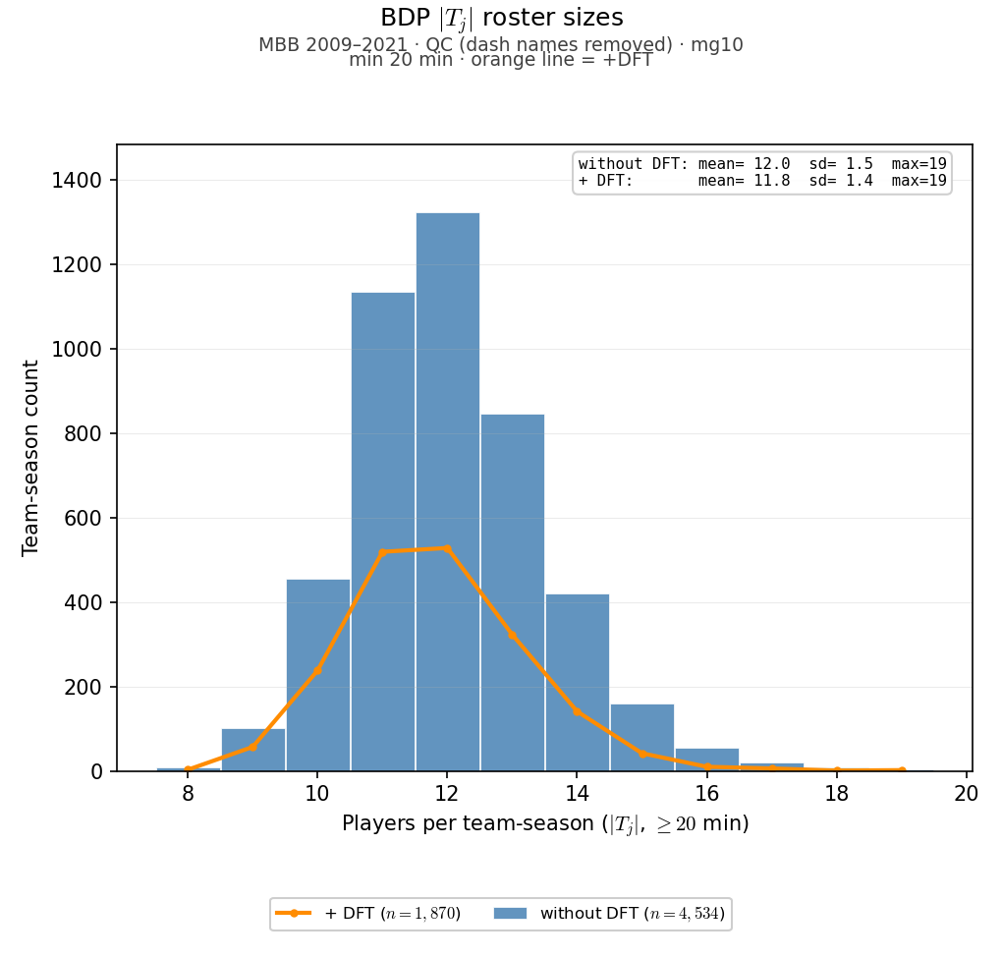
Slide 19 — Team roster size $\left|T_{j}\right|$
BDP slide 18 analog · all-ps · ALLT + orange +DFT
• Roster depth distribution — full panel (all-ps), not last-ps cross-section.
• Validates team-season cardinality under min20 · mg10 lock filters.
• Orange +DFT overlay: teams with at least one draftee in sample.
python sports/scripts/reigning_hero_basic_plots.py --only team_size
$\left|T_{j}\right|mean=12.04$ · $median=12$ · $n=4,534$ team-seasons · all-ps · orange=+DFT
Rows: all-ps · HAND: BDP slide 18

