Slide 1
Slide 1 — Reigning hero star sweep
20 run slides · 2026-08-27 · vs lock EW16 · 09_21
Purpose: sensitivity of named reigning hero to EW ventile count and season window.
Reigning lock (slide 12): EW16 · 2009–2021 · poolq_LOO · ever · last-ps · ALLT · equal_width · min20 · mg10 · winsor 1–99.
Varied in this sweep:
• n_bins ∈ {8, 10, 12, 20, 24} (lock EW16 not in grid — use EW12/EW20 as neighbors)
• season_window ∈ {09_21, 11_21, 13_21, 09_19}
Each candidate slide explains Δ vs the lock; β₂ comparisons apply within the same era.
Regenerate runs: python sports/scripts/reigning_hero_star_sweep.py
Rebuild deck: python sports/scripts/build_reigning_hero_star_sweep_slides.py

Slide 2
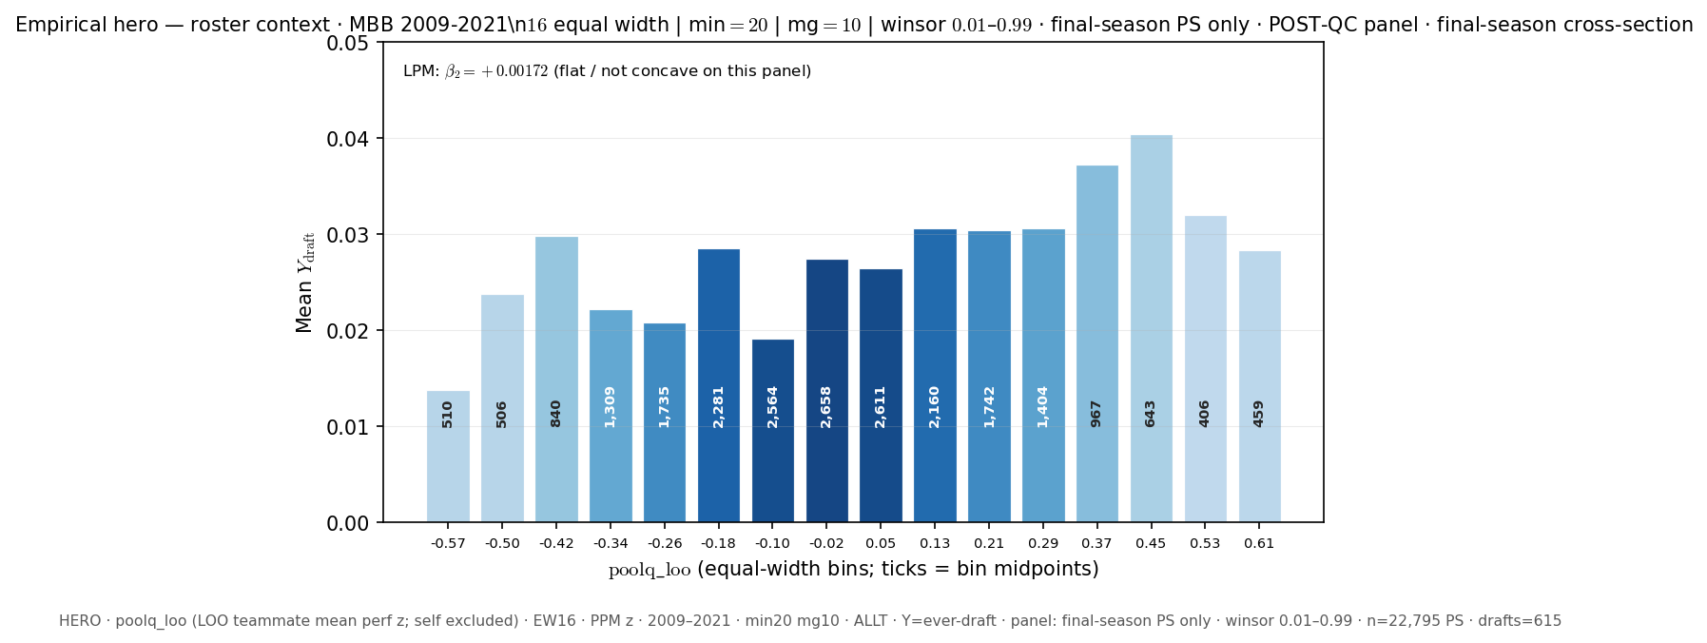
09_21
Slide 2 — Reigning hero (reference lock)
Slide 12 · tag `perm_loo_ever_lastps_ew16` · EW16 · 2009–2021
• Named hero from 09–21 permutation deck (HAND matrix slide 12).
• Star sweep varies only EW bin count and season window; everything else matches this lock.
• Sweep grid omits EW16 — nearest neighbors are EW12 and EW20 at 09–21.
• β₂ ≈ +0.00172 (flat / not concave) on 2009–2021.
16

Slide 3
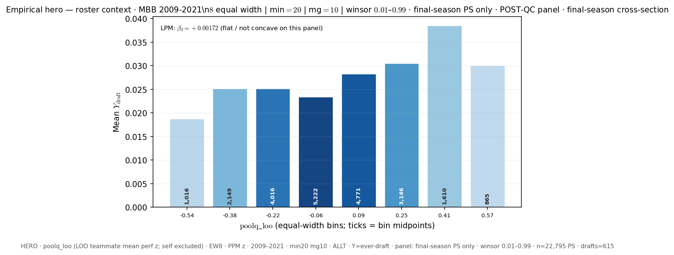
09_21
Slide 3 — Star EW8 · 09–21 · last-ps · LOO · ever · ALLT
Δ vs reigning lock (EW16 · 09–21): n_bins: 16 → 8
• EW ventiles: 16 → 8 (coarser equal-width bins on poolq_LOO). Bar heights and ventile labels change; LPM fits continuous poolq_LOO so β₂ should match lock within the same season window.
• Same season window as reigning lock (2009–2021).
• LPM β₂ = +0.00172 — matches lock (+0.00172); bin count is a display choice only.
python sports/scripts/pass_a_empirical_bundle.py \ --season-min 2009 \ --season-max 2021 \ --y-draft-mode ever \ --panel-rows last-ps \ --roster-x poolq_loo \ --n-bins 8 \ --poolq-binning equal_width \ --output-tag star_ew8_09_21 \ --output-root 3-Master_Plan/re_entry/HEROs_and_PASSes/population_sandbox/hero
8
Shape: bin1=1.87% · peak=ventile 7 @ 3.851% · last=3.006% · LPM β₂=+0.00172
Held vs lock: poolq_loo · y-draft-mode ever · panel-rows last-ps · ALLT · …

Slide 4
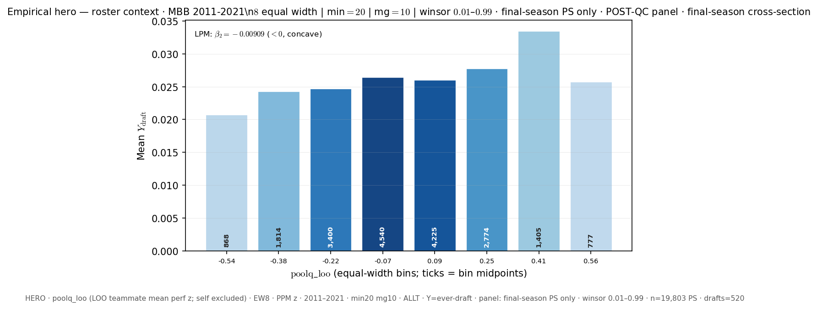
11_21
Slide 4 — Star EW8 · 11–21 · last-ps · LOO · ever · ALLT
Δ vs reigning lock (EW16 · 09–21): n_bins: 16 → 8; season_window: 09_21 → 11_21
• EW ventiles: 16 → 8 (coarser equal-width bins on poolq_LOO). Bar heights and ventile labels change; LPM fits continuous poolq_LOO so β₂ should match lock within the same season window.
• Drops 2009–10 vs lock — full ESPN panel start (2011–21).
• LPM β₂ = -0.00909 — era shift vs lock; concave/negative β₂ common off 09–21.
python sports/scripts/pass_a_empirical_bundle.py \ --season-min 2011 \ --season-max 2021 \ --y-draft-mode ever \ --panel-rows last-ps \ --roster-x poolq_loo \ --n-bins 8 \ --poolq-binning equal_width \ --output-tag star_ew8_11_21 \ --output-root 3-Master_Plan/re_entry/HEROs_and_PASSes/population_sandbox/hero
8
Shape: bin1=2.074% · peak=ventile 7 @ 3.345% · last=2.574% · LPM β₂=-0.00909
Held vs lock: poolq_loo · y-draft-mode ever · panel-rows last-ps · ALLT · …

Slide 5
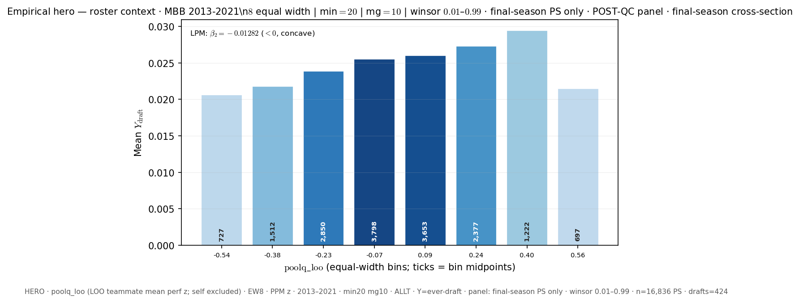
13_21
Slide 5 — Star EW8 · 13–21 · last-ps · LOO · ever · ALLT
Δ vs reigning lock (EW16 · 09–21): n_bins: 16 → 8; season_window: 09_21 → 13_21
• EW ventiles: 16 → 8 (coarser equal-width bins on poolq_LOO). Bar heights and ventile labels change; LPM fits continuous poolq_LOO so β₂ should match lock within the same season window.
• Drops 2009–12 vs lock — primary campaign window (2013–21).
• LPM β₂ = -0.012825 — era shift vs lock; concave/negative β₂ common off 09–21.
python sports/scripts/pass_a_empirical_bundle.py \ --season-min 2013 \ --season-max 2021 \ --y-draft-mode ever \ --panel-rows last-ps \ --roster-x poolq_loo \ --n-bins 8 \ --poolq-binning equal_width \ --output-tag star_ew8_13_21 \ --output-root 3-Master_Plan/re_entry/HEROs_and_PASSes/population_sandbox/hero
8
Shape: bin1=2.063% · peak=ventile 7 @ 2.946% · last=2.152% · LPM β₂=-0.01282
Held vs lock: poolq_loo · y-draft-mode ever · panel-rows last-ps · ALLT · …

Slide 6
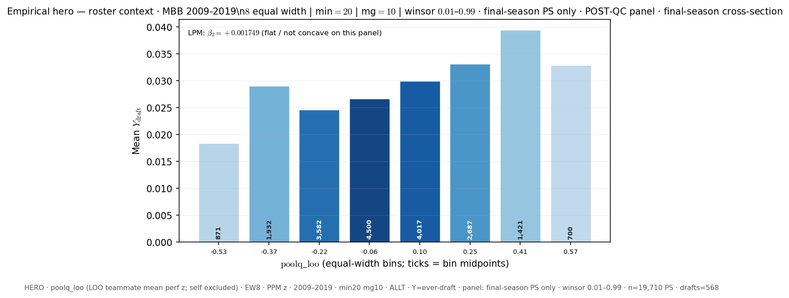
09_19
Slide 6 — Star EW8 · 09–19 · last-ps · LOO · ever · ALLT
Δ vs reigning lock (EW16 · 09–21): n_bins: 16 → 8; season_window: 09_21 → 09_19
• EW ventiles: 16 → 8 (coarser equal-width bins on poolq_LOO). Bar heights and ventile labels change; LPM fits continuous poolq_LOO so β₂ should match lock within the same season window.
• Drops 2020–21 vs lock — pre-COVID end state (2009–19).
• LPM β₂ = +0.001749 — era shift vs lock; concave/negative β₂ common off 09–21.
python sports/scripts/pass_a_empirical_bundle.py \ --season-min 2009 \ --season-max 2019 \ --y-draft-mode ever \ --panel-rows last-ps \ --roster-x poolq_loo \ --n-bins 8 \ --poolq-binning equal_width \ --output-tag star_ew8_09_19 \ --output-root 3-Master_Plan/re_entry/HEROs_and_PASSes/population_sandbox/hero
8
Shape: bin1=1.837% · peak=ventile 7 @ 3.941% · last=3.286% · LPM β₂=+0.001749
Held vs lock: poolq_loo · y-draft-mode ever · panel-rows last-ps · ALLT · …

Slide 7
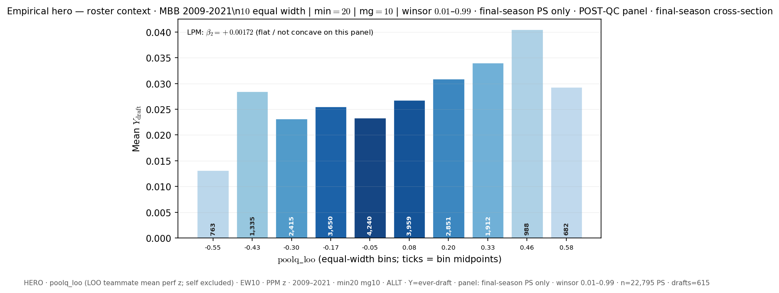
09_21
Slide 7 — Star EW10 · 09–21 · last-ps · LOO · ever · ALLT
Δ vs reigning lock (EW16 · 09–21): n_bins: 16 → 10
• EW ventiles: 16 → 10 (coarser equal-width bins on poolq_LOO). Bar heights and ventile labels change; LPM fits continuous poolq_LOO so β₂ should match lock within the same season window.
• Same season window as reigning lock (2009–2021).
• LPM β₂ = +0.00172 — matches lock (+0.00172); bin count is a display choice only.
python sports/scripts/pass_a_empirical_bundle.py \ --season-min 2009 \ --season-max 2021 \ --y-draft-mode ever \ --panel-rows last-ps \ --roster-x poolq_loo \ --n-bins 10 \ --poolq-binning equal_width \ --output-tag star_ew10_09_21 \ --output-root 3-Master_Plan/re_entry/HEROs_and_PASSes/population_sandbox/hero
10
Shape: bin1=1.311% · peak=ventile 9 @ 4.049% · last=2.933% · LPM β₂=+0.00172
Held vs lock: poolq_loo · y-draft-mode ever · panel-rows last-ps · ALLT · …

Slide 8
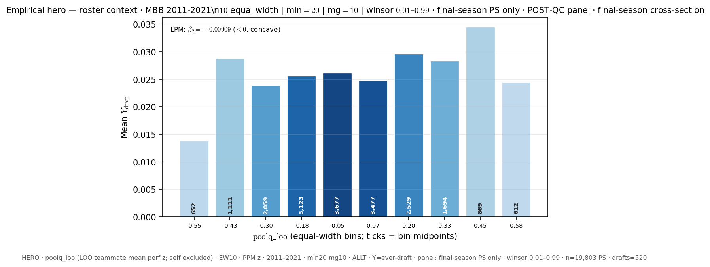
11_21
Slide 8 — Star EW10 · 11–21 · last-ps · LOO · ever · ALLT
Δ vs reigning lock (EW16 · 09–21): n_bins: 16 → 10; season_window: 09_21 → 11_21
• EW ventiles: 16 → 10 (coarser equal-width bins on poolq_LOO). Bar heights and ventile labels change; LPM fits continuous poolq_LOO so β₂ should match lock within the same season window.
• Drops 2009–10 vs lock — full ESPN panel start (2011–21).
• LPM β₂ = -0.00909 — era shift vs lock; concave/negative β₂ common off 09–21.
python sports/scripts/pass_a_empirical_bundle.py \ --season-min 2011 \ --season-max 2021 \ --y-draft-mode ever \ --panel-rows last-ps \ --roster-x poolq_loo \ --n-bins 10 \ --poolq-binning equal_width \ --output-tag star_ew10_11_21 \ --output-root 3-Master_Plan/re_entry/HEROs_and_PASSes/population_sandbox/hero
10
Shape: bin1=1.38% · peak=ventile 9 @ 3.452% · last=2.451% · LPM β₂=-0.00909
Held vs lock: poolq_loo · y-draft-mode ever · panel-rows last-ps · ALLT · …

Slide 9
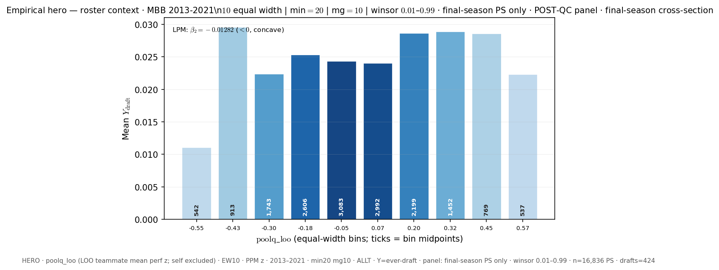
13_21
Slide 9 — Star EW10 · 13–21 · last-ps · LOO · ever · ALLT
Δ vs reigning lock (EW16 · 09–21): n_bins: 16 → 10; season_window: 09_21 → 13_21
• EW ventiles: 16 → 10 (coarser equal-width bins on poolq_LOO). Bar heights and ventile labels change; LPM fits continuous poolq_LOO so β₂ should match lock within the same season window.
• Drops 2009–12 vs lock — primary campaign window (2013–21).
• LPM β₂ = -0.012825 — era shift vs lock; concave/negative β₂ common off 09–21.
python sports/scripts/pass_a_empirical_bundle.py \ --season-min 2013 \ --season-max 2021 \ --y-draft-mode ever \ --panel-rows last-ps \ --roster-x poolq_loo \ --n-bins 10 \ --poolq-binning equal_width \ --output-tag star_ew10_13_21 \ --output-root 3-Master_Plan/re_entry/HEROs_and_PASSes/population_sandbox/hero
10
Shape: bin1=1.107% · peak=ventile 2 @ 2.957% · last=2.235% · LPM β₂=-0.01282
Held vs lock: poolq_loo · y-draft-mode ever · panel-rows last-ps · ALLT · …

Slide 10
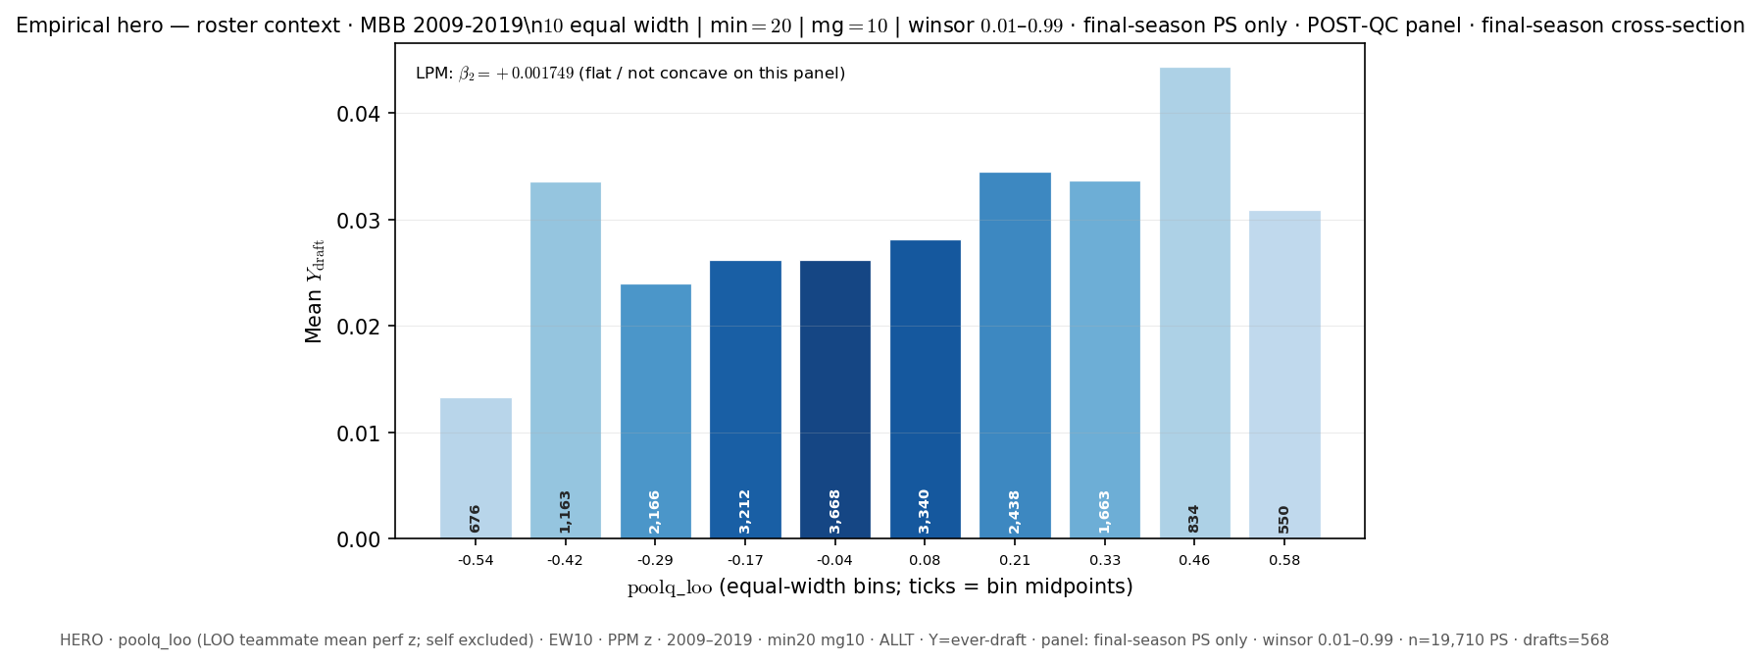
09_19
Slide 10 — Star EW10 · 09–19 · last-ps · LOO · ever · ALLT
Δ vs reigning lock (EW16 · 09–21): n_bins: 16 → 10; season_window: 09_21 → 09_19
• EW ventiles: 16 → 10 (coarser equal-width bins on poolq_LOO). Bar heights and ventile labels change; LPM fits continuous poolq_LOO so β₂ should match lock within the same season window.
• Drops 2020–21 vs lock — pre-COVID end state (2009–19).
• LPM β₂ = +0.001749 — era shift vs lock; concave/negative β₂ common off 09–21.
python sports/scripts/pass_a_empirical_bundle.py \ --season-min 2009 \ --season-max 2019 \ --y-draft-mode ever \ --panel-rows last-ps \ --roster-x poolq_loo \ --n-bins 10 \ --poolq-binning equal_width \ --output-tag star_ew10_09_19 \ --output-root 3-Master_Plan/re_entry/HEROs_and_PASSes/population_sandbox/hero
10
Shape: bin1=1.331% · peak=ventile 9 @ 4.436% · last=3.091% · LPM β₂=+0.001749
Held vs lock: poolq_loo · y-draft-mode ever · panel-rows last-ps · ALLT · …

Slide 11
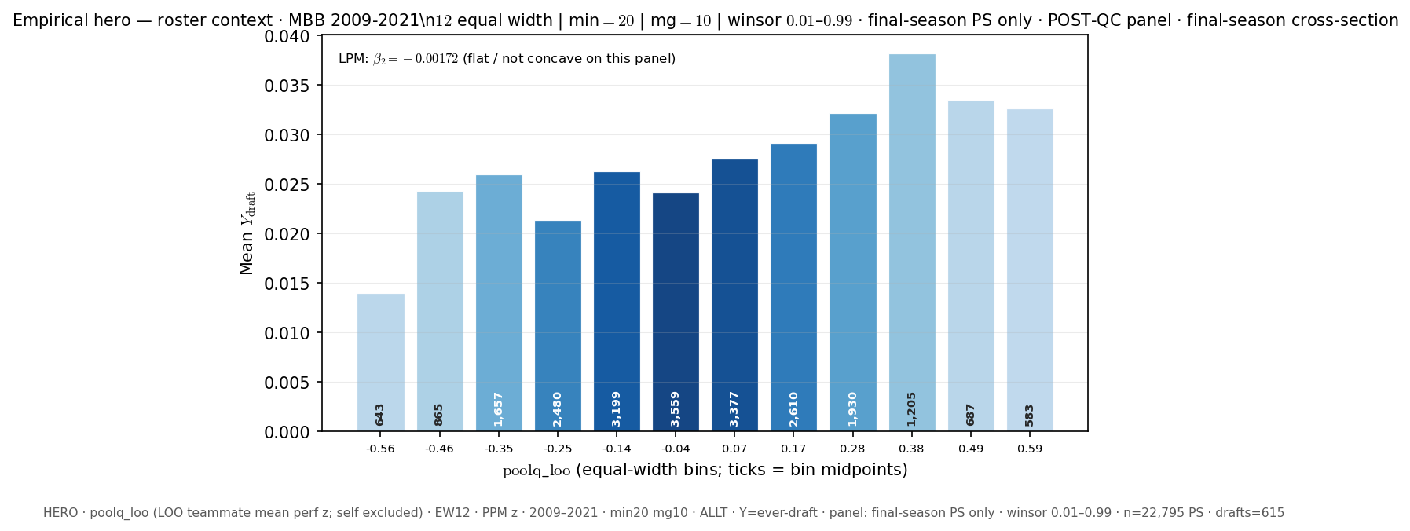
09_21
Slide 11 — Star EW12 · 09–21 · last-ps · LOO · ever · ALLT
Δ vs reigning lock (EW16 · 09–21): n_bins: 16 → 12
• EW ventiles: 16 → 12 (coarser equal-width bins on poolq_LOO). Bar heights and ventile labels change; LPM fits continuous poolq_LOO so β₂ should match lock within the same season window.
• Same season window as reigning lock (2009–2021).
• LPM β₂ = +0.00172 — matches lock (+0.00172); bin count is a display choice only.
python sports/scripts/pass_a_empirical_bundle.py \ --season-min 2009 \ --season-max 2021 \ --y-draft-mode ever \ --panel-rows last-ps \ --roster-x poolq_loo \ --n-bins 12 \ --poolq-binning equal_width \ --output-tag star_ew12_09_21 \ --output-root 3-Master_Plan/re_entry/HEROs_and_PASSes/population_sandbox/hero
12
Shape: bin1=1.4% · peak=ventile 10 @ 3.817% · last=3.259% · LPM β₂=+0.00172
Held vs lock: poolq_loo · y-draft-mode ever · panel-rows last-ps · ALLT · …

Slide 12
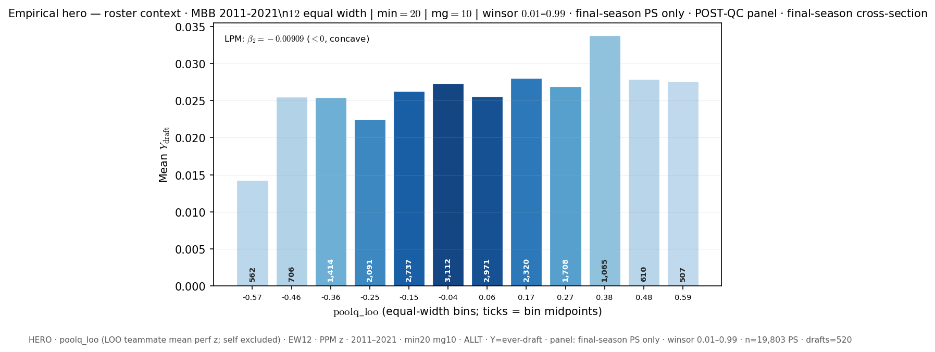
11_21
Slide 12 — Star EW12 · 11–21 · last-ps · LOO · ever · ALLT
Δ vs reigning lock (EW16 · 09–21): n_bins: 16 → 12; season_window: 09_21 → 11_21
• EW ventiles: 16 → 12 (coarser equal-width bins on poolq_LOO). Bar heights and ventile labels change; LPM fits continuous poolq_LOO so β₂ should match lock within the same season window.
• Drops 2009–10 vs lock — full ESPN panel start (2011–21).
• LPM β₂ = -0.00909 — era shift vs lock; concave/negative β₂ common off 09–21.
python sports/scripts/pass_a_empirical_bundle.py \ --season-min 2011 \ --season-max 2021 \ --y-draft-mode ever \ --panel-rows last-ps \ --roster-x poolq_loo \ --n-bins 12 \ --poolq-binning equal_width \ --output-tag star_ew12_11_21 \ --output-root 3-Master_Plan/re_entry/HEROs_and_PASSes/population_sandbox/hero
12
Shape: bin1=1.423% · peak=ventile 10 @ 3.38% · last=2.761% · LPM β₂=-0.00909
Held vs lock: poolq_loo · y-draft-mode ever · panel-rows last-ps · ALLT · …

Slide 13
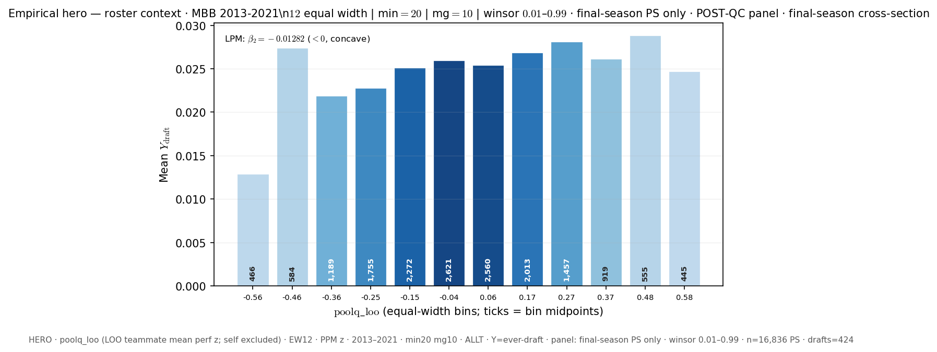
13_21
Slide 13 — Star EW12 · 13–21 · last-ps · LOO · ever · ALLT
Δ vs reigning lock (EW16 · 09–21): n_bins: 16 → 12; season_window: 09_21 → 13_21
• EW ventiles: 16 → 12 (coarser equal-width bins on poolq_LOO). Bar heights and ventile labels change; LPM fits continuous poolq_LOO so β₂ should match lock within the same season window.
• Drops 2009–12 vs lock — primary campaign window (2013–21).
• LPM β₂ = -0.012825 — era shift vs lock; concave/negative β₂ common off 09–21.
python sports/scripts/pass_a_empirical_bundle.py \ --season-min 2013 \ --season-max 2021 \ --y-draft-mode ever \ --panel-rows last-ps \ --roster-x poolq_loo \ --n-bins 12 \ --poolq-binning equal_width \ --output-tag star_ew12_13_21 \ --output-root 3-Master_Plan/re_entry/HEROs_and_PASSes/population_sandbox/hero
12
Shape: bin1=1.288% · peak=ventile 11 @ 2.883% · last=2.472% · LPM β₂=-0.01282
Held vs lock: poolq_loo · y-draft-mode ever · panel-rows last-ps · ALLT · …

Slide 14
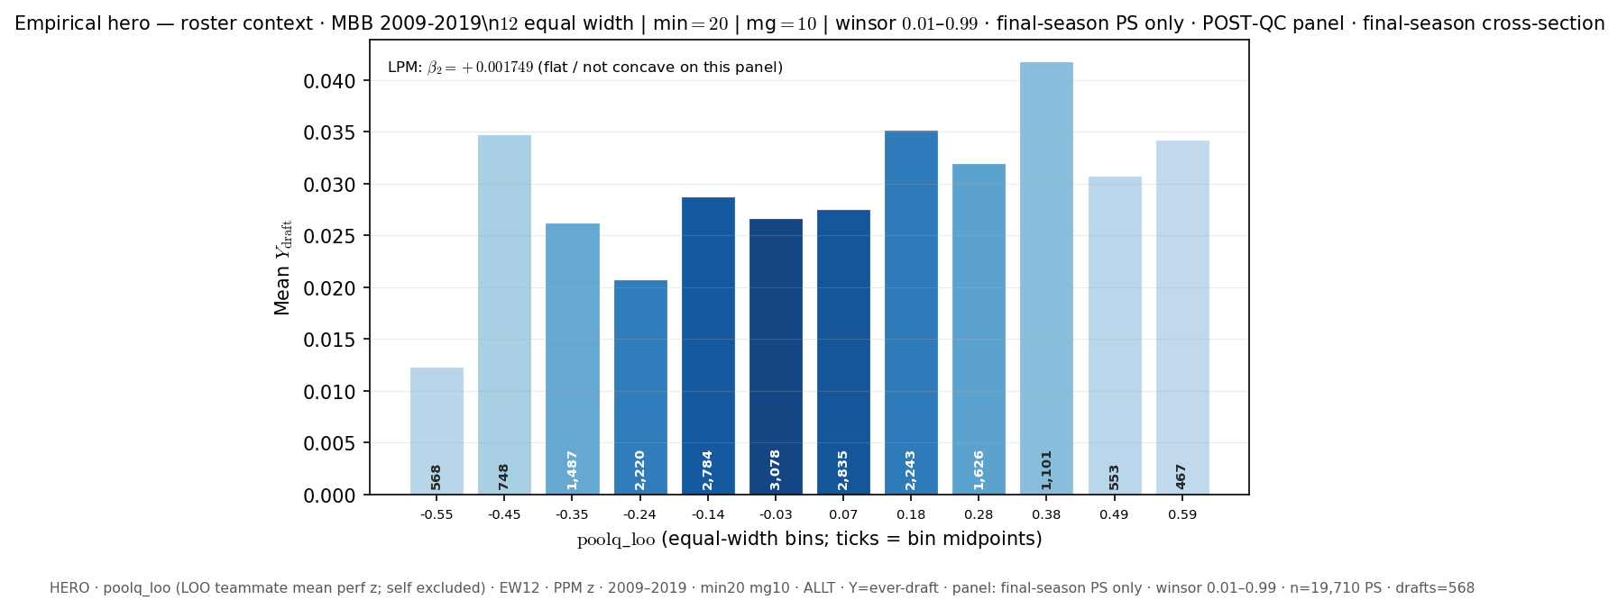
09_19
Slide 14 — Star EW12 · 09–19 · last-ps · LOO · ever · ALLT
Δ vs reigning lock (EW16 · 09–21): n_bins: 16 → 12; season_window: 09_21 → 09_19
• EW ventiles: 16 → 12 (coarser equal-width bins on poolq_LOO). Bar heights and ventile labels change; LPM fits continuous poolq_LOO so β₂ should match lock within the same season window.
• Drops 2020–21 vs lock — pre-COVID end state (2009–19).
• LPM β₂ = +0.001749 — era shift vs lock; concave/negative β₂ common off 09–21.
python sports/scripts/pass_a_empirical_bundle.py \ --season-min 2009 \ --season-max 2019 \ --y-draft-mode ever \ --panel-rows last-ps \ --roster-x poolq_loo \ --n-bins 12 \ --poolq-binning equal_width \ --output-tag star_ew12_09_19 \ --output-root 3-Master_Plan/re_entry/HEROs_and_PASSes/population_sandbox/hero
12
Shape: bin1=1.232% · peak=ventile 10 @ 4.178% · last=3.426% · LPM β₂=+0.001749
Held vs lock: poolq_loo · y-draft-mode ever · panel-rows last-ps · ALLT · …

Slide 15
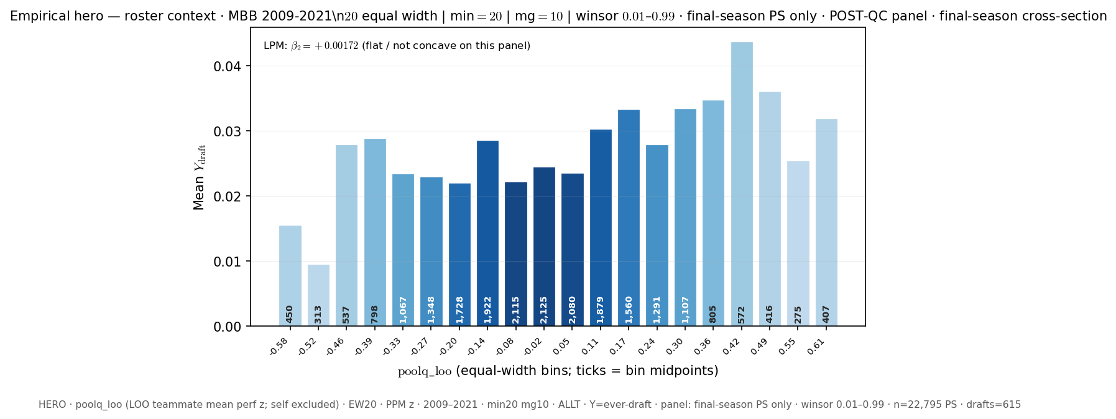
09_21
Slide 15 — Star EW20 · 09–21 · last-ps · LOO · ever · ALLT
Δ vs reigning lock (EW16 · 09–21): n_bins: 16 → 20
• EW ventiles: 16 → 20 (finer equal-width bins on poolq_LOO). Bar heights and ventile labels change; LPM fits continuous poolq_LOO so β₂ should match lock within the same season window.
• Same season window as reigning lock (2009–2021).
• LPM β₂ = +0.00172 — matches lock (+0.00172); bin count is a display choice only.
python sports/scripts/pass_a_empirical_bundle.py \ --season-min 2009 \ --season-max 2021 \ --y-draft-mode ever \ --panel-rows last-ps \ --roster-x poolq_loo \ --n-bins 20 \ --poolq-binning equal_width \ --output-tag star_ew20_09_21 \ --output-root 3-Master_Plan/re_entry/HEROs_and_PASSes/population_sandbox/hero
20
Shape: bin1=1.556% · peak=ventile 17 @ 4.371% · last=3.194% · LPM β₂=+0.00172
Held vs lock: poolq_loo · y-draft-mode ever · panel-rows last-ps · ALLT · …

Slide 16
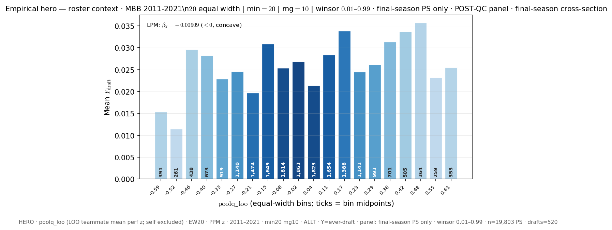
11_21
Slide 16 — Star EW20 · 11–21 · last-ps · LOO · ever · ALLT
Δ vs reigning lock (EW16 · 09–21): n_bins: 16 → 20; season_window: 09_21 → 11_21
• EW ventiles: 16 → 20 (finer equal-width bins on poolq_LOO). Bar heights and ventile labels change; LPM fits continuous poolq_LOO so β₂ should match lock within the same season window.
• Drops 2009–10 vs lock — full ESPN panel start (2011–21).
• LPM β₂ = -0.00909 — era shift vs lock; concave/negative β₂ common off 09–21.
python sports/scripts/pass_a_empirical_bundle.py \ --season-min 2011 \ --season-max 2021 \ --y-draft-mode ever \ --panel-rows last-ps \ --roster-x poolq_loo \ --n-bins 20 \ --poolq-binning equal_width \ --output-tag star_ew20_11_21 \ --output-root 3-Master_Plan/re_entry/HEROs_and_PASSes/population_sandbox/hero
20
Shape: bin1=1.535% · peak=ventile 18 @ 3.571% · last=2.55% · LPM β₂=-0.00909
Held vs lock: poolq_loo · y-draft-mode ever · panel-rows last-ps · ALLT · …

Slide 17
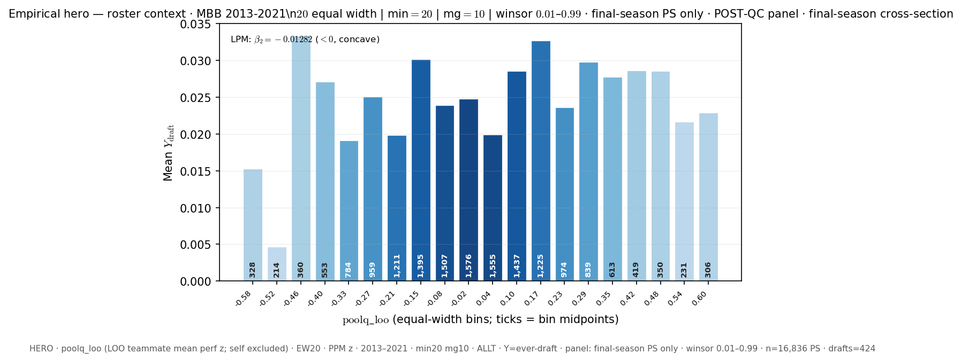
13_21
Slide 17 — Star EW20 · 13–21 · last-ps · LOO · ever · ALLT
Δ vs reigning lock (EW16 · 09–21): n_bins: 16 → 20; season_window: 09_21 → 13_21
• EW ventiles: 16 → 20 (finer equal-width bins on poolq_LOO). Bar heights and ventile labels change; LPM fits continuous poolq_LOO so β₂ should match lock within the same season window.
• Drops 2009–12 vs lock — primary campaign window (2013–21).
• LPM β₂ = -0.012825 — era shift vs lock; concave/negative β₂ common off 09–21.
python sports/scripts/pass_a_empirical_bundle.py \ --season-min 2013 \ --season-max 2021 \ --y-draft-mode ever \ --panel-rows last-ps \ --roster-x poolq_loo \ --n-bins 20 \ --poolq-binning equal_width \ --output-tag star_ew20_13_21 \ --output-root 3-Master_Plan/re_entry/HEROs_and_PASSes/population_sandbox/hero
20
Shape: bin1=1.524% · peak=ventile 3 @ 3.333% · last=2.288% · LPM β₂=-0.01282
Held vs lock: poolq_loo · y-draft-mode ever · panel-rows last-ps · ALLT · …

Slide 18
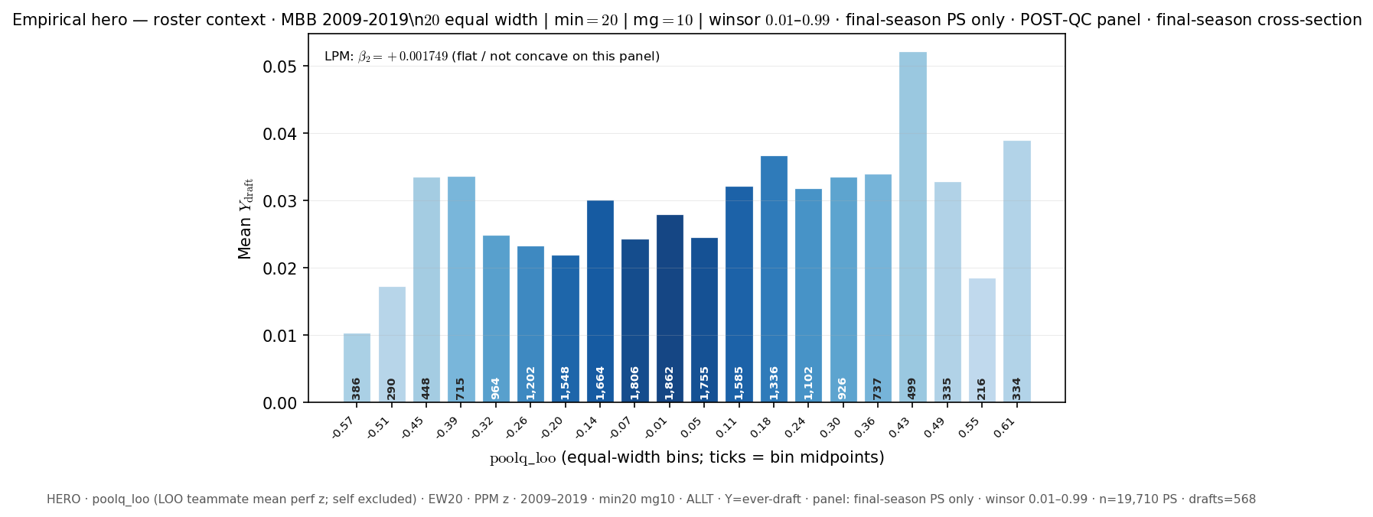
09_19
Slide 18 — Star EW20 · 09–19 · last-ps · LOO · ever · ALLT
Δ vs reigning lock (EW16 · 09–21): n_bins: 16 → 20; season_window: 09_21 → 09_19
• EW ventiles: 16 → 20 (finer equal-width bins on poolq_LOO). Bar heights and ventile labels change; LPM fits continuous poolq_LOO so β₂ should match lock within the same season window.
• Drops 2020–21 vs lock — pre-COVID end state (2009–19).
• LPM β₂ = +0.001749 — era shift vs lock; concave/negative β₂ common off 09–21.
python sports/scripts/pass_a_empirical_bundle.py \ --season-min 2009 \ --season-max 2019 \ --y-draft-mode ever \ --panel-rows last-ps \ --roster-x poolq_loo \ --n-bins 20 \ --poolq-binning equal_width \ --output-tag star_ew20_09_19 \ --output-root 3-Master_Plan/re_entry/HEROs_and_PASSes/population_sandbox/hero
20
Shape: bin1=1.036% · peak=ventile 17 @ 5.21% · last=3.892% · LPM β₂=+0.001749
Held vs lock: poolq_loo · y-draft-mode ever · panel-rows last-ps · ALLT · …

Slide 19
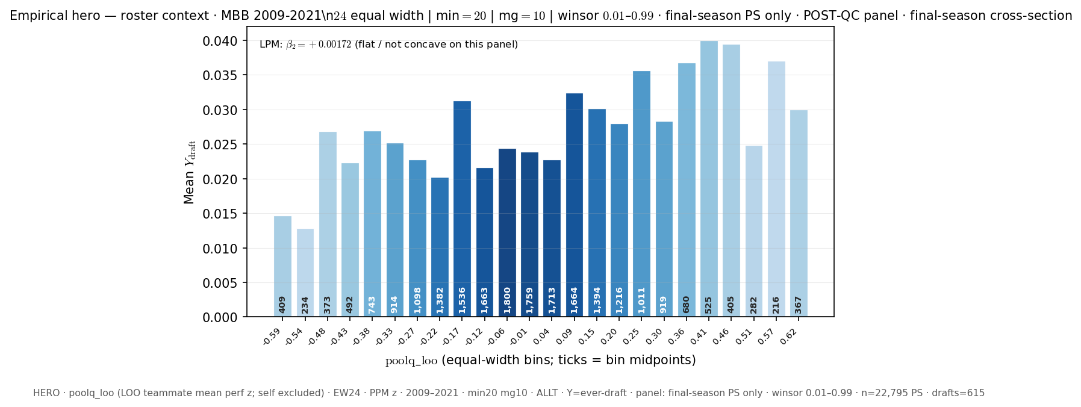
09_21
Slide 19 — Star EW24 · 09–21 · last-ps · LOO · ever · ALLT
Δ vs reigning lock (EW16 · 09–21): n_bins: 16 → 24
• EW ventiles: 16 → 24 (finer equal-width bins on poolq_LOO). Bar heights and ventile labels change; LPM fits continuous poolq_LOO so β₂ should match lock within the same season window.
• Same season window as reigning lock (2009–2021).
• LPM β₂ = +0.00172 — matches lock (+0.00172); bin count is a display choice only.
python sports/scripts/pass_a_empirical_bundle.py \ --season-min 2009 \ --season-max 2021 \ --y-draft-mode ever \ --panel-rows last-ps \ --roster-x poolq_loo \ --n-bins 24 \ --poolq-binning equal_width \ --output-tag star_ew24_09_21 \ --output-root 3-Master_Plan/re_entry/HEROs_and_PASSes/population_sandbox/hero
24
Shape: bin1=1.467% · peak=ventile 20 @ 4.0% · last=2.997% · LPM β₂=+0.00172
Held vs lock: poolq_loo · y-draft-mode ever · panel-rows last-ps · ALLT · …

Slide 20
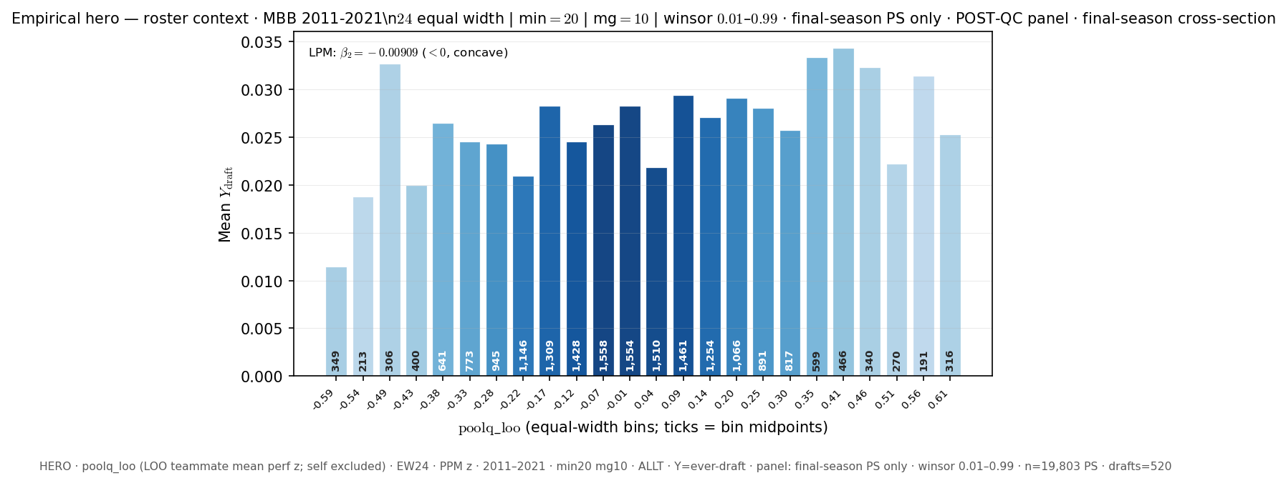
11_21
Slide 20 — Star EW24 · 11–21 · last-ps · LOO · ever · ALLT
Δ vs reigning lock (EW16 · 09–21): n_bins: 16 → 24; season_window: 09_21 → 11_21
• EW ventiles: 16 → 24 (finer equal-width bins on poolq_LOO). Bar heights and ventile labels change; LPM fits continuous poolq_LOO so β₂ should match lock within the same season window.
• Drops 2009–10 vs lock — full ESPN panel start (2011–21).
• LPM β₂ = -0.00909 — era shift vs lock; concave/negative β₂ common off 09–21.
python sports/scripts/pass_a_empirical_bundle.py \ --season-min 2011 \ --season-max 2021 \ --y-draft-mode ever \ --panel-rows last-ps \ --roster-x poolq_loo \ --n-bins 24 \ --poolq-binning equal_width \ --output-tag star_ew24_11_21 \ --output-root 3-Master_Plan/re_entry/HEROs_and_PASSes/population_sandbox/hero
24
Shape: bin1=1.146% · peak=ventile 20 @ 3.433% · last=2.532% · LPM β₂=-0.00909
Held vs lock: poolq_loo · y-draft-mode ever · panel-rows last-ps · ALLT · …

Slide 21
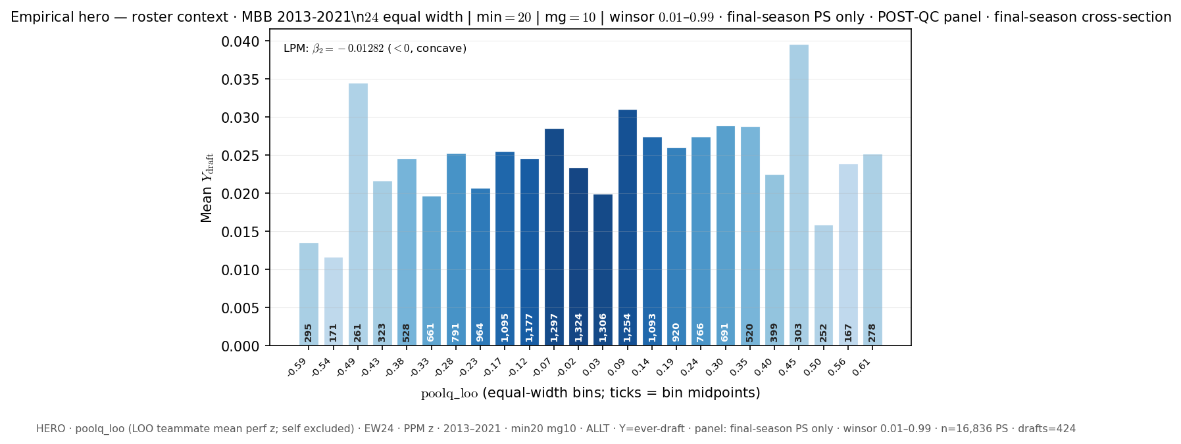
13_21
Slide 21 — Star EW24 · 13–21 · last-ps · LOO · ever · ALLT
Δ vs reigning lock (EW16 · 09–21): n_bins: 16 → 24; season_window: 09_21 → 13_21
• EW ventiles: 16 → 24 (finer equal-width bins on poolq_LOO). Bar heights and ventile labels change; LPM fits continuous poolq_LOO so β₂ should match lock within the same season window.
• Drops 2009–12 vs lock — primary campaign window (2013–21).
• LPM β₂ = -0.012825 — era shift vs lock; concave/negative β₂ common off 09–21.
python sports/scripts/pass_a_empirical_bundle.py \ --season-min 2013 \ --season-max 2021 \ --y-draft-mode ever \ --panel-rows last-ps \ --roster-x poolq_loo \ --n-bins 24 \ --poolq-binning equal_width \ --output-tag star_ew24_13_21 \ --output-root 3-Master_Plan/re_entry/HEROs_and_PASSes/population_sandbox/hero
24
Shape: bin1=1.356% · peak=ventile 21 @ 3.96% · last=2.518% · LPM β₂=-0.01282
Held vs lock: poolq_loo · y-draft-mode ever · panel-rows last-ps · ALLT · …

Slide 22
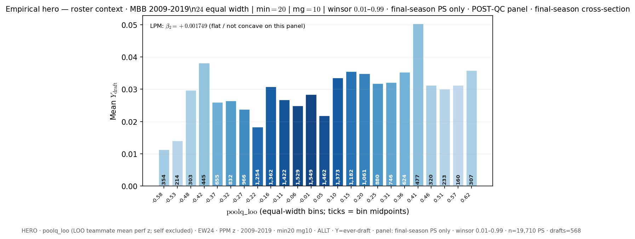
09_19
Slide 22 — Star EW24 · 09–19 · last-ps · LOO · ever · ALLT
Δ vs reigning lock (EW16 · 09–21): n_bins: 16 → 24; season_window: 09_21 → 09_19
• EW ventiles: 16 → 24 (finer equal-width bins on poolq_LOO). Bar heights and ventile labels change; LPM fits continuous poolq_LOO so β₂ should match lock within the same season window.
• Drops 2020–21 vs lock — pre-COVID end state (2009–19).
• LPM β₂ = +0.001749 — era shift vs lock; concave/negative β₂ common off 09–21.
python sports/scripts/pass_a_empirical_bundle.py \ --season-min 2009 \ --season-max 2019 \ --y-draft-mode ever \ --panel-rows last-ps \ --roster-x poolq_loo \ --n-bins 24 \ --poolq-binning equal_width \ --output-tag star_ew24_09_19 \ --output-root 3-Master_Plan/re_entry/HEROs_and_PASSes/population_sandbox/hero
24
Shape: bin1=1.13% · peak=ventile 20 @ 5.031% · last=3.583% · LPM β₂=+0.001749
Held vs lock: poolq_loo · y-draft-mode ever · panel-rows last-ps · ALLT · …

